Slide 1
Evaluation metrics
Suchismit Mahapatra
Slides : S. Lazebnik

Slide 2
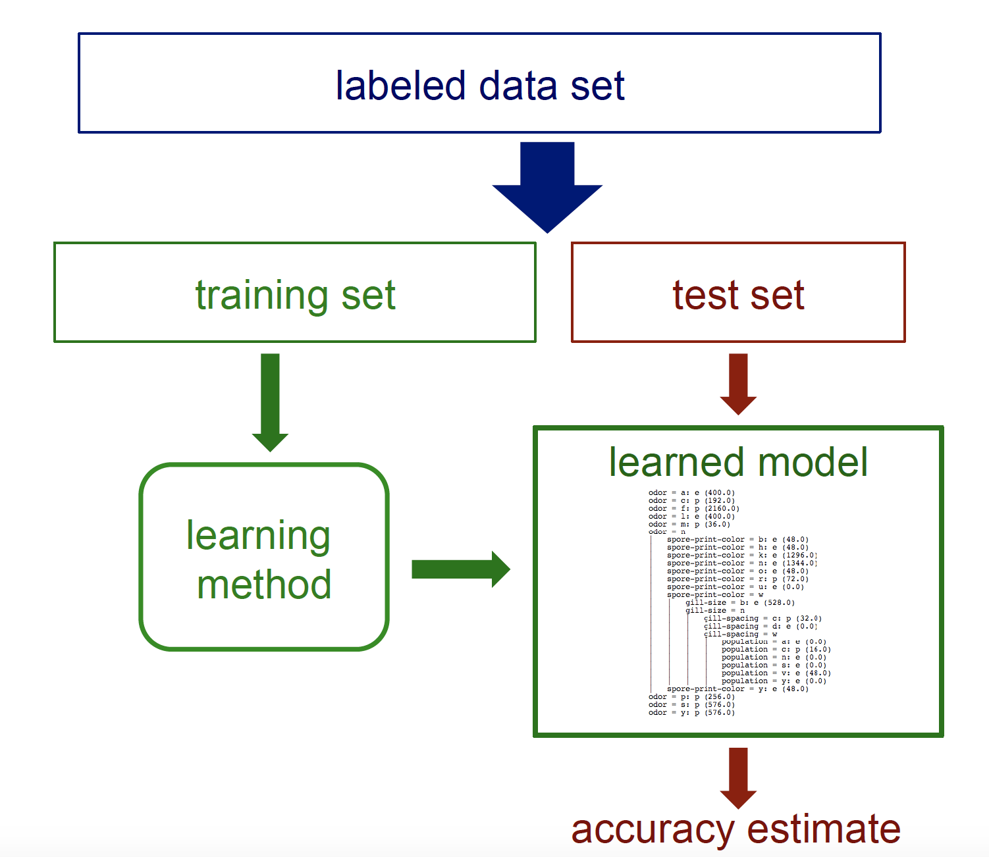
Test set revisited
How can we get an unbiased estimate of the accuracy of a learned model?

Slide 3
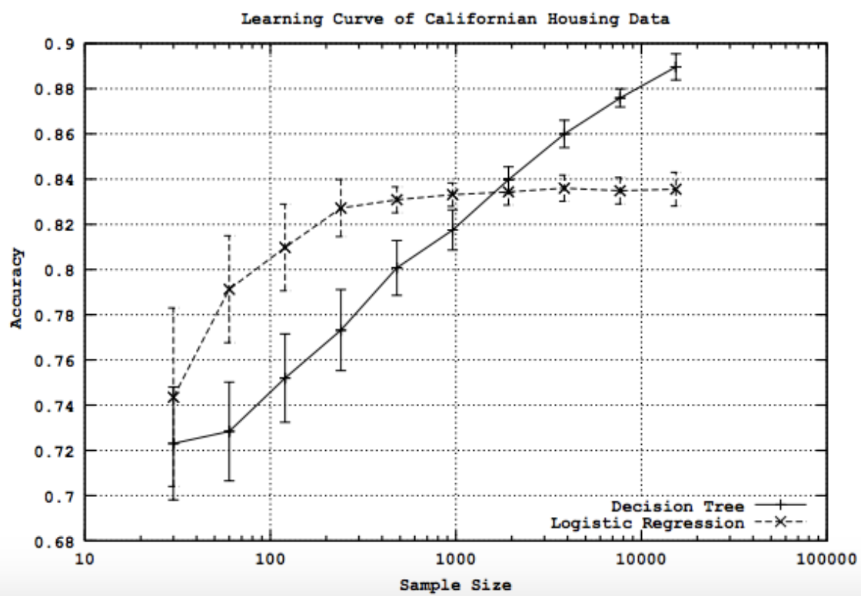
Learning curves
For each sample size s on learning curve (repeat if needed)
Randomly select s instances from training set
Learn model
Evaluate model on test set to determine accuracy a
Plot (s, a) or (s, avg. accuracy and error bars)

Slide 4
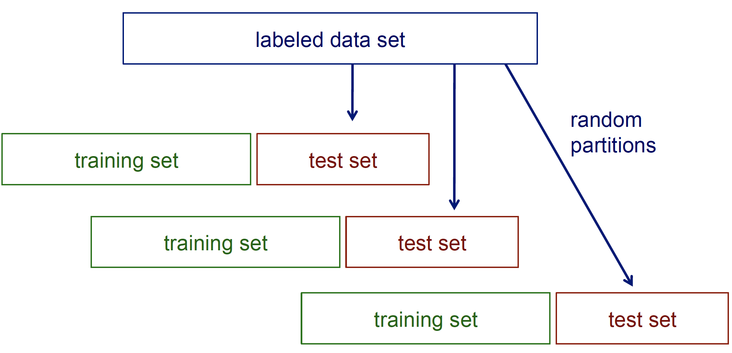
Random resampling

Slide 5
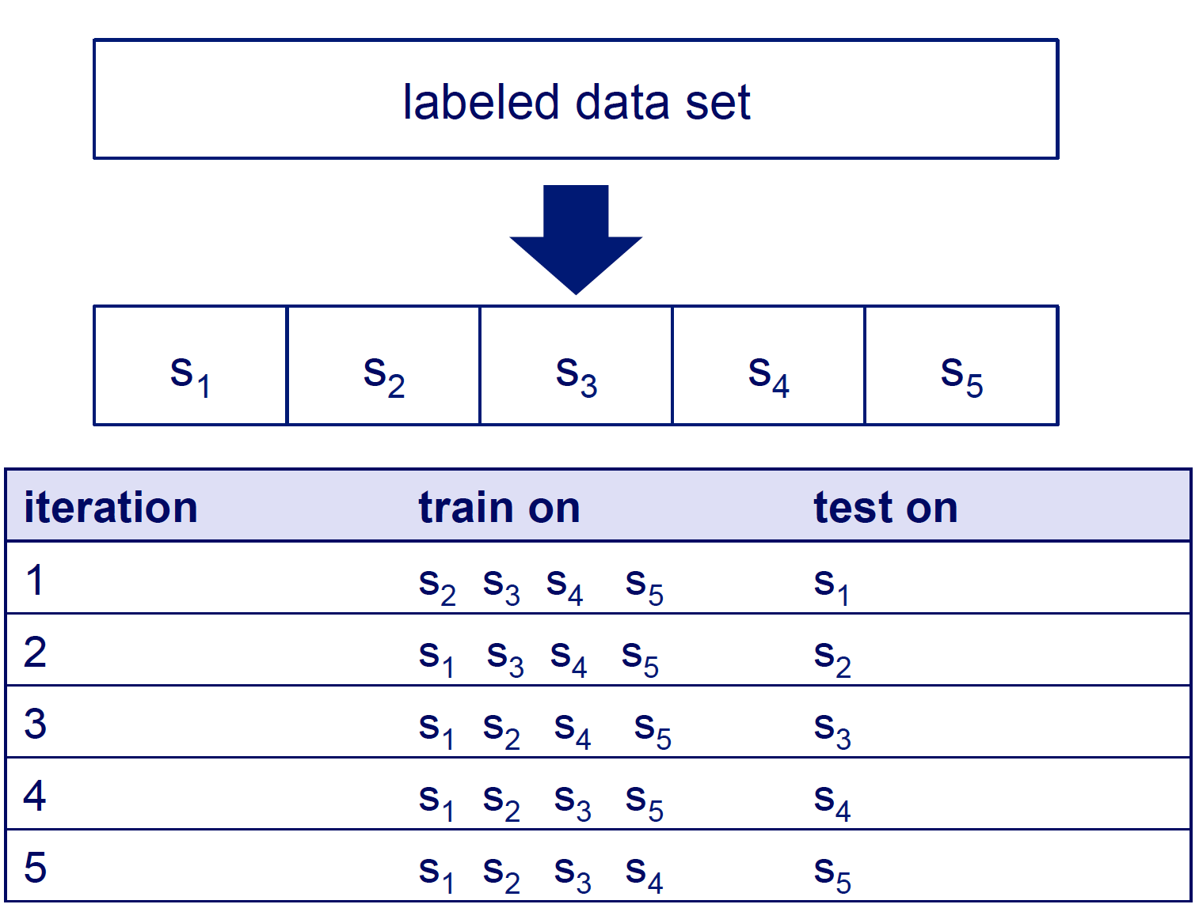
Cross-validation

Slide 6
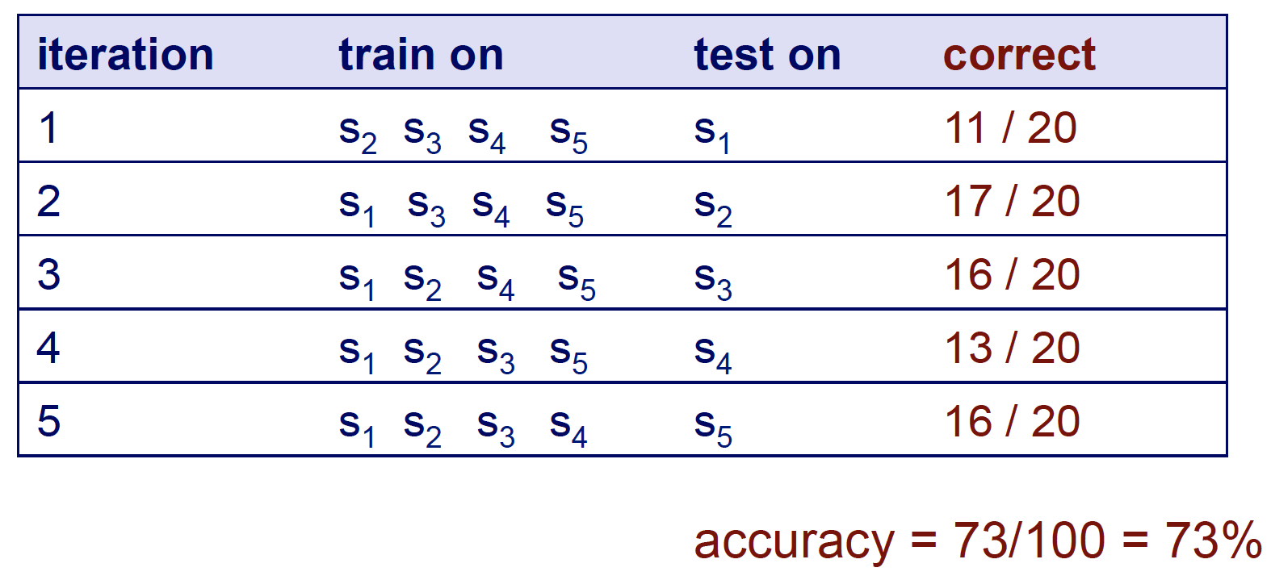
Cross validation example

Slide 7
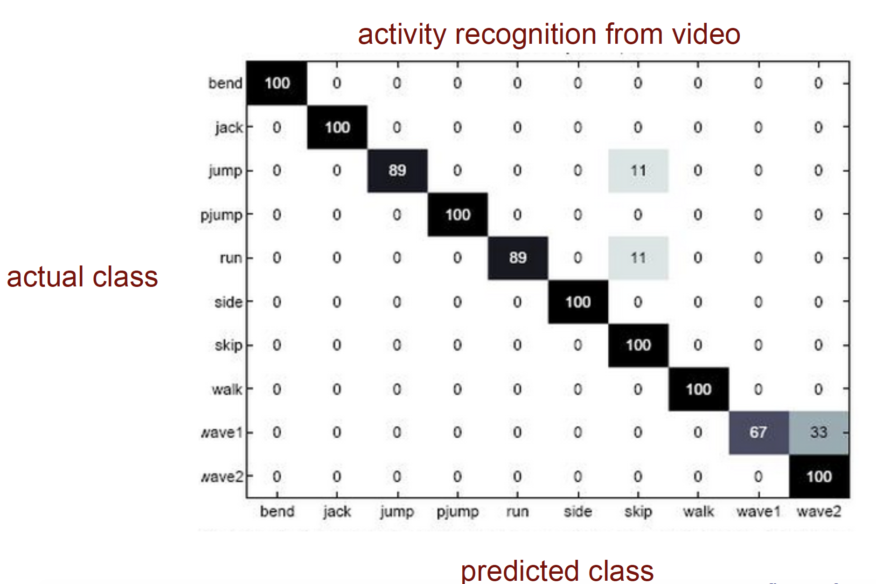
Confusion matrix
How can we understand what types of mistakes a learned model makes?

Slide 8
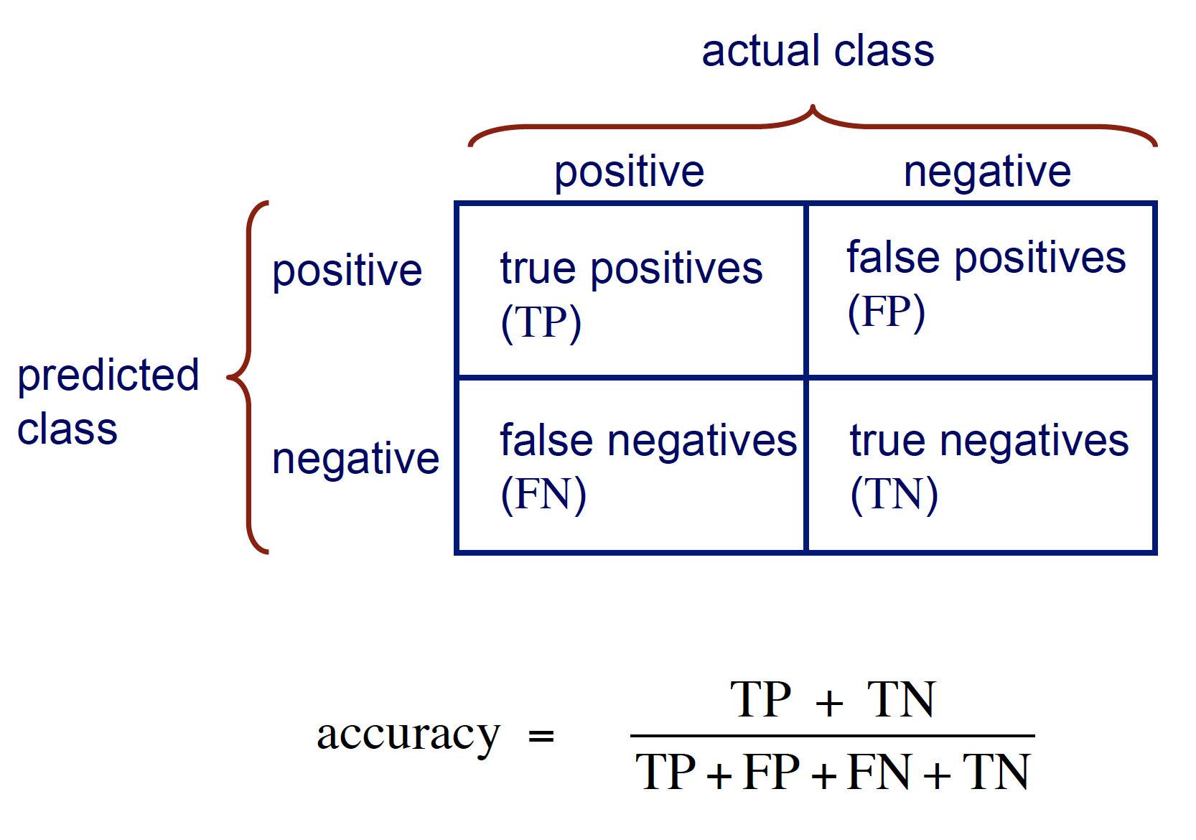
Confusion matrix for two class problems

Slide 9
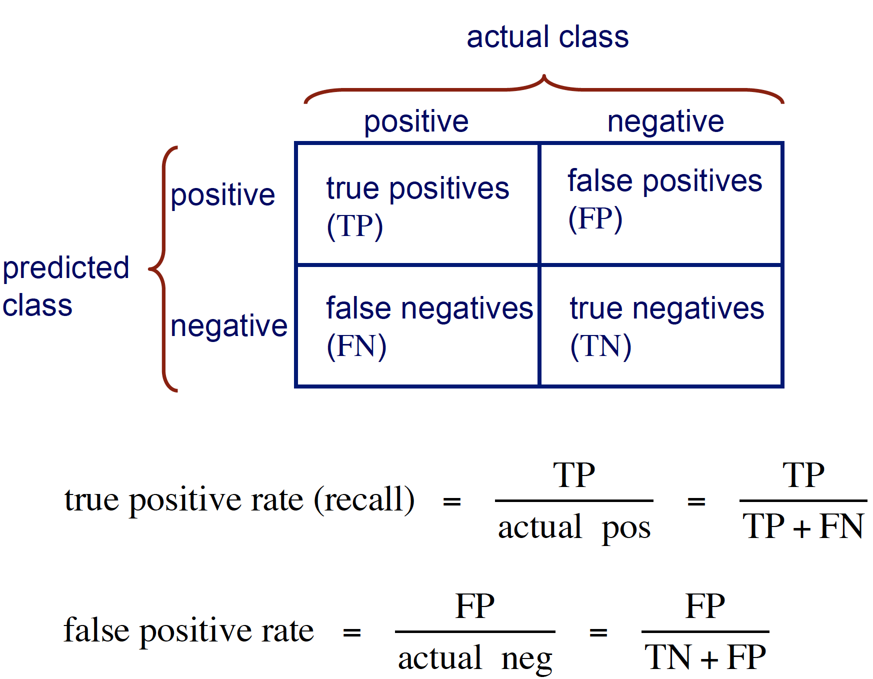
Other accuracy metrics

Slide 10
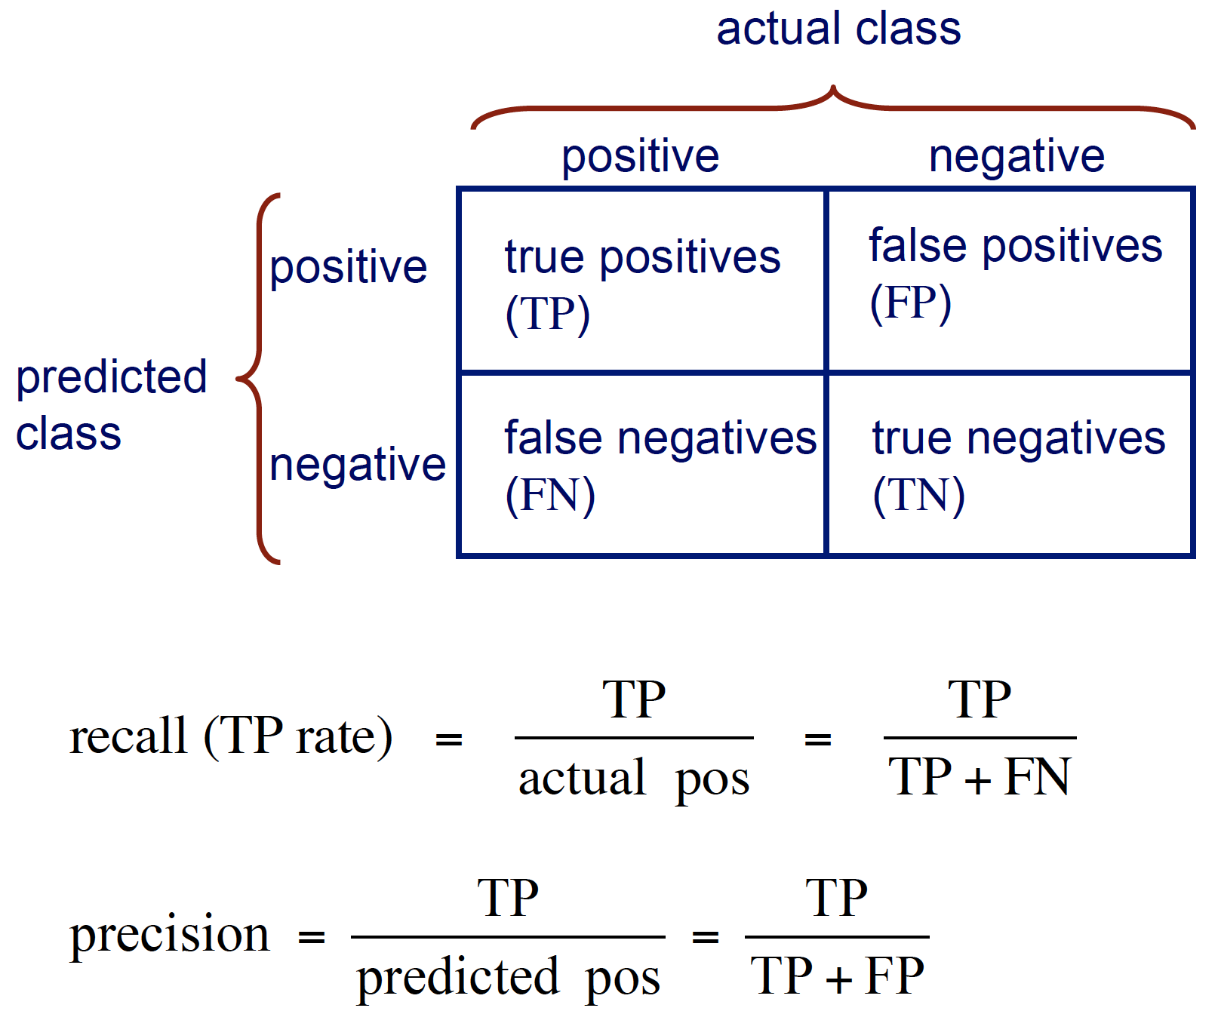
Other accuracy metrics

Slide 11
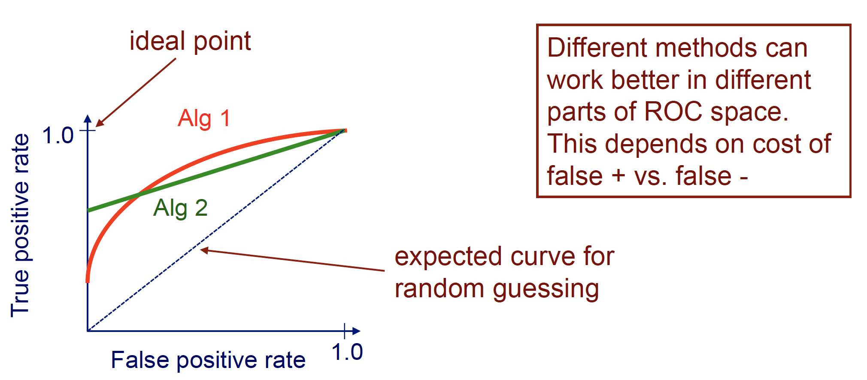
ROC curves
A Receiver Operating Characteristic (ROC) curve plots the TP-rate vs. the FP-rate as a threshold on the confidence of an instance being positive is varied.

