Slide 1
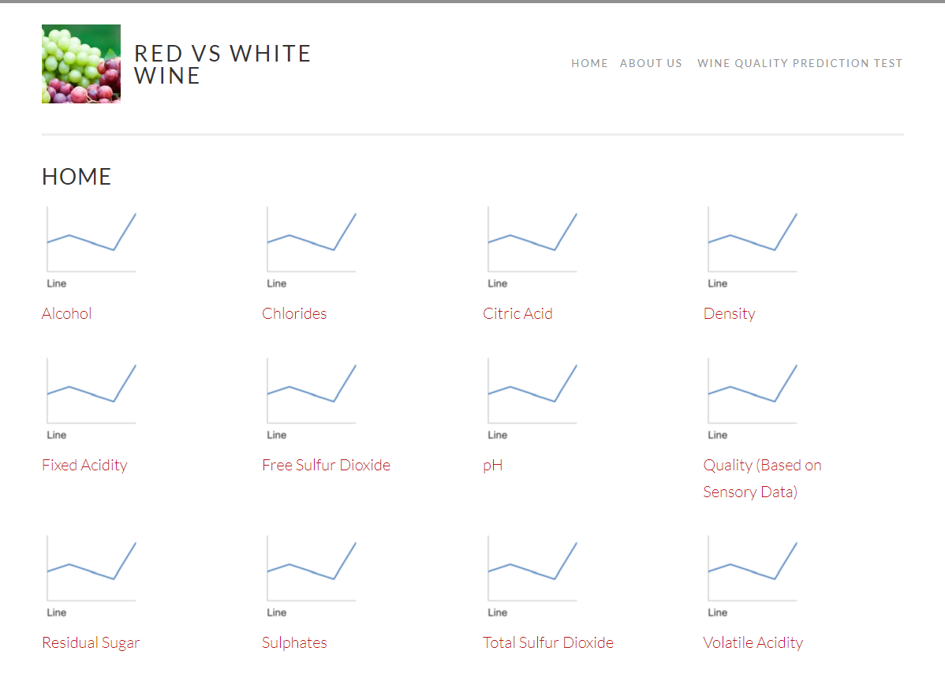
This is a mockup of what the homepage will look like. The thumbnails shown above will be changed out when the dashboard is built. It will display a thumbnail of a graph. The graphs will be different based on the features it is displaying and will be for both white and red wines. The name will link to the actual graph from tableau

Slide 2
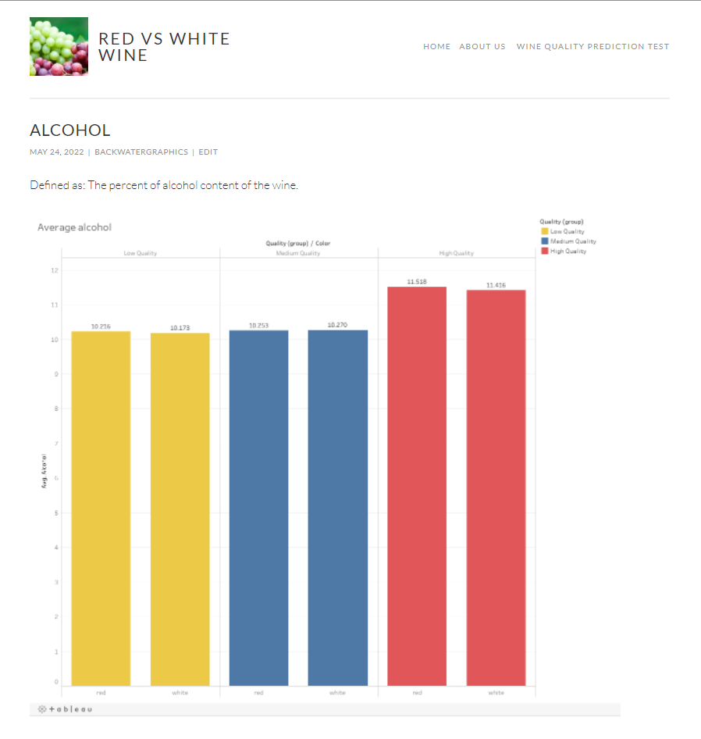
This is a mockup of what the secondary page will look like after you click the link of a feature from the homepage, it will show both white and red wine numbers in each graph

Slide 3
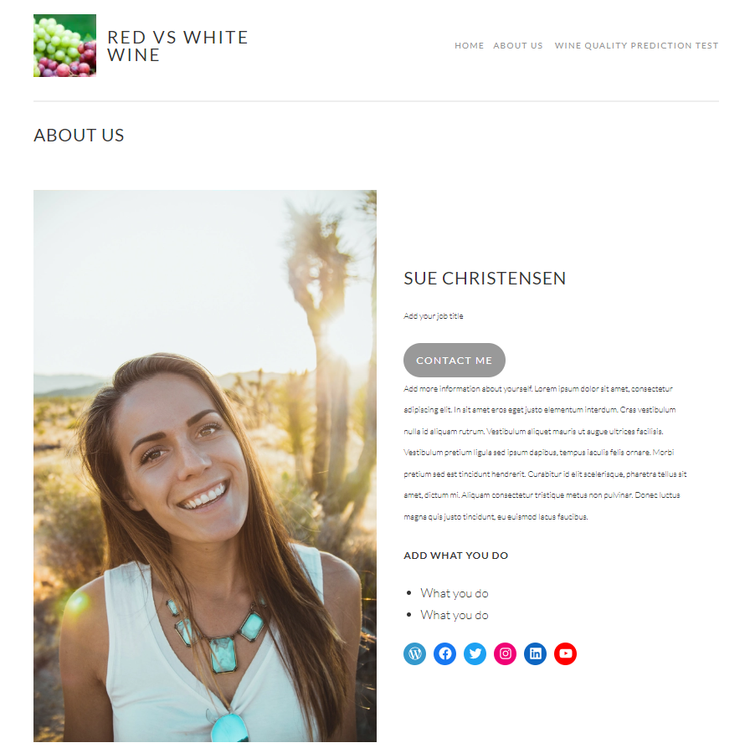
This is a mockup of what the top Level page(TLP) for the about us. It will have information about each member of the team

Slide 4
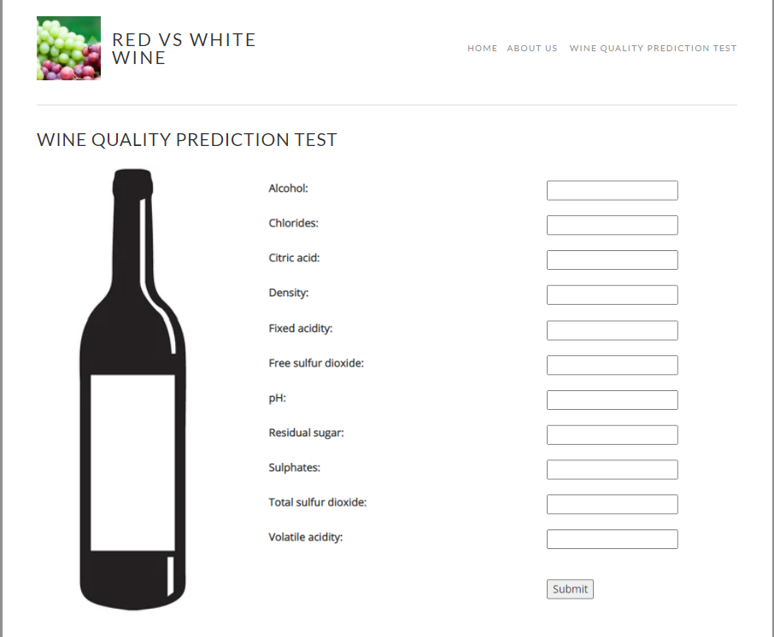
This is a mockup of what the top Level page(TLP) for the wine quality prediction test, for wine makers to enter to find out what their wine quality is at so that they can adjust to make their wine better

