Slide 1
Some new plots for the milliQan cosmic muon background
10 July 2023
Anson Kost

Slide 2
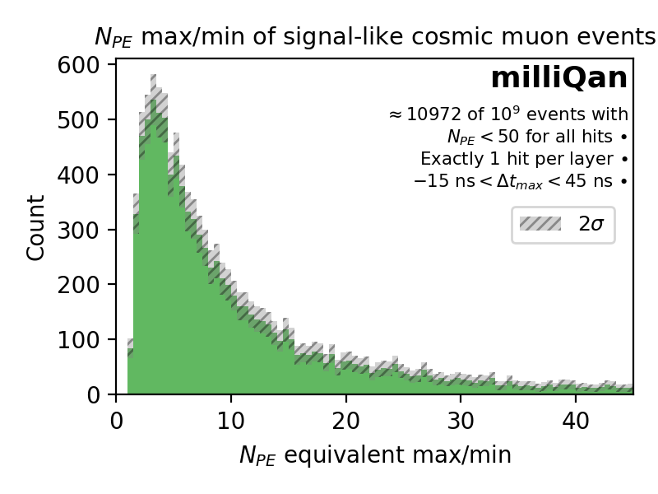
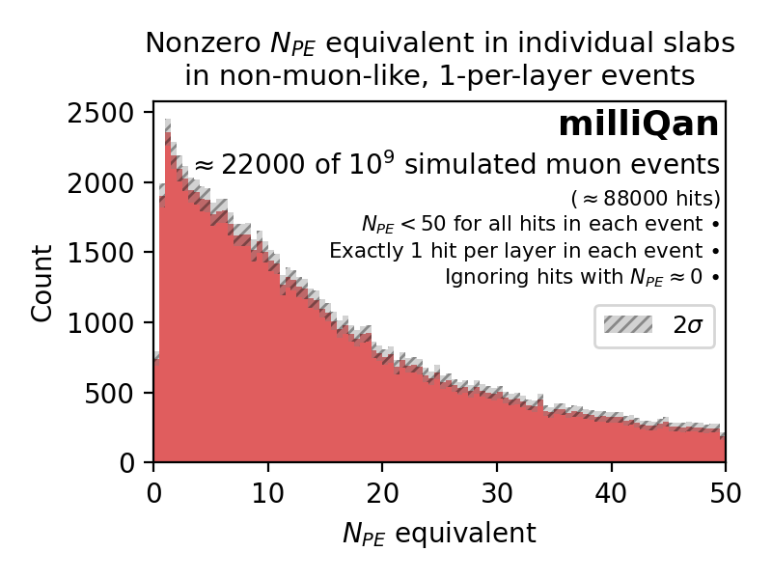
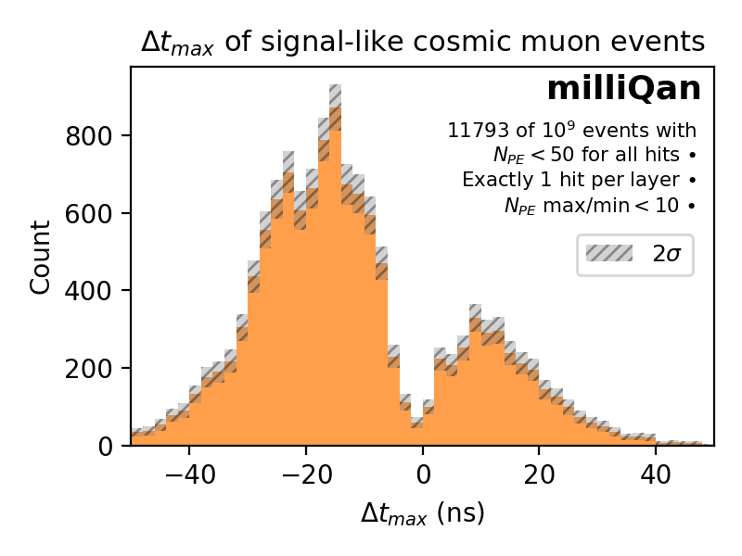

Slide 6
Next Steps
Very soon:
Updated cuts for the plot data (sum up hits per slab per event)
Soon:
Analyze the run 3 sim data
Reduce the background and increase the sensitivity of milliQan
Thanks, Ryan, for your fantastic guidance.

