Slide 1
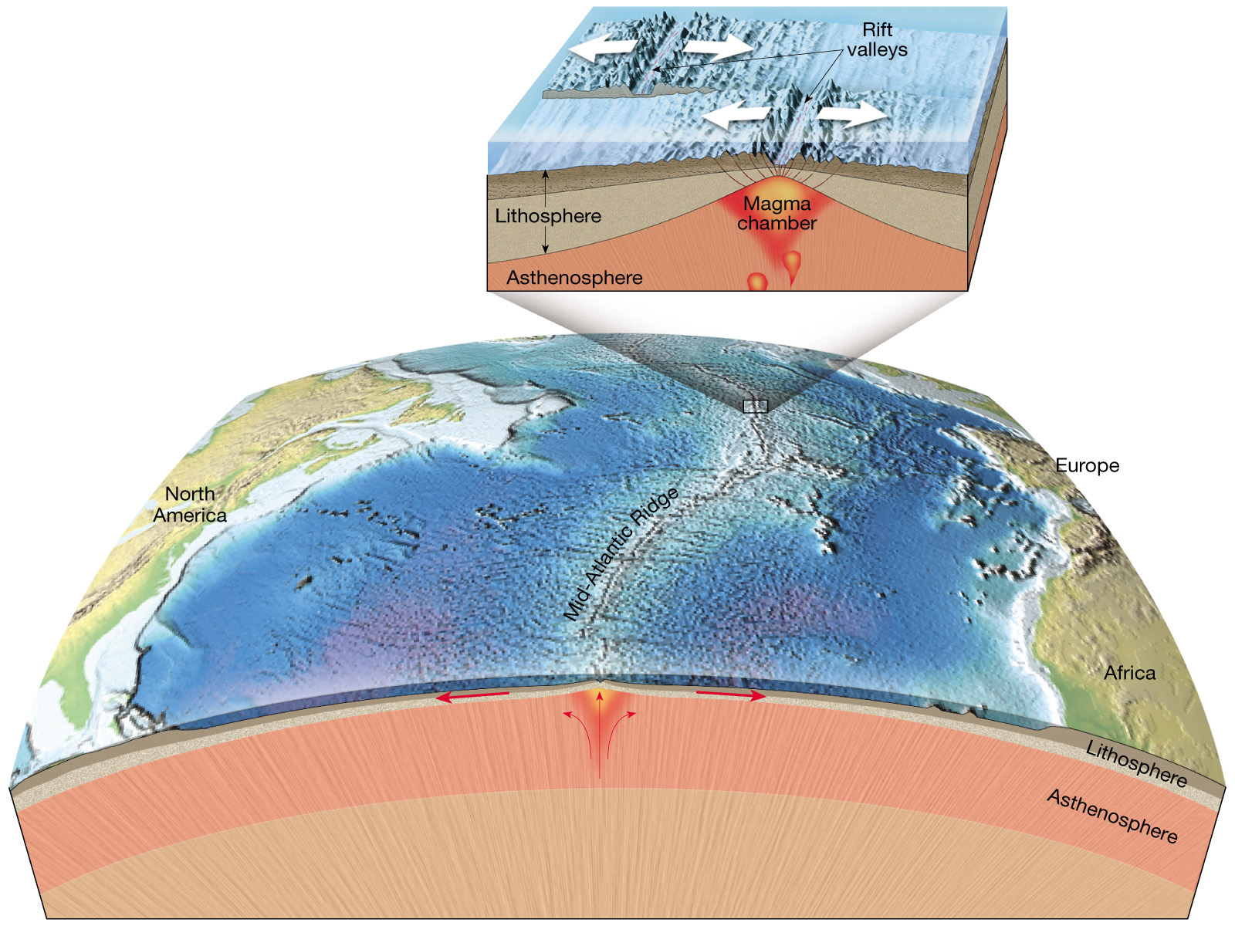
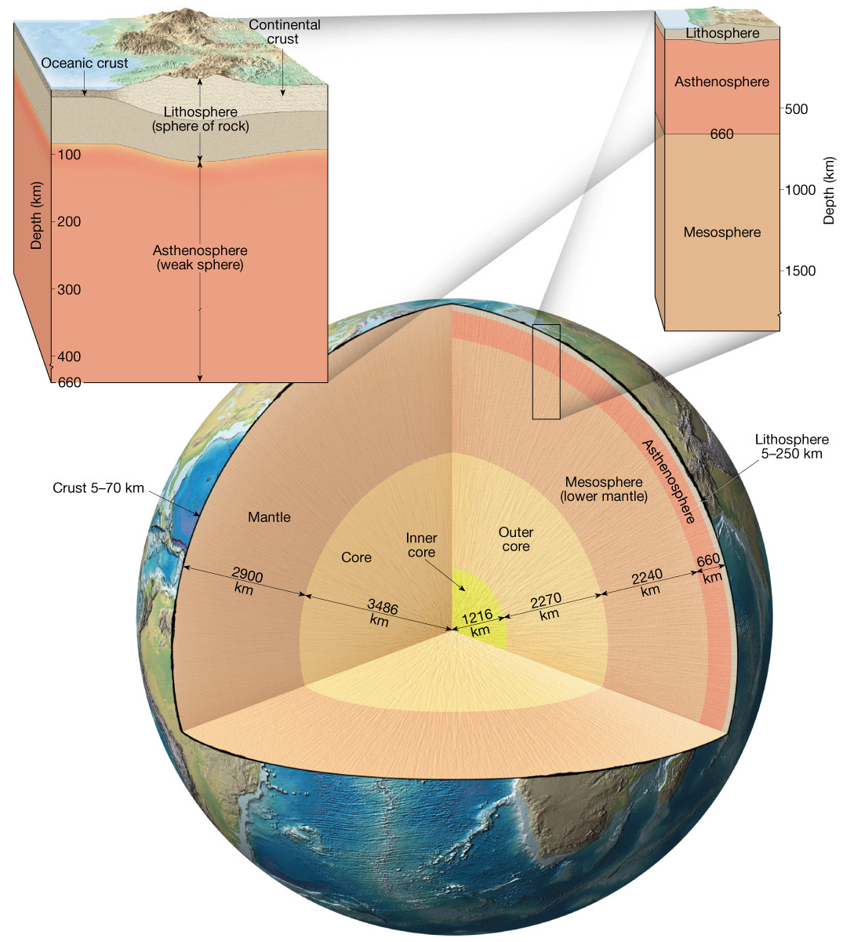
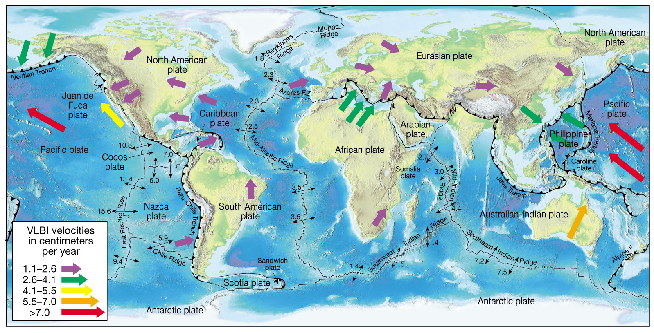
Earthquake Magnitude
GE391

Slide 2
Why do we need to define the size of an earthquake?
We need some way to measure quantitatively the size of an earthquake so that we can compare the sizes of different events.
Our measure of earthquake size must be based on basic physical principles.

Slide 3
What data can we use to measure earthquake size?
We can use measurements of the sizes of waves on seismographs (easy to measure).
We can use measures of deformations of the ground (limited to large earthquakes; hard to measure).
We can use earthquake felt or damage effects (limited to large earthquakes; observations often imprecise).

Slide 4
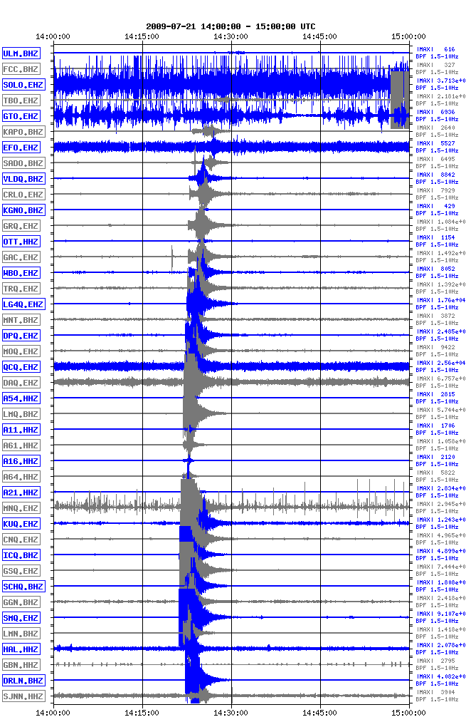
Look at how seismogram amplitudes vary with distance from the earthquake epicenter. Why?

Slide 5
Why seismogram amplitudes vary with distance from the earthquake focus:
Geometric Spreading: For hypocentral distance R_{h}, amplitude decreases as 1/R_{h} for body waves; for epicentral distance R_{e}, amplitude decreases as 1/(R_{e})^{1/2} for surface waves.
Anelastic attenuation: Friction in the rock during seismic wave passage absorbs energy from the seismic wave, decreasing the wave energy as e^{-γX} where γ is the attenuation coefficient and X is the distance traveled by the wave.

Slide 6
Total attenuation effect:
e^{-γX}/X (body waves)
or
e^{-γX} /(X)^{1/2} (surface waves)
where X is the distance traveled by the wave

Slide 7
http://earthquake.usgs.gov/learning/animations/

Slide 8
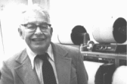
Richter’s Idea
(Bulletin of the Seismological Society of America, 1935)
Wave amplitudes from an earthquake decay with distance from a source. Extrapolate those amplitudes to some prescribed distance from the source (Richter used 100 km). The log₁₀ of the extrapolated amplitude at 100 km is used as the measure of earthquake size.

Slide 9
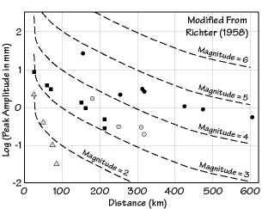
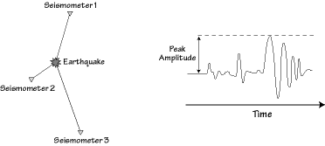
Richter’s Data
The following shows a plot of some data from Richter’s 1958 book on seismology. Each symbol shape is from a different earthquake.
A
Log₁₀(A)=3.37 - 3 log₁₀(Δ)
Δ

Slide 10
Richter’s Magnitude Scale
Richter knew that there was a tremendous variation in the sizes of seismic events. Since he was an amateur astronomer, he knew that base-10 logarithms could reduce a wide range of numbers to a manageable size. Thus, he based his magnitude scale on base-10 logarithms. Furthermore, he adjusted his scale so that the largest expected magnitude is about 10 and the smallest is about 0.

Slide 11
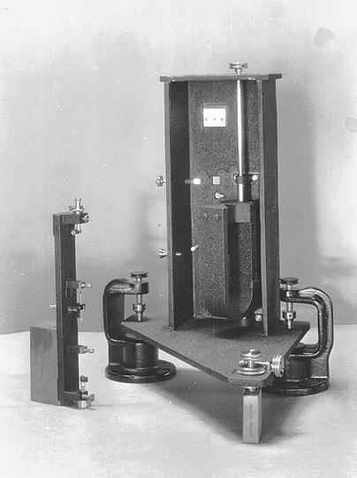
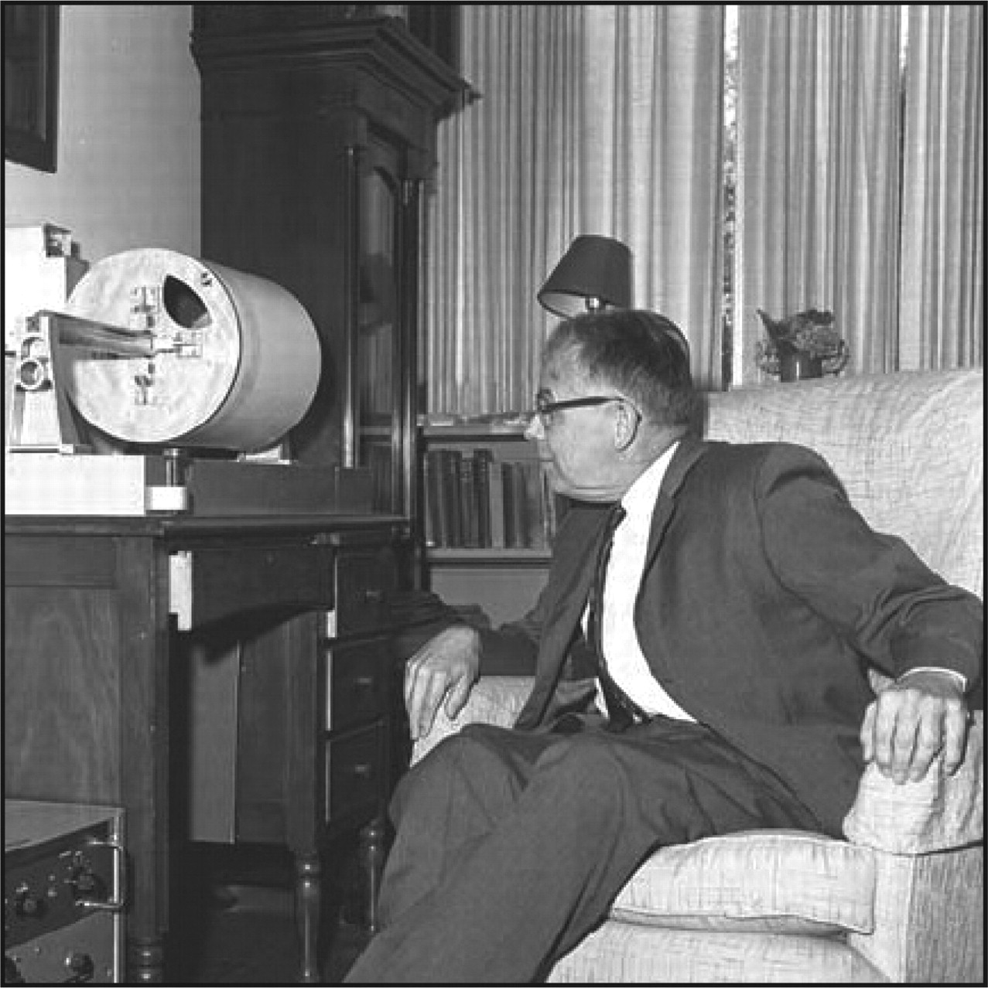
Richter’s Method and the Wood-Anderson Seismograph
Richter’s original amplitude measurements were all made from a Wood-Anderson torsion seismograph, and his original magnitude scale assumed that instrument was being used.
Richter in his livingroom.

Slide 12
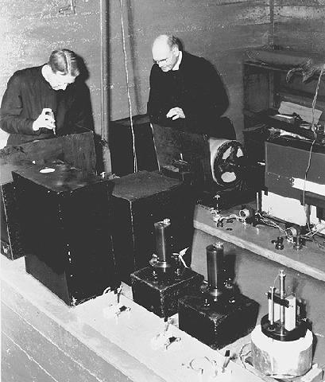
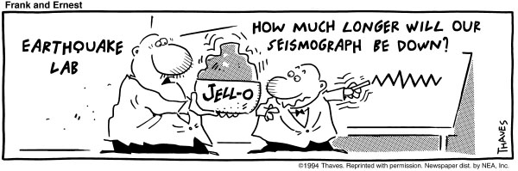
Richter’s Method and the Wood-Anderson Seismograph
Seismograph operation: Light from a source would travel to the instrument, reflect off of a mirror that would rotate as the ground moved horizontally, and then return and expose a piece of photographic paper.

Slide 13
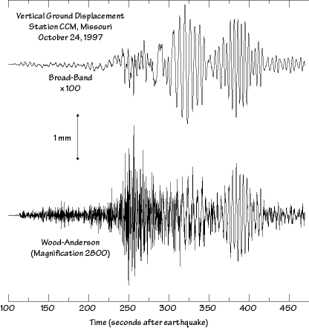
Today, Wood-Anderson seismographs are no longer used, but we can use digital filtering of other seismograms to simulate their response from broadband seismographic recordings.

Slide 14
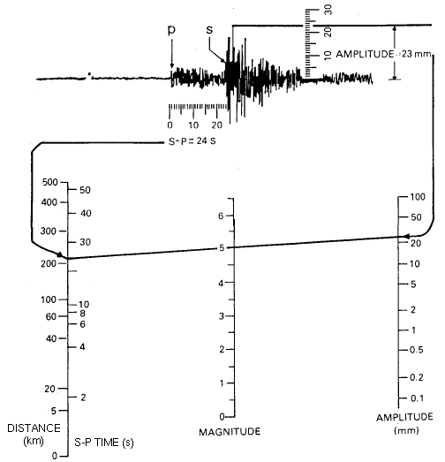
In the days before computers, people used a “nomogram” as a convenient way to calculate the results of simple formulas from measurements. Richter invented a nomogram for his magnitude scale.

Slide 15
Richter’s Method Extended to the World
Because seismic attenuation γ is different in every part of the world, Richter’s original magnitude scale (formula) only works in California. Different magnitude scales need to be developed for different areas of the world, for different kinds of seismic waves, and for different frequencies f, since γ(f) is a function of frequency.

Slide 16
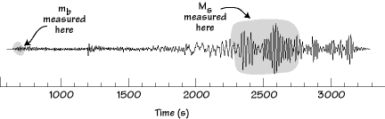
Richter’s Method Extended to the World (cont.)
To extend Richter’s method to the world, Beno Gutenberg and Charles Richter developed some other magnitude scales--the body-wave magnitude scale and the surface-wave magnitude scale. Each works somewhat differently, but each was calibrated to give the same kinds of magnitude numbers as Richter’s original scale.

Slide 17
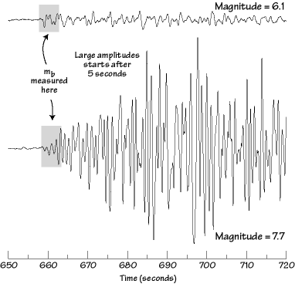
Richter’s Method Extended to the World (cont.)
An example of an amplitude measurement for m_{b}:

Slide 18
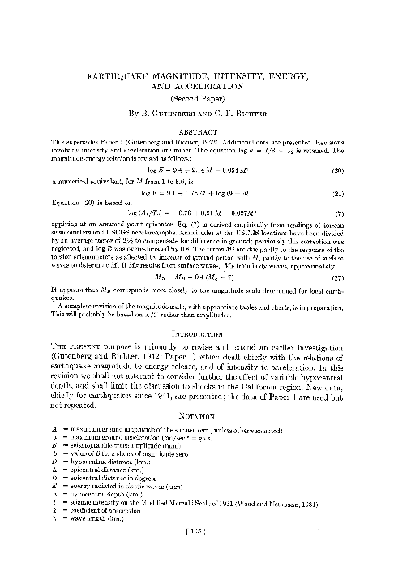

Slide 19
Why magnitude formulas are based on A/T or A
Gutenberg and Richter (1942) argue that magnitude formulas should be based on the wave amplitude A divided by the wave period T (or A/T). If a wave period for the magnitude measurement is specified, then the magnitude can be based on A only.
The reason for this is that A/T is a measure of the ground velocity in the wave. Ground velocity is important because the kinetic energy of the wave is E=1/2 m v².

Slide 20
Why magnitude formulas are based on A/T or A (cont.)
If we take the logarithm of the kinetic energy formula, then we get
log₁₀(E)= log₁₀(1/2)+log₁₀(m)+log₁₀(A/T)
or
log₁₀(E)= log₁₀(1/2)+log₁₀(m)+log₁₀(A)-log₁₀(T)
These have the form of magnitude formulas, and they allow magnitude to be related to energy. Gutenberg and Richter worked out relationships between energy and magnitude.

Slide 21
Magnitude-Energy Relationships
Richter TNT for Seismic Example
Magnitude Energy Yield (approximate)
-1.5 6 ounces Breaking a rock on a lab table
1.0 30 pounds Large Blast at a Construction Site
1.5 320 pounds
2.0 1 ton Large Quarry or Mine Blast
2.5 4.6 tons
3.0 29 tons
3.5 73 tons
4.0 1,000 tons Small Nuclear Weapon
4.5 5,100 tons Average Tornado (total energy)
5.0 32,000 tons
5.5 80,000 tons Little Skull Mtn., NV Quake, 1992
6.0 1 million tons Double Spring Flat, NV Quake, 1994
6.5 5 million tons Northridge, CA Quake, 1994
7.0 32 million tons Hyogo-Ken Nanbu, Japan Quake, 1995;
Largest Thermonuclear Weapon
7.5 160 million tons Landers, CA Quake, 1992
8.0 1 billion tons San Francisco, CA Quake, 1906
8.5 5 billion tons Anchorage, AK Quake, 1964
9.0 32 billion tons Chilean Quake, 1960
10.0 1 trillion tons (San-Andreas type fault circling Earth)
12.0 160 trillion tons (Fault Earth in half through center,
OR Earth's daily receipt of solar energy)

