Slide 1
The Value Modelling Value
The Cube: Sicheng Chu, Yiwen Wang, Luke Zheng

Slide 2

Introduction
There is big money in real estate
Interpretable and robust model

Slide 3
Selecting Predictors
Select fewer variables in favor of interpretability and prevent overfitting
Some initial simple linear regressions
Rely on intuition

Slide 4
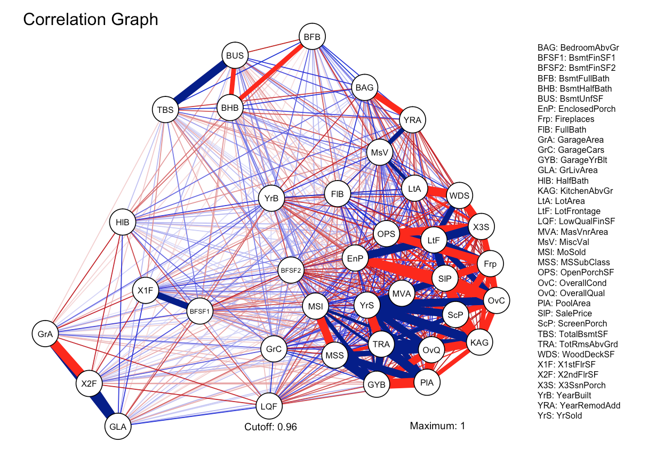
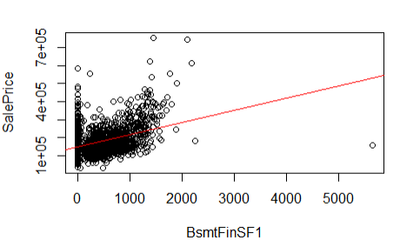
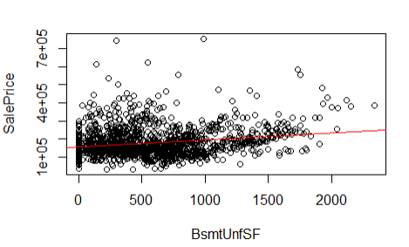
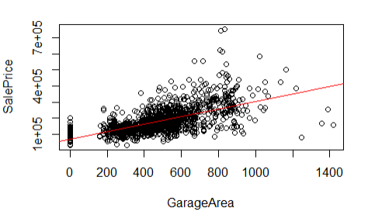
Selecting Predictors - Quantitative

Slide 5
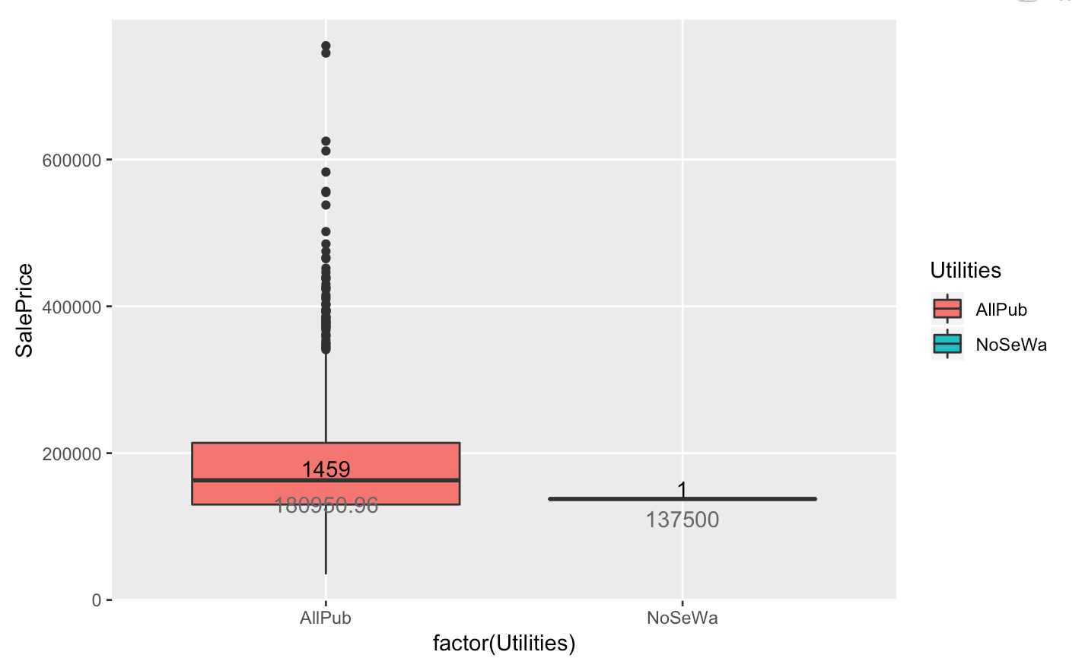
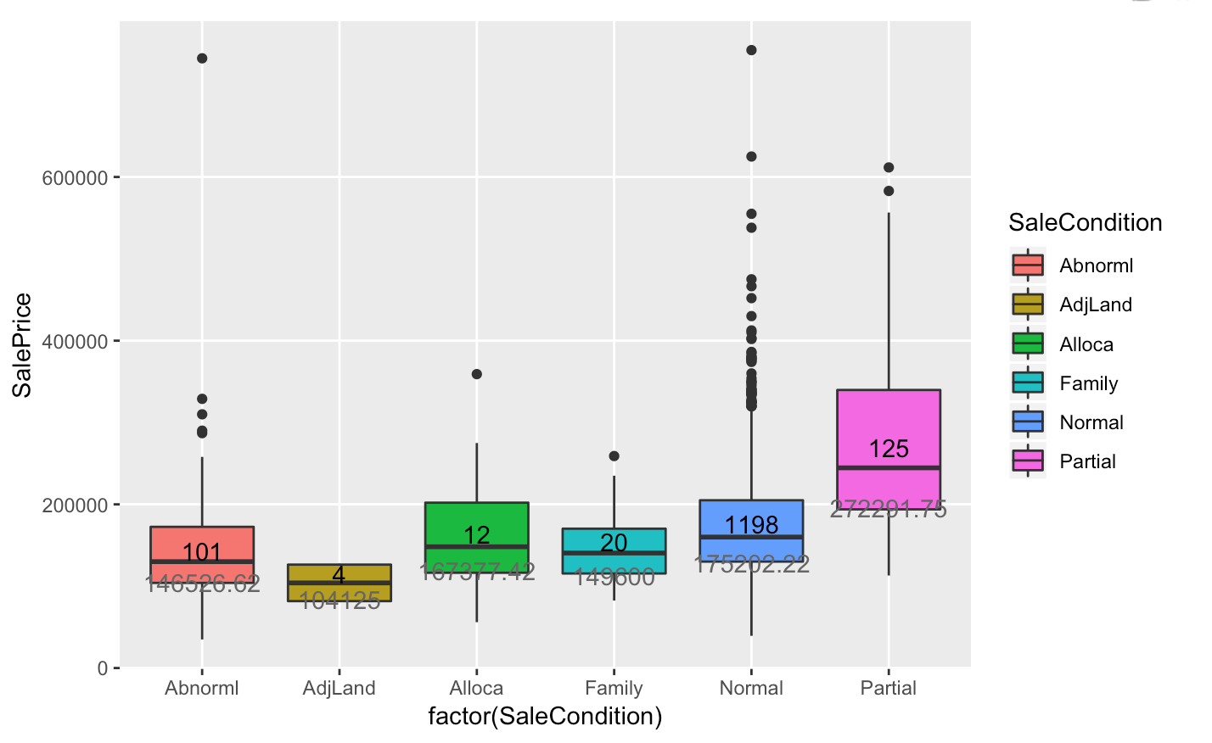
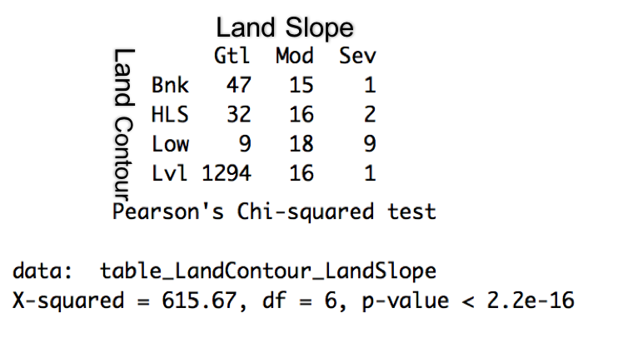
Selecting Predictors - Qualitative

Slide 6
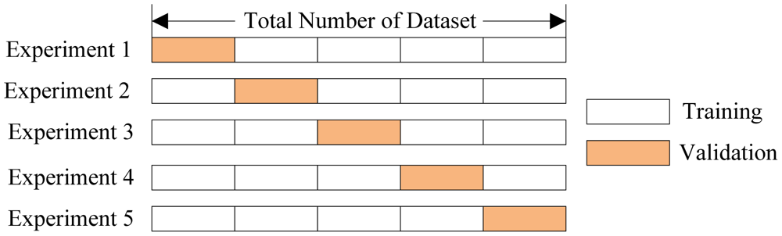
Selecting Predictors - Cross-Validation
To check if our model overfits
5-fold CV
Withholds ⅕ of training data to be used testing data, while the remaining ⅘ is used to train the model.

Slide 7
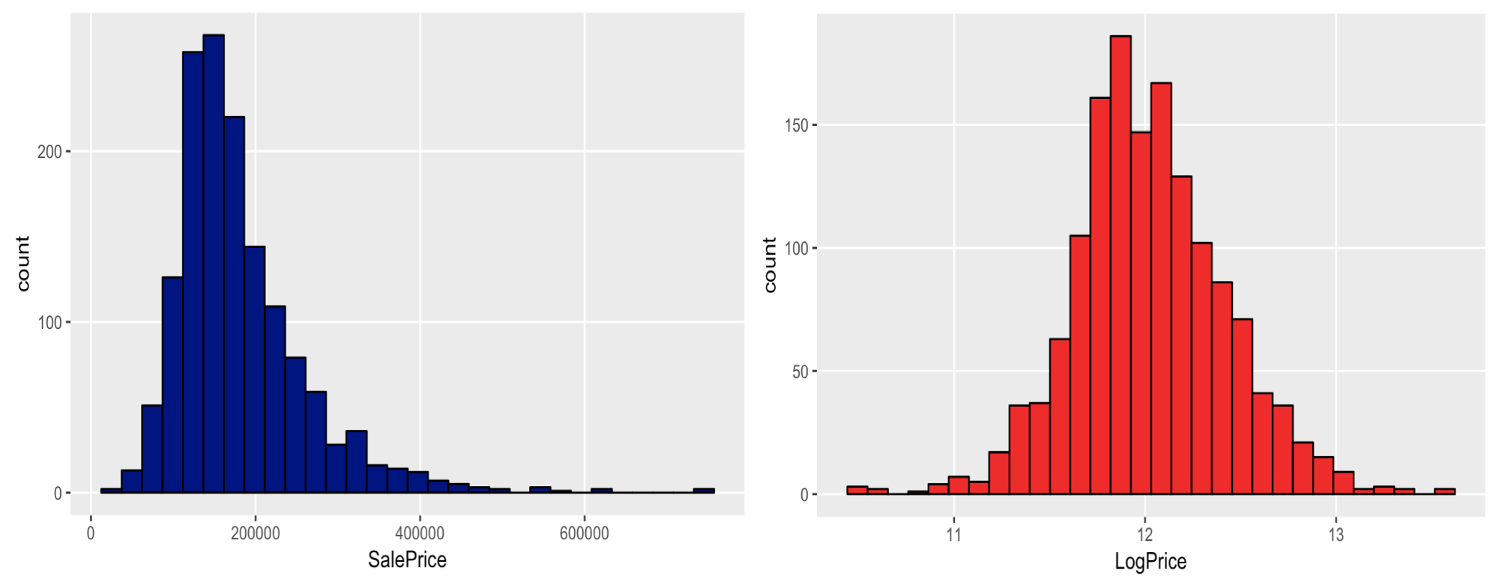
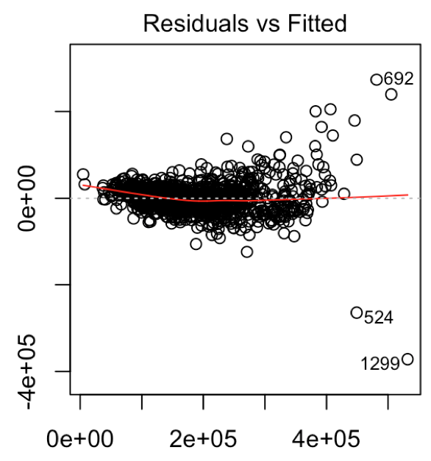
Data transformation
Logical Variable: Qualitative Variable: Sale Condition, Basement Exposure
Quantitative Variable: Porch
Scale: Ground Living Area, Basement Finished Area Type1, Year Built,
Year Remodeled
Log transformation: Sale Price

Slide 8
Model
lm = lm(LogPrice ~ scale(GrLivArea) + GarageCars + TRUE_Porch + SaleConNormal + scale(BsmtFinSF1) + CentralAir + baseExpoAverage + LotShape + LandContour + Neighborhood + BldgType + OverallQual + YearBuilt + YearRemodAdd + OverallCond, data = train)

Slide 9
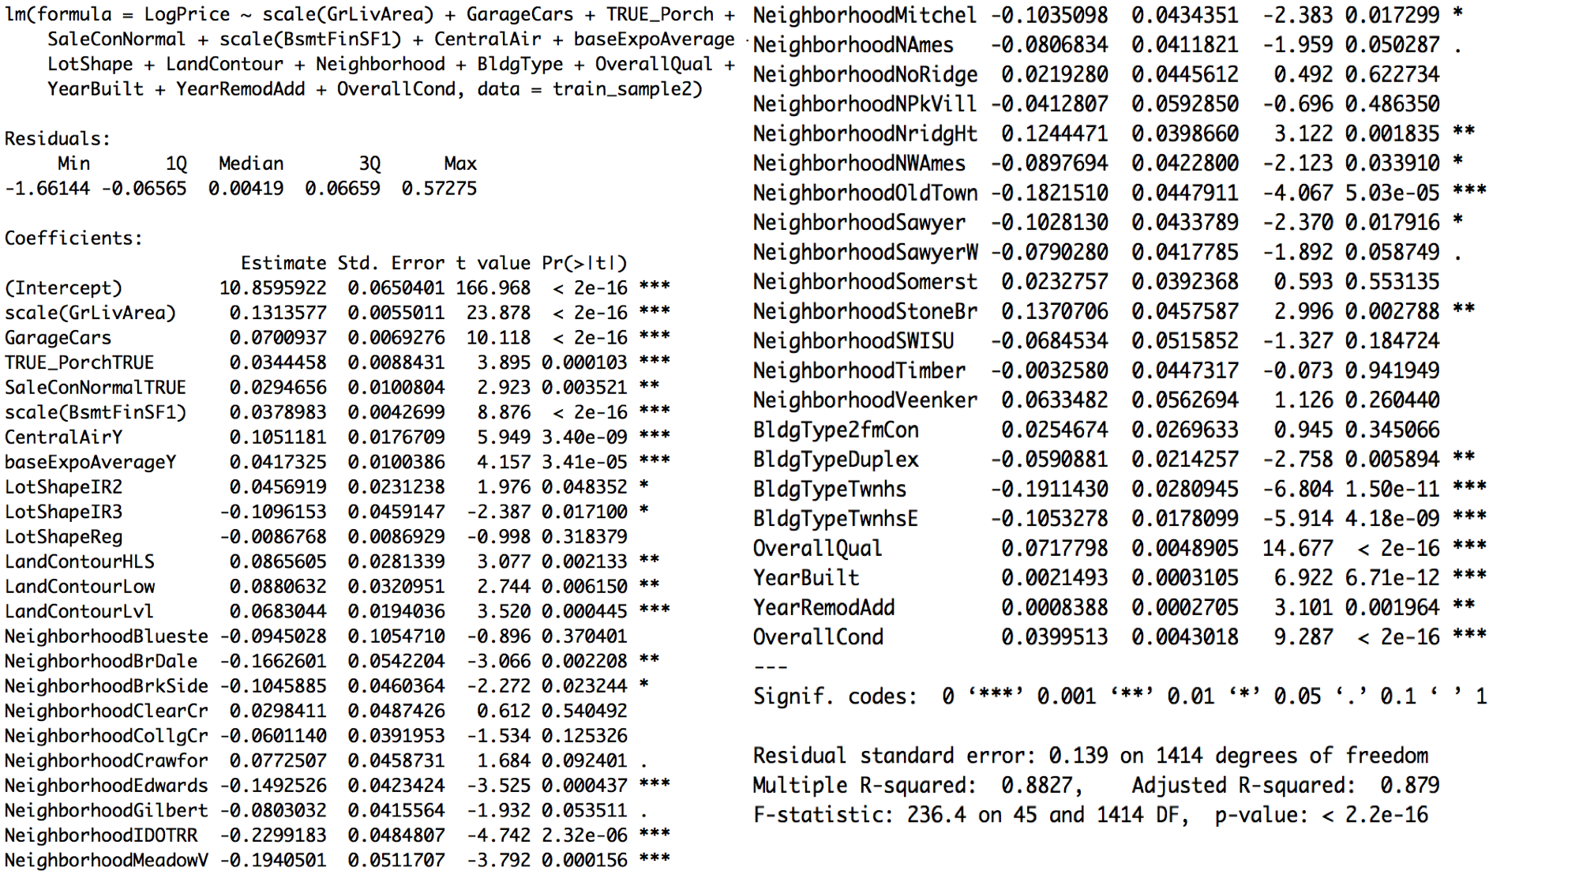
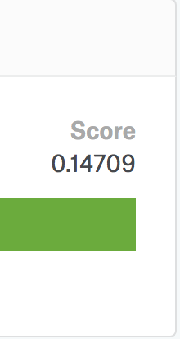
Results - Linear Model Summary
Kaggle
Root MSE

Slide 10
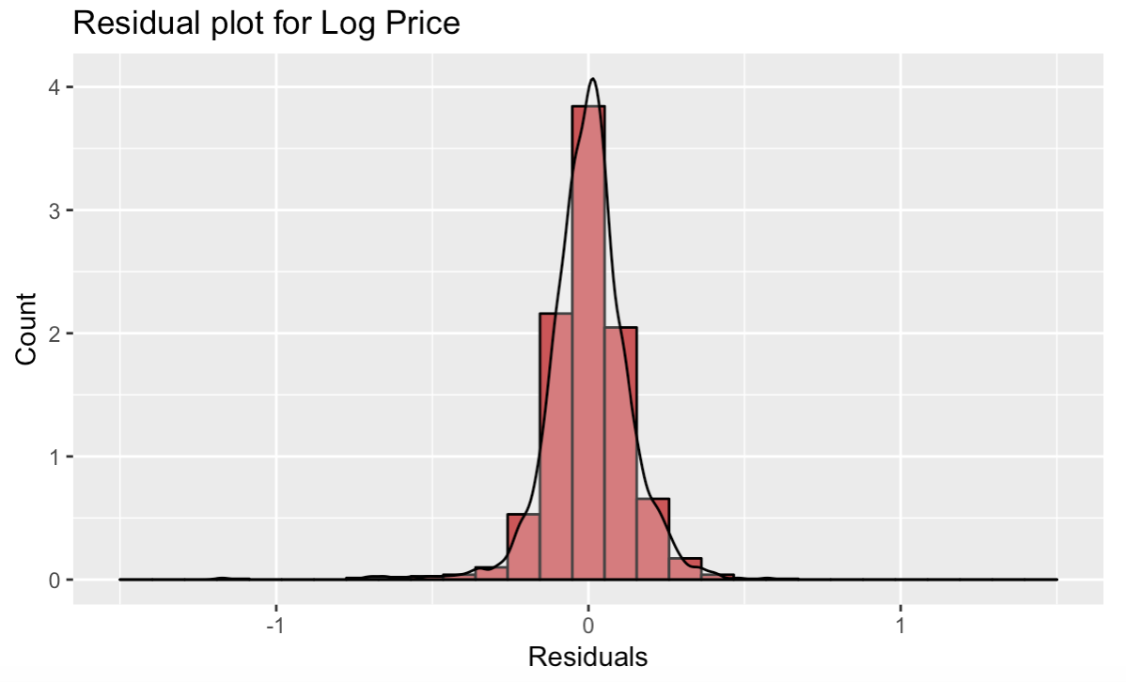
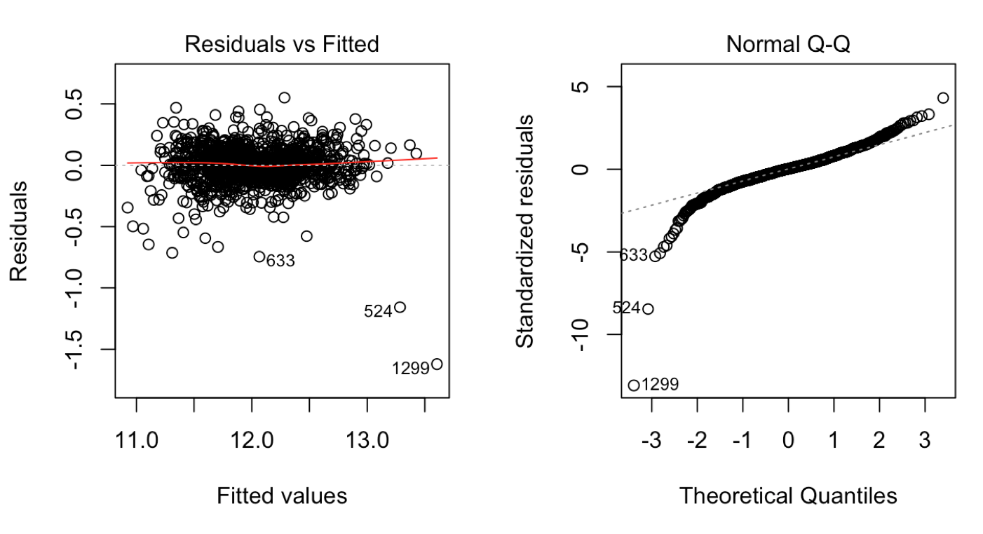
Results - Residuals

Slide 11
Interpretation

Slide 12
Future Direction
Conditional linear regressions on houses with basements and without basements (presence of garage,...)
Non-linear and interaction terms in model
Better tuning of data

Slide 13
Thank you!

Slide 14
Sources
https://www.housingwire.com/articles/29281-why-are-socal-housing-prices-running-so-hot
https://tex.stackexchange.com/questions/429451/k-fold-cross-validation-figure-using-tikz-or-table
https://stackoverflow.com/questions/7382039/chi-square-analysis-using-for-loop-in-r

