Slide 1
Racing in Hyperspace: Closing Hyper-Threading Side Channels on SGX with Contrived Data Race
Guoxing Chen¹* & Wenhao Wang^{2,3}*, Tianyu Chen², Sanchuan Chen¹,
Yinqian Zhang¹, XiaoFeng Wang², Ten-Hwang Lai¹, Dongdai Lin³
(*co-first authors)
¹The Ohio State University,
²Indiana University Bloomington,
³Institute of Information Engineering, CAS

Slide 2

Intel SGX
Untrusted application
Enclave
Code and data
Side channels
Untrusted OS

Slide 3

Side channels
Physical core
Enclave code
Attack code
Caches
BPUs
Asynchronous Enclave eXit (AEX)
AEX-detection based mitigations: T-SGX, Déjà Vu
Side channels enabled or assisted by Hyper-Threading
[1] Shih et al, “T-SGX: Eradicating controlled-channel attacks against enclave programs,” NDSS, 2017
[2] Chen et al, “Detecting privileged side-channel attacks in shielded execution with Déjà Vu,” AsiaCCS, 2017

Slide 4
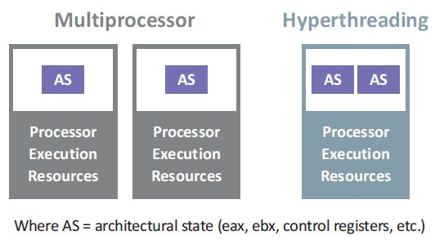
Hyper-Threading
Intel’s proprietary implementation of simultaneous multithreading (SMT)
Caches
BPUs
TLBs

Slide 5
Hyper-Threading enabled side channels
Side Channel | Shared | Cleansed at AEX | HT only
Store Buffers^{[1][2]} | No | N/A | Yes
FPUs | Yes | N/A | Yes
TLBs | Yes | Flushed | Yes
Caches | Yes | Not flushed | No
BPUs | Yes | Not flushed | No
[1] Moghimi et al, “MemJam: A false dependency attack against constant-time crypto implementations,” arXiv, 2017
[2] Sullivan et al, “Microarchitectural minefields: 4k-aliasing covert channel and multi-tenant detection in IaaS clouds,” NDSS, 2018

Slide 6
Hyper-Threading assisted side channels
Hyper-Threading helps reduce AEXs
Sneaky Page Monitoring assisted by Hyper-Threading[1]
Invalidate Transactional Synchronization Extensions (TSX) based cache side-channel protection[2]
[1] Wang et al, “Leaky cauldron on the dark land: Understanding memory side-channel hazards in SGX,” CCS, 2017
[2] Gruss et al, “Strong and efficient cache side-channel protection using hardware transactional memory,” USENIX Security, 2017

Slide 7
Research goals
Close all these Hyper-Threading enabled or assisted side channels
Detect AEX-based side channel attacks

Slide 8


Challenges
Simply disabling Hyper-Threading
No effective way to verify: cpuid, rdtscp and rdpid are not supported in enclave mode
Remote attestation
Does not contain information about Hyper-Threading
Create a shadow thread from the enclave program to occupy the other hyper-thread
How to reliably verify the physical-core co-location?

Slide 9
HyperRace overview
Context switches trigger AEXs
Physical core
Physical core
Protected thread
Terminate if fail
AEX detected!
Shadow thread
Frequently check AEX
Co-location test
Co-location test
Contrived data race

Slide 10
Contrived data race: an illustrating example
Two threads operate on the same shared variable ν:
Protected thread loops:
Writes 0 to ν
Waits for 10 cycles
Reads ν
Shadow thread loops:
Writes 1 to ν
Physical core
Enclave data: v
Protected thread
Shadow thread
Untrusted OS
L1 cache
Protected thread reads ν=1 with a high probability

Slide 11
Contrived data race: an illustrating example
Physical core
Physical core
Protected thread
Untrusted thread
Shadow thread
Untrusted thread
L1 cache
L1 cache
Cache coherence protocol
(latency ~ 190 cycles on Skylake)
Protected thread reads ν=1 with a low probability

Slide 12
Contrived data race
Physical core
Physical core
Physical core
Communication time:
Execution time:
When co-located, communication time < execution time
When not co-located, communication time > execution time
Protected thread
Protected thread
Shadow thread
Untrusted thread
Shadow thread
Untrusted thread
L1 cache
L1 cache
L1 cache
write
read

Slide 13
A refined data-race design
Physical core
Enclave data: v
Protected thread
Shadow thread
Both threads observe data races with high probability
Untrusted OS
L1 cache

Slide 14
A refined data-race design
Communication time
Protected thread
read
write
read
write
Shadow thread
read
write
read
write
When co-located, communication time < execution time
Each thread read the value written by the other thread with very high probability.

Slide 15
A refined data-race design
Physical core
Physical core
Protected thread
Untrusted thread
Shadow thread
Untrusted thread
L1 cache
L1 cache
At least one observe data races with low probability

Slide 16
A refined data-race design
Communication time
Protected thread
read
write
read
write
Shadow thread
read
write
read
write
When not co-located, communication time > execution time
Each thread read the value written by the other thread with very low probability.

Slide 17
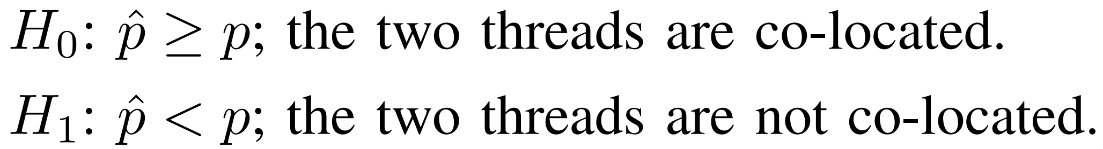
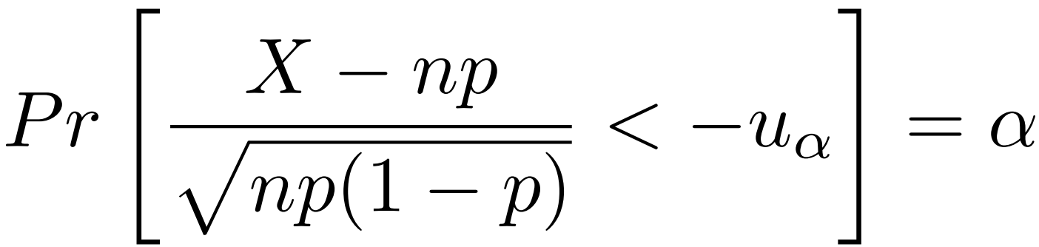

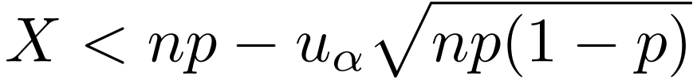
Co-Location Test via Hypothesis Testing

Slide 18
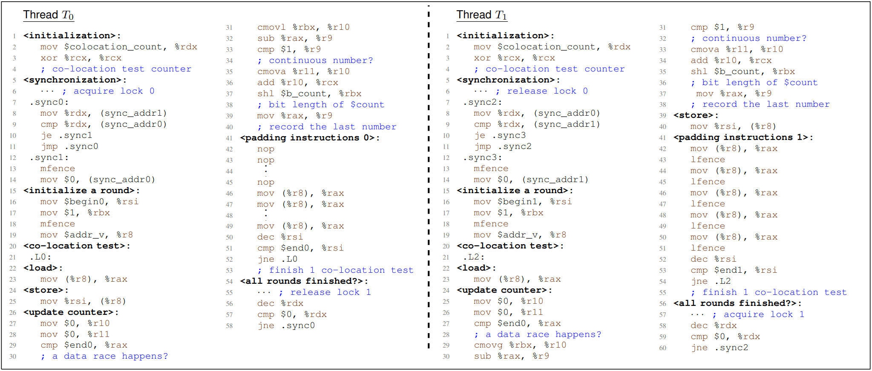
Co-Location Test code

Slide 19
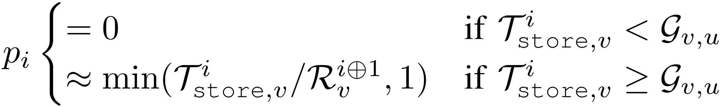
Security requirements
Necessary conditions to pass the co-location tests:
1) communication time < execution time
2) execution time for both threads should be roughly the same
Theoretical model:
Protected thread
LD
ST
LD
ST
Shadow thread
LD
ST
LD
ST
LD
ST

Slide 20
Threat model
Physical core
Physical core
Protected thread
Shadow thread
Attack code
Attack code
L1 cache
L1 cache
Try to pass the co-location test by
Flushing cache
Changing CPU frequency
Disabling caching
Disabling caching + changing CPU frequency
……

Slide 21
Security analysis
Latency of cache eviction
Latency of cross-core communication
Theoretical model
Effects of CPU frequency changes
Effects of disabling caching
The adversary cannot meet both security requirements simultaneously

Slide 22
Implementation
Instrumented code
protected thread code
if (aex_detected()) {
co_location_test();
}
Original code
LLVM
Every q
instructions
if (aex_detected()) {
co_location_test();
}
Shadow thread code
HyperRace library
if (aex_detected()) {
co_location_test();
}
AEX detection via monitoring the SSA [1].
[1] Gruss et al, “Strong and efficient cache side-channel protection using hardware transactional memory,” in USENIX Security, 2017.

Slide 23
Performance
Runtime overhead:
AEX detections
Co-location tests
Memory overhead:
Increased code size
AEX detection
Co-location test
Enclave code
AEX detected!
AEX detected!

Slide 24
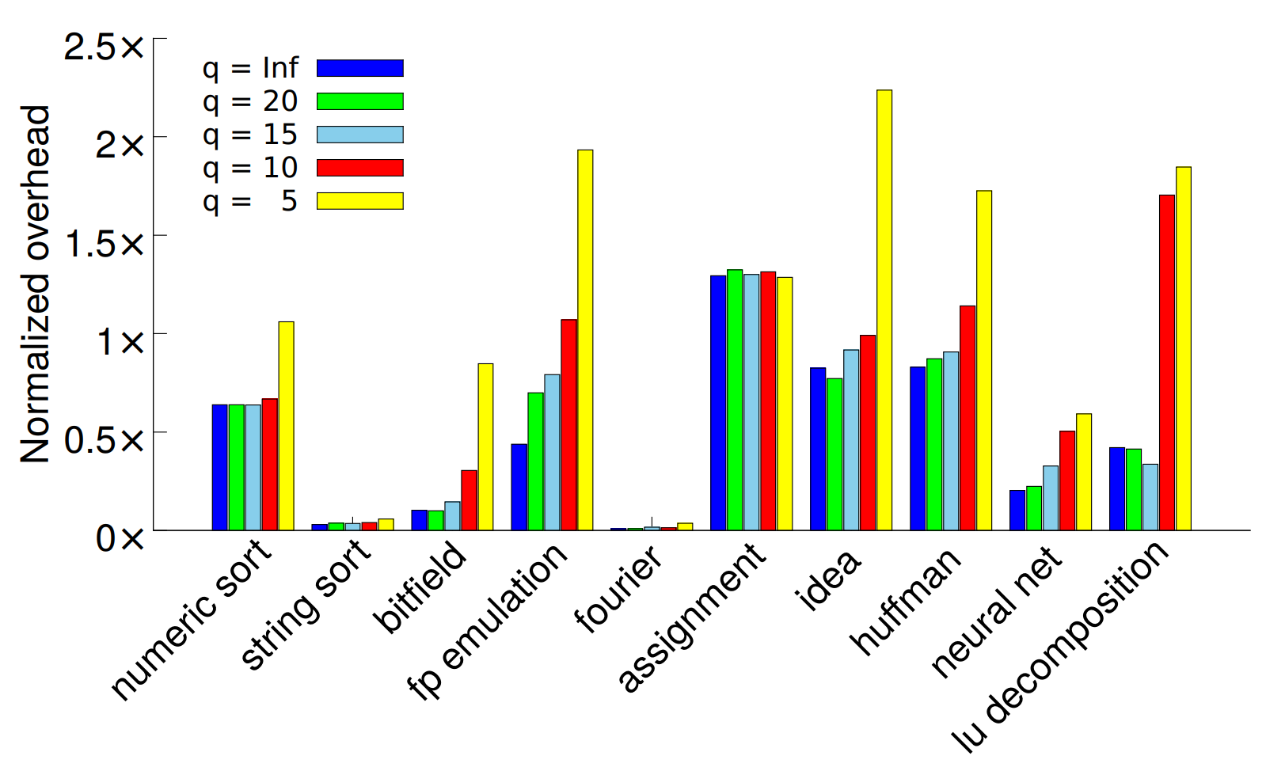
Performance
Runtime overhead due to AEX detection (nbench)
Geometric mean = 101.8% when q = 5.

Slide 25
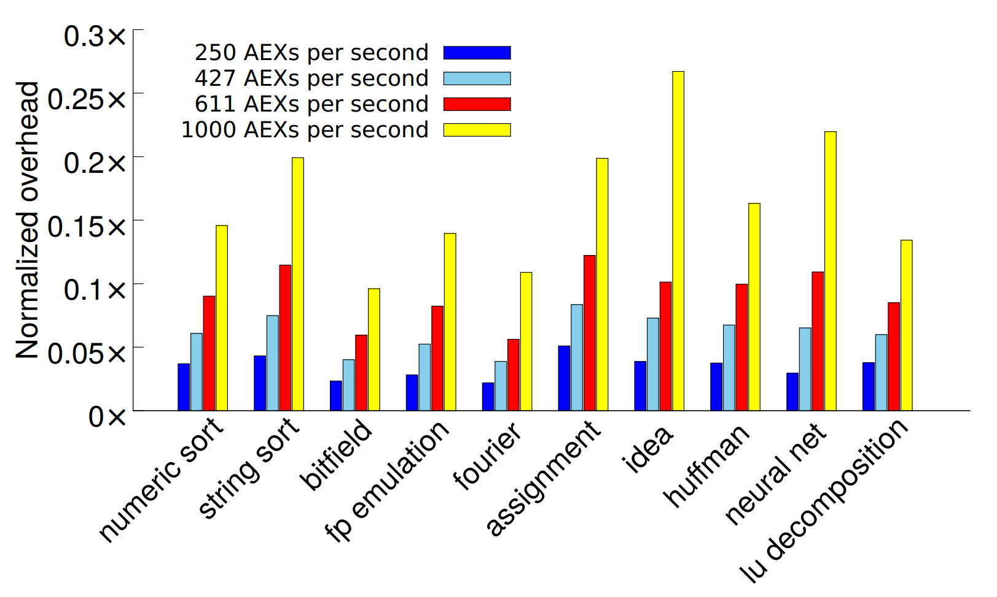
Performance
Runtime overhead due to co-location test (nbench) with q = 20
Geometric mean = 16.6% when 1000 AEXs per sec.

Slide 26
Performance
Memory overhead (nbench)
 | Original | q=20 | q=15 | q=10 | q=5
Bytes | 207,904 | 242,464 | 246,048 | 257,320 | 286,448
Overhead | - | 16.6% | 18.3% | 23.7% | 37.7%

Slide 27
Discussion and conclusion
We designed and implemented a novel co-location technique to close the Hyper-Threading side channels
A bigger lesson: hardware design is performance oriented, but how about their security implications? what can we do if it is vulnerable?
We show that a software approach could mitigate the threat
A composition of software solution and hardware feature might help strike a better balance between security and performance

Slide 28


