Slide 1


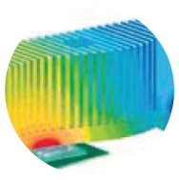



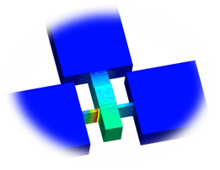
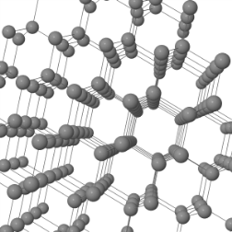





Computational Modelling of Transport Phenomena in Complex Engineering Systems
## Cristina H. Amon
Advanced Thermal & Fluid Optimization, Modelling, and Simulation (ATOMS) Laboratory, Department of Mechanical & Industrial Engineering, University of Toronto
a.nabovati@utoronto.ca
1. Introduction
Some bullet points here
And here
And maybe here
3. How Computational Modelling Can Help Engineers
1. Predict the internal state of engineering systems
2. Address current issues
3. Foresee future challenges
4. Propose robust solutions
5. Evaluate the outcome of proposed design modifications
6. Develop and Optimize next generation of devices and technologies
7. Reduce development cost and time-to-market
4. Results
Point 1
Point 2
5. Summary
Summarize
You usually do not need any figure here
And it does not need to be this large
Device Level
Package Level
e⁻
e⁻
Die Level (Processor)
H₂
H₂
e⁻
O₂
2. Computational Modelling
My method is awesome
Reason 1
Reason 2
And more.
More about my method
And more
Transistors & Logic Gates
Geometry
& Boundary Conditions
e⁻
2H⁺
Heat
H₂
2H⁺
Material
(Atomistic Level)
Atomic Interactions
H₂O
Figure 1: Different levels of thermal transport hierarchy for modelling electronic devices.
Flow Field Plate
Flow Field Plate
Gas Diffusion Layer (Anode)
Gas Diffusion Layer (Cathode)
Catalyst
Proton Exchange Membrane
Catalyst
More points
Even more
Figure 2: Structure of a polymer electrolyte membrane fuel cell.
Acknowledgement:

