Slide 1


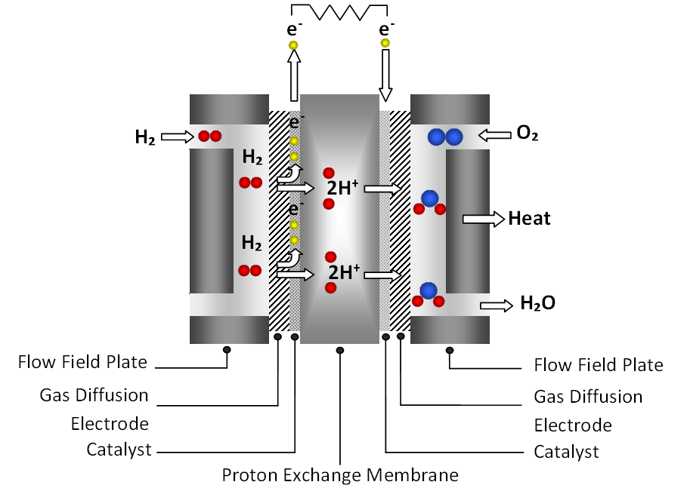

Preferably choose a title which is long enough to fill one line and fits in one line
## ## ## Cristina H. Amon
Department of Mechanical & Industrial Engineering, University of Toronto
##@utoronto.ca
Introduction
Hydrogen-based power systems, specifically fuel cells, offer low CO₂ emission, high efficiency, and versatility.
Objective
A
B
Methodology
Very complicated stuff
Results
Intro or Results or Methodology
In a typical PEM fuel cell:
  Weird things happen!
We model them.
Fig. 2. Goofy,
Results
or more figures.
Summary
We are awesome.
We are doing the best research in the world.
Fig. 1: Schematic of a PEM fuel cell operation

