Slide 1
Measuring Height with a Smartphone and Numerical Integration
Albert Schueller
Whitman College, Walla Walla, WA
MathFest 2025, Sacramento, CA

Slide 2


Where’s Whitman College?

Slide 3
Linear Acceleration Data
A nice activity for Calculus II (integral calculus). Explores the following topics:
Relationship between acceleration, velocity, and position via integration.
Transition from continuous models to sampled data, numerical integration.
Integration is tolerant of noise in data.

Slide 4


Smartphone Sensors
Smartphones are ubiquitous. Packed with a variety of sensors. Record accelerometer data during movement of phone along a linear path.
These apps allow real-time recording of raw phone sensor data. Free! Android and apple phones.

Slide 5

Measurement
Start recording.
Rest phone on floor at person’s feet for a few seconds.
Smoothly lift phone to person’s height. Keep phone in constant orientation during motion, no rotation.
Hold phone at height for a few seconds.
Lower phone and stop recording.

Slide 6
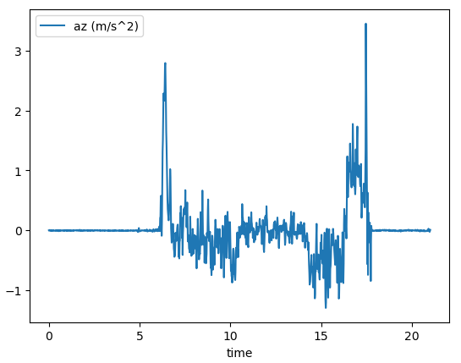
Visualize the Raw Accelerometer Data
From feet to head
Not needed

Slide 7
Visualize and Integrate
Move to your favorite data analysis and visualization tools.
Today: Python, pandas, plotly.
Alternative: Excel or Google Sheets
Find resources on GitHub page.

Slide 8

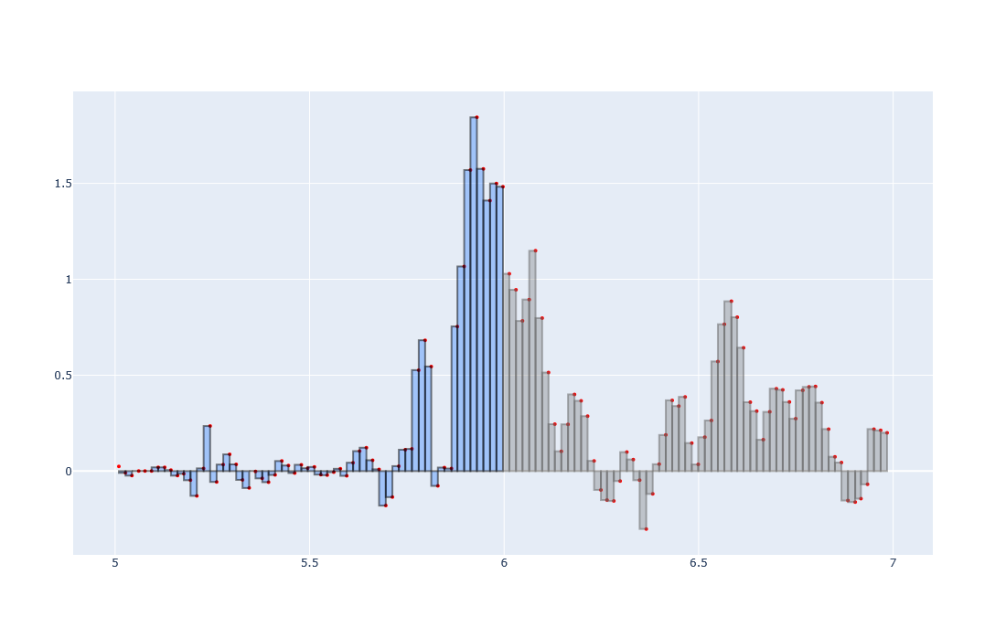



Numerical Integration and Noise

Slide 9


Thank You for Coming!
Thank You Organizers: Marissa Masden and Julia Eaton Julia Eaton
Albert Schueller, Whitman College
Materials from this talk (github):
Other phone sensor projects (github):

