Slide 1
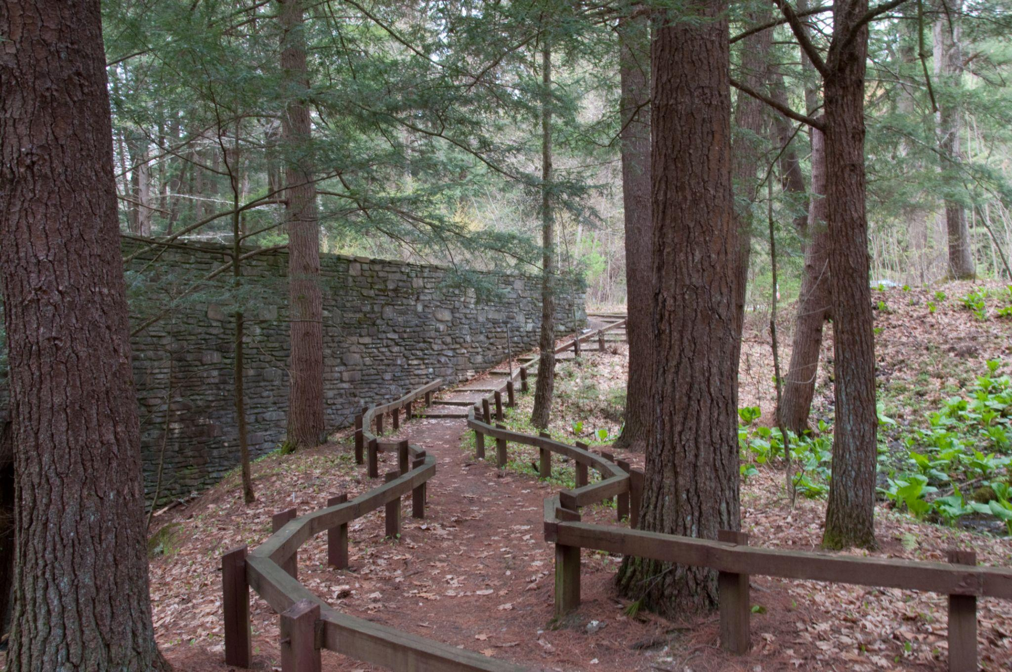
Temperature and seasonal patterns at the Cary Institute: What’s Changing?
Amy Schuler
March 2026
Yale Environmental Data Science Certificate Program
Notes:
Photo: Fern Glen at the Cary Institute of Ecosystem Studies, Millbrook, NY, USA. Credit: Lisa Dellwo

Slide 2
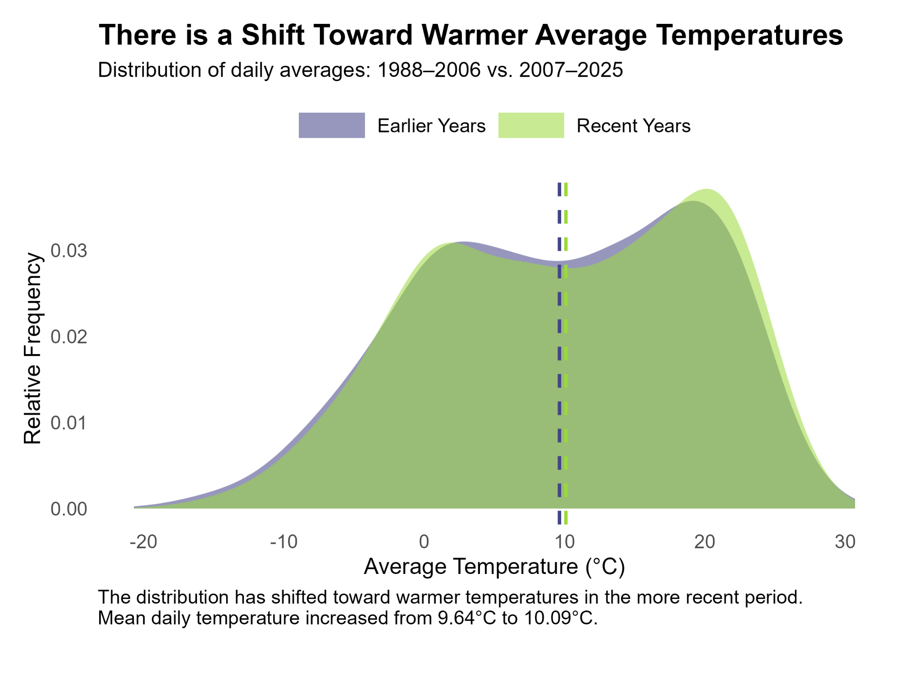
Why do we care?
The 2,000 acre property at the Cary Institute of Ecosystem Studies is used for research, education, and public access. The grounds, waterways, trails and roads need to be safe and accessible for all uses.
Who cares about warming temperatures and seasonal changes?
Property managers and operations crews, when planning work on trails, roads, bridges, buildings and other infrastructure
Researchers, students, and visitors, when siting field locations and timing their work
Educators and naturalists, who plan and coordinate outdoor programs
Hunters, anglers, and other recreational users who use paved and unpaved access roads and trails
Data
Daily average, minimum, and maximum temperatures
(° C), 1988-2025, collected as part of the Cary Environmental Monitoring Program.
Cary Institute meteorological station is co-located with a US Climate Reference Network (CRN) station.
Notes:
Cary Institute of Ecosystem Studies Environmental Monitoring Program is a long-term data collection program.

Slide 3
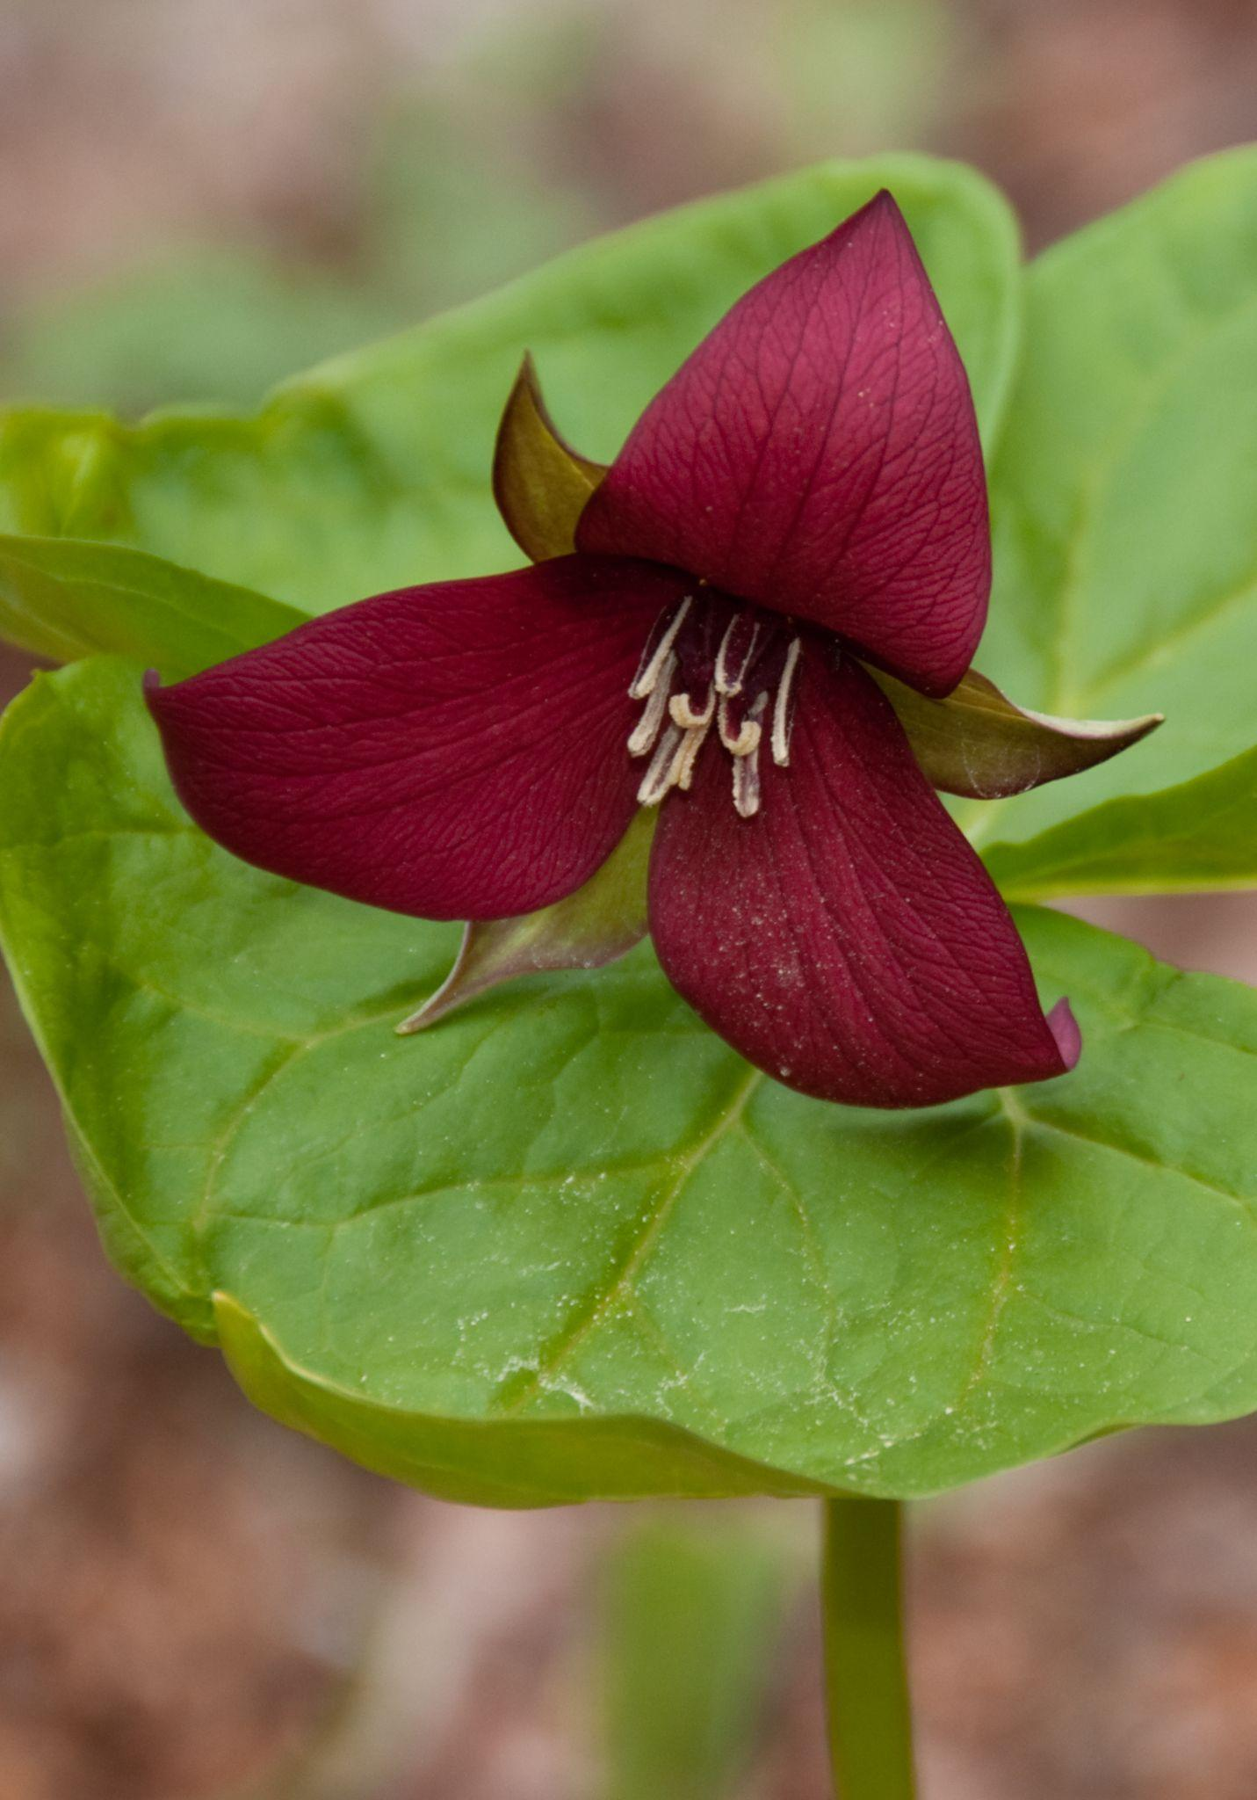
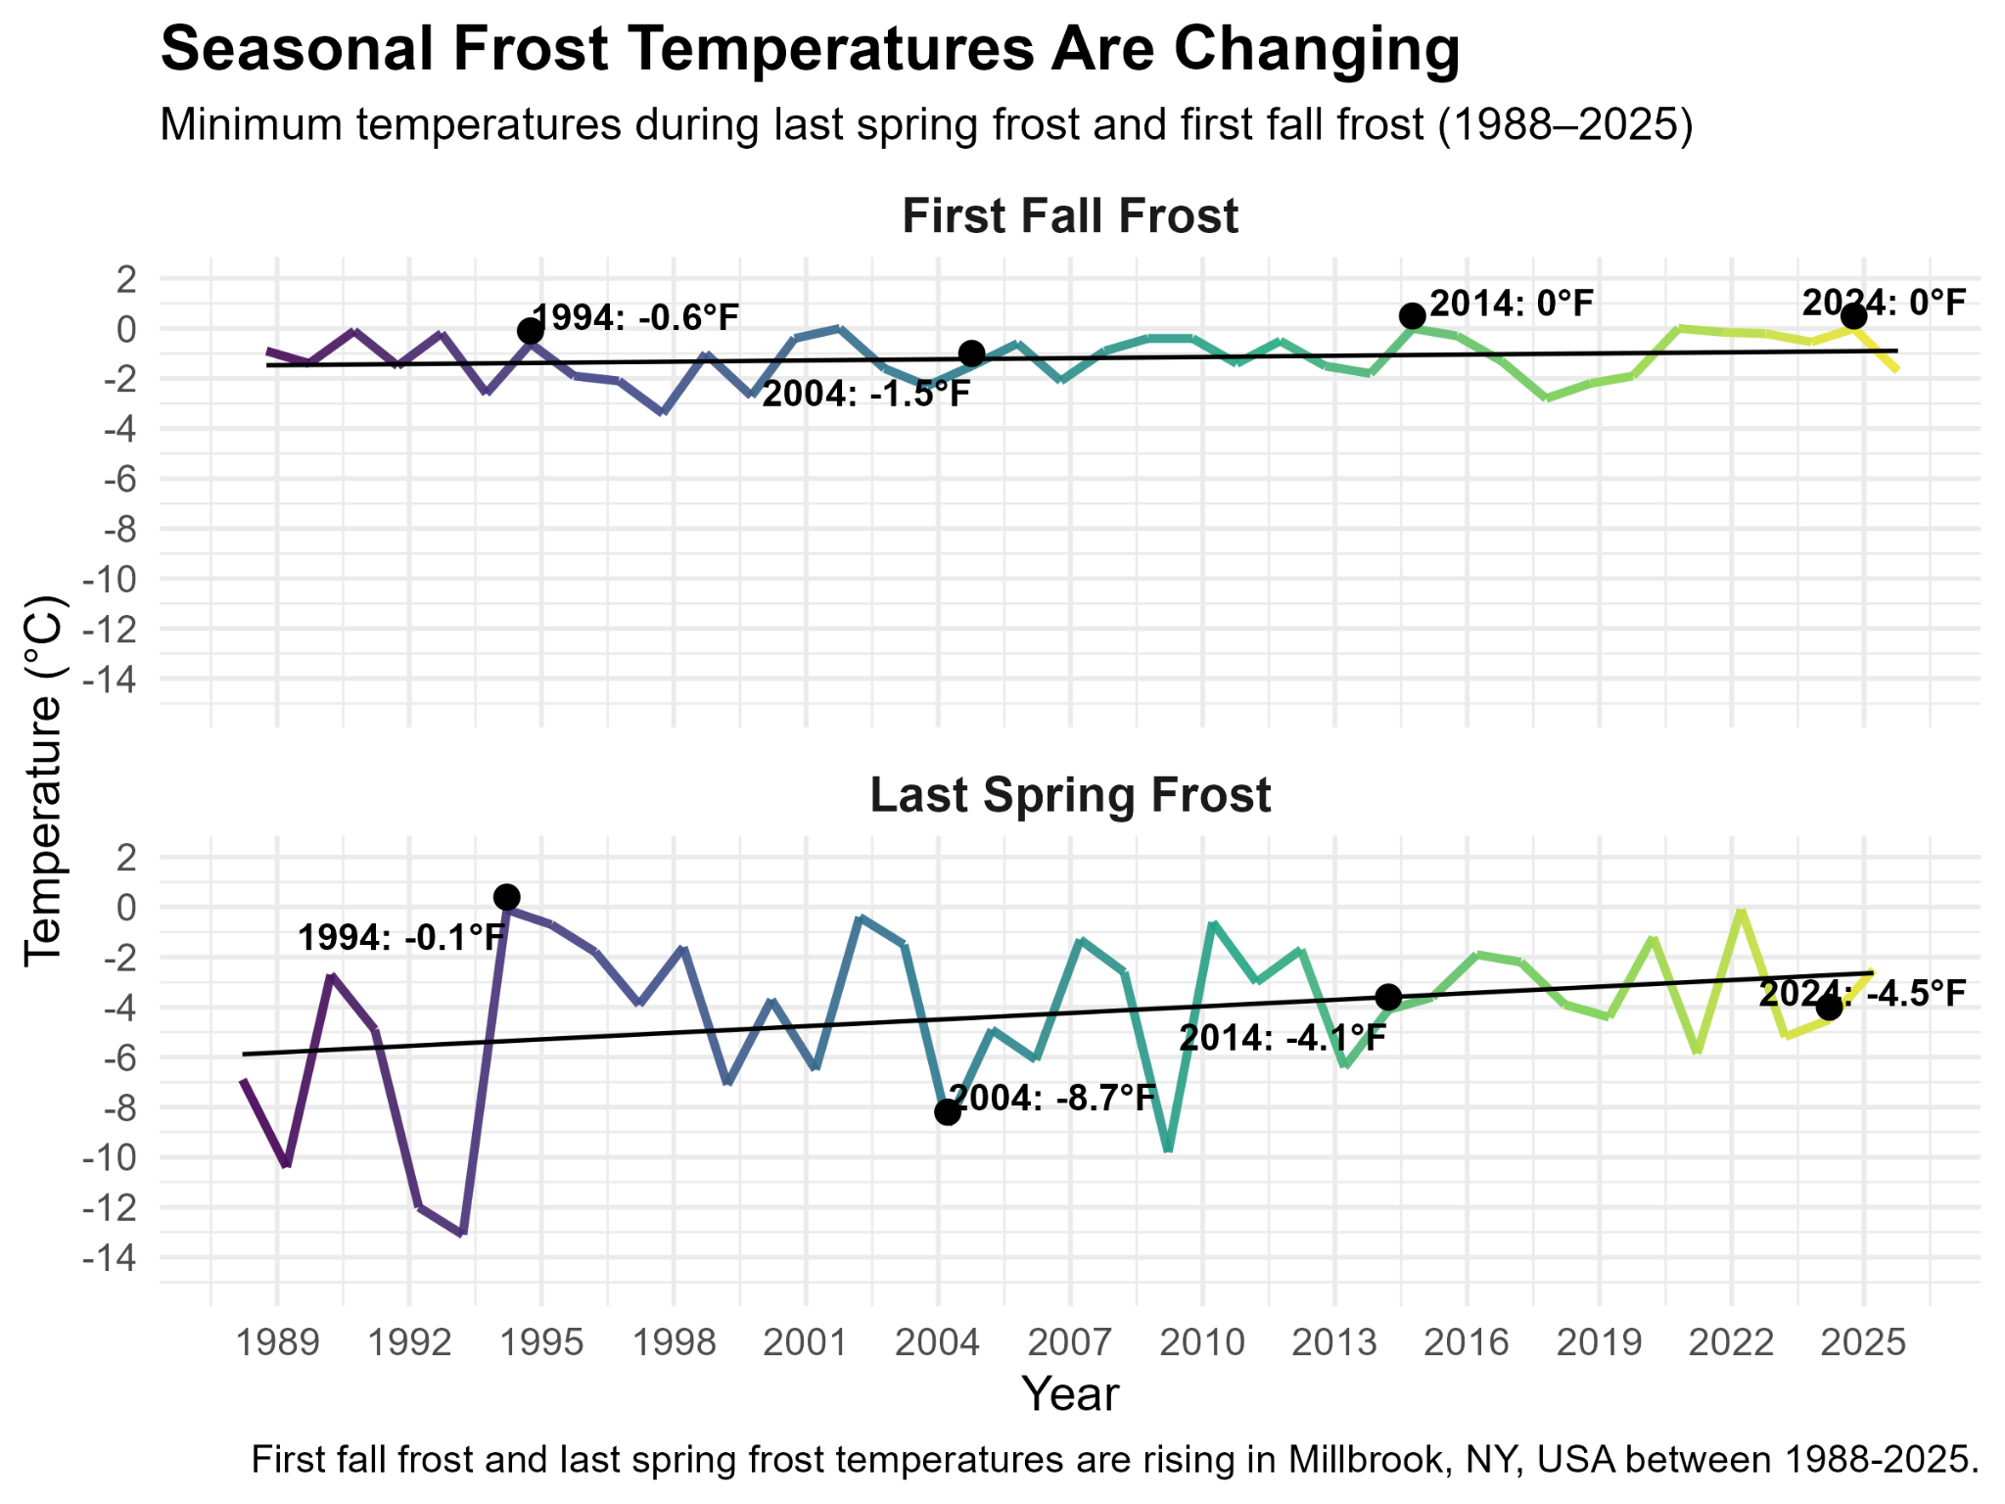
Trillium erectum, the red trillium, is a favorite spring ephemeral on the Cary Phenology Trail.
Notes:
Photo of red trillium at the Cary Institute. Credit: Lisa Dellwo.

Slide 4
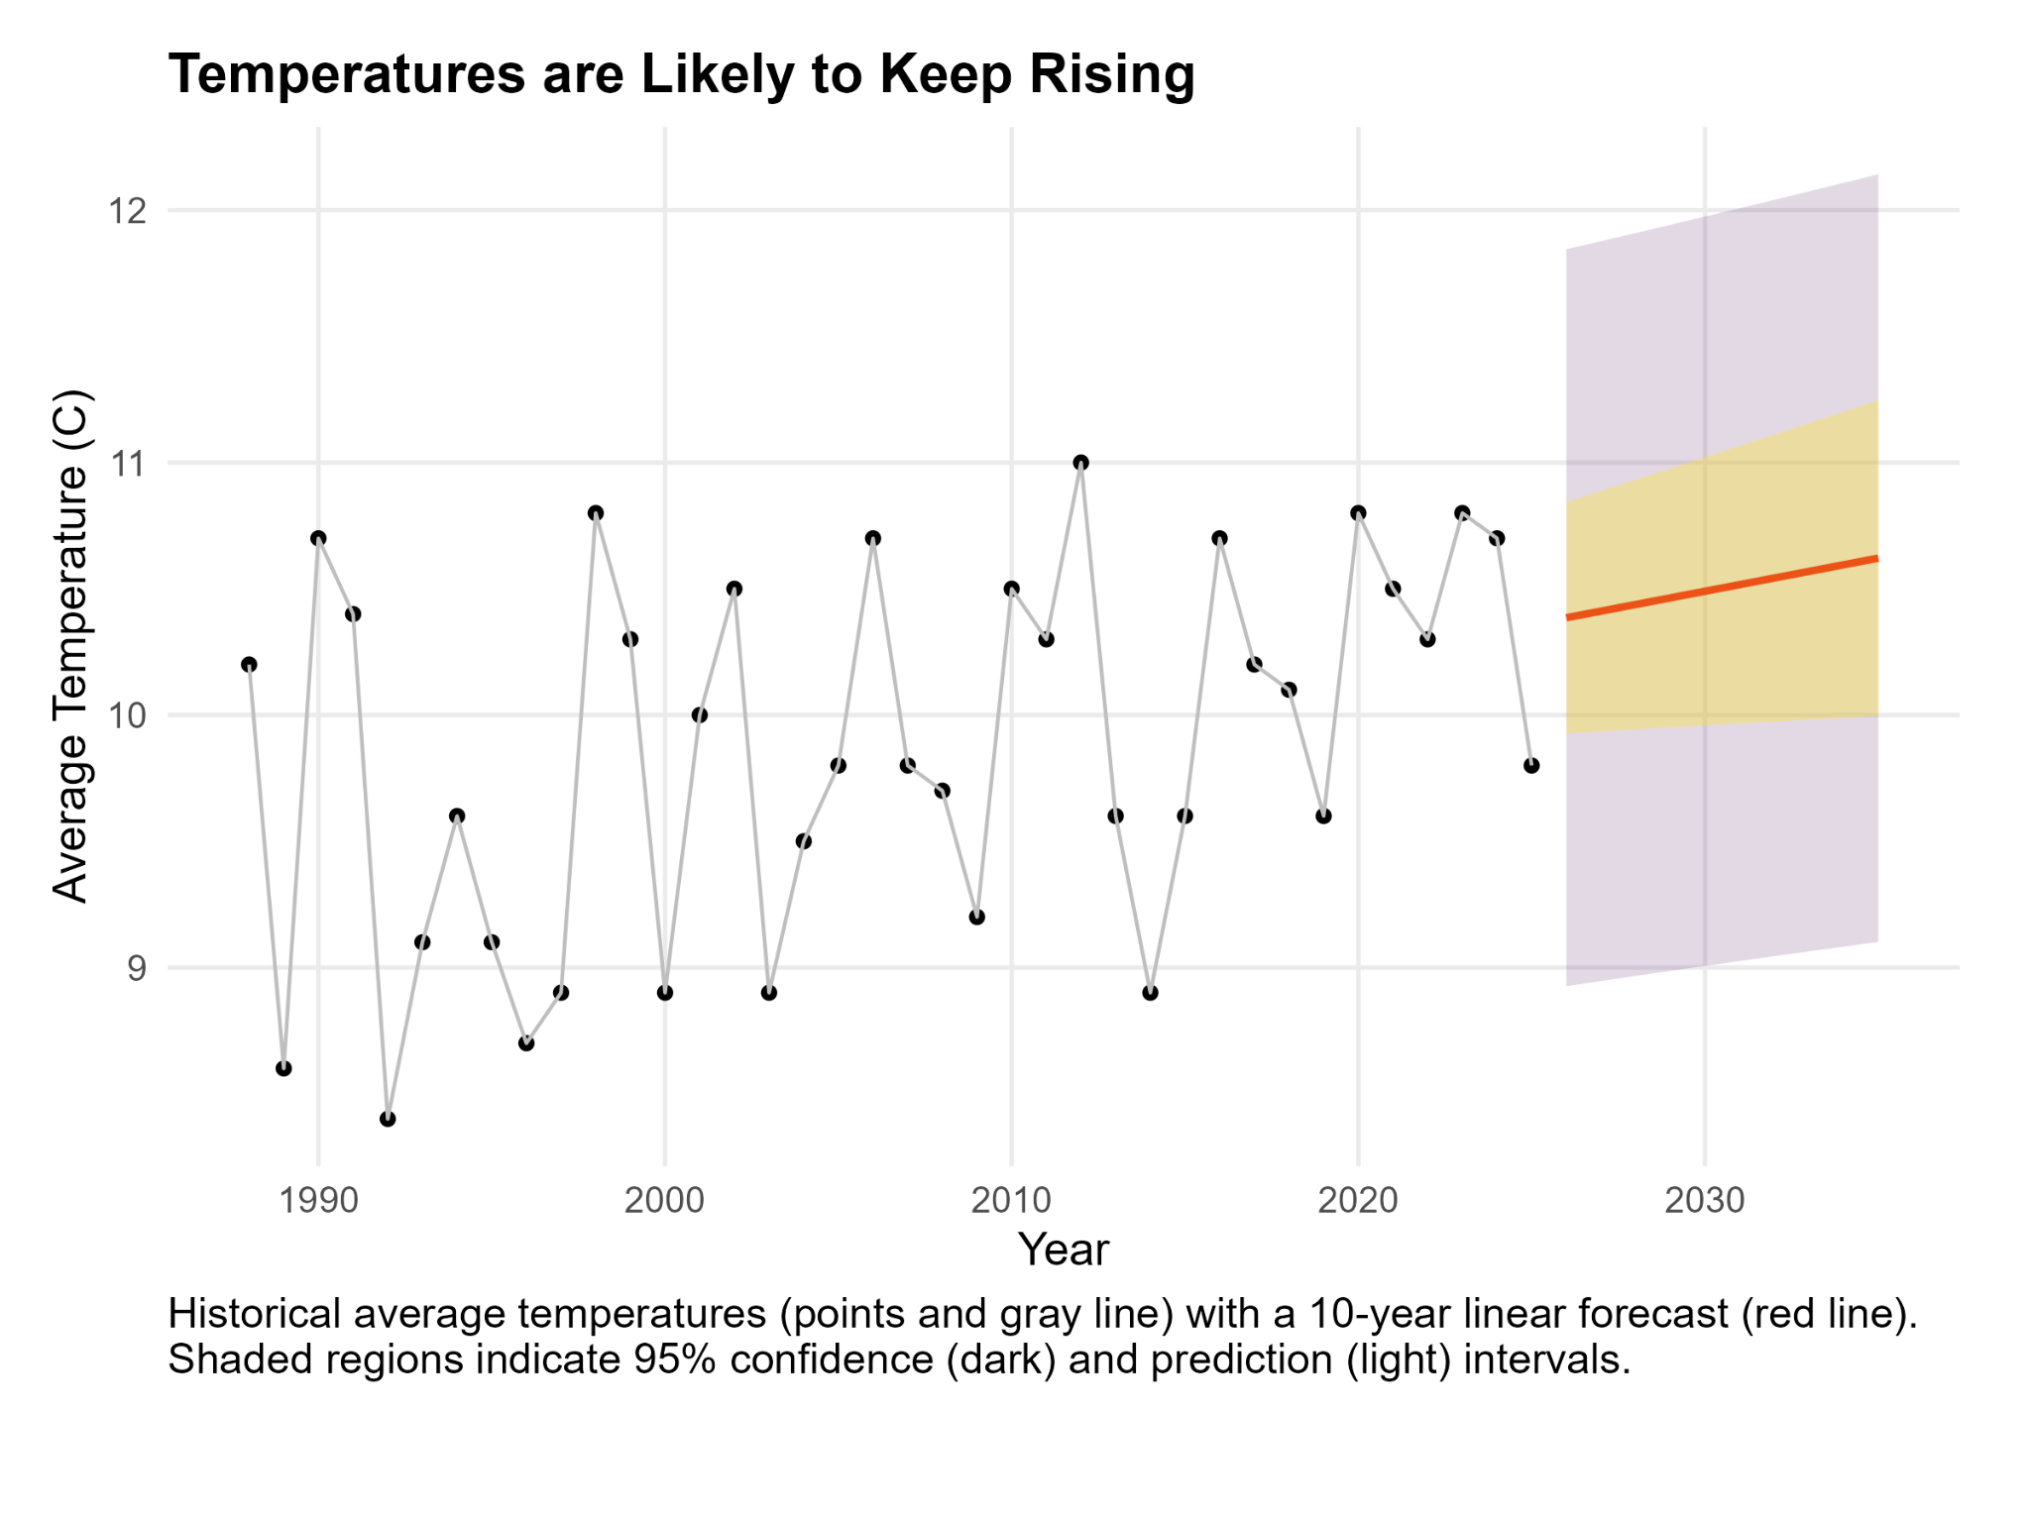

Slide 5
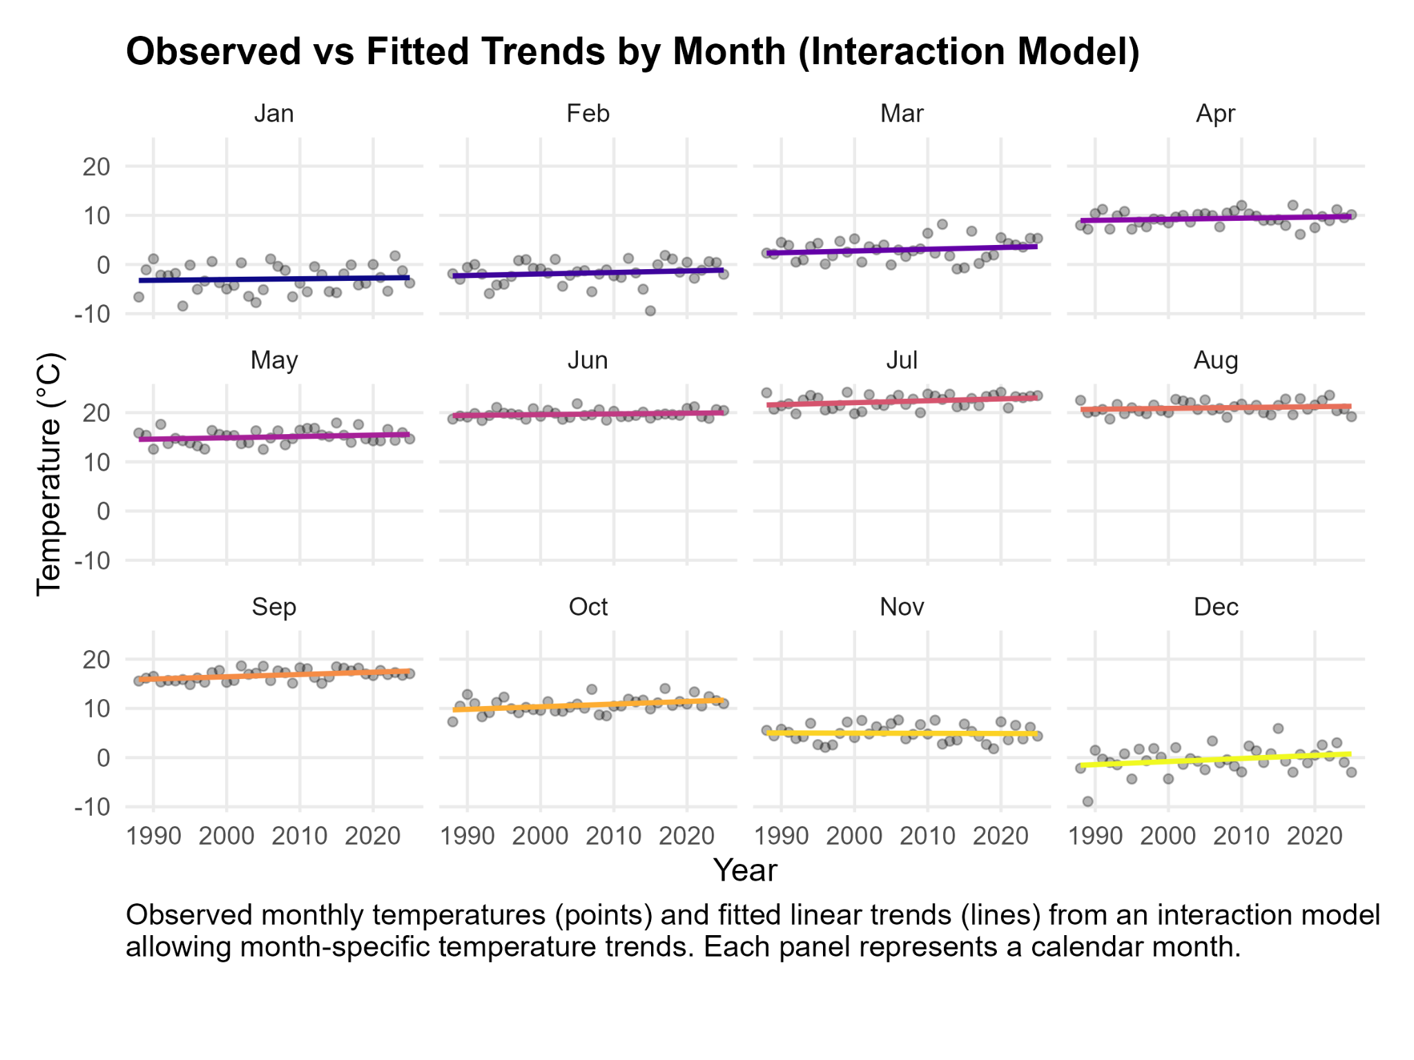
However, each month has its own temperature baseline
and its own warming rate

Slide 6
Key Findings
avg_temp_C ~ year simple linear model
Simple statistical extrapolation of 38 years of temperature data at Cary indicates a significant warming trend, with an estimated increase of 0.026°C per year (95% CI: 0.006–0.047 °C/year, p = 0.014).
avg_temp ~ year * month interaction model
This model shows that month-to-month differences in warming rate are suggestive but not statistically strong.

Slide 7
Next steps
Seasonal trend decomposition
tease apart long-term trend, seasonal pattern and random noise
Further investigation of frost dates and timing
Exploring relationships between other meteorological variables, including snow data

