Slide 1
Academic Posters
SME 954
1 Dec 09

Slide 2
What Is a Poster?
A poster itself is a visual presentation comprising whatever the contributor wishes to display on the poster board. Usually, a poster is made up entirely of sheets of paper pinned or attached with velcro strips to the board, but there is no reason why other visual aids should not be used.
The purpose of a poster is to outline a piece of work in a form that is easily assimilated and stimulates interest and discussion. The ultimate aim is a fruitful exchange of ideas between the presenter and the people reading the poster, but you should not be disappointed if readers do not stop to chat—a properly prepared poster will at least have given useful information and food for thought.

Slide 3
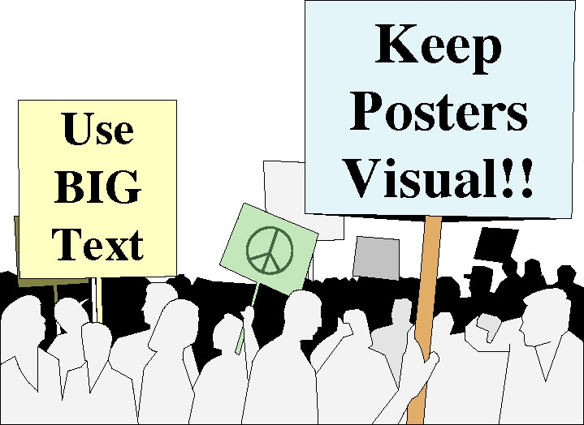
Effective Poster Presentations
George R. Hess
Department of Forestry &
Environmental Resources
North Carolina State University
Raleigh, North Carolina 27695-8002 USA
Notes:
* Work done in collaboration with five graduate students in a special course

Slide 4
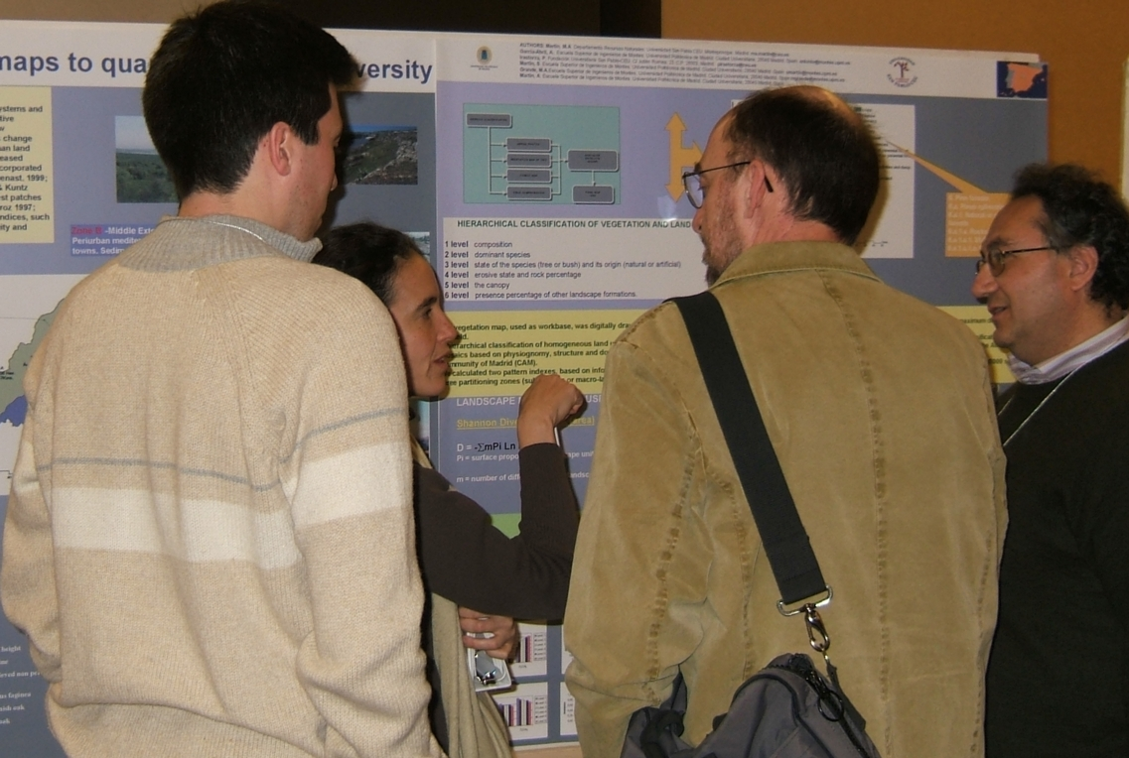

What is a poster?
A visual communication tool
An effective poster will help you …
… engage colleagues in conversation.
Notes:
* Work done in collaboration with five graduate students in a special course

Slide 5
What is a poster?
A visual communication tool
An effective poster will help you …
… get your main point across to as many people as possible.
Notes:
* Work done in collaboration with five graduate students in a special course

Slide 6
An effective poster …
delivers a clear message,
is highly visual, and
is easily read from 1-2 meters away.
Notes:
* Work done in collaboration with five graduate students in a special course

Slide 7
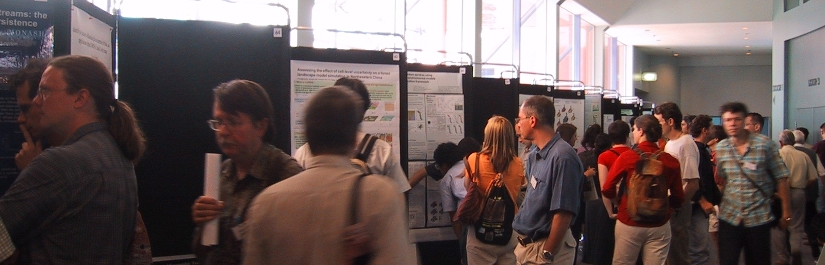
Know your audience
Specialists only
Wide-ranging discipline
Very general audience
Notes:
* Work done in collaboration with five graduate students in a special course

Slide 8
Layout
Headings identify key sections
Balance placement of text & graphics
Use white space creatively
Don’t fight “reader gravity”
Use a column format
Notes:
* Work done in collaboration with five graduate students in a special course

Slide 9
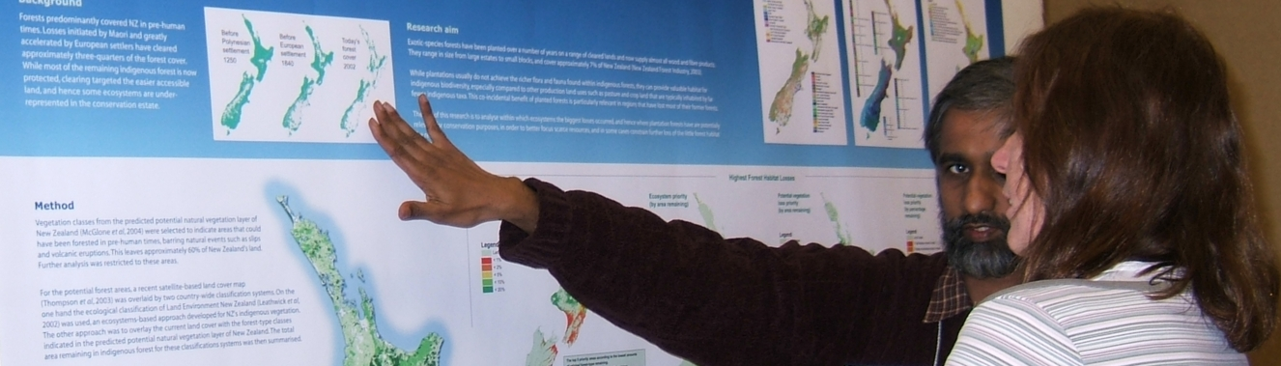
Text
Keep text elements short
Use phrases and active voice
Use serif font for text
San-serif font OK for title & headings
Notes:
* Work done in collaboration with five graduate students in a special course

Slide 10
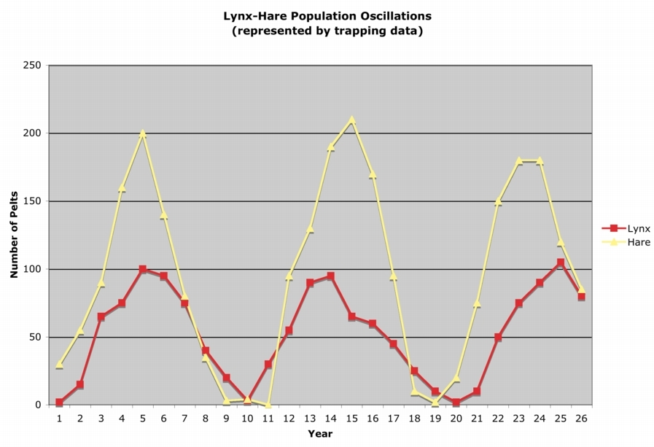
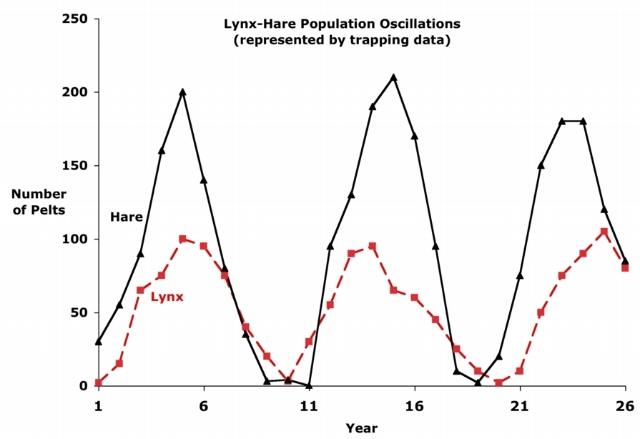
Graphs
Graphs communicate relationships
Keep them simple and clean
Avoid 3D graphs unless you’re showing 3D data - and then be careful
Notes:
* Work done in collaboration with five graduate students in a special course

Slide 11
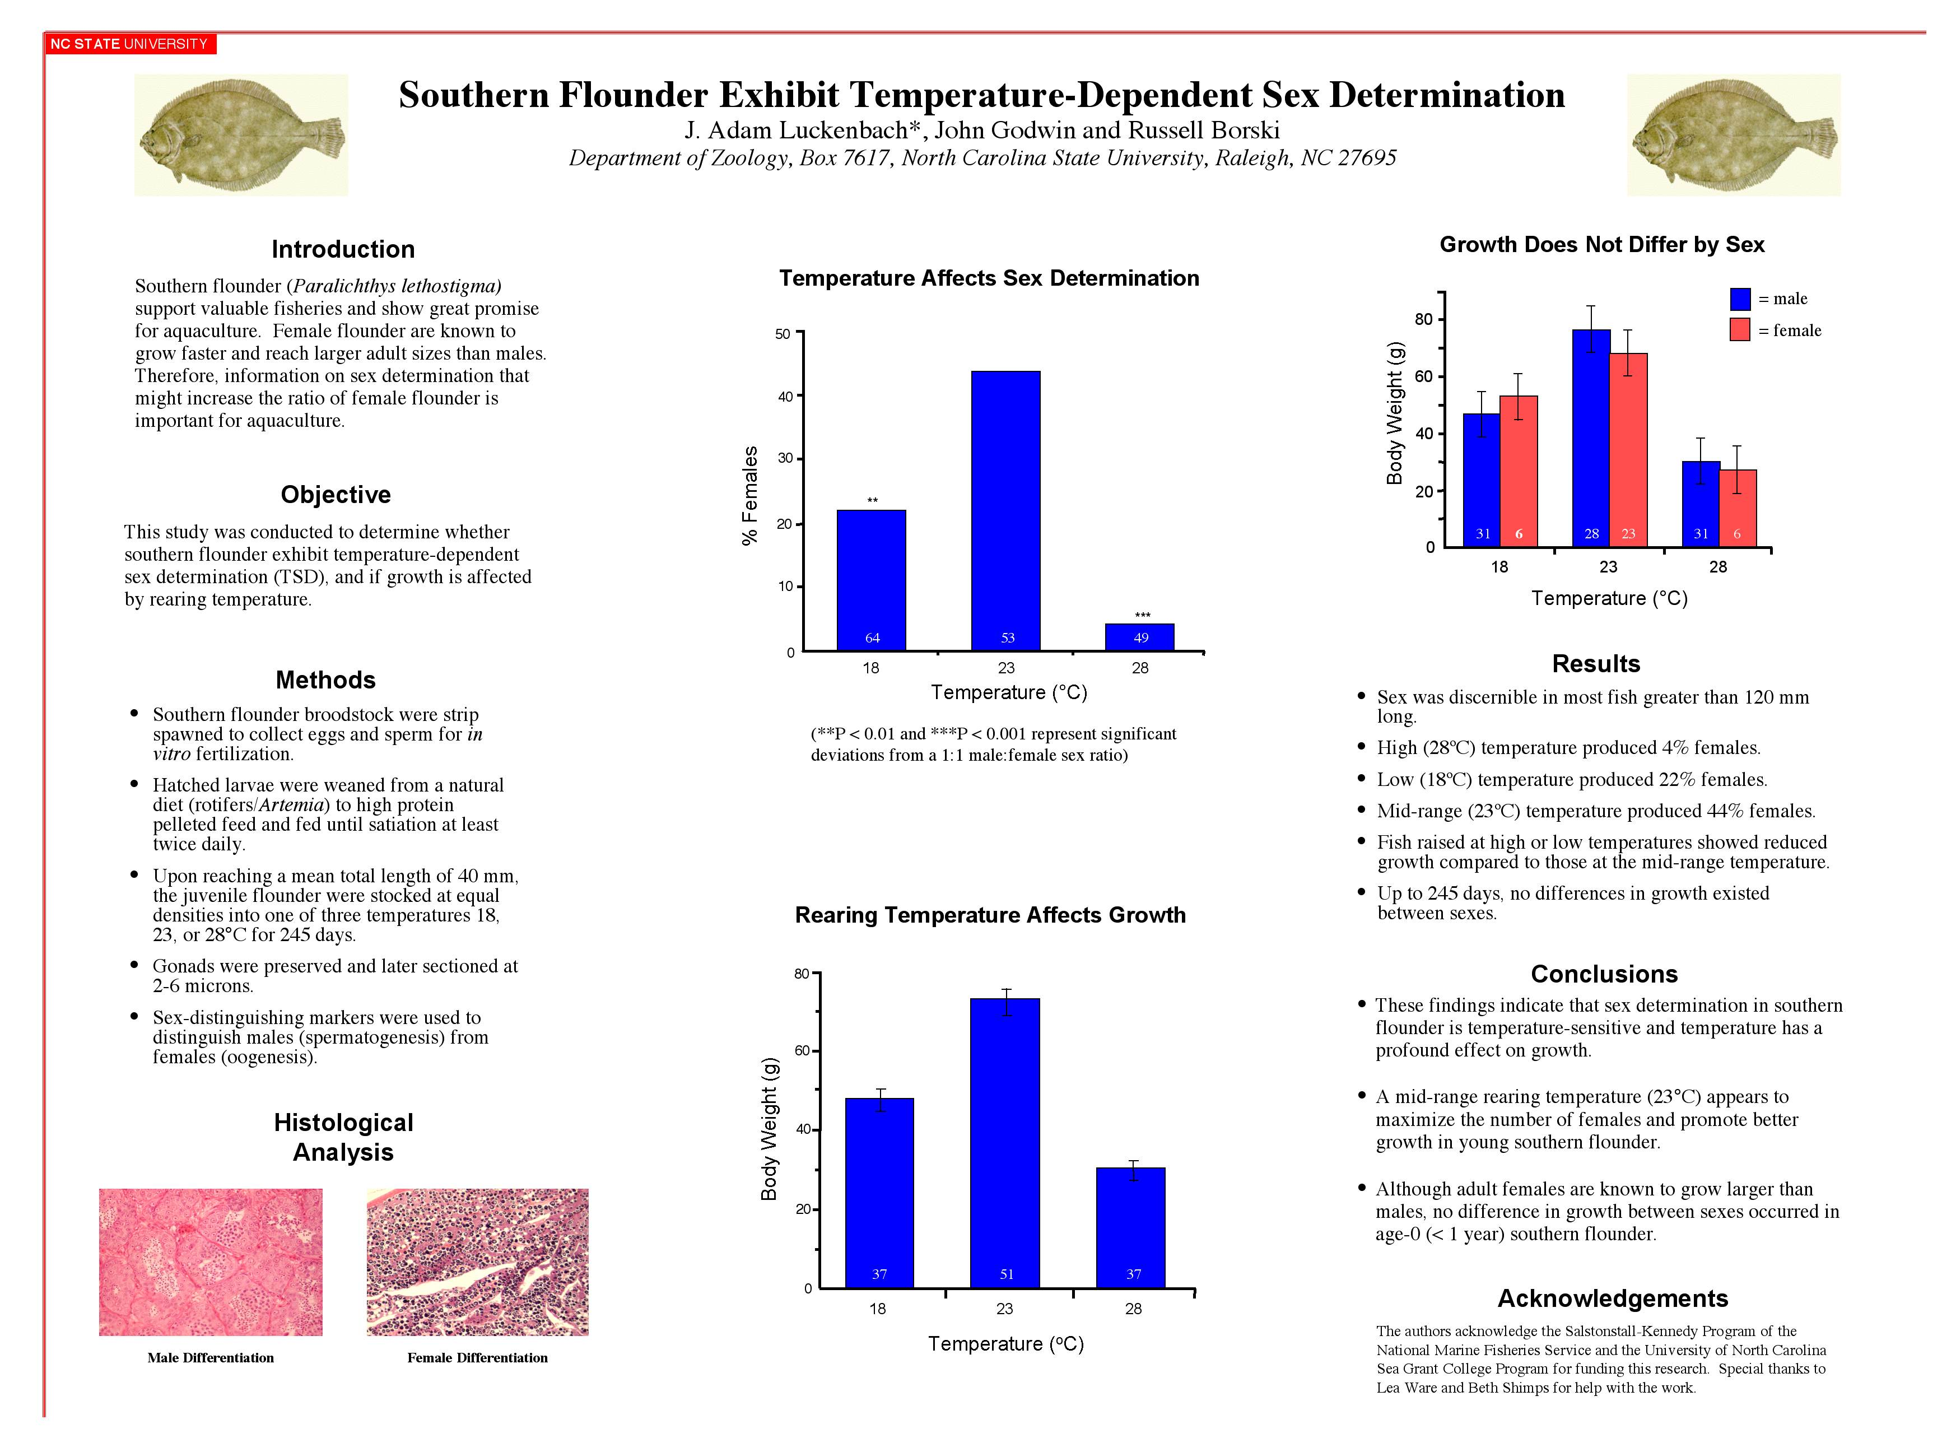

Slide 12
AERA Poster Guidelines
The poster surface measures 4’ x 6'
Material should be mounted on poster board or cardboard
Lettering should be at least 2/3" high, 1" for more important information, and preferably in bold font.
The paper title and the authors' name should appear at the top of the poster.
Align materials in columns rather than rows

Slide 13
Suggested arrangement (AERA)
Abstract of Introduction in the upper left
Conclusion in the lower right hand
Useful panels
  Aims of the Research
  Methods
  Subjects
  Experimental tasks
  Results
  Presentation of main points in tables or figures.

Slide 14
More on posters from AERA
The poster should be as self explanatory as possible so that your main job is to supplement the information it contains. The poster format provides a mechanism for in depth discussion of your research, but this is possible only if the display includes enough information to have a sketch pad and drawing materials available to help you make you points.
Figures and tables should be kept as simple as possible, so that viewers can readily take away the main message. A brief large type heading of no more than one or two lines should be provided above each illustration, with more detailed information added in smaller type beneath the illustration.

Slide 15
Evaluating Posters
What to include on proposal posters?

