Slide 1
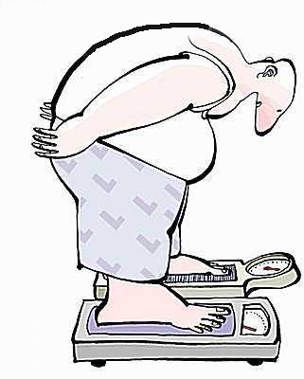
Cellular Respiration
Case 2: The Dieter

Slide 2
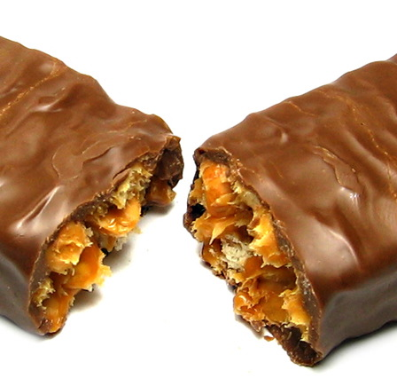
The Dieter
Regretting having indulged in so many high-calorie foods, which ended up as stored fat, Darryl would like to lose weight.
He has to eat less food so that his body will metabolize that stored fat.

Slide 3
1. The Dieter
Daryll’s cells are doing similar things as Rhonda’s, but he did not eat a candy bar. In fact, he ate nothing before going out for a walk. How do his cells capture the chemical energy they need from his stored fat?
Fats are oxidized in the cytoplasm to provide chemical potential energy.
Fats are converted into sugars, which enter glycolysis.
Fats are broken into smaller units which enter the Krebs cycle.

Slide 4
2. The Dieter
Fats are more reduced than sugars when each begins respiration. This means that when fats are metabolized:
more energy management molecules are produced.
fewer energy management molecules are produced.
the same number of energy management molecules are produced.

Slide 5
3. The Dieter
When fats are metabolized to meet the energy needs of a cell, Darryl will lose weight (mass). What happens to this weight (mass)? It is converted to:
the energy he needs.
ATP
water and carbon dioxide.
heat, which escapes from his body.

