Slide 1
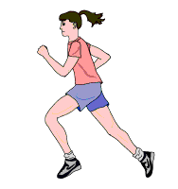
Cellular Respiration
Case 1: The runner

Slide 2
The Runner
Rhonda is a runner. She knows that she needs 300 calories to run 3 miles. She eats a 300-calorie candy bar, which she knows will fuel her muscles for that distance.
Rhonda wonders how her body uses the candy bar to fuel her muscles…

Slide 3
1. The Runner
1
1
A calorie is a measure of:
the mass of the candy bar.
the mass of candy bar that will be digested.
the mass of the candy bar that will be used up.
the potential energy of the candy bar.
the potential energy of the candy bar released during digestion.
!1
1
1
1

Slide 4
2. The Runner
Rhonda eats the candy bar, which she knows will be digested. What happens to her candy bar during digestion?
The mass is converted to energy.
The large biomolecules are broken down into subunits.
The large biomolecules are broken into carbon dioxide and water.
The calories from the candy bar are absorbed in the gut.

Slide 5
3. The Runner
What happens to the products (e.g., sugars, lipids, amino acids) of digestion?
They are converted to energy and used up.
They are carried by the blood to cells.
They combine with oxygen in the blood to provide energy to cells.

Slide 6
4. Cellular Respiration
The general reaction of respiration is:
glucose + oxygen carbon dioxide + water
Do the products of cellular respiration, carbon dioxide and water, have more or less chemical potential energy than the reactants and why?
The products have more because they are oxidized.
The products have more because they are reduced.
The products have less because they are oxidized.
The products have less because they are reduced.

Slide 7
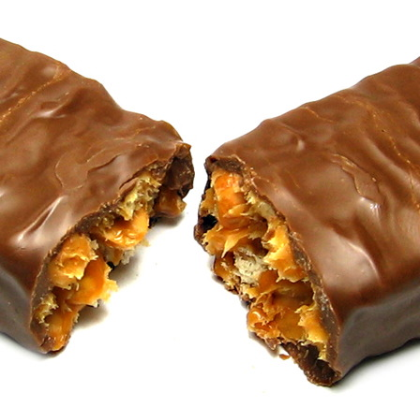
The Runner
Rhonda the runner ate a candy bar, which was digested. The sugars traveled through the blood system to individual cells, where the sugars were oxidized, which required oxygen. The chemical potential energy of the products (CO₂ and water) is less than that of the sugars.
What matter and energy transformations happened in the cell and how?

Slide 8
Cellular Respiration
& The Runner
The first step of cellular respiration in
Rhonda's cells is glycolysis.

Slide 9
5. Glycolysis: matter
By the end of glycolysis, Rhonda’s cells have broken one molecule glucose into two molecules of pyruvate. How many of the six carbon atoms from glucose remain at the conclusion of the these reactions?
6
5
4
3
2

Slide 10
6. Glycolysis: energy
At the conclusion of glycolysis, in which molecule does the largest quantity of chemical potential energy reside?
In the ATP molecules produced.
In the NADH molecules produced.
In the FADH₂ molecules produced.
In the two remaining molecules of pyruvate.

Slide 11
7. Glycolysis: location
What is the destination for the NADH produced during glycolysis?
It remains in the cytoplasm.
It is transported to the nucleus.
It is transported to a mitochondrion.
It is combined with ATP.
It is used in the Krebs cycle.

Slide 12
8. Glycolysis: energy
Which of the following get reduced during glycolysis?
The carbon in glucose.
NAD+
ADP
The carbon in pyruvate.

Slide 13
Cellular Respiration
& The Runner
The next step of cellular respiration in Rhonda's cells is the Krebs cycle.

Slide 14
9. Krebs: matter
By the conclusion of the Krebs cycle, how many carbon dioxide molecules were released from a single molecule of pyruvate?
3
2
1
0

Slide 15
10. Krebs: location
The reactions of the Krebs cycle take place in the:
cytoplasm.
mitochondrial matrix.
inner membranes of the mitochondria.
outer membrane of the mitochondria.

Slide 16
11. Krebs: matter
Regarding the Krebs cycle:
Some of the outputs are reduced molecules such as NADH and FADH₂.
No carbon-based molecules leave the Krebs cycle.
Because it is a cycle, the inputs are regenerated at its completion.
All of the outputs of the Krebs cycle are more reduced than the inputs.

Slide 17
12. Krebs: energy
In the Krebs cycle, chemical potential energy is:
lost.
gained.
created.
transferred.

Slide 18
Cellular Respiration
& The Runner
The final step of cellular respiration in Rhonda's cells is oxidative phosphorylation (Electron Transport Chain).

Slide 19
13. ETC: matter
Six carbons began their journey through aerobic cellular respiration in the form of glucose. How many of these six carbon atoms can also be found in the collective reactions of the Electron Transport Chain?
6
4
3
2
0

Slide 20
14. ETC: energy
During the sum of the reactions that make up the ETC, hydrogen ions are pumped from the mitochondrial matrix into the intermembrane space. This action is directly responsible for the formation of:
NADH
NAD⁺
ADP
ATP
O₂

Slide 21
15. ETC: matter
What happens to the oxygen in oxidative phosphorylation?
It leaves the system as oxygen gas.
It becomes reduced.
It becomes oxidized.
It reacts with carbon molecules to form CO₂.

Slide 22
16. ETC: energy
Lots of ATP is produced in the electron transport chain. What drives its formation?
The reduction by NADH and FADH₂.
The bond energy of proteins in the mitochondrial membrane.
The bond energy of reduced sugars in the mitochondrial membrane.
A proton gradient.

Slide 23
17. ETC: location
The role of mitochondrial membranes is to:
prevent ATP from leaving the mitochondrion.
develop a proton gradient.
separate NADH from ATP.
prevent sugars from leaking into the inner space.

