Slide 1
Cellular Respiration
Burning Marshmallow

Slide 2
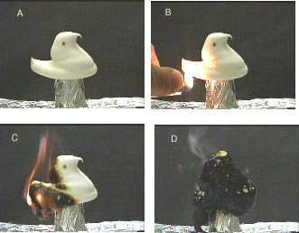
Peeps
Burning a Peep is the same as oxidizing a Peep.
When something is oxidized something else is reduced.
Combustion = oxidation = respiration = controlled combustion/oxidation

Slide 3
1. Peeps
Which of the following is true?
The unburned Peep has more chemical potential energy (CPE) than the burned one.
The burned Peep has more CPE than the unburned one.
The burning Peep has more CPE than both the burned and unburned ones.
These four Peeps all have the same CPE.

Slide 4
2. Peeps
What are the products produced by burning the Peep?
Energy, smoke, ash, carbon, CO₂ and water.
Energy and carbon.
Smoke, ash, carbon, CO₂ and water.
Smoke, ash, and carbon.

Slide 5
3. Peeps
The burned Peep weighs less than the unburned Peep. The missing mass was converted to:
smoke and energy, which was used up.
smoke, heat, and light.
smoke.
smoke, water, and CO₂.

Slide 6
4. Peeps
What are the energy transformations during oxidation of the Peep (sugar)? Chemical potential energy in the sugar is:
converted to chemical potential of carbon, smoke, and ash.
transferred to the air.
converted to heat and light.
converted to the chemical potential energy of carbon dioxide.

