Slide 1
Cellular Respiration
Energy Rules

Slide 2

Energy Rules
The reduced forms of carbon have more chemical potential energy than the oxidized forms.
That is, C-H and C-C bonds have more chemical potential energy than C-O bonds.

Slide 3
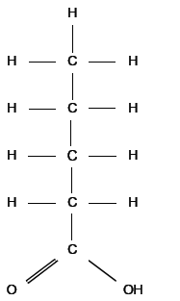
1. Energy Rules
Most of the carbon atoms are:
oxidized because they’re bonded to hydrogen.
oxidized because they’re bonded to carbon.
reduced because they’re bonded to hydrogen and/or carbon.
(saturated fatty acid)

Slide 4
2. Energy Rules
Which of the following types of molecules has the most chemical potential energy per gram?
Carbohydrates (general formula - [CH₂O]_{n})
Lipids (general formula - [CH₂]_{n})
amino acids (general formula - NH₃-HCR-COOH

