Slide 1


Beyond Multiple Choice: Automated analysis of student writing reveals heterogeneous student thinking in STEM
Luanna Prevost
Michigan State University
Automated Analysis of Constructed Response (AACR)
research group

Slide 2
Outline
Theoretic Framework and Research Objectives
Automated Analysis Approach
Results: Chemistry of Biology

Slide 3
Constructed Response Assessment
Students learn by constructing knowledge
Assessment should allow students to represent their knowledge in their own language
Large enrollment courses prohibit the use of constructed responses assessments
(Bransford, 2000; Von Glasersfeld, 1994)

Slide 4
Objectives
Evaluate students’ understanding of scientific concepts
Create models of student thinking
Use lexical and statistical analysis to analyze students’ writing
Develop resources - libraries and categories
Validate by predicting expert ratings
Notes:
Create models using students own language
We use an Iterative procedure to produce these models of student thinking and predictions of expert scoring

Slide 5
Automated Analysis Approach
Rubric
(Holistic or Analytic)
Human
Scoring
Statistical Prediction
Machine Scoring
Item
Construction
Collect Student Responses
(Gather Data)
Machine Extraction
Notes:
Item which allow constructed or written responses
Rubrics: Correct – incorrect; continuum of novice to expert; or presence or absence of concepts, misconceptions
Administer
Human scoring
Machine extraction – categories or discrete homogenous ideas

Slide 6
Functional Groups: Multiple Choice
Consider two small organic molecules in the cytoplasm of a cell, one with a hydroxyl group (-OH)
and the other with an amino group (-NH₂).
Which of these small molecules (either or both) is most likely to have an impact on the cytoplasmic pH?
A. Compound with amino group
B. Compound with hydroxyl group
C. Both
D. Neither
33%
49%
12%
6%
Explain your answer
Haudek, K., Prevost, L., Moscarella, R. B. A., Merrill, J. E., & Urban-Lurain, M. (In Revision). What are they thinking? Automated analysis of student writing about acid/base chemistry in introductory biology. CBE - Life Sciences Education.

Slide 7
Text Analysis
Software
SPSS Text Analysis for Surveys
SPSS Modeler – Text Mining
Procedure
Library Construction
Extraction
Categorization
Notes:
7
Library – relevant to the topic
Extract terms from responses
Categorize these terms… for a more visual depiction, we can take a look at a screen shot during text analysis

Slide 8
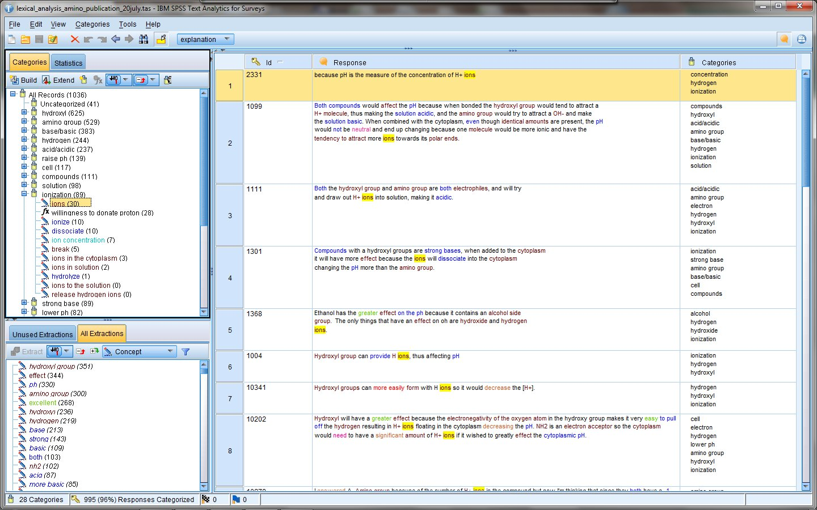
Categories
Responses
Terms
Notes:
8

Slide 9
Responses
Notes:
9

Slide 10
Categories
Notes:
10
Machine extraction is done in parallel with human scoring

Slide 11
Example Holistic Rubric: Expert Ratings of Explanations
Two experts rated explanations from correct answers using 3-bin rubric
Bin 1: Correct explanations of functional group chemistry (may include correct supporting reasoning)
Bin 2: Partly correct explanations with errors in facts or reasoning
Bin 3: Totally incorrect/irrelevant response
37%
10%
53%
Inter-rater reliability = .90
Notes:
We then compared categories for responses in each of these groupings
We began with 22 categories including hydroxyl, amino, ionization, acid, base

Slide 12
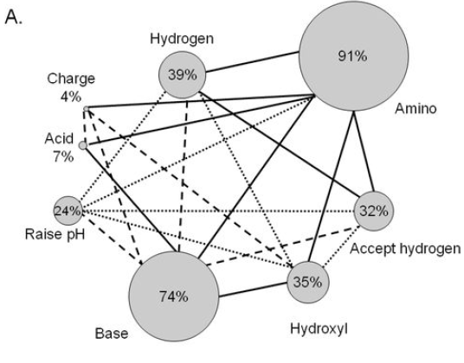
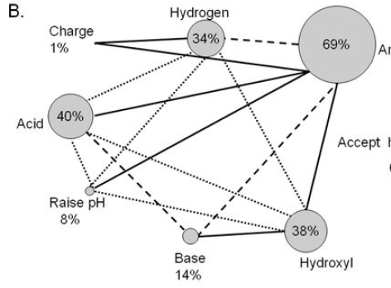
Web Diagrams: Connections among categories
Bin 1: Correct
Bin 3: Incorrect
Amino
Amino
0%
Accept
hydrogen
Accept
hydrogen
lines represent the % shared responses between categories
25 -49%; 50-74; ≥ 75%
Notes:
Of the 22 categories, we identified 8 that were significant in predicting expert ratings using discriminant analysis. These 8 are observed here in circles (nodes)
Size proportional amino base, accept hydrogen; lines amino-base vs amino-acid

Slide 13
Summary
Automated Text Analysis can facilitate constructed responses assessments
Lexical analysis provides a whole-class picture of term / concept usage
Statistical analysis can help identify categories of importance
Heterogeneity of student ideas is captured in categories and the connections among categories
Notes:
Point 2 – mention – rapid feedback
Expand this work to other areas via collaboration with other assessment teams – JK and MS GCA; ross nehm at OSU

Slide 14
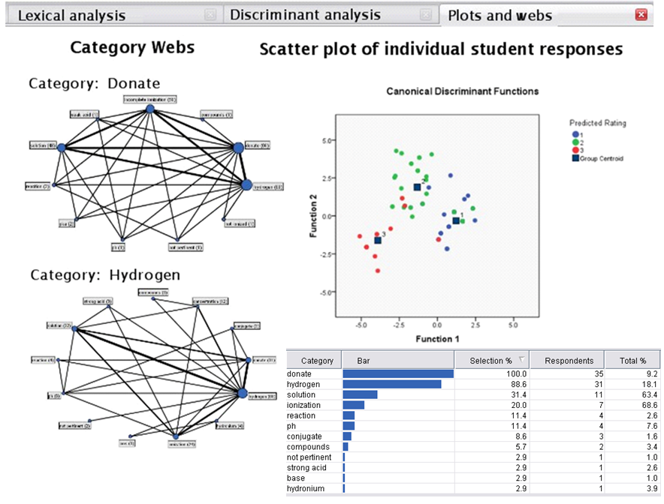
Future Work – Web Portal
Notes:
Instructors can use items for which we’ve developed models and use that to obtain picture of the class
Rapid feedback to instructors – identify common misconceptions or incorrect ideas; identify how students relate ideas; inform their next lesson/activity

Slide 15
AACR Research Group
Michigan State University
Kevin Haudek
Merle Heidemann
Jennifer Kaplan
Julie C Libarkin
Andrew League
Fengjie Li
Tammy Long
John Merrill
Rosa Anna Moscarella
Alan Munn
Joyce Parker
Luanna Prevost
Duncan Sibley
Mark Urban-Lurain
Michele Weston
University of Colorado - Boulder
Jennifer Knight
University of Maine
Michelle Smith
The Ohio State University
Ross Nehm
Judy Ridgway
Hendrick Haertig
Minsu Ha
Grand Valley State University
Neal Rogness
Brittany Shaffer
Western Michigan University
Mary Anne Sydlik
University of Georgia
Jennifer Kaplan

Slide 16
Funding
NSF DUE 0736952 and DUE 1022653
Website:
aacr.crcstl.msu.edu

