Slide 1
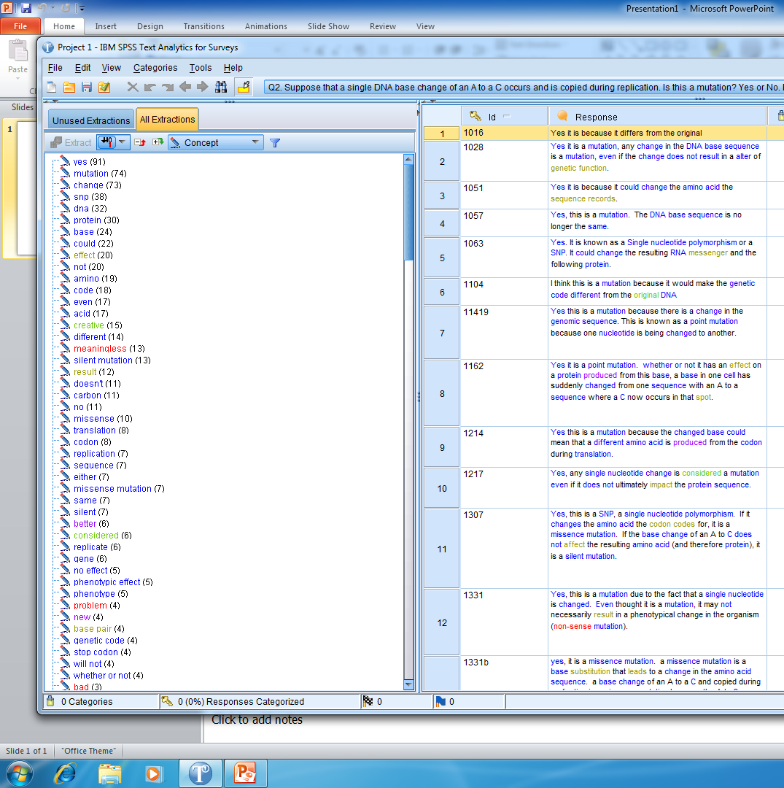
CU_genetics9oct
library only

Slide 2
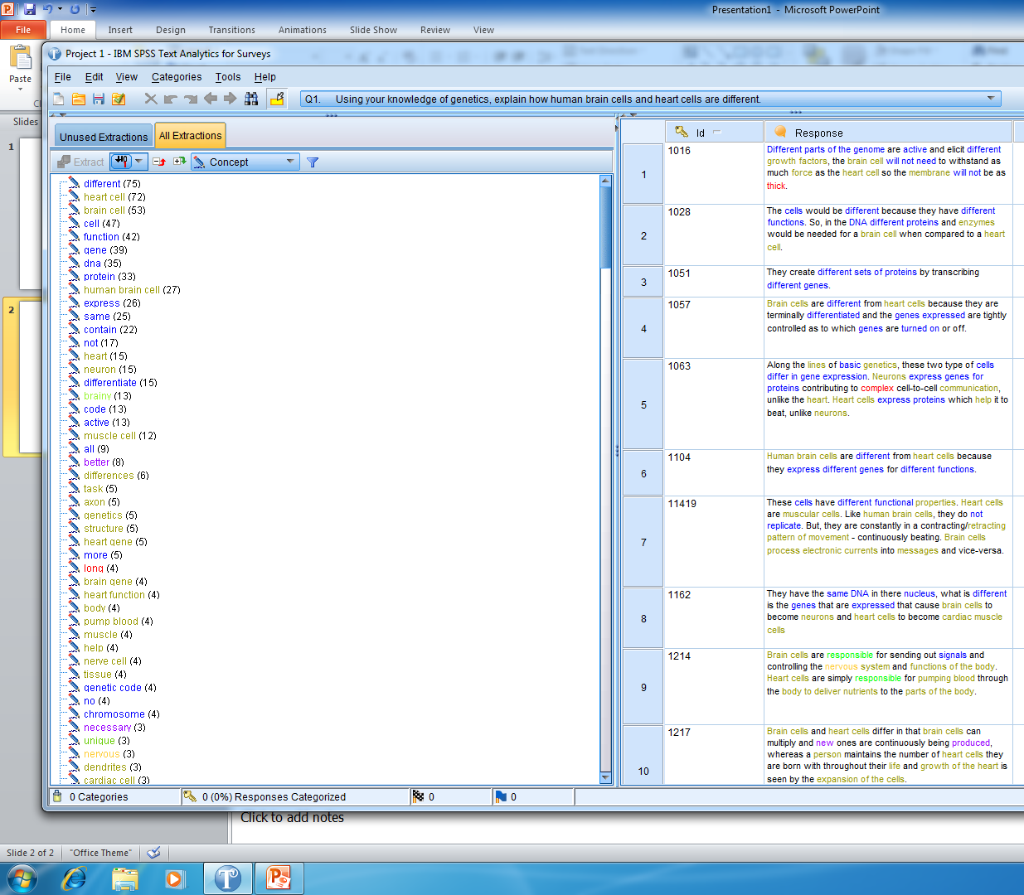

CU_genetics9oct
library only

