Slide 1

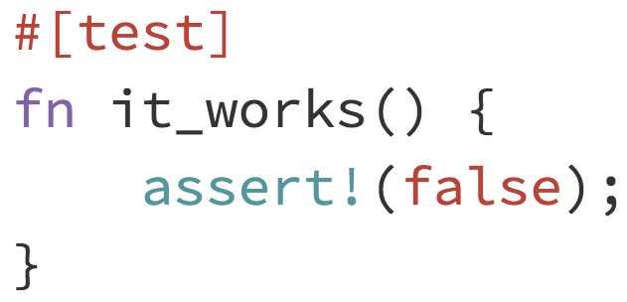
Rust Compiler (or other Rust project)
What is ?
New programming language
Places emphasis on compiler code checking and testing
Aspires to replace C/C++
Possible Rust projects:
The Rust compiler
Lots of opportunities to test (e.g. compiler verification)
Probably very challenging
Servo (browser engine)
Piston (game engine)
and many more.
Conclusion: Lots to learn + an awesome Community :)

