Slide 1
RESEARCH PAPER SUMMARIZATION
Bay Area Rockers Team
SHAWN CHUMBAR
DHRUVAL SHAH
SAJAL AGARWAL

Slide 2
INTRODUCTION
This project introduces a Flask-based web application designed for the summarization of complex PDF documents using Natural Language Processing (NLP) techniques.
The application leverages machine learning models to parse, interpret, and condense extensive textual data, aiming for high-precision summaries.
Challenges include extracting relevant information from unstructured text and condensing it without losing essential meaning.

Slide 3
METHODOLOGY

Slide 4
Methodology
NLP Processing
Summarization Using AI Models
User Interaction & Data Upload
Text Extraction
Summary Generation and Presentation

Slide 5
FLOW CHART

Slide 6
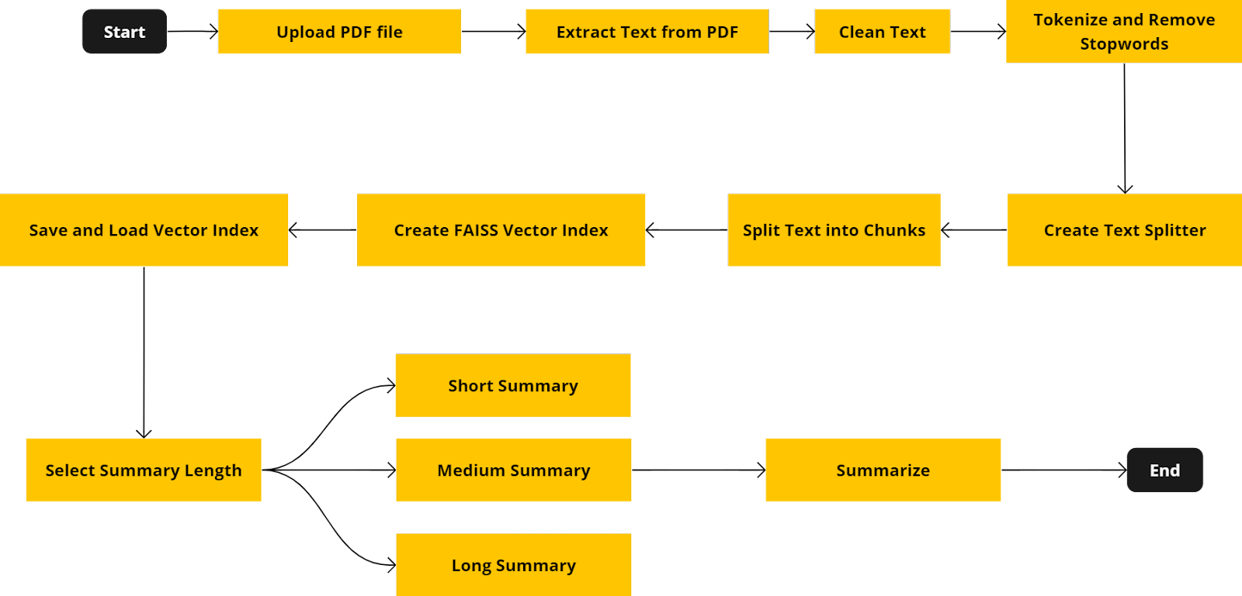

Slide 7
DEMO

Slide 8
FUTURE EXTENSIONS
Scalability and Performance Optimization : Focus on scaling the system to handle large volumes of requests and optimize performance to provide summaries more rapidly.
Multi-Format Documents : Plans to broaden the application's capability to include diverse document formats, catering to a wider range of data science applications.
Interactive Summarization : Introduce interactive elements where users can ask questions or request further details on specific parts of the research paper, and the system provides targeted summaries or expansions.

Slide 9
THANK YOU

