Slide 1
JFrog OIDC for Existing Web Apps & Serverless
Replace stored JFrog tokens and registry passwords with short-lived OIDC tokens, in place, without recreating apps.
SUDHAKAR CHUNDU | Platform Tools
Notes:
Humana already runs about 1,000 web apps and serverless apps on Azure, plus GCP apps as a second wave (estimate; real count comes from discovery). The goal is to remove the stored JFrog credentials from those apps in place. New apps get JFrog OIDC from day one as a second step.

Slide 2
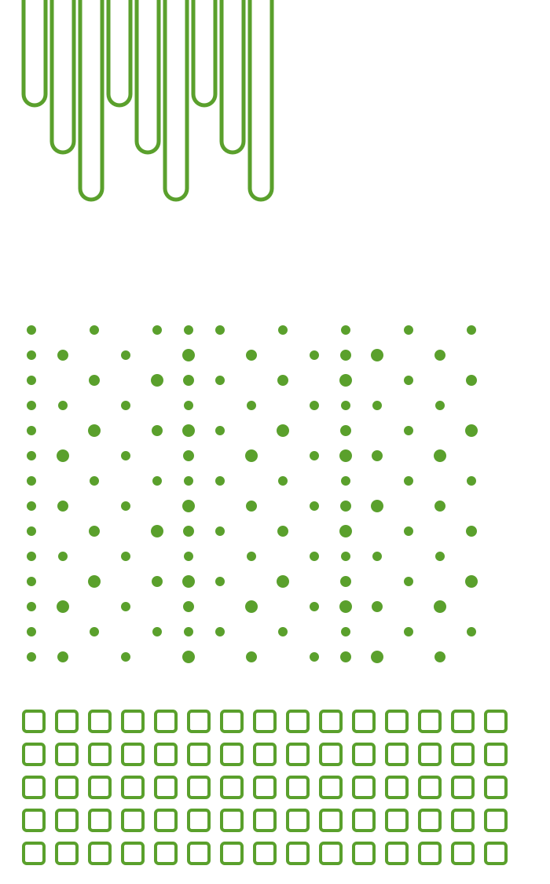
What we will cover in the next 10 minutes
AGENDA
01
The Problem
Long-lived JFrog credentials in existing apps
02
The Solution
OIDC token exchange with the app's managed identity
03
How It Works
Runtime and build flows
04
Implementation
What changes per app; verify, then revoke
05
Impact & Next Steps
Security, effort, pilot ask

Slide 3






Existing apps use long-lived JFrog credentials
THE PROBLEM
ADO service connections & variables
Web App & Function settings
JFrog Token
Registry passwords for image pulls
Key Vault & GCP Secret Manager
No expiry until rotated by hand
Notes:
Every place on this slide is a long-lived credential someone created, copied and has to rotate. A leak stays valid until it is rotated everywhere.

Slide 4
Replace stored credentials with OIDC token exchange
THE SOLUTION
The app signs in with its managed identity; JFrog exchanges the Entra token for a 1-hour access token.
Azure managed identity
System- or user-assigned identity, enabled on the existing app without redeploy
GCP: the app's service account
Azure managed identity
Entra audience app
JFrog OIDC integration
Entra audience app
One app registration per tenant; the identity gets its JFrog.Exchange app role and can request tokens for it
GCP: Google ID token, audience = JFrog
Token ≤ 1 h, nothing stored
Notes:
Azure: managed identity (system- or user-assigned) gets an Entra token for the JFrog audience app; JFrog integration per tenant. GCP (second wave): the service account every Cloud Run service, function and App Engine app already has; JFrog integration for the Google issuer. Mappings decide which identity reads which repositories.

Slide 5
JFrog validates the token and issues an access token
THE SOLUTION
JFrog checks issuer, audience and subject, then maps the app to a read-only group.
JFrog OIDC integration
One per tenant, trusts the Entra issuer; one identity mapping per app to a read-only group
GCP: one integration for the Google issuer
Azure managed identity
Entra audience app
JFrog OIDC integration
Token ≤ 1 h, nothing stored
Cached in memory, refreshed before expiry; not in app settings, Key Vault or pipeline variables
Old credential removed after the 4 checks pass
Token ≤ 1 h, nothing stored

Slide 6
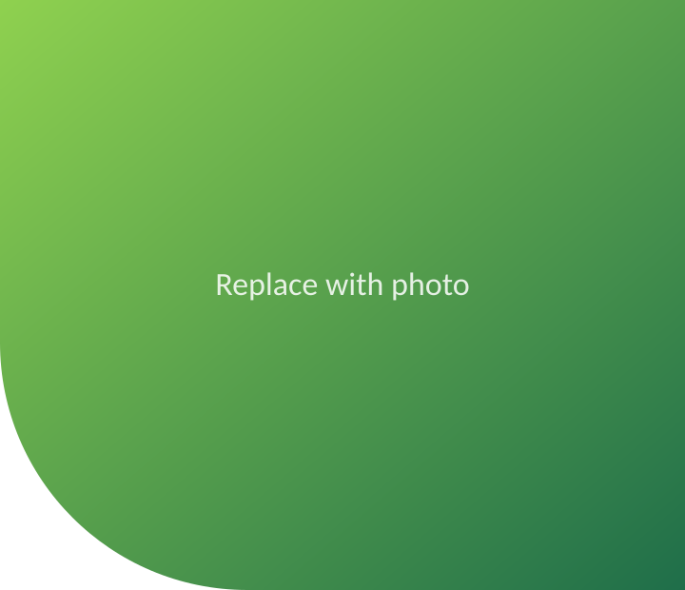
Runtime: managed identity to JFrog access token
RUNTIME FLOW
Existing app
managed identity on
Microsoft Entra ID
JFrog audience app
JFrog Access
OIDC integration, per tenant
Artifactory
read-only repositories
1 get token: audience = JFrog app
2 short-lived signed JWT (oid, aud, iss)
3 exchange the JWT (provider: azure-entra)
checks issuer + audience
mapping → reader group
4 JFrog token, at most 1 h, cached in memory
5 read packages and artifacts with the JFrog token
Set once per app: identity on · JFrog.Exchange role · identity mapping · JFROG_URL, JFROG_OIDC_PROVIDER, JFROG_OIDC_AUDIENCE
GCP: the service account's Google ID token goes into the same exchange

Slide 7
Build and image pulls with no stored password
BUILD FLOW
JFrog Artifactory
packages · base images
1 OIDC token → JFrog token; pull
4 runtime reads: OIDC exchange
Azure DevOps pipeline
JFrog service connection on OIDC
Existing app
Web App · Functions
Container Apps
managed identity
code apps: zip / jar deploy, no image
Azure Container Registry
per team or environment
2 build and push the image
3 pull with its identity (AcrPull)
Nothing stored: no registry password, no JFrog token in the app or the pipeline
GCP: Artifact Registry and the service account take the place of ACR and the managed identity

Slide 8
Per app: identity, mapping, settings, verify, revoke
IMPLEMENTATION
Runtime reads: only apps whose code calls JFrog
1 Enable the app's managed identity (no redeploy)
2 Assign it JFrog.Exchange on the Entra audience app
3 JFrog: identity mapping on the tenant integration
4 App settings: JFROG_URL, provider, audience
5 Code that reads JFrog: client library, a few lines
Build and image pulls: every app, no code change
1 ADO JFrog service connection on OIDC, once per project
2 Pipeline pulls from JFrog, pushes to the app's ACR
3 App pulls from ACR with its identity (AcrPull)
4 Registry password removed from app settings
5 Code deploys: pip / Maven / NuGet via JFrog at build
Then, every app: 4 checks pass (settings, role, mapping, live token) → stored credential deleted
GCP: same steps with the service account, the Google integration and Artifact Registry
Notes:
Most apps only touch JFrog in their build: switching the ADO JFrog service connection to OIDC removes those tokens with no app change. Image pulls move to ACR (GCP: Artifact Registry) fed by the build. Only apps whose code reads JFrog at runtime need a small code change. Azure, per app: az webapp/functionapp/containerapp identity assign turns on the system-assigned identity without redeploying. The pipeline assigns the JFrog.Exchange app role on the audience app (one per tenant), creates the identity mapping <app>-runtime on the tenant's JFrog integration (claims: the identity's object ID, audience, issuer) to a read-only group, and sets JFROG_URL, JFROG_OIDC_PROVIDER, JFROG_OIDC_AUDIENCE (AZURE_CLIENT_ID only for a user-assigned identity). Image pulls: the build pushes to ACR and the app pulls with its identity (AcrPull), so DOCKER_REGISTRY_SERVER_PASSWORD or the Container Apps registry secret is removed. Apps that read JFrog at runtime also switch to the client library (a few lines). GCP (second wave): the service keeps its service account; the mapping matches its email on the Google integration; a new revision gets the JFROG_* variables; images come through an Artifact Registry remote repository of JFrog. Then four checks: app settings, Entra role, JFrog mapping, live token from /healthz/jfrog. Only after they pass is the old credential deleted; rollback is restoring it.

Slide 9




Security is the driver; savings grow with app count
SECURITY & EFFORT
~240 h
~1 yr
≤ 1 h
0
saved per year at 100 apps; ~2,700 h at 1,000
payback at 1,000 apps; ~5 yr at 100 apps
max token TTL, scoped to one app identity
stored JFrog credentials to rotate or leak
Notes:
Hours: 100 apps save ~240 h a year against ~1,150 h once (platform included): ~5 years payback, so hours alone do not justify it at that size. At 1,000 apps: ~2,700 h a year saved against ~2,900 h once, about 1 year. The platform cost is paid once and is largely built. The main reason is risk: a shared pipeline token or registry password that leaks gives access to every app and repository it covers, and stays valid until someone rotates it. OIDC tokens last at most 1 hour and are bound to one identity. Also counts for audits: no secret to rotate, every JFrog access traced to a cloud identity.

Slide 10
Status and next steps
STATUS & ASK
✓ Design & test pipelines
Our ask
Read-only access for inventory: Azure and GCP
JFrog admin: create prod OIDC integrations
2–3 pilot app teams
Real rotation data to replace estimates
Onboarding pipeline, existing apps
Pilot: 10–20 apps
Rollout in waves
Grey = complete · Outlined = in progress · Purple = next
Notes:
Done: design and the test pipelines (Azure and GCP test apps created only because our test subscriptions were empty). Next: the brownfield onboarding pipeline, proven on test apps, then a pilot on 10–20 real existing apps.

Slide 11

Questions?
Managed identity in, short-lived JFrog token out. No stored credentials.
SUDHAKAR CHUNDU | Platform Tools

Slide 12
Web apps and serverless that need JFrog OIDC
APPENDIX · APPS IN SCOPE
Service | Deployed as | Uses JFrog for | JFrog OIDC change
Web App (App Service), Linux & Windows | code or container | build packages; image pull | pipeline on OIDC; ACR pull; identity
Function App: Flex Consumption | code | build packages | pipeline on OIDC; identity
Function App: Premium / Dedicated | code or container | build packages; image pull | pipeline on OIDC; ACR pull; identity
Functions on Container Apps | container | image pull; runtime reads | ACR pull; identity + settings
Container Apps: apps and jobs | container | image pull; runtime reads | ACR pull; identity + settings
GCP: Cloud Run services, jobs, functions, worker pools | container | image pull; runtime reads | Artifact Registry; SA mapping
GCP: App Engine standard | code | build packages | pipeline on OIDC; JFROG_* in app.yaml

Slide 13




Onboarding existing apps in place
APPENDIX · BROWNFIELD ROLLOUT
01
02
03
04
Discover
Resource Graph (GCP: Asset Inventory) finds JFrog settings
Classify
Build, image pull or runtime read; owner; wave
Onboard
Inventory PR → pipeline adds identity, mapping, settings
Verify, then revoke
4 checks pass, then the old credential is deleted
Notes:
Nothing is recreated. Discovery (Azure Resource Graph) lists apps and where they hold a JFrog credential. Each app goes into an inventory file by pull request; the onboarding pipeline enables its identity, adds the JFrog mapping and app settings, runs the health check, and only then deletes the old credential. Rollback = restore the old setting.

Slide 14
Credential usage and effort estimate
APPENDIX · EFFORT ESTIMATE
Used at build, not at runtime
most apps touch JFrog only from the pipeline
Effort: 100 apps / 1,000 apps
90-day rotation, 1 h each (to confirm)
Pipelines: one shared token per team
Image pulls: registry password, each restart
Runtime reads: ~10% of apps call JFrog
≈ 60 credentials per 100 apps, not 100
Today: ~320 h / ~3,200 h a year
Onboarding: ~190 h / ~1,900 h once
Running OIDC: ~80 h / ~440 h a year
Platform, once for all apps: ~960 h
Notes:
Most web apps and serverless apps do not talk to JFrog while running. The stored credential is used by the build pipeline (dependencies, images) and by the platform to pull the image: Web App and Container Apps use the registry password on every restart and scale-out, so an expired password takes the app down at the next restart. Only apps that read artifacts at runtime hold a token in their settings. So credentials are fewer than apps: per 100 apps assume ~20 shared pipeline tokens, ~30 registry passwords, ~10 runtime tokens. Today = 60 × 4 rotations × 1 h + expired-token outages (6 apps × 4 h × 2 people) + 15 new apps × 2 h ≈ 320 h. Onboarding = 20 × 1 h + 30 × 2 h + 10 × 6 h + 100 × 0.5 h verification ≈ 190 h. Running OIDC ≈ 40 h + 0.4 h per app a year. If Humana rotates yearly or never, today's hours are lower, and the risk is higher.

