Slide 1
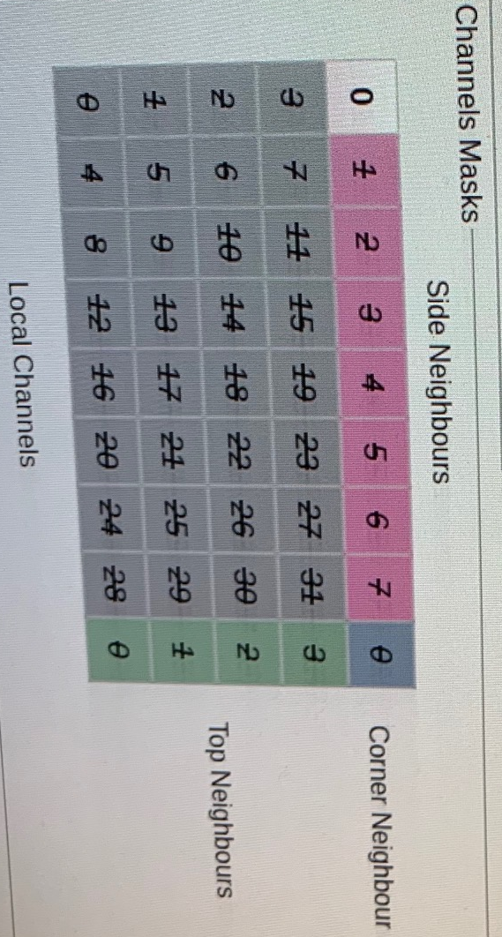
A
B
0 | 1 | 2 | 3
4 | 5 | 6 | 7
8 | 9 | 10 | 11
12 | 13 | 14 | 15
16 | 17 | 18 | 19
20 | 21 | 22 | 23
24 | 25 | 26 | 27
28 | 29 | 30 | 31
1 | 2 | 3
5 | 6 | 7
9 | 10 | 11
13 | 14 | 15
17 | 18 | 19
21 | 22 | 23
25 | 26 | 27
29 | 30 | 31
0-side
4-side
8-side
12-side
16-side
20-side
24-side
28-side
C
D
4 | 5 | 6 | 7
8 | 9 | 10 | 11
12 | 13 | 14 | 15
16 | 17 | 18 | 19
20 | 21 | 22 | 23
24 | 25 | 26 | 27
28 | 29 | 30 | 31
5 | 6 | 7
9 | 10 | 11
13 | 14 | 15
17 | 18 | 19
21 | 22 | 23
25 | 26 | 27
29 | 30 | 31
4-side
8-side
12-side
16-side
20-side
24-side
28-side
0-up | 1-Up | 2-up | 3-up
1-Up | 2-up | 3-up
0-Corner

