Slide 1
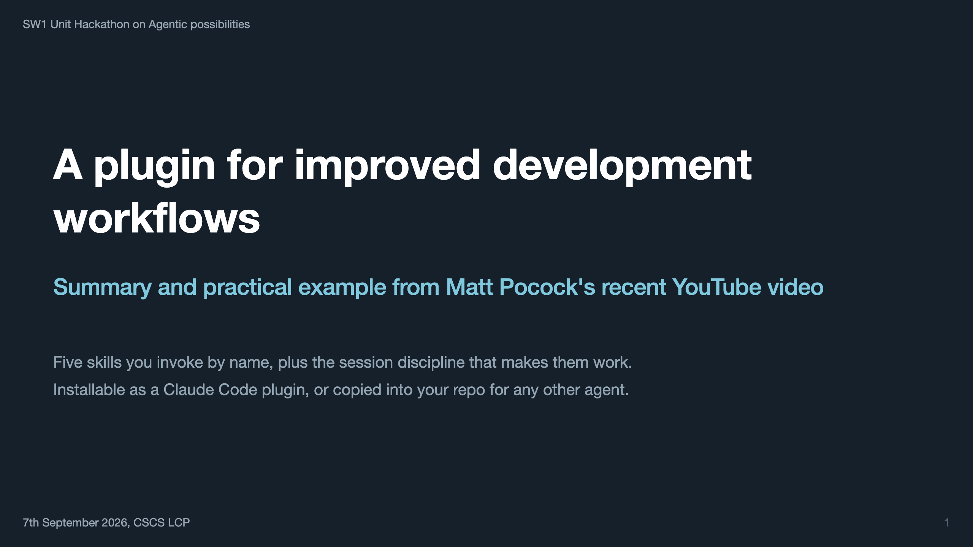
Notes:
Stand-alone deck — assumes nothing from any other talk. Open by saying what this is: one practitioner's end-to-end system for agentic coding, not a framework and not an autonomous agent. Everything here comes from one video and the public repository behind it.

Slide 2
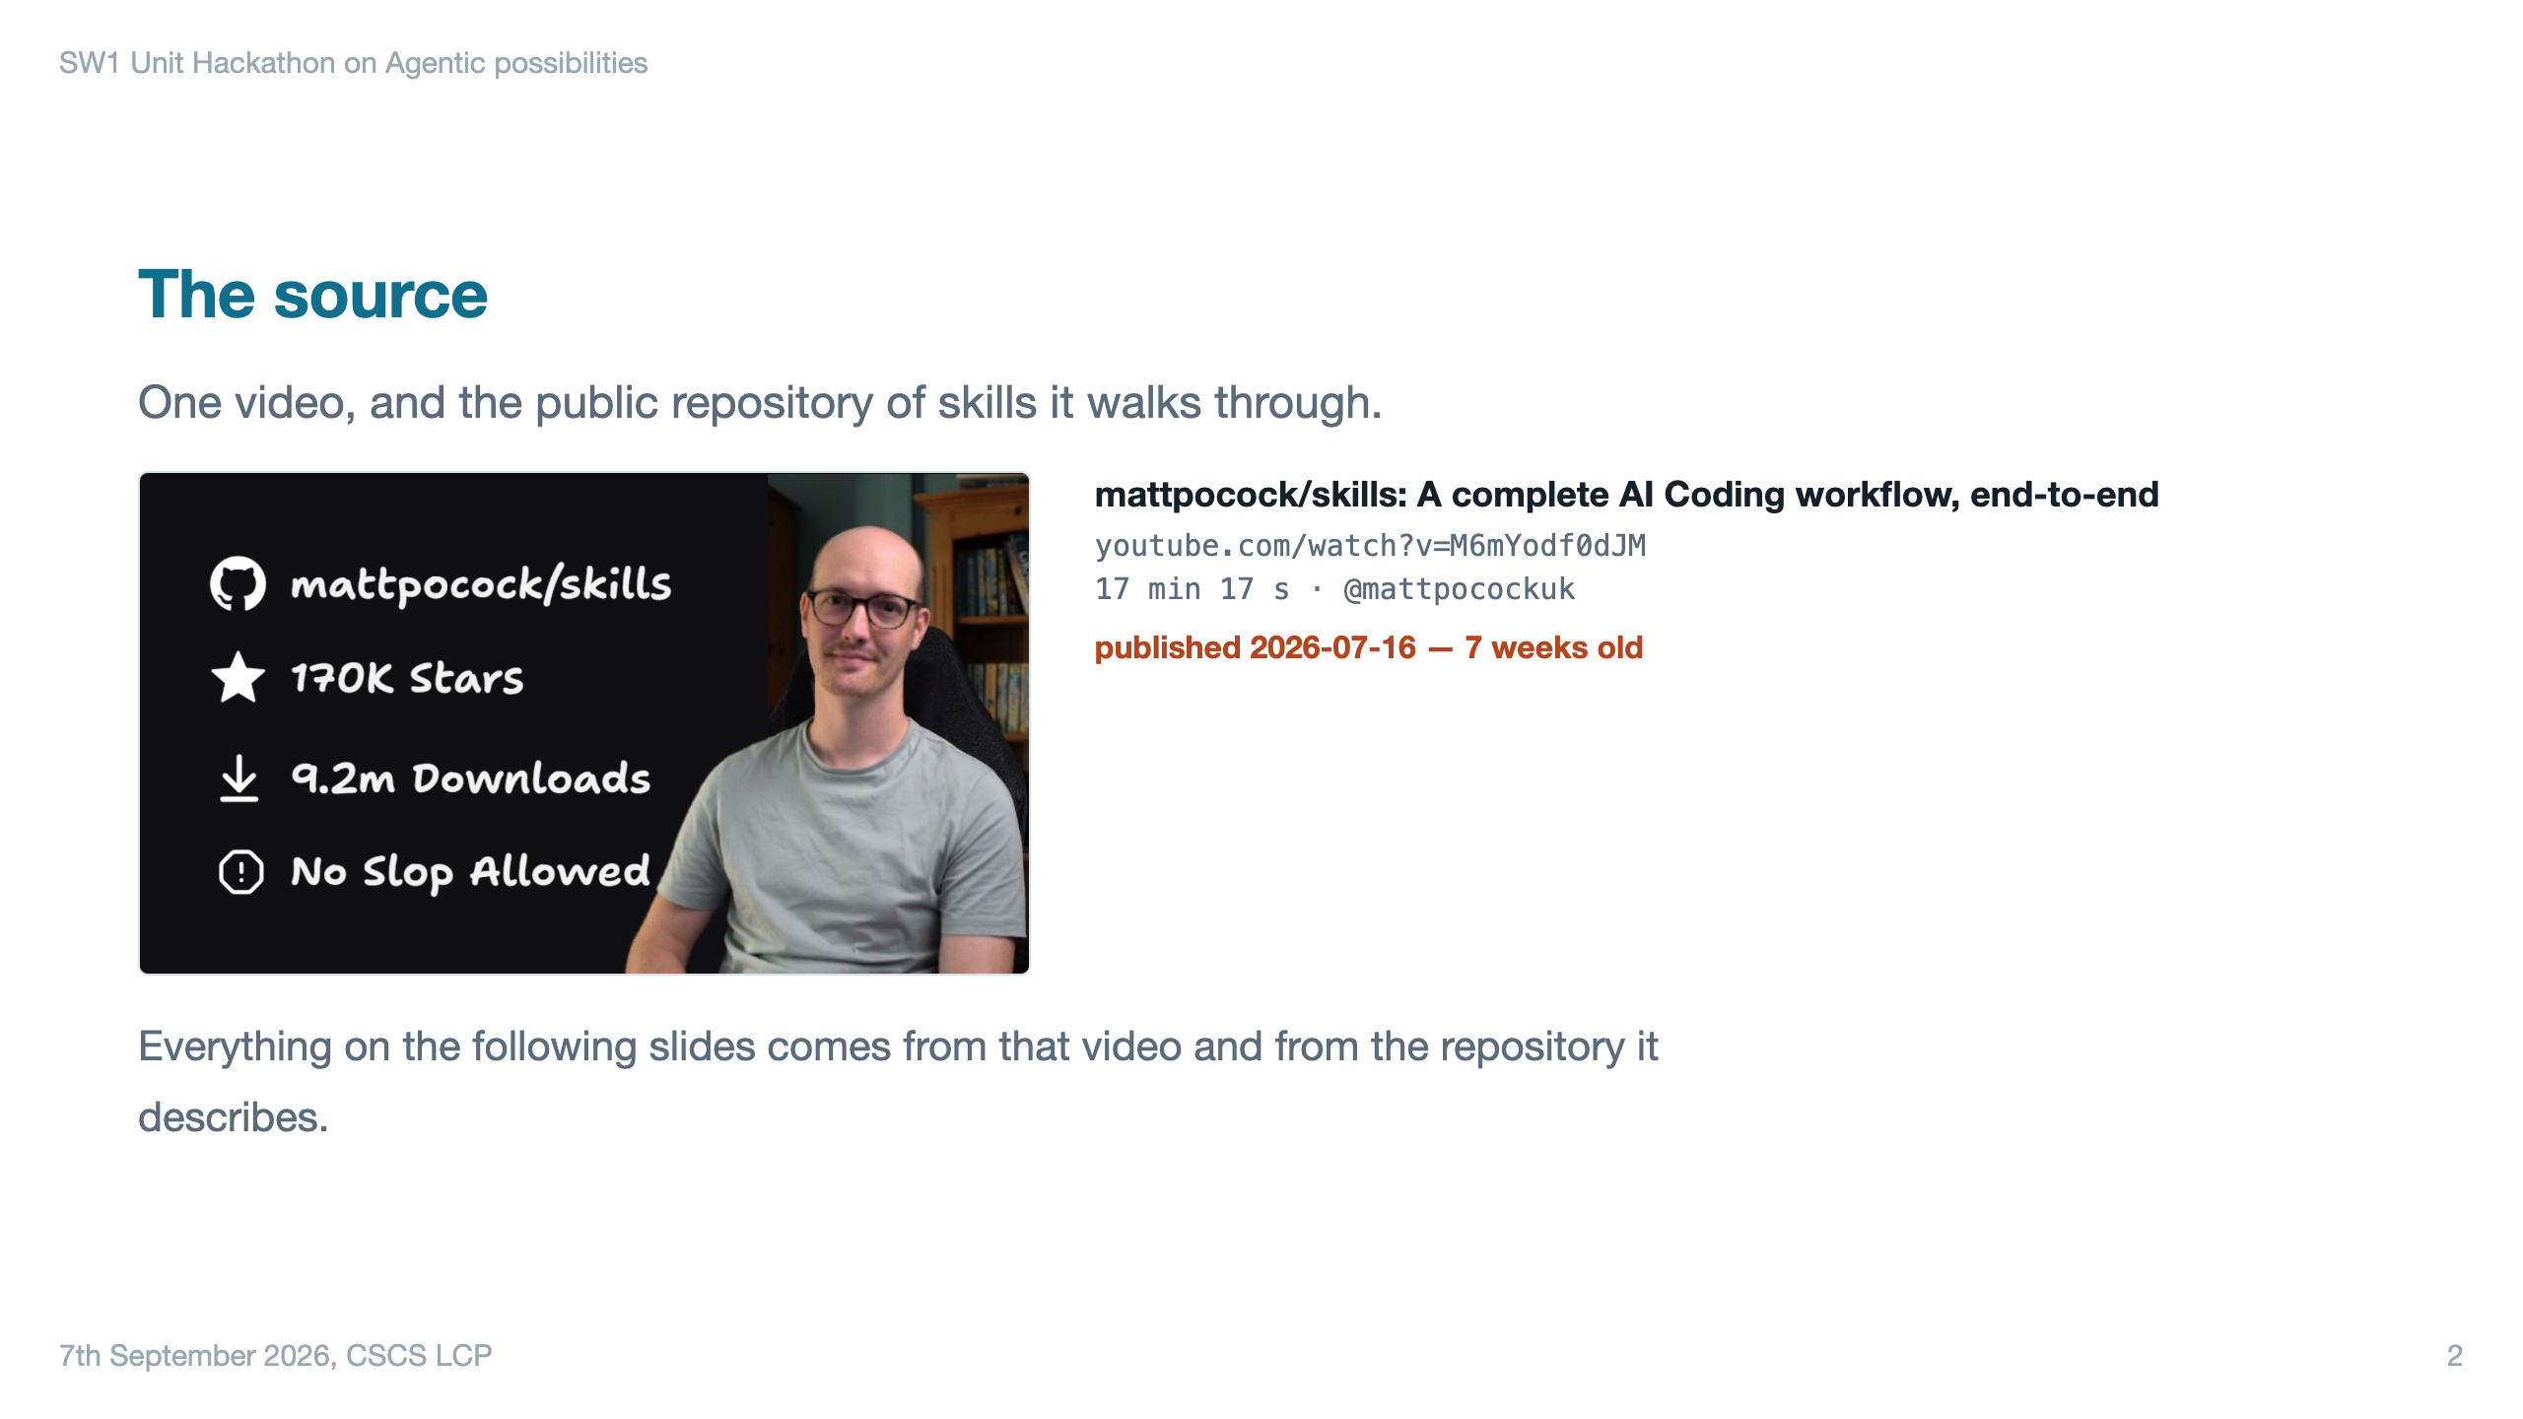
Notes:
Say the date out loud. The point is that the audience can judge for themselves how stale any of this might be by the time they try it.

Slide 3
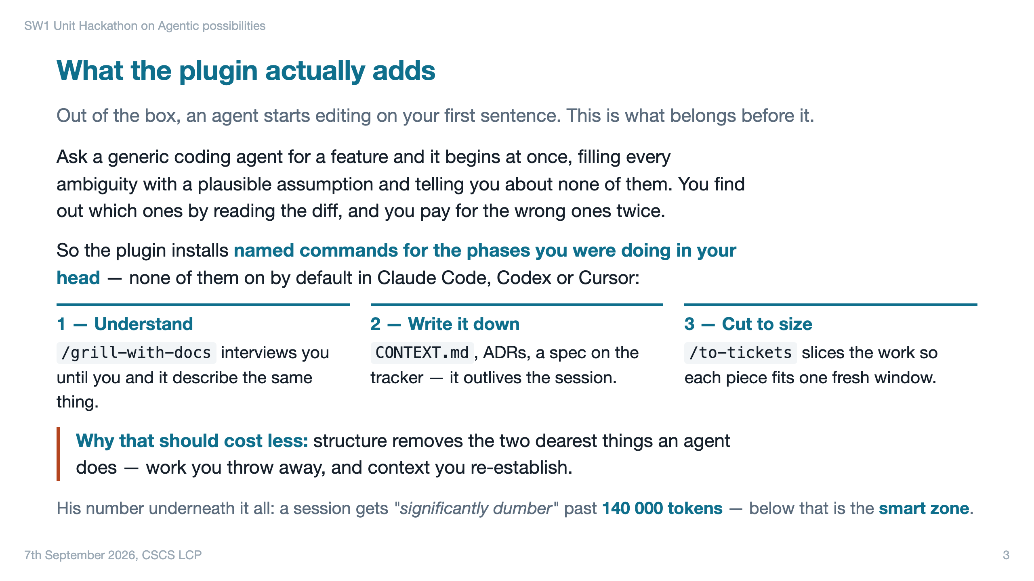

Slide 4
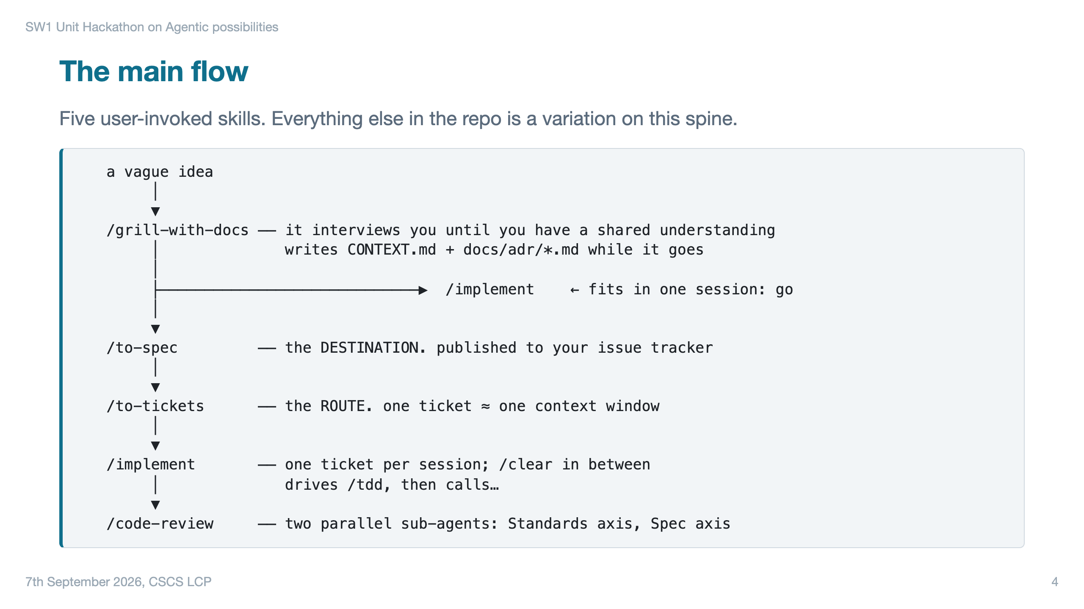

Slide 5
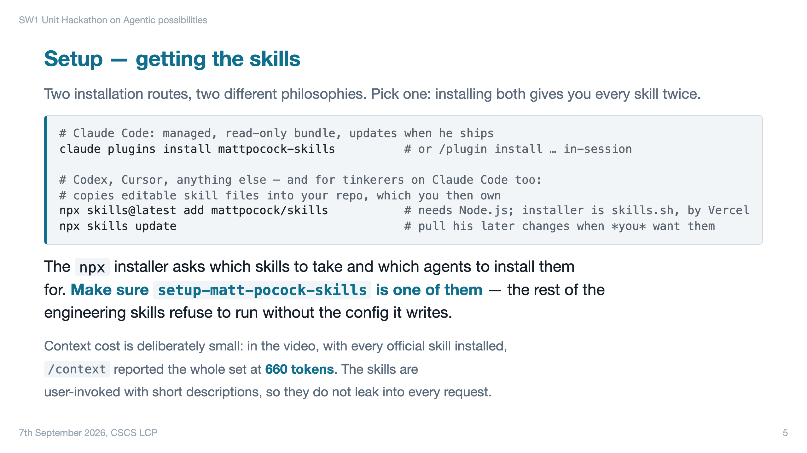

Slide 6
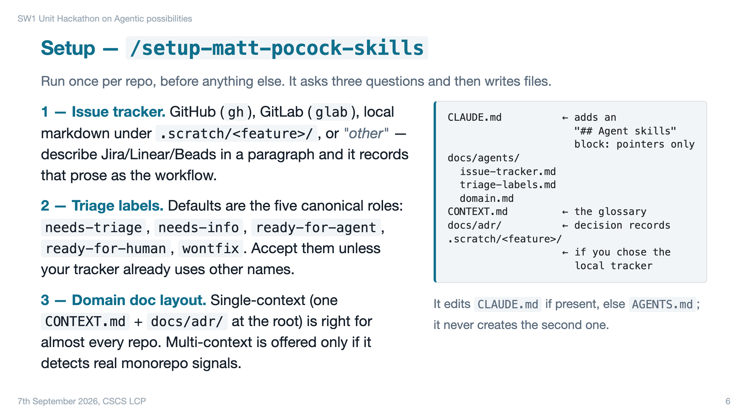

Slide 7
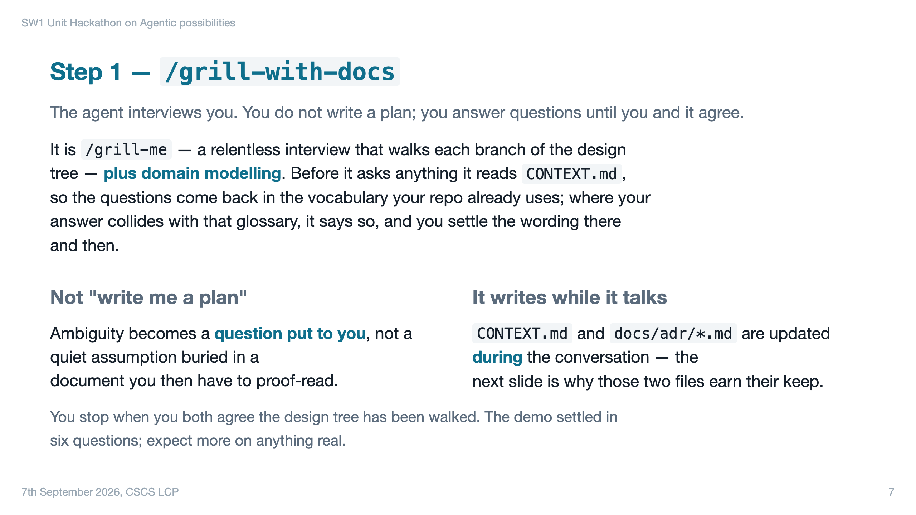

Slide 8
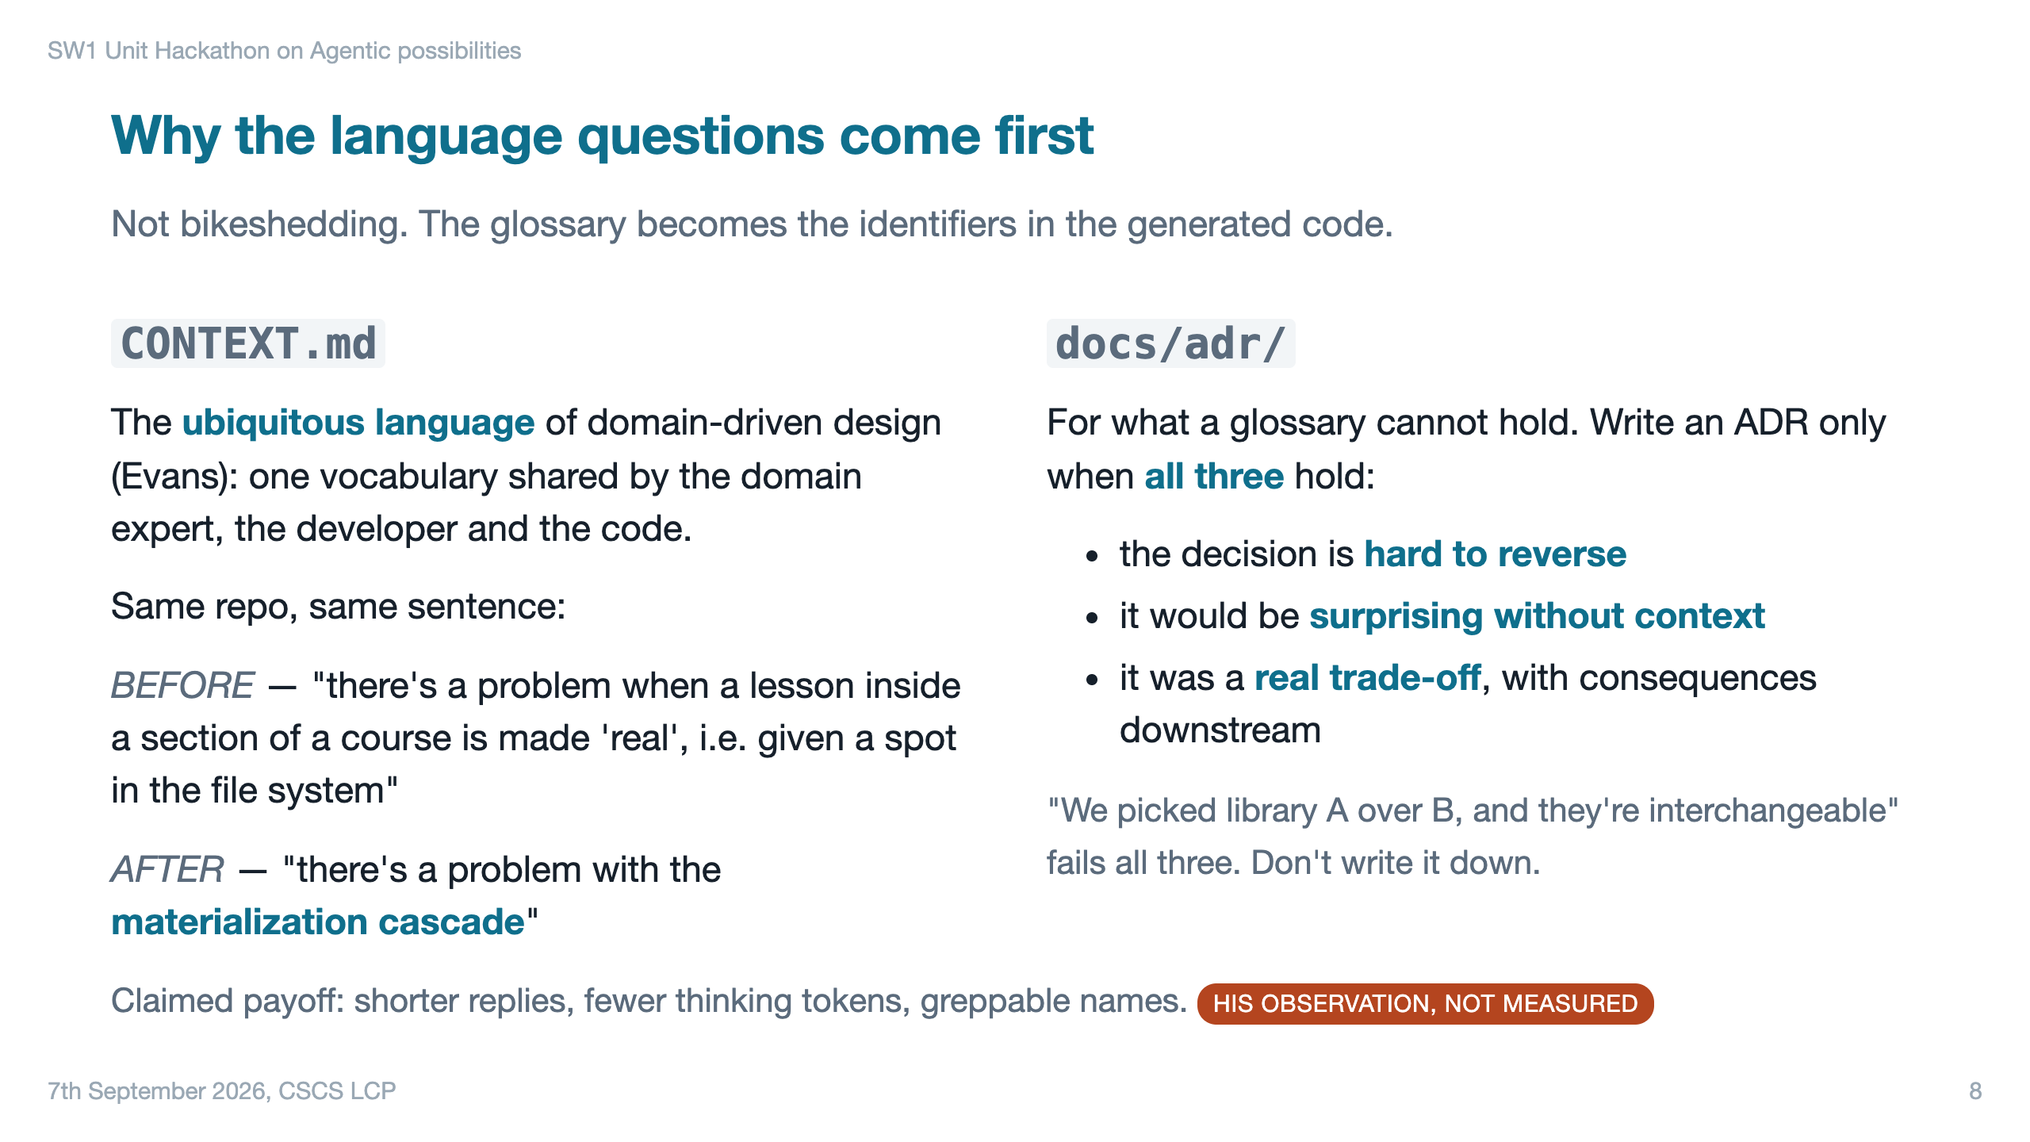

Slide 9
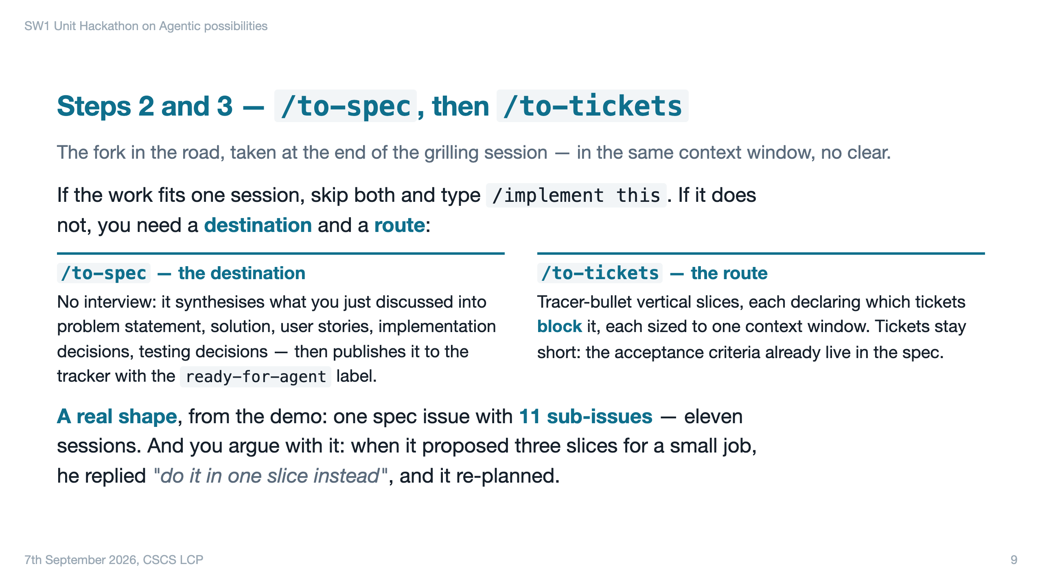

Slide 10
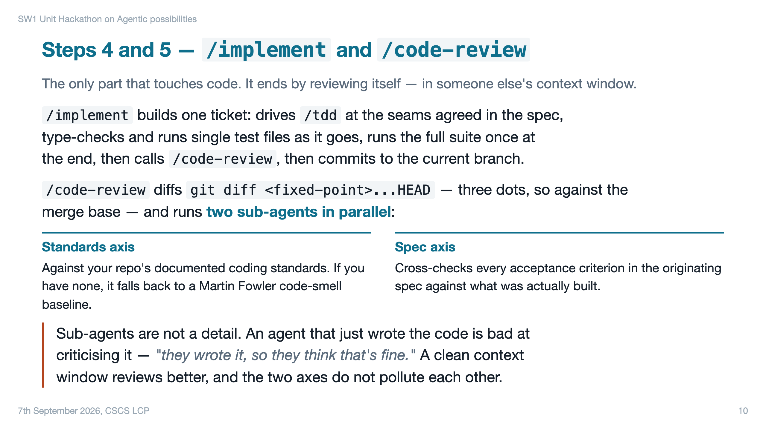

Slide 11
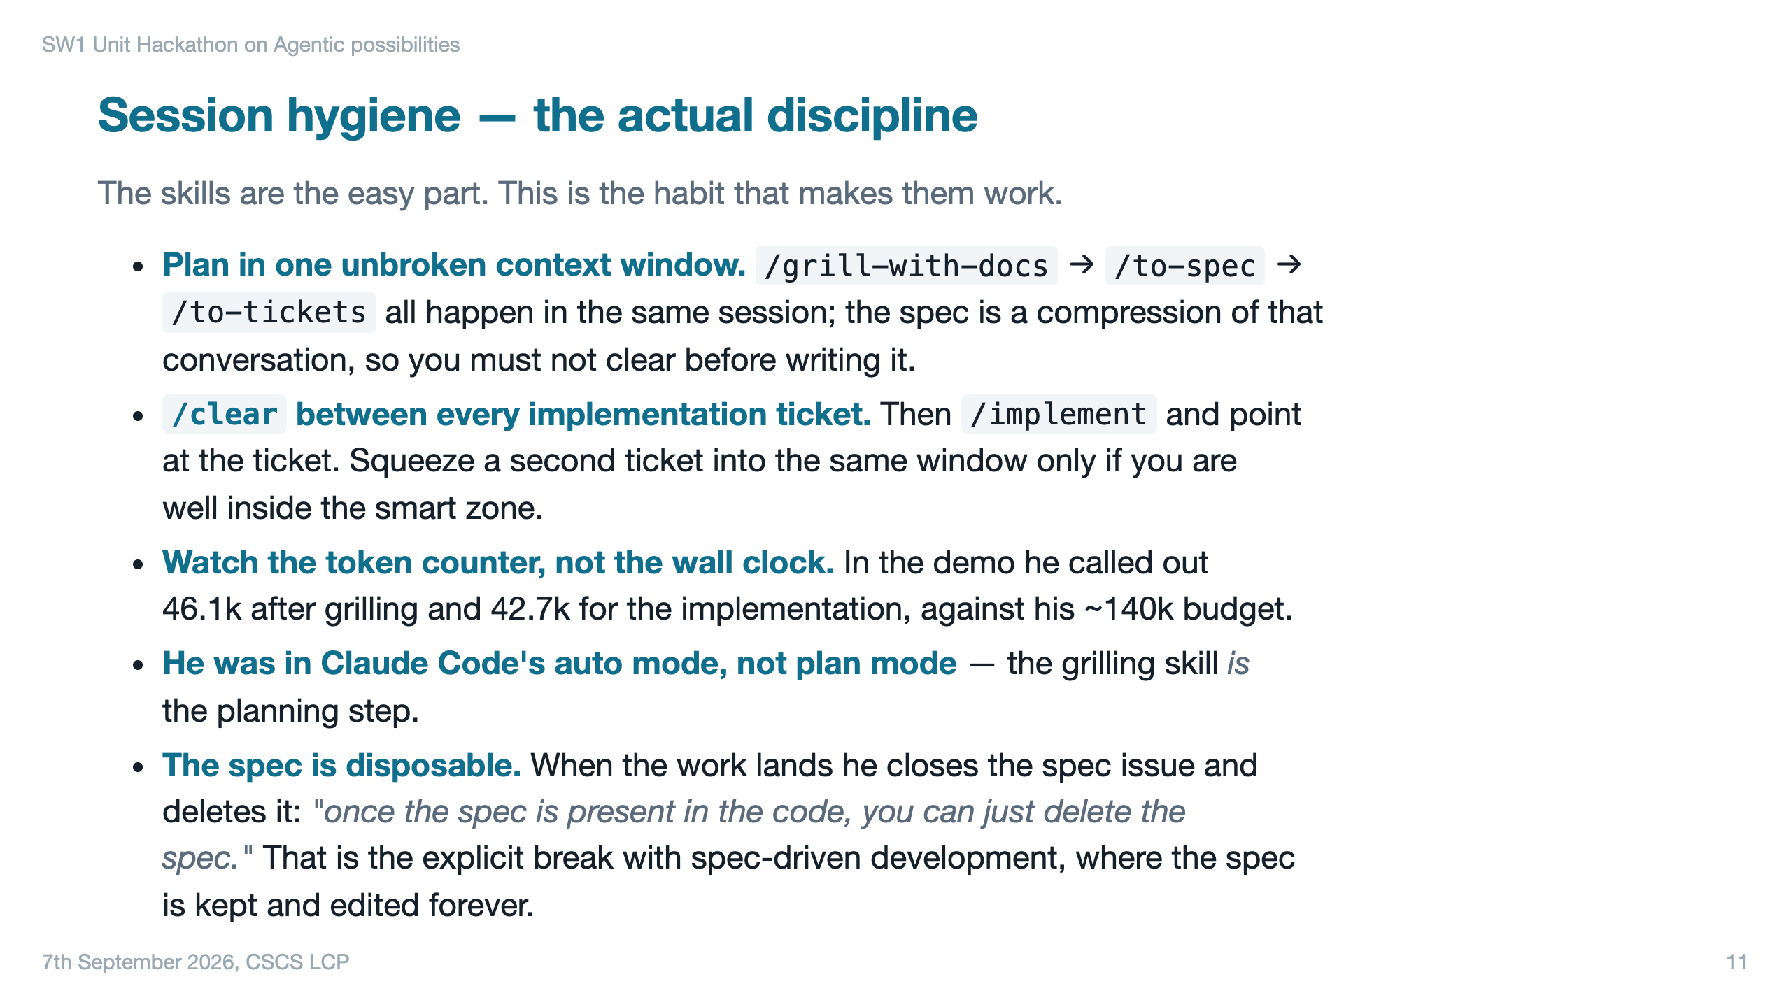

Slide 12
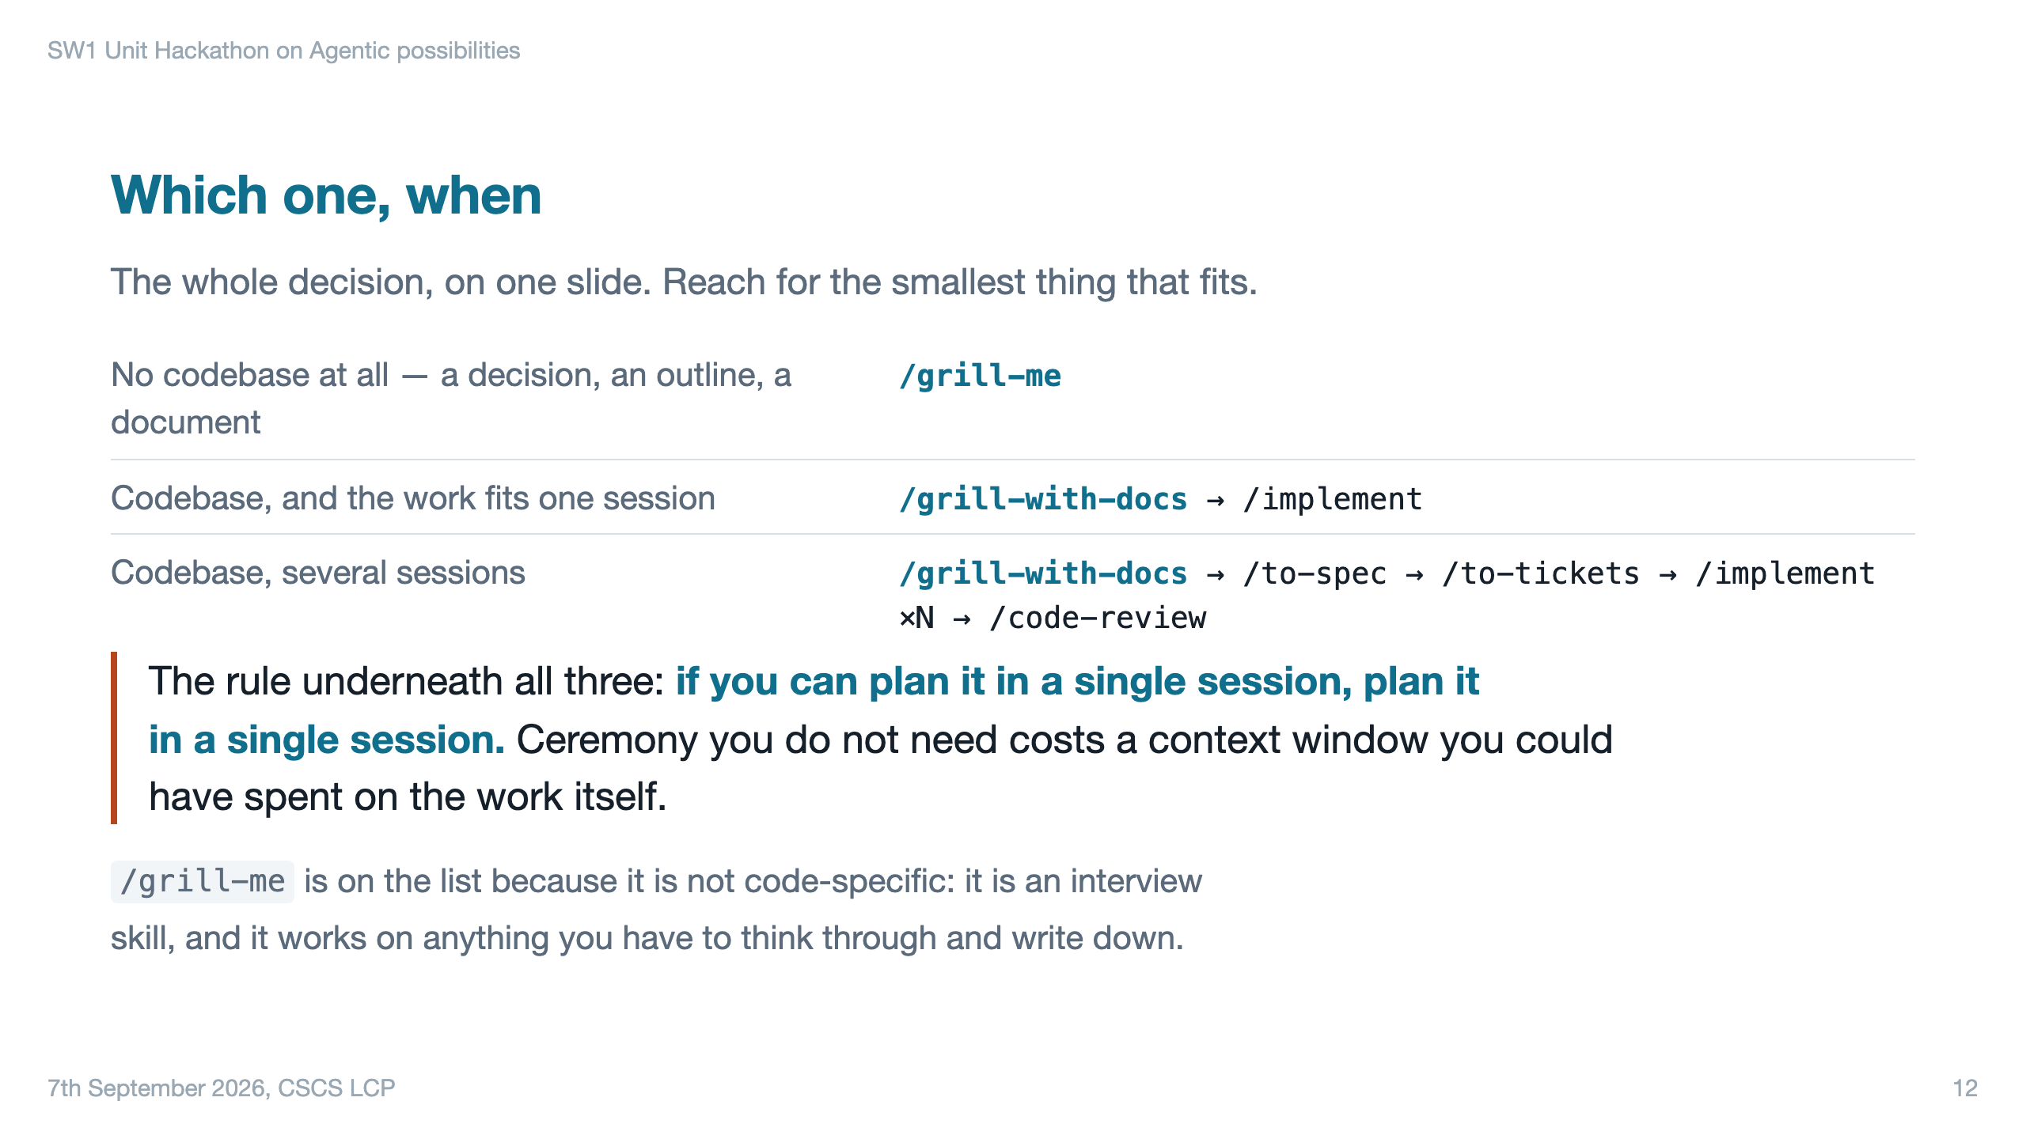

Slide 13
