Slide 1
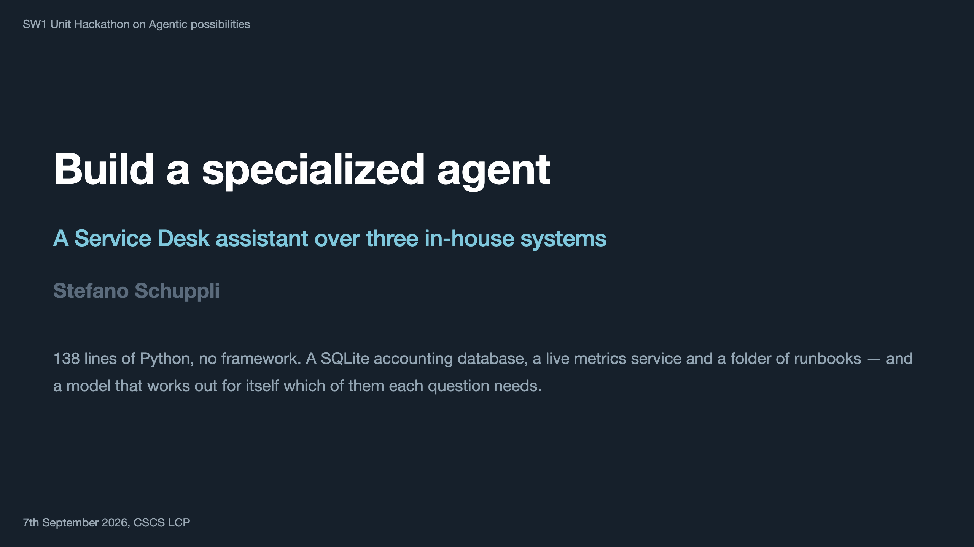
Notes:
Stand-alone deck: assumes nothing from any other talk. Two slides of scenario, four of code, then everything else happens at the terminal. Keep it moving.

Slide 2
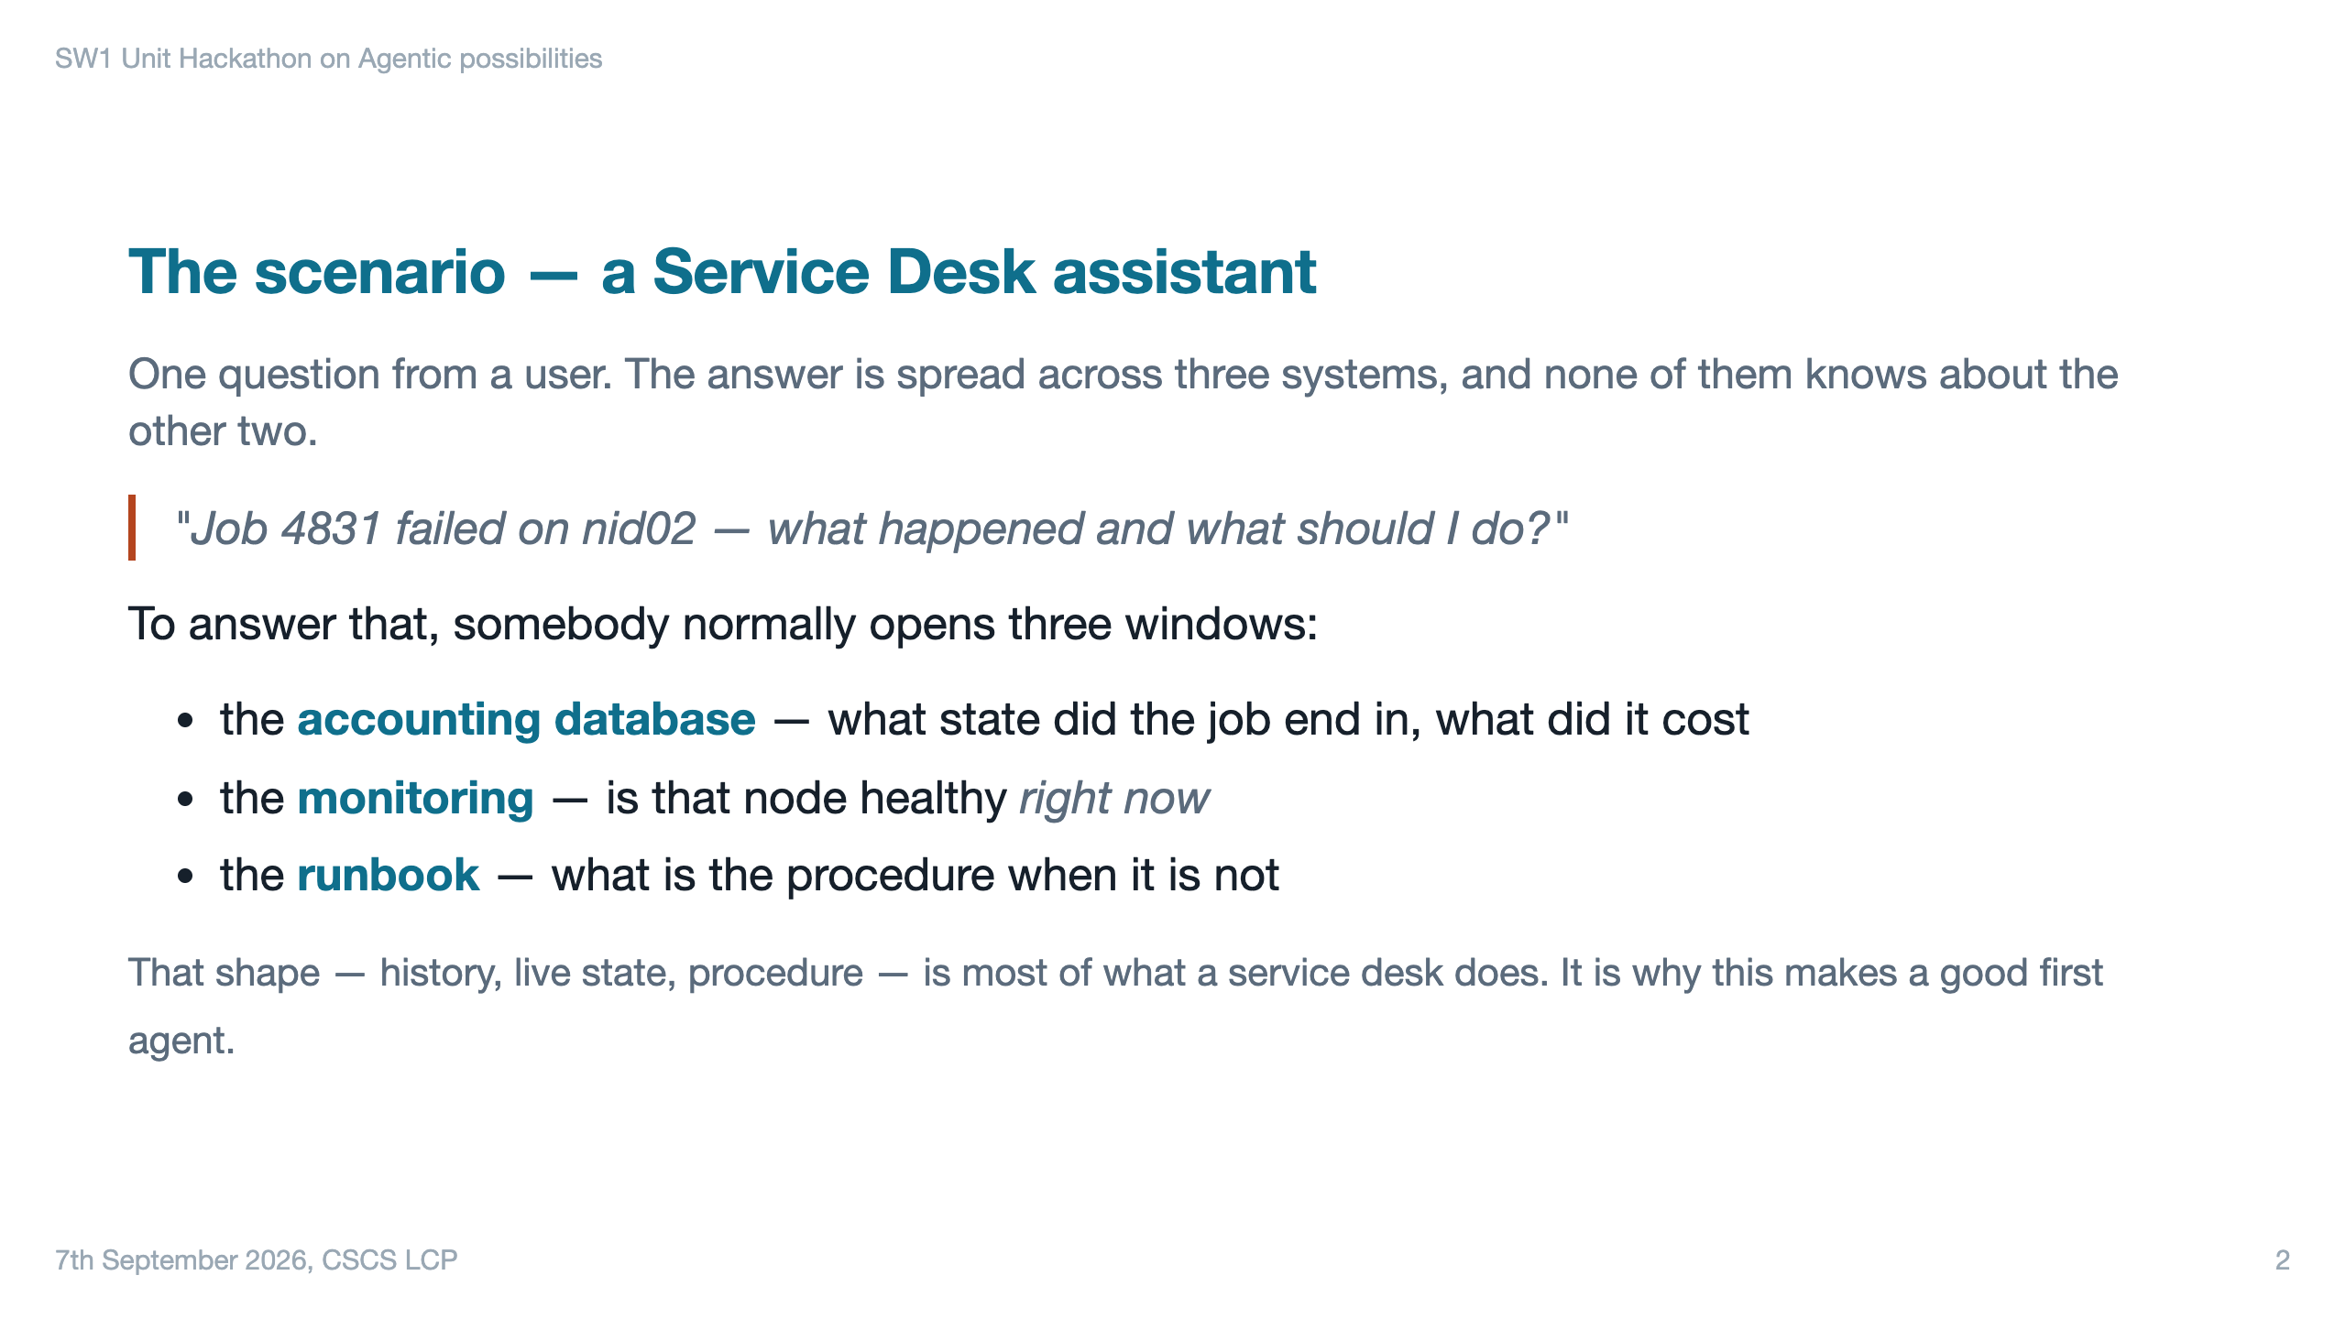

Slide 3
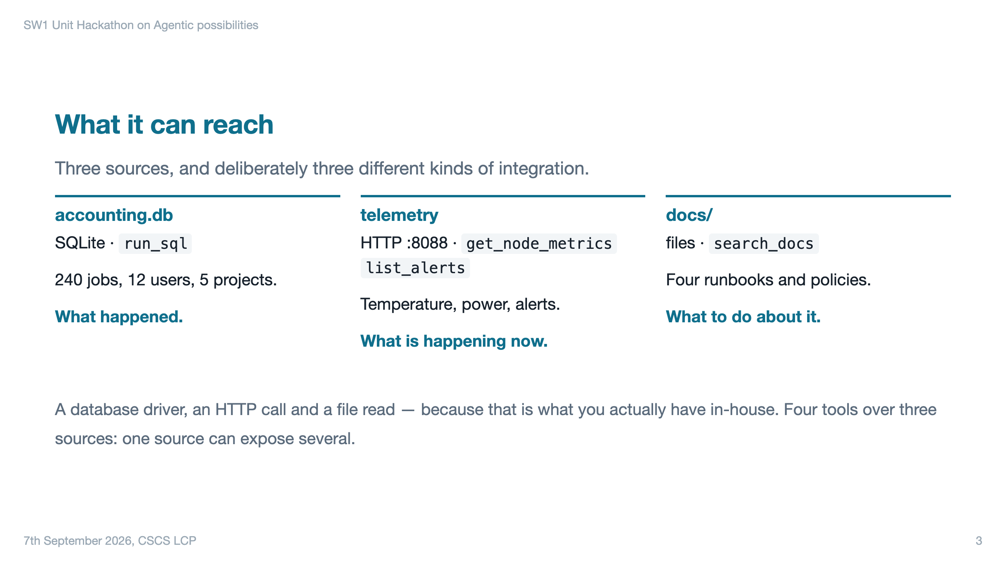

Slide 4
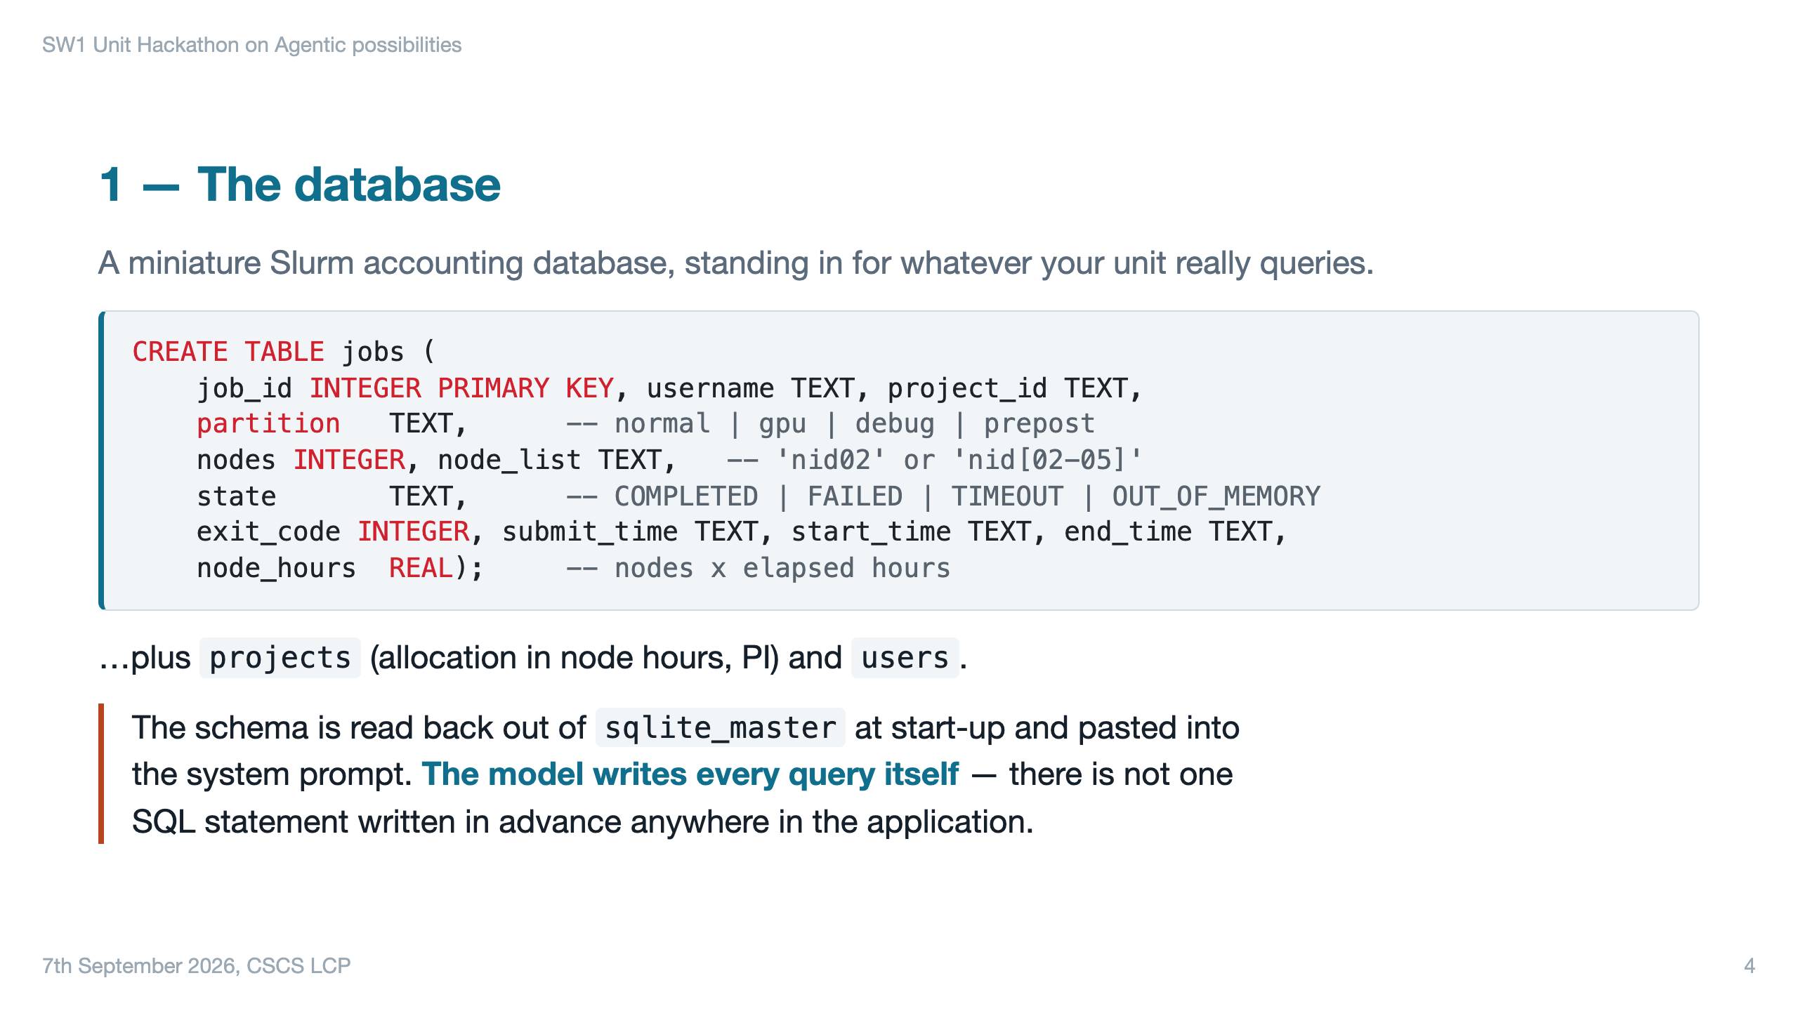

Slide 5
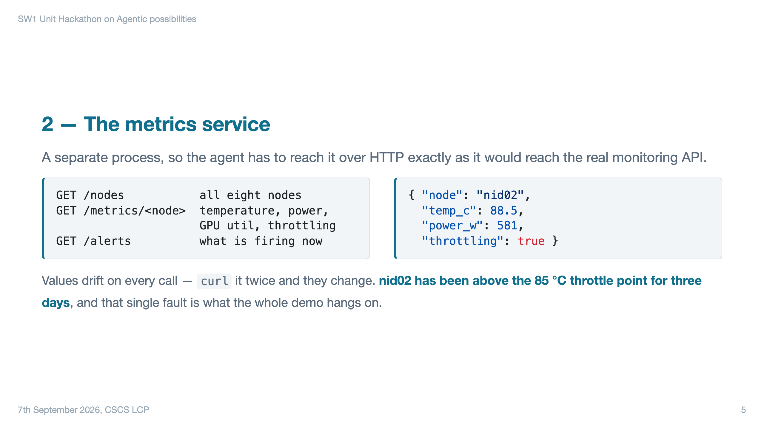

Slide 6
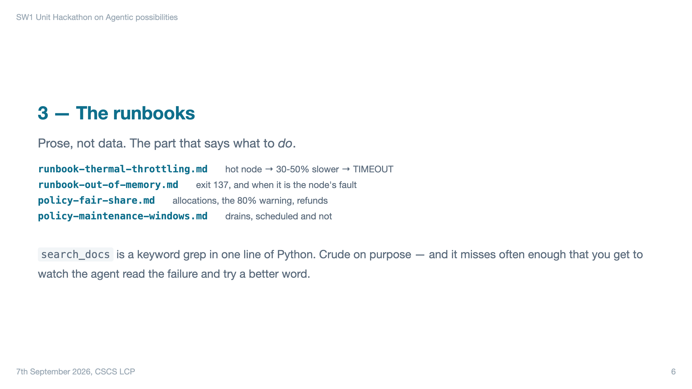

Slide 7
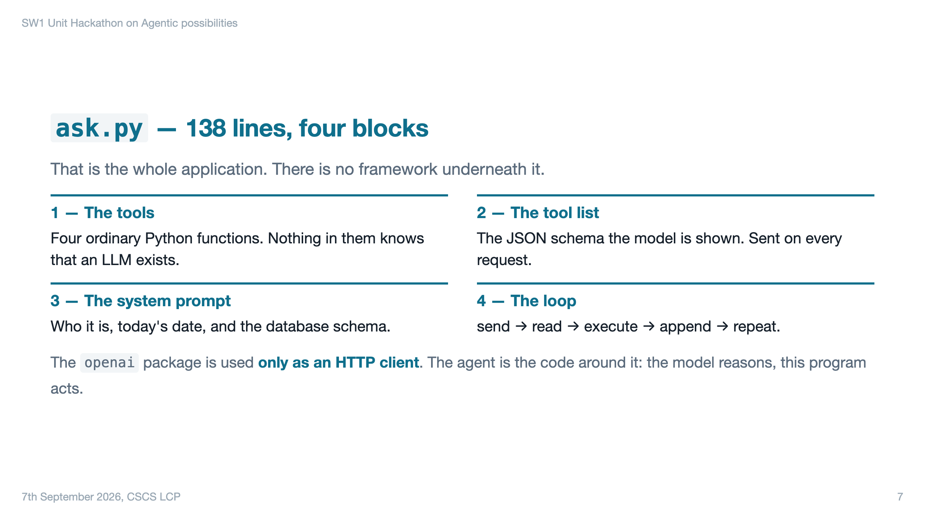

Slide 8
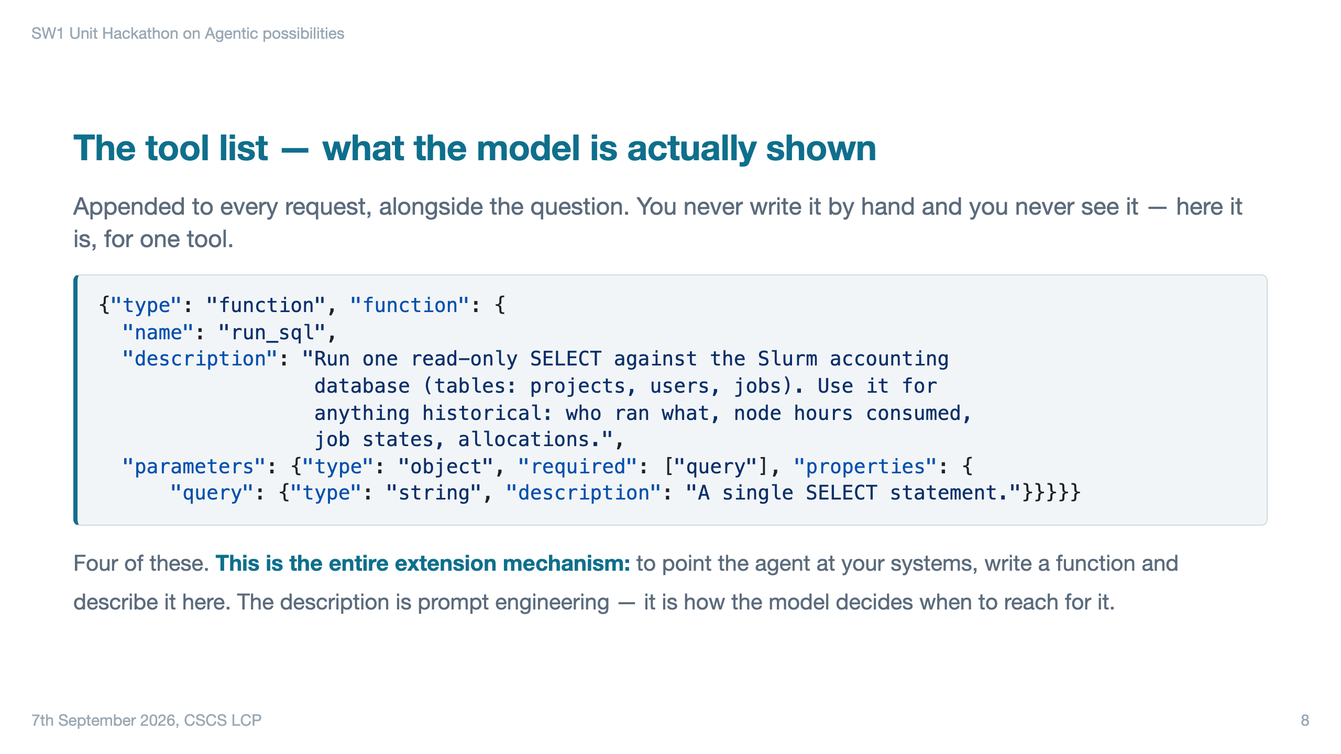

Slide 9
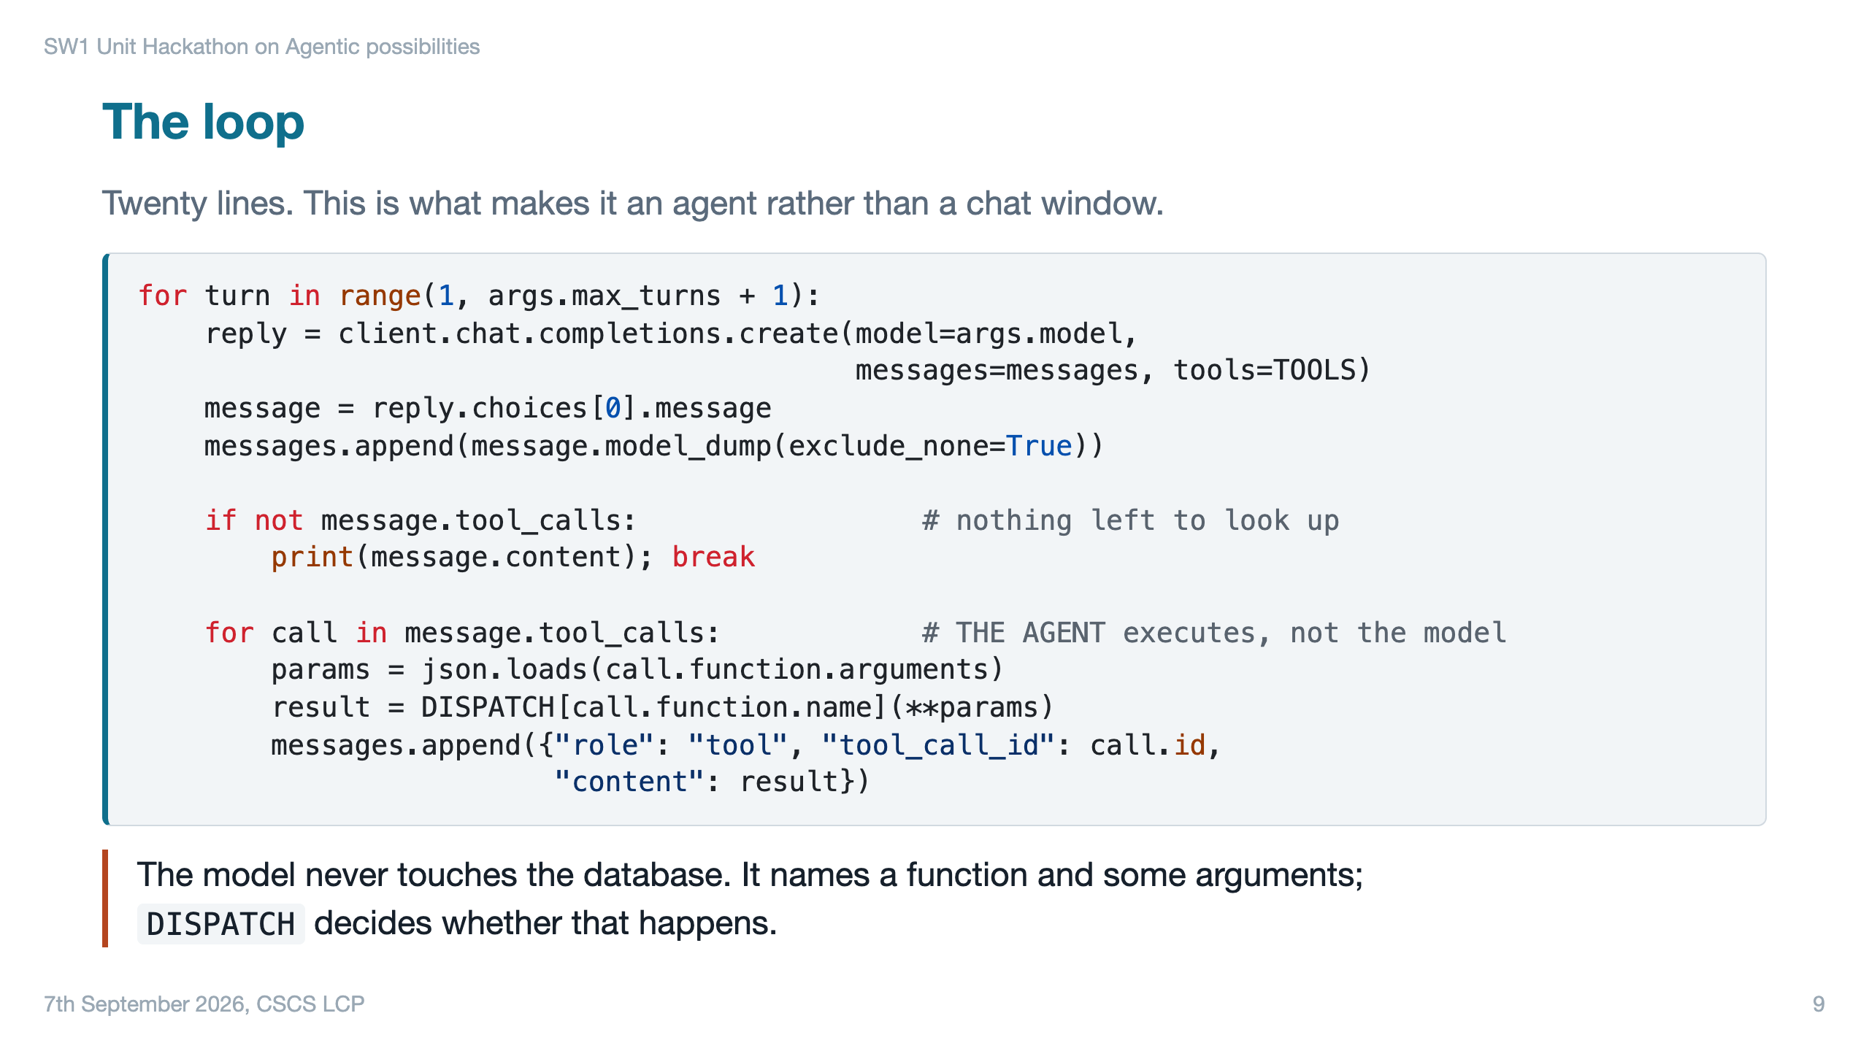

Slide 10
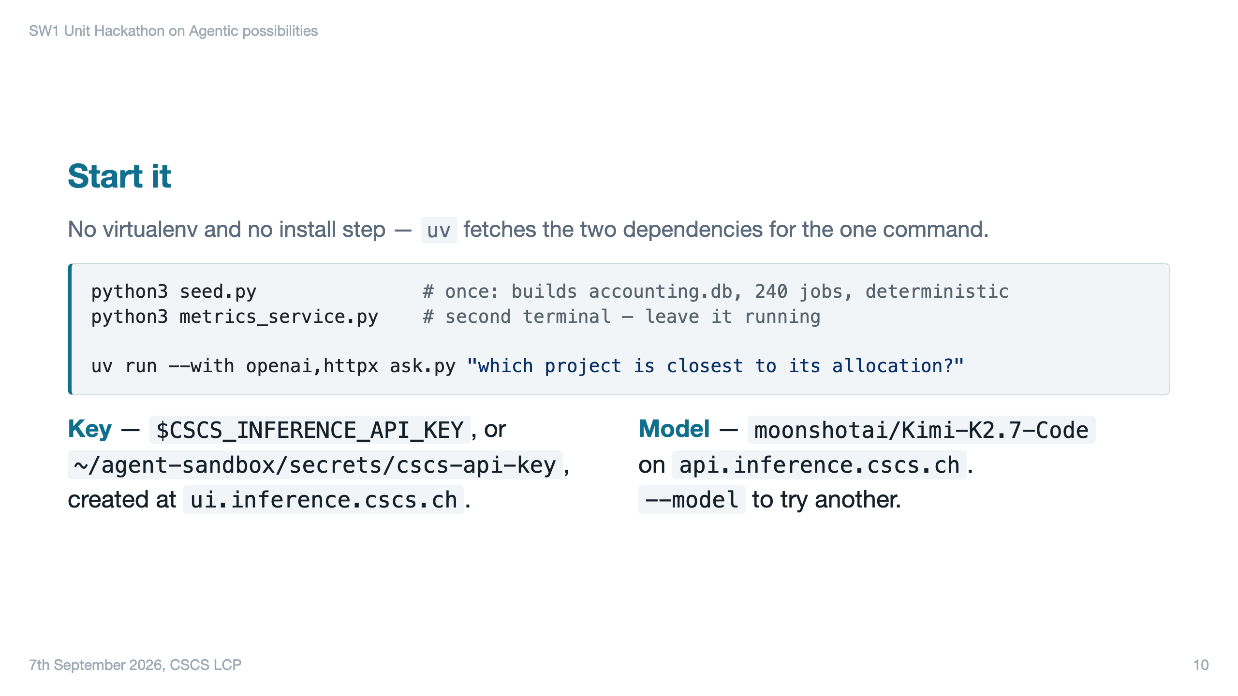

Slide 11
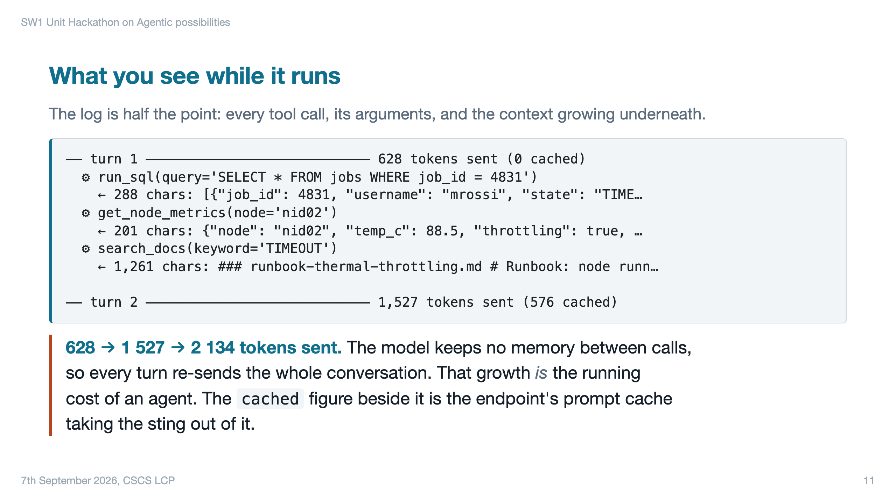

Slide 12
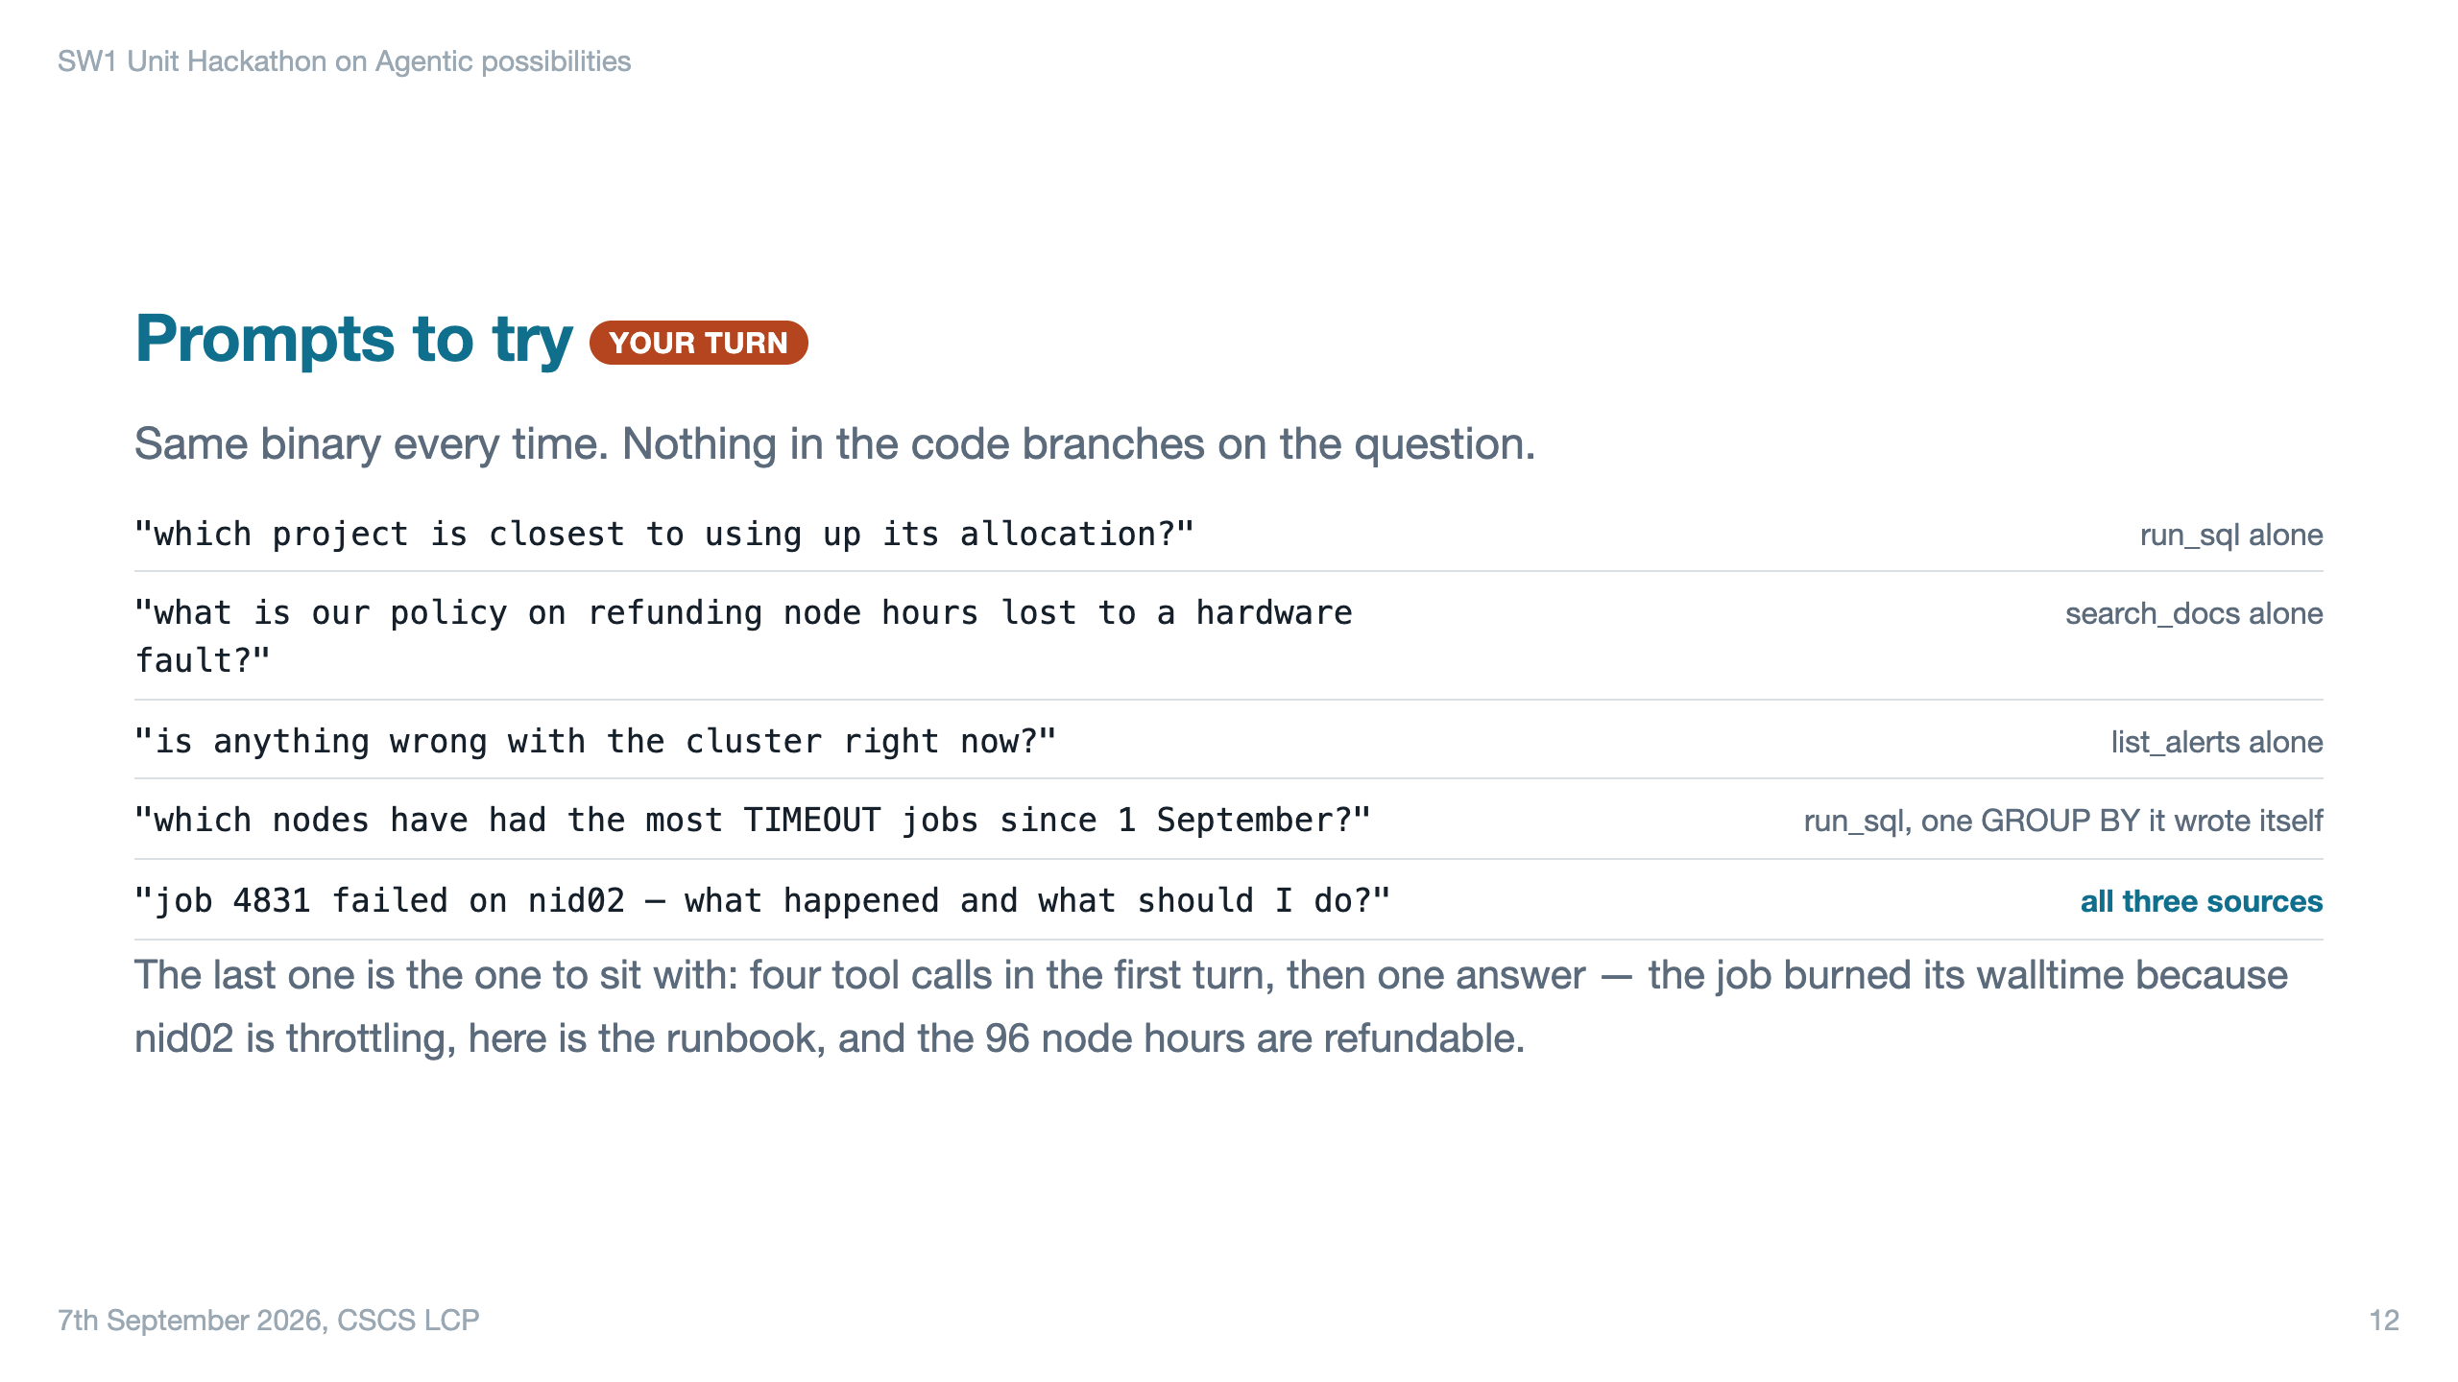
Notes:
The path varies run to run — the shape is stable, the exact SQL is not. Narrate the shape, not the steps. Good harder one if there is time: "have other jobs on nid02 timed out recently?" — the nid[02-05] range notation is awkward in SQL and you get to watch it iterate for four or five turns.

Slide 13
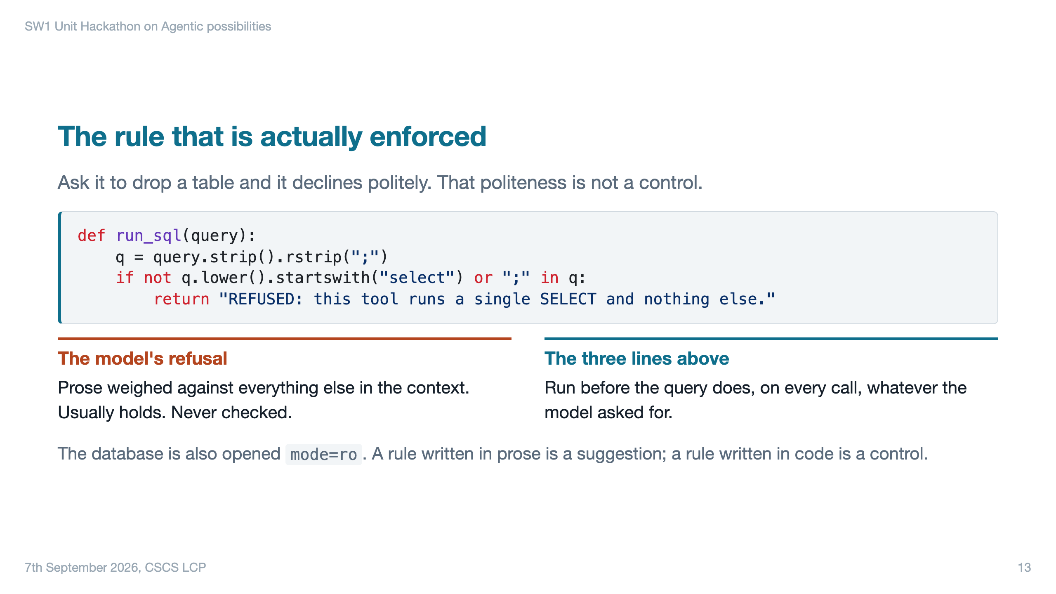

Slide 14
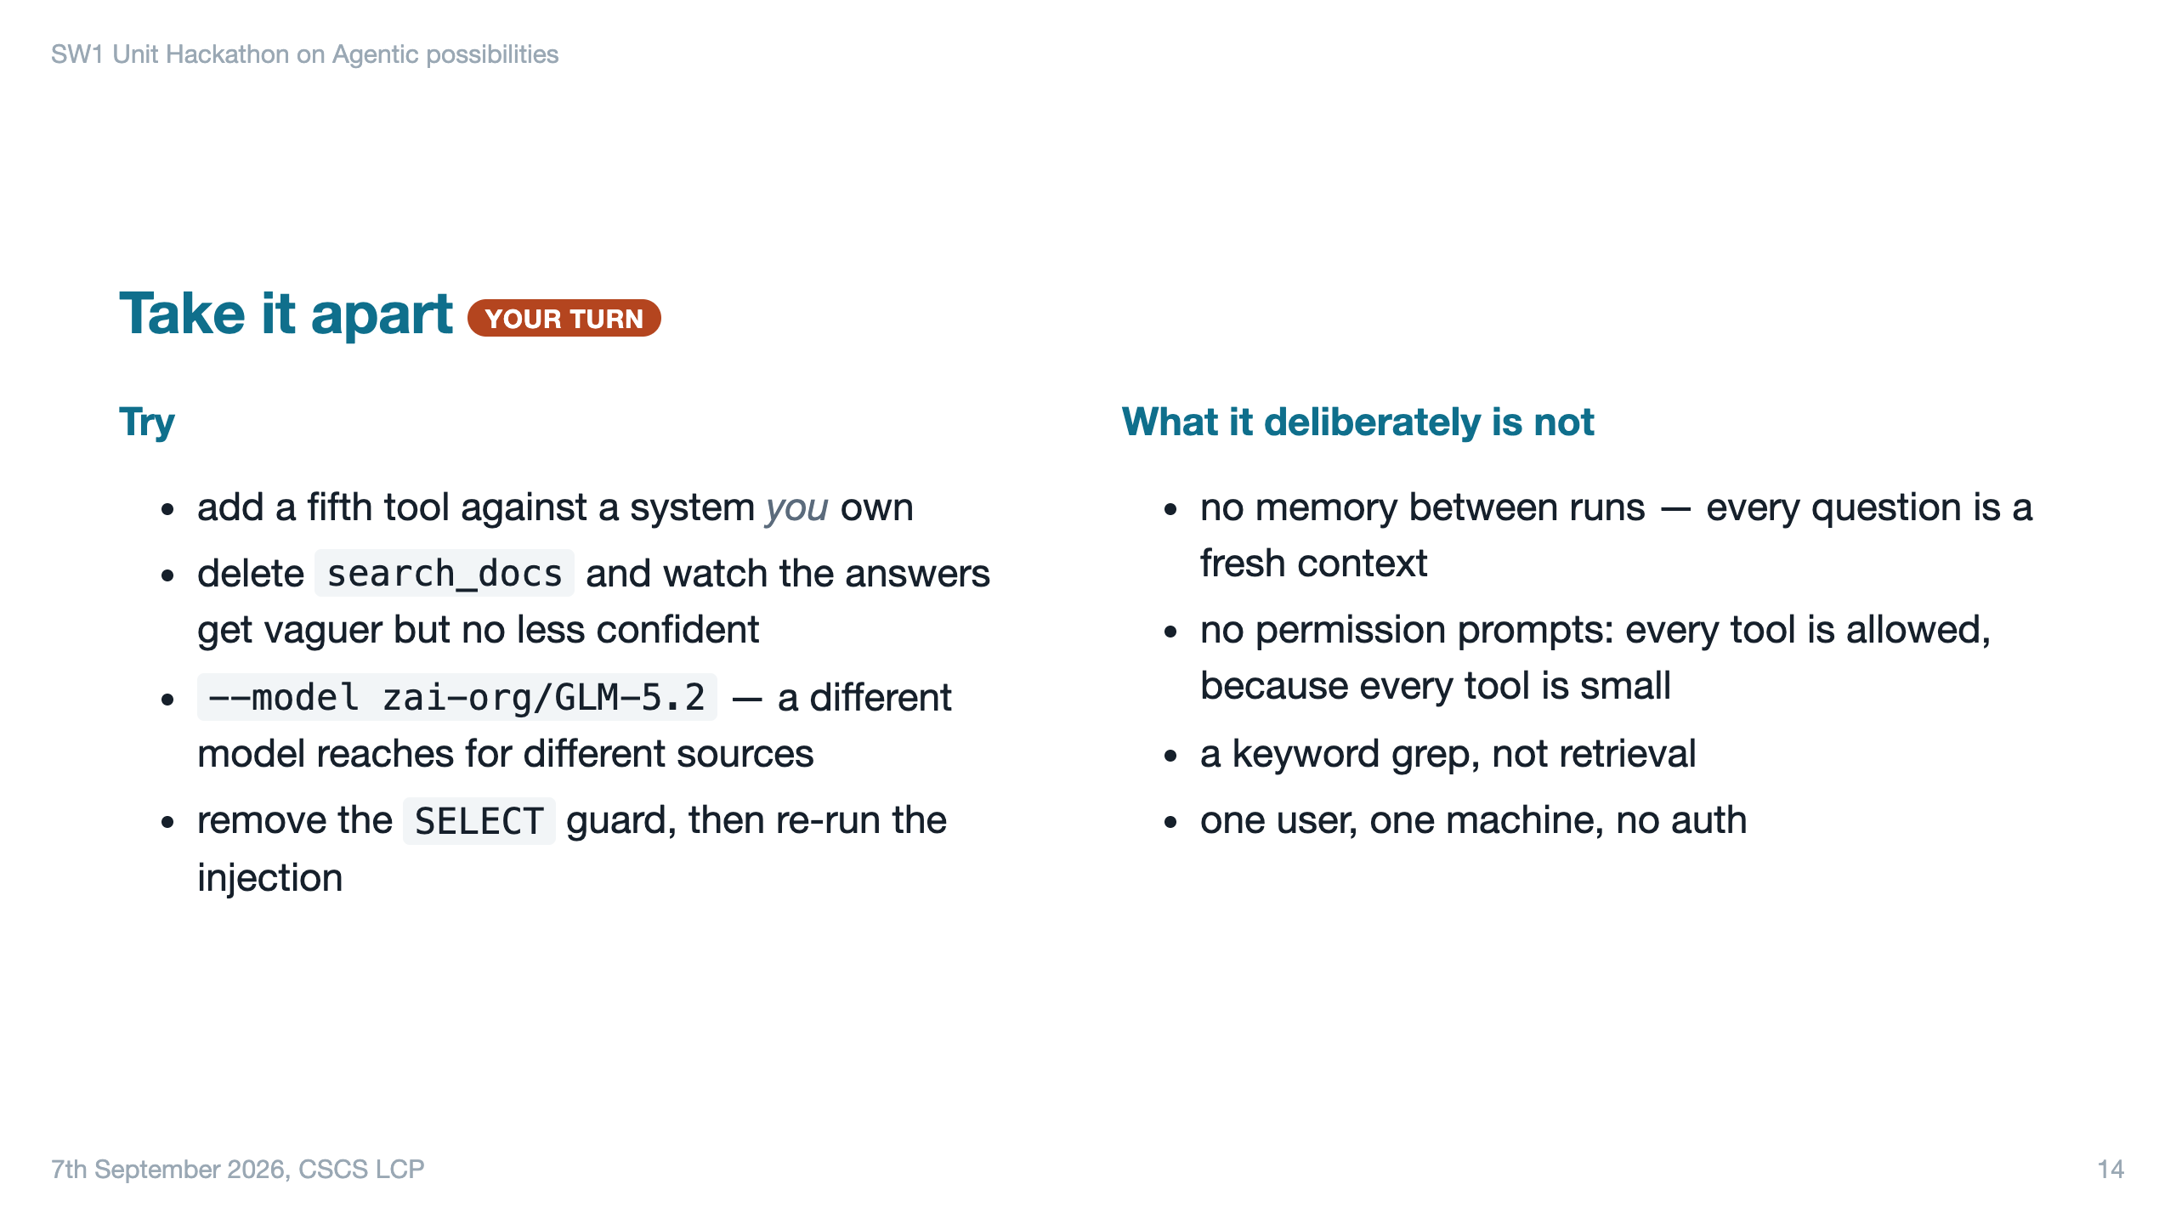

Slide 15
