Slide 1
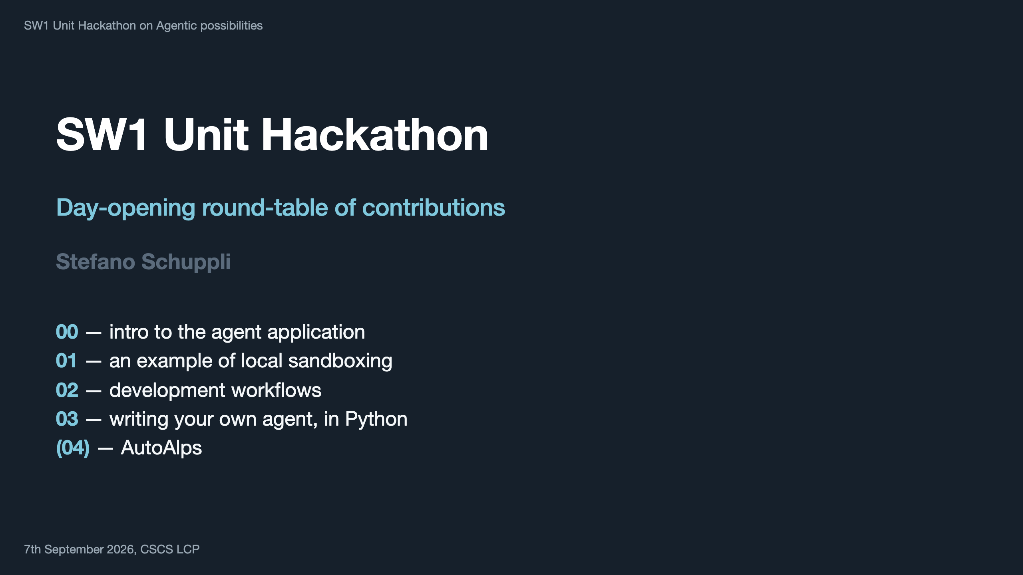
Notes:
Shared hour, several presenters — keep it tight. 00 is the only part that needs slides; 01 and 03 happen at the terminal. Decks: 00-agents-introduction/ · 01-sandboxing/ · 02-workflow/ · 03-agent-example/ 03 is a hand-written Python agent — deliberately not Codex, Claude Code or opencode, to show the loop has no magic in it.

