Slide 1
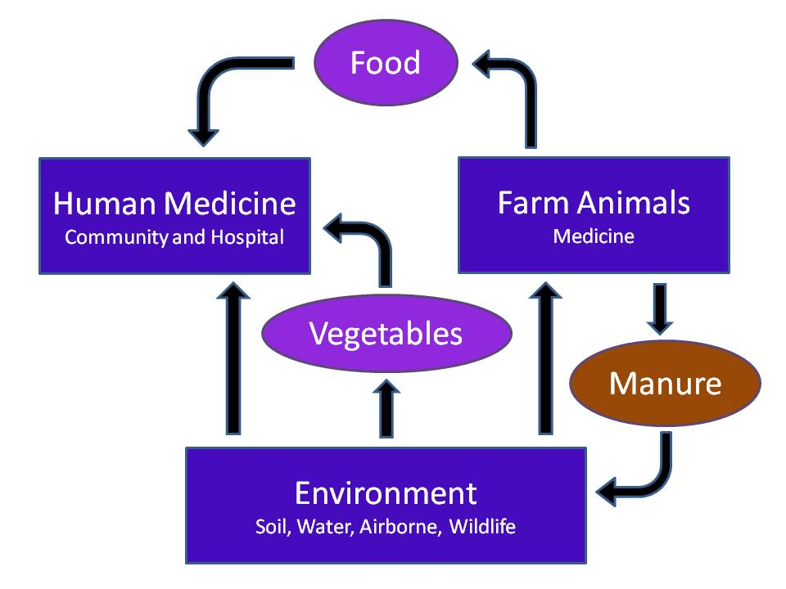
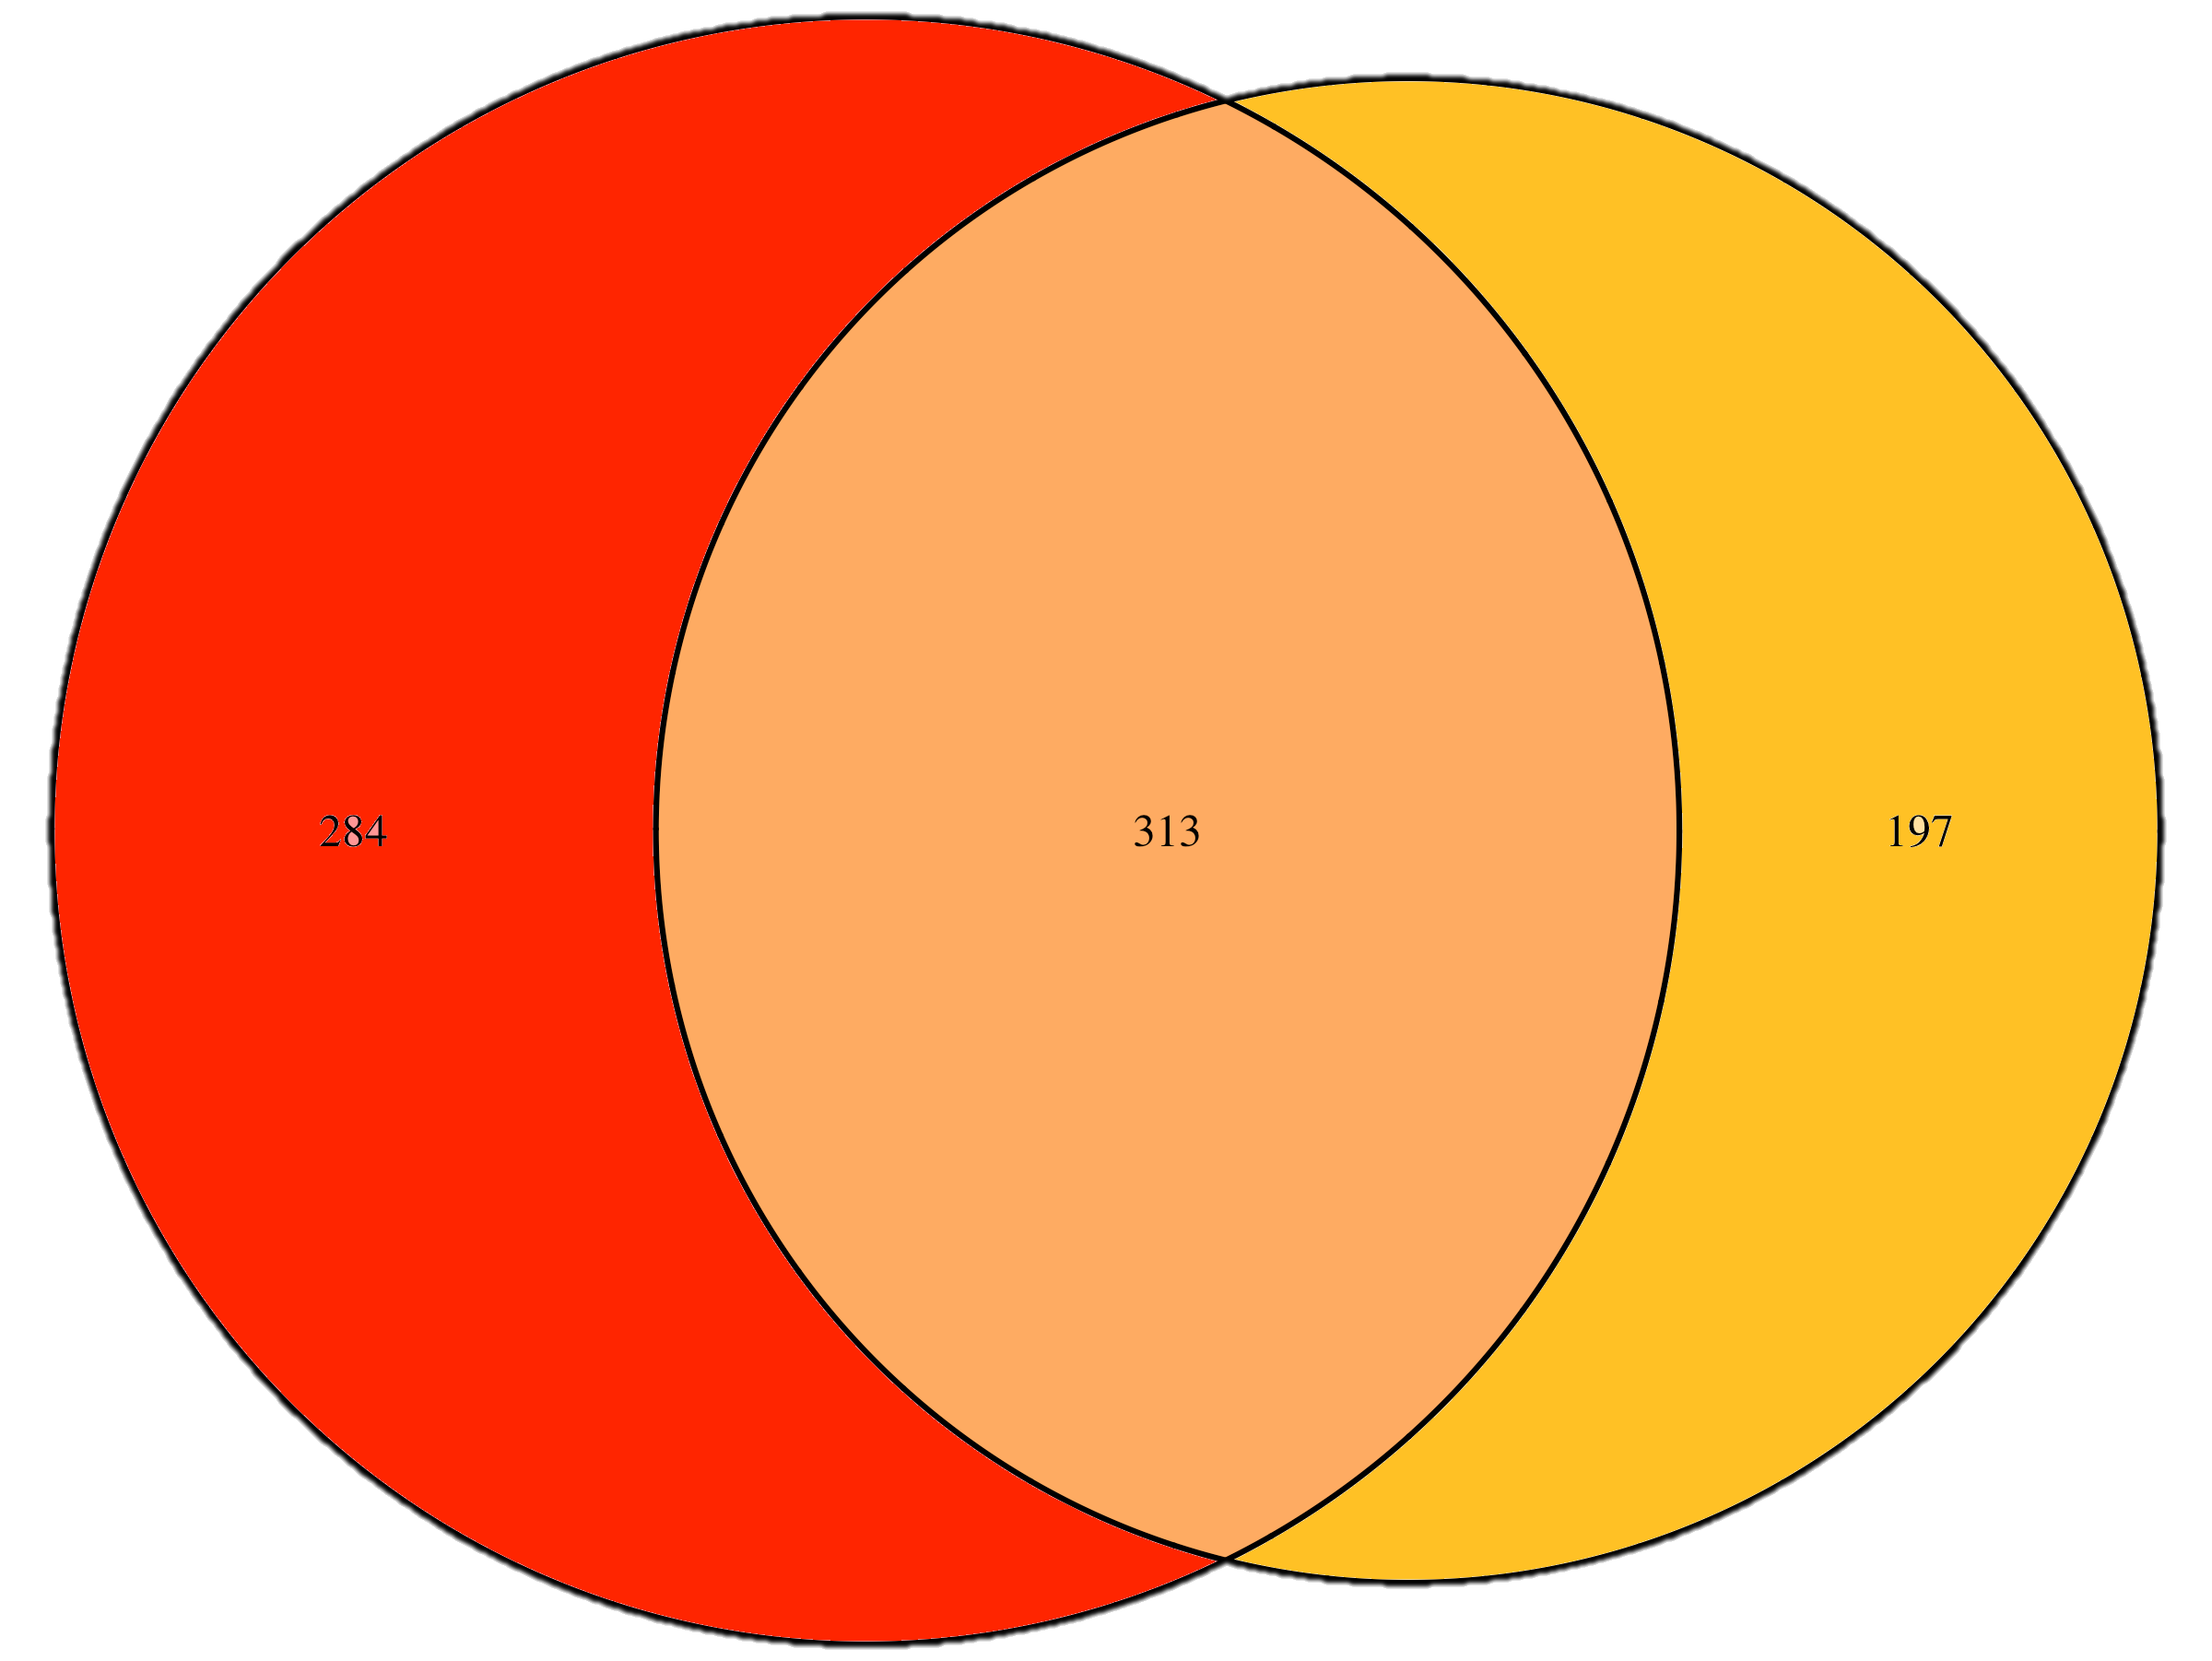
Poster Presenter: Schuyler D. Smith - Bioinformatics and Computational Biology - Iowa State University of Science and Technology
Examining antibiotic resistance gene (ARG) horizontal transfer and introduction through farmland soil microbiomes as a result of modern agricultural practices
Schuyler D. Smith² , Jinlyung Choi^{1*}, Elizabeth M. Luby^{1*}, Michelle L. Soupir¹, James R. Cole, Thomas B. Moorman⁴, Beth Douglass, Adina Howe^{1*}
¹Department of Agricultural and Biosystems Engineering, Iowa State University, Ames, IA, USA
²Department of Bioinformatics and Computational Biology, Iowa State University, Ames, IA USA
³Ribosomal Database Project, Michigan State University, East Lansing, MI, USA
⁴National Laboratory for Agriculture and the Environment, USDA-ARS, Ames, IA, USA
Materials and Methods
All known erm associated sequences were identified and clustered at 99% nucleotide similarity using CD-HIT (v4.6.1c), resulting in 66 unique clusters. Representative sequences for each cluster were identified by CD-HIT and were aligned using Muscle with the following parameters: gap open -400, gap extend 0, clustering method UPGMB. Sequences belonging to each representative cluster were used to determine diversity of bacteria associated with each cluster (Figure 2).
he presence of erm genes was characterized in swine and cattle manure metagenomes. DNA was extracted from two biological replicates (three technical replicates each) of manure. Soils samples were collected from the Iowa State Nashua research farm, which is a corn and soybean farm with swine manure applied every other year since 1993. Metagenomic libraries were prepared and sequenced at Iowa State University DNA Sequencing Facility with an Illumina HiSeq 2500. Sequences were compared to representatives of erm genes described above (BLAST, v2.4.0+).
Objectives
Identify antibiotic resistance genes (ARGs) that are present in farmland soil microbiomes, and which are present in manure from livestock that have been given antibiotic treatments. Being able to identify these will hopefully allow for identification of which artificially introduced resistance genes are moving through the environment and potentially affecting human health.
Introduction
The use of antibiotics has been a boon to the human food and health industries Unfortunately, the overuse of such methods of combatting harmful microbes has lead to the proliferation of genes that encode for resistance to these antibiotics. This occurrence is very common in agricultural livestock and farming systems where antibiotics are introduced to animals for their own health and, once passed through, are spread across cropland in fertilizers and water runoff. The most pressing concern (Arias and Murray 2009) is development of resistance in microbes that affect human health, and the fear that these could be passed through agricultural products (Figure 1). Binding site modification by RNA methylases is a common form of resistance and genes that confer this have been termed erm genes, as they code for erythromycin RNA methylases (Weisblum, 1995; Vester and Douthwaite, 2001). To look at how these resistance genes might be moving throughout the environment, the microbiomes of farmland soil and manure from livestock were sequenced individually, with primers targeting the erm genes.
Figure 2: Distribution of Phyla present across each of the 66 resulting erm gene clusters. The clusters colored are genes captured by primers currently used for analysis, the clusters not colored are ones found by primers designed specifically as a part of this study.
Figure 4: Distribution of reads by sample type, Phyla source, and antibiotic resistance genes (ARGs).
When these genes are further examined, for antibiotic resistance class and source, we find that they vary even further. The erm genes in the manure samples primarily come from the Firmicutes Phylum and confer resistance for the Tetracyclines and MLS classes. The soil genes are sourced from Proteobacteria and Actinobavteria that developed resistance classes of genes for Fluoroquinolones and MLS (Figure 4).
Discussion
The analysis of the microbiomes show that there are clearly differing sources of the ARGs and also which class of ARGs are present. The next step that is currently being conducted is to see which of these genes can be horizontally passed along into the soil microbiomes from the manure with applications of the manure as fertilizer and treated with simulated rainfall in a soil-column experiment.
References
Arias and Murray 2009. Antibiotic-Resistant Bugs in the 21st
Century — A Clinical Super-Challenge.
Weisblum. 1995. Erythromycin resistance by ribosome
modification.
Vester and Doutwaite. 2001. Macrolide resistance conferred
by base substitutions in 23S rRNA.
Figure 1: Movement of antibiotics, antibiotic resistant bacteria, and antibiotic resistant genes (ARGs).
284
314
197
Figure 3: Distribution of unique erm genes across manure and soil microbiomes.
Results
With 1.1 million paired reads for manure and 109 thousand for soil samples we found 794 unique erm genes. From these genes we identified ones that were unique for each source, manure and soil. We found that the soil samples had 197 genes not found in manure and 284 in the manure not found in the soil samples (Figure 3).
Acknowledgements: USDA-NIFA Award No. 1007922 and the NSF-NRT P3 Program

