Slide 1
ContainerS, ItERATORS, ALGORITHMS
Greg Hodgson

Slide 2
What containters are in the standard?
Sequence Containers
vector, deque, list, forward_list, array
Special, Higher-level Containers
stack, queue, priority_queue
Associative Containers
set, multiset, unordered_set, unordered_multiset
map, multimap, unordered_map, unordered_multimap

Slide 3
Sequence containers

Slide 4
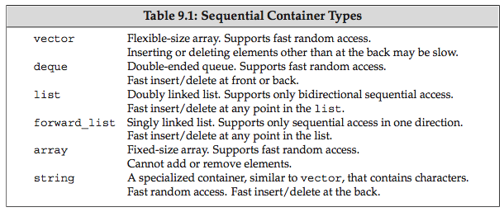
Sequential Containers
All are dynamic expandable except array.

Slide 5
std::array
A “replacement” for built-in arrays
a template wrapper that holds a static array
data stored locally (not on heap)
Provides STL-like features:
begin(), end(), size(), empty(), at(), front(), back()
and of course operator[] (not range-checked)

Slide 6
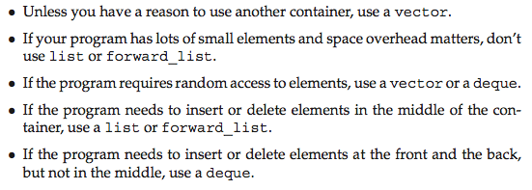
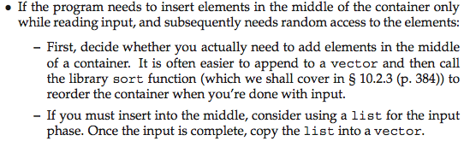
Guidelines for Expandable Containers

Slide 7
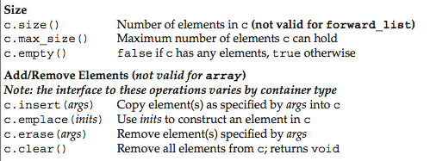
Common Container Operations

Slide 8
emplace_back vs. push_back
push_back requires a previously constructed object to copy (or move) into the container
emplace_back builds the object in place
from arguments you provide
no temporary object is created

Slide 9
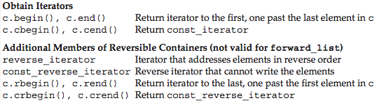
Obtaining Iterators
Notes:
Illustrate reverse iteration.

Slide 10

Assigning from a Different Container Type

Slide 11
Specialized containers

Slide 12
Specialized Containers
“Higher-level” Containers
they privately use sequential containers for storage
Have a restricted set of operations
stack
queue
priority_queue
Notes:
Look at their specs on cppreference.cpp

Slide 13

std::stack
Defined in <stack>
Uses a deque for storage by default
Can change: stack<int, vector<int>> stk;

Slide 14
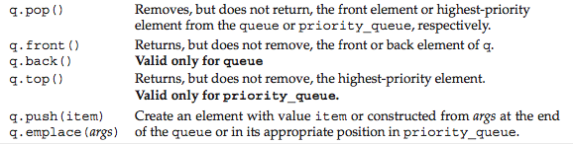
std::queue and std::priority_queue
Defined in <queue>
queue uses a deque by default
priority_queue uses a vector by default
can’t use a list
Notes:
Heaps(priority_queue’s) need contiguous storage.

Slide 15
Associative containers

Slide 16
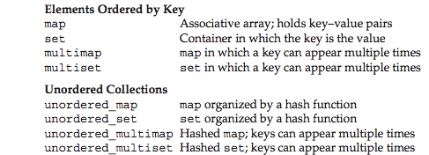
Associative Containers
The ordered containers used tree-based storage
O(log n) retrieval complexity
The unordered containers are hash tables
O(1) retrieval complexity

Slide 17
Ordered Set Example
#include <iostream>
#include <set>
#include <string>
using namespace std;
int main()
{
// Populate a set:
set<string> s;
s.insert("Alabama");
s.insert("Georgia");
s.insert("Tennessee");
s.insert("Tennessee");

Slide 18
// Print it out:
auto p = s.begin();
while (p != s.end())
cout << *p++ << endl;
cout << endl;
// Do some searches:
string key = "Alabama";
p = s.find(key);
cout << (p != s.end() ? "found " : "didn't find ")
<< key << endl;
key = "Michigan";
p = s.find(key);
cout << (p != s.end() ? "found " : "didn't find ")
<< key << endl;
}

Slide 19
// Output:
Alabama
Georgia
Tennessee
found Alabama
didn't find Michigan

Slide 20
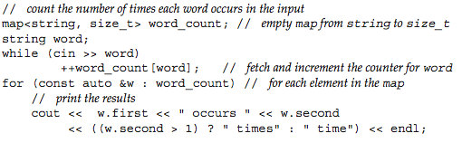

Word Count Program

Slide 21
std::pair In <utility>
Holds a pair of any two types:
pair<int,string> p1(10,”ten”);
auto p1 = make_pair(10,string(“ten”));
Used to hold the key and value in a map
Retrieve values with first and second
struct data members
See pair.cpp

Slide 22
std::tuple An extension of std::pair
Holds an arbitrary number of items
Handy for returning multiple items from a function
Can retrieve by position
with template args (get<1>(tup), etc.)
Can do item-wise assignment
See tuple.cpp
Notes:
tuple assignment with tie. get<pos>. make_tuple in <utility>. tuple_size, tuple_element. pair is a special case. all relational ops supported.

Slide 23
Another Map Example
#include <iostream>
#include <map>
#include <string>
using namespace std;
int main()
{
// Insert some elements (three ways):
map<string, string, greater<string>> m;
m.insert(make_pair("Alabama","Montgomery"));
m.insert({"Tennessee","Knoxville"});
m["Georgia"] = "Atlanta";
m["Tennessee"] = "Nashville"; // Overwrites
Notes:
insert doesn’t overwrite.

Slide 24
// Print the map:
for (const auto& elem: m)
cout << '{' << elem.first << ','
<< elem.second << "}\n";
cout << endl;
Notes:
Note the reference.

Slide 25
// Retrieve via a key:
cout << '"' << m["Georgia"] << '"' << endl;
cout << m.size() << endl;
cout << '"' << m["Texas"] << '"' << endl;
cout << m.size() << endl;
}
// Output:
{Tennessee,Nashville}
{Georgia,Atlanta}
{Alabama,Montgomery}
"Atlanta"
3
""
4

Slide 26
An Alternate map Constructor
Allows passing a comparator object
You must still specify the type in the 3rd template argument
map<string, string, greater<string>> m;
auto comp = [](string x, string y){return x>y;};
map<string, string, decltype(comp)> m(comp);

Slide 27
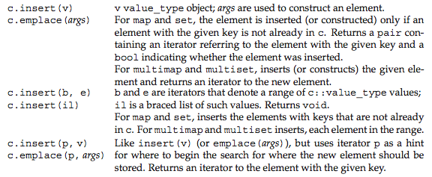
Insert Operations
insert vs. [ ] — insert ignores duplicates; [ ] overwrites

Slide 28
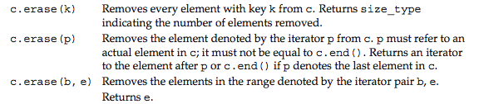
Erase Operations

Slide 29
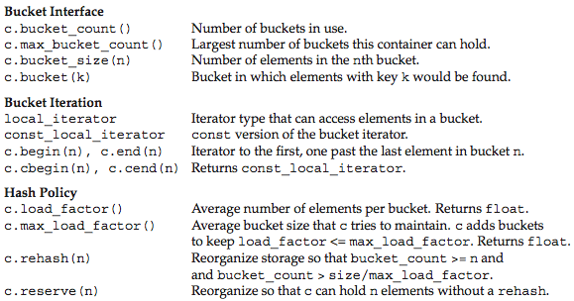
Unordered Container Operations

Slide 30
Comparators and ordering

Slide 31
Strict Partial Orderings A Model of “Less-than”
priority_queue and ordered associative containers (set, map, multi_set, multi_map) require strict partial ordering comparators
AKA “strict weak order” (http://en.wikipedia.org/wiki/Weak_ordering)
behaves like less< >( ) ( (which calls operator<( ))
never use <= or anything like it (no '=')!!!
No equality comparison used by these containers! (see next slide)
Definition: f(x,y) is a SPO if:
f(x,x) = false (irreflexive)
f(x,y) = !f(y,x) (anti-symmetric)
f(x,y) && f(y,z) => f(x,z) (transitive)
Notes:
Just think “less-than” to understand SWOs. It allows ordering and searching with one operation (no need for an equal-to operator).

Slide 32
map and set use SPOs!
Necessary to maintain proper order in the underlying tree data structure
They test for equivalence, not equality, to maintain uniqueness
x and y are equivalent iff !cmp(x,y) && !cmp(y,x)
i.e., neither precedes the other
Example:
swo.cpp
(ignores non-alpha characters in strings)
Notes:
In swo.cpp, change the < to <= in line 20 and compare the result! The test for equivalence fails!

Slide 33
Another Example
Creates a last/first key type
Defines a strict-partial bool operator( )
See records.cpp
Note: ALL containers require a default constructor for their containees!
Use =default if applicable

Slide 34
Regular Expressions
A “mini-language” describing search patterns for strings
See http://en.wikipedia.org/wiki/Regular_expression
regex_search: searches for a substring matching a pattern
regex_match: checks if the entire string matches a pattern
regex iterator: iterates through all matching substrings in a string
regex_replace: replaces matches with a string
See regex.cpp and regex2.cpp

Slide 35
regex_match
Determines if entire sequence (string or cstring) matches an expression, returns a bool
Given string s = “<tag>Hello</tag>”
and std::regex rgx(“.+H.l+.”)
note: ‘.’ Matches any character and ‘+’ says 1 or more of the previous character
std::regex_match(s,rgx) will return true
can pass a std::cmatch(for char*) or std::smatch(for string) by reference to return value of the first found capture
std::cmatch match;
If(std::regex_match(s.c_str(),match,rgx) )
cout<<match.str(); //prints: <tag> Hello</tag>

Slide 36
regex_search
Determines if a subsequence can be found (string or cstring) to match an expression, returns a bool for success
Given string s = “123SuperUser!”
and std::regex rgx(“[1-9]+([A-Za-z]+)”)
note: ‘[]’ indicates a set of characters to be acceptable, ‘()’ indicates a capture group that can be accesed if found.
std::smatch match;
std::regex_match(s,match,rgx) will return true and populate match
std::cmatch match;
If(std::regex_match(s.c_str(),match,rgx) ){
cout<<match.str(); //prints: 123SuperUser note: no ‘!’
cout<<match[0].str(); //prints: same as above
cout<<match[1].str(); //prints: SuperUser note: the first specified capture group in ‘()’
}

Slide 37
regex_replace
Takes an input string, regex, and replacement string for subsequences that match the pattern and returns a modified string
Handy for fromatting
Given string s = “ data \t\n ”
and std::regex rgx(“^\\s+(\\S+)\\s+$”)
note: ‘^’ is an anchor meaning must be the start and ‘$’ means must be the end. \s is all whitespace and \S is all non-white space
std::regex_replace(s,match,”whatever”) will return the string: “whatever,” replacing the entire string
Though typically you would only want to match on smaller subsequences, here we will use a capture group placeholder:
std::regex_replace(s,match,”$1”) will return “data”, replacing the entire string for group 1
This is essentially ‘trim’, a typical function eliminating leading and trailing white space.

Slide 38
regex_iterator
This is an bidirectional iterator object that traverses over a collection of characters and iterates on matches to a regular expression
Auto it = sregex_iterator(myString.begin(),myString.end(), std::regex(“//w+”))
It will be an iterator to the first match of ‘\w’, or a collection of sequential letters, numbers, and ‘_’ s.
See regex.cpp and regex2.cpp

Slide 39
Class Inheritance

Slide 40
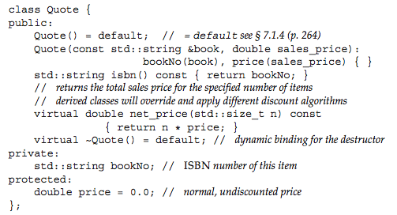

Defining A Base Class

Slide 41
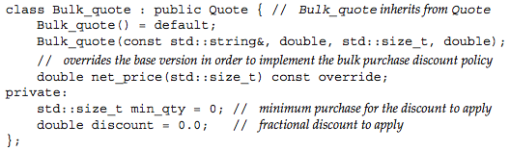
Defining A Derived Class

Slide 42
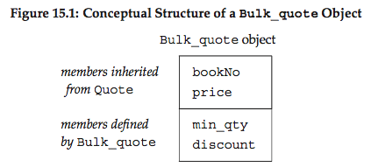

Derived Objects

Slide 43
struct A {
A() {cout << "A::A()\n";}
~A() {cout << "A::~A()\n";}
};
struct B {
B() {cout << "B::B()\n";}
~B() {cout << "B::~B()\n";}
};
struct C : A {
C() {cout << "C::C()\n";}
~C() {cout << "C::~C()\n";}
B b;
};
int main() {
C c;
}
A::A()
B::B()
C::C()
C::~C()
B::~B()
A::~A()

Slide 44
// Using Initializers
struct A {
A(int i) {cout << "A::A(" << i << ")\n";}
~A() {cout << "A::~A()\n";}
};
struct B {
B(int j) {cout << "B::B(" << j << ")\n";}
~B() {cout << "B::~B()\n";}
};
struct C : A {
C(int i, int j) : A(i), b(j) {
cout << "C::C(" << i << ',' << j << ")\n";
}
~C() { cout << "C::~C()\n"; }
B b;
};
int main()
{
C c(1,2);
}

Slide 45
A::A(1)
B::B(2)
C::C(1,2)
C::~C()
B::~B()
A::~A()

Slide 46
Object Initialization The Real Story
(1) The base class constructor(s) run(s) first
in declaration order with multiple inheritance
use the initializer list to pass data
otherwise default initialization occurs
(2) Then any member objects are initialized
in declaration order
(3) Then the derived class constructor runs
Destruction is the reverse of this process

Slide 47
The Goal of OOP Subtype Polymorphism (= “Dynamic Dispatch”)
To treat all objects as base objects
via a pointer-to-base
But to have their behavior vary automatically
depending on the dynamic type of the object
etc.
Employee
Employee
SalariedEmployee
SalariedEmployee

Slide 48
Heterogeneous Collections
int main()
{
using namespace std;
Employee e("John Hourly",16.50);
e.recordTime(52.0);
SalariedEmployee e2("Jane Salaried",1125.00);
e2.recordTime(1.0);
Employee* elist[] = {&e, &e2};
int nemp = sizeof elist / sizeof elist[0];
for (int i = 0; i < nemp; ++i)
cout << elist[i]->getName() << " gets "
<< elist[i]->computePay() << endl;
}
John Hourly gets 957
Jane Salaried gets 1125

Slide 49
Function Binding Static vs. Dynamic Dispatch
Function binding dispatches (determines) the code to execute for a particular function call
Static binding occurs at compile time
Non-virtual functions are bound at compile-time
Dynamic binding occurs at run time
virtual functions are bound at runtime
must be called through a pointer or reference
determined by the dynamic type of the object pointed to

Slide 50
How Virtual Functions Work
Employee
vtbl for Employee
vptr
Employee::computePay()
name
rate
timeWorked
SalariedEmployee
vtbl for SalariedEmployee
vptr
SalariedEmployee::computePay
salaryGrade
Each class has a vtbl (pointers to its virtual functions)
Each object has a vptr (points to its class’s vtbl)

Slide 51
Advantages of Dynamic Binding
Client code can just deal with the base type (e.g., Employee*)
Behavior varies transparently according to an object’s dynamic type
Client code remains unchanged when new derived types are created!
No “ripple effect” for maintainers

Slide 52
Object Slicing Your last warning to pass objects by reference!
Suppose B derives from A
Suppose f takes an A parameter by value: void f(A a) {…}
You can send a b to f: f(b); // B “is-a “A
But you have a problem…
an A object is created locally
only the A part is copied (the B part is discarded/sliced)
The object a has the vptr for class A!
Moral: Pass lvalue objects by reference! Sheesh!

Slide 53
Another Caution
Use pointers (preferably unique_ptr) in containers instead:
vector<unique_ptr<Employee>> v;
Notes:
Unless you store pointers.

Slide 54
Derived Destructors
Recall that base class destructors are called automatically when a derived object dies:
struct B
{
~B() {std::cout << "~B\n";}
};
struct D : B // public by default
{
~D() {std::cout << "~D\n";}
};
int main()
{
D d;
}
~D
~B

Slide 55
Deleting via a Pointer-to-Base
int main()
{
B* pb = new D;
delete pb;
}
~B // Oops! Derived part not cleaned up! Why?

Slide 56
Virtual Destructors
Needed when deleting via a pointer-to-base
struct B
{
virtual ~B() {std::cout << "~B\n";}
};
int main()
{
B* pb = new D;
delete pb;
}
~D // Fixed!
~B

Slide 58

Virtual Destructors
Destructors can be declared virtual
necessary when a base class pointer refers to a derived class object
Rule: Base classes should always have a virtual destructor

Slide 59
Virtual Functions and Default Arguments
Default arguments are resolved at compile time
This means that they follow the static type of the object that calls the function
the pointer type (usually a base class type)
no polymorphism involved to determine the default value
So, to avoid confusion, you should use the same default value in derived methods as in the (top) base class
it’s best to not have default args for virtual functions
See defaultargs.cpp

Slide 60
Access Control 3 levels
private class members are only accessible in member functions of the class
protected class members are also accessible in methods of a derived, but only through derived objects
however deeply derived
See derived_access.cpp
Base classes provide two interfaces:
one for universal access (the public interface)
one for derived clients (the protected interface)
See protected.cpp

Slide 61
The Template Method Design Pattern (Providing a Protected Interface)
Allows derived classes to customize parts of an algorithm
The invariant parts stay in the base class
Derived classes override protected member functions
which are called from the algorithm skeleton in the base class

Slide 62
Template Method Sketch

Slide 63
Template Method Example The Public Interface
class IBase {
public:
virtual ~IBase() = default;
virtual void theAlgorithm() = 0;
};

Slide 64
Template Method Example The Algorithm Skeleton
class Base : public IBase {
void fixedop1() { cout << "fixedop1\n"; }
void fixedop2() { cout << "fixedop2\n"; }
public:
void theAlgorithm() override final {
fixedop1();
missingop1();
fixedop2();
missingop2();
}
protected:
virtual void missingop1() = 0;
virtual void missingop2() = 0;
};
Notes:
Only virtual functions can be marked final.

Slide 65
Template Method Example The Customization
class Derived : public Base {
void missingop1() override {
cout << "missingop1\n";
}
void missingop2() override {
cout << "missingop2\n";
}
};
int main() {
Derived d;
d.theAlgorithm();
}
/* Output:
fixedop1
missingop1
fixedop2
missingop2
*/

Slide 66
Pure Virtual Functions
Abstract classes usually have abstract methods:
A “place holder” function declaration meant to be overridden in derived classes
Don’t need an implementation in the base class (but can have in C++)
The presence of such a pure virtual function makes a class abstract
Append “= 0”(zero not ‘oh’) to the function's declaration
Example: vehicle.cpp

Slide 67
Protected Constructors
Prevents public clients from instantiating an object
(But class/derived class member functions can)
So base objects exist only as a subobject in a derived object
The class is, in effect, an abstract class
but it can be instantiated where non-public access is allowed
Notes:
With pure virtual functions, of course.

Slide 68
Abstract Class Example Reference-counted Self-destruction
As soon as no references to an object exist, it self-destructs
Put the counting and self-destruction in an abstract base class
Let's call it Counted
Then have the existing class to derive from Counted (see counted.cpp)
(Diagram on next slide)

Slide 69
Using the Counted Abstract Class
See counted2.cpp for a shared_ptr implementation.

Slide 70
Inheritance in C++ 3 Types
public
Most common
“is-a” relationship
Derived class inherits both interface and implementation
Derived objects can substitute for base objects
via a pointer or a reference
No change in access to inherited items via derived objects
protected
private

Slide 71
Non-public Inheritance “Secretly” using another class
Protected Inheritance
Private Inheritance
Base classes of such derived objects are not accessible in certain contexts

Slide 72
public Inheritance
public Base members are accessible everywhere
Derived “is-a” Base
Base members are part of the public interface of Derived
Everyone knows that Derived inherits from Base
including clients of Derived objects and below

Slide 73
protected Inheritance
Only objects of Derived and its subclasses know that Derived inherits from Base
public members of Base are downgraded to protected in Derived
Base members are part of the protected interface of Derived
Clients of Derived objects or its subclasses cannot access any Base members via those objects

Slide 74
private Inheritance aka “Implementation Inheritance”
No one knows that Derived inherits from Base
Base members are downgraded to private in Derived
Similar to composition, but without explicit forwarding
See stack-private-list.cpp

Slide 75
Managing Accessibility
A derived class using non-public inheritance can selectively “open-up” base members
With a using declaration
Place declarations in the protected or public section
Warning: Can’t give more accessibility than the original offered!
Opens up all overloaded members with that name
See publish.cpp, publish2.cpp

Slide 76

Some Things to Remember
void f(Base& x) {…} // Can pass a Derived object

Slide 77
An Important Design Heuristic
The important part of public inheritance is the is-a relationship
interface sharing is more important (and more flexible) than code sharing
because programming to an interface is the keystone of good OO design
therefore…
In general, public base classes should be abstract classes
only the leaves are concrete

Slide 78
Implicit Interfaces
A set of assumed operations
a.k.a. “Duck Typing”
If they’re there, things just work
If not, compile error
Example: STL Sequences (vector, list, deque)
Expected interface:
copy/move constructor
copy/move assignment operator
equality operator
Example: STL Container Adaptors (see queue0.cpp)
Notes:
“Container Adaptors” is a bad term. They are just high-level data structures.

Slide 79
RTTI
Runtime Type Identification
The typeid operator
Returns a type_info object
Include <typeinfo>
Not useful for much
Reveals the type name
For built-in and polymorphic types only
Example: vehicle2.cpp

Slide 80
dynamic_cast
A runtime cast
Used to “downcast” a base pointer
If the dynamic type is substitutable for (i.e., “is-a”) the requested type, a valid pointer is returned
Otherwise nullptr is returned
Rarely needed
Normally we just let polymorphism do the Right Thing
Example: vehicle3.cpp

Slide 81
Name Hiding “Gotcha”
Beware when “overriding” functions in derived classes
Only override virtual functions
Signatures must match exactly
Using the override qualifier will enforce this
Example: Hide.cpp

Slide 82
Name Lookup Rules Compiler Actions
1. Find a scope for the name
A class constitutes a scope
A derived class scope is considered “nested” in the base class’s scope
2. Perform overload resolution in that scope
Pick unambiguous “best fit”
3. Finally, check access permission
Examples: Lookup1-3.cpp

Slide 83
A Lookup Oddity?
Why does the following compile?
#include <iostream>
#include <string>
int main() {
std::string s = "hello";
std::cout << s;
// Calls std::operator<<(ostream&, const string&);
// but I didn’t import or specify it!
}

Slide 84
Argument-dependent Lookup (ADL)
When looking for a function definition to match a function call, the namespaces (scopes) of the parameters are also searched
Since s is in std, it looks in std for operator<<(ostream&, const string&)
A convenience
“Implicit import”, if you will

