Slide 1
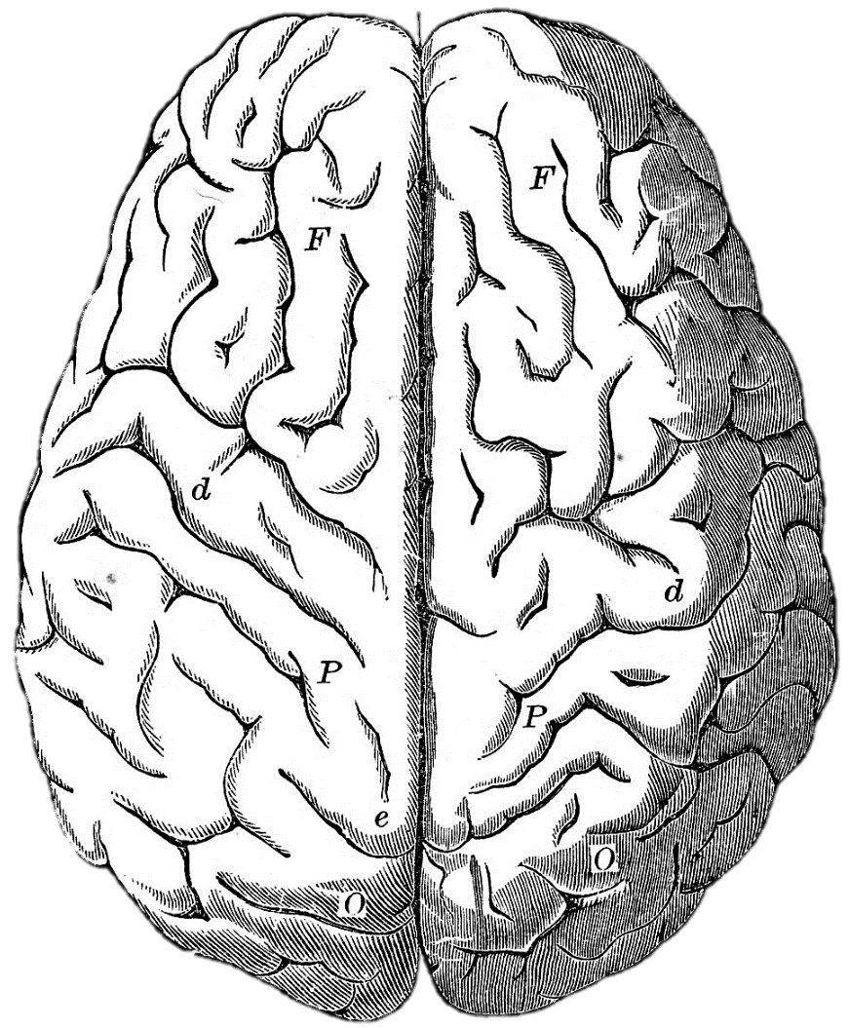
Learning Disorders, Intelligence, and Psychiatric Symptoms
Sam Vaughn
April 16, 2026

Slide 2
Goals and Objectives
Recognize when learning weakness may be driving psychiatric symptoms
Identify the common specific learning disorders and the basics of how they are diagnosed
Adjust formulation, risk assessment, and treatment planning when learning weakness is central

Slide 3

Diagnostic Dilemma
Behavior: irritability and suicidality
Psychiatric problem-
MDD, GAD, ADHD
Learning problems- LD, cognitive weakness, attachment
Treatment resistance or underlying cognitive/social factor?

Slide 4
Psychiatric Symptoms and Cognitive Weakness
Common Symptoms
Irritability/outbursts
Inattention in class
School anxiety
Demoralization/depression
Self-harm/suicidality
Substance use
Common Formal DSM-5 Diagnoses
ADHD
Mood Disorder/MDD/DMDD
PTSD/RAD
Anxiety Disorder
IED/Impulse Control disorder
Disruptive Behavior/Oppositional Defiant/Conduct
Personality traits/disorder
Comorbid? Secondary? Misattributed?

Slide 5
Diagnosing Specific Learning Disorder
Persistent difficulty in reading, written expression, and/or mathematics for at least 6 months despite intervention
Functional impact: well below age expectioations
Developmental course: began during school years
Specific domains: reading, written expression, mathematics
Rating: Mild, Moderate, Severe

Slide 6
Prevalence of Learning Disorders
5-15% of school-age children have a learning disability
80% of those with a LD have impairment in reading
20% of the population has dyslexia

Slide 7
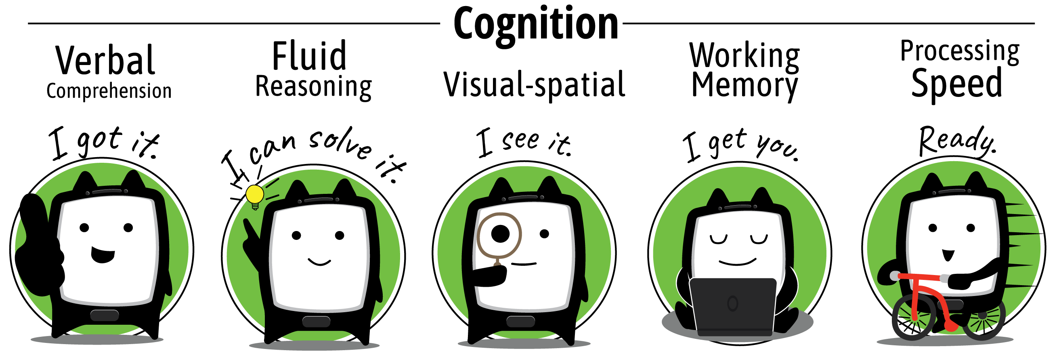
WISC-V

Slide 8
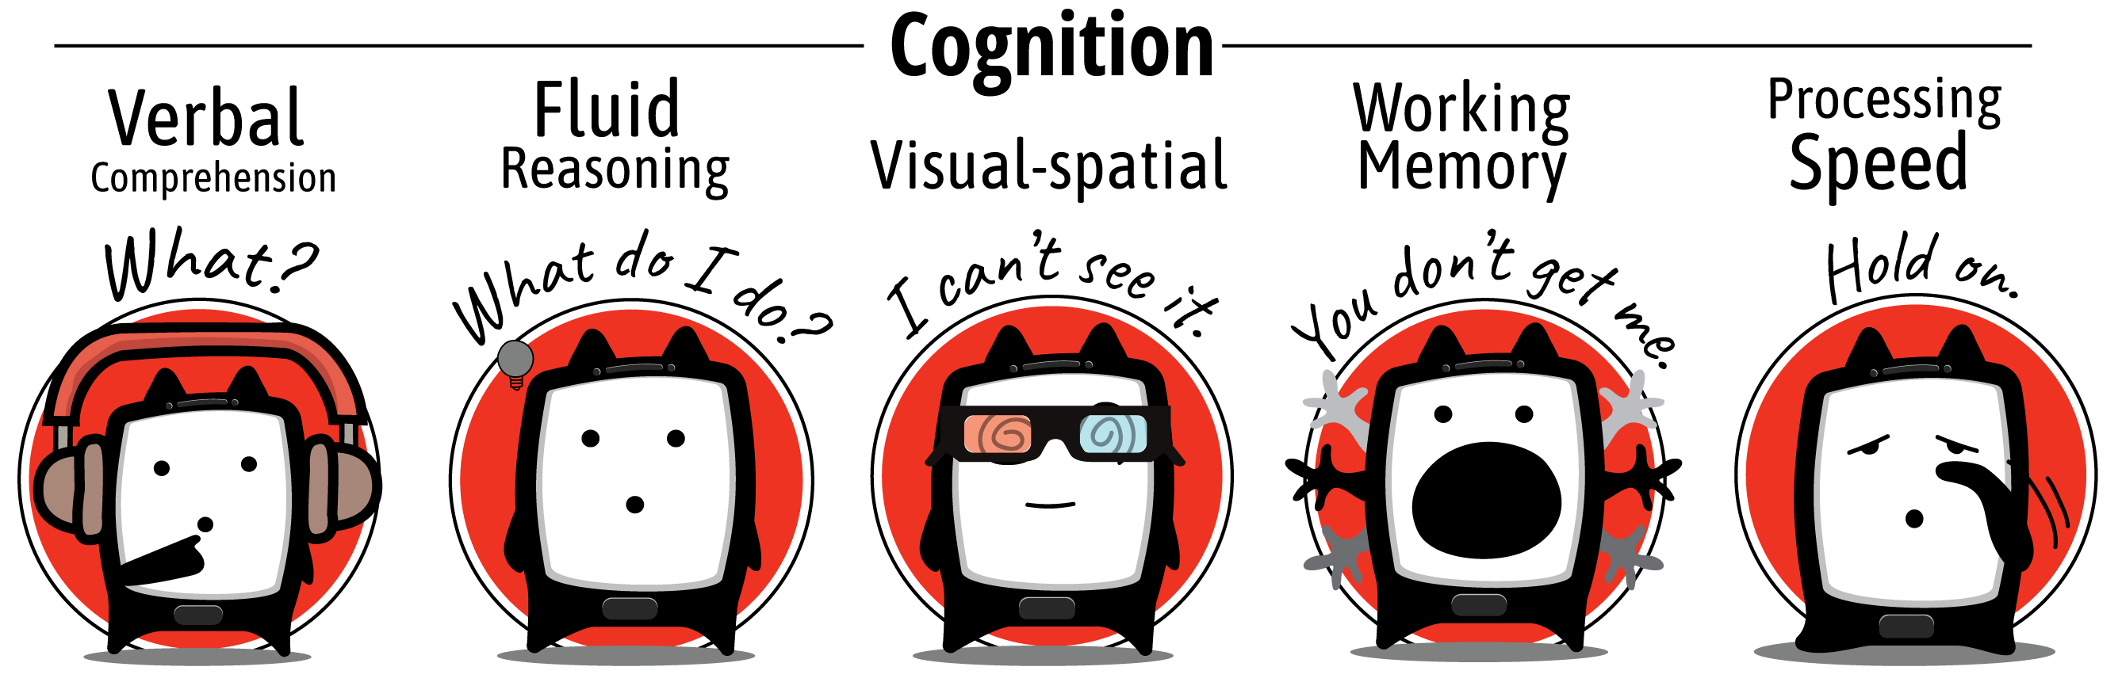
WISC-V

Slide 9
Impact of Cognitive Weaknesses
Can impact all aspects of life: school home, work
Repeated failure → shame → avoidance/irritability → continued escalation of behaviors
Chronic mismatch → exhaustion and hopelessness
Now a minor trigger leads to a disproportionate crisis

Slide 10
Examples
13 yo with falling grades, nightly homework battles, escalating school refusal, then suicidal statements after losing phone privileges.

Slide 11
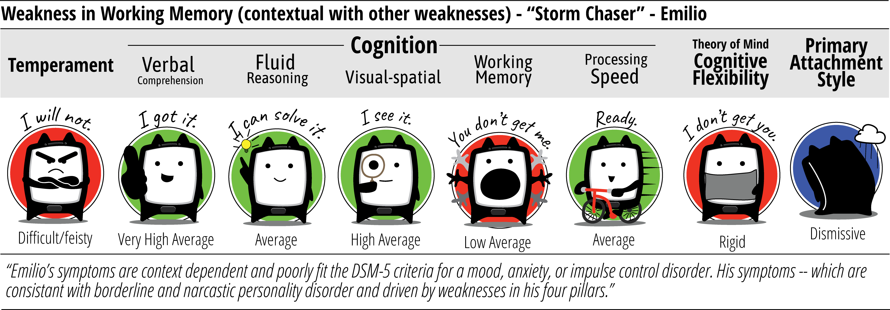
Emilio

Slide 12
Putting it into action
Ask about specific tasks: classroom/subjects/work
Review testing if able
Treat comorbid disorders as appropriate
Advocate for appropriate testing/interventions

