Slide 1
Admin Guide of Integrated File Transmission System
2011. 11.
IT System team

Slide 2
Contents
1 . Login to admintool
Login to admintool of Integrated File Transmission
2. Management of Admin Account
Change password of admin account
Register admin account
Delete admin account
Management of System
Register internal IP
Register information of storages
Management of Webhard Shared Folder
Search information of Webhard shared Folder
Add / Delete new user to Webhard shared Folder
Change approver of Webhard 2nd Approval for File checkout
Extend usable period of webhard shared Folder
Re-send email and Retry to error task
Set the max attachment size of Mass mail
5 . Logs
Logs of Webhard Shared Folder
Detail Logs of approval of Webhard Shared Folder

Slide 3
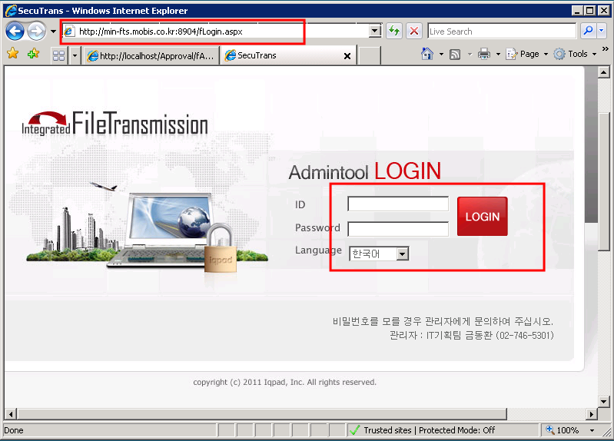
1. Login to Admintool
1) Login to admintool of Integrated File Transmission
1
Connect to admintool URL, Using Admin Account, Login to admintool . (Admin Account: admin / 1q2w3e] ※ Admintool URL by Corporations
Code | Country/City | URL
MAL | 미국-몽고메리 | mal-fts.mobis.co.kr:8904
MAL-GA | 미국-조지아 | mgl-fts.mobis.co.kr:8904
MNA | 미국-디트로이트 | mna-fts.mobis.co.kr:8904
MIN | 인도-첸나이 | min-fts.mobis.co.kr:8904
MINR | 인도-하이데라바드 | minr-fts.mobis.co.kr:8904
MPME | 두바이 | mpme-fts.mobis.co.kr:8904
MPME-EG | 이집트 | mpeg-fts.mobis.co.kr:8904
MCZ | 체코-노소비체 | mcz-fts.mobis.co.kr:8904
MSK | 슬로박-질리나 | msk-fts.mobis.co.kr:8904
MPE | 독일-오펜바흐 | mpe-fts.mobis.co.kr:8904
MRU | 러시아-상트페테르부르크 | mru-fts.mobis.co.kr:8904
JMA | 강소 | jma-fts.mobis.co.kr:8904
WMA | 무석 | wma-fts.mobis.co.kr:8904
SMA | 상해 | sma-fts.mobis.co.kr:8904
BMA | 북경 | bma-fts.mobis.co.kr:8904
BMT | 북경변속기 | bmt-fts.mobis.co.kr:8904
BMC | 북경중차 | bmc-fts.mobis.co.kr:8904
TMA | 천진 | tma-fts.mobis.co.kr:8904

Slide 4
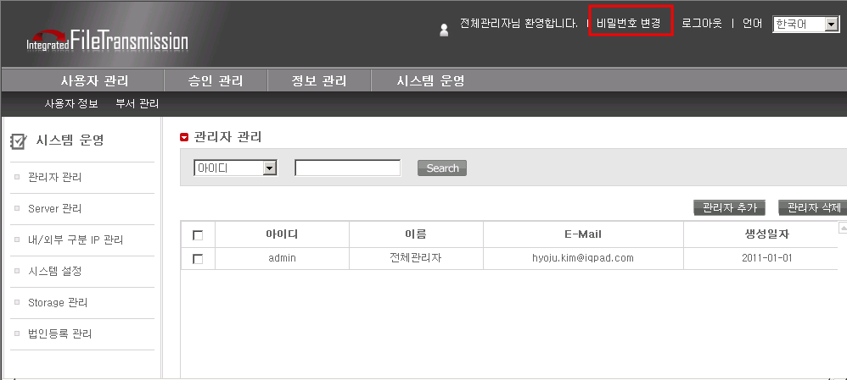
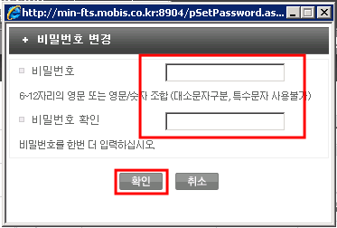
2. Management of Admin Account
1) Change password of admin account
1
After login, click the “Change password” on the top of the webpage. Can change password in the pop-up. ※ The password of admin account has been set temporary. Please change the password .

Slide 5
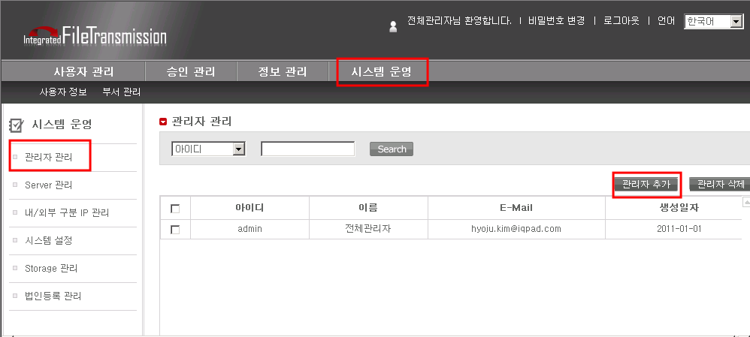
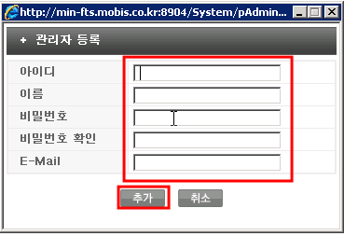
2. Management of Admin Account
2) Register admin account
1
Select the [System > Administrator Manager] menu, Click the “Add Administrator” button. Enter the information of administrator you want to add, click the “ ADD” button.

Slide 6
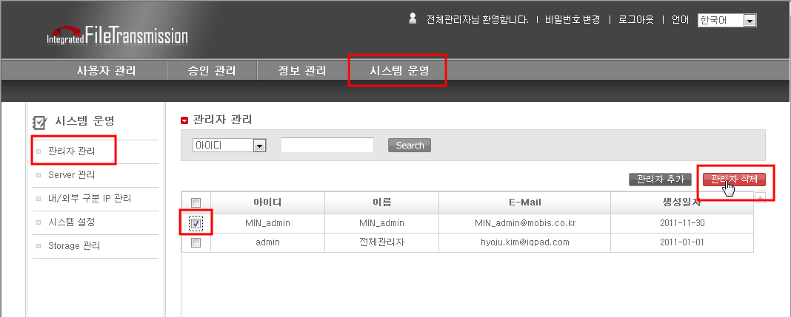
2. Management of Admin Account
3) Delete admin account
1
Select the [System > Administrator Manager] menu, Check the checkbox of administrator you want to delete. Click the “Delete administrator” button.

Slide 7
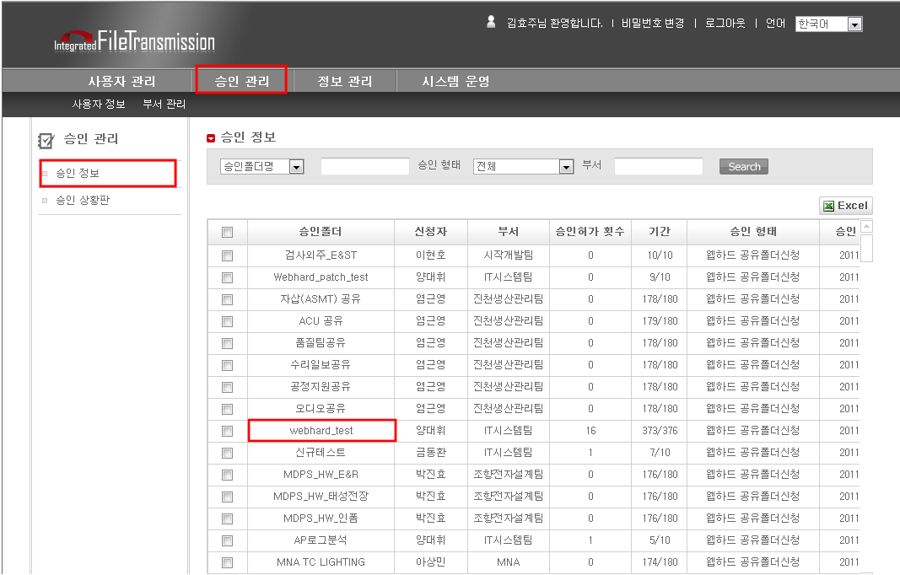
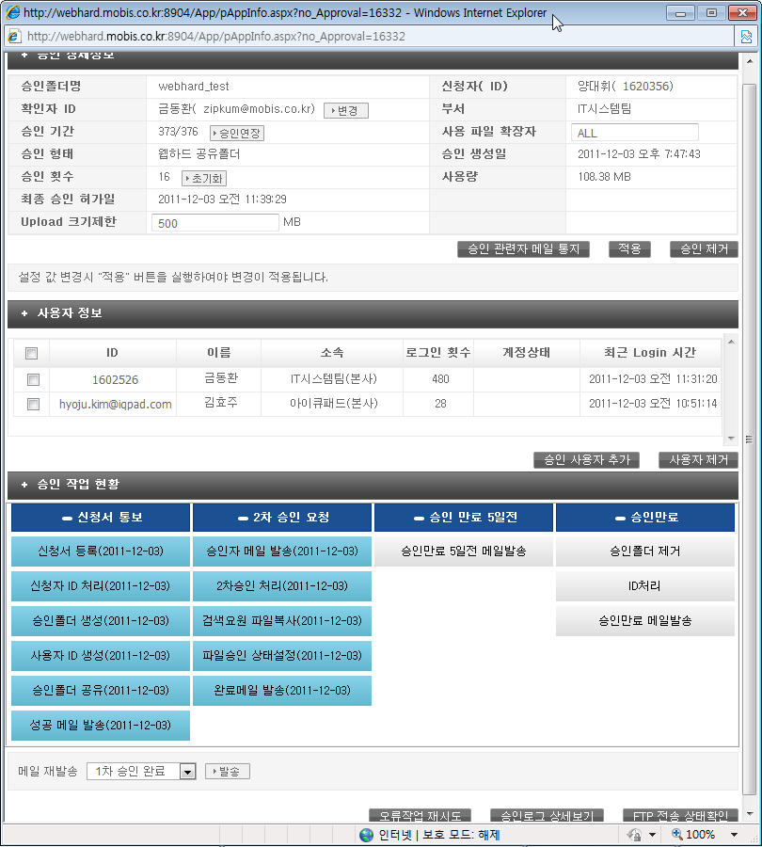
4. Management of Webhard Shared Folder
1) Search information of webhard shared folder
1
Search the webhard shared folder [Approval > Information of approval] menu. On searched list, click the name of webhard shared folder you want, and then the pop-up comes on. (Reference next page) On the pop-up, you can check status of the webhard shared folder and approval process.

Slide 8
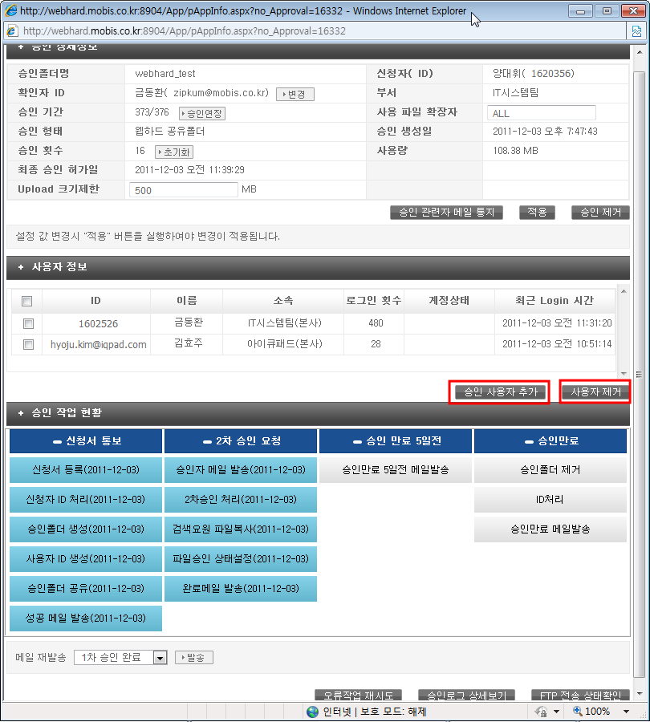
4. Management of Webhard Shared Folder
2) Add / Delete new user to Webhard shared Folder
1
If you want to add new user to webhard shared folder, click “Add User” button. And then you can add new user through searching user you want to add. If you want to delete user, check the user you want to delete and click “Delete User” button.

Slide 9
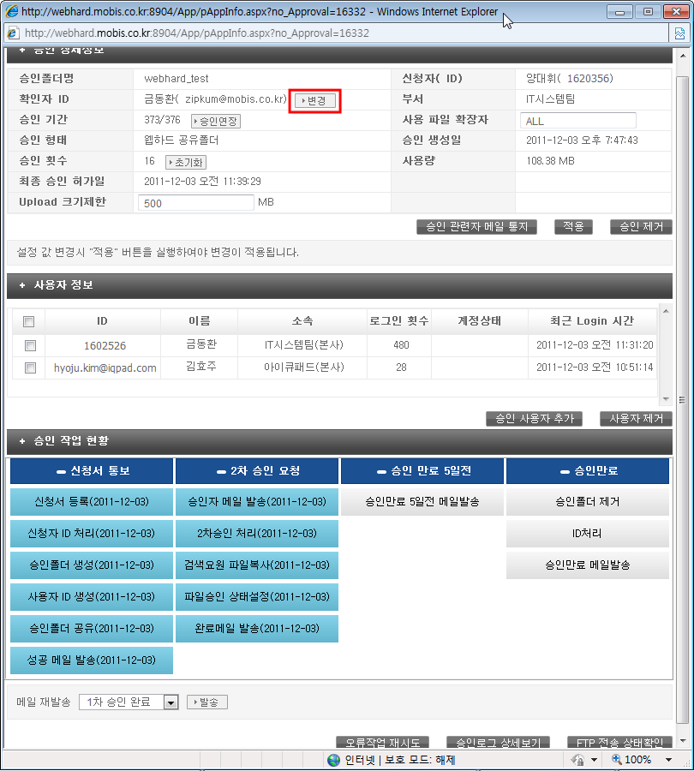
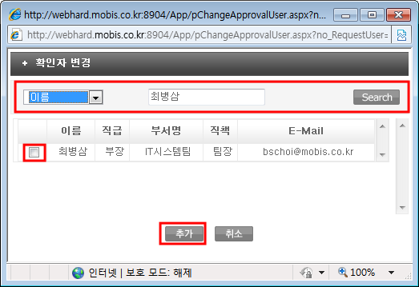
4. Management of Webhard Shared Folder
3) Change approver of Webhard 2nd Approval for File checkout
1
On the pop-up, click “change” button, The other pop-up comes on. After searching approver you want to change, Click “ADD” button, then the approver of 2nd approval for file checkout should be changed. ※ What is the 2nd Approval for file checkout? => When upload files inside company, the file status is “Approval ago”, they cannot be downloaded outside company. => If you want to download the file, the 2nd approval for file checkout. (file status : Approval ago-> Approval permit] The file that status is “Approval permit” can be downloaded outside company. => 1st approval : Request and approval to create the webhard shared folder

Slide 10

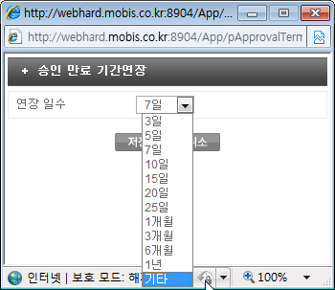
4. Management of Webhard Shared Folder
4) Extend usable period of webhard shared Folder
1
On the pop-up, click “Renew” button, The other pop-up comes on. Select the extend days you want to extend the approval period on combo box, click “Save” button. Lastly, click “Apply” button, then the approval period should be extended.

Slide 11
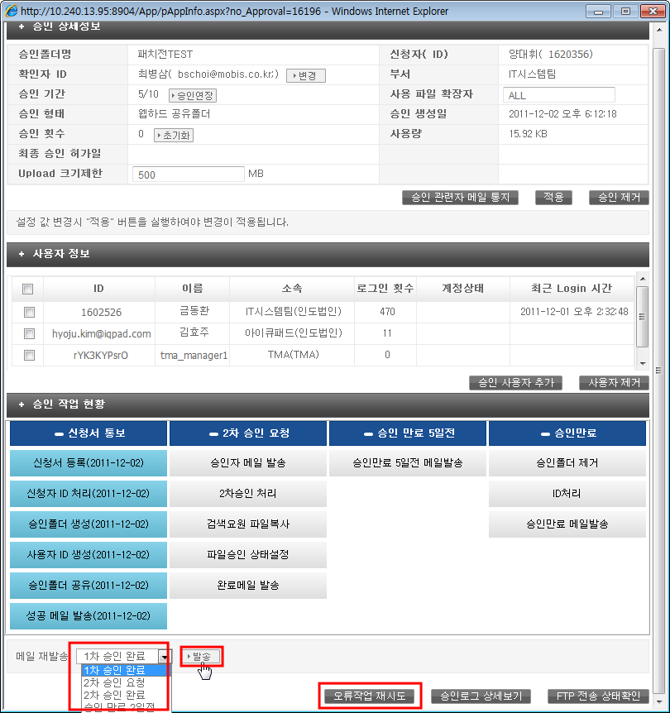
4. Management of Webhard Shared Folder
5) Re-send email and Retry to error task
1
On the bottom of the pop-up, Select the mail you want to resend, and then click “ Send” button. If sending e-mail was failed , you can resend the notice mail through resending function. (The notice mail on each approval steps can be re-sand.) An error occurred on approval process, click “Retry of Error Occurred Task” button, and then retry the process from next last success task. If an error occurred ,when Creating Webhard shared folder or 2nd approval for file checkout, first, find the cause of the error , and solve it. And then using the retry of error occurred task, start next job.

Slide 12
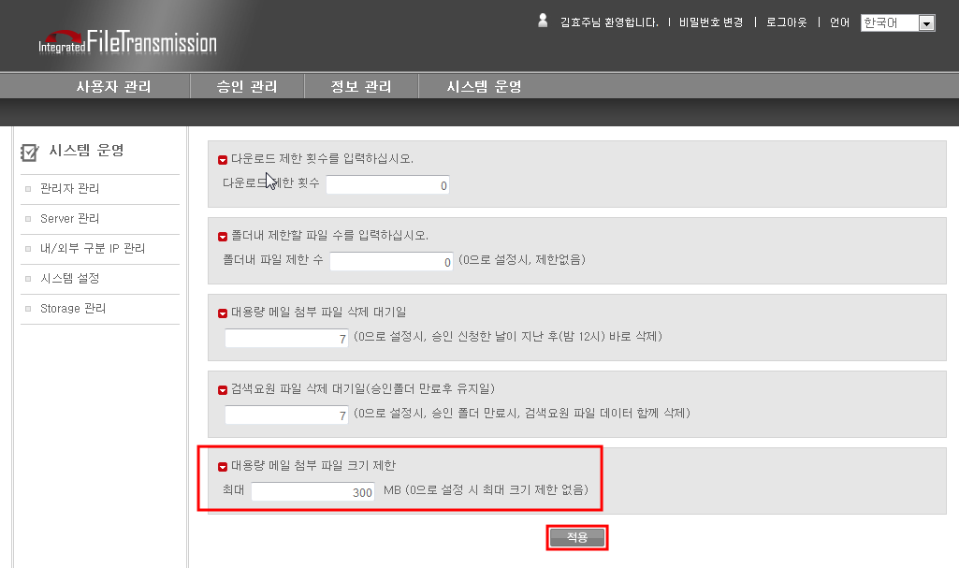
4. Management of Webhard Shared Folder
6) Set the max attachment size of Mass mail
1
On [System > System Settings] menu, Set the mass attachments allowed maximum size, and then click the “ Apply” button. (The maximum size mean by each file size of attachments]

Slide 13
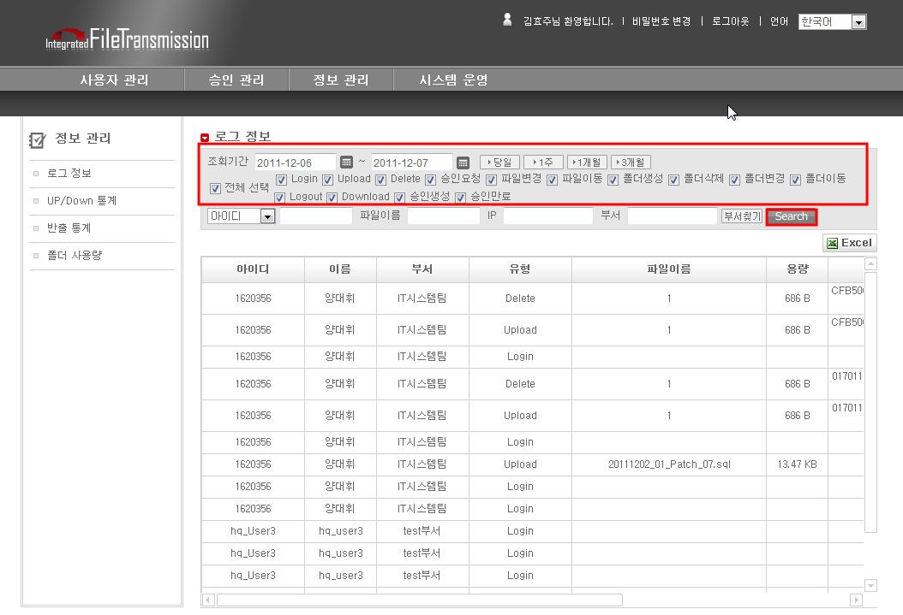
5. Logs
1) Logs of Webhard Shared Folder
1
On [Information > Logs] menu, Select the check box and set the period for searching, click “Search” button. (Searched logs can be read more through moving scroll bar.)

Slide 14
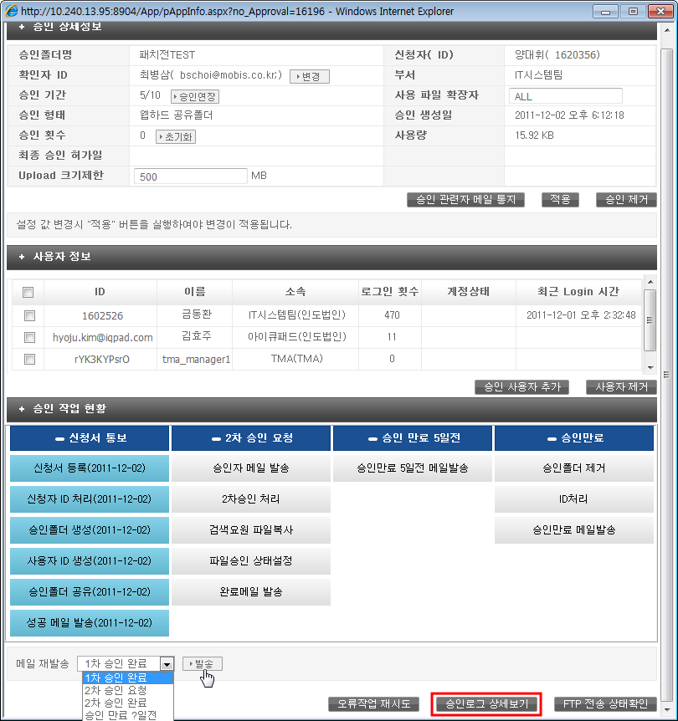
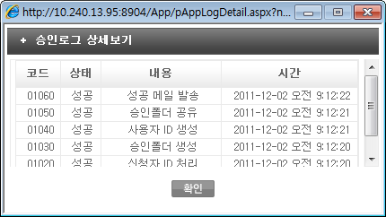
5. Logs
2) Detail Logs of approval of Webhard Shared Folder
1
On the pop-up, click “Detail view of Approval Logs” button, The other pop-up comes on. [On the pop-up , can check approval logs of the webhard shared folder.]

Slide 15
Thank you.

