Slide 1
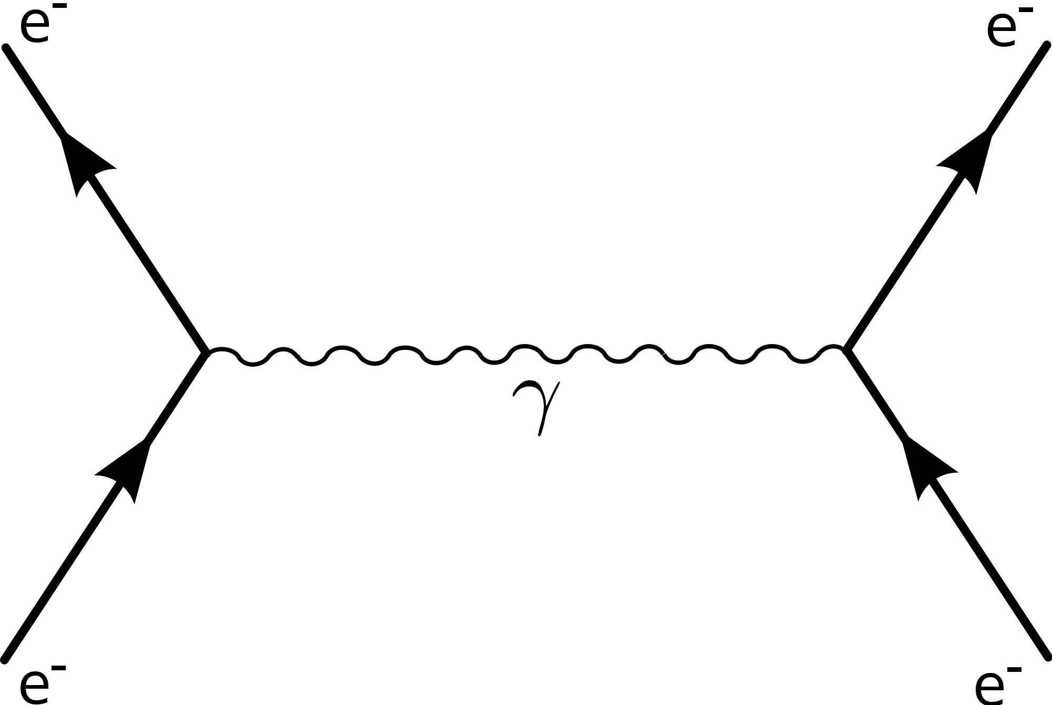
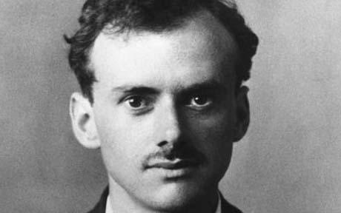

x
e⁻
p⁺
p⁺
e⁻
x
x

