Slide 1
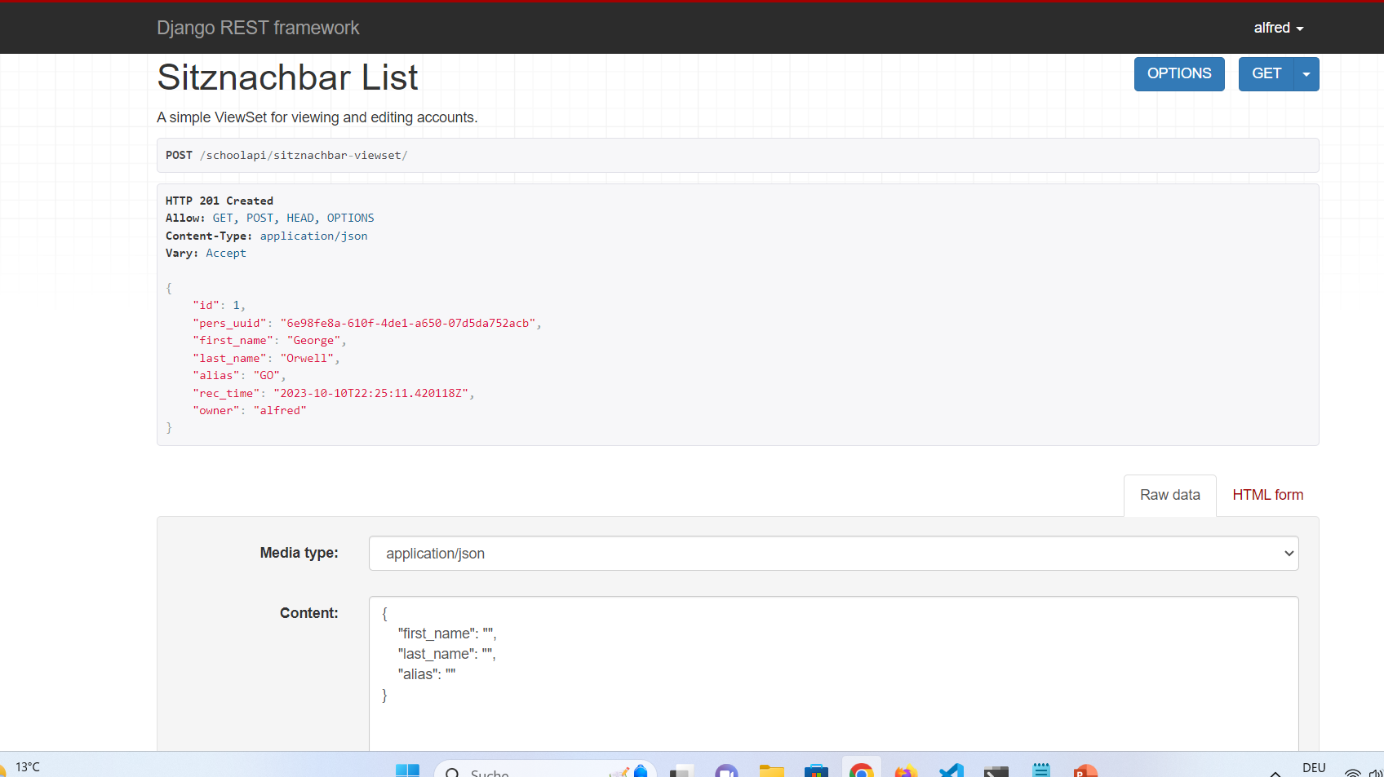
WORKS!!!
{
"first_name": "George",
"last_name": "Orwell",
"alias": "GO",
"hobbies": [{"hobby_desc":"Bike"}]
}
…beschreibe welche Datenstrukturen benötigt werden, kein 1:1 Beispiel vorgeben!

Slide 2
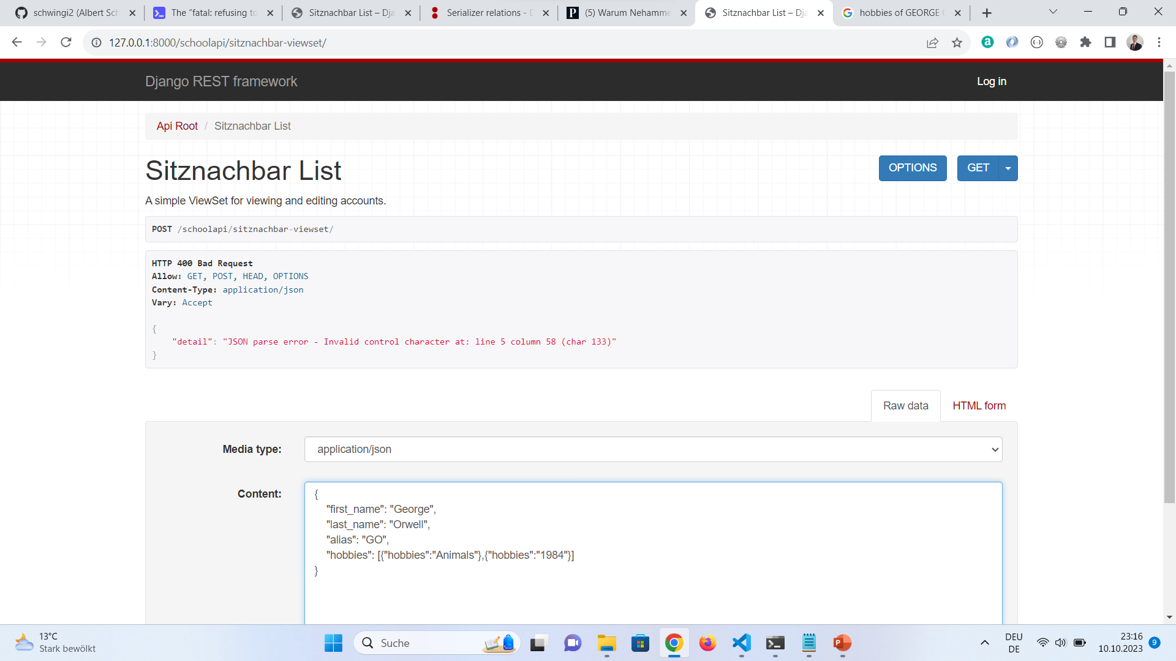

Slide 3
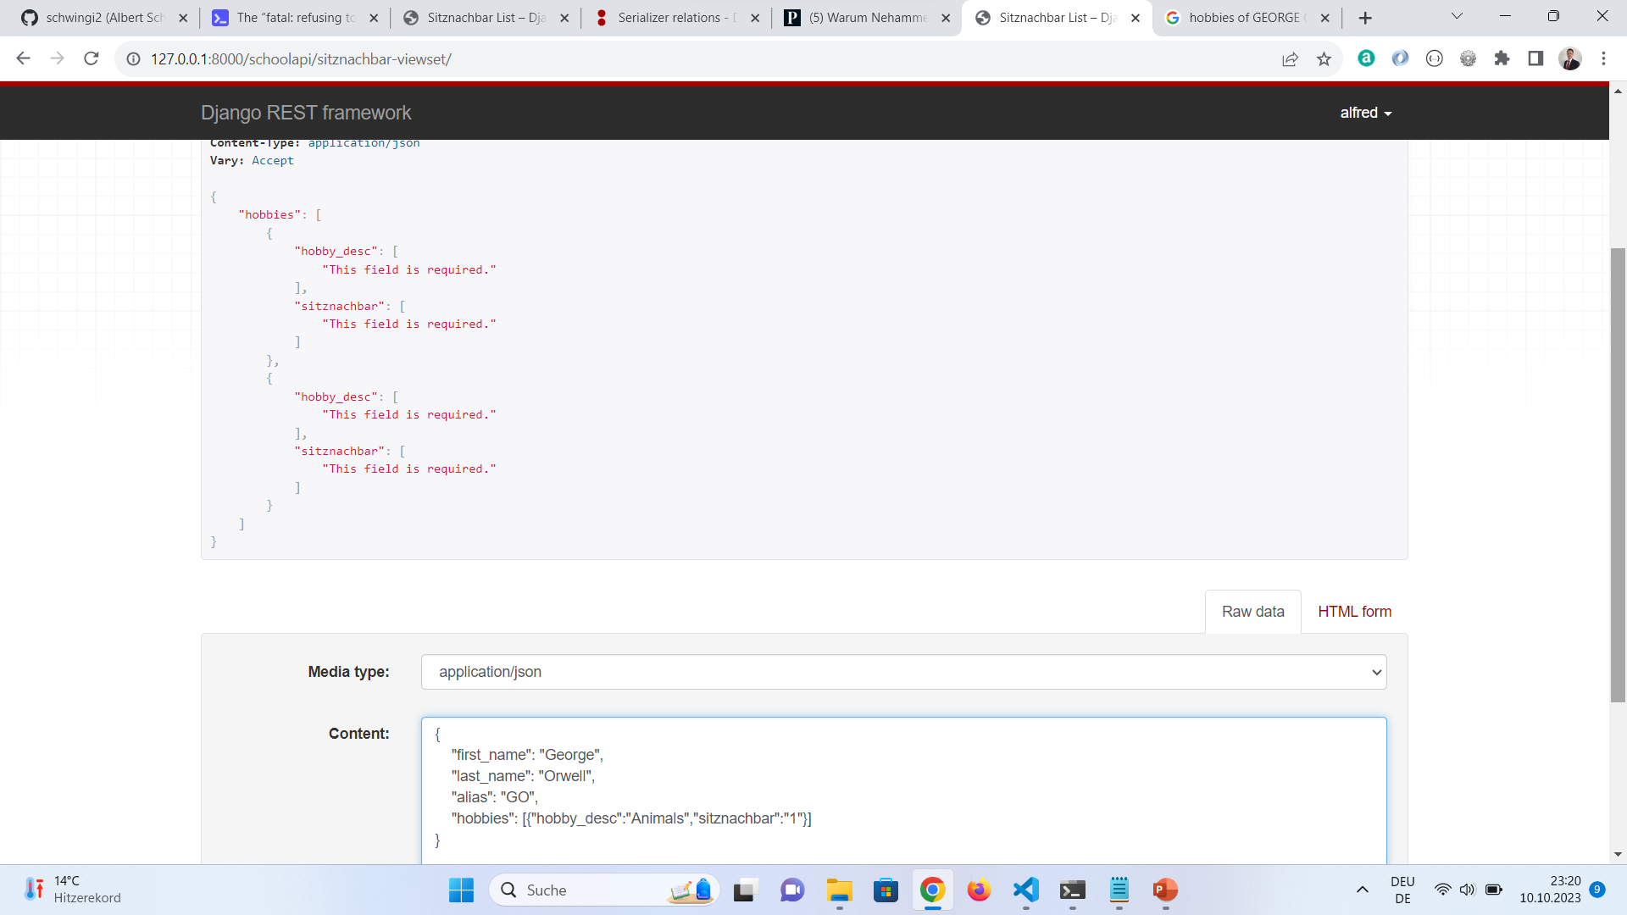

Slide 4
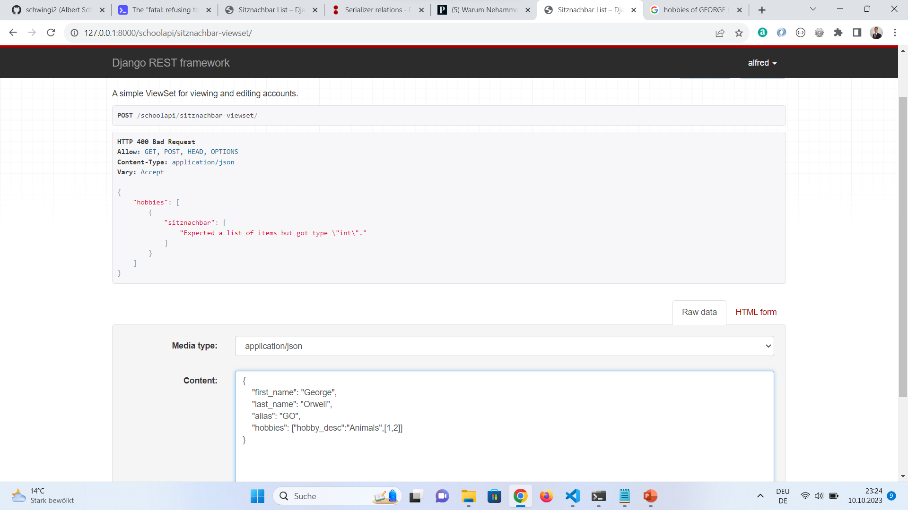
"hobby_desc":"Animals"

Slide 5
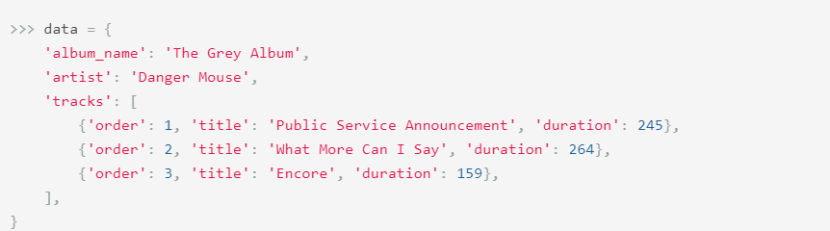
{
"first_name": "George",
"last_name": "Orwell",
"alias": "GO",
"hobbies": [
{"hobby_desc":"Bike", "sitznachbar":["1","2"]}]
}
{
"first_name": "George",
"last_name": "Orwell",
"alias": "GO",
"hobbies": [
{"hobby_desc":"Bike“},
],
}

Slide 6
{
"first_name": "George",
"last_name": "Orwell",
"alias": "GO",
"hobbies": [{"hobby_desc":"Bike"}]
}

