Slide 1
Figures for:
Chlorination paper – MD simulations
https://doi.org/10.1016/j.cej.2026.174542
https://doi.org/10.1016/j.jece.2026.122119
https://doi.org/10.1021/acsestengg.5c01068

Slide 2
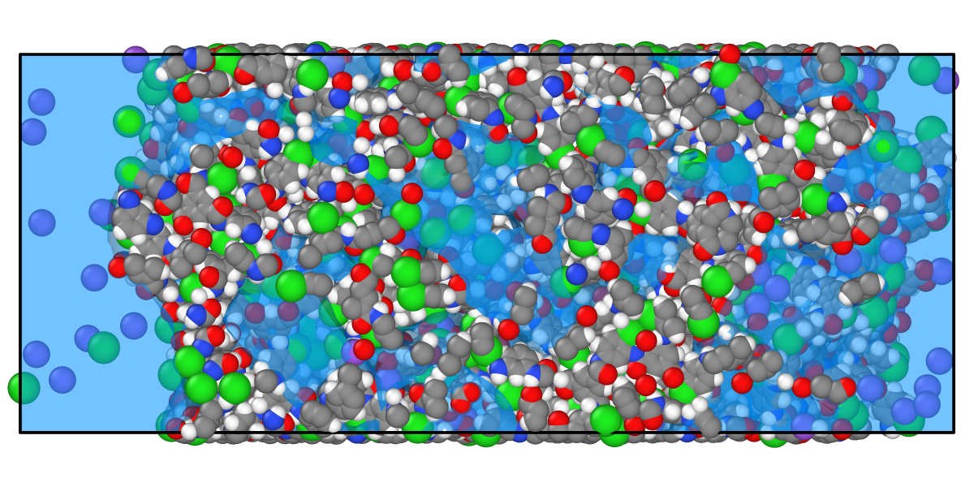
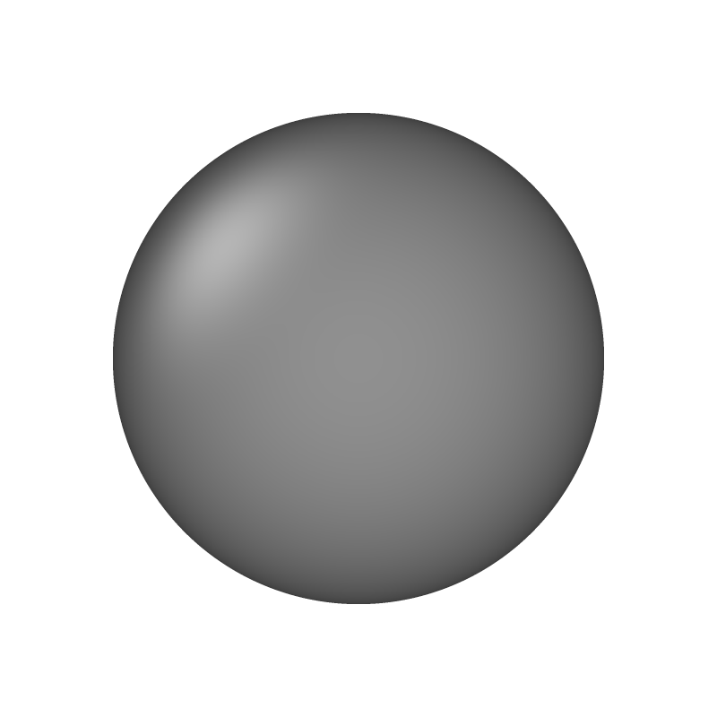
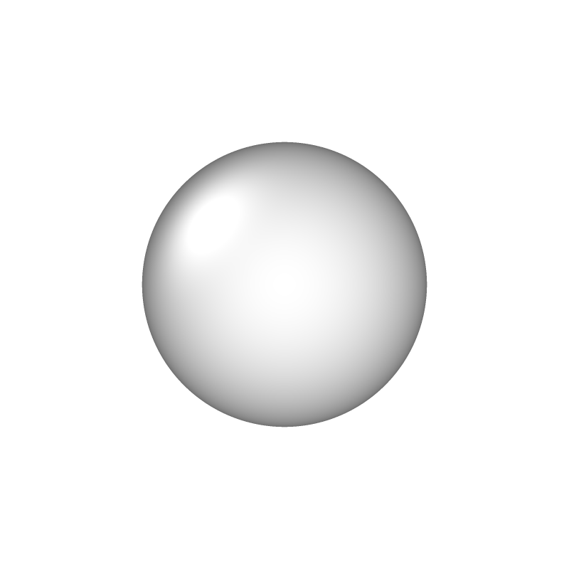
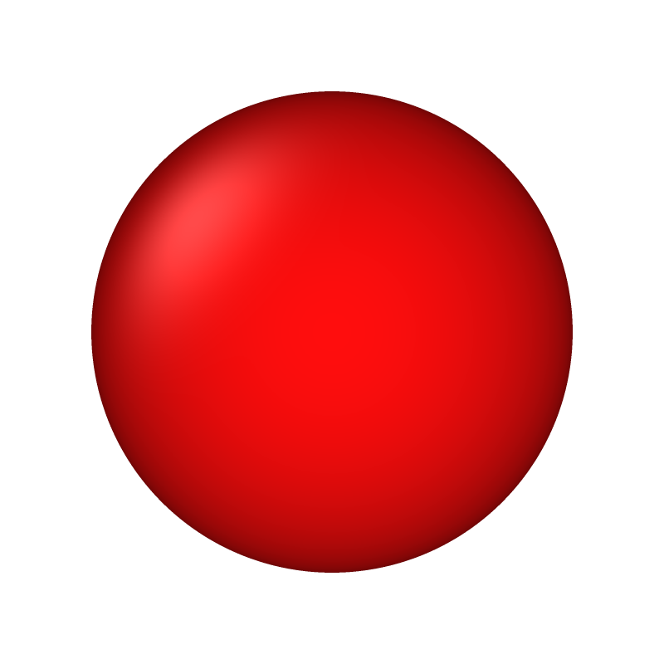
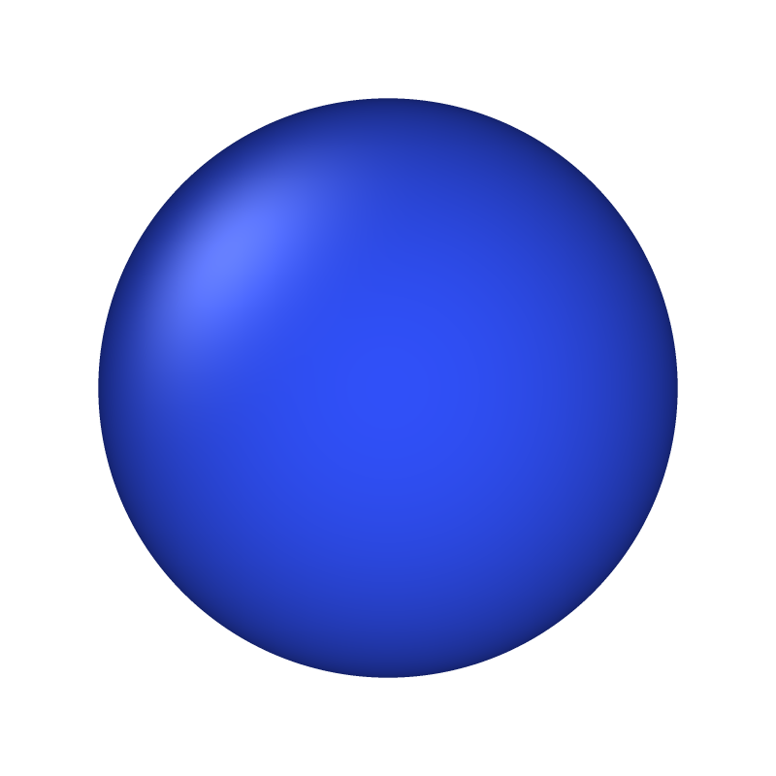
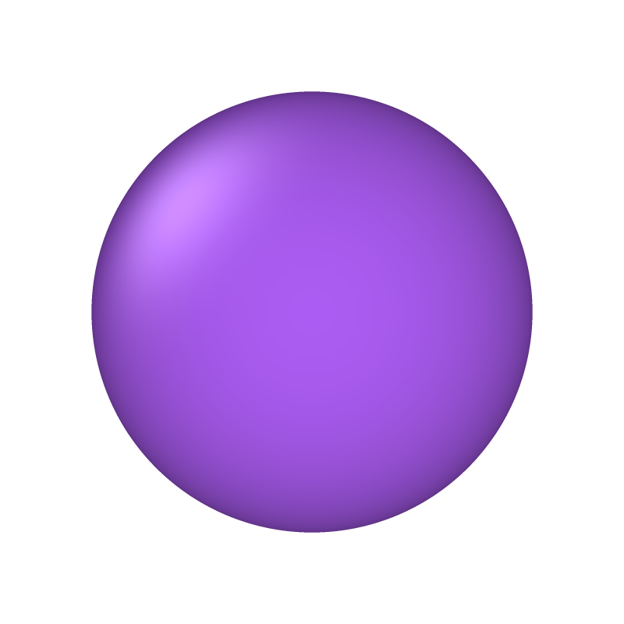
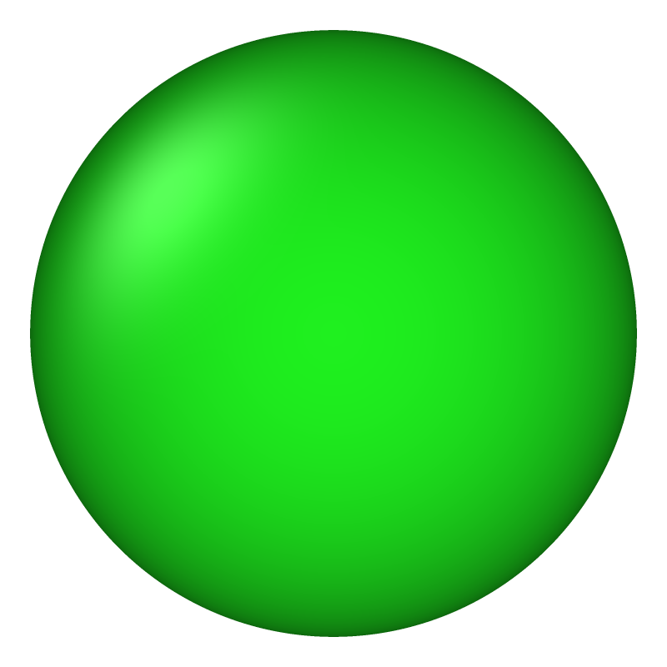
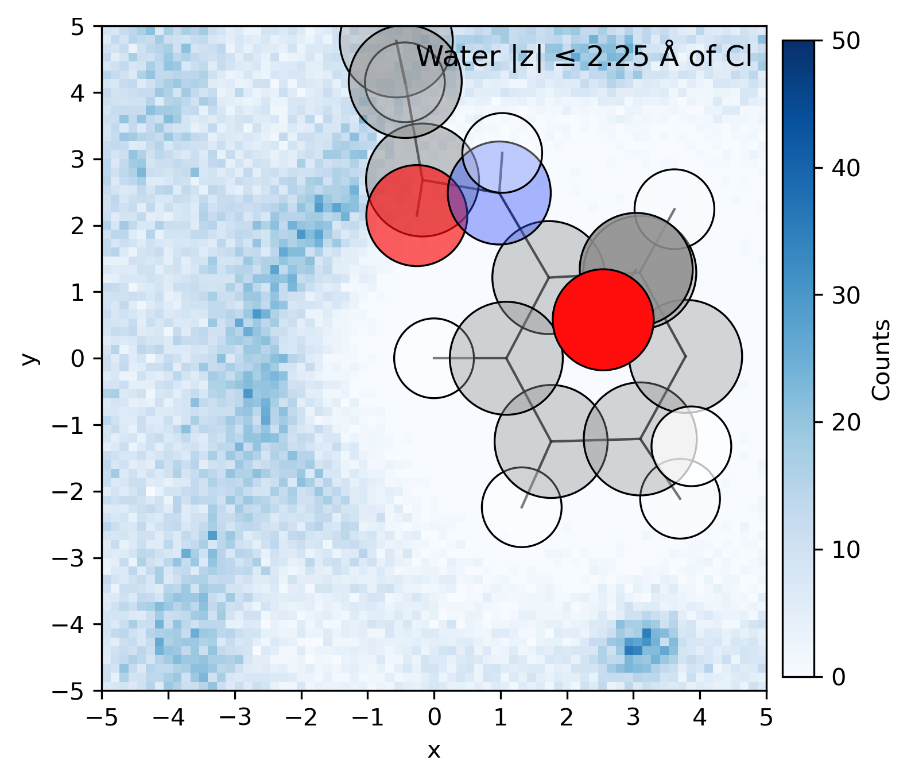
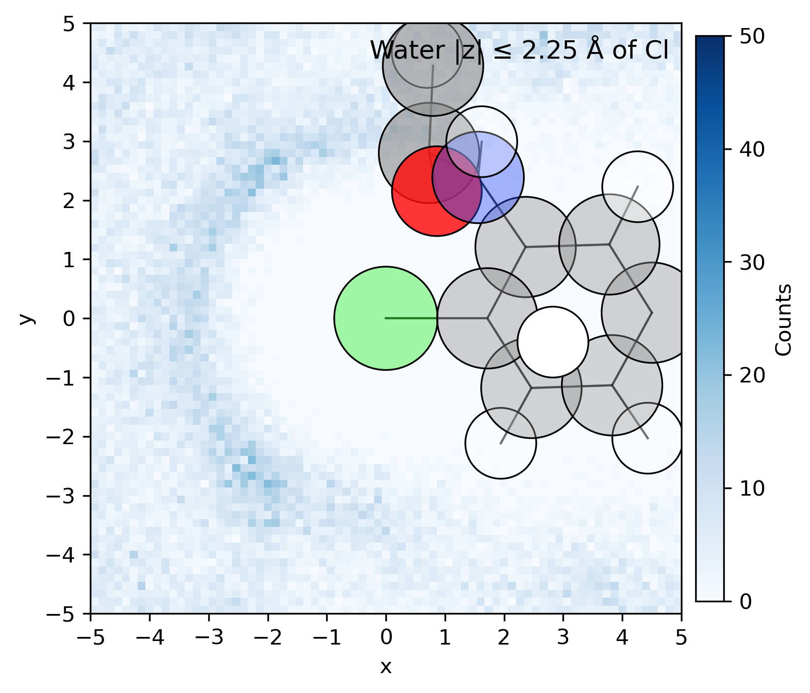
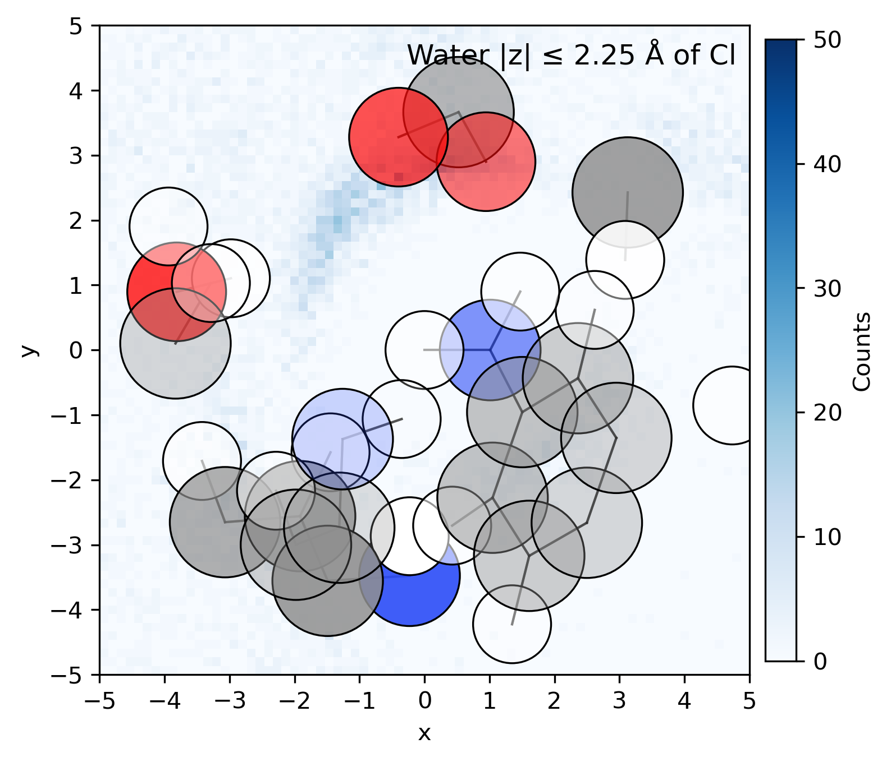
Figure 1.6 – MD simulations
A
B
carbon
hydrogen
oxygen
nitrogen
sodium
chlorine
C
D
E
F
Pristine
NaOCl
NaOCl + NaOH
label
pdf

Slide 3
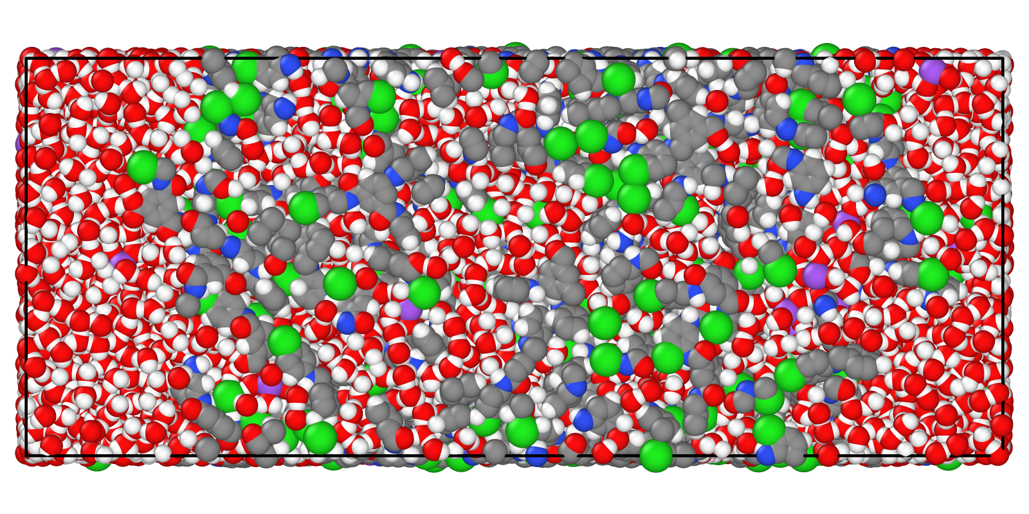
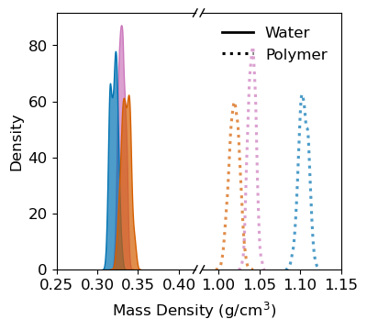
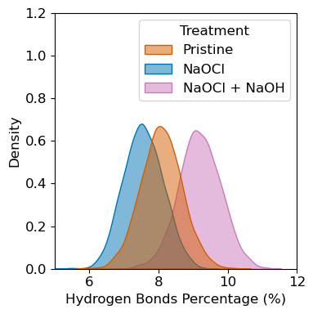
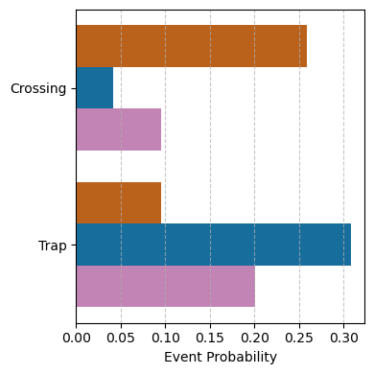
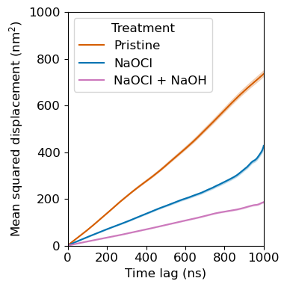
Figure 1.5 – MD simulations
A
B
carbon
hydrogen
oxygen
nitrogen
sodium
chlorine
C
D
E
Polymer-polymer hbonds
F
Pristine
NaOCl
NaOCl + NaOH
To Do:
Check what they removed in text – is there anything that should be included?
  Clarify misleading text
Transparent surface for water molecules in FigA
Water per carbon for FigB
Water MSD for FigD
  Draft couple sentences explaining
Share all H-bonds data with Sasha et al
Draft couple sentences explaining FigF
SI:
  Water diffusion as a function of percent time near polymer – larger discussion of why simulation does not match experimental trends
  Hydrogen bond definitions
SI figs:
d
label
pdf

Slide 4
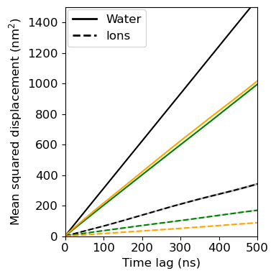
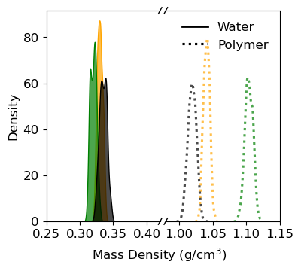
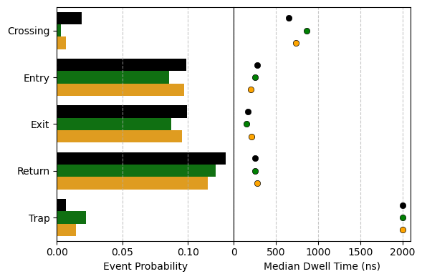
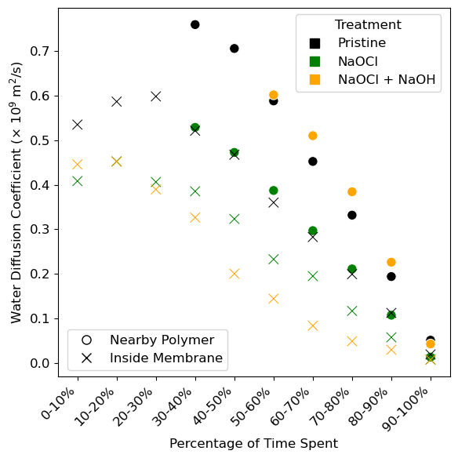
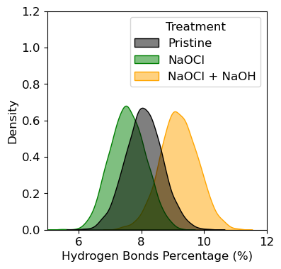
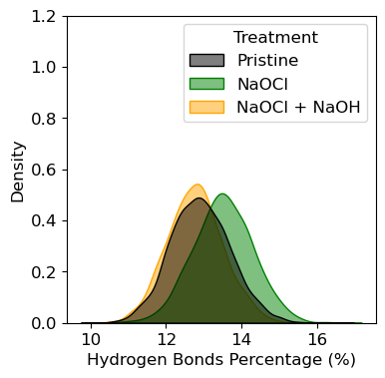
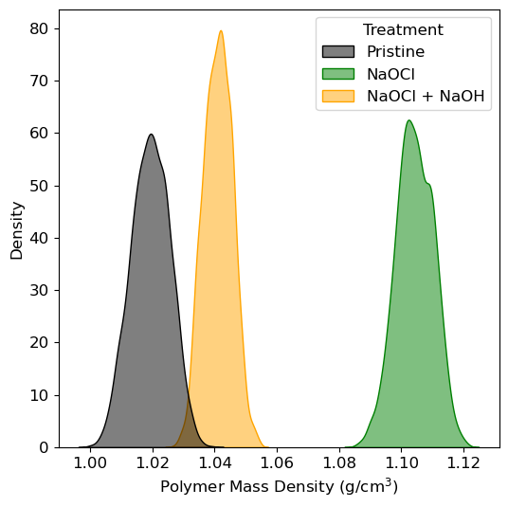
Figure 1.4 – MD simulations
A
B
carbon
hydrogen
oxygen
nitrogen
sodium
chlorine
C
D
E
F
Pristine
NaOCl
NaOCl + NaOH
SI figs:
Polymer-polymer hbonds
Polymer mass density
Polymer-water hbonds
label
pdf

Slide 5
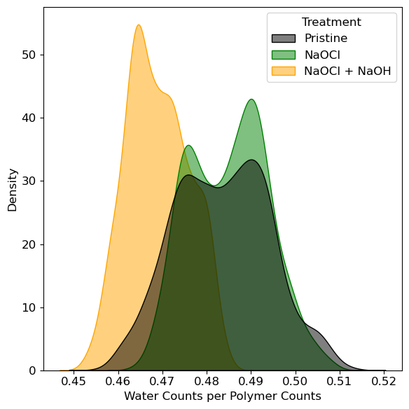
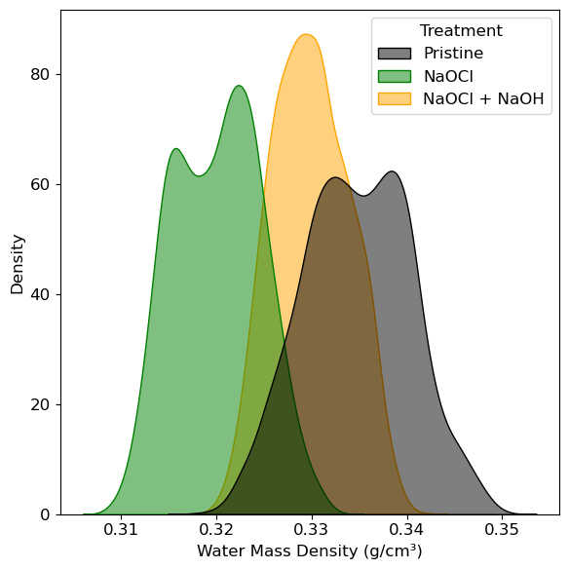
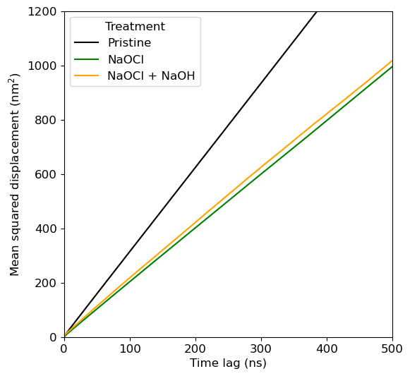
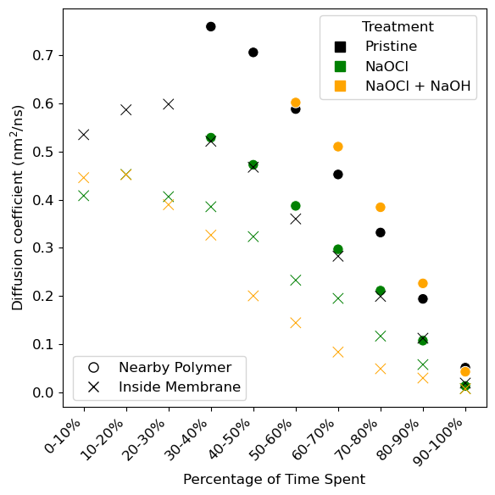
Figure 1.3 – MD simulations
A
B
Pristine
Diffusion coefficients of salts
carbon
hydrogen
oxygen
nitrogen
sodium
chlorine
NaOCl
C
D
Can we look at rubbery transitions from simulations?
NaOCl + NaOH
Transport pathways, are they blocked? How long are dwell times? Do they have to turn back?
E
F
Make a notebook for plotting to share
SI figs:
Polymer-polymer hbonds
Polymer mass density
Polymer-water hbonds
label
pdf

Slide 6
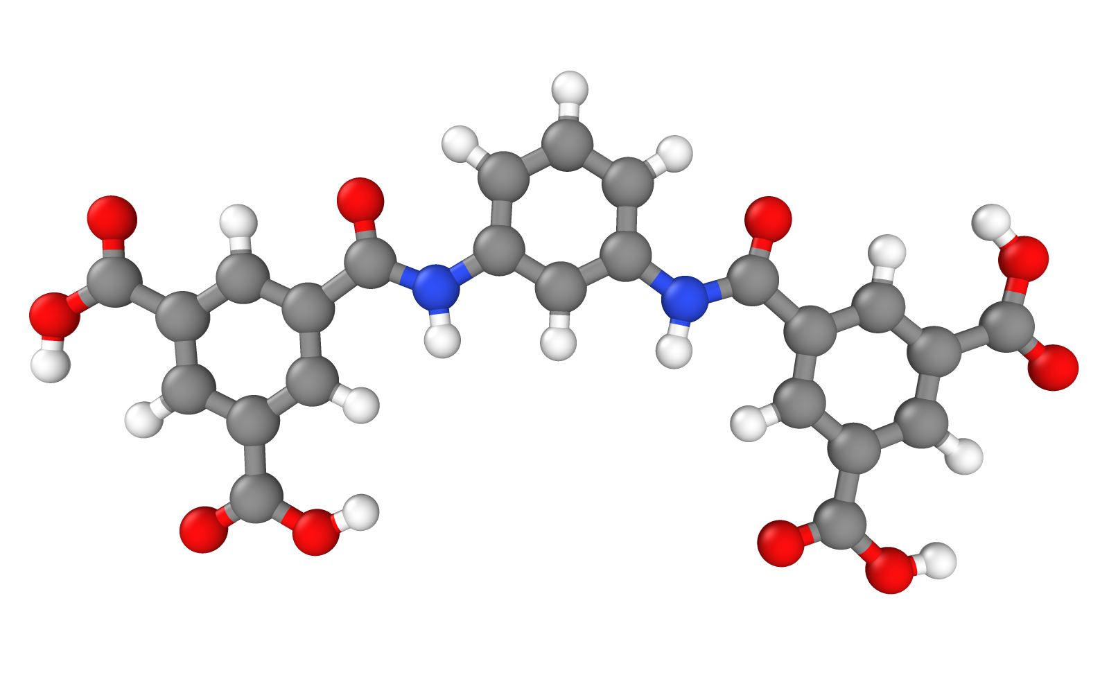
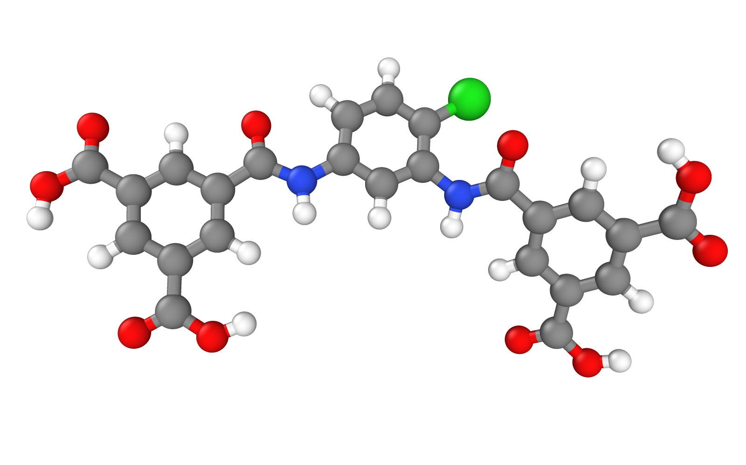
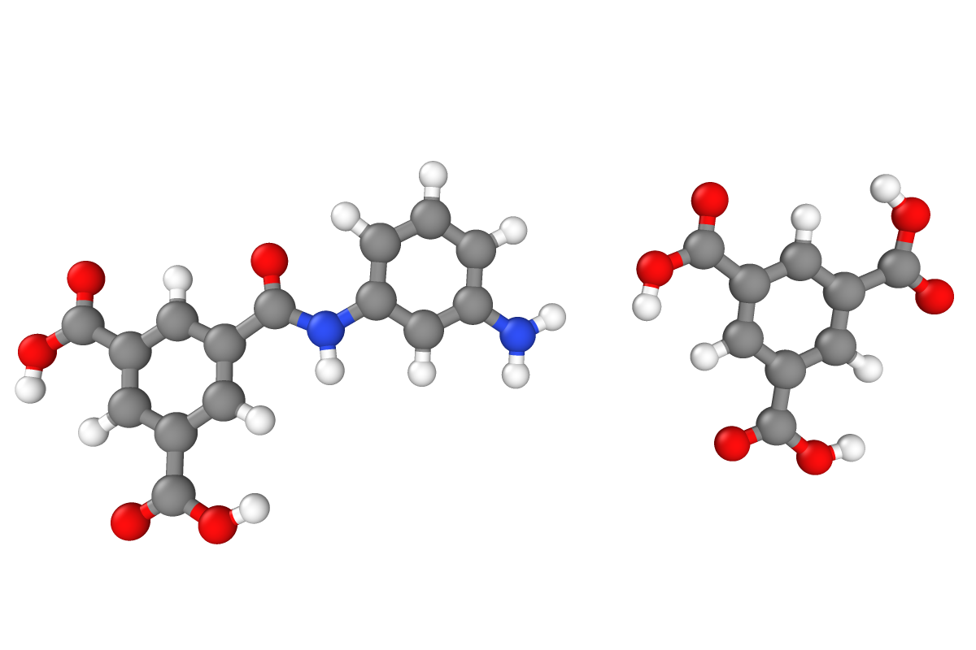
Figure 1.2 – MD simulations
A
B
Pristine
NaOCl
NaOCl +
NaOH
carbon
hydrogen
oxygen
nitrogen
sodium
chlorine
More confined, so less water density
Most density lies between the broken amide (NH2 and COO)
C
Pristine
NaOCl
NaOCl + NaOH
D
E
Polymer mass density is consistent with diffusion coefficients
Packing density is similar in Pristine and NaOCl, lower in NaOCl + NaOH
label
pdf

Slide 7
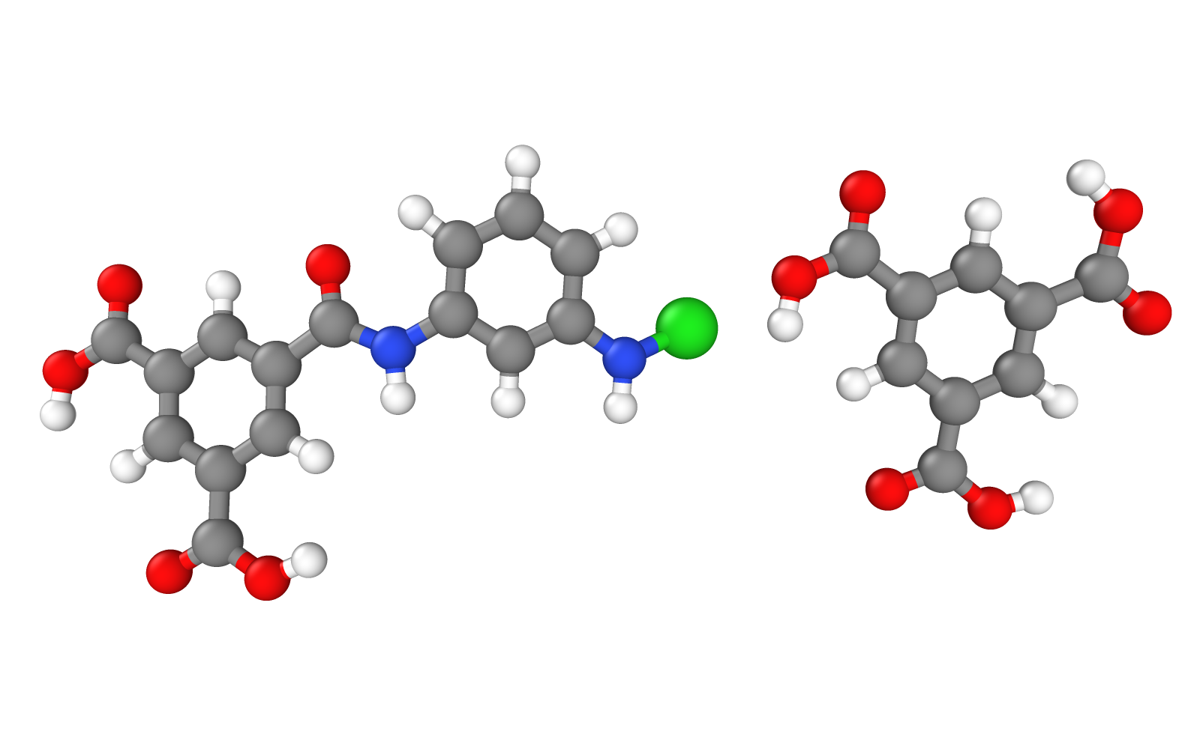
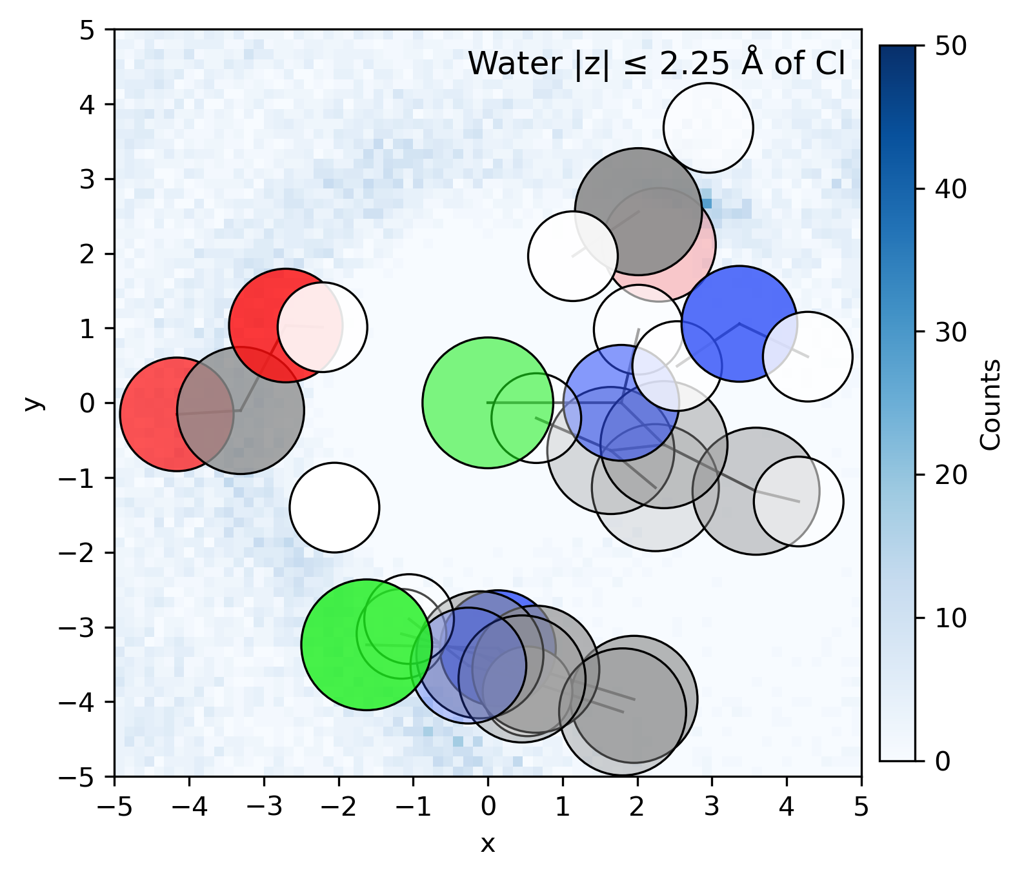
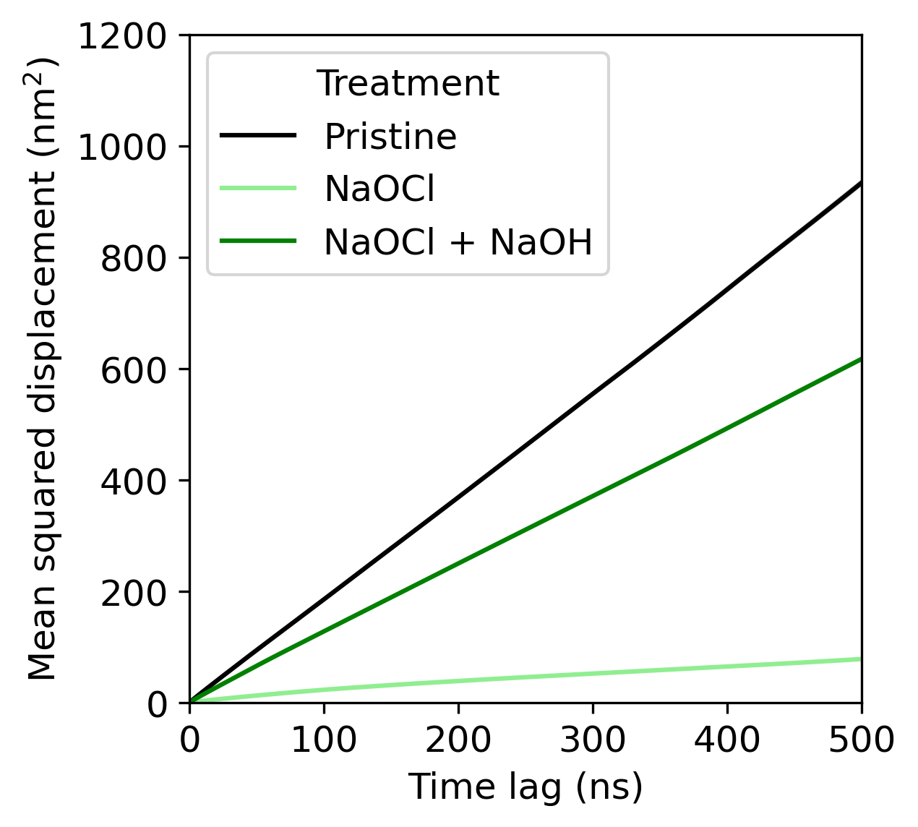
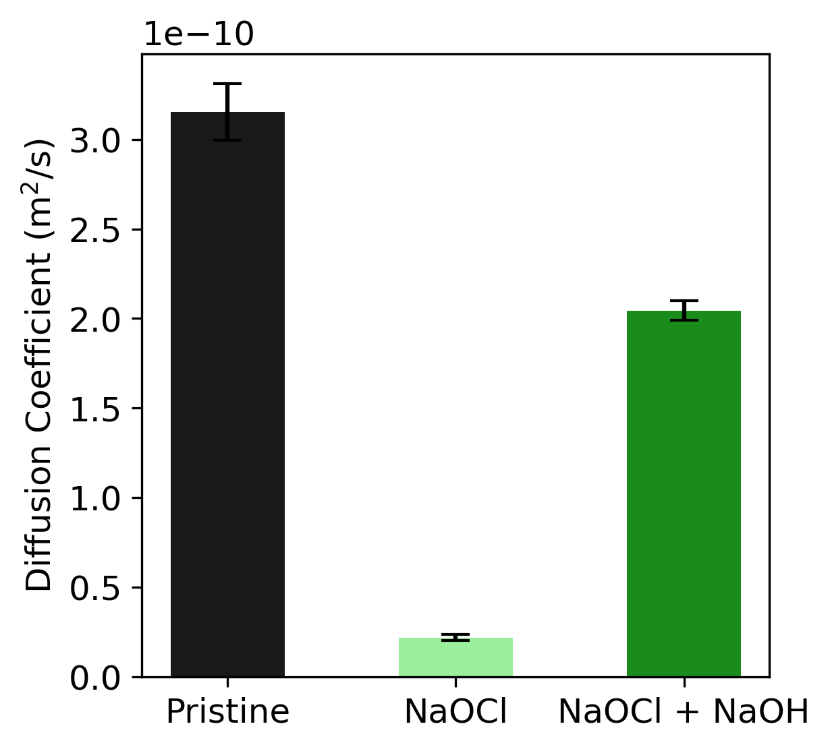
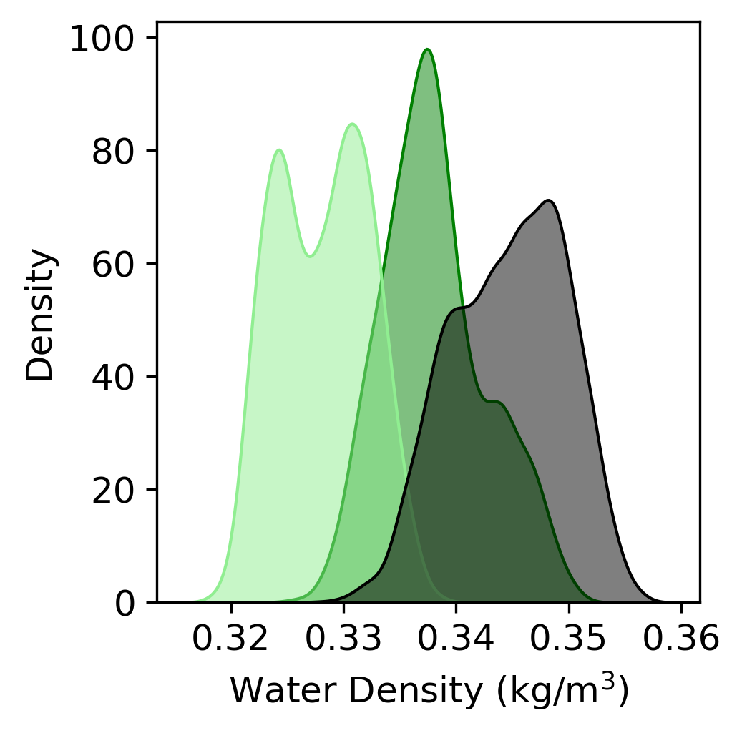
Figure 1.1 – MD simulations
A
B
Pristine
NaOCl
NaOCl +
NaOH
carbon
hydrogen
oxygen
nitrogen
chlorine
C
Pristine
NaOCl
NaOCl + NaOH
Broken crosslink without Cl for third panel – bigger effect from crosslinks
D
E
Diffusion coefficients with only the 60-70%
Add the NaOCl + NaOH – Cl section
label
pdf

Slide 8
Exploratory Figures for:
Chlorination paper – MD simulations

Slide 9
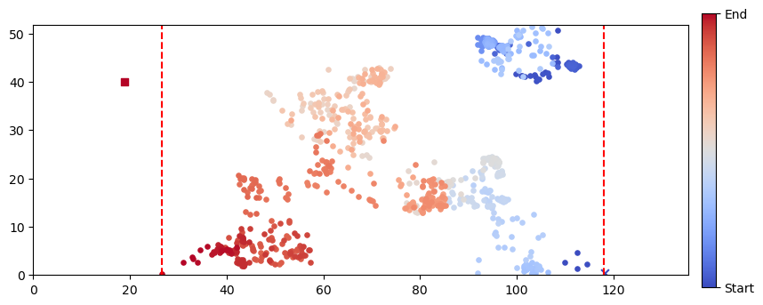
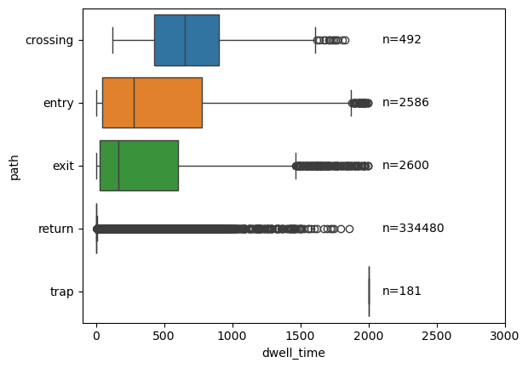
Membrane
crossing
entry
exit
return
trap

Slide 10
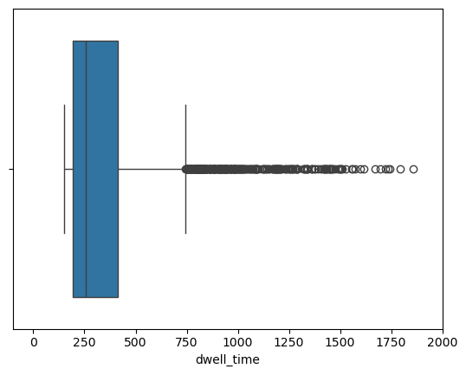
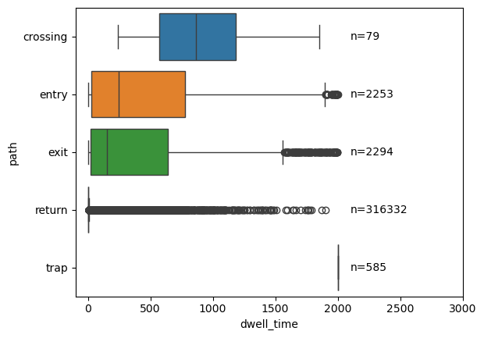
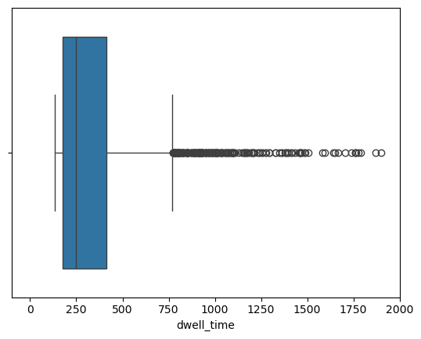
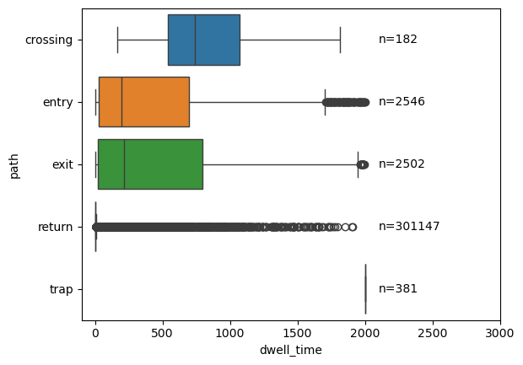
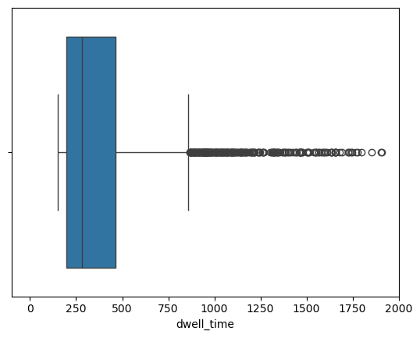
Pristine
Top 1% dwell time for “return”
n=3343
NaOCl
n=3149
NaOCl + NaOH
n=3007

Slide 11
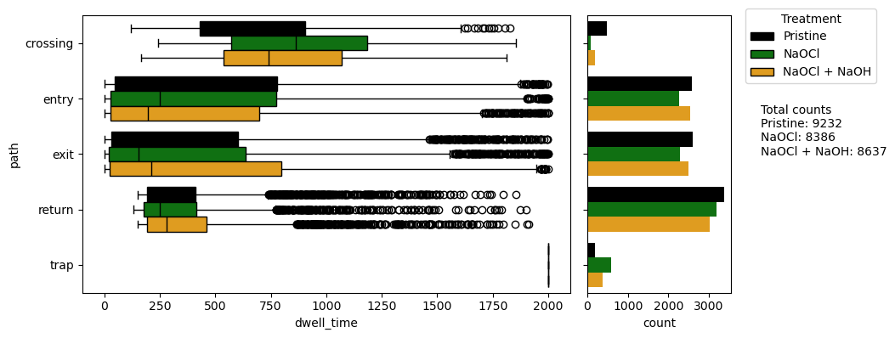
Crossing dwell times are generally:
Pristine < NaOCl + NaOH < NaOCl
Same trend for “crossing”
Top 1% dwell times
More returns for the NaOCl than NaOCl + NaOH
Reverse trend for “trap”
Number of “membrane events”:
Pristine > NaOCl + NaOH > NaOCl
Consistent with diffusion coefficients

Slide 12
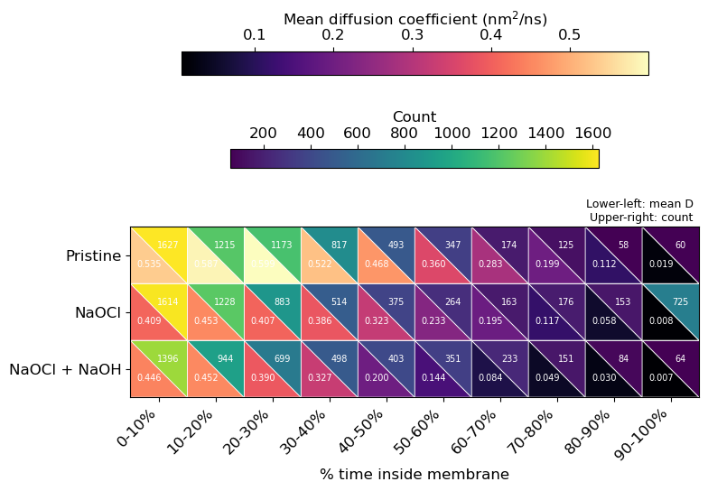
Figure 1 – MD simulations
No % time selection replicates the experimental trend in diffusion coefficient
  Generally, Pristine > NaOCl > NaOCl+NaOH
Looking at last three columns (i.e. lots of time in membrane), the number of water molecules follows expected trend
  NaOCl has the most trapped water
  Pristine and NaOCl+NaOH have similarly low trapped water
label
pdf

Slide 13
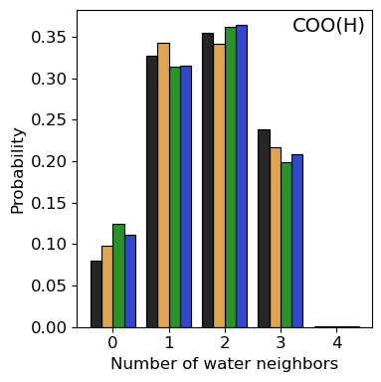
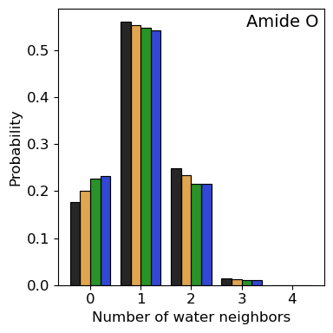
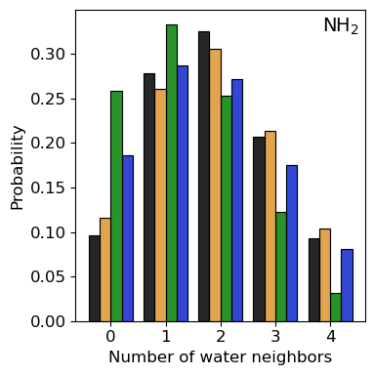
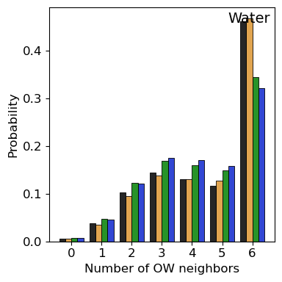
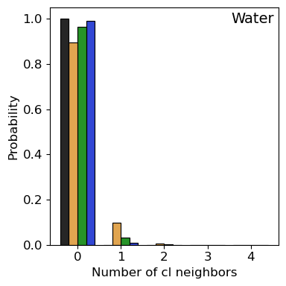
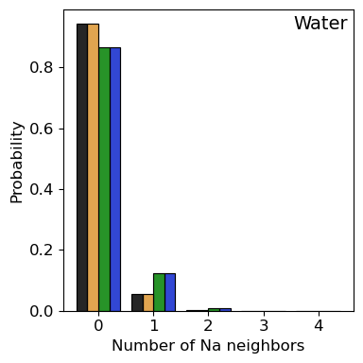
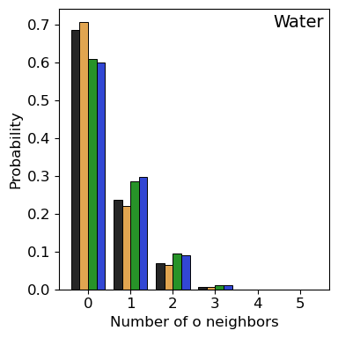

Nearest waters for different membrane groups
label
pdf

Slide 14



Nearest neighbors for waters
Pristine
NaOCl + NaOH
NaOCl
NaOCl + NaOH - Cl
Pristine → NaOCl is very similar, other than in NaOCl there is interaction with 1 Cl
  Slightly less frequently near two polymer groups in NaOCl
  Which would correspond to being pushed out from Cl groups or being blocked by polymer
Pristine → NaOCl + NaOH shows less waters in solution and more frequent waters with only a few water molecules nearby (1-3)
  Pristine and NaOCl show more interaction with all-water neighbors, since they have more solution volume
Pristine → NaOCl + NaOH shows more interaction with O on the membrane, could be that there are a few more but I think the change is more significant than that
  Avoids the Cl and instead interacts with O
More interaction with Na+ in NaOH treated membranes
  Polymer is looser, Na+ can move more
label
pdf

Slide 15

Density of step distance in the membrane z
Looking at only the water molecules that are within 5 A of the polymer for 60-70% of the simulation
label
pdf

Slide 16



Diffusion coefficients of individual waters
Heterogeneity is important, especially for the TST measurements
In our small simulation box, it is likely we do not capture this heterogeneity well
  Evidenced by odd diffusion coefficient behavior (when calculated normally)
Since our goal is to provide insight into experimental trends, we choose a selection of water molecules that follow those trends
  Then we can gain some insight into the mechanisms those waters experience
We see the polymer density also follows this trend, but the water does not
Check diffusion coeff of water in polymer
Notes:
Calculated the diffusion coefficients for each water molecule by fitting that water’s MSD to a line – using 50 ns to 250 ns time lags
Also calculate the closest polymer atom (within 5 A) for each water on each time step
If there is not a polymer within 5 A, that data point (water, time step) is not included
This way I can see how long (in percentage of simulation time) a water stays near the polymer
I then bin up these percentages and calculate the average diffusion coefficients using those water molecules

Slide 17




Distribution of hop lengths in membrane
Pristine
NaOCl
NaOCl + NaOH
NaOCl + NaOH - Cl
Do water molecules move all the way through
Notes:
Calculated the diffusion coefficients for each water molecule by fitting that water’s MSD to a line – using 50 ns to 250 ns time lags
Also calculate the closest polymer atom (within 5 A) for each water on each time step
If there is not a polymer within 5 A, that data point (water, time step) is not included
This way I can see how long (in percentage of simulation time) a water stays near the polymer
I then bin up these percentages and calculate the average diffusion coefficients using those water molecules

Slide 18



Average number of atoms with 5 A
Looking at number of waters with each of the groups
Notes:
Calculated the diffusion coefficients for each water molecule by fitting that water’s MSD to a line – using 50 ns to 250 ns time lags
Also calculate the closest polymer atom (within 5 A) for each water on each time step
If there is not a polymer within 5 A, that data point (water, time step) is not included
This way I can see how long (in percentage of simulation time) a water stays near the polymer
I then bin up these percentages and calculate the average diffusion coefficients using those water molecules

Slide 19

Diffusion coefficients vs percent time in membrane
Notes:
Calculated the diffusion coefficients for each water molecule by fitting that water’s MSD to a line – using 50 ns to 250 ns time lags
Also calculate the closest polymer atom (within 5 A) for each water on each time step
If there is not a polymer within 5 A, that data point (water, time step) is not included
This way I can see how long (in percentage of simulation time) a water stays near the polymer
I then bin up these percentages and calculate the average diffusion coefficients using those water molecules

Slide 20




Diffusion coefficients vs percent time in membrane (all)
Pristine
NaOCl
NaOCl + NaOH
NaOCl + NaOH
- Cl
Notes:
Calculated the diffusion coefficients for each water molecule by fitting that water’s MSD to a line – using 50 ns to 250 ns time lags
Also calculate the closest polymer atom (within 5 A) for each water on each time step
If there is not a polymer within 5 A, that data point (water, time step) is not included
This way I can see how long (in percentage of simulation time) a water stays near the polymer
I then bin up these percentages and calculate the average diffusion coefficients using those water molecules

Slide 21




Diffusion coefficients vs percent time in membrane
Pristine
NaOCl
NaOCl + NaOH
NaOCl + NaOH
- Cl
Notes:
Calculated the diffusion coefficients for each water molecule by fitting that water’s MSD to a line – using 50 ns to 250 ns time lags
Also calculate the closest polymer atom (within 5 A) for each water on each time step
If there is not a polymer within 5 A, that data point (water, time step) is not included
This way I can see how long (in percentage of simulation time) a water stays near the polymer
I then bin up these percentages and calculate the average diffusion coefficients using those water molecules

Slide 22




Diffusion coefficients vs percent time in membrane
Pristine
NaOCl
NaOCl + NaOH
NaOCl + NaOH
- Cl
Notes:
Calculated the diffusion coefficients for each water molecule by fitting that water’s MSD to a line – using 50 ns to 250 ns time lags
Also calculate the closest polymer atom (within 5 A) for each water on each time step
If there is not a polymer within 5 A, that data point (water, time step) is not included
This way I can see how long (in percentage of simulation time) a water stays near the polymer
I then bin up these percentages and calculate the average diffusion coefficients using those water molecules

Slide 23




Diffusion coefficients vs percent time in membrane
Pristine
NaOCl
NaOCl + NaOH
NaOCl + NaOH
- Cl
Notes:
Calculated the diffusion coefficients for each water molecule by fitting that water’s MSD to a line – using 50 ns to 250 ns time lags
Also calculate the closest polymer atom (within 5 A) for each water on each time step
If there is not a polymer within 5 A, that data point (water, time step) is not included
This way I can see how long (in percentage of simulation time) a water stays near the polymer
I then bin up these percentages and calculate the average diffusion coefficients using those water molecules

Slide 24

Diffusion coefficients of individual waters

Slide 25


Diffusion coefficients of individual waters
NaOCl case
Notes:
Calculated the diffusion coefficients for each water molecule by fitting that water’s MSD to a line – using 50 ns to 250 ns time lags
Also calculate the closest polymer atom (within 5 A) for each water on each time step
If there is not a polymer within 5 A, that data point (water, time step) is not included
This way I can see how long (in percentage of simulation time) a water stays near the polymer
I then bin up these percentages and calculate the average diffusion coefficients using those water molecules

Slide 26


Diffusion coefficients of individual waters
Notes:
NaOCl case
Fitting MSD from lag 50 ns to 250 ns

Slide 27




Diffusion coefficients of individual waters
Pristine
NaOCl
NaOCl + NaOH
NaOCl + NaOH - Cl

Slide 28


























Diffusion coefficients of individual waters
Notes:
These are all for NaOCl case
D range = 0.0350 – 0.4962

Slide 29





With Cl removed – 1-30-26
Polymer-polymer hydrogen bonds
Polymer-water hydrogen bonds
label
pdf

Slide 30




With Cl removed – 1-30-26
Histogram of number of waters that contribute to each time fraction in membrane
MSDs per particle
Pristine
Restricted to membrane, 80% of time
Unrestricted
Distributions of the diffusion coefficients, only take the fast peak?
NaOCl + NaOH - Cl
Restricted to membrane, 80% of time
Unrestricted
Residence time for waters near chlorine
label
pdf

Slide 31





With Cl removed – 1-23-26
Water-water vs water-polymer interactions
Water per amount of polymer (like monomer)
Diffusion coefficient with different time percentages (i.e. water must stay in membrane x, y, z, etc. percent of time)
Number of water neighbors? Rubbery vs microvoids
Spatial distribution of water density?
label
pdf

Slide 32


With Cl removed
label
pdf

Slide 33

For an arbitrary cutoff look at water-water coordination number
label
pdf

Slide 34
Supplemental Figures for:
Chlorination paper – MD simulations

Slide 35
Figure S? – membrane density
label
pdf

Slide 36

Figure S? – hydrogen bonding
label
pdf

Slide 37
Figure S? – Water RDFs
label
pdf

Slide 38
Figure S? – Cl RDFs
label
pdf

Slide 39


Figure S? – local water density, RDFs
label
pdf

