Slide 1
Introduction to WebCenter Sites 11g
Michele Sciabarra
michele@sciabarra.com
Sciabarra.com – Just Add Content

Slide 2
The Hidden Secrets of the Zen Master
What you always asked about it and no-one told you

Slide 3
The 3 Best Kept Secrets of WebCenter Sites
It is all about cache and publishing
Content Model is the king
If you start doing smart things in templates, you are doomed

Slide 4
It is all about cache and publishing
Sites has a very complex content model stored in the database
Database access is inefficient (tens of queries for each asset)
Caching is absolutely critical to get a fast site
The number 1 error of devlopers is ignoring caching until it is too late
Publishing and caching are related
Cache must be invalidated only partially when publishing
Hence dependencies between assets and pagelet must be tracked
The number 2 error of developers is ignoring dependencies so the WHOLE cache must be invalidated after each publish

Slide 5
Content Model is the king
A CMS is good as long as it is easy to edit a site
Hence you need to design a website that is easy to edit
This does NOT translate in a web site that is easy to develop
The biggest complain of end user is that the site is awkward to edit
This is the result of database-like content model definition
It is wrong because it is inefficient and very hard to edit
The typical nightmare: a "relation asset"

Slide 6
Do not do SMART things in templates
Developer very often think that templates are simply JSP they can do whatever with it.
They are NOT:
Templates are cached:
you cannot pass parameters around
You cannot do complex calculation every time
Template must adapt to an easy (for the editor) Content Model
That makes the code often hard to write and complex
Complex (smart) code breaks all of it

Slide 7
4 noble truth about Sites
Sites is not a development environment
IT IS A WEM/CMS/ECM system

Slide 8
4 noble truths about Sites
Sites is not a development environment
Sites is not designed for developing applications
It is good for fast, cached content
It is bad for slow, dynamic web output

Slide 9
4 noble truths about Sites
Sites is not a development environment
Sites is not designed for developing applications
You should not do web applications with Sites
Because it is too constrained
Because it is too limited
Because it is not its job
Because there are better way doing it

Slide 10
4 noble truths about Sites
Sites is not a development environment
Sites is not designed for developing applications
You should not do web applications with Sites
Sites does not have good support for developing applications
In short it is a CMS, not something else
Did I mention you should not try to develop application with Sites?

Slide 11
Sites Rendering 1-2-3
The most important concepts to understand
when you design your content model and templates
for WebCenter Sites

Slide 12
Basic Terminology
Asset
All the content is an asset
It is publishabe;
Each asset has a type
Very roughly, a (simple) asset is a record in a table
Flex Assets
Have attributes
Can change their attribute set (definition)
Roughly they are a master-detail table set

Slide 13
Basic Terminology
Element
The underlying code executed by a Template
JSP mostly
Also XML and Groovy
It is NOT an asset – but can be part of an Asset
Template (and CSElement)
It is a (special) asset
It can render a (non executable) asset
They wraps Elements with metadata
It is executable
It is publishabe

Slide 14
CMS main concept
Separate content from presentation
Select an asset (content data)
c is the content type
cid is the content id
Select an element (presentation logic)
pagename is the Element
You always apply an element to an asset
So you need a pagename and a c+cid

Slide 15
Variables
C
CID
PAGENAME
SITE
RENDERMODE
Content Type
Content ID
Site Entry to render
The current site
The rendering mode (live, insite, preview)

Slide 16
The rendering process
It starts always with a Wrapper and c/cid
It will select an asset and a layout
You will apply different elements to different content on the road
Wrapper
Layout
TopNav
SideNav
Detail
Footer

Slide 17
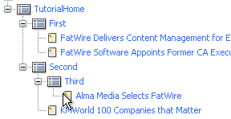
The Site Plan
Select your content type
c=Page
c=News
NOT ALWAYS you will render a Page asset to a full web page
Page
News

Slide 18
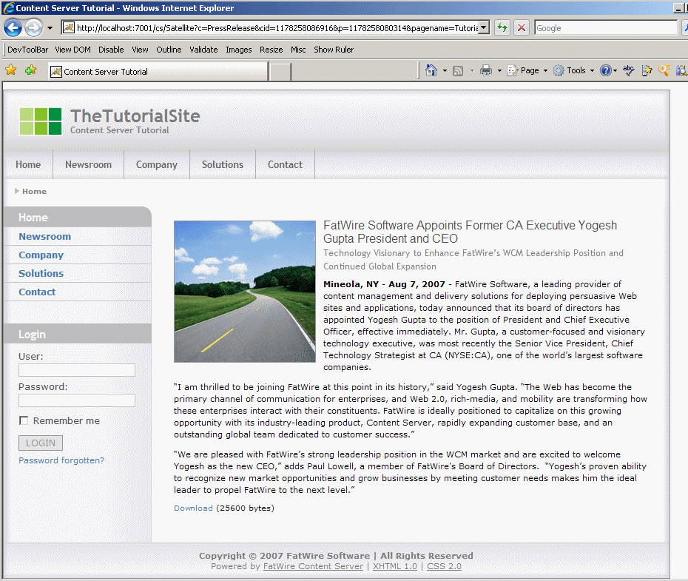
Render News
News/Detail
News/Layout with c=News
Call News/Detail
Call Image/Detail
Image/Detail

Slide 19
News/Layout
TopNav
Page/Link
Layouts render
TopNav
SideNav
Footer
Navigations consult siteplan for c/cid
Call Page/Link for the links
SideNav
Footer

Slide 20
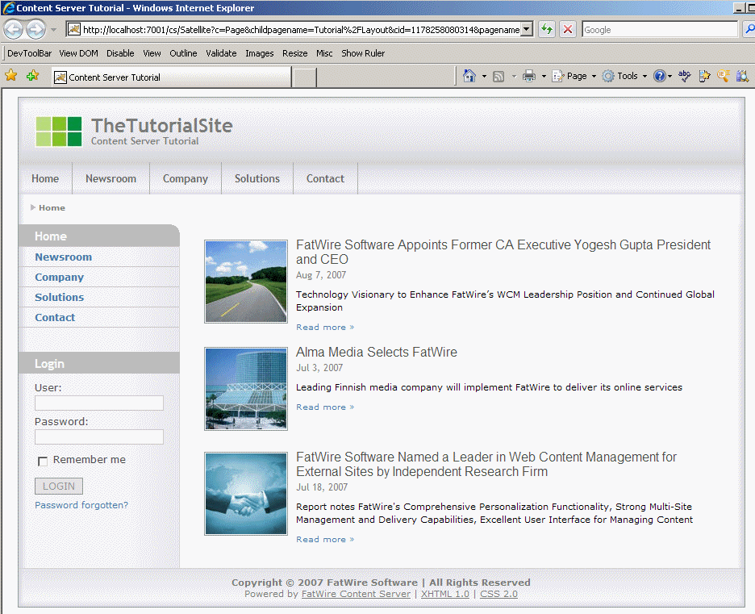
Render Page
Page/Detail
Page/Layout
Call
Page/Detail
For each children
Call News/Summary
News/Summary

Slide 21
Render Summary
Image/Summary
Call Image/Summary
Call News/Link
News/Link

Slide 22
Templates & CSElements
Page/Detail
Page/Link
News/Detail
News/Link
News/Summary
Image/Detail
Image/Summary
Wrapper
Page/Layout
News/Layout
TopNav
SideNav
Footer

Slide 23
Test Drive Sites UI and Development tools
Let's see how it works

Slide 24
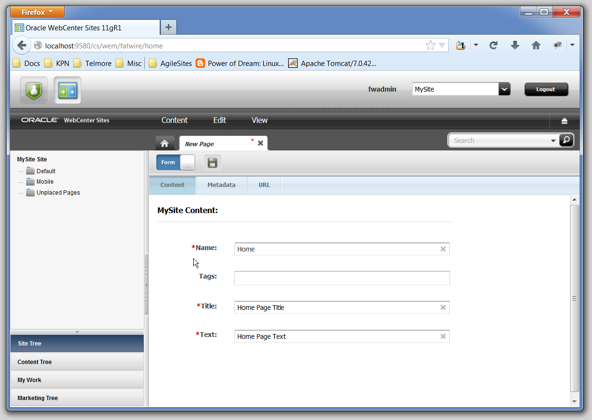
Contributor Interface - Form

Slide 25
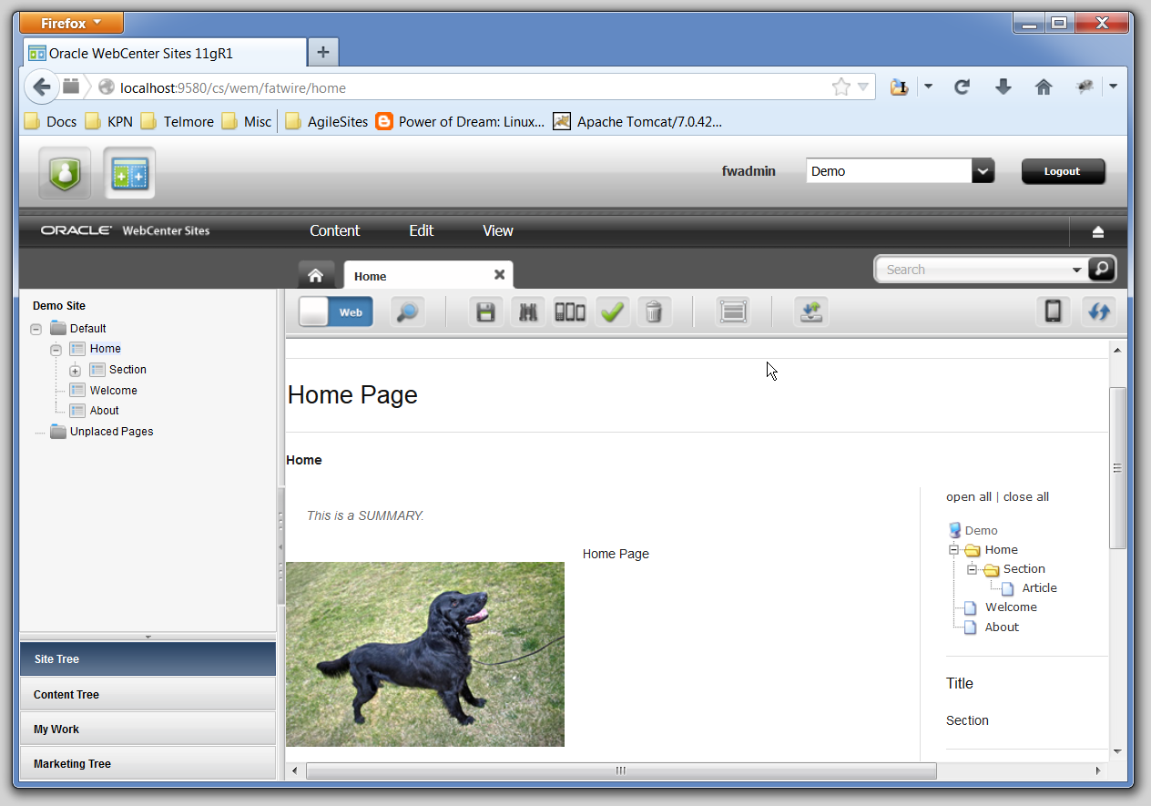
Contributor Interface - Visual

Slide 26
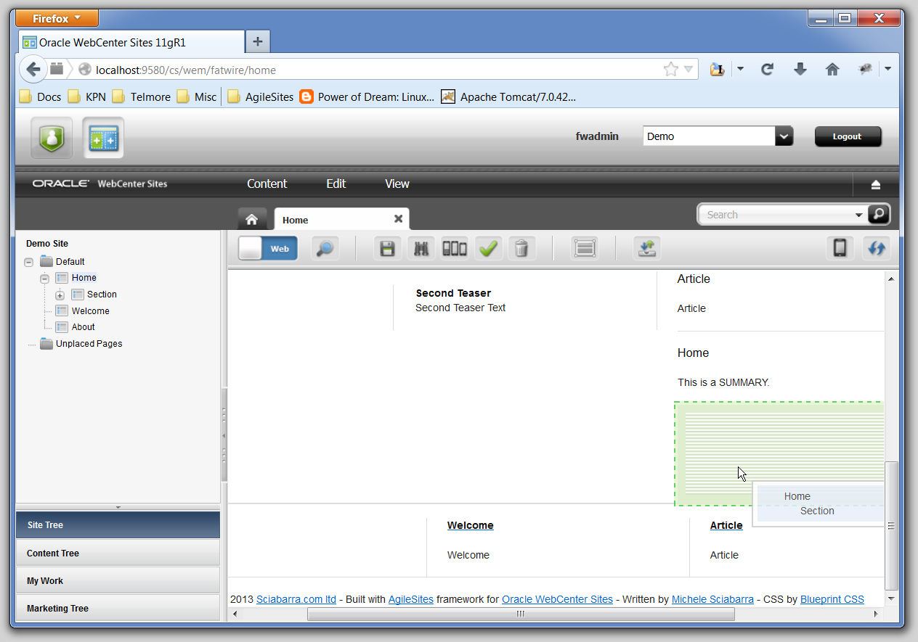
Contributor Interface - Slot

Slide 27
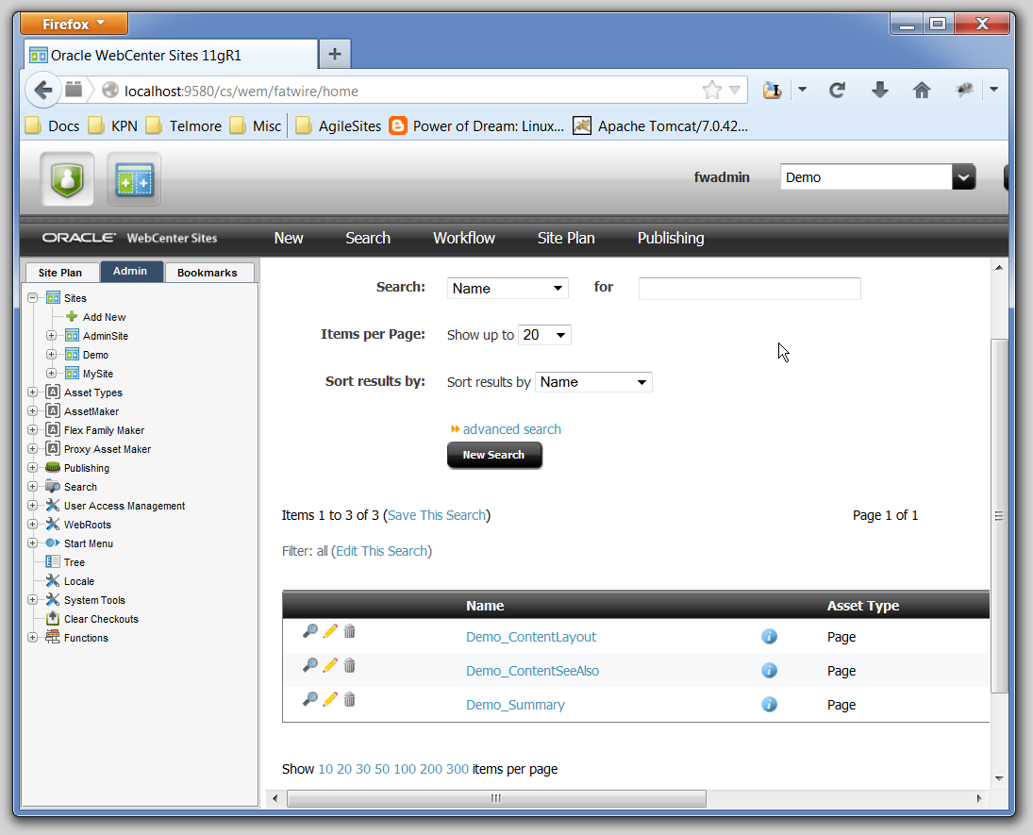
Admin Interface

Slide 28
Beginning Content Modelling
Lean how to create your content model

Slide 29
Hierarchy
Type:
Page
PageDefinition
Subtype: Home
PageAttribute
Attribute:
Text
Site_Home
Attr Types
Attribute:
Title
Site_Text
Site_Title

Slide 30
Attributes
Attributes can be
single
multiple
AttributeEditors
Stock
Custom
Attributes have different types
String
Text (long string)
Image
Asset

Slide 31
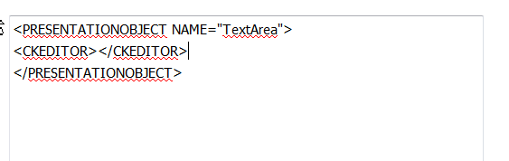
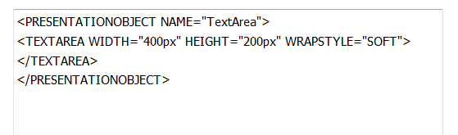
Attribute Editors
Attribute editors define editing options for attributes
TEXTAREA
CKEDITOR
Defined with an XML file
Unfortunately
Documented in developer manual

Slide 32
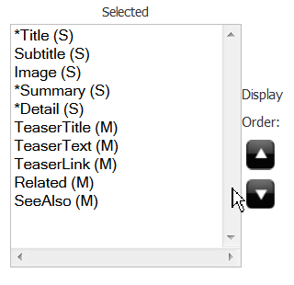
Definitions
Definitions
A set of Attributes
Used by contents to define their attributes

Slide 33
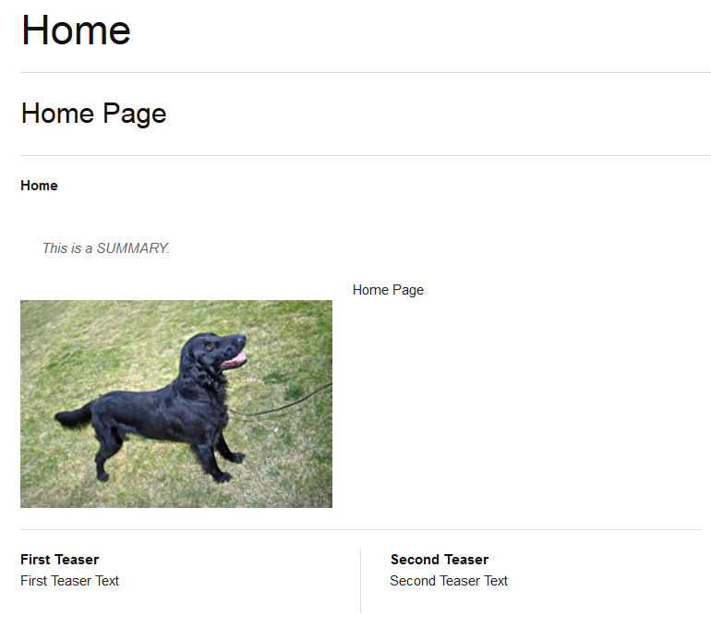
Attributes
Title
Subtitle
Sumary
Image
Detail
TeaserText
TeaserTitle

Slide 34
ABC of Element Development
Time to start getting hands dirty

Slide 35
Sites Elements
You do development in Sites using Java Server Pages or Groovy
JavaServer Pages
Sites has a proprietary tag library
Output is Buffered
Output is the Cached
Groovy (+AgileSites)
Groovy is 99% like Java (except it is slower)
It does not matter because in Sites everything should be cached
http://groovy.codehaus.org/Differences+from+Java
Plus a number of nice extensions

Slide 36
Templates & CSElement
It is an Asset holding an Element
It is Publishable
It contains meta data
It is UNCACHED
Use for rendering logic that embed html in the caller
In is an Asset holding an Element
It is Publishable
It contains meta data
It is CACHED
Use for rendering logic that create separate Pagelets

Slide 37
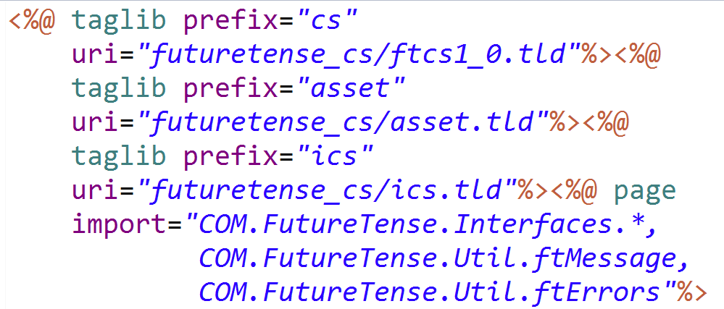
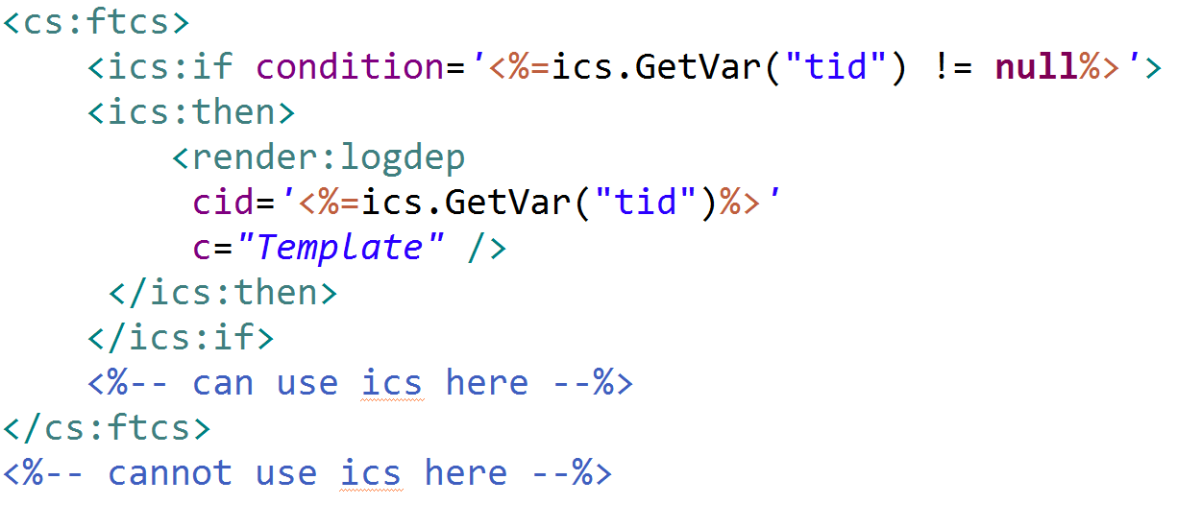
A generic JSP
Mandatory imports
Where your code should go

Slide 38
The ubitiquous ICS
ICS is the Interface to Content Server
A facade used for almost everything
Must be uses inside a <cs:ftcs> block
Content Server is the internal name of the product
Future Tense is the original developer of Sites
It contains:
Variables (Strings)
Lists (tables, actually)
Object (arbitrary pojos)

Slide 39
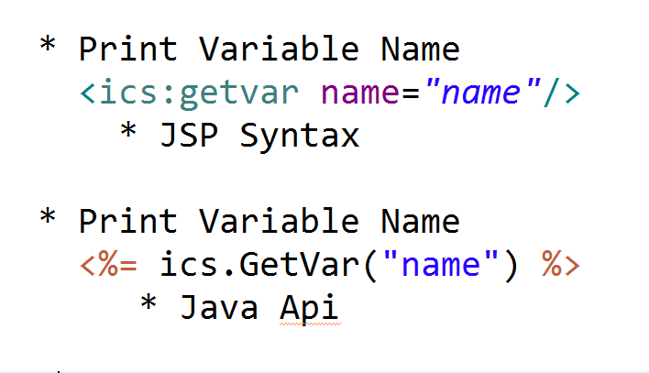
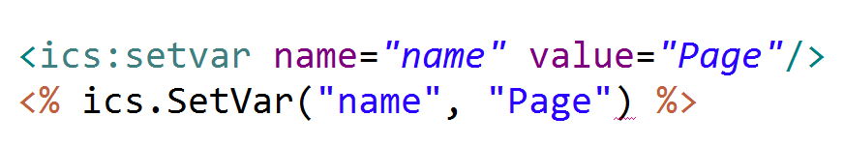
Variables in Sites

Slide 40
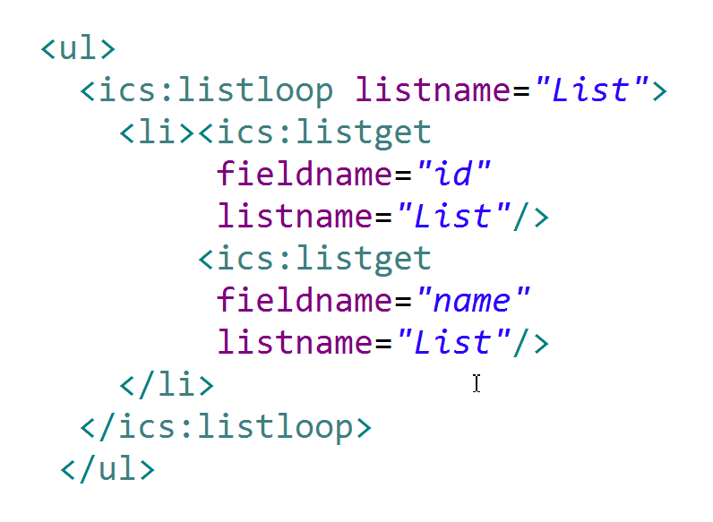
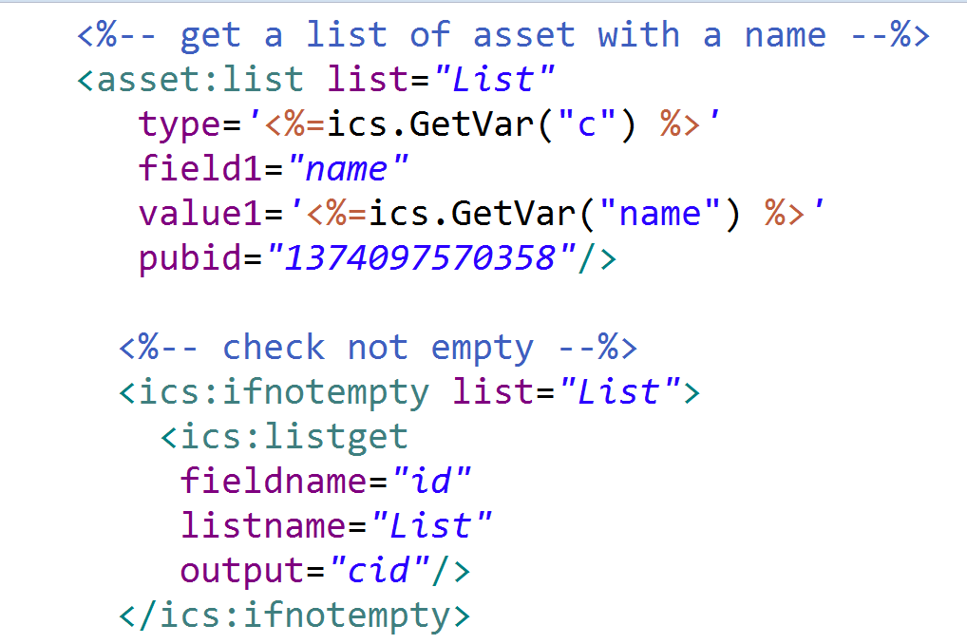
Lists in Sites
Get a list of assets
Loop a list
DO NOT DO THIS! ONLY A SAMPLE
List Output

Slide 41
Extracting attributes
Let's start adding the content

Slide 42
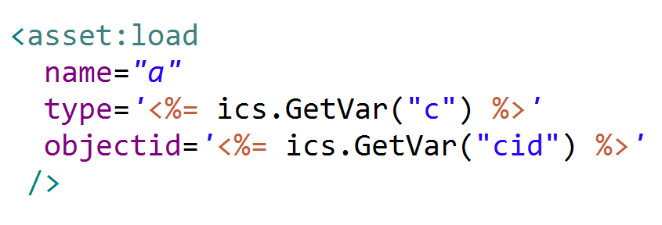
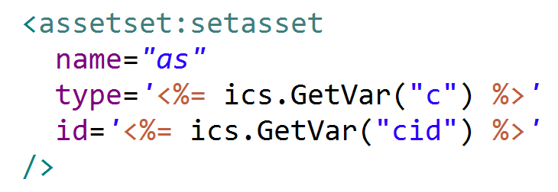
Loading an asset
Load the asset "head"
Load the attibutes

Slide 43
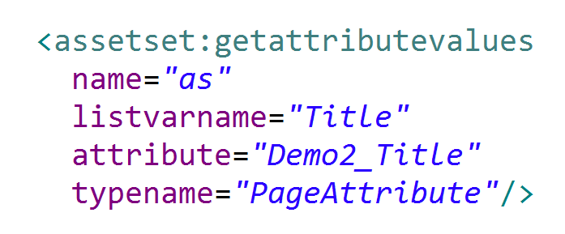
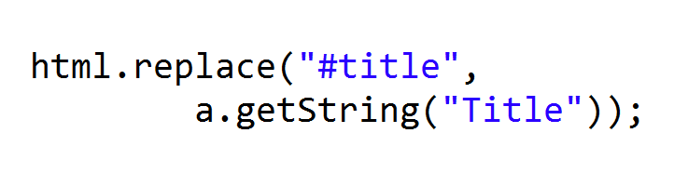

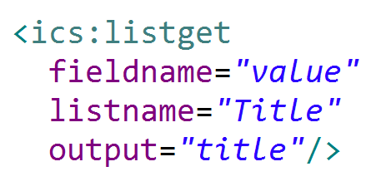

Reading single attribute
Load the attributes
Extract the value
Print
Get the attribute and place in the mockup

Slide 44
Cache & Dependencies
Speed up your WebCenter SIte

Slide 45
Multiple cache in Sites

Slide 46
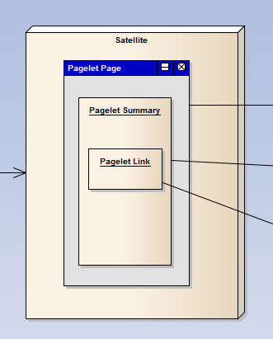
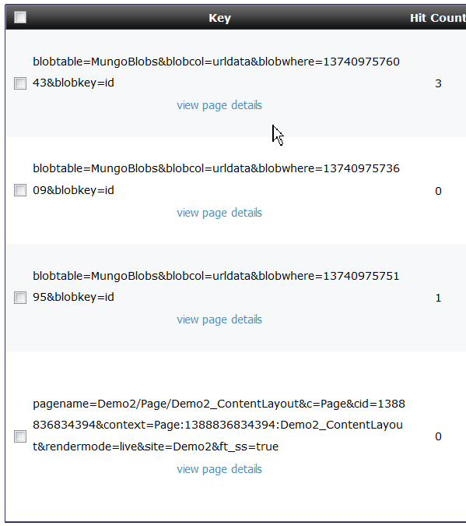
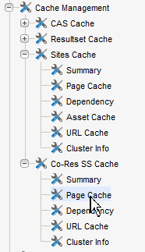
Satellite Page(let) and blob Cache

Slide 47
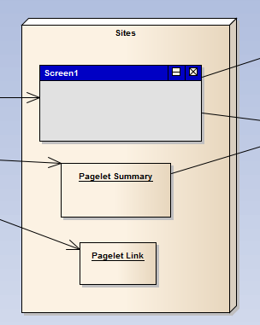
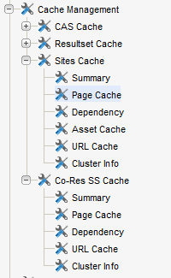
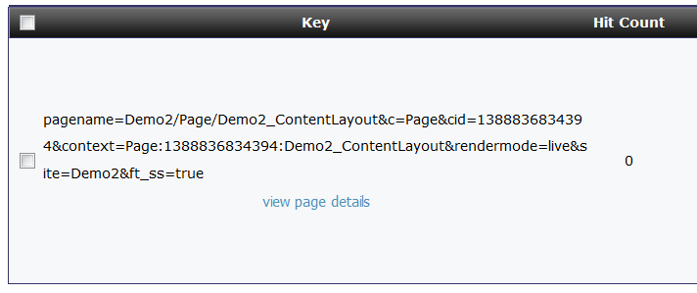
Sites Page(let) cache

Slide 48
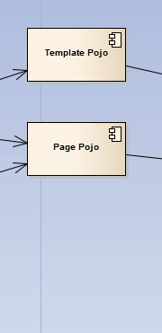
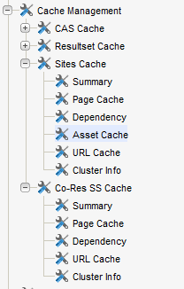
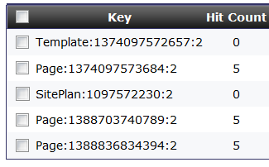
Asset (pojo) Cache

Slide 49
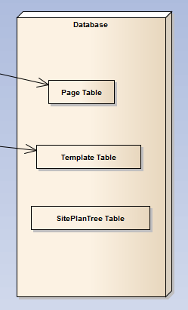
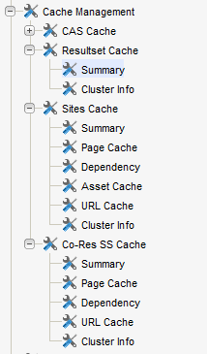
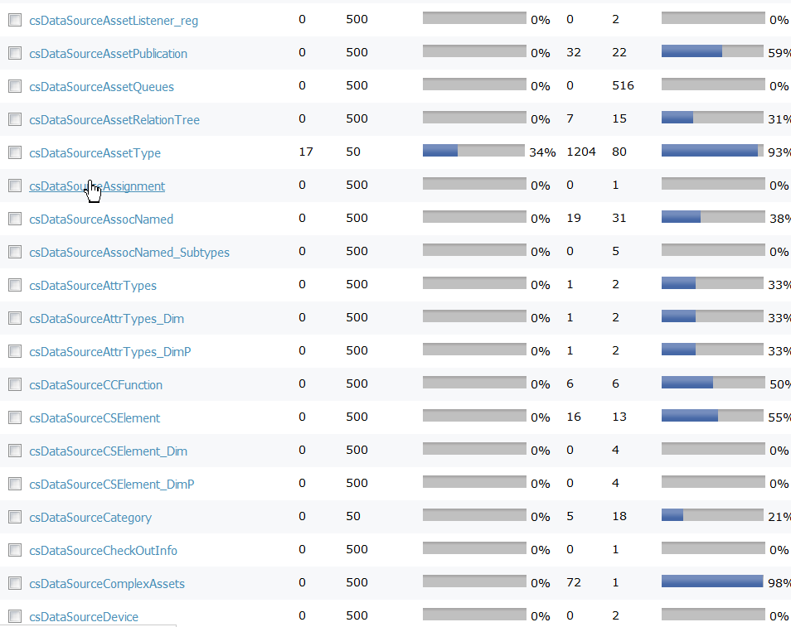
ResultSet (table) cache

Slide 50
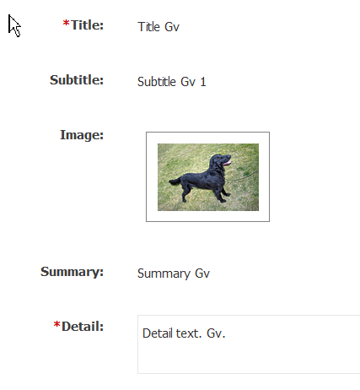
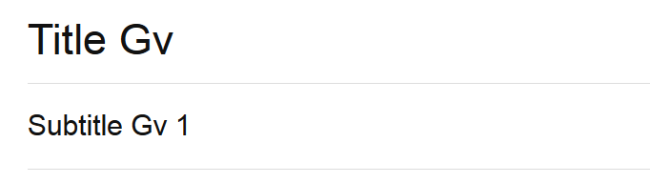
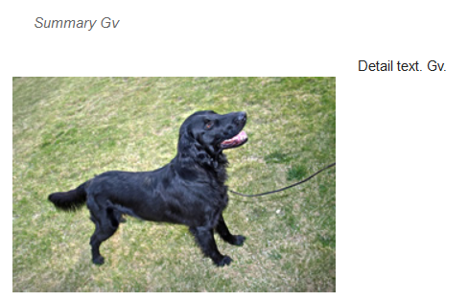
Dependencies (the easy part)

Slide 51
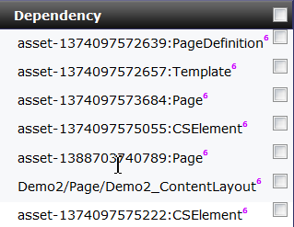
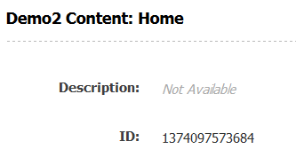
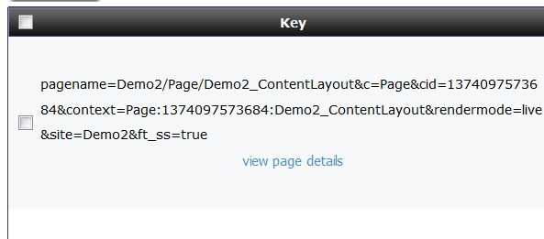
Checking dependencies
Quiz:
From where they are coming

Slide 52

Answer

Slide 53

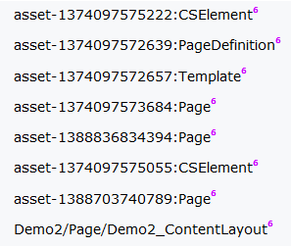
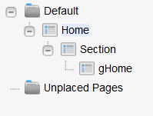
Dependencies (the hard part)

Slide 54
Flex Families
More advanced content modelling

Slide 55

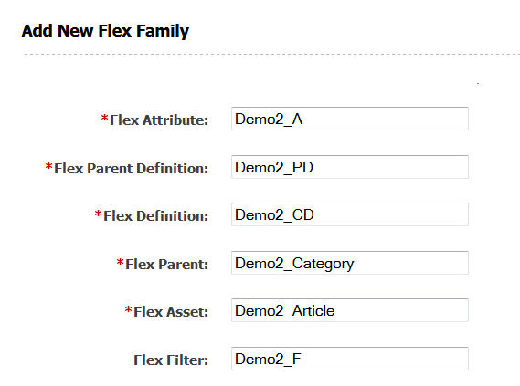
Creating a new Flex Family
Create a new flex family
Convention: use the site name prefix
Demo_A Demo_PD Demo_CD Demo_F for developers
Demo2_Category Demo2_Article for users

Slide 56
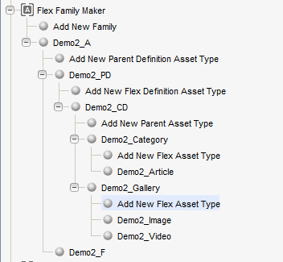
Additional Parent and Content
Articles grouped in Categories
Video and Images grouped in Galleries
One flex family is enough!
Do not create one flex family for each new content!

Slide 57
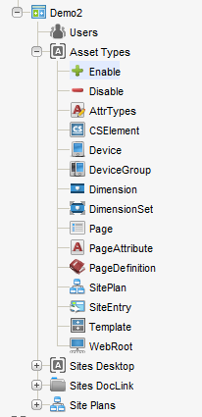
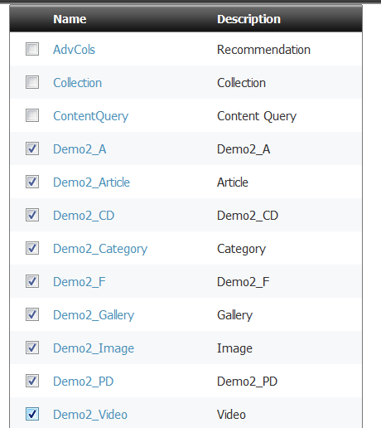
Enabling the types in the site

Slide 58
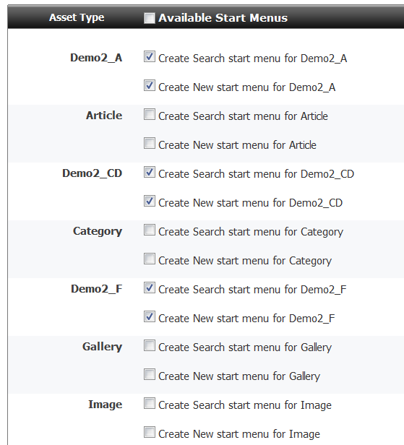
Create initial start menu…
For developer Asset, generally yes
For user Asset better not
You will refine better later

Slide 59
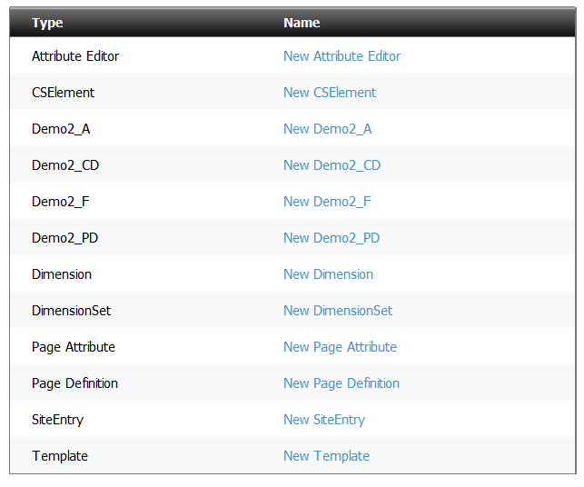
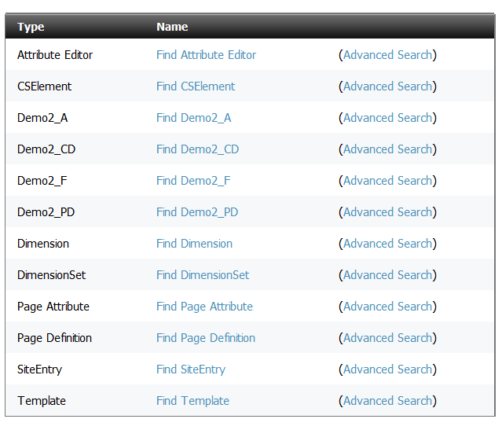
You have then now in Admin UI

