Slide 1


COMMERCIAL
SCI-AGRO
Presentation
Your product.
Our responsibility.
SCI-AGRO • A GLP Laboratory

Slide 2

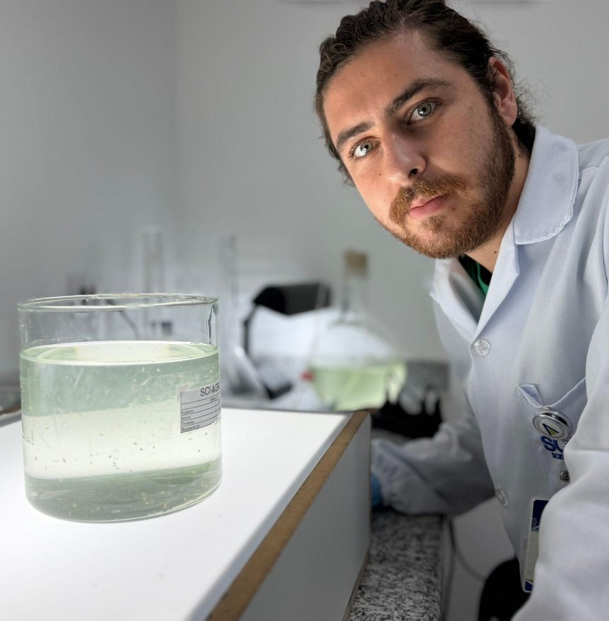




Who we are
KNOWLEDGE APPLIED TO THE SAFE DEVELOPMENT OF AGRICULTURE
The sponsor is our priority
Focus on partnership, responsive technical contact and compliance with agreed deadlines.
A team of more than 130 specialized professionals.
Initial GLP recognition in March 2019.
High scientific quality
Applied scientific research based on test guidelines, including specific demands that are uncommon in registration packages.
SCI-AGRO • Commercial Presentation
02

Slide 3

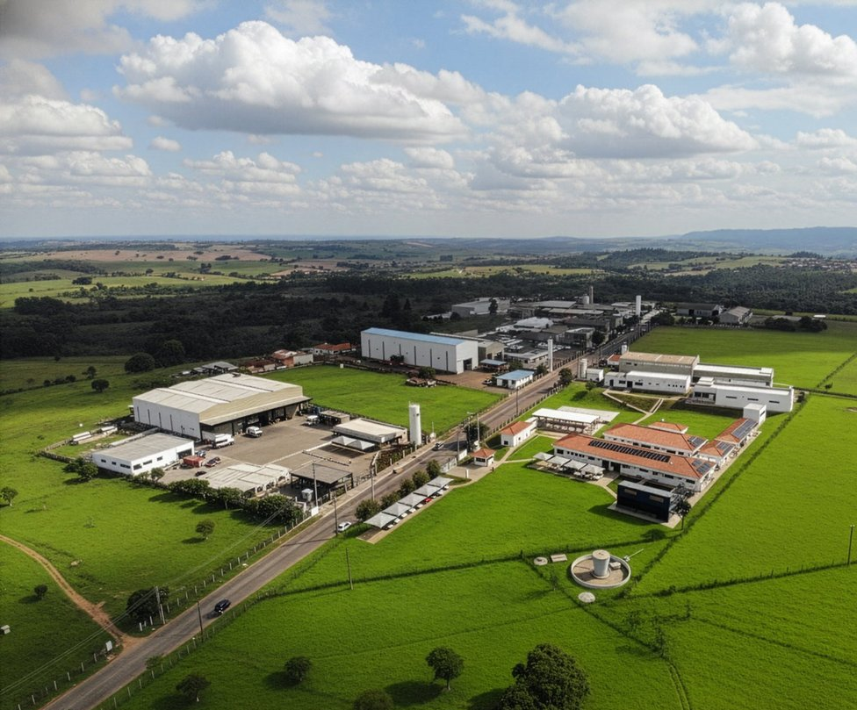



Facilities
TEST FACILITY LOCATED IN CHARQUEADA/SP, BRAZIL
11,000 m²
Continuous expansion
of area supporting studies and laboratory routines.
Ongoing investment in facilities and technology.
A structure designed to combine operational capacity, technical reliability and a fast response to market demands.
SCI-AGRO • Commercial Presentation
03

Slide 4
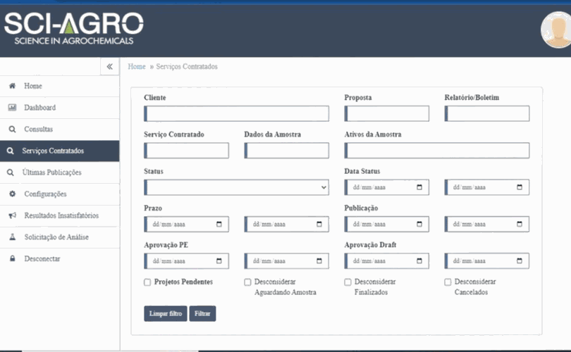





Quality and monitoring
TRANSPARENCY IN PROJECT MANAGEMENT
PMO
Client portal
Responsible for monitoring project progress.
Project status and report access through the website.
Technical team
Languages
Experienced professionals and quick contact.
Simultaneous issuance when required.
Structured monitoring to reduce noise, gain predictability and keep the sponsor close to the operation.
SCI-AGRO • Commercial Presentation
04

Slide 5









Our services
TECHNICAL SCOPE FOR DIFFERENT REGULATORY DEMANDS
5-batch
5-batch Analysis
Genotoxicity Studies
Physicochemical Studies
Ecotoxicology Studies
In vivo & in vitro Toxicology Studies
Microbiology
In silico Toxicology
Pesticide Residues
R&D and training
A
SCI-AGRO • Commercial Presentation
05

Slide 6
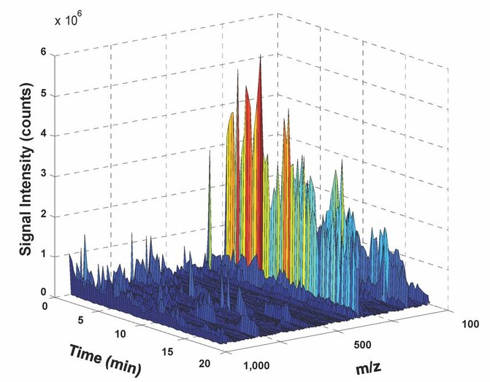
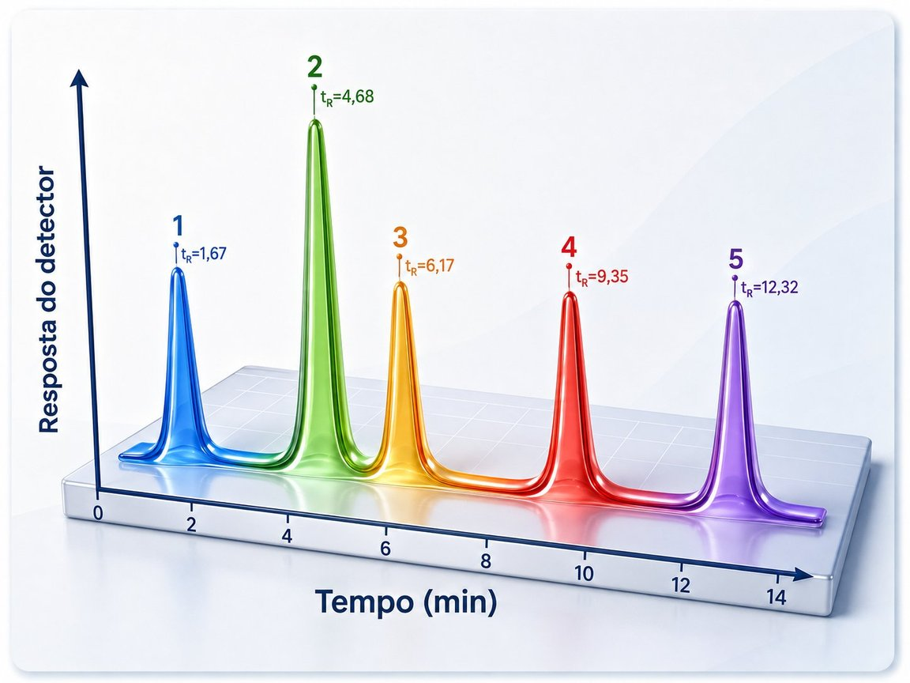
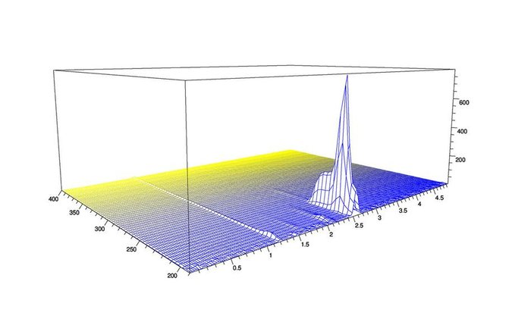
5-batch Analysis
ROBUSTNESS FOR TECHNICAL AND PHYTOCHEMICAL PRODUCTS
Compliance with multiple regulatory authorities: SENAVE, SENASA, COFEPRIS, EU, EPA, among others.
Experienced team in conducting studies and in the technical interpretation of data.
Isolation and certification of impurity standards with unequivocal identification.
An advantage for phytochemical products.
SCI-AGRO • Commercial Presentation
06

Slide 7
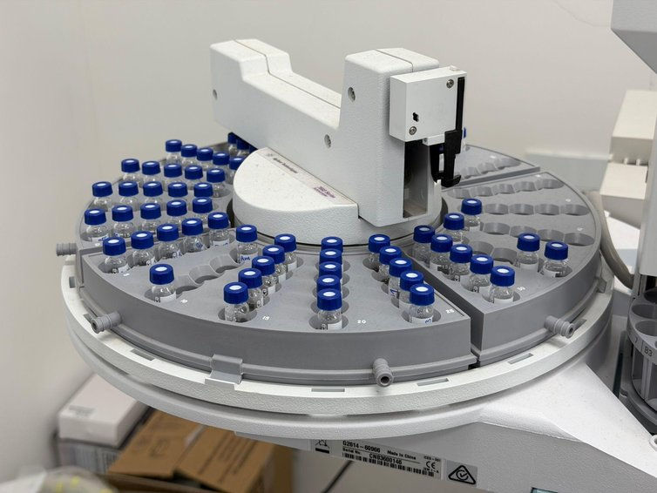

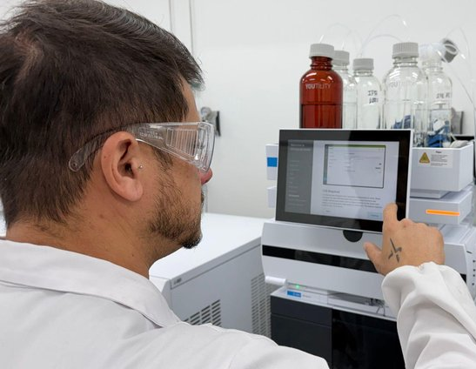
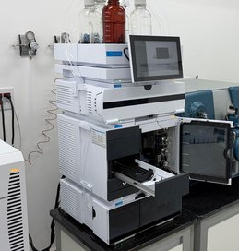
Physicochemical Studies
MORE THAN 63 STUDIES IN SCOPE
Extensive scope covering requirements in Brazil, Europe and South American countries.
Includes studies such as explosivity, Henry's law constant, chemical incompatibility and auto-ignition.
Critical assessment of test guidelines for each formulation type.
Investment in modern equipment for speed and precision.
Precise technical application of the guidelines: one less layer of uncertainty in the regulatory package.
SCI-AGRO • Commercial Presentation
07

Slide 8
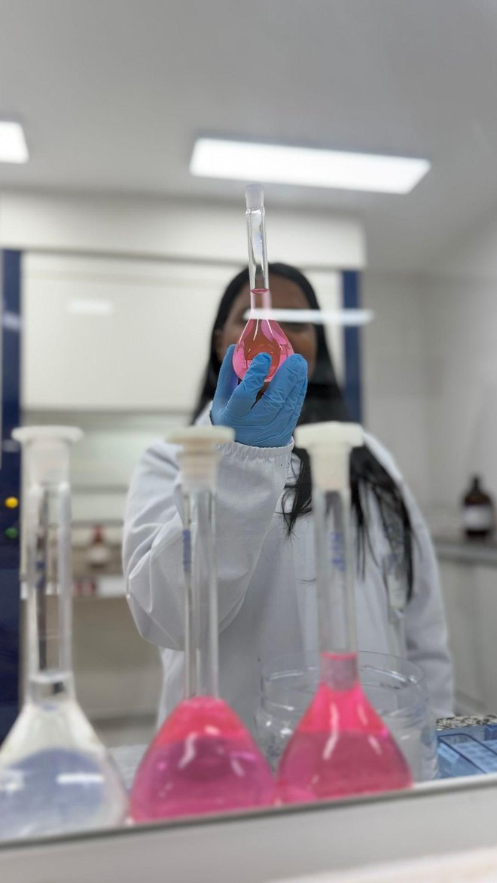
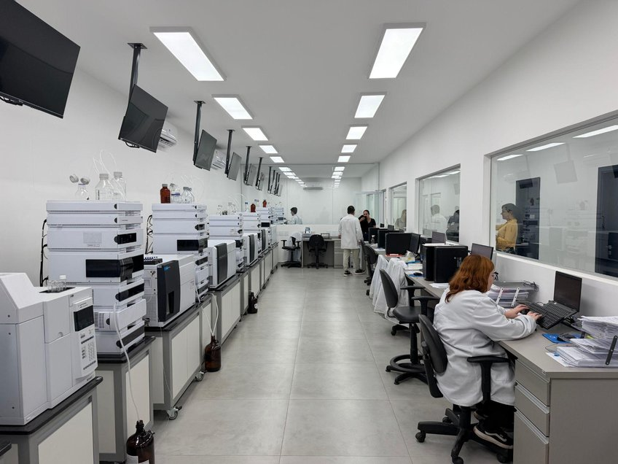
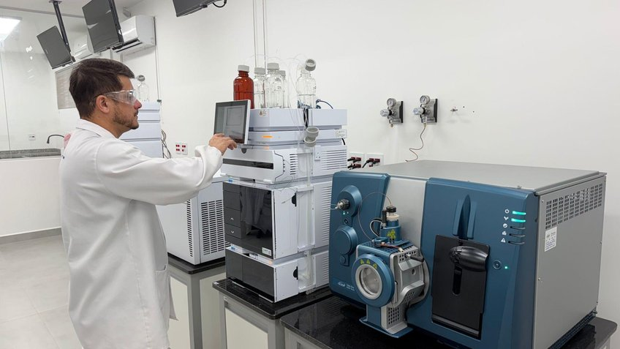
Physicochemical Laboratory
MODERN ANALYTICAL INFRASTRUCTURE
Equipment, team and method working as a single technical mechanism.
An environment prepared for studies that require precision, traceability and control at every stage.
SCI-AGRO • Commercial Presentation
08

Slide 9
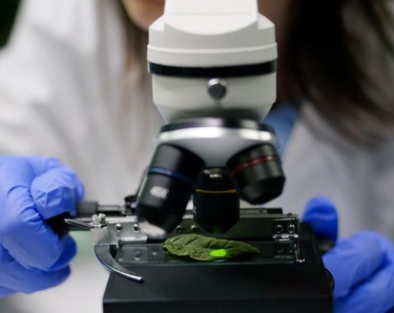
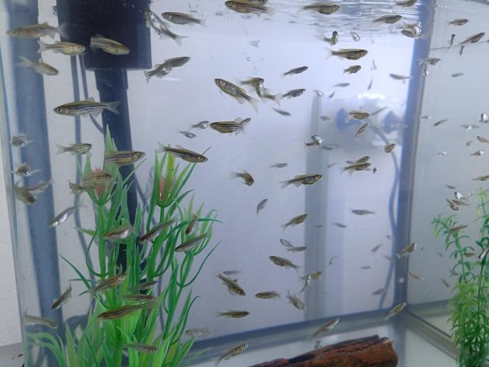
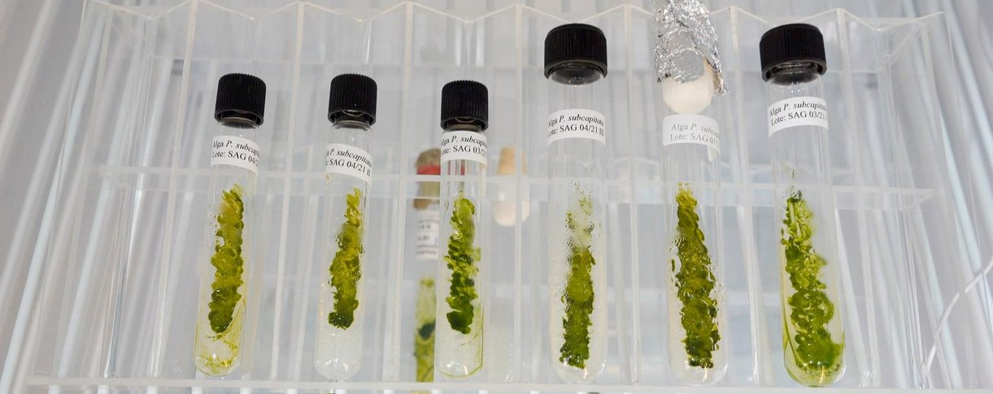
Ecotoxicology Studies
AQUATIC AND TERRESTRIAL
Rigorous conditioning of species according to each test guideline.
Specific care in the experimental handling of each species, including bees and climate conditions.
Analysis of working solutions by sensitive techniques such as LC/MS-MS, reducing questions and regulatory requirements.
Non-GLP testing during the formulation development stage.
Detailed experimental control for technically sound biological responses.
SCI-AGRO • Commercial Presentation
09

Slide 10
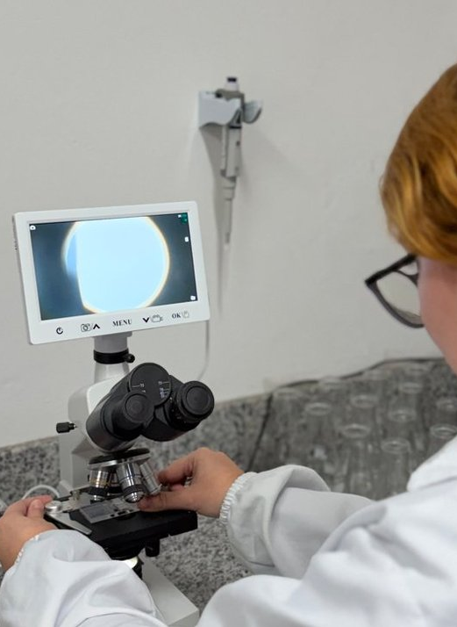
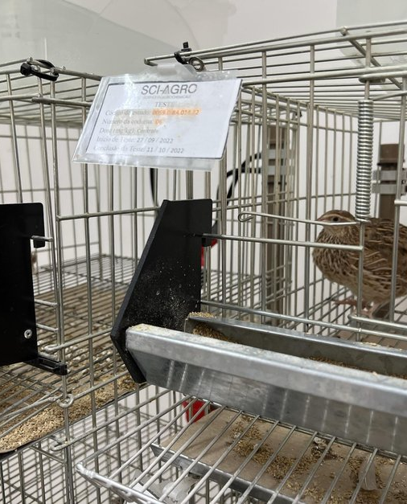
Ecotoxicology Laboratory
EXPERIMENTAL WORK WITH SENSITIVE SPECIES
Facilities, protocols and operational care for reliable ecotoxicology studies.
Proper preparation and conditioning help protect the validity of the assay even before the first reading.
SCI-AGRO • Commercial Presentation
10

Slide 11
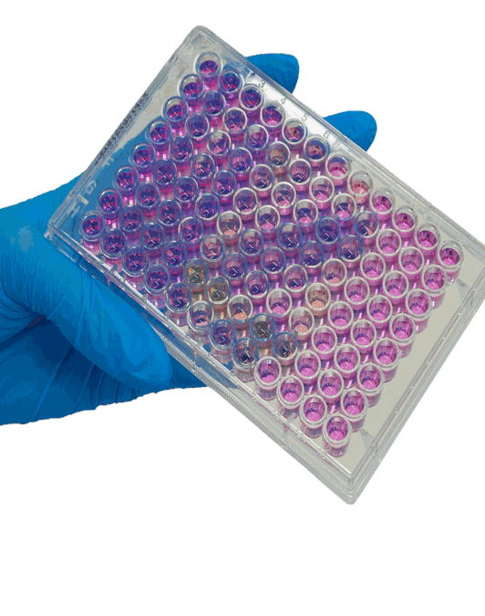
Genotoxicity Studies
MEETING REQUIREMENTS AND OECD GUIDELINES
Studies designed to meet regulatory requirements, including OECD 490 and 476.
Modern, higher-precision equipment, such as flow cytometry for micronucleus studies.
OECD 471
Bacterial Reverse Mutation (Ames)
OECD 474
In vivo Mammalian Erythrocyte Micronucleus
OECD 487
In vitro Mammalian Cell Micronucleus
OECD 476 / 490
In vitro Mammalian Cell Gene Mutation
SCI-AGRO • Commercial Presentation
11

Slide 12
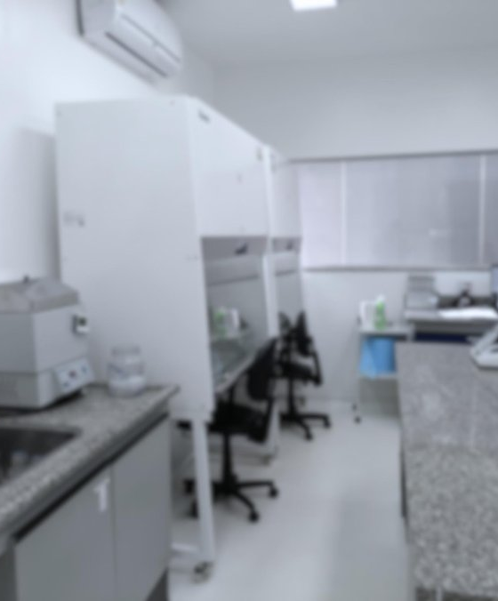

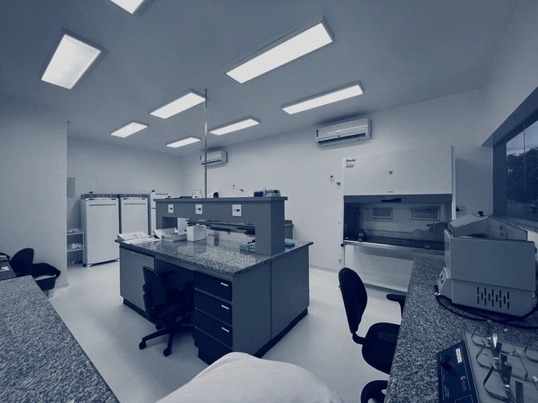
Genotoxicity Laboratory
PRECISION IN CELLULAR AND MOLECULAR STUDIES
A technical environment prepared for studies requiring repeatability, standardization and precise readings.
The combination of method, instrumentation and team reduces the margin of uncertainty in critical assessments.
SCI-AGRO • Commercial Presentation
12

Slide 13
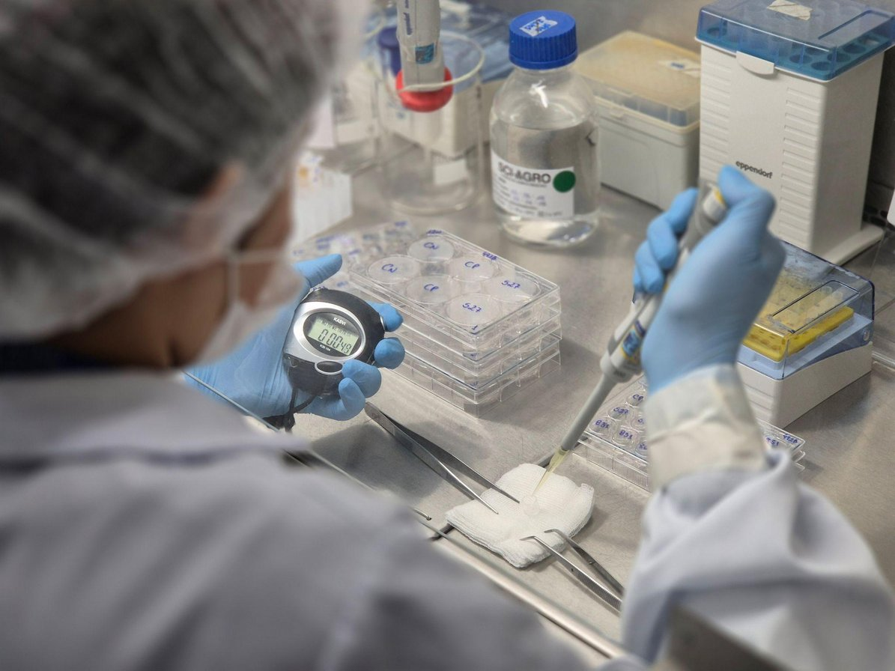
In vitro Toxicology Studies
TECHNICAL EXPANSION ALIGNED WITH CONCEA
Expanding in vitro toxicology, implementing new test guidelines as they are recognized by CONCEA (Brazil's national animal research council).
Includes guidelines such as 492B and 442D.
IATA (Integrated Approaches to Testing and Assessment).
Successful acceptance of OECD 490 studies for Phase II of a technical product.
Less reliance on in vivo models and greater technical speed whenever the guideline allows.
SCI-AGRO • Commercial Presentation
13

Slide 14
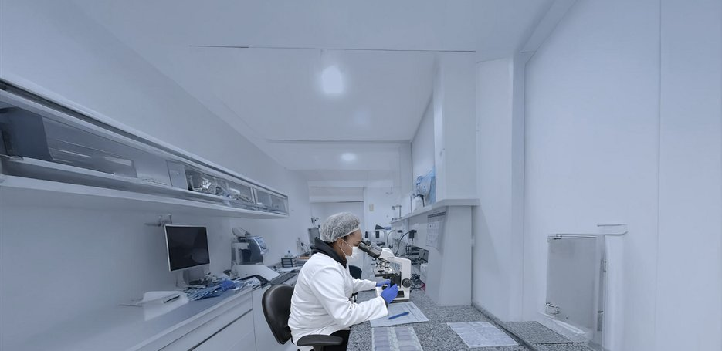
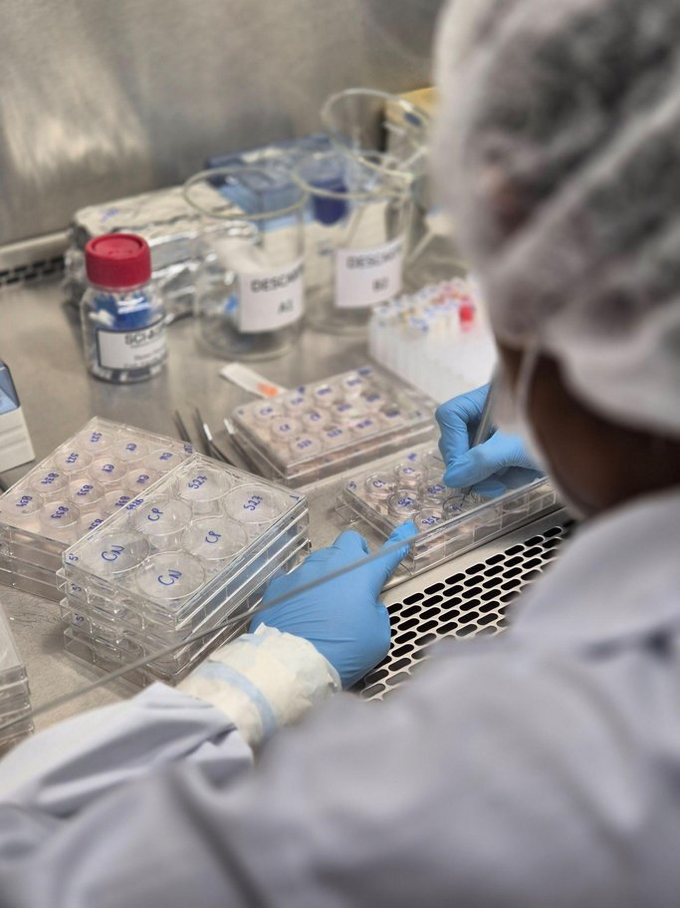
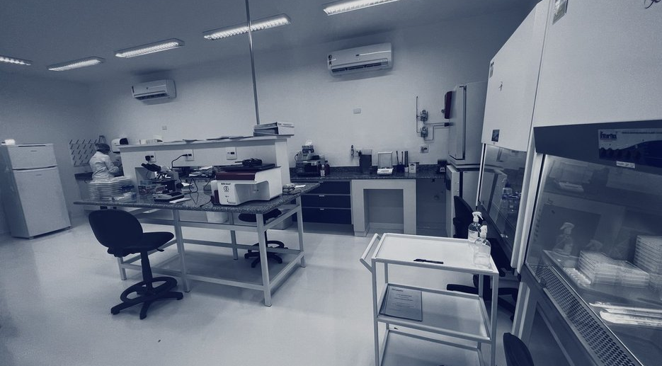
In vitro Toxicology Laboratory
NEW GUIDELINES, NEW MODELS, GREATER EFFICIENCY
A growing area for faster studies, with technical rigor and alignment with good practices.
The expansion of in vitro work follows regulatory developments and the search for technically accepted alternatives.
SCI-AGRO • Commercial Presentation
14

Slide 15
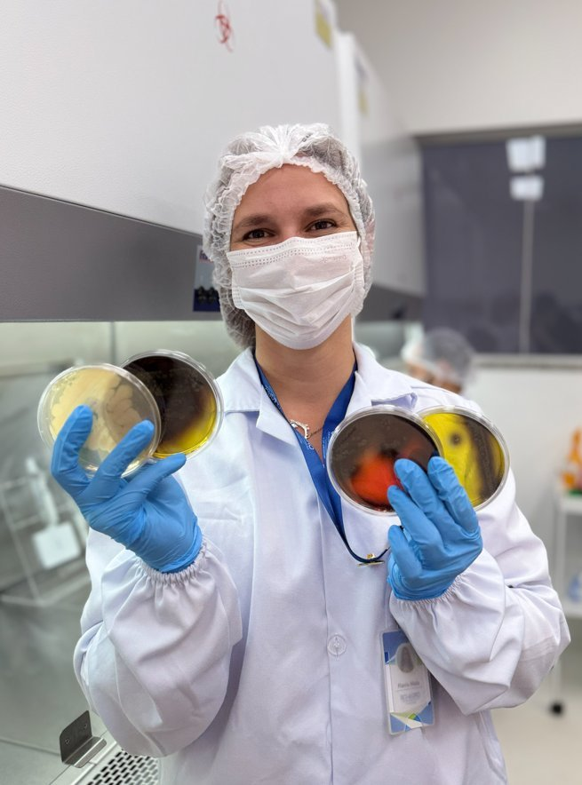
Microbiology Studies
MICROBIOLOGICAL SAFETY OF THE PRODUCT
SCI-AGRO performs microbiological analyses to assess the presence and behavior of microorganisms in different matrices, contributing to product quality and compliance with regulatory requirements.
Microbiology applied to safety and compliance
SCI-AGRO • Commercial Presentation
15

Slide 16
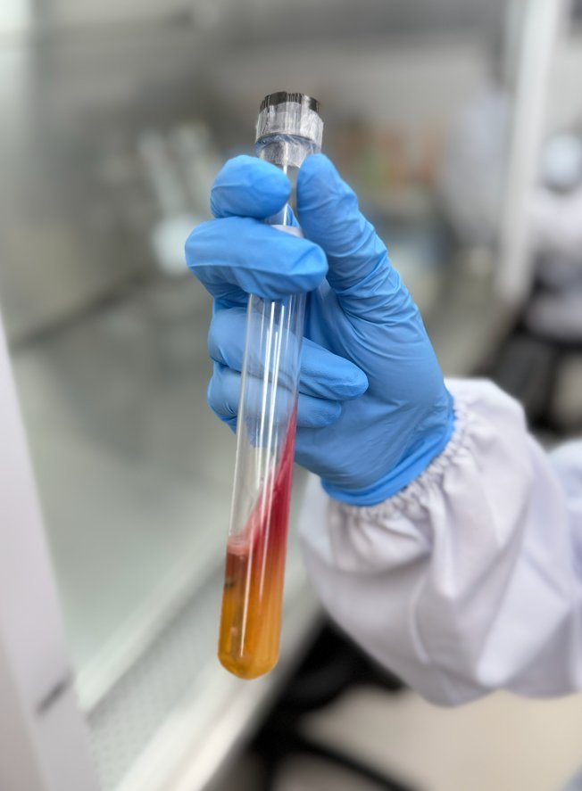
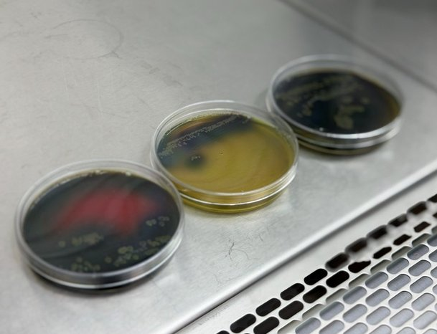
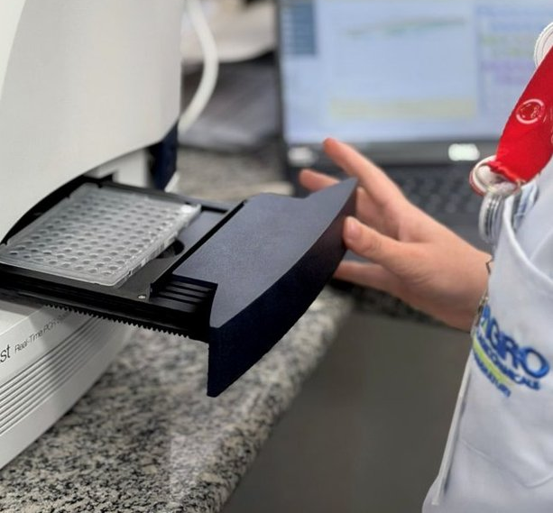
Microbiology Laboratory
CULTURE, ISOLATION AND COUNTING UNDER CONTROL
Assessment of the presence and behavior of microorganisms in different matrices;
Assays conducted to support quality control and product safety;
Infrastructure prepared for specific studies, including the Ames test with Salmonella to assess mutagenic potential.
Reliable microbiological data support safer decisions, regulatory compliance and responsible product development.
SCI-AGRO • Commercial Presentation
16

Slide 17
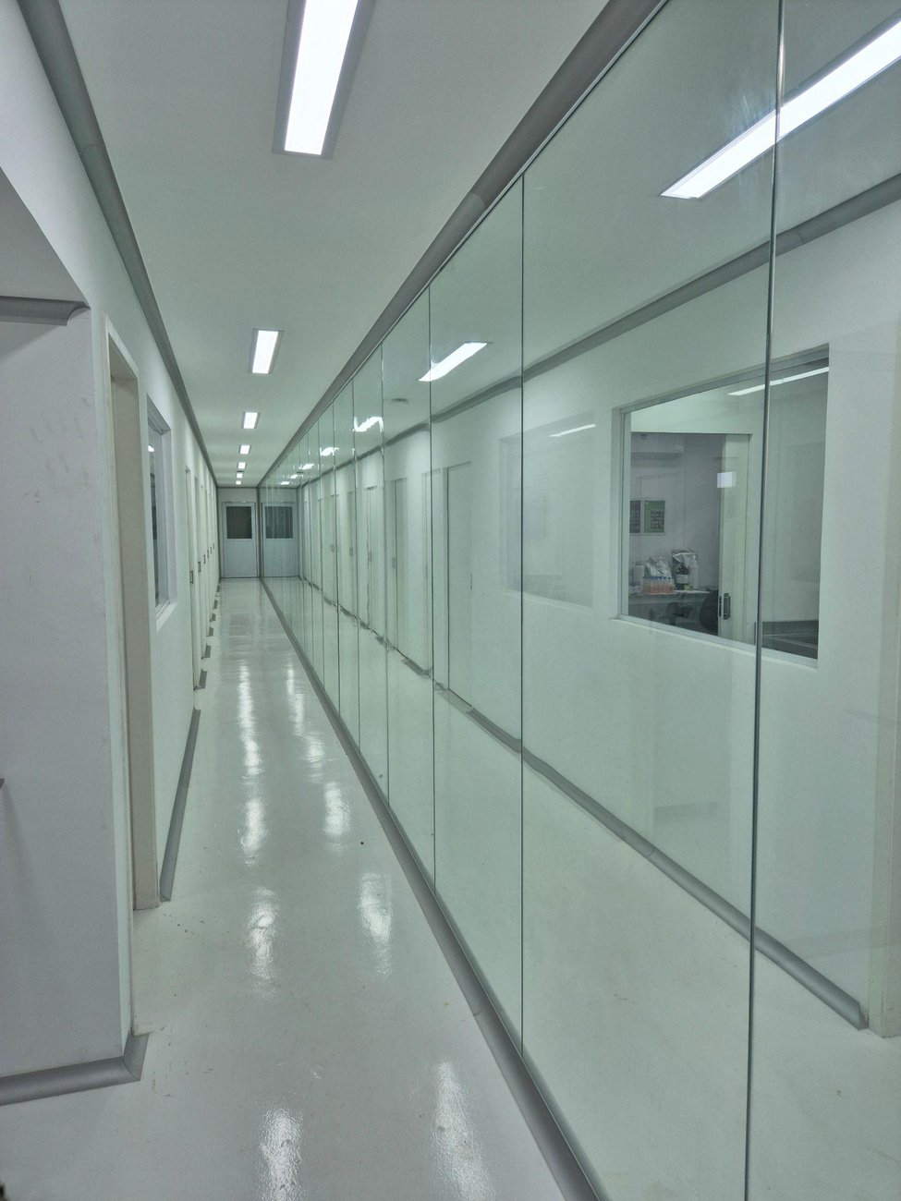
In vivo Toxicology Studies
RELIABILITY, CONTROL AND ETHICAL RESPONSIBILITY
Reduction in the number of in vivo studies: ocular, dermal and micronucleus.
Modern animal facility with an appropriate air exchange system and clean rooms, preventing external contamination.
SCI-AGRO CEUA (institutional animal care and use committee): tests reviewed and approved to minimize animal suffering.
Registered with CONCEA.
Environmental control and ethical responsibility are part of the reliability of the result.
SCI-AGRO • Commercial Presentation
17

Slide 18
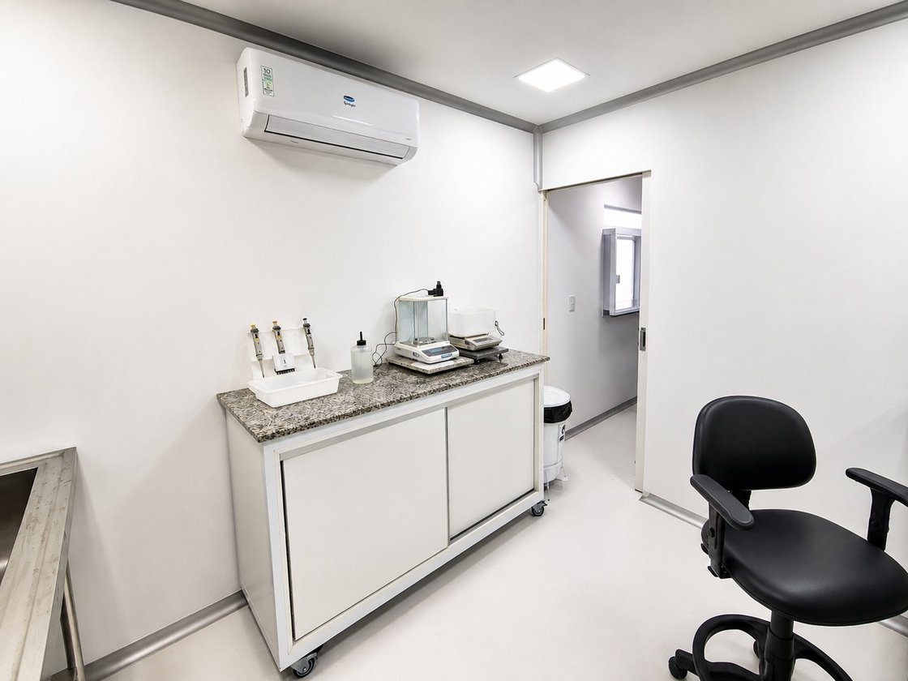
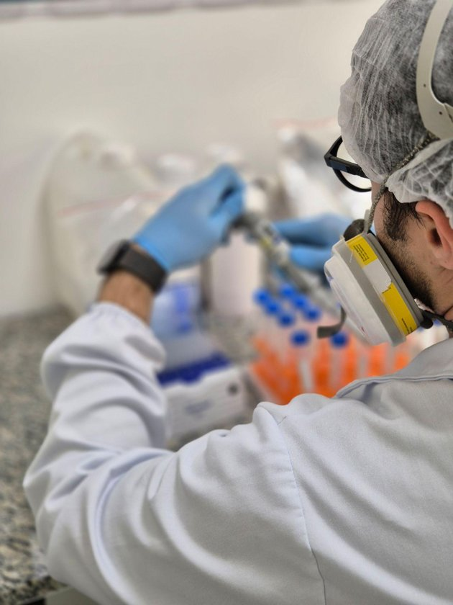
In vivo Toxicology Laboratory
CONTROLLED ENVIRONMENTS FOR CRITICAL STUDIES
Rooms, animal facility and operational flow designed to reduce external variables.
The routine combines controlled infrastructure, ethical approval and documented traceability.
SCI-AGRO • Commercial Presentation
18

Slide 19

Pesticide Residue Studies
ANALYTICAL PHASE WITH STATE-OF-THE-ART TECHNOLOGY
Analytical phase of residue studies.
Professionals experienced in method development, validation and analytical conduct.
State-of-the-art equipment: liquid chromatography (LC/MS-MS) and gas chromatography (GC/MS).
Able to act as Principal Investigator or Study Director.
Analytical precision to support regulatory decisions and product development.
SCI-AGRO • Commercial Presentation
19

Slide 20
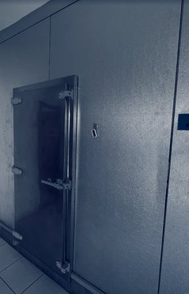
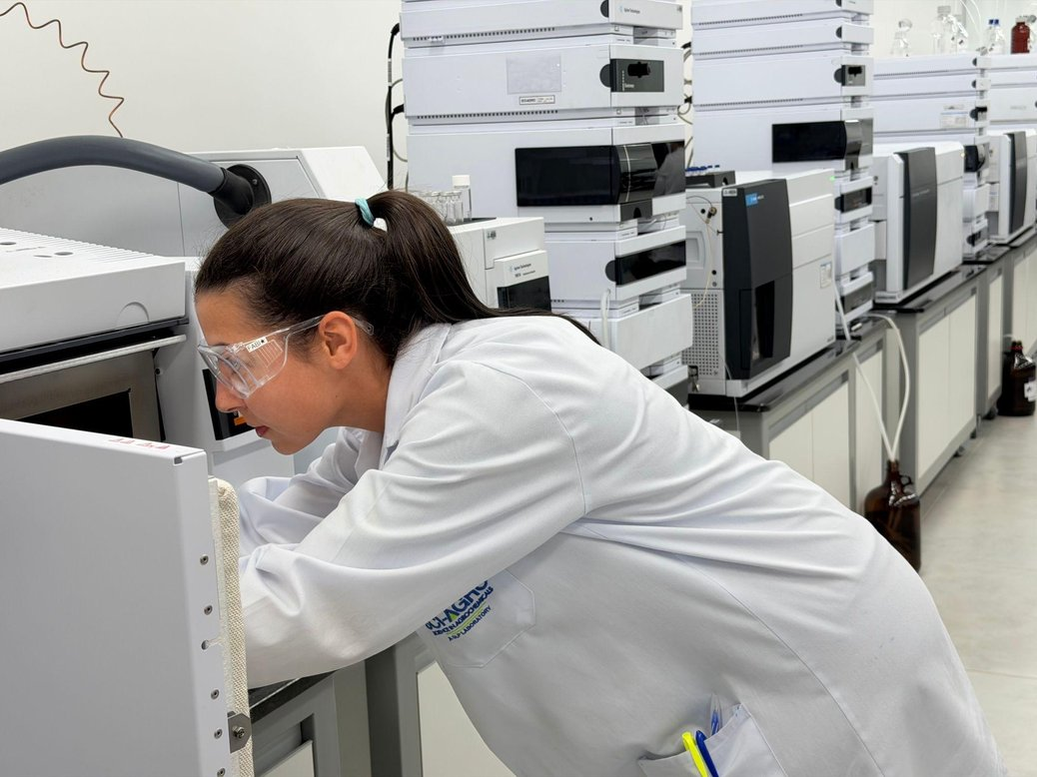
Pesticide Residue Laboratory
INSTRUMENTATION FOR SENSITIVE ANALYSES
Infrastructure focused on sensitive detection, traceability and data robustness.
A key stage for products that need to reach the market with technical consistency.
SCI-AGRO • Commercial Presentation
20

Slide 21



Predictive Toxicology
IN SILICO - QSAR
Use of at least three software platforms.
Cross-referencing of predictive data with literature data for a complete, well-founded report.
Approval by regulatory authorities with no further requirements.
Integration of software, literature and technical interpretation to reduce uncertainty.
SCI-AGRO • Commercial Presentation
21

Slide 22
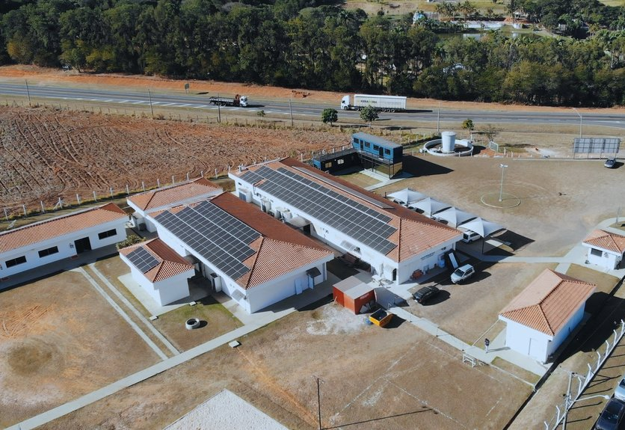



The SCI-AGRO Commitment
APPLIED SCIENCE TO BRING NEW PRODUCTS TO MARKET
Helping new and better products reach the market, with a commitment to safeguarding health, human safety and the protection of the environment.
ISO 17025
GLP
AAALAC
SCI-AGRO • Commercial Presentation
22

Slide 23
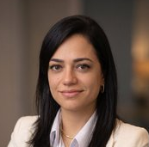
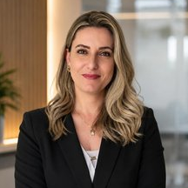
Contact
TALK TO OUR COMMERCIAL TEAM
Lahys Caetano Tomaz
lahys.caetano@sci-agro.com
Mobile +55 (19) 98196-4544
Commercial Director
Ellen Moraes
e.moraes@sci-agro.com
Mobile +55 (19) 99946-2639
Commercial Manager
sales@sci-agro.com
Phone: +55 (19) 3186-2117
Mobile: +55 (19) 99506-0422
LinkedIn: SCI-AGRO
Instagram: @sciagrolab
SCI-AGRO • Commercial Presentation
23

