Slide 1
Session 3: Fission gas behaviour

Slide 2
Nuclear fuel rod
Stack of oxide (UO₂ / MOX) fuel pellets wrapped in metallic (zircaloy / stainless steel) cladding.
Used in both thermal and fast reactors.
Its performance is fundamental for safety and efficiency.
Spring
Plenum
Cladding
Fuel
Gap
Helium

Slide 3
Nuclear fuel rod
Use of fuel performance codes and integral irradiation experiments:
To assess the fuel rod thermo-mechanical behaviour (σ, ε, and T)
Fission gas behaviour = gaseous swelling & fission gas release
How does fission gas affect the safety and performance of the fuel rod?
Spring
Plenum
Cladding
Fuel
Gap
Helium

Slide 4
Nuclear fuel rod behaviour
Thermo-mechanics
Modelling and simulation of many interrelated phenomena:
Thermo-mechanical
Thermo-chemical
Micro-structural evolution
Irradiation effects on materials
Coolant temperature
Thermo-chemistry
Power
Cladding temperature
Irradiation effects on material
Neutronics
Fuel temperature
Micro-structural evolution
Fission products

Slide 5







Nuclear fuel rod, multi-scale modelling approach
Engineering scale, fuel rod
Fuel pellet
Fuel grain-scale, microstructure
Spring
Plenum
Gap
Pellet
Grain boundary
Cladding
Grains
Cladding
Fuel
Grain boundary
Gap
Intergranular bubbles
Helium

Slide 6
Multi-scale modelling approach, requirements
Physics-based models, to bridge between different scales:
From the atomic scale
Up to the macroscopic, engineering scale of the fuel rod
Requirements:
Numerical robustness
Low computational time for effective use within fuel performance codes
Meso-scale model called at each thermo-mechanical iteration, in each time-step of the simulation, in each mesh point
Possibly, open-source!
Plenum
Spring
Cladding
Fuel
Gap
Helium
Grain boundary
Intergranular bubbles

Slide 7
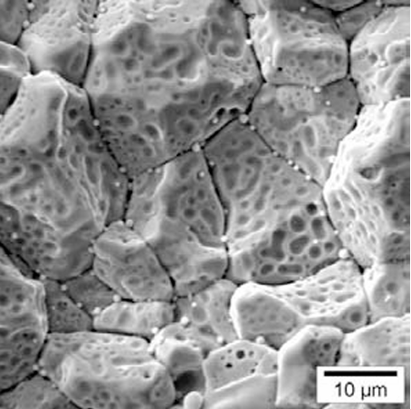
Nuclear fuel, UO₂ grain

Slide 8

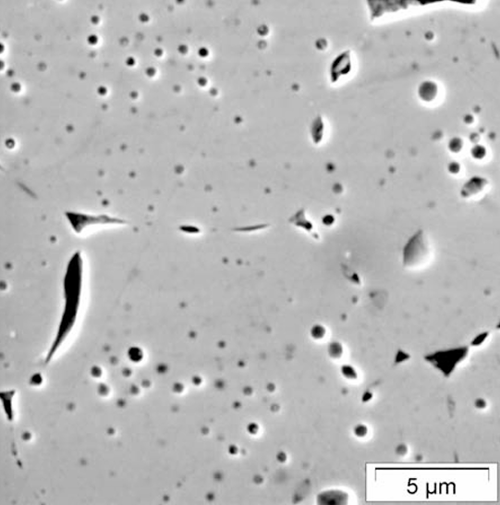
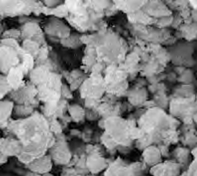
Fission gas behaviour, main physical aspects
Fission reactions
Fission gases (Xe, Kr) and fission products (Cs, I, Te, …)
Intra-granular (single atoms)
Diffusion
Trapping
Inter-granular / grain-boundary bubbles
Intra-granular bubbles
Re-solution
Gaseous fuel swelling
Grain-face saturation and/or micro-cracking
High-burnup structure
Fission gas release

Slide 9

SCIANTIX, fission gas behaviour modelling
Zero-dimensional (0D) stand-alone code
Developed at Politecnico di Milano
To model fission gas behaviour using physics-based approaches
Designed for the development, verification, and validation of fission gas behaviour models, as well as for the simulation of separate-effect test experiments
Can be integrated into multi-physics platforms and fuel performance codes
SCIANTIX 2.0 released as open-source software under the MIT license

Slide 10



SCIANTIX, main features
0D stand-alone code, describing fission gas behaviour with physics-based approaches:
Stable and radioactive fission gases, helium
Gaseous swelling, fuel microstructure
Standard version
https://github.com/sciantix/sciantix-official
Verified (method of manufactured solutions)
Validated (separate-effect experiments)
Regression test available
Coupling with fuel performance codes
TRANSURANUS (JRC-Ka)
FRAPCON/FRAPTRAN (CIEMAT, Madrid)
OFFBEAT (EPFL, Lausanne)

Slide 11

Education and training
Massive Open Online Course (MOOC) on fission gas behaviour, produced within OperaHPC (WP8).
Soon to be distributed via Polimi Open Knowledge platform!

Slide 12
Intra-granular fission gas behaviour
Fission reactions
Fission gases (Xe, Kr) and fission products (Cs, I, Te, …)
Intra-granular (single atoms)
Diffusion
Trapping
Inter-granular / grain-boundary bubbles
Intra-granular bubbles
Re-solution
Gaseous fuel swelling
Grain-face saturation and/or micro-cracking
High-burnup structure (HBS)
Fission gas release

Slide 13
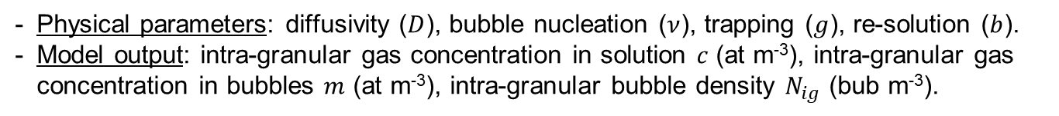
The SCIANTIX code, intra-granular fission gas behaviour
Physical parameters: diffusivity ($D$), bubble nucleation ($ν$), trapping ($g$), re-solution ($b$).
Model output: intra-granular gas concentration in solution $c$ (at m⁻³), intra-granular gas concentration in bubbles $m$ (at m⁻³), intra-granular bubble density $N_{ig}$ (bub m⁻³).
Gap
Pellet
Grain boundary
Grains
Cladding
Grain boundary
Intergranular bubbles

Slide 14
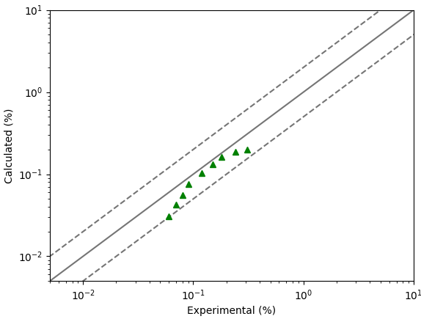
Intra-granular bubble evolution, separate-effect validation
Figure of merit: Intra-granular gaseous swelling
Separate-effect validation performed in SCIANTIX: agreement with experimental data
Experimental data from Baker, 1977, JNM.
Calculation from G. Zullo, PhD Thesis, 2024.

Slide 15
Inter-granular fission gas behaviour
Fission reactions
Fission gases (Xe, Kr) and fission products (Cs, I, Te, …)
Intra-granular (single atoms)
Diffusion
Trapping
Inter-granular / grain-boundary bubbles
Intra-granular bubbles
Re-solution
Gaseous fuel swelling
Grain-face saturation and/or micro-cracking
High-burnup structure
Fission gas release

Slide 16
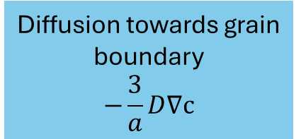
The SCIANTIX code, inter-granular fission gas behaviour
Fission gases from the intra-granular diffusion are accumulated in grain-boundary bubbles
Grain boundary bubble evolution leads to fission gas release and gaseous swelling
Gap
Pellet
Grain boundary
Grains
Cladding
Grain
Grain boundary
Fission gas release
Trapping
Re-solution
Fission gas in grain-boundary bubbles

Slide 17
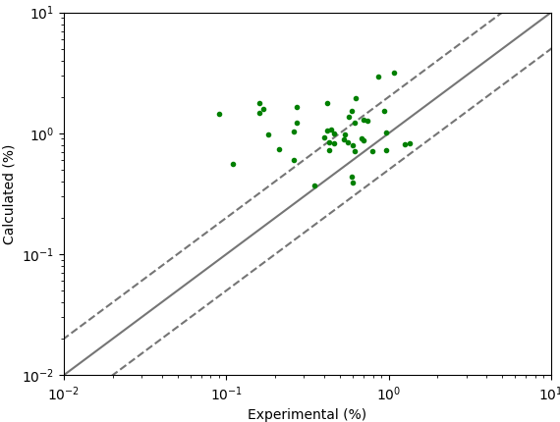
Inter-granular bubble evolution, separate-effect validation
Figure of merit: Inter-granular gaseous swelling
Separate-effect validation performed in SCIANTIX: agreement with experimental data
Data from White, 2004.
Calculation from G. Zullo, PhD Thesis, 2024.

Slide 18
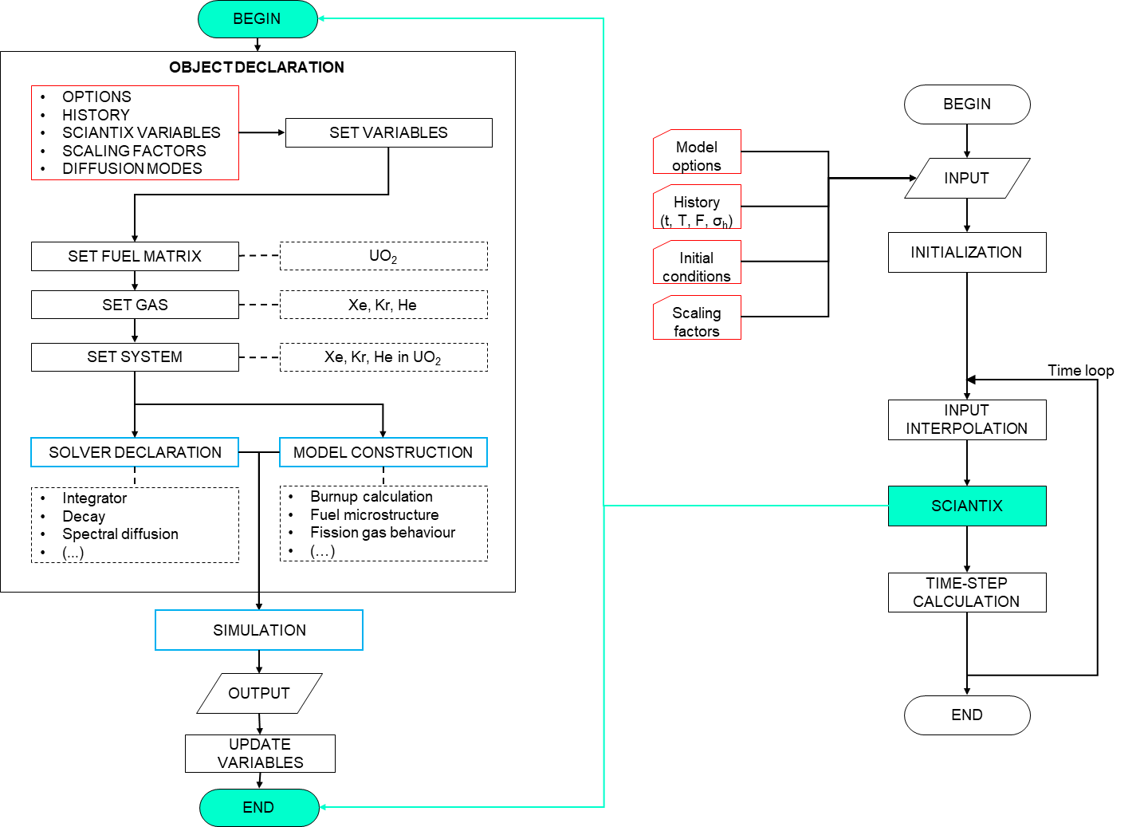
The SCIANTIX flowchart
External shell (right) representing the coupling with fuel performance codes (TRANSURANUS, OFFBEAT, …)
Meso-scale module (left) containing physical / behavioural models
Construction of specific objects for fission gas behaviour modelling
Definition of solvers (robust numerics)
Simulation = models + solvers
  Verification and validation, continuous activities, matrix of cases for non-regression tests

Slide 19
The SCIANTIX inheritance diagram
Variable
Variable
Material
Material
Variable
PhysicsVariable
PhysicsVariable
Variable
Gas
Matrix
InputVariable
HistoryVariable
SciantixVariable
InputVariable
System
Solver
Model
Simulation

Slide 20

The SCIANTIX inheritance diagram
Variable
Variable
Material
Material
Variable
PhysicsVariable
PhysicsVariable
Variable
Gas
Matrix
InputVariable
HistoryVariable
SciantixVariable
InputVariable
System
Helium in UO₂ / MOX
Solver
Model
Helium behaviour
Production
Diffusion
Solubility
Interaction with fission gases 🡪 bubbles
Simulation

Slide 21

The SCIANTIX inheritance diagram
Variable
Variable
Material
Material
Variable
PhysicsVariable
PhysicsVariable
Variable
Gas
Matrix
InputVariable
HistoryVariable
SciantixVariable
InputVariable
System
Cesium (Cs), Iodine (I), Tellurium (Te),
CsI, … in … UO₂/MOX
Solver
Model
Interaction with thermochemistry module
Useful for experimental design (source term estimation)
Step towards Joint Oxyde-Gaine models
Simulation

Slide 22

The SCIANTIX inheritance diagram
Variable
Variable
Material
Material
Variable
PhysicsVariable
PhysicsVariable
Variable
Gas
Matrix
InputVariable
HistoryVariable
SciantixVariable
InputVariable
System
Solver
Model
Connected to fuel microstructure (e.g., high-burnup structure)
Connection to material properties
Use of advanced modelling techniques (surrogate modelling)
Simulation

Slide 23
Exercises on fission gas behaviour with SCIANTIX

Slide 24

The SCIANTIX code
SCIANTIX GitHub repository: https://github.com/sciantix/sciantix-official
  Includes "training" branch with tutorials and code executable
Input files: history, settings, initial conditions, scaling factors
Simulation cases:
  Constant irradiation condition
  Transient irradiation condition

Slide 25
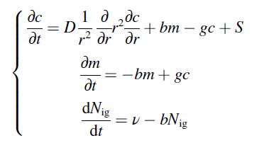
The SCIANTIX code, intra-granular fission gas behaviour
Physical parameters: diffusivity ($D$), bubble nucleation ($ν$), trapping ($g$), re-solution ($b$).
Model output: intra-granular gas concentration in solution $c$ (at m⁻³), intra-granular gas concentration in bubbles $m$ (at m⁻³), intra-granular bubble density $N_{ig}$ (bub m⁻³).
Gap
Pellet
Grain boundary
Grains
Cladding
Grain boundary
Intergranular bubbles

Slide 26
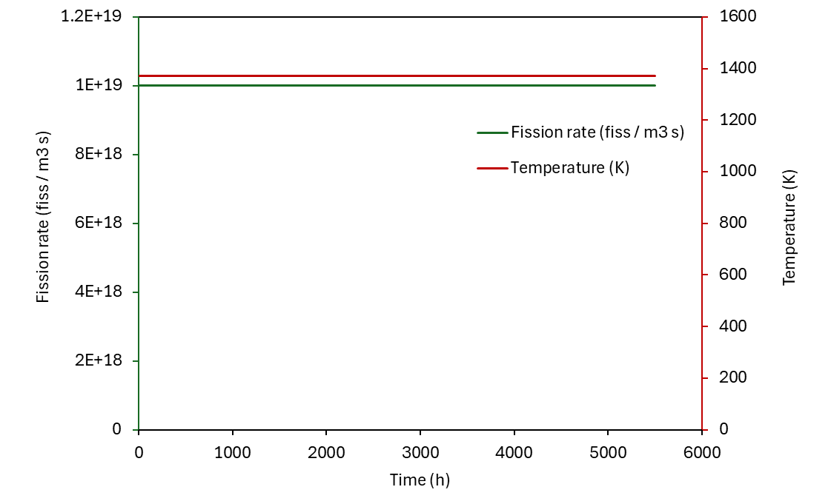

Simulation case: stationary irradiation conditions
input_history.txt
Constant temperature, 1373 K
Constant fission rate density, 10¹⁹ fiss m⁻³ s⁻¹
Zero hydrostatic stress applied
The irradiation time is 5500 hours

Slide 27
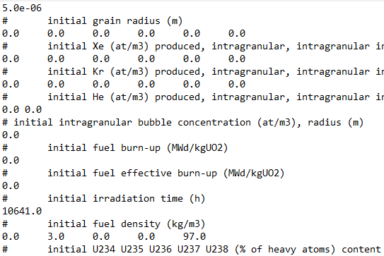
Simulation case: stationary irradiation conditions
input_initial_conditions.txt
Fresh, unirradiated UO₂, 3%at.-enriched
Grain radius = 5 µm

Slide 28
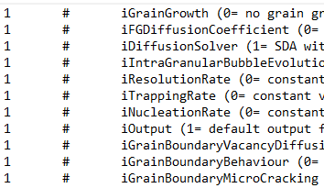
Simulation case: stationary irradiation conditions
input_settings.txt
Each entry corresponds to a modelling option for a specific physical phenomenon
In this tutorial, we use default settings, which includes validated models for the physical phenomena of interest

Slide 29
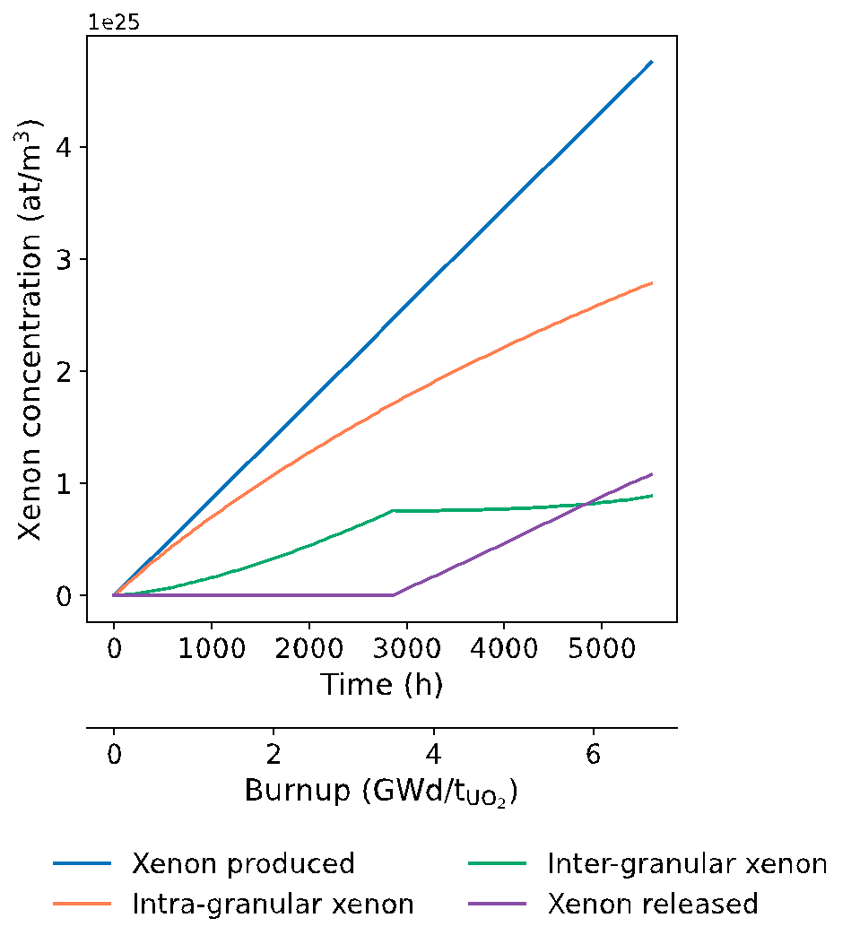
Simulation results: stationary irradiation conditions
The xenon produced (blue line) increases linearly as the product between the xenon fission yield, fission rate and irradiation time
A fraction of the gas produced remains in the grain (orange line) as gas in solution and gas in the bubbles
The gas that reaches the grain boundary (green line) is eventually released (violet line) when the saturation of the grain boundary is reached

Slide 30
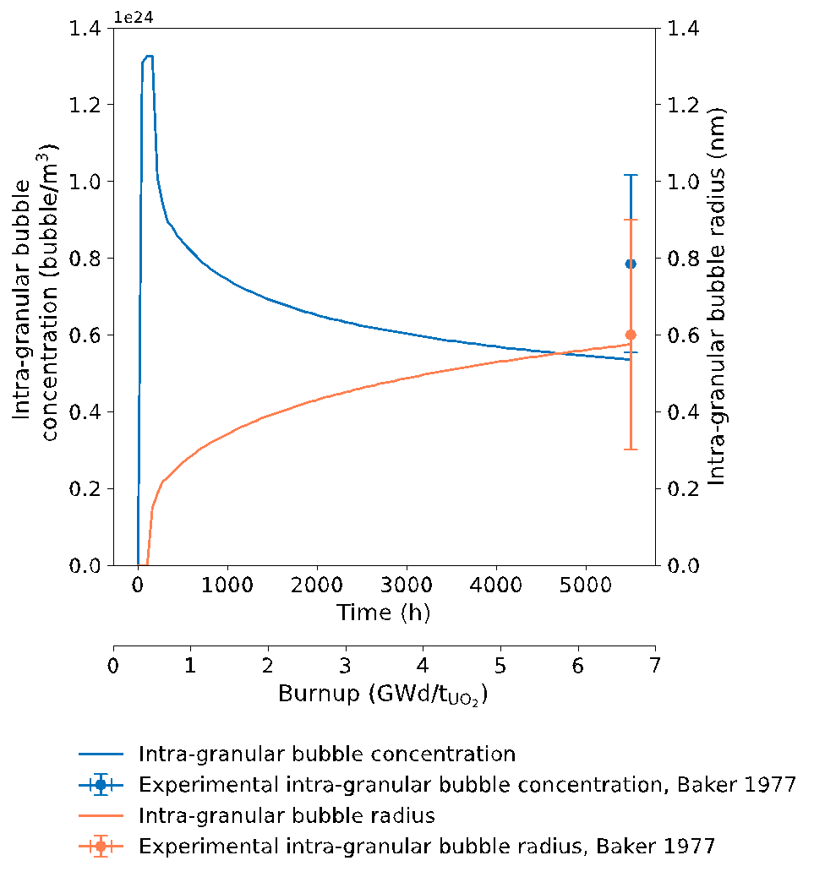
Simulation results: stationary irradiation conditions
The initial increase of intra-granular bubble concentration (blue line) is due to the nucleation
As the intra-granular bubble radius (orange line) increases steadily as a result of trapping, the intra-granular bubble concentration decreases with burnup

Slide 31

The SCIANTIX code, inter-granular fission gas behaviour
Fission gases, from the intra-granular diffusion, are accumulated in grain-boundary bubbles
Grain-boundary bubble evolution leads to fission gas release and gaseous swelling
Gap
Pellet
Grain boundary
Grains
Cladding
Grain
Grain boundary
Fission gas release
Trapping
Re-solution
Fission gas in grain-boundary bubbles

Slide 32
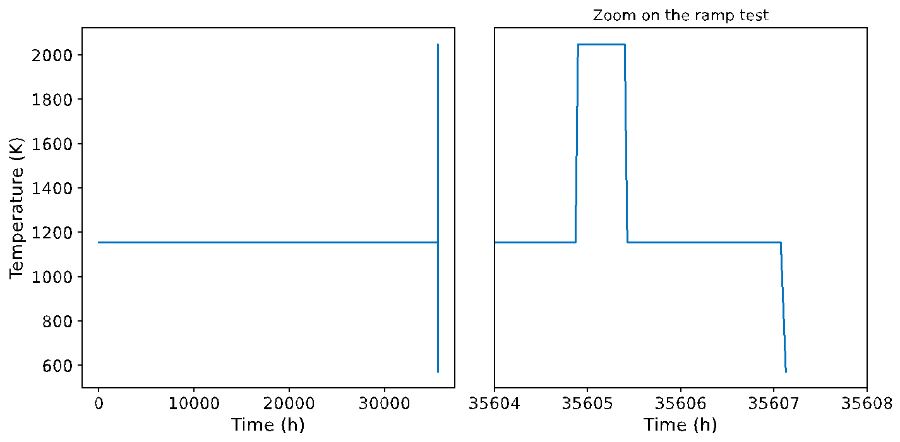
Simulation case: transient irradiation conditions
One of the experimental UO₂ sample of White, 2004 to showcase the SCIANTIX capabilities in a case of irradiation under transient conditions

Slide 33
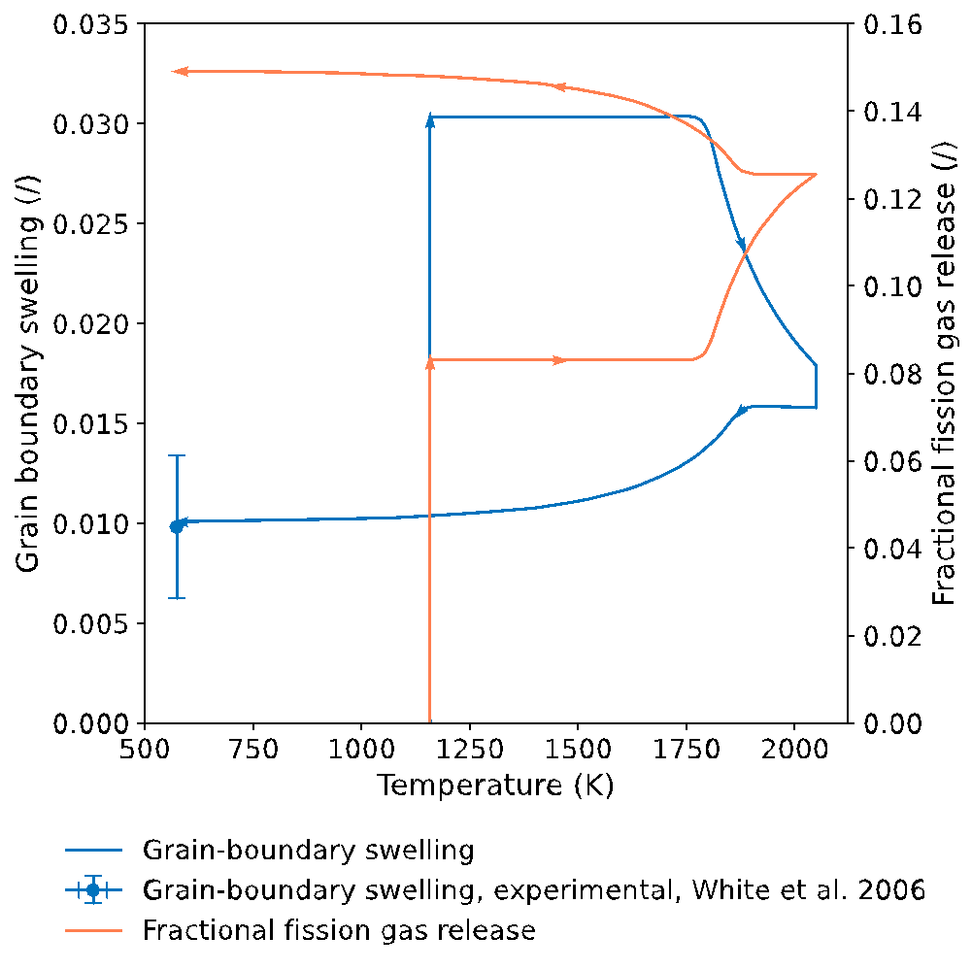
Simulation results: transient irradiation conditions
Base irradiation corresponds to the vertical line at 1157 K and the holding on top of the temperature ramp corresponds to the vertical line at 2048 K
The increase of grain-boundary swelling during the base irradiation is due to the absorption of vacancy
The reduction in grain-boundary swelling during the heating and cooling transient arises from the burst release triggered by grain-boundary micro-cracking (Barani et al., 2017)

Slide 34
References
Baker, C. (1977). The fission gas bubbles distribution in uranium dioxide from high temperature irradiated SGHWR fuel pins. Journal of Nuclear Materials, 66, 283–291. https://doi.org/10.1016/0022-3115(77)90117-9
Pizzocri, D., Barani, T., & Luzzi, L. (2020). SCIANTIX: A new open source multi-scale code for fission gas behaviour modelling designed for nuclear fuel performance codes. Journal of Nuclear Materials, 532, 152042. https://doi.org/10.1016/j.jnucmat.2020.152042
Zullo, G., Pizzocri, D., & Luzzi, L. (2023). The SCIANTIX code for fission gas behaviour: Status, upgrades, separate-effect validation, and future developments. Journal of Nuclear Materials, 587, 154744. https://doi.org/10.1016/j.jnucmat.2023.154744
White, R. J. (2004). The development of grain-face porosity in irradiated oxide fuel. Journal of Nuclear Materials, 325(1), 61–77. https://doi.org/10.1016/j.jnucmat.2003.10.008
Zullo, G. (2024). Development and assessment of an open-source code for fission gas and volatile fission products behaviour in LWR fuel (PhD dissertation, Politecnico di Milano). https://www.politesi.polimi.it/handle/10589/228452
Barani, T., Bruschi, E., Pizzocri, D., Pastore, G., Van Uffelen, P., Williamson, R. L., & Luzzi, L. (2017). Analysis of transient fission gas behaviour in oxide fuel using BISON and TRANSURANUS. Journal of Nuclear Materials, 486,96–110. https://doi.org/10.1016/j.jnucmat.2017.01.050

Slide 35
Thank you for your attention

