Slide 1

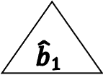

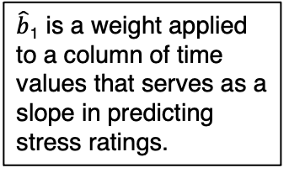
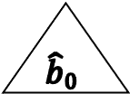




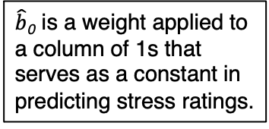

A: OLS path diagram
B: OLS matrix notation
$$\hat{b}0$$
Stress
1
Time
$\hat{b}$₁
ε
=
+
$\hat{b}$₀ is a weight applied to a column of 1s that serves as a constant in predicting stress ratings.
$$\hat{b}0$$
$$\hat{b}1$$
$\hat{b}$₁ is a weight applied to a column of time values that serves as a slope in predicting stress ratings.
4.95
4.91
4.92
4.25
5.17
4.69
4.60
3.97
5.20
5.22
5.15
4.76
Stress_{ij}
1
1
1
1
1
1
1
1
1
1
1
1
1_{ij}
0
1
2
3
0
1
2
3
0
1
2
3
Time_{ij}
$$\hat{b}0$$
-0.07
0.09
0.33
-0.12
0.14
-0.13
0.00
-0.40
0.17
0.41
0.56
0.38
ε_{ij}
+
$\hat{b}$₁
1
Time_{ij}
=
Stress_{0j}
Stress_{1j}
Stress_{2j}
Stress_{3j}
y
=
$$X$$
$$\hat{β}$$
+
ε
C: Matrix solution for b₀ and b₁
ε_{1j}
ε_{2j}
ε_{2j}
ε_{3j}
$\hat{β}$ = (XʹX)⁻¹ Xʹy

Slide 2
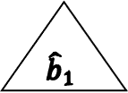
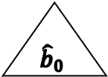
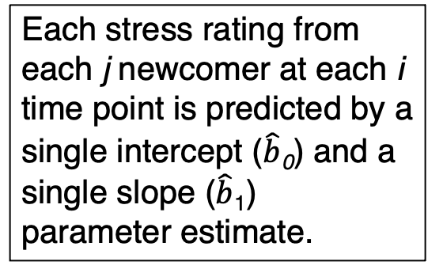
Each stress rating from each j newcomer at each i time point is predicted by a single intercept ($\hat{b}$₀) and a single slope ($\hat{b}$₁) parameter estimate.
$$\hat{b}0$$
$$\hat{b}1$$
1
Time_{ij}
Stress_{0j}
Stress_{1j}
Stress_{2j}
Stress_{3j}
ε_{1j}
ε_{2j}
ε_{2j}
ε_{3j}

Slide 3
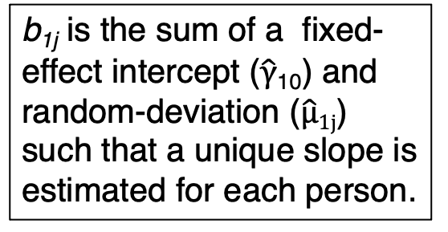
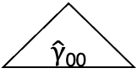
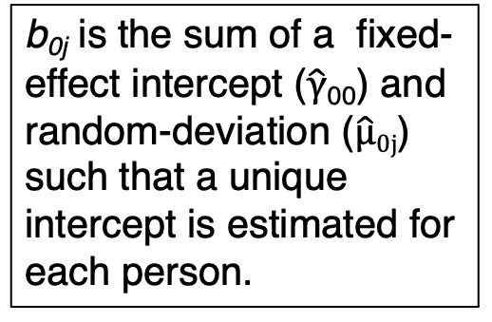
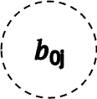



$\hat{γ}$₀₀
$\hat{γ}$₁₀
b_{0j} is the sum of a fixed-effect intercept ($\hat{γ}$₀₀) and random-deviation ($\hat{µ}0j$) such that a unique intercept is estimated for each person.
b_{1j} is the sum of a fixed-effect intercept ($\hat{γ}$₁₀) and random-deviation ($\hat{µ}1j$) such that a unique slope is estimated for each person.
$b$_{0j}
b_{1j}
$$\hat{µ}0j$$
$\hat{µ}$_{1j}
1
Time_{ij}
Stress_{0j}
Stress_{1j}
Stress_{2j}
Stress_{3j}
ε_{0j}
ε_{1j}
ε_{2j}
ε_{3j}

Slide 4

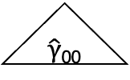


The intercept (b_{0j}) is now a latent variable that is specified with identical loadings (1) so that it is estimated as a constant.
$\hat{γ}$₀₀
$\hat{γ}$₁₀
The slope (b_{1j}) is now a latent variable that is specified with increasing loadings (0, 1, 2, and 3) to specify a linear pattern of change.
$$\hat{µ}0j$$
b_{0j}
b_{1j}
$\hat{µ}$_{1j}
0
1
2
3
1
1
1
1
Stress_{0j}
Stress_{1j}
Stress_{2j}
Stress_{3j}
ε_{0j}
ε_{1j}
ε_{2j}
ε_{3j}

Slide 5




$\hat{γ}$₀₀
$\hat{γ}$₁₀
$$\hat{σ}00$$
b_{0j}
b_{1j}
$$\hat{σ}10$$
0
4
1
2
3
1
1
1
1
1
Sress_{0j}
Stress_{1j}
Stress_{2j}
Stress_{3j}
Stress_{4j}
ε_{0j}
ε_{1j}
ε_{2j}
ε_{3j}
ε_{4j}

Slide 6
$\hat{γ}$₀₀
$\hat{γ}$₁₀
$$\hat{σ}00$$
b_{0j}
b_{1j}
$$\hat{σ}10$$
Time_{0j}
Time_{4j}
Time_{1j}
Time_{2j}
Time_{3j}
1
1
1
1
1
Sress_{0j}
Stress_{1j}
Stress_{2j}
Stress_{3j}
Stress_{4j}
ε_{0j}
ε_{1j}
ε_{2j}
ε_{3j}
ε_{4j}

Slide 7












A categorical latent variable specifies three response groups
C
$\hat{γ}$¹₀₀
$\hat{γ}$¹₀₀
$\hat{γ}2$₀₀
$\hat{γ}21$₀
$\hat{γ}3$₀₀
$\hat{γ}31$₀
b¹_{0j}
b¹_{1j}
$$\hat{µ}20j$$
b²_{0j}
b²_{1j}
$$\hat{µ}21j$$
$$\hat{µ}30j$$
b³_{0j}
b³_{1j}
$$\hat{µ}10j$$
$$\hat{µ}11j$$
$$\hat{µ}31j$$
0
0
0
1
2
1
2
1
2
3
3
3
1
1
1
1
1
1
1
1
1
1
1
1
Stress
_{T0}
Stress
_{T1}
Stress
_{T2}
Stress
_{T3}
Stress
_{T0}
Stress
_{T1}
Stress
_{T2}
Stress
_{T3}
Stress
_{T0}
Stress
_{T1}
Stress
_{T2}
Stress
_{T3}
ε¹_{0j}
ε¹_{1j}
ε¹_{2j}
ε¹_{3j}
ε²_{0j}
ε²_{1j}
ε²_{2j}
ε²_{3j}
ε³_{0j}
ε³_{1j}
ε³_{2j}
ε³_{3j}

Slide 8
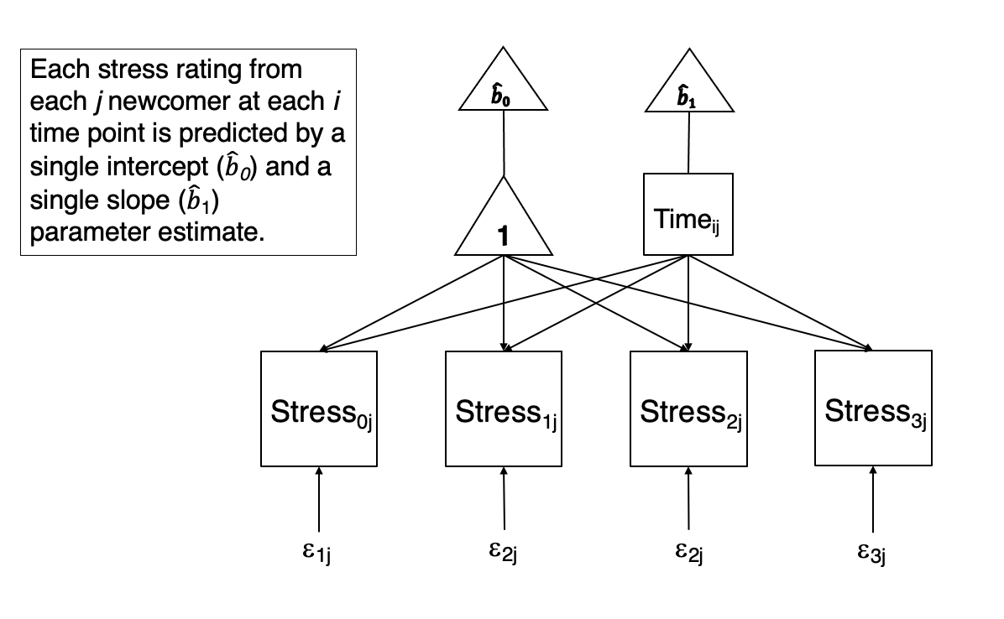
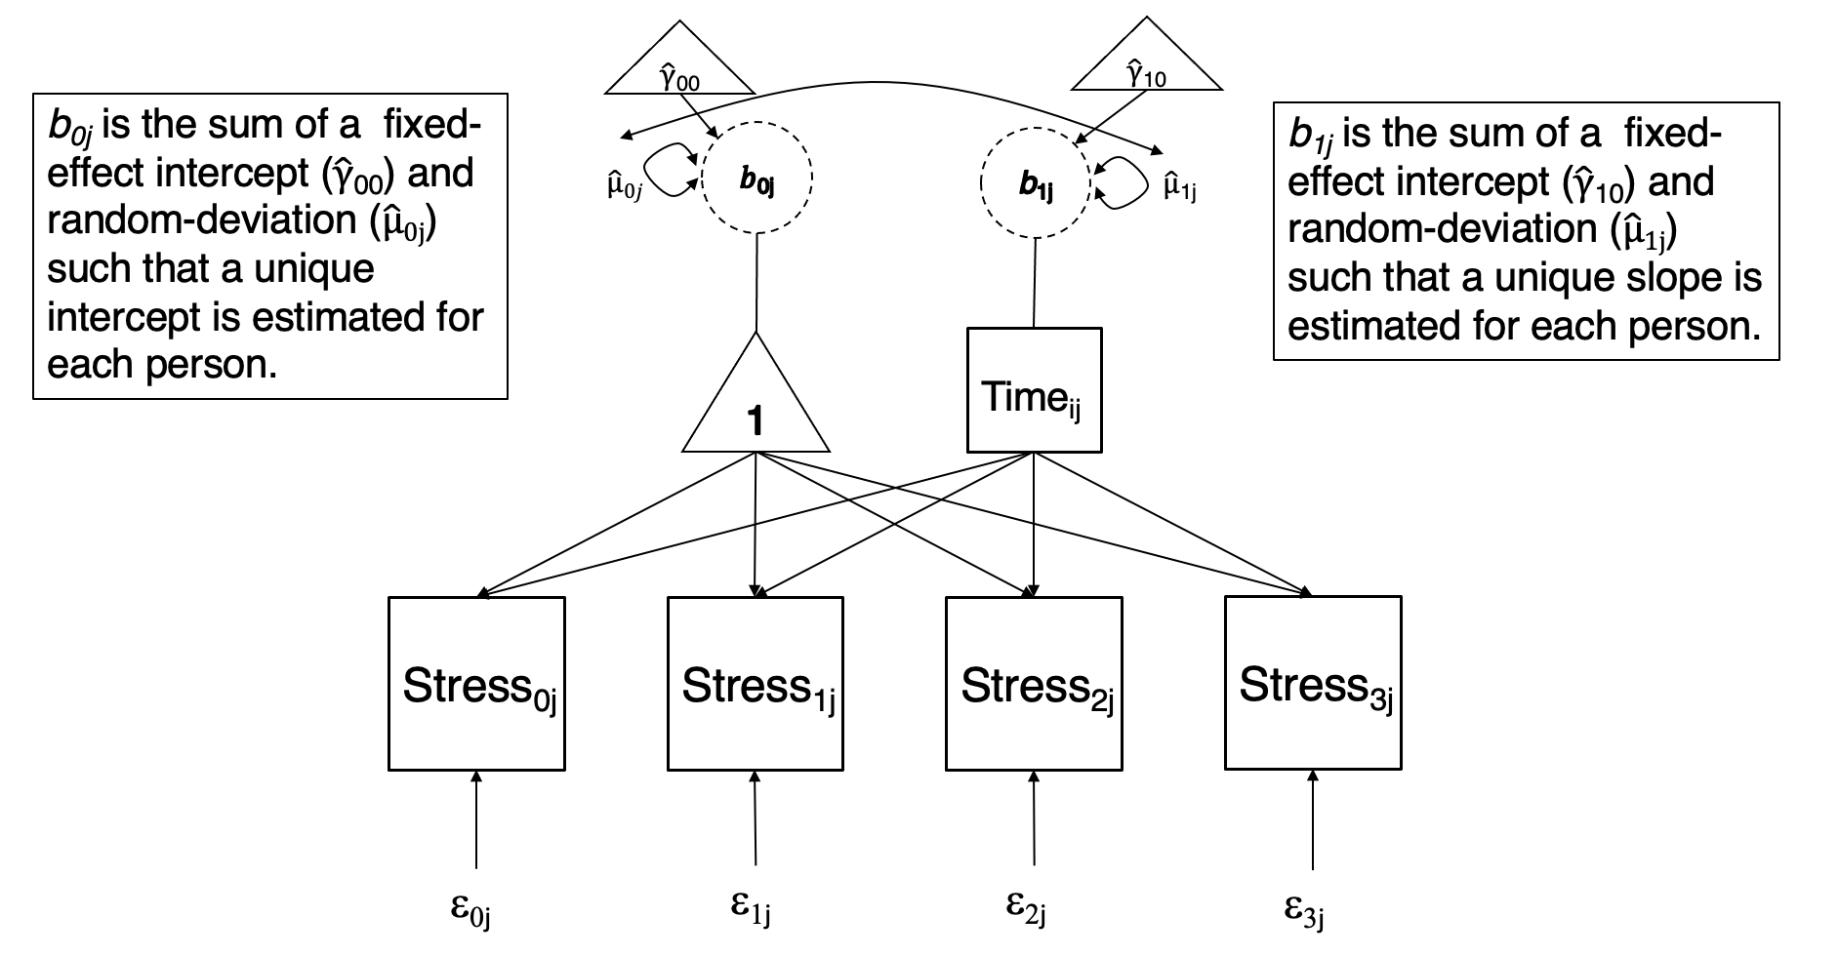
A: OLS path diagram
B: Multilevel path diagram

Slide 9
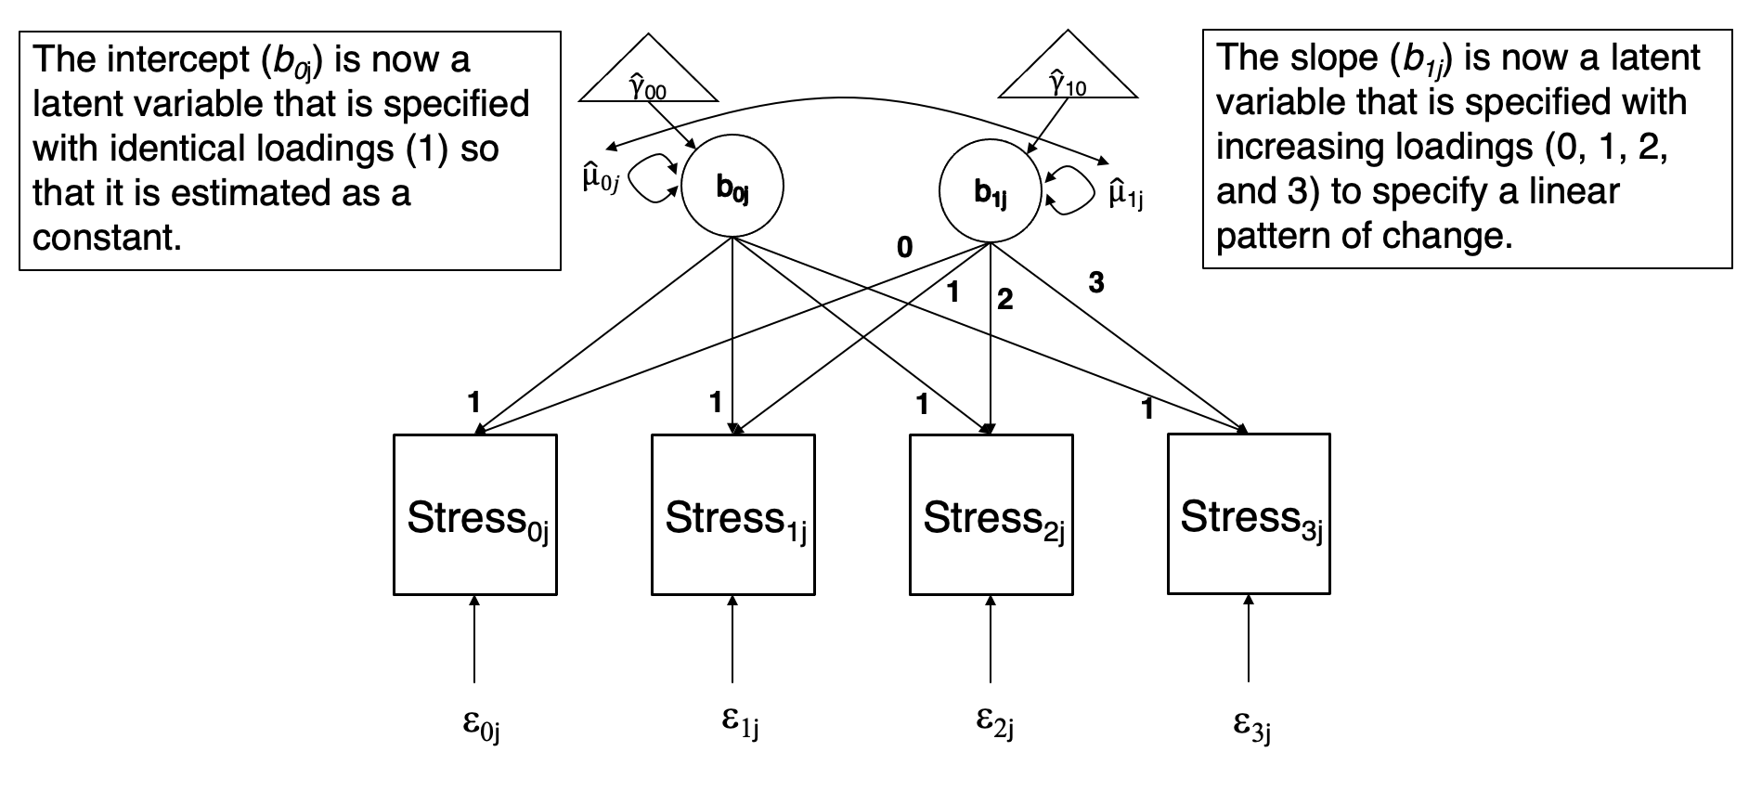
B: Latent growth curve path diagram
A: Multilevel path diagram

Slide 10
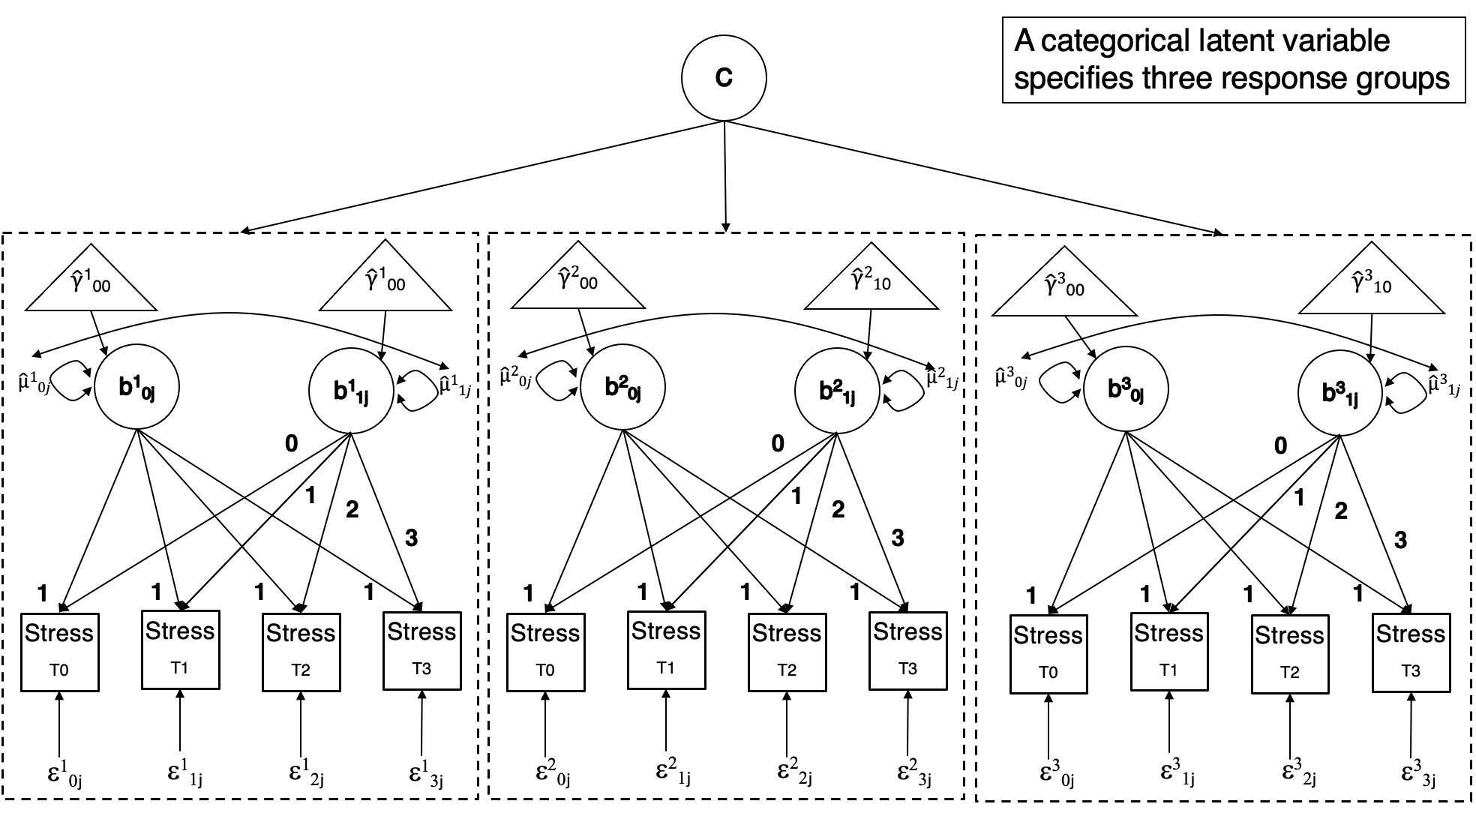
D: Path diagram for three-class growth mixture model
C: Latent growth curve path diagram

Slide 11
1₂
γ₀₀
γ₁₀
μ_{0j}
β_{0j}
β_{1j}
μ_{1j}
0
λ₃
1
λ₂
1
1
1
1
Stress_{T0}
Stress_{T1}
Stress_{T2}
Stress_{T3}
ε_{ij}
ε_{ij}
ε_{ij}
ε_{ij}

Slide 12
μ_{0j}
β_{0j}
γ₀₀
Stress_{ij}
ε_{ij}
1₂
γ₁₀
β_{1j}
μ_{1j}
Time_{i}

