Slide 1
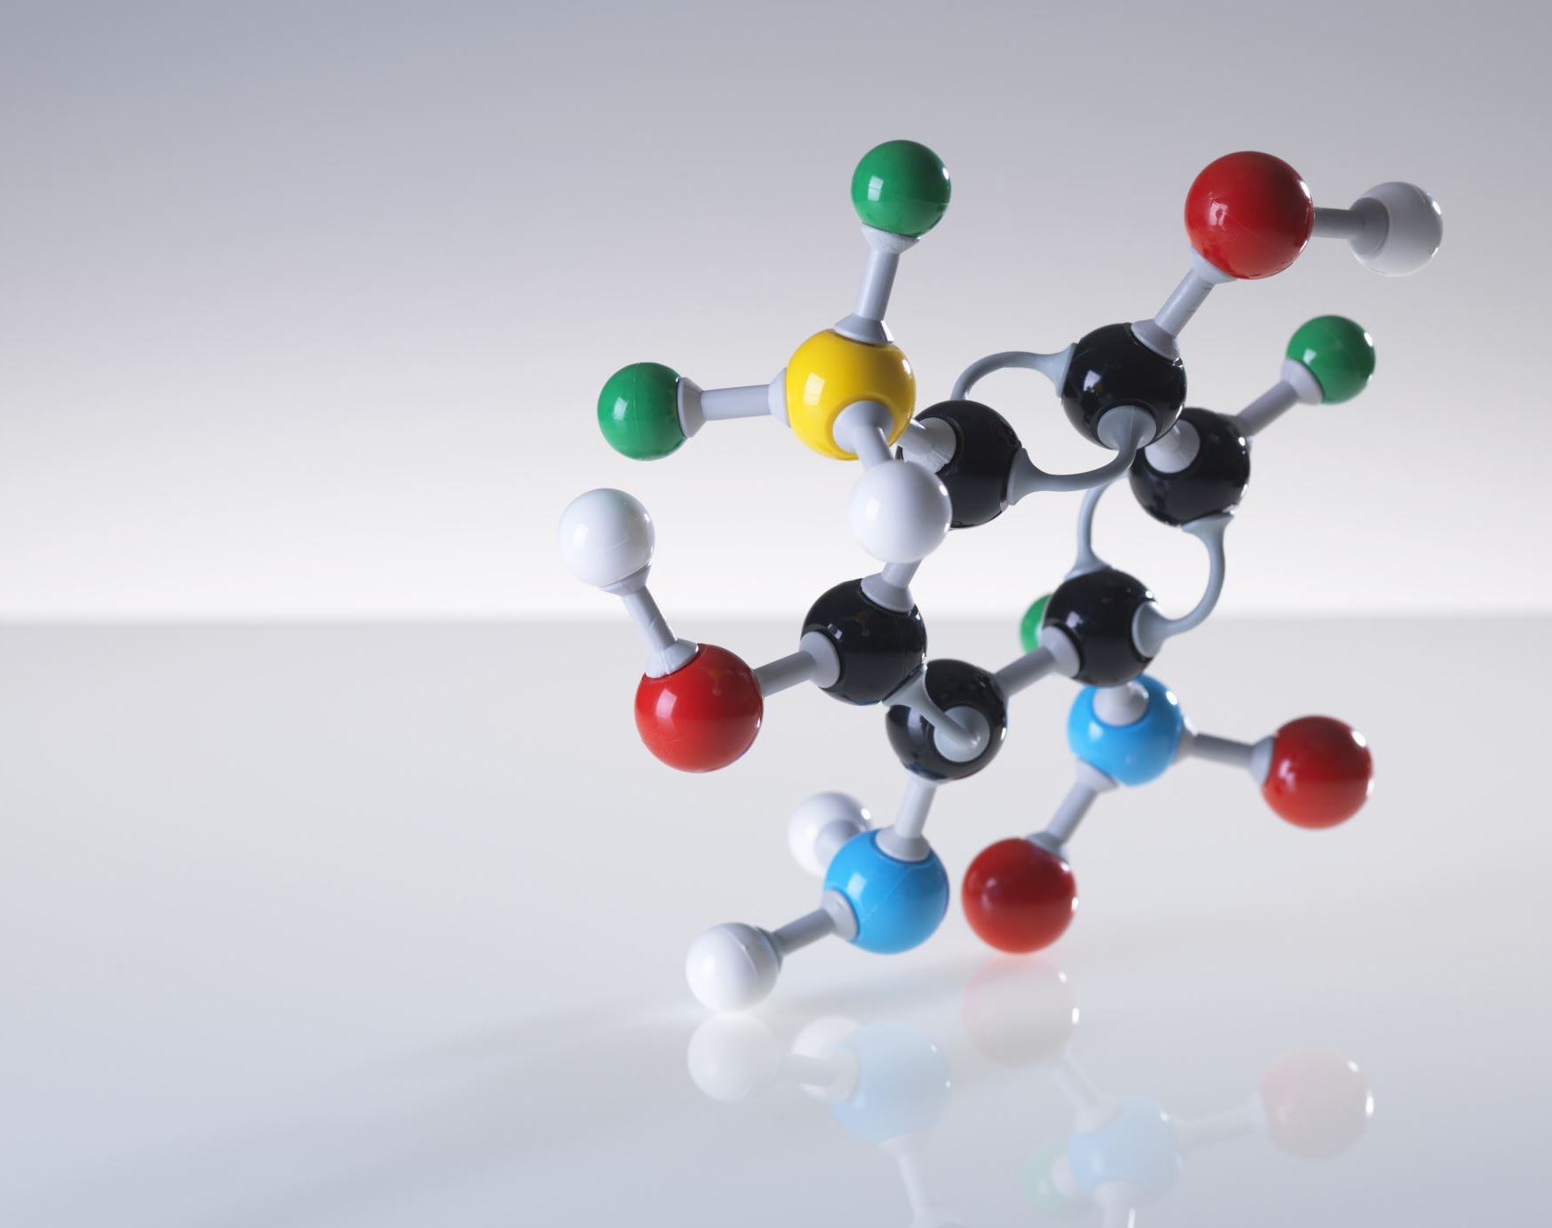
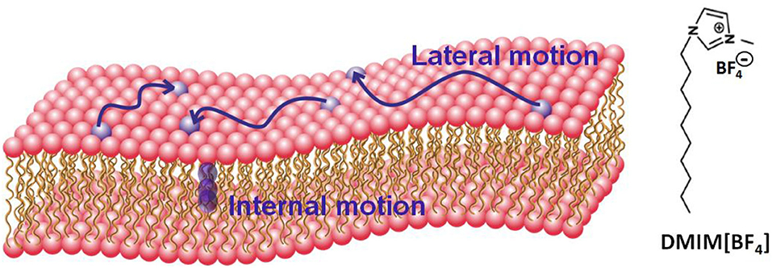
Structure and Dynamics of model lipid bilayers using All atom MD Simulations
This Photo by Unknown author is licensed under CC BY.

Slide 2
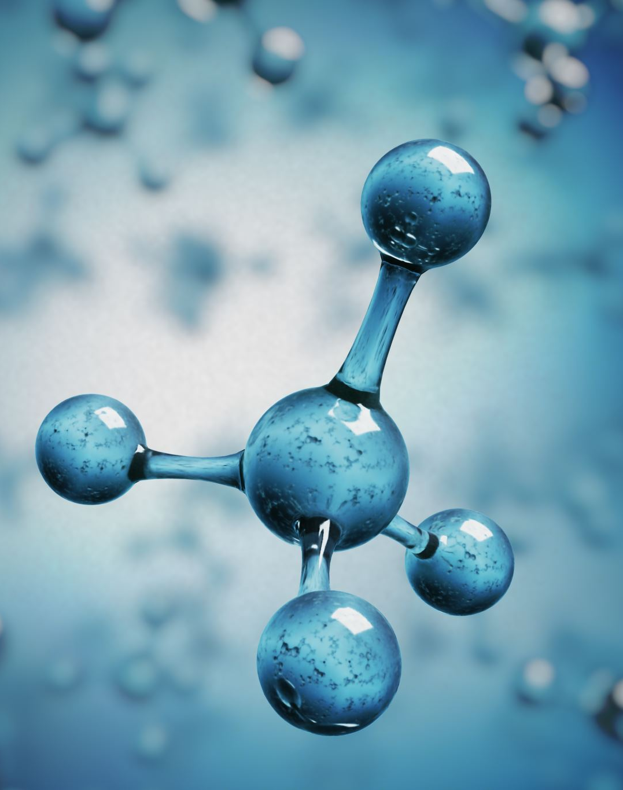
Outline
Why study lipid dynamics in membranes?
Insights from such studies
Condensed phase dynamics
Lipid movements in cell membranes
Experimental methods to study lipid dynamics
Membrane Phase Transition
Computational Insights to phase transition of DMPG
Conclusion

Slide 3
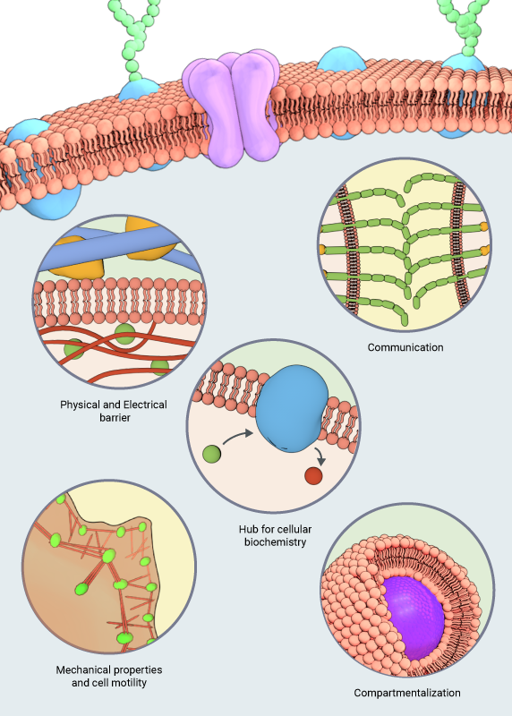
Why study lipid dynamics?
Understanding the dynamics will help one study membrane function catering to different cellular processes
https://www.mechanobio.info/membrane-dynamics/#:~:text=Dynamic%20lipid%2Dprotein%20interactions%20on,domains%2C%20such%20as%20lipid%20rafts.

Slide 4
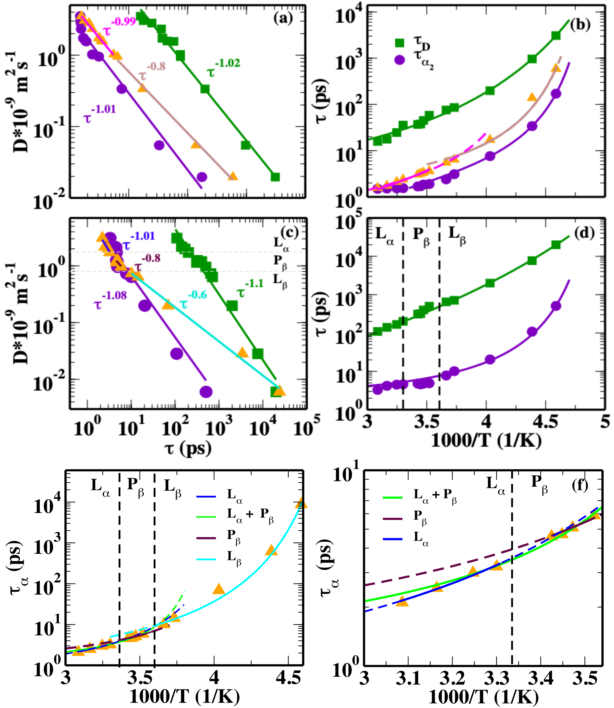
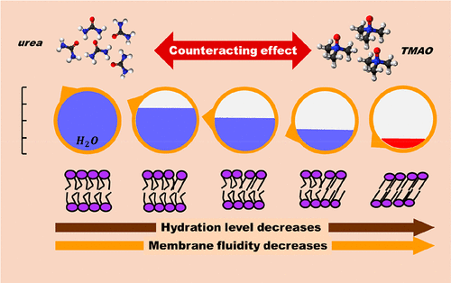
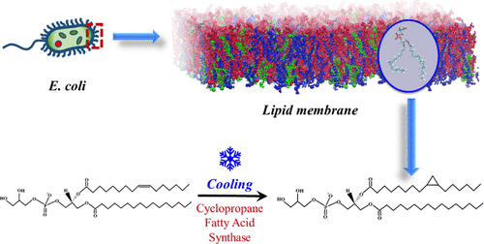
Insights from such studies
Relaxation time scales of interfacial water upon fluid to ripple to gel phase transitions of bilayers
J. Chem. Phys. 158, 114503 (2023)
Phase transition of membranes in presence of small organic molecules.
J. Phys. Chem. B 2021, 125, 36, 10149–10165
Functional group changes in lipid chain protecting cells in cold shock conditions
J. Phys. Chem. B 2023, 127, 7, 1607–1617
Changes in membrane-bound water
Cellular protection at extreme conditions

Slide 5
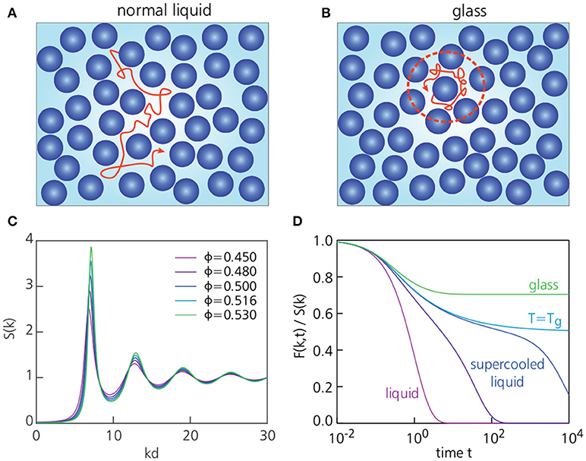
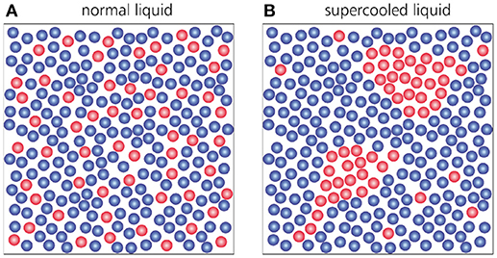
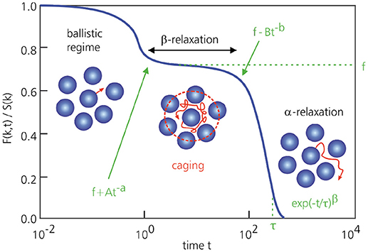
Dynamics in condensed phase
Front. Phys., 02 October 2018

Slide 6
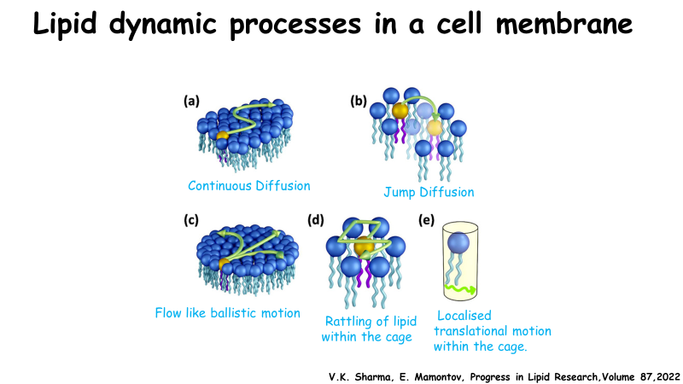
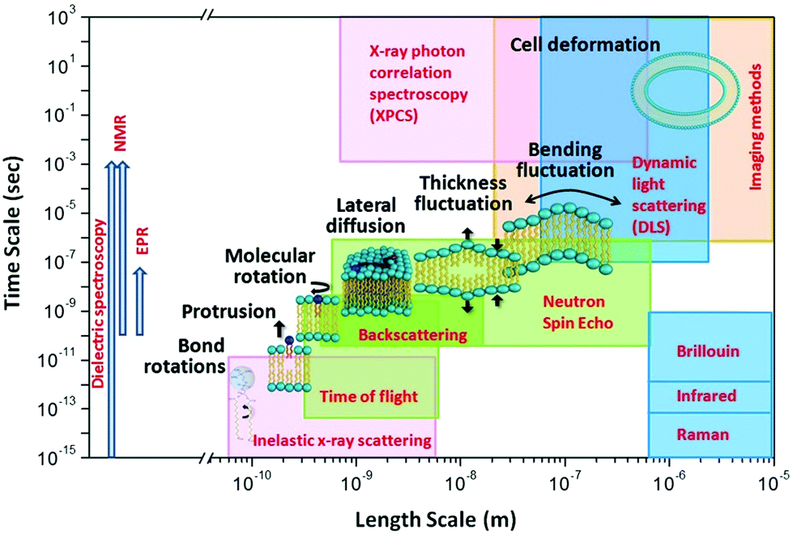
How lipid molecules move in a cell membrane?
Qian et al., Langmuir, 36, 15189–15211

Slide 7
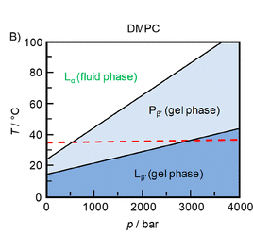
Phase transition in cell membranes
Roland Winter et al. , Chem. Rev. 2023, 123, 1, 73–104
Crowe JH, Hoekstra FA, Crowe LM. Membrane phase transitions are responsible for imbibitional damage in dry pollen. Proc Natl Acad Sci U S A. 1989 Jan;86(2):520-3. doi: 10.1073/pnas.86.2.520. PMID: 16594011; PMCID: PMC286503

Slide 8
Simulation details
Seven temperatures - 280K, 284K,290K,292K,300K,308K,310K
CHARMM force field is used
Thermostat:- Berendsen
Barostat:- Berendsen
With H-bond constrains
LINCS algorithm for H-bond constraint
TIP4P/2005 water model is used
Setting up DMPG System (With and Without Salt)
Done by Dr. Sheeba Malik
NPT Equilibriation
NVT Equilibration
Analysis NPT Trajectories by in-house scripts
Performing SISF Calculation using in-house scripts
Area per lipid
Bilayer Thickness
Headgroup density
NVT Run lengths as required for different temperatures

Slide 9
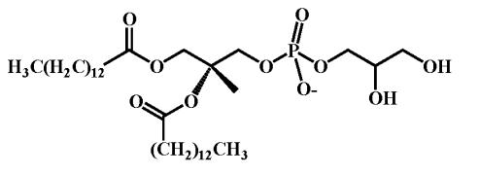
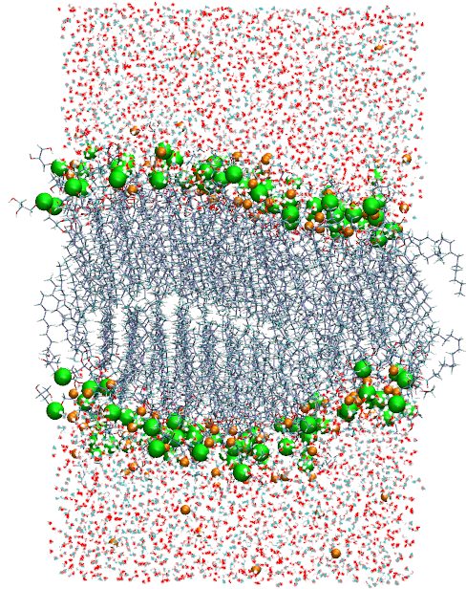
System information
DMPG Lipid
System Details
Without Salt:-
DMPG Molecules:- 128
Water Molecules:- 5743
Sodium Ions:- 128
With Salt (Concn.-0.1M):-
Sodium Ions:- 18
Chloride Ions:- 18
System prepared using CHARMM GUI Membrane builder

Slide 10
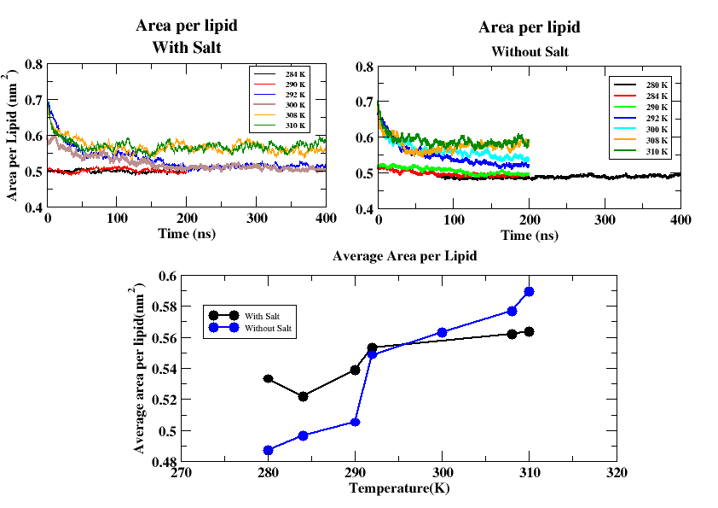
Structural Observation from NPT Simulations (CHARMM)
There is a prominent phase change in the absence of salt.
Structurally, no change occurs in the bilayer on addition of salt

Slide 11
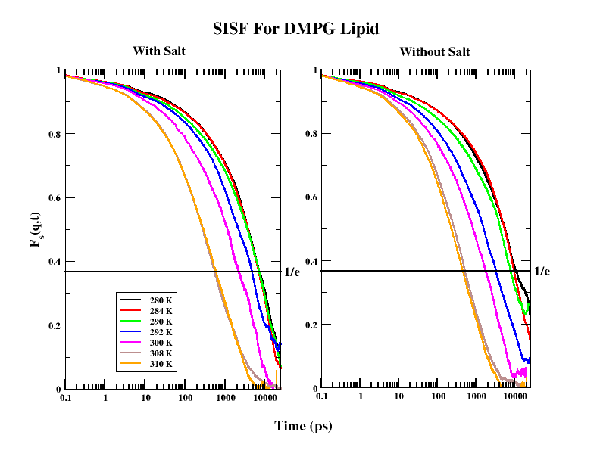
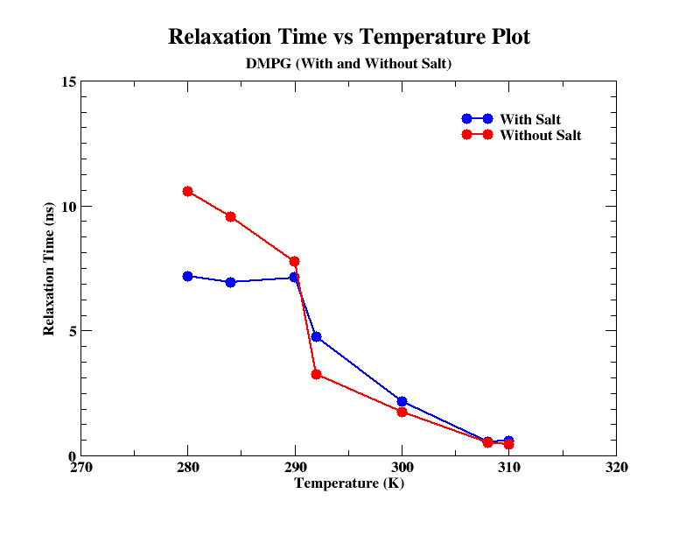

Observation from relaxation times (CHARMM)
Dynamics in presence of salt becomes faster below the melting temperature.
Crossover in relaxation times is observed on regions above the melting temperature!!
The SISF shows change in the dynamical properties in presence of salts and also change in the temperature
J. Chem. Phys. 158, 114503 (2023)

Slide 12
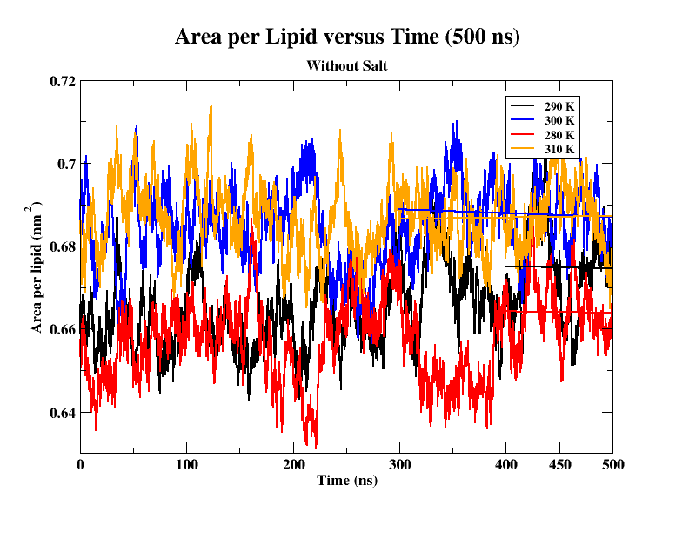
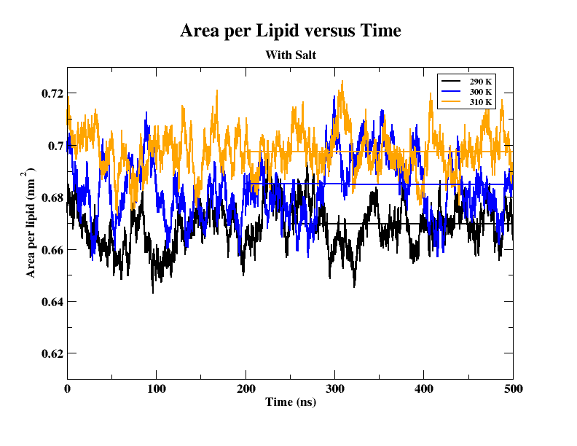
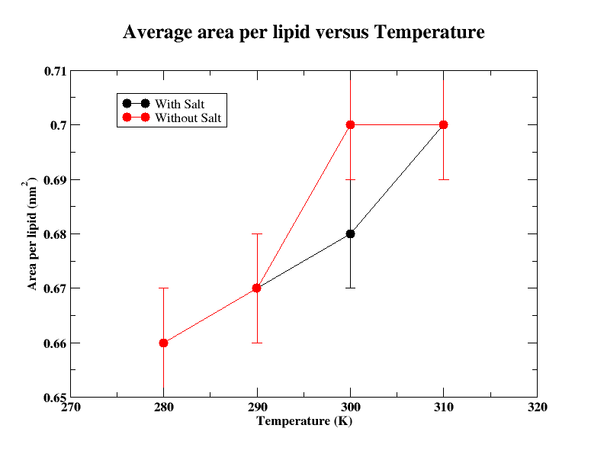
Structural observation using SLIPIDS

Slide 13
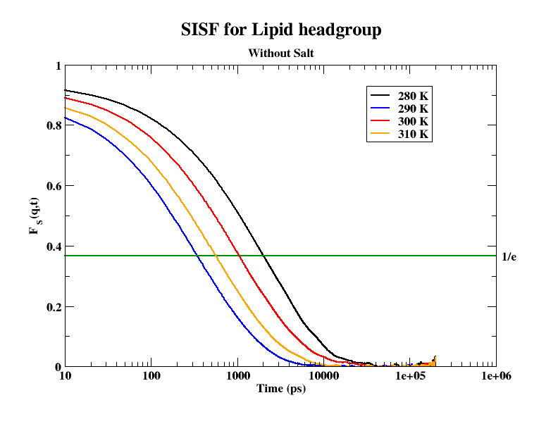
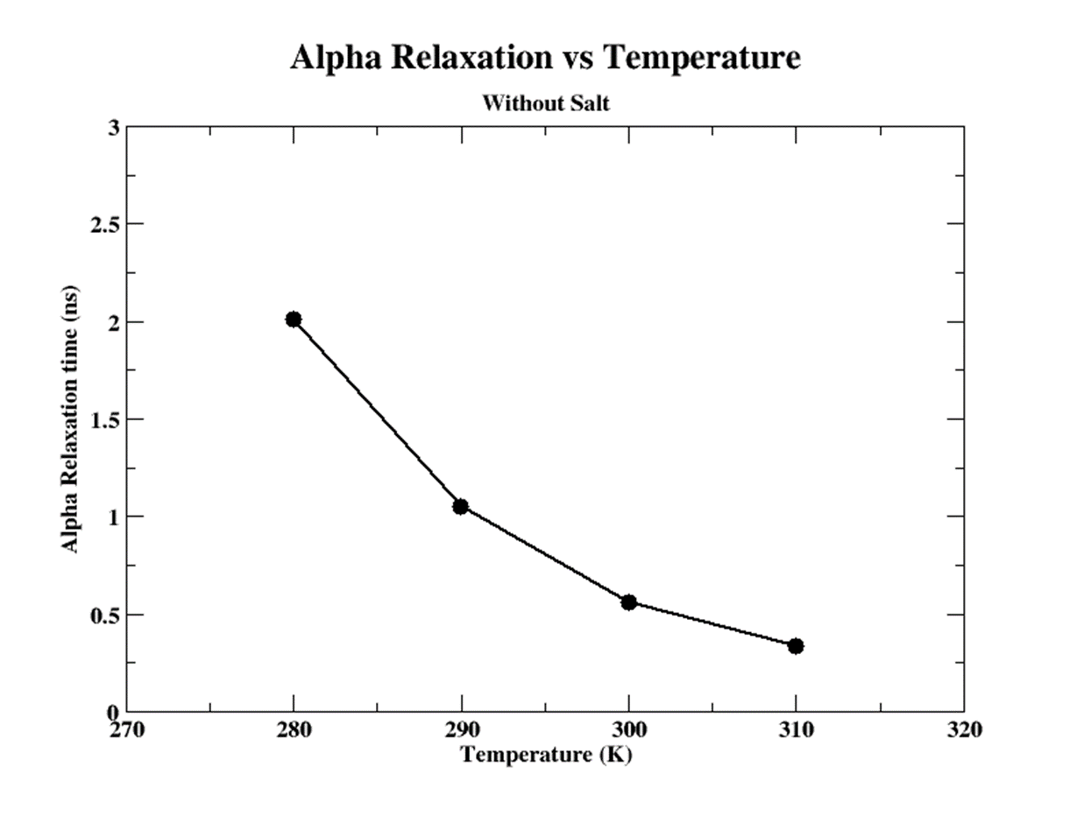
Alpha relaxation study using SLIPIDS
Dynamics is faster at higher temperatures, i.e. the alpha relaxation is much more in the fluid phase.

Slide 14
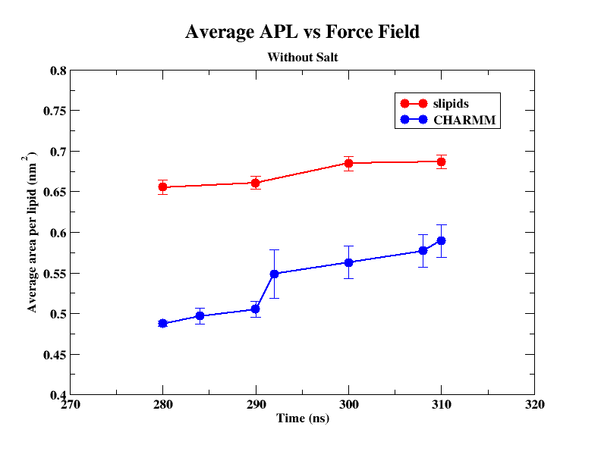
Structural comparison between the 2 force fields

Slide 15
Conclusion
Lipid bilayers are condensed phase systems and the motion of lipids can be correlated.
The force field change causes the change in observed structural and dynamical observations.

Slide 16

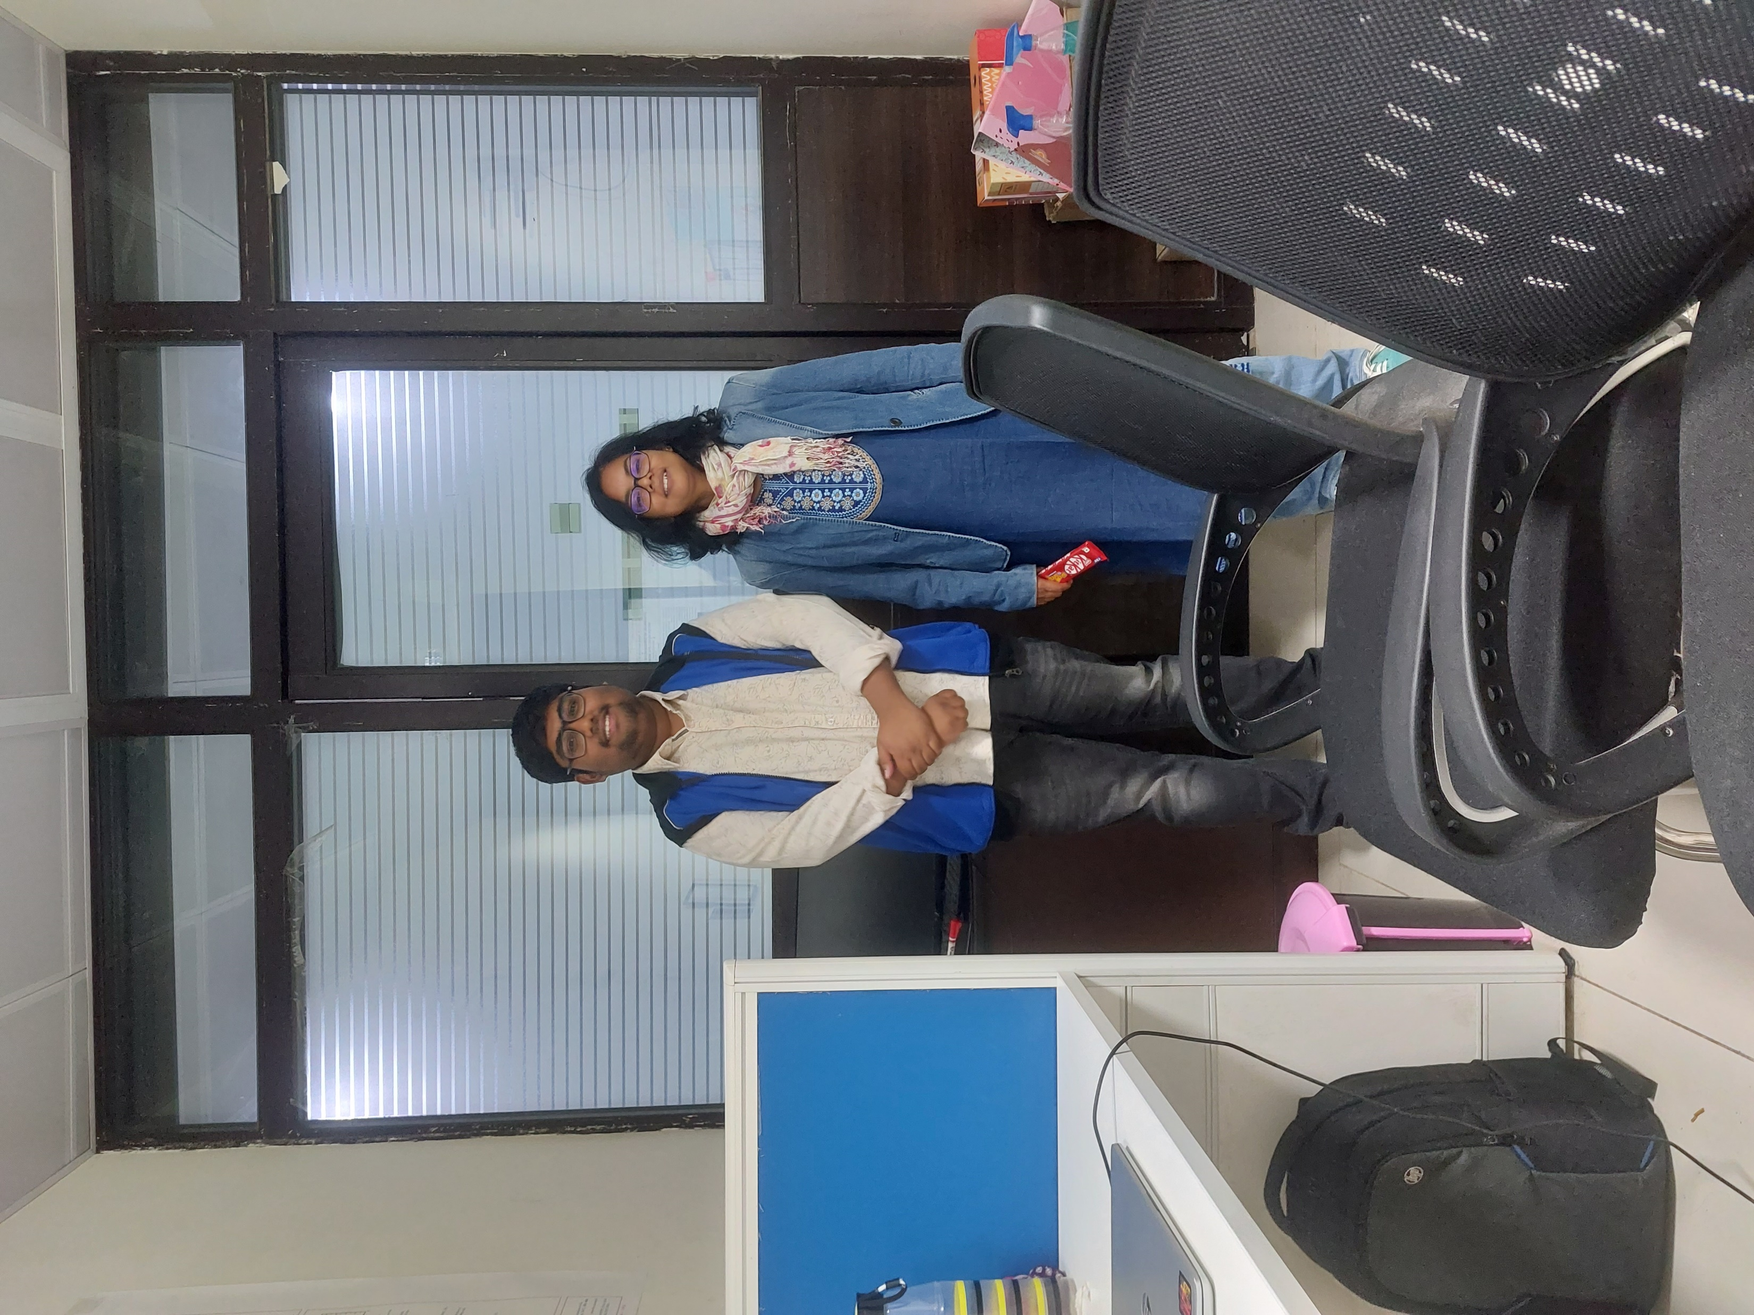
Acknowledgement
Prof. Ananya Debnath (Professor at IIT Jodhpur)
Dr. Sheeba Malik (Post Doctoral student at University of Tennessee Knoxville and ORNL)
CCB Lab, IIT Jodhpur
Department of Chemistry and Theoretical Chemistry Faculties, IIT Jodhpur
High-Performance Computational Facility, IIT Jodhpur

Slide 17
Thank You

Slide 18
