Slide 1

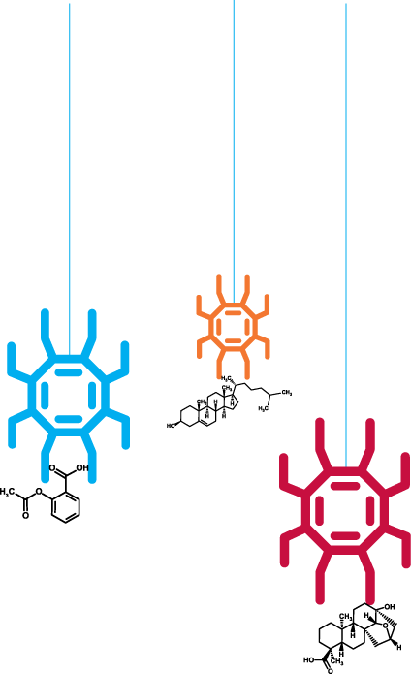
Meeting UoS with RSC
Tuesday 9th April of the pillars of a

Slide 2


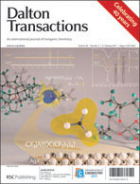
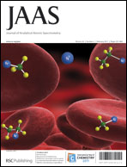
RSC eScience Databases
RSC Databases
  Publishing Platform
  ChemSpider Molecules
  ChemSpider Spectra
  ChemSpider SyntheticPages
  ChemSpider Reactions
  ChemSpider Materials
Digitally Enhancing RSC Archive (DERA)
  1841 – present, >300k articles
  Text mining and information retrieval
  OSR, graphs and spectra extraction
  Layering ontologies and adding semantic meaning
  Technology will be used on other corpora
  Feeds back to RSC Databases

Slide 3


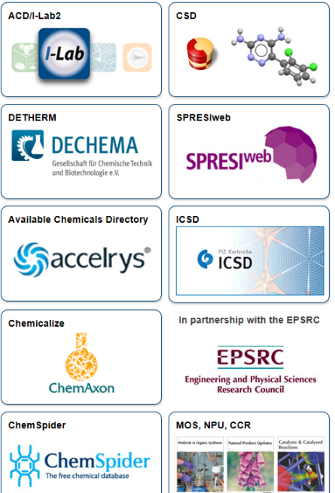
RSC eScience Projects
Grants and Projects
  Open PHACTS
    Semantic Web
    Artificial Intelligence
    Hosting Data and Algorithms
  PharmaSea
    Chemical Database for Natural Products
    Drug Discovery
  National Chemical Database Service
    Chemistry Database Service
    Chemistry Data Repository
  Open Source Drug Discovery
    Collaborating with Indian scientists

Slide 4
RSC Global Chemistry Hub
Data → Knowledge
  RSC Archive and Publishing Platform
  RSC (ChemSpider) Databases
  DERA
  National Data Repository
  Semantic Web projects
Community → Professional Networks
  Challenger - crowdsourcing
  Rewards and Recognition - altmetrics
Open Innovation
  Open Innovation Platform

Slide 5
ChemSpider Materials
Types of data
  CIFs
  X-Rays
  Photographs
Use cases?
Existing examples?

Slide 6
DaM and ELN
Platform(s)
  CSSP
  Blog3
  LabTrove
ChemSpider components and data services
Workflow
Minimal requirements
Existing prototypes
Screenshots

Slide 7
RSC Databases
UI components
Data services
Federated system modules
Security model
SPARQL API

Slide 8
National Data Repository

Slide 9
Wow projects
Visualization
  zSpace and alike
Massive parallel computing

Slide 10




Thank you
Email: tkachenkov@rsc.org
Blog: www.chemspider.com/blog
SLIDES: http://www.slideshare.net/valerytkachenko16

