Slide 1


SciELO
Markup PMC
BIREME/OPAS/OMS
Unidade SciELO
21 de agosto de 2009 – Reunião interna

Slide 2
Modificações
Title manager – geração de uma tabela issue.mds com dados complementares à pt_issue.mds, es_issue.mds, em_issue.mds
Markup PMC = Markup + XML Body

Slide 3
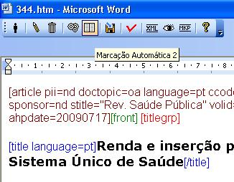
Novos botões
Botão marcação automática 2 - Vancouver

Slide 4
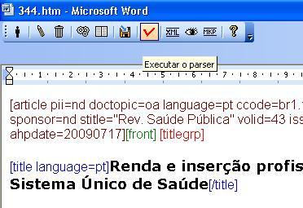
Novos botões de funções
Botão Executar o Parser

Slide 5
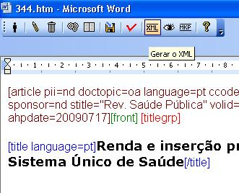
Novos botões de funções
Botão Gerar XML

Slide 6
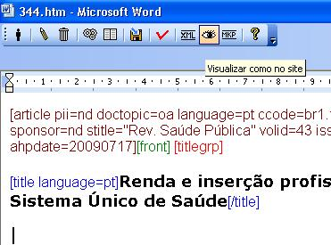
Novos botões de funções
Botão Visualizar como no site

Slide 7
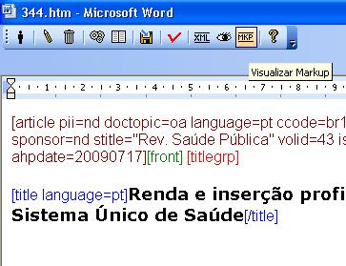
Novos botões de funções
Botão Visualizar Markup

Slide 8
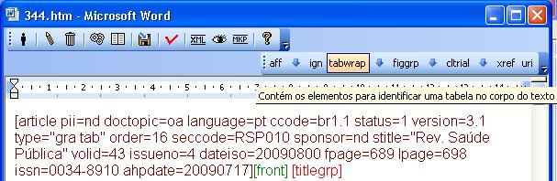
Novos elementos flutuantes
Tabwrap - tabela

Slide 9
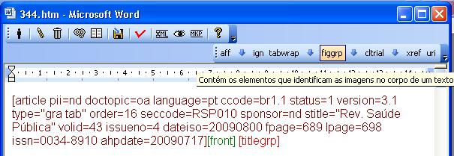
Novos elementos flutuantes
Figgrp - figura

Slide 10
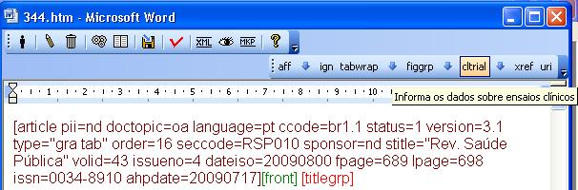
Novos elementos flutuantes
Cltrial – clinical trial

Slide 11
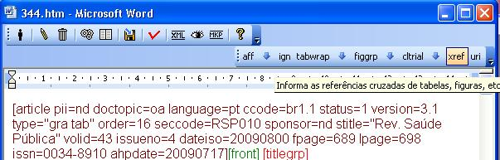
Novos elementos flutuantes
Xref – marca quaisquer referencias cruzadas: tabelas, imagens, citações, etc

Slide 12
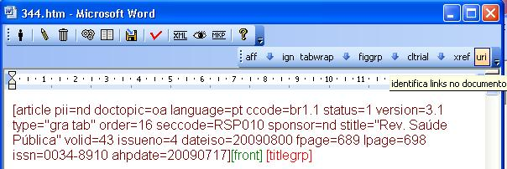
Novos elementos flutuantes
Uri – marca quaisquer link, interno e externo

Slide 13
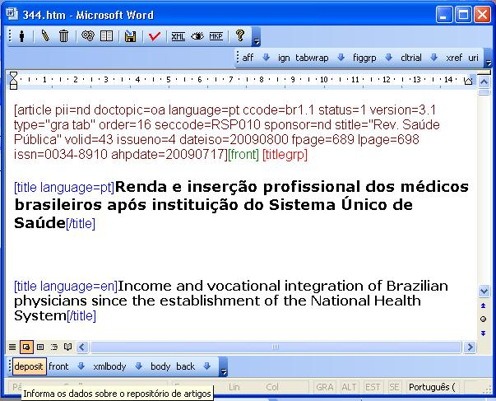
Novos elementos
Deposit – usado na metodologia SciELO Repositorio

Slide 14
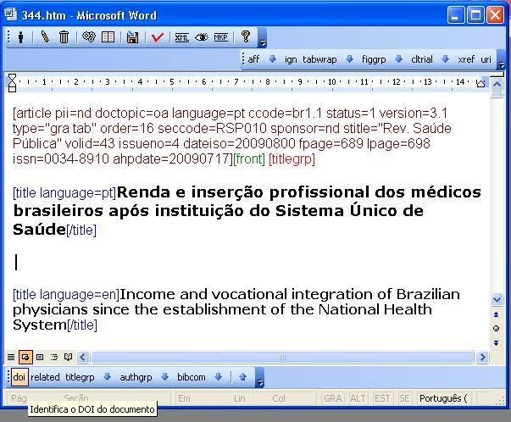
Novos elementos
DOI – para identificar um DOI obtido fora da SciELO

Slide 15
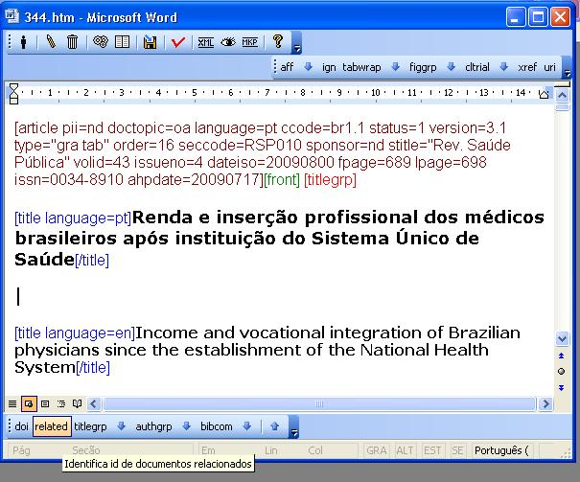
Novos elementos
related –para identificar documentos relacionados como: press release, e medias, quando existe

Slide 16
Novos elementos
related –para identificar documentos relacionados como: press release, e medias, quando existe

Slide 17
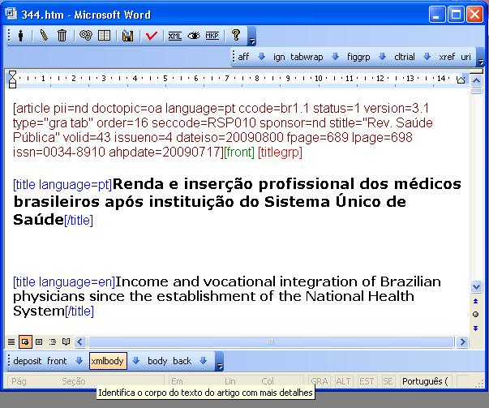
Elementos do body
Xmlbody
Section
Sectitle
P
Mais os elementos flutuantes: uri, xref, figgrp, tabwrap

Slide 18
novos elementos nas referencias
Patgrp – patent, orgname, date
url
Doi

Slide 19
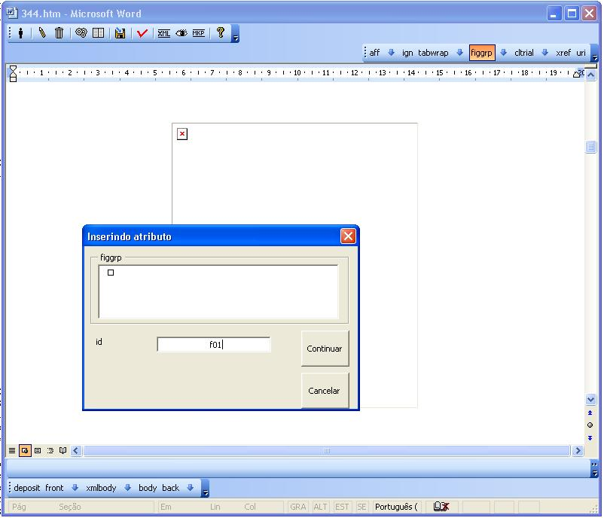
Novos elementos flutuantes
Figgrp - figura

Slide 20
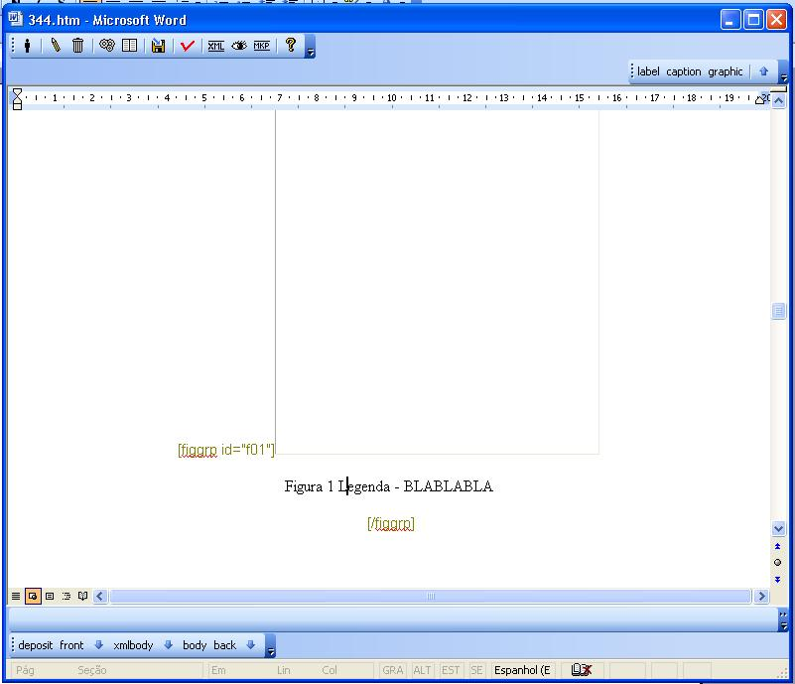
Novos elementos flutuantes
Figgrp - figura

Slide 21
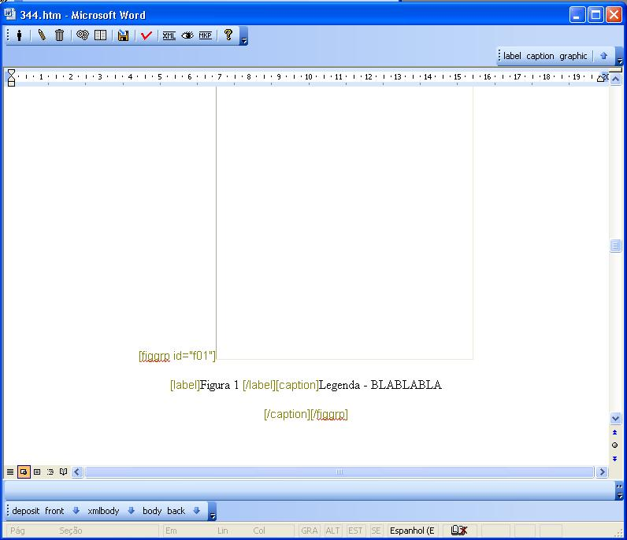
Novos elementos flutuantes
Figgrp - figura

Slide 22
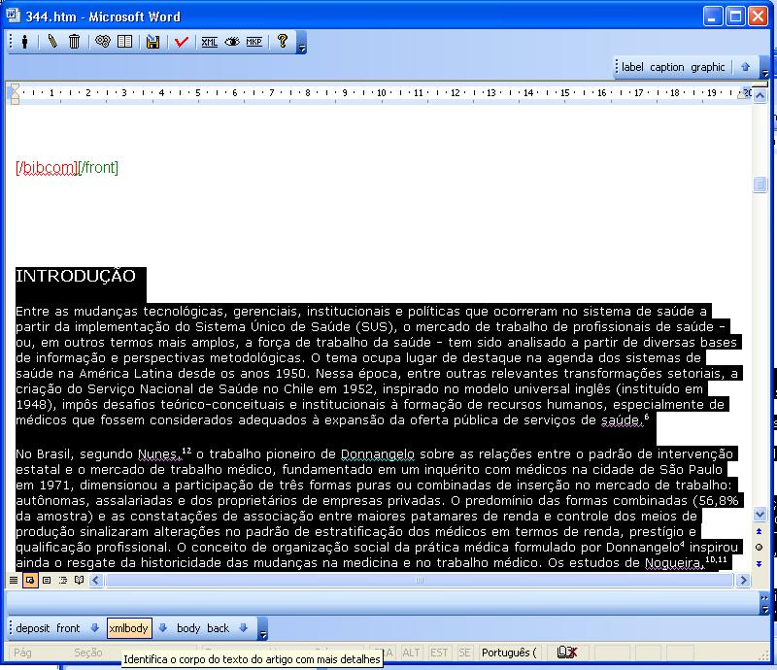

Slide 23
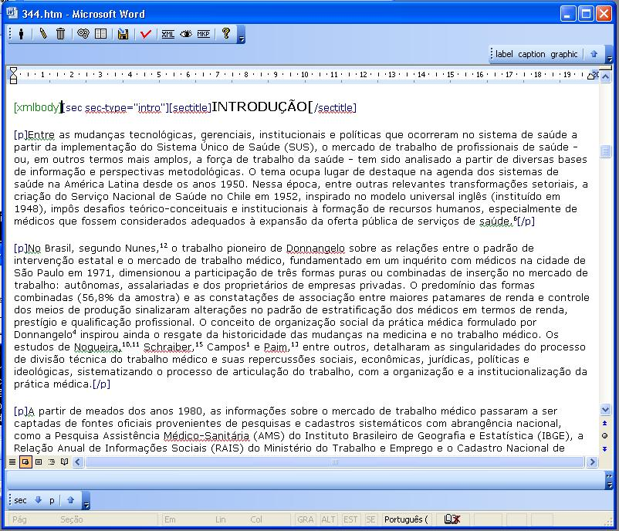

Slide 24
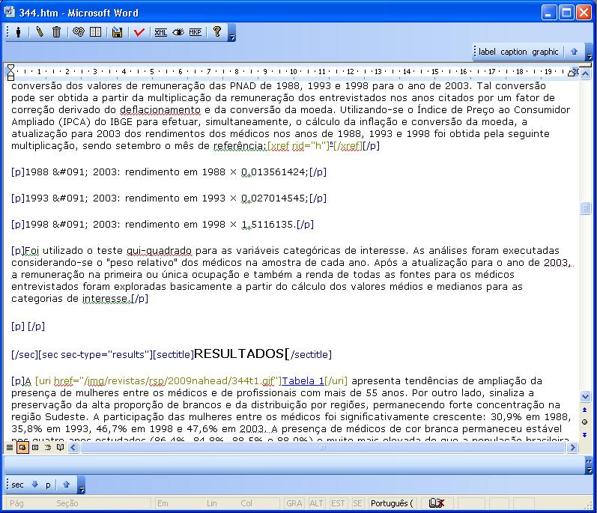

Slide 25
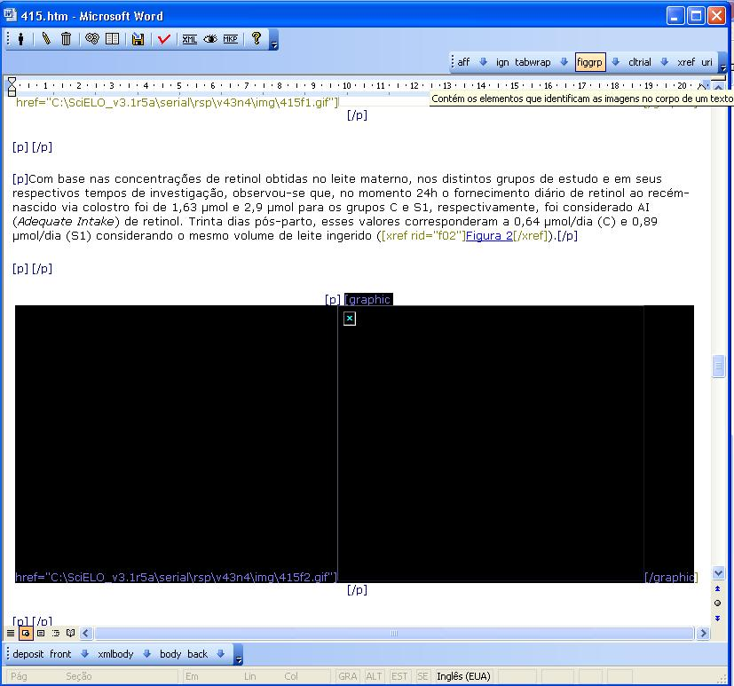

Slide 26
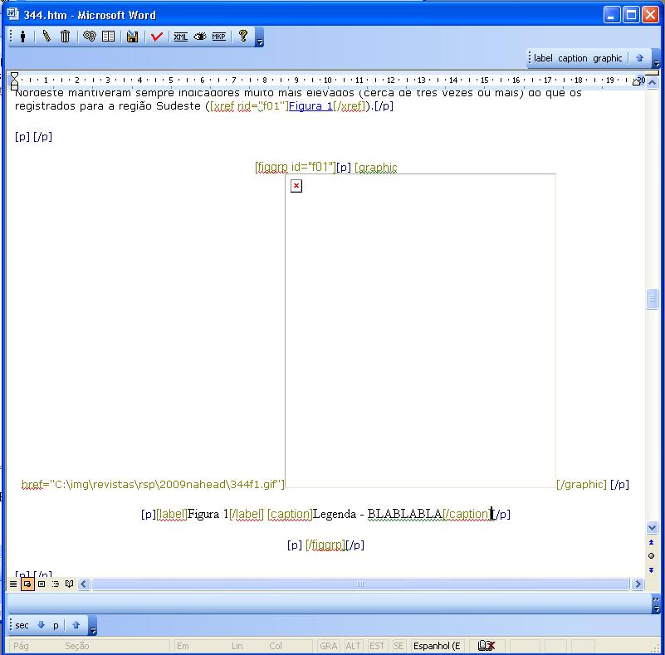

Slide 27
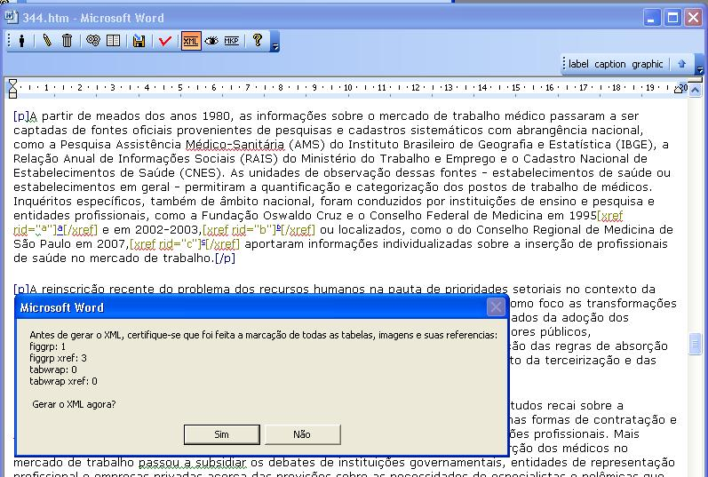

Slide 28
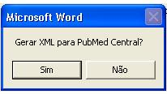

Slide 29
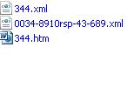

Slide 30
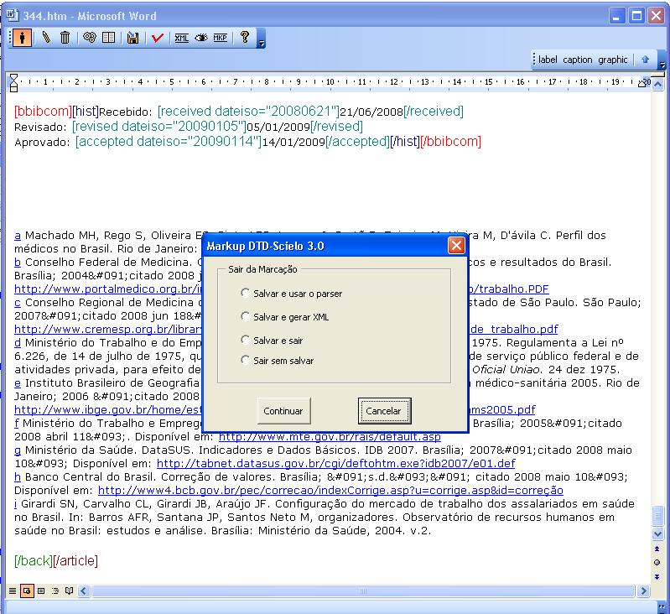

Slide 31
Regras do PMC
DTD: http://dtd.nlm.nih.gov/publishing/
http://www.pubmedcentral.nih.gov/about/pubinfo.html
  high-resolution TIFF or EPS
  Especificação de qualidade de imagens - http://www.pubmedcentral.nih.gov/about/image_quality_table.html
  http://www.pubmedcentral.nih.gov/about/equation_process.html
  http://www.pubmedcentral.nih.gov/about/tablespec.html
  http://www.pubmedcentral.nih.gov/about/equationspec.html

Slide 32
Dados obrigatorios no XML
Journal ISSN
Journal ID or Journal title abbreviation
Journal Publisher
Copyright statement, where applicable
Volume, issue (if applicable), and article sequence number or pagination
Issue publication date
Article electronic publication date

Slide 33
<license license-type="open-access" xlink:href="http://creativecommons.org/licenses/by/2.5/">
<p>This is an open-access article distributed under the terms of the Creative Commons Attribution License, which permits unrestricted use, distribution, and reproduction in any medium, provided the original work is properly cited.</p>
</license>

Slide 34
Naming Conventions
jour-vol-pg.ext
jour is an alphanumeric identifier such as the journal abbreviation. The ISSN may be used, in addition to the alphanumeric identifier. vol identifies a specific journal volume. pg is the first page of the article.
For articles that start on the same page, to make the file names unique, add a sequence letter (-a, -b, -c) to the end of the page number. Use sequence letter -a for the first article that starts on that page.
For electronic journals that assign each article a unique article sequence number (e-ID) in place of pagination, use this e-ID as the "first page".
ext is the lowercase file type extension (.xml or .pdf).

Slide 35
Naming Graphics and Supplementary Files
jour-vol-pg-typ.ext is the PMC naming convention for GRAPHICS and SUPPLEMENTARY DATA files
jour, vol, pg, and ext are the same as above. typ is NOT to be used with full-text article XML or PDFs, is optional, and indicates one of the following:
-g figure graphic + alphanumeric identifier -i inline graphic + alphanumeric identifier -s supplementary data file + alphanumeric identifier -e equation + alphanumeric identifier

Slide 36
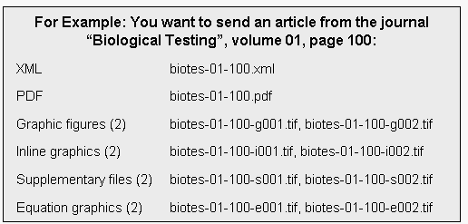

Slide 37
File Organization, Packaging, and Delivery
Accepted formats
PMC accepts ONLY .zip, .tar, .gz, and .tgz.
PMC does not accept bzip2 compressed .zip files.
PMC recommends using compression software that supports the Zip 2.0 standard file format.
If using WinZip PMC recommends using the Maximum (portable) compression option for compatability.

Slide 38
File Organization, Packaging, and Delivery
jour-vol-issue.ext
jour is an alphanumeric identifier such as a journal abbreviation.
Naming MUST be consistent across all submissions.
If articles are not organized into issues, the issue may be omitted from the container file naming convention.
Include all files for an issue in one directory. DO NOT create separate subdirectories for each article in an issue inside the container file.
Package all the files for an issue in the same container file, or create a separate container file for each class of files (XML/SGML, PDFs, Images, Supplemental Material) in an issue.

Slide 39
File Organization, Packaging, and Delivery
DO NOT send files as attachments to an email message. Either FTP them or send them on CD/DVD or tape. To transfer the files via FTP, write to pmc@ncbi.nlm.nih.gov for an account on the PMC FTP site.
Send an email notification for each submission including:
  Journal title
  Volume
  Issue
  Container filename(s) and size(s)
  Address the email to: pmc@ncbi.nlm.nih.gov.
If sending files on DVD, CD, or tape, mail them to:
PubMed Central
National Center for Biotechnology Information
National Library of Medicine
Building 45,Room 5AN12
45 Center Drive, MSC 6510
Bethesda, Maryland 20892-6510 USA

Slide 40
Submitting Revised or Corrected Files
Consultar o site

Slide 41
FIM

