Slide 1
Thank you So much for your interest in my lecture material! I hope you found this powerpoint useful in your instruction. If you like my presentation style, please check out my other PowerPoint content available on TpT. I have over 100 lecture presentations covering a wide range of physical, earth, and life science topics.
If you wish to purchase all of my powerpoints for any particular subject area, please send me an email at ben_wylam@yahoo.com and we'll work out a discount for the bulk purchase.
http://www.teacherspayteachers.com/Store/BJ/Products

Slide 2

Jeopardy Directions
Remember answers must be in the form of a question.
Highlight the key vocabulary and corresponding definitions/concepts in your notes as we progress through the game. Remember, you will see these on the test!
Good Luck!
Click here to begin.

Slide 3


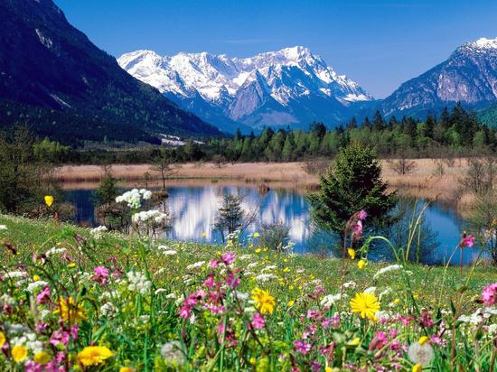
Cell Jeopardy
Cell
Organelles
Organization
Of
Life
Organization
Of
Life
Cell Basics
Cell
Extras
Geology!
Plate Tectonics, Volcanoes,
Earthquakes, and More!
Q $100
Q $100
Q $100
Q $100
Q $100
(Part 2)
Q $200
Q $200
Q $200
Q $200
Q $200
Q $300
Q $300
Q $300
Q $300
Q $300
Q $400
Q $400
Q $400
Q $400
Q $400
Q $500
Q $500
Q $500
Q $500
Q $500

Slide 4
Geology
Earth’s Interior
Plate
Tectonics
Volcanoes
Earthquakes
Geology
Extras
Q $100
Q $100
Q $100
Q $100
Q $100
Q $200
Q $200
Q $200
Q $200
Q $200
Q $300
Q $300
Q $300
Q $300
Q $300
Q $400
Q $400
Q $400
Q $400
Q $400
Q $500
Q $500
Q $500
Q $500
Q $500
Final Jeopardy

Slide 5
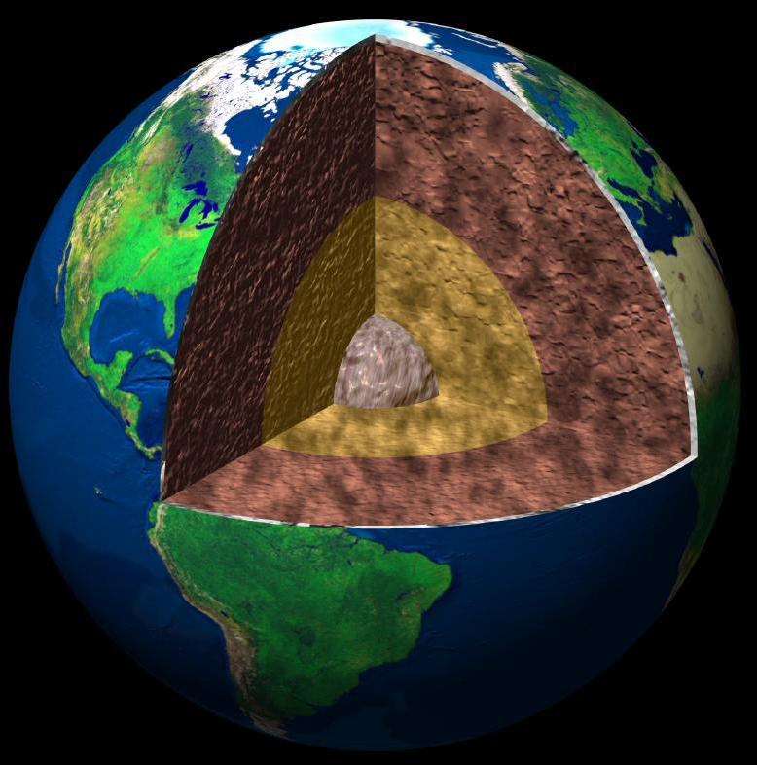
$100 Question from
“Earth’s Interior”
Liquid hot plastic material in Earth’s mantle

Slide 6
$100 Answer from
Earth’s Interior
What is “magma?”

Slide 7
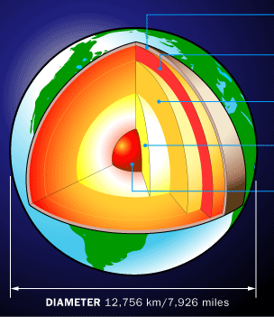
$200 Question from
Earth’s Interior
Common term for “Lithosphere”

Slide 8
$200 Answer from
Earth’s Interior
What is the “crust?”

Slide 9
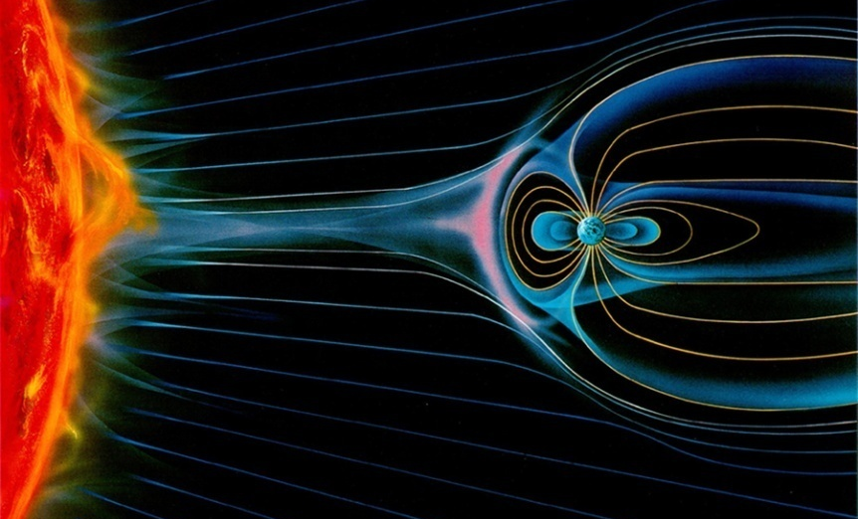
$300 Question from
Earth’s Interior
Protects the planet from dangerous, high energy solar radiation

Slide 10
$300 Answer from
Earth’s Interior
What is the “magnetic field?”

Slide 11
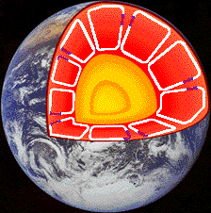
$400 Question from
Earth’s Interior
A powerful force in the asthenosphere which drives plate tectonics

Slide 12
$400 Answer from
Earth’s Interior
What is “convection?”

Slide 13
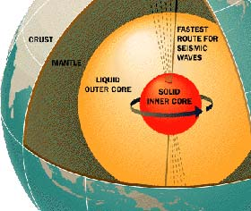
$500 Question from
Earth’s Interior
I’ll give you 5 cents if you can name this element found in Earth’s core

Slide 14
$500 Answer from
Earth’s Interior
What is “Nickel?”

Slide 15

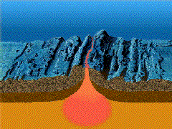
$100 Question from
Plate Tectonics
Convection currents generate new
crust in these oceanic regions

Slide 16
$100 Answer from
Plate Tectonics
What are “divergent
plate boundaries?”
(or regions of sea floor spreading)

Slide 17
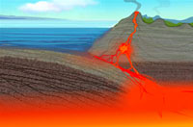
$200 Question from
Plate Tectonics
A phenomenon in which old sea floor is thrust into the mantle where it burns up

Slide 18
$200 Answer from
Plate Tectonics
What is “Subduction?’

Slide 19
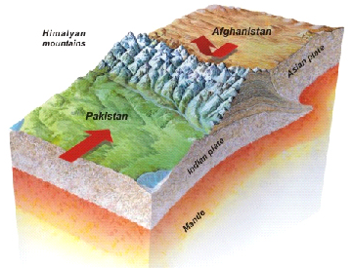
$300 Question from
Plate Tectonics
When 2 continental tectonic plates collide, it forms one of these:

Slide 20
$300 Answer from
Plate Tectonics
What is a “mountain range?”

Slide 21
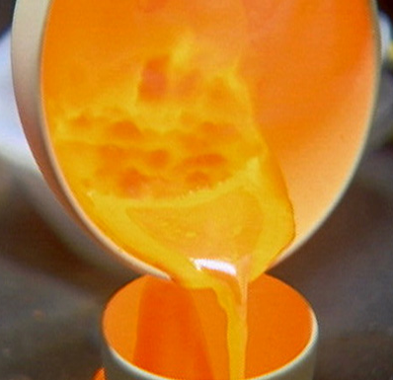
$400 Question from
Plate Tectonics
When magma reaches the Earth’s surface through volcanism, it is called this:

Slide 22
$400 Answer from
Plate Tectonics
What is “lava?”

Slide 23
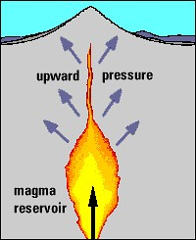
$500 Question from
Plate Tectonics
When magma cools inside the lithosphere, it usually forms this common igneous rock

Slide 24
$500 Answer from
Plate Tectonics
What is “granite?”

Slide 25
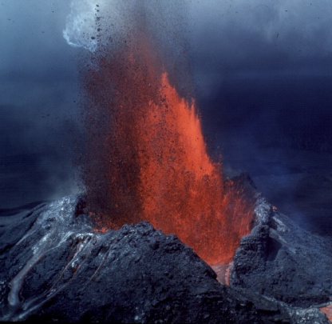
$100 Question from
Volcanoes
Ash and cinder created from thick lava pile up around the vent forming this kind of volcano

Slide 26
$100 Answer from
Volcanoes
What is a “cinder cone” volcano?

Slide 27
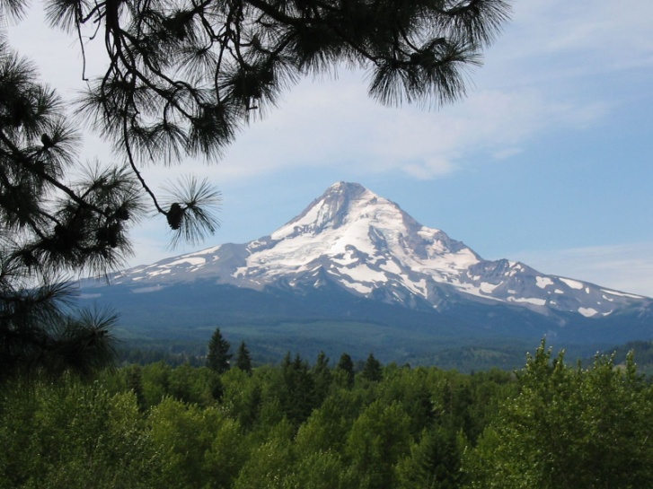
$200 Question from
Volcanoes
Mt. Shasta is an example of one
of these types of volcanoes

Slide 28
$200 Answer from
Volcanoes
What is a “dormant” volcano?
(also accept “composite” volcano.)

Slide 29
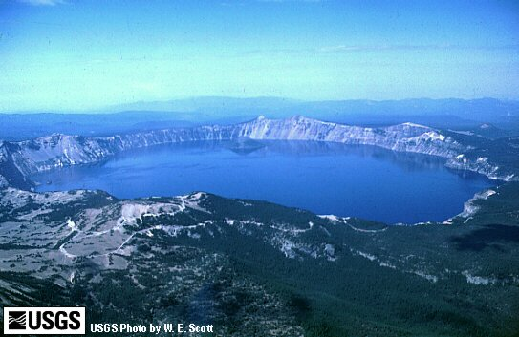
$300 Question from
Volcanoes
Geologic formation courtesy of
a collapsed magma chamber

Slide 30
$300 Answer from
Volcanoes
What is a “caldera?”

Slide 31
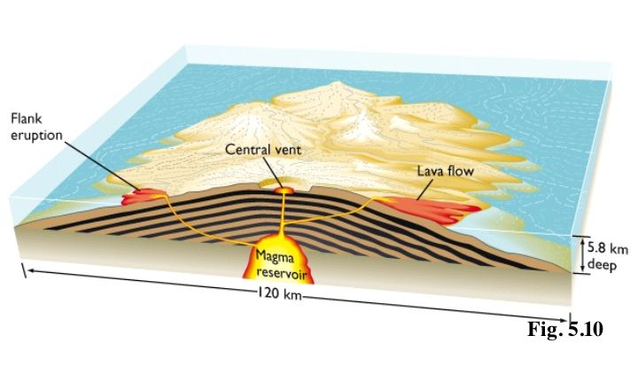
$400 Question from
Volcanoes
These volcanoes formed
the Hawaiian islands

Slide 32
$400 Answer from
Volcanoes
What are “shield Volcanoes?”

Slide 33
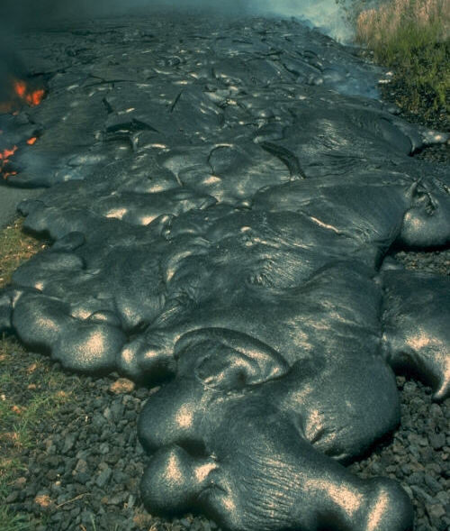
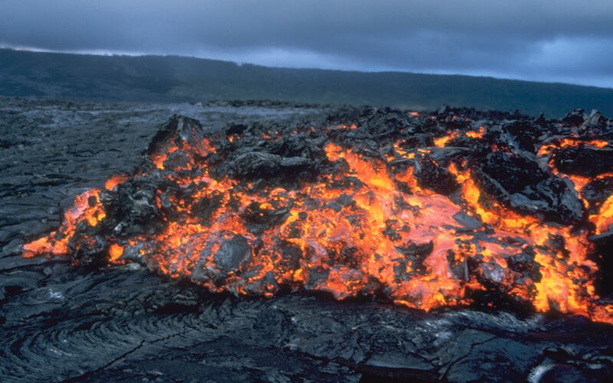
$500 Question from
Volcanoes
2 types of lava

Slide 34
$500 Answer from
Volcanoes
What are “Pahoehoe and Aa?”

Slide 35
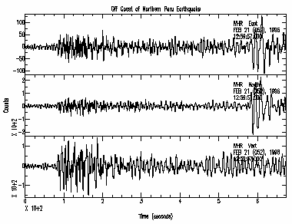
$100 Question from
Earthquakes
A machine used to record the
strength of an earthquake

Slide 36
$100 Answer from
Earthquakes
What is a “Seismograph?”

Slide 37
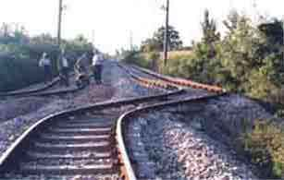
$200 Question from
Earthquakes
Region where 2 parts of
Earth’s crust slide against
one another

Slide 38
$200 Answer from
Earthquakes
What is a “transform plate boundary?” (or fault)

Slide 39
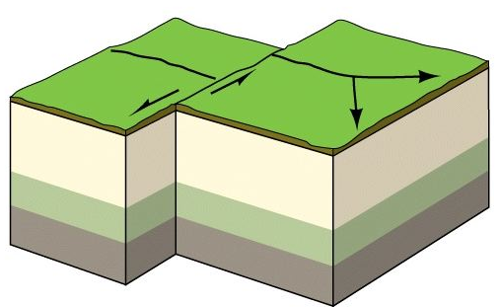
$300 Question from
Earthquakes
Earthquakes can result from tension forces, compression forces, or this kind of stress in the crust.

Slide 40
$300 Answer from
Earthquakes
What are “shearing” forces?

Slide 41
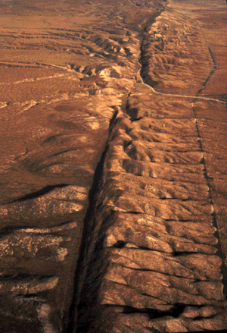
$400 Question from
Earthquakes
The “San Andreas” is an example
of this kind of fault

Slide 42
$400 Answer from
Earthquakes
Who is a “transform plate boundary?”
or (“strike-slip fault”)

Slide 43
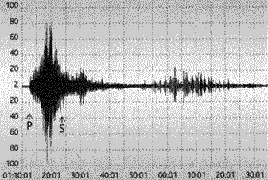
$500 Question from
Earthquakes
A quake that measures “5” on the Richter scale is this many times more powerful than one that measures “4”

Slide 44
$500 Answer from
Earthquakes
What is “ten?”

Slide 45
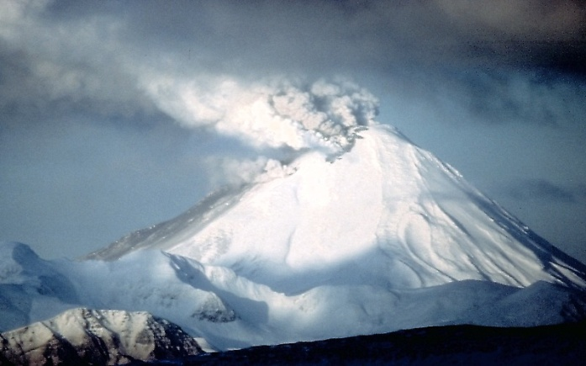
$100 Question from
Geology Extras
Although not currently active, these
volcanoes may erupt any time within the
next few thousand years.

Slide 46
$100 Answer from
Geology Extras
What are “dormant” volcanoes?

Slide 47
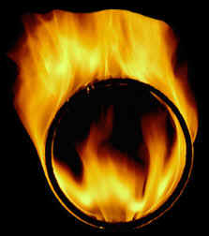
$200 Question from
Geology Extras
The “Ring of Fire” is an area of volcanism surrounding this large tectonic plate

Slide 48
$200 Answer from
Geology Extras
What is the “Pacific” plate.

Slide 49

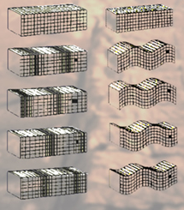
$300 Question from
Geology Extras
2 types of seismic waves

Slide 50
$300 Answer from
Geology Extras
What are “P and S” waves?

Slide 51
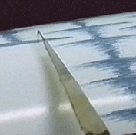
$400 Question from
Geology Extras
The magnitude of an earthquake is measured using this scale:

Slide 52
$400 Answer from
Geology Extras
What is “the “Richter Scale?”

Slide 53
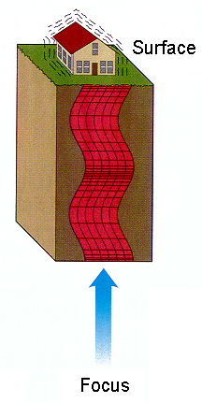
$500 Question from
Geology Extras
This can be found directly above the focus of an earthquake

Slide 54
$500 Answer from
Geology Extras
What is the “epicenter?”

Slide 55
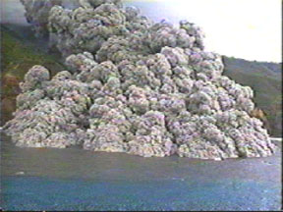

Final Jeopardy!
A mass of ash, cinder and hot rock hurled from a volcano with incredible force

Slide 56
Final Jeopardy Answer
What is a “Pyroclastic flow?”

