Slide 1
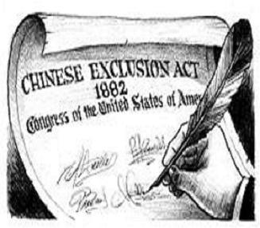
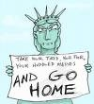

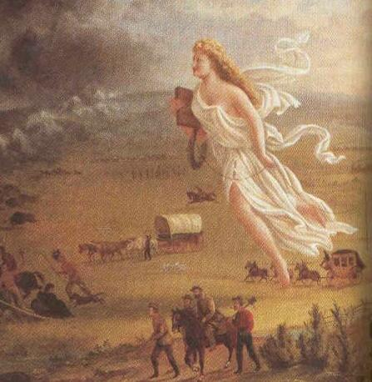
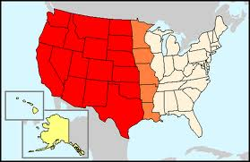
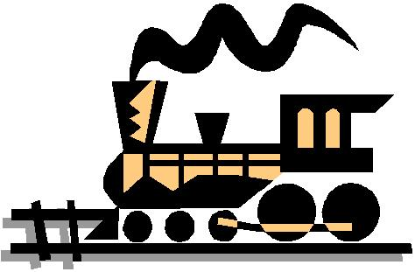
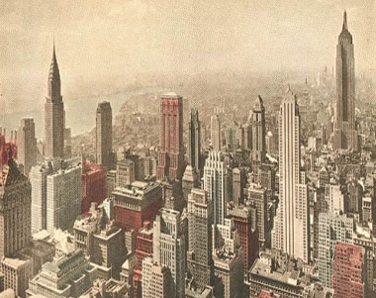
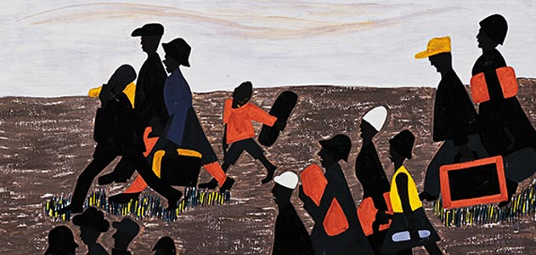
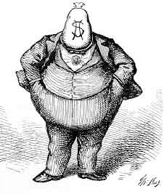
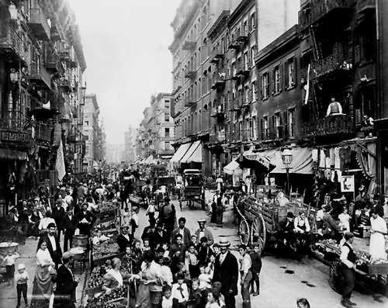
Urbanization
and the Immigrant Experience
STAAR review 12

Slide 2
TEKS – A Changing Society
US.12 (A) analyze the impact of physical and human geographic factors on the settlement of the Great Plains, the Klondike Gold Rush (pg. 34)
US.13 (A) analyze the causes and effects of changing demographic patterns resulting from migration within the United States, including western expansion, rural to urban, the Great Migration, (pg. 35)
US.13 (B) analyze the causes and effects of changing demographic patterns resulting from legal and illegal immigration to the United States. (pg. 36)
US.14 (A) identify the effects of population growth and distribution on the physical environment; (pg. 37)
US.25 (B) describe impacts of significant cultural movements country and western music on American society; (pg. 50)
US.3 (D) describe the optimism of the many immigrants who sought a better life in America. (pg. 62)
US.15 (A) describe how the economic impact of the Transcontinental Railroad and Homestead Act contributed to the close of the frontier in the late 19th century; (pg. 93)
US.15 (C) explain how foreign policies affected economic issues such as the Chinese Exclusion Act of 1882, and immigration quotas; (pg. 94)
US.23 (B) evaluate various means of achieving equality of political rights, congressional acts such as the American Indian Citizenship Act of 1924; (pg. 109)
US.26 (B) discuss the Americanization movement to assimilate immigrants and American Indians into American culture; (pg. 115)

Slide 3
Learning Objective
US.13 (A) analyze the causes and effects of changing demographic patterns resulting from migration within the United States, including western expansion, rural to urban, the Great Migration, (pg. 35)
US.3 (D) describe the optimism of the many immigrants who sought a better life in America. (pg. 62)
US.15 (C) explain how foreign policies affected economic issues such as the Chinese Exclusion Act of 1882, and immigration quotas; (pg. 94)
Vocabulary
Nativists – Anti-immigrant groups who support protecting the ‘natives’ (those here first) at the expense of immigrants. “Welcome to America, now go home.”
Assimilation – adopting the culture of a particular nation, forcing someone to give up their culture, language, religion, etc. to become ‘similar’ to others. Often called ‘Americanization’.
Political Machines – politicians that used bribery and votes in return for favors to stay in office. Led to corruption in government.
Notes:
A Changing Society

Slide 4
Proof of Learning
Critical Writing and Purposeful Talk
By the end of the lesson you will be expected to –
Discuss with your partner/group –
  Analyze why ‘nativists’ hated on immigrants and do you think this still happens today? Give support for your opinion.
  Compare and Contrast the ‘good’ and the ‘bad’ of political machines.
Critical Writing –
  You are a ‘New’ Immigrant and have been in the USA for a short time. Write a letter home to a loved one telling them about the Push/Pull factors that led you to America.
  Describe how your immigrant experience. (problems with housing, jobs, friends, neighbors, language, other cultures)
Notes:
A Changing Society

Slide 5


Slide 6
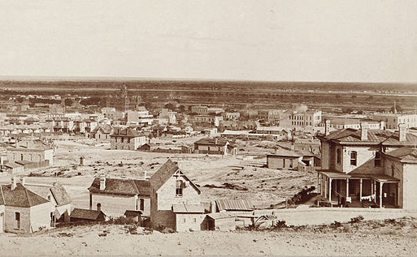
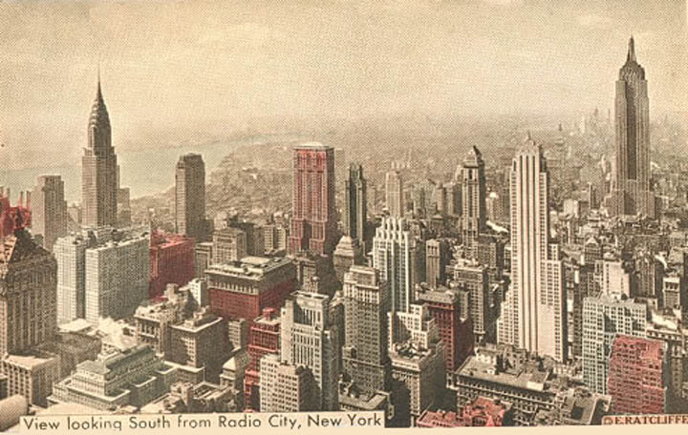
Urbanization
An important result of industrialization was the rapid growth of cities.
In 1865, only two cities had a population over 500,000 – New York and Philadelphia.
By 1900, this number increased to six cities as Americans were moving to more urban areas.
There were several reason for this rapid urbanization.
From this….
To this….

Slide 7
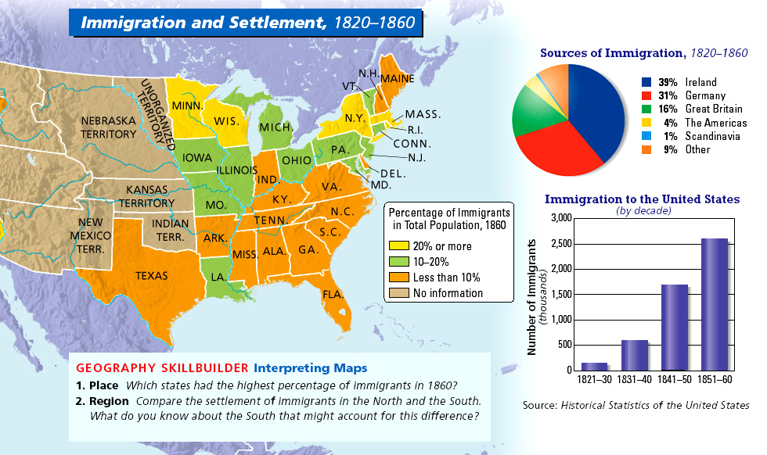
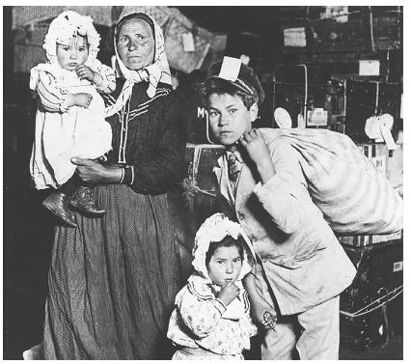
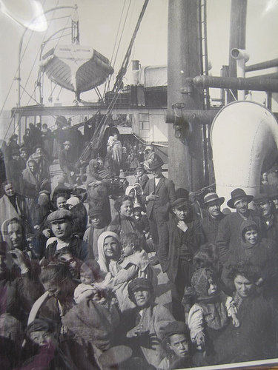
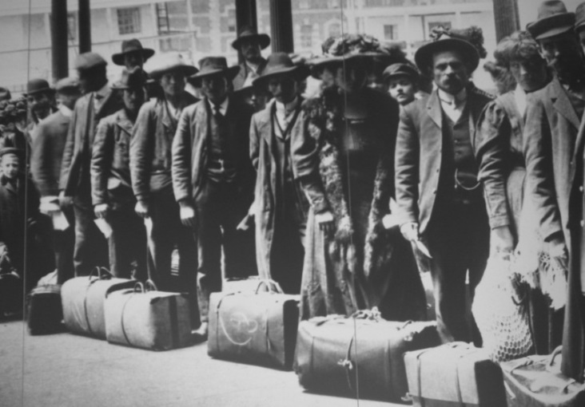
Causes of Urbanization
Improved farm equipment; Increased immigration; Migration of African-Americans:
Increased Immigration;
Large numbers of immigrants were coming to America.
These immigrants were mostly coming from Europe and most had very little money.
They got off the ships and found jobs in the factories of the cities.
This steady supply of labor helped the factories grow as well as increased the size of cities.
Notes:
A Changing Society

Slide 8
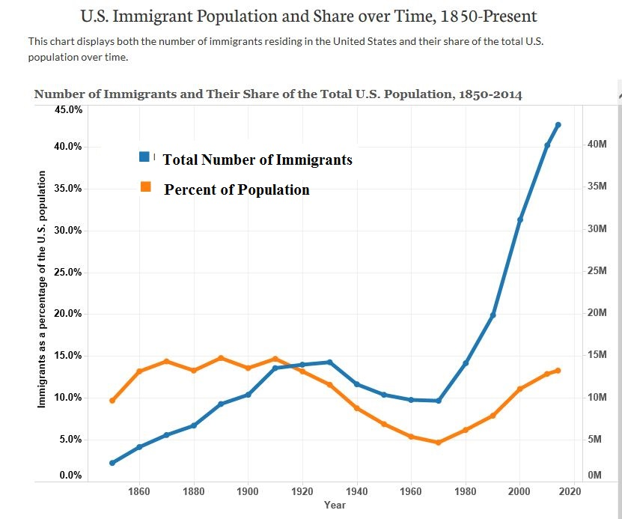

Slide 9
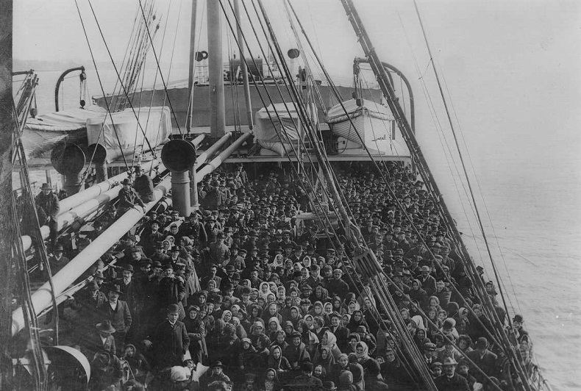
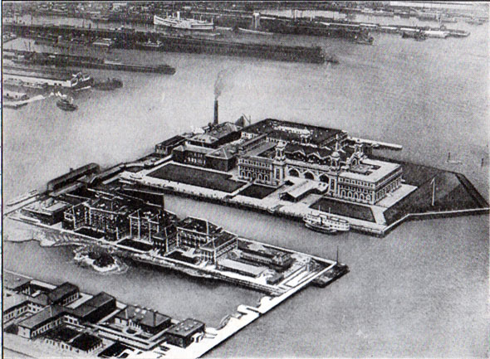
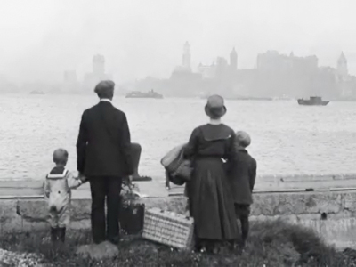
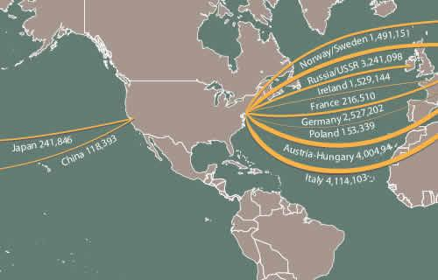
Immigration
This flood of immigrants coming into the USA, mostly came through Ellis Island, NY.
They came looking for the American Dream, to find a job, escape oppression and poverty, or to reconnect with family.
Before 1890 most of these immigrants came from Western and Northern Europe.
After 1890 they mostly came from Eastern and Southern Europe.

Slide 10
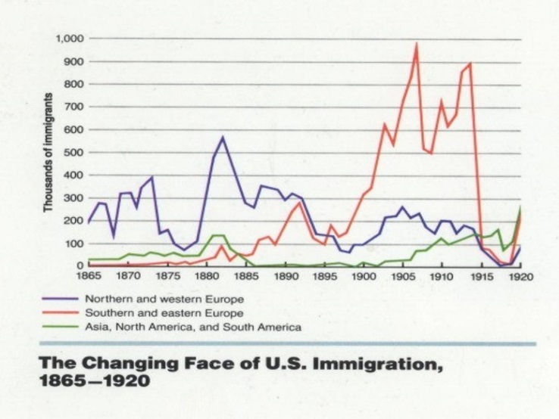

Slide 11
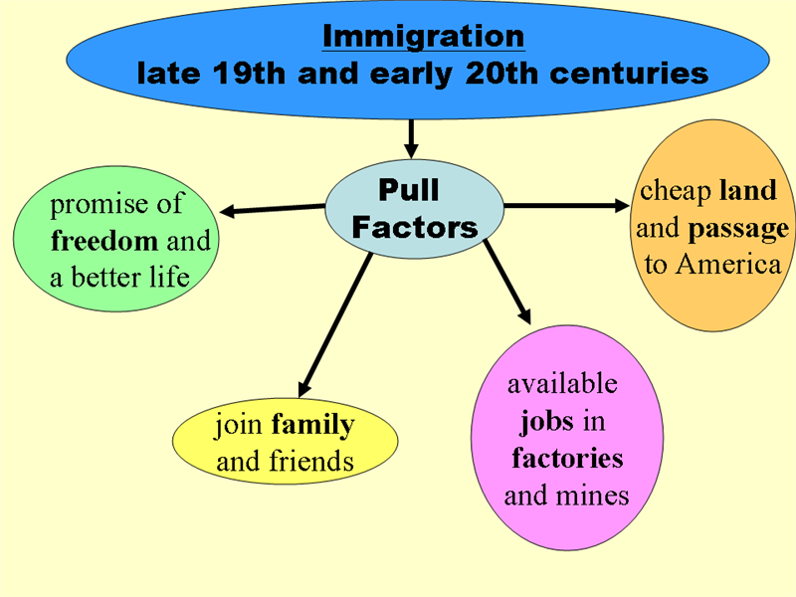
Why Immigrants Came to USA
Pull Factors – things that make a person want to move to another country
  Religious freedoms
  Job opportunities in factories, Transcontinental Railroad, gold mines, etc.
  Stable, democratic governments
  Hook up with family members already here
  Availability of cheap or free land
Push Factors – things that force people to leave their home country for another
  Wars in their homelands
  Famines (a severe lack of food)
  Lack of quality jobs
  Political unrest (bad leaders)
  Religious differences

Slide 12
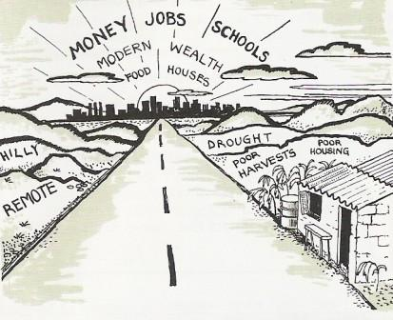
STAAR Practice Question
Use the image to answer the question.
The horizon of money, jobs, food and housing represents which of the following:
Push Factors
Pull Factors
ANSWER
Letter B
They are Pull Factors, they give people a reason to come to USA

Slide 13
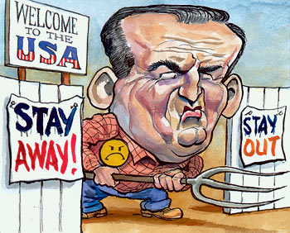
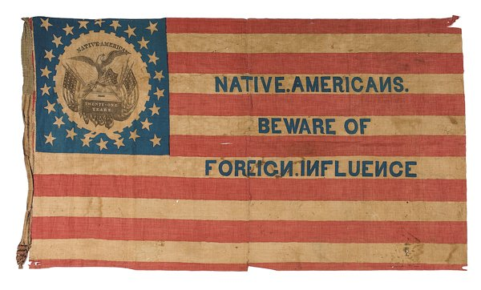
The Immigrant Experience
As more immigrants came to the USA, more Americans began to hate on these new immigrants.
These immigrant haters became known as Nativists, they thought they were here first and wanted the immigrants to go back where they came from.
Nativists hated on immigrants because they felt immigrants:
  Increased the crime rate
  Brought diseases to this country
  Took jobs from real Americans
  Competed for limited resources
  Basically they were just different!

Slide 14
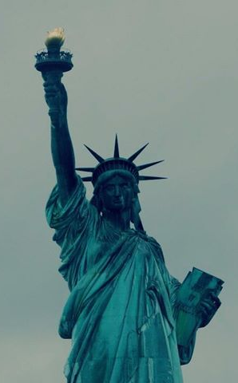
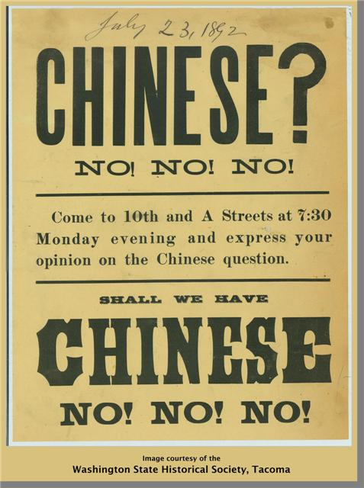
Early Restrictions on Immigration
Send us your …
For most of the 19th century there were no limits at all on immigration to the USA.
Anyone who was healthy and could afford to get here was permitted.
Things were about to change, in 1882 the Chinese Exclusion Act (1882) was passed.
The first federal law to restrict immigration into the USA.
Hundreds of thousands of Chinese had migrated to California, Chinese workers had even helped build part of the Transcontinental Railroad.
Now, Californians blamed the Chinese for their economic problems.
But, No Chinese

Slide 15
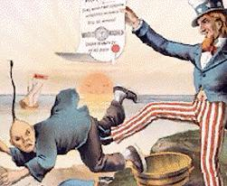
Early Restrictions on Immigration
The Chinese Exclusion Act banned anyone from immigrating from China to the USA.
It also placed new restrictions of those Chinese already living here by restricting their travel.
Chinese children born in the USA were denied citizenship.
Many believed this violated their 14th Amendment rights.
In U.S. v. Wong Kim Ark (1898), the Supreme Court ruled the act did violate the 14th Amendment.

Slide 16
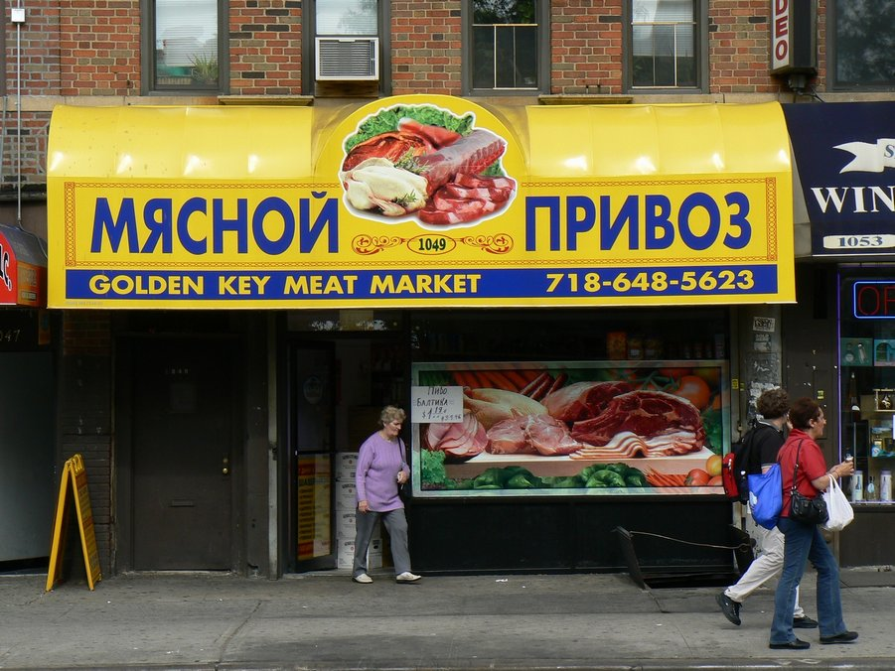
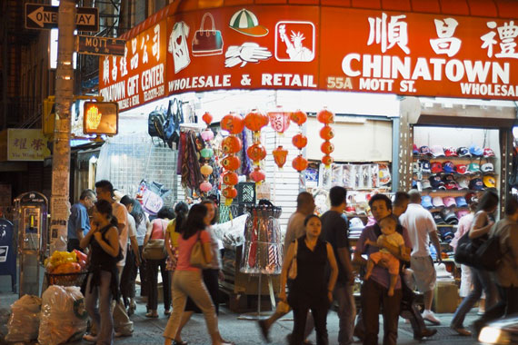
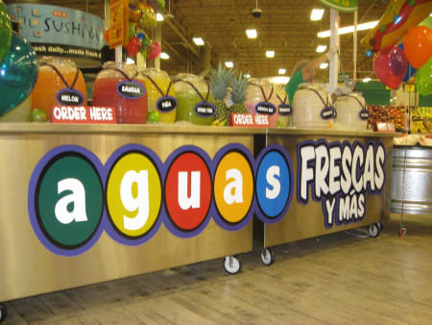
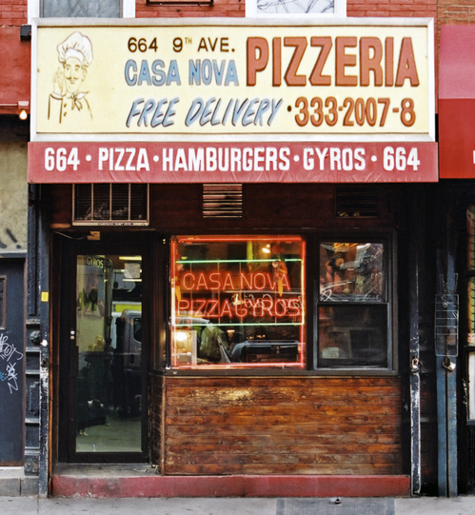
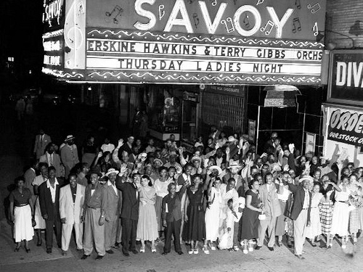
The Immigrant Experience
After 1880 immigration changed, now they came from Southern and Eastern Europe, especially Poland, Italy, Greece, & Russia.
Immigrants settled in areas of the cities where others of the same nationality lived.
These ethnic neighborhoods were called ghettos.
People felt more comfortable around those from the “Old Country” or those who spoke the same language and had similar customs.
But, these ethnic ghettos often isolated immigrants from mainstream American life, making it difficult for them to adapt to their new lives.

Slide 17
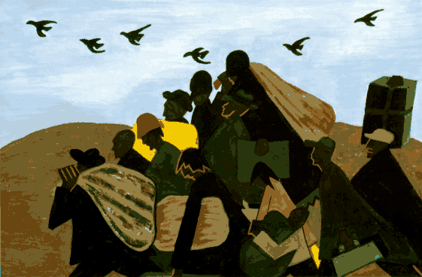
Causes of Urbanization
Improved farm equipment; Increased immigration; Migration of African-Americans:
Migration of African-Americans;
The 13th Amendment to the Constitution abolished slavery.
Former slaves were now free, but it didn’t seem like it.
African-Americans migrated north to the cities in search of work in the factories.
They also were attempting to escape the discrimination still found in the South.

Slide 18

The Great Migration

Slide 19
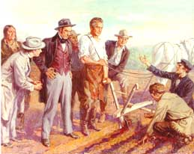
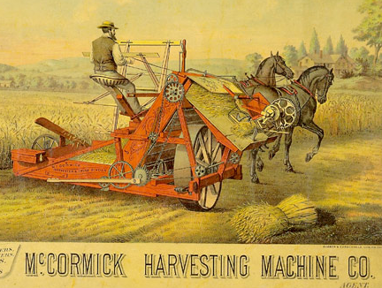
Causes of Urbanization
Improved farm equipment; Increased immigration; Migration of African-Americans:
Improved farm equipment;
The Bessemer Process produced a better quality of steel making farm equipment more efficient.
John Deere’s steel plow allowed farmers to plant more crops.
Cyrus McCormick’s reaper reduced the number on people required to harvest the crops.
People left the farms to find jobs in the factories of the cities.

Slide 20
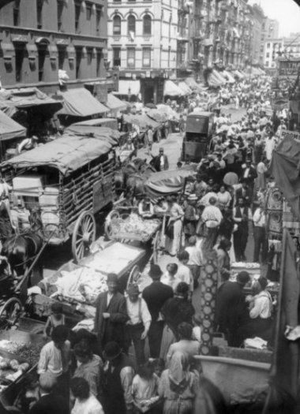
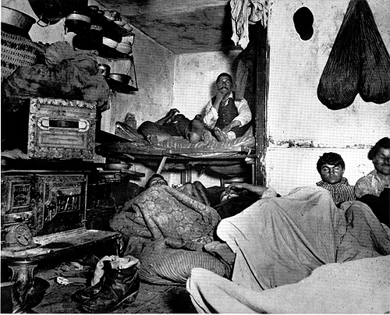
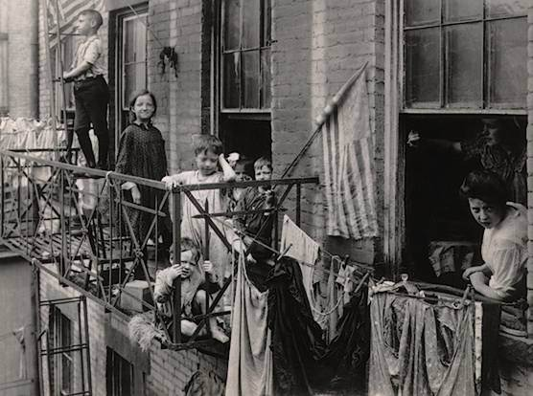
Problems Caused by Urbanization
This rapid urbanization of the cities led to many problems.
Overcrowding and congestion caused a lack of housing, transportation, and clean water.
It also brought about an increase in the spread of diseases and crime.
Many families were forced to crowd into tenements – single room apartments that often lacked the basic necessities.

Slide 21
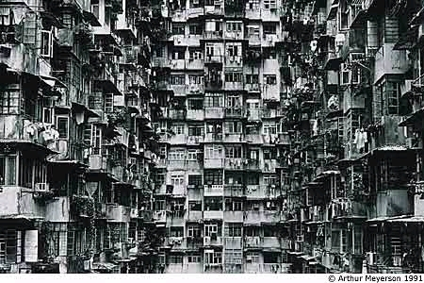
Growth of Cities Brings Problems
Did you here Joe coughing all night?
Boy this water sure smells funny
Look out below !
The toilet doesn’t flush again !
Wish we could afford to move
Billy Bob you shouldn’t smoke in bed
If they don’t shut up I’m going to kick their &#@!
Thank goodness you have a factory job
Something sure stinks

Slide 22
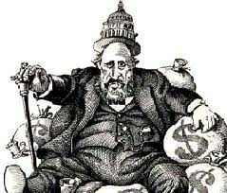
Political Machines
Politicians also formed political machines.
These political machines were run by powerful politicians who did favors for people in return for bribes and votes.
These political machines were corrupt and took advantage of immigrants, if you wanted a job, you had to pay the ‘boss’.
But at the same time they also helped them get things they wanted or needed.
One of the most famous political machines was Tammany Hall in New York City, it was run by Boss Tweed. (shown as a fat money grabber)

Slide 23
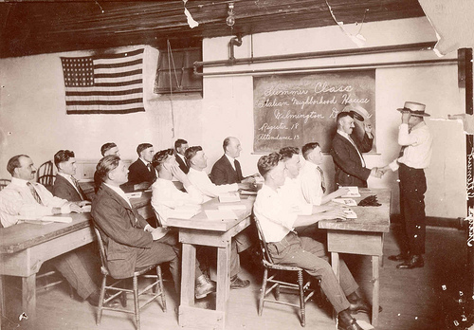
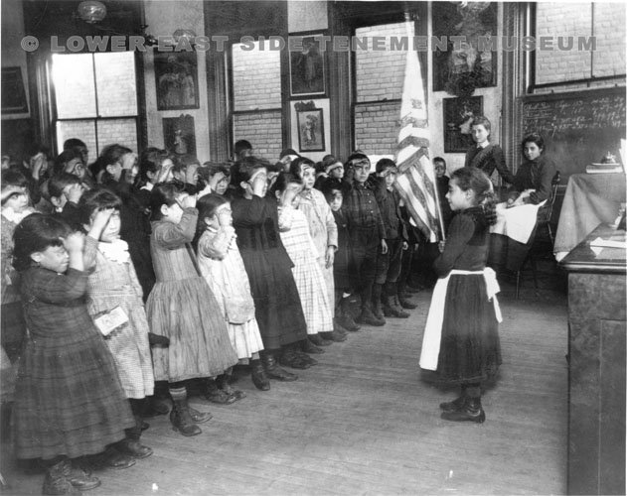
Americanization
Some adult immigrants did attend night schools to learn English, but they were mostly to busy working.
It was the immigrant children that would become Americanized - learning to dress, speak, and act like other Americans.
These immigrant children would become assimilated – they became similar to other Americans.
America became a “melting pot” in which immigrants were melted down and reshaped.

Slide 24
Proof of Learning
Critical Writing and Purposeful Talk
By the end of the lesson you will be expected to –
Discuss with your partner/group –
  Analyze why ‘nativists’ hated on immigrants and do you think this still happens today? Give support for your opinion.
  Compare and Contrast the ‘good’ and the ‘bad’ of political machines.
Critical Writing –
  You are a ‘New’ Immigrant and have been in the USA for a short time. Write a letter home to a loved one telling them about the Push/Pull factors that led you to America.
  Describe how your immigrant experience. (problems with housing, jobs, friends, neighbors, language, other cultures)

