Slide 1
Topic 1 Revision
Linear relationships

Slide 2
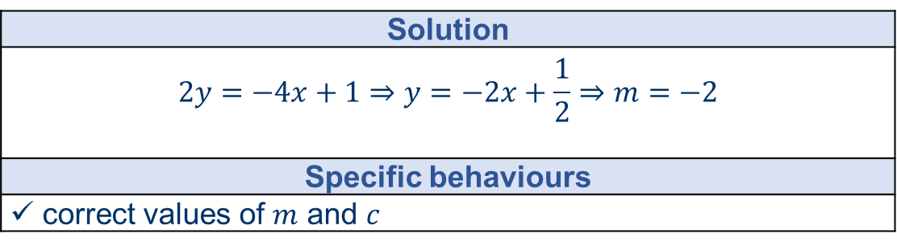
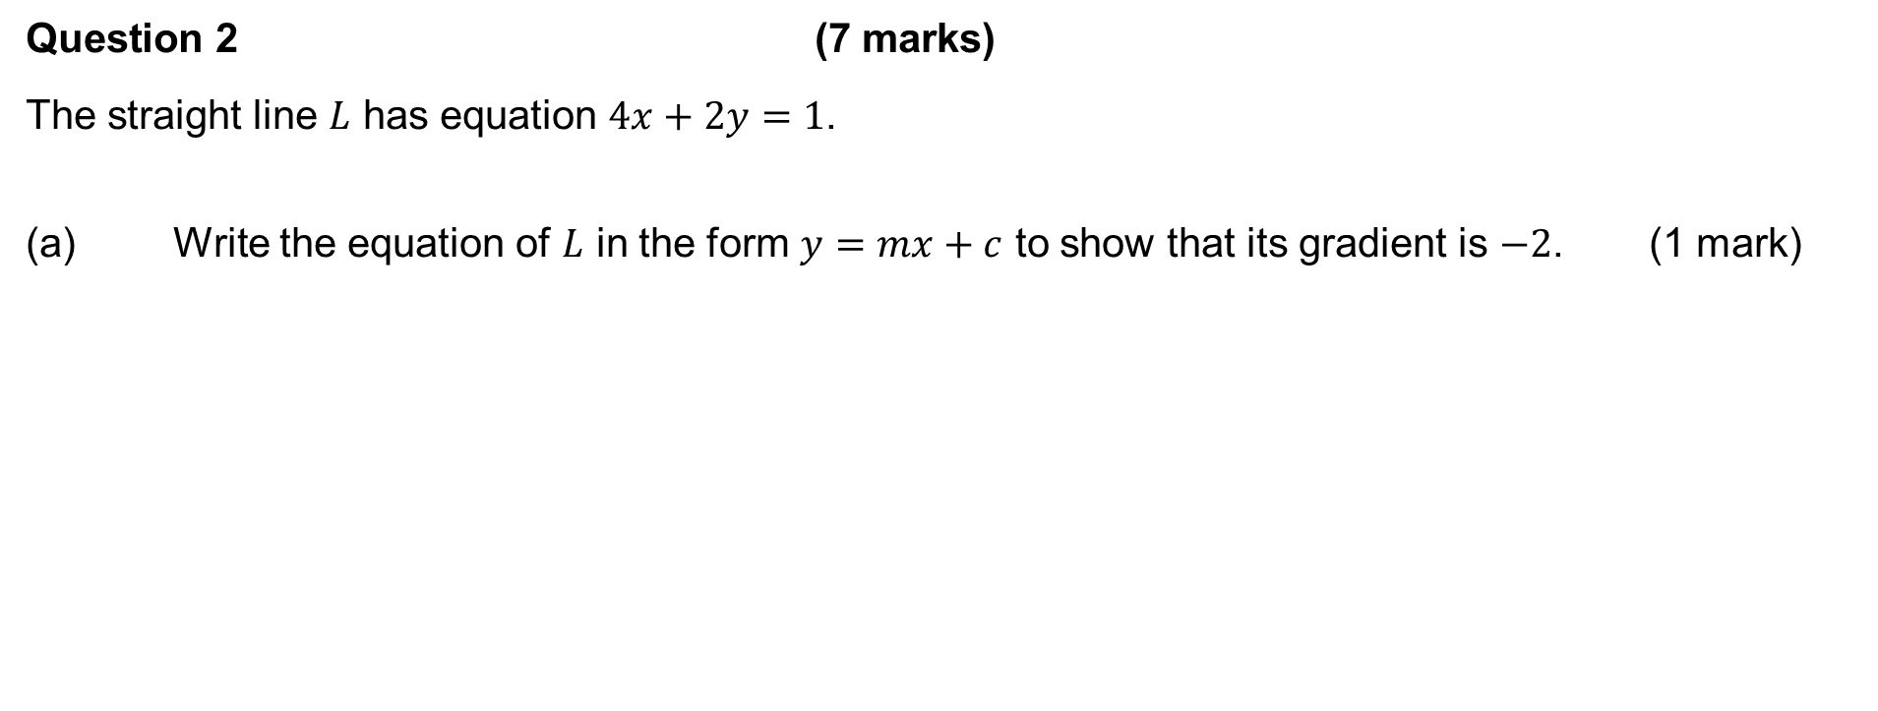
2021 Calc-free
Question 2 (7 marks)
The straight line $L$ has equation $4x+2y=1$.
(a) Write the equation of $L$ in the form $y=mx+c$ to show that its gradient is $−2$. (1 mark)
Solution
$$2y=−4x+1⇒y=−2x+\frac{1}{2}⇒m=−2$$
Specific behaviours
✓ correct values of $m$ and $c$

Slide 3
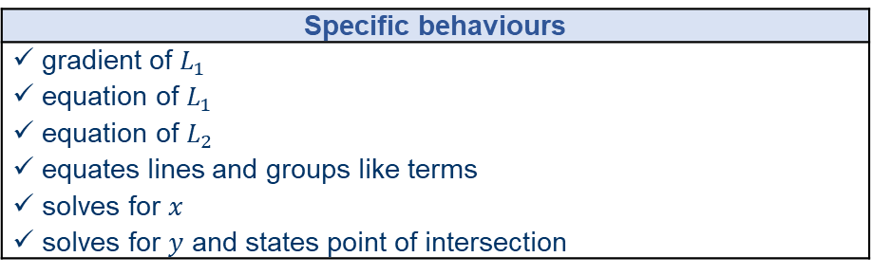
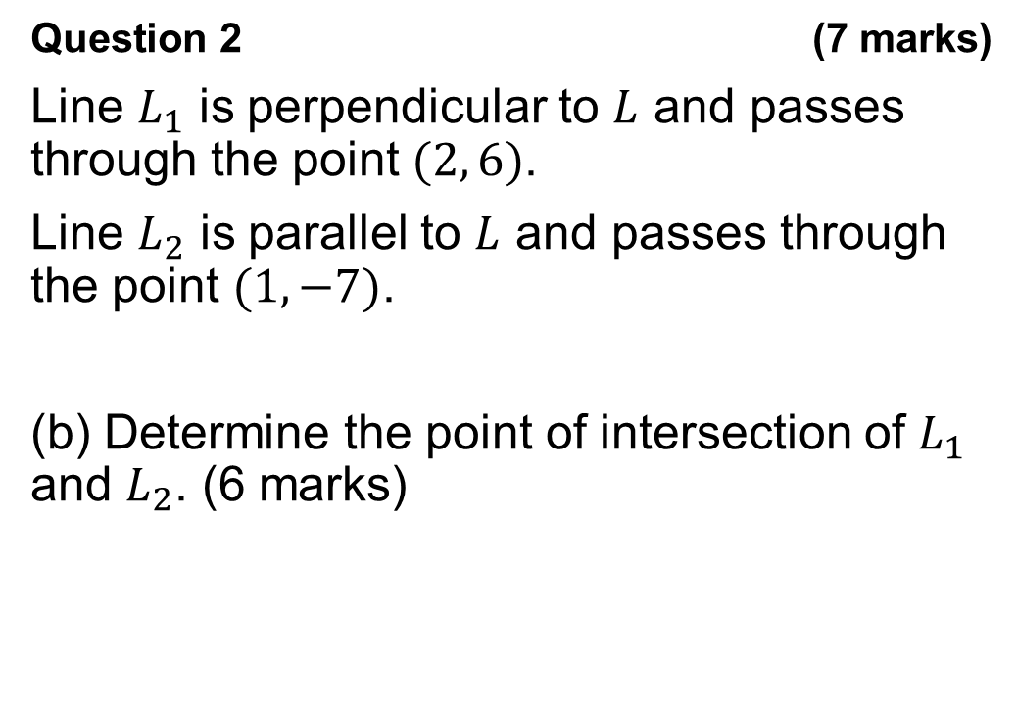
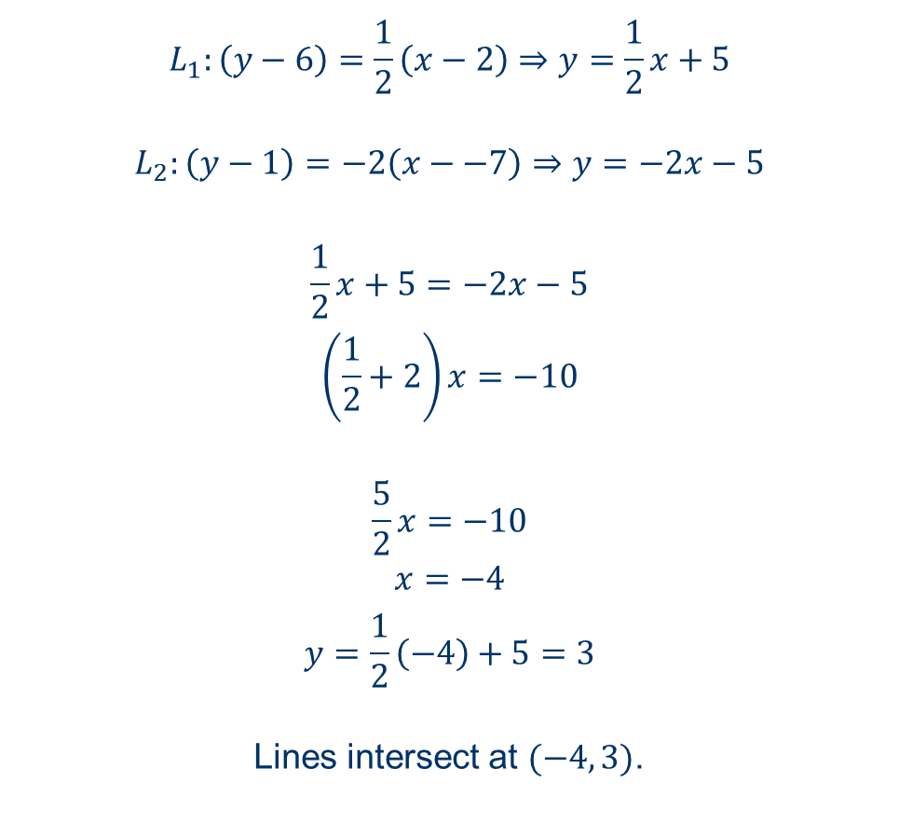
2021 Calc-free
Question 2 (7 marks)
Line $L_{1}$ is perpendicular to $L$ and passes through the point $(2, 6)$.
Line $L_{2}$ is parallel to $L$ and passes through the point $(1, −7)$.
(b) Determine the point of intersection of $L_{1}$ and $L_{2}$. (6 marks)
$$L_{1}:\left(y−6\right)=\frac{1}{2}\left(x−2\right)⇒y=\frac{1}{2}x+5$$
$$L_{2}:\left(y−1\right)=−2\left(x−−7\right)⇒y=−2x−5$$
$$\frac{1}{2}x+5=−2x−5$$
$$\left(\frac{1}{2}+2\right)x=−10$$
$$\frac{5}{2}x=−10$$
$$x=−4$$
$$y=\frac{1}{2}\left(−4\right)+5=3$$
Lines intersect at $(−4, 3)$.
Specific behaviours
ü gradient of $L_{1}$ ✓ equation of $L_{1}$ ü equation of $L_{2}$ ü equates lines and groups like terms ü solves for $x$ ü solves for $y$ and states point of intersection

Slide 4
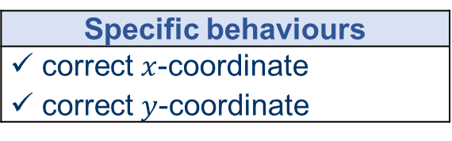
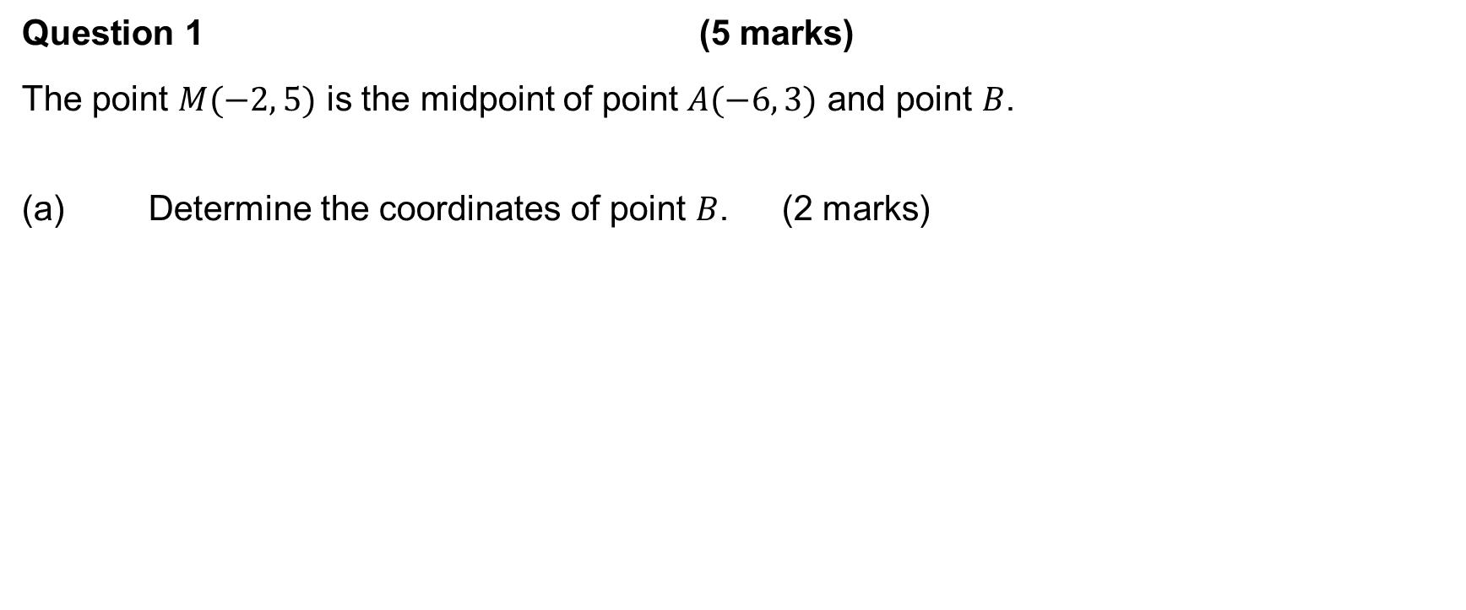
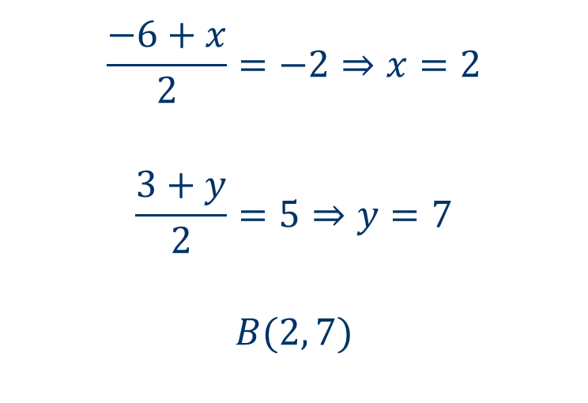
2020 Calc-free
Question 1 (5 marks)
The point $M(−2, 5)$ is the midpoint of point $A(−6, 3)$ and point $B$.
(a) Determine the coordinates of point $B$. (2 marks)
$$\frac{−6+x}{2}=−2⇒x=2$$
$$\frac{3+y}{2}=5⇒y=7$$
$$B(2, 7)$$
Specific behaviours
✓ correct $x$-coordinate ✓ correct $y$-coordinate

Slide 5
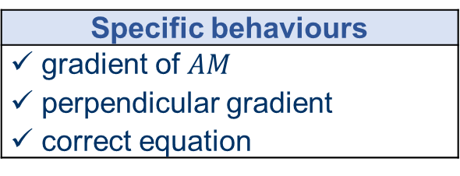
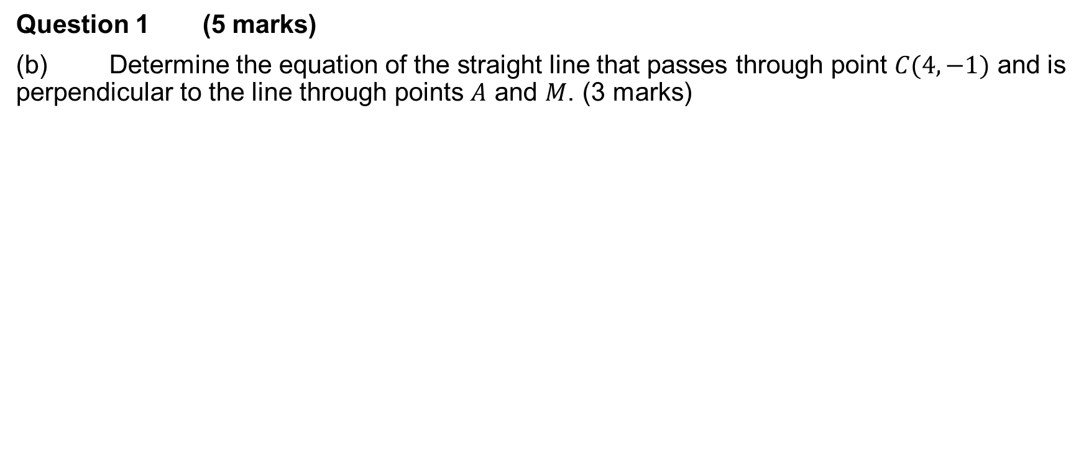
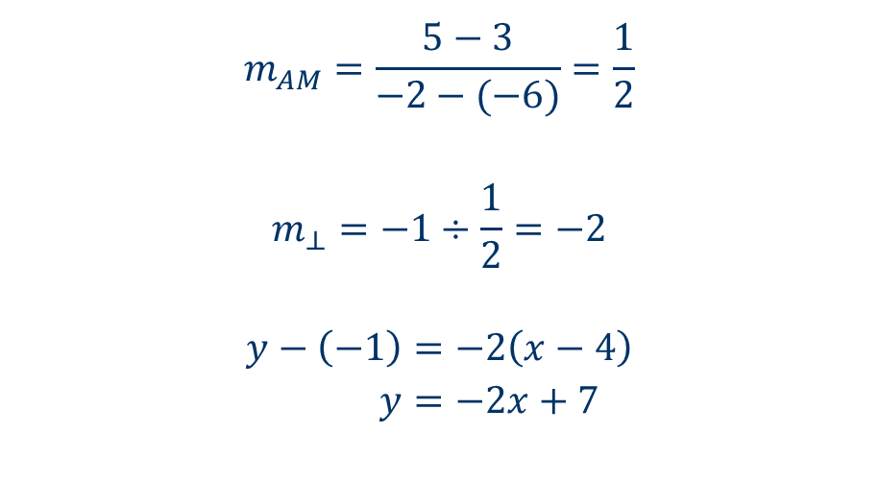
2020 Calc-free
Question 1 (5 marks)
(b) Determine the equation of the straight line that passes through point $C(4, −1)$ and is perpendicular to the line through points $A$ and $M$. (3 marks)
$$m_{AM}=\frac{5−3}{−2−(−6)}=\frac{1}{2}$$
$$m_{⊥}=−1÷\frac{1}{2}=−2$$
$$y−\left(−1\right)=−2\left(x−4\right) \\ y=−2x+7$$
Specific behaviours
✓ gradient of $AM$ ü perpendicular gradient ü correct equation

Slide 6
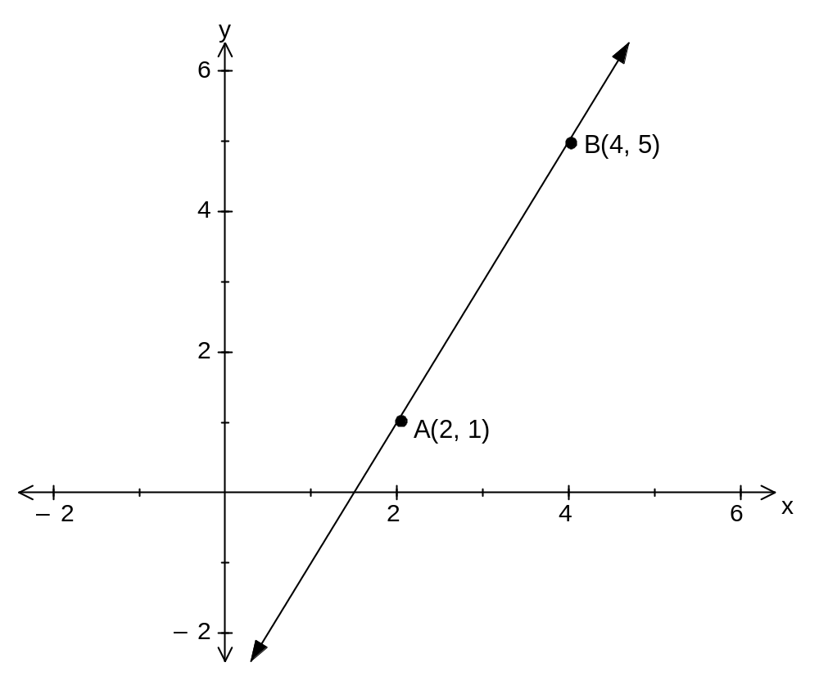
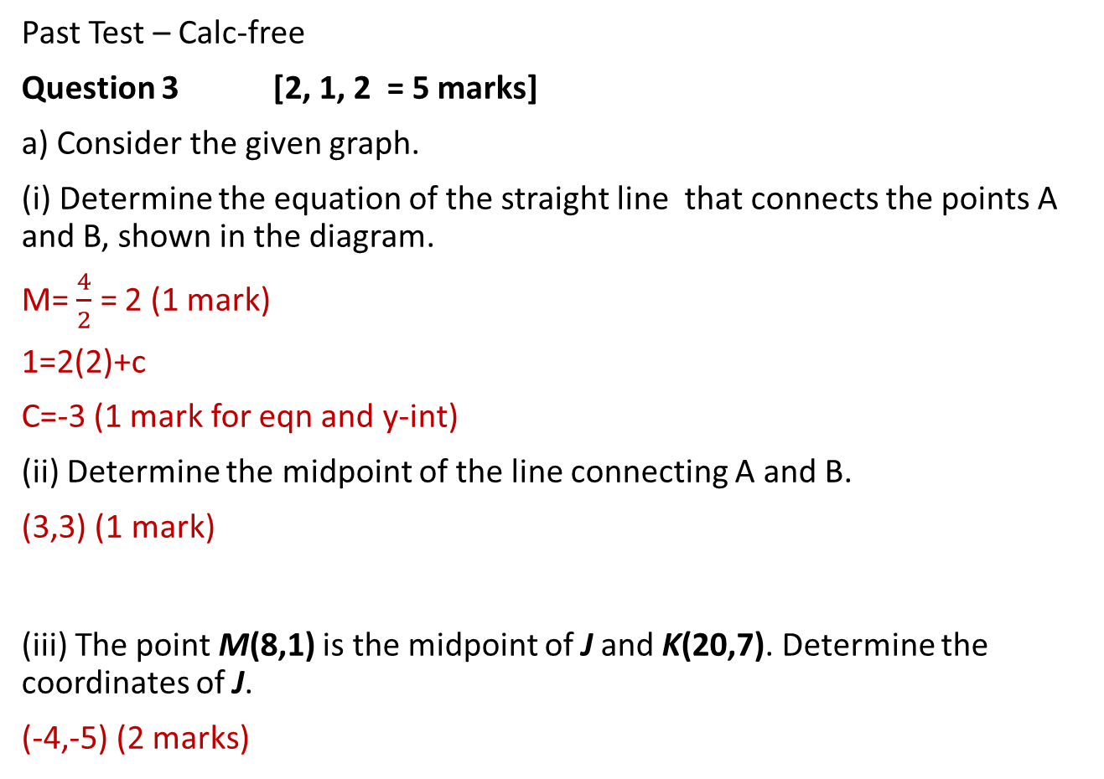
Past Test – Calc-free
Question 3 [2, 1, 2 = 5 marks]
a) Consider the given graph.
(i) Determine the equation of the straight line that connects the points A and B, shown in the diagram.
M= $\frac{4}{2}$ = 2 (1 mark)
1=2(2)+c
C=-3 (1 mark for eqn and y-int)
(ii) Determine the midpoint of the line connecting A and B.
(3,3) (1 mark)
(iii) The point M(8,1) is the midpoint of J and K(20,7). Determine the coordinates of J.
(-4,-5) (2 marks)

Slide 7
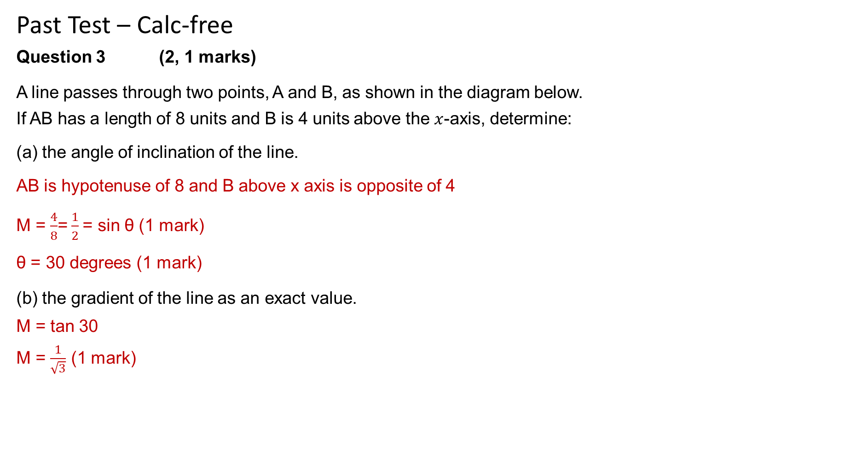
Past Test – Calc-free
Question 3 (2, 1 marks)
A line passes through two points, A and B, as shown in the diagram below.
If AB has a length of 8 units and B is 4 units above the $x$-axis, determine:
(a) the angle of inclination of the line.
AB is hypotenuse of 8 and B above x axis is opposite of 4
M = $\frac{4}{8}$= $\frac{1}{2}$= sin θ (1 mark)
θ = 30 degrees (1 mark)
(b) the gradient of the line as an exact value.
M = tan 30
M = $\frac{1}{\sqrt{3}}$ (1 mark)

Slide 8
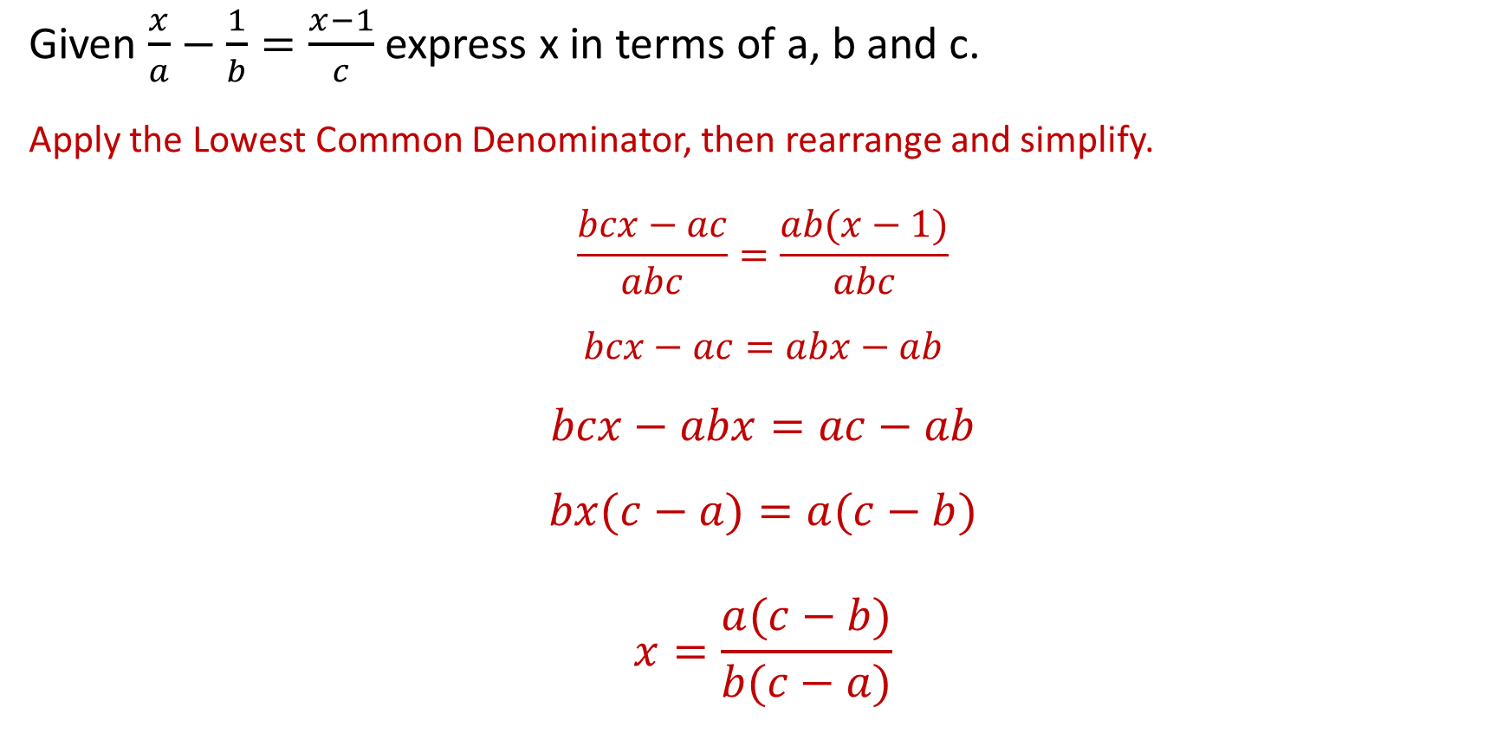
Klup Chapter 2 Review Q 11
Given $\frac{x}{a}−\frac{1}{b}=\frac{x−1}{c}$ express x in terms of a, b and c.
Apply the Lowest Common Denominator, then rearrange and simplify.
$$\frac{bcx−ac}{abc}=\frac{ab(x−1)}{abc}$$
$$bcx−ac=abx−ab$$
$$bcx−abx=ac−ab$$
$$bx(c−a)=a(c−b)$$
$$x=\frac{a(c−b)}{b(c−a)}$$

Slide 9
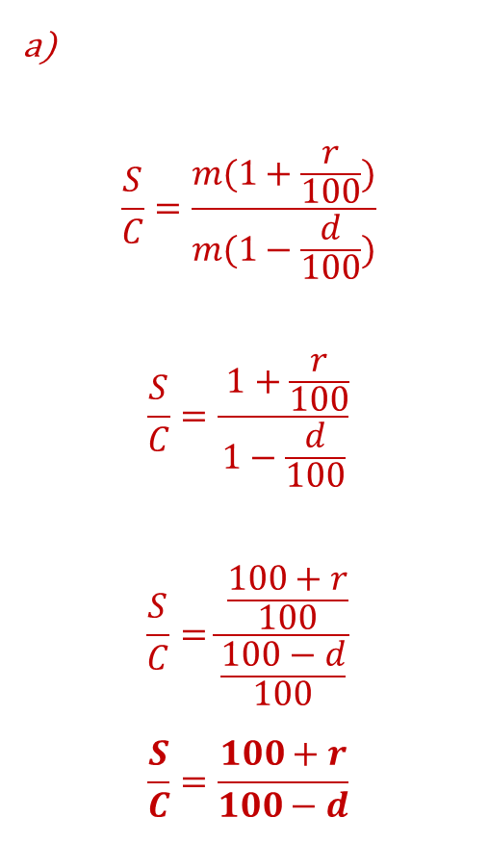
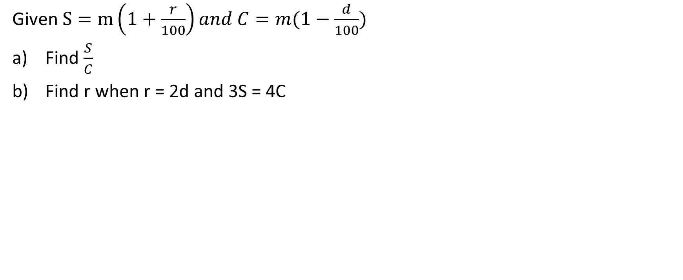
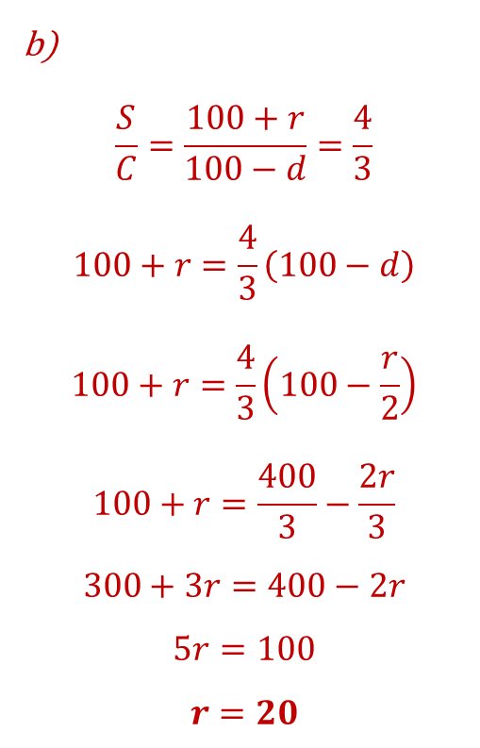
Klup Chapter 2 Review Q 13
Given $S=m\left(1+\frac{r}{100}\right)and C=m(1−\frac{d}{100})$
Find $\frac{S}{C}$
Find r when r = 2d and 3S = 4C
a)
$$\frac{S}{C}=\frac{m(1+\frac{r}{100})}{m(1−\frac{d}{100})}$$
$$\frac{S}{C}=\frac{ 1+\frac{r}{100}}{1−\frac{d}{100}}$$
$$\frac{S}{C}=\frac{ \frac{100+r}{100}}{\frac{100−d}{100}}$$
$$\frac{S}{C}=\frac{100+r}{100−d}$$
b)
$$\frac{S}{C}=\frac{100+r}{100−d}=\frac{4}{3}$$
$$100+r=\frac{4}{3}\left(100−d\right)$$
$$100+r=\frac{4}{3}\left(100−\frac{r}{2}\right)$$
$$100+r=\frac{400}{3}−\frac{2r}{3}$$
$$300+3r=400−2r$$
$$5r=100$$
$$r=20$$

Slide 10
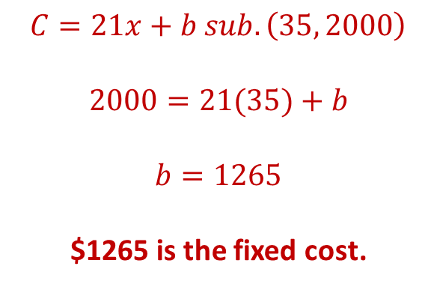
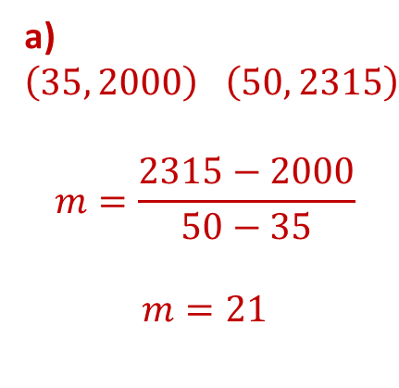
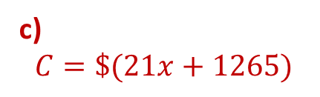
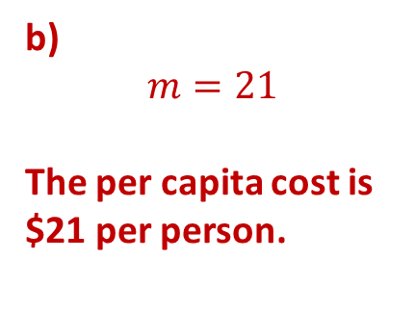
Klup Chapter 4 Review Q 19
The total cost, $C, of running a weekend camp is made up of a fixed cost plus a per capita cost. The total cost of the camp is $2000 if 35 people attend and $2315 if 50 people attend.
Find the fixed cost associated with running the camp.
Find the per capita cost of running this camp.
Find the cost of running this camp if x people attend.
a) $\left(35, 2000\right) \left(50, 2315\right)$
$$m=\frac{2315−2000}{50−35}$$
$$m=21$$
$$C=21x+b sub. \left(35, 2000\right)$$
$$2000=21(35)+b$$
$$b=1265$$
$1265 is the fixed cost.
b)
$$m=21$$
The per capita cost is $21 per person.
c)
$$C=\$(21x+1265)$$

Slide 11
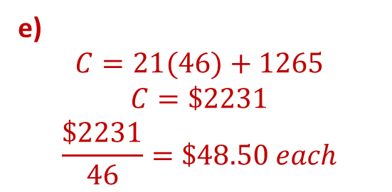
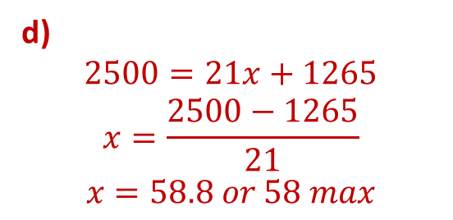
Klup Chapter 4 Review Q 19
The total cost, $C, of running a weekend camp is made up of a fixed cost plus a per capita cost. The total cost of the camp is $2000 if 35 people attend and $2315 if 50 people attend.
d) If $2500 is set aside for this camp, what is the maximum number of people that can attend?
e) If 46 people attend the camp and it has to be self-funded, how much must each person contribute?
d)
$$2500=21x+1265$$
$$x=\frac{2500−1265}{21}$$
$$x=58.8 or 58 max$$
e)
$$C=21(46)+1265$$
$$C=\$2231$$
$$\frac{\$2231}{46}=\$48.50 each$$

Slide 12
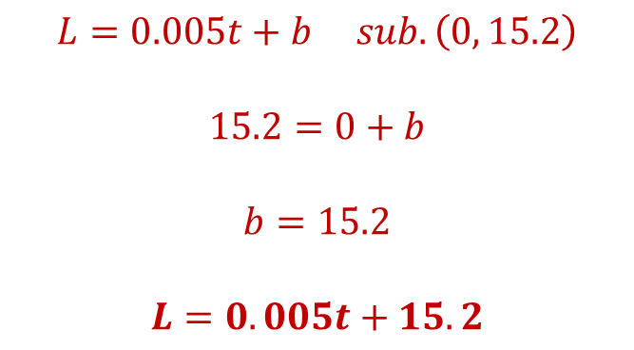
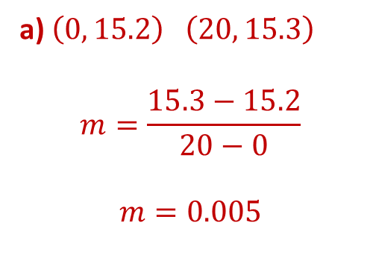
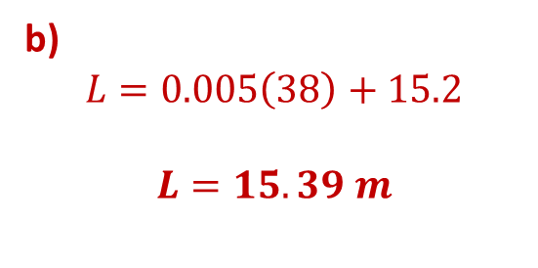
Klup Chapter 4 Review Q 20
A metallurgist calculates that the length (L) of a metal rod is linearly related to the temperature (t) of the rod. He found that a metal rod was 15.2 metres long at 0 ⁰C and 15.3 m at 20 ⁰C.
Write an equation that relates length and temperature.
What will be the length of this rod if heated to 38 ⁰C?
a) $\left(0, 15.2\right) \left(20, 15.3\right)$
$$m=\frac{15.3−15.2}{20−0}$$
$$m=0.005$$
$$L=0.005t+b sub. \left(0, 15.2\right)$$
$$15.2=0+b$$
$$b=15.2$$
$$L=0.005t+15.2$$
b)
$$L=0.005\left(38\right)+15.2$$
$$L=15.39 m$$

