Slide 1
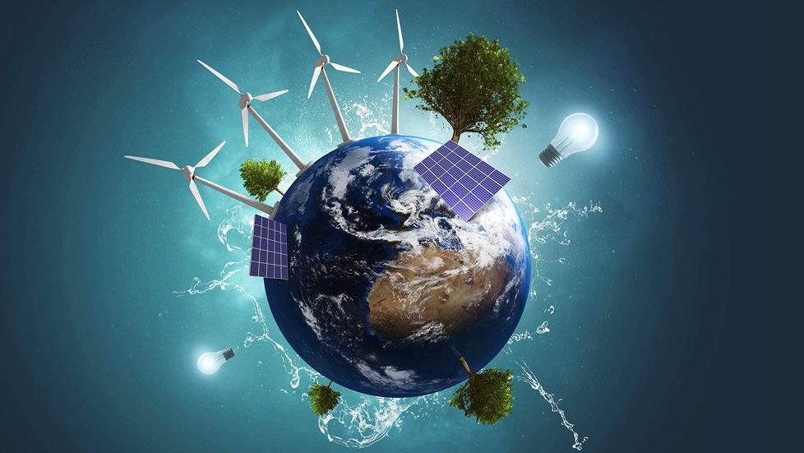
Factors of Production
2

Slide 2

Success Criteria:
Define land, labor, capital, and entrepreneurship in economic terms
Identify and categorize factors of production in a scenario.

Slide 3
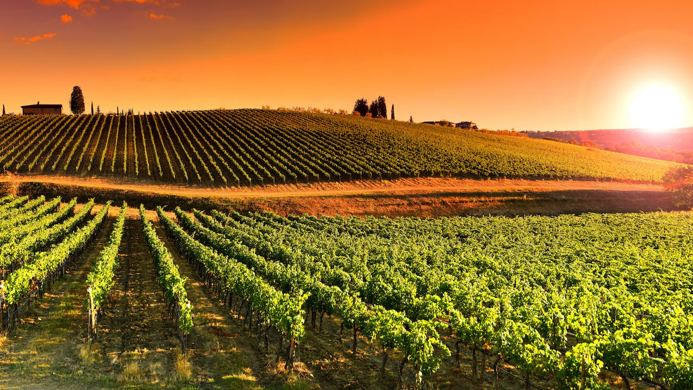

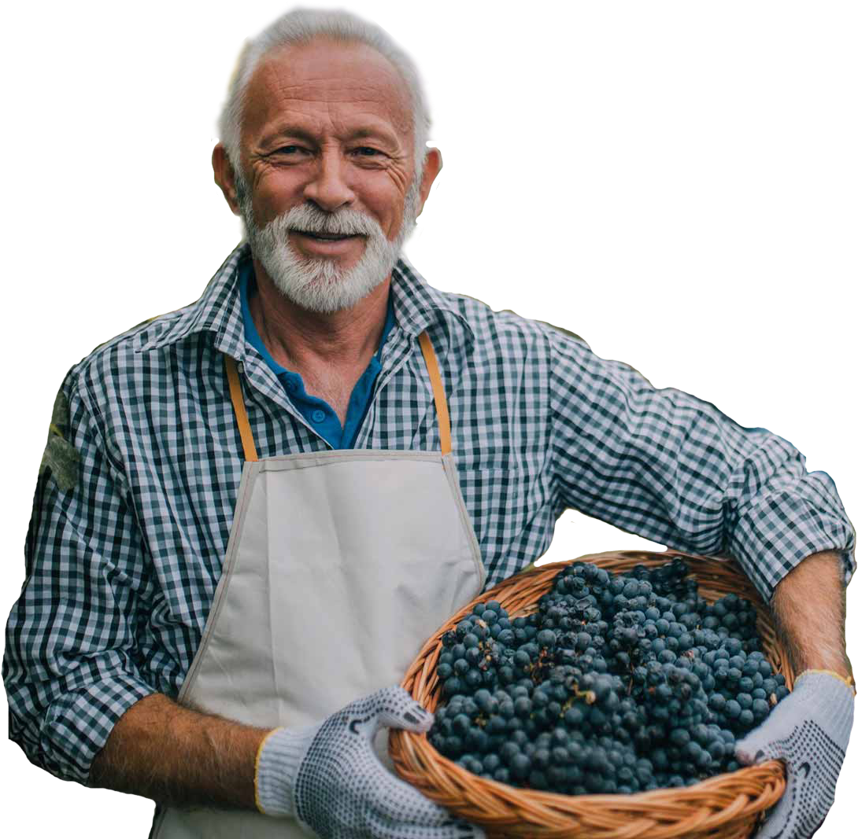



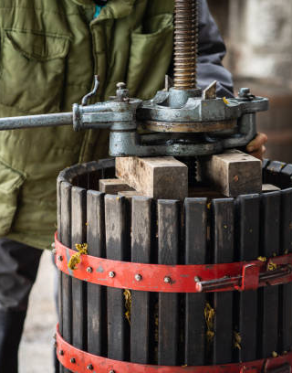



The Factors of Production
To understand how producers create goods and services for consumers in a society, economists have identified four factors of production.
  Factors of Production- resources needed to produce goods and services
  Land
  Labor
Capital
Enterprise

Slide 4
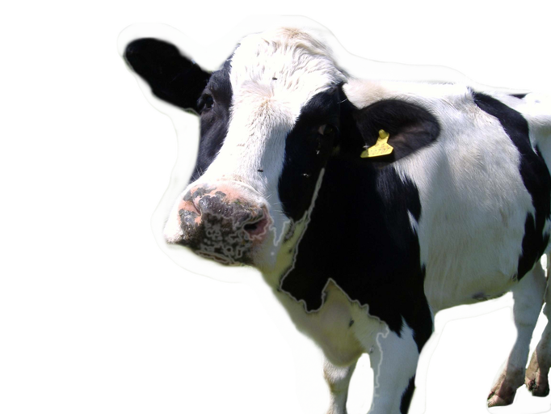


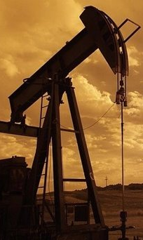

The Factors of Production
To understand how producers create goods and services for consumers in a society, economists have identified four factors of production.
  Factors of Production- resources needed to produce goods and services
  Land
  Labor
In economic terms, land includes all the natural resources found on or under ground that are used to produce goods and services.
  Examples: Water, timber, livestock, minerals, gas, oil, etc.
Capital
Entrepreneurship

Slide 5





The Factors of Production
In economic terms, land includes all the natural resources found on or under ground that are used to produce goods and services.
  Examples: Water, timber, livestock, minerals, gas, oil, etc.
Labor is all the human time, effort, and talent that go into the making of products
  Examples: factory worker, architect, teacher, doctors, clerks, etc.

Slide 6


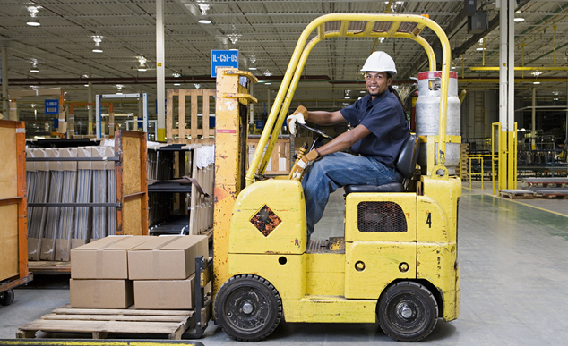


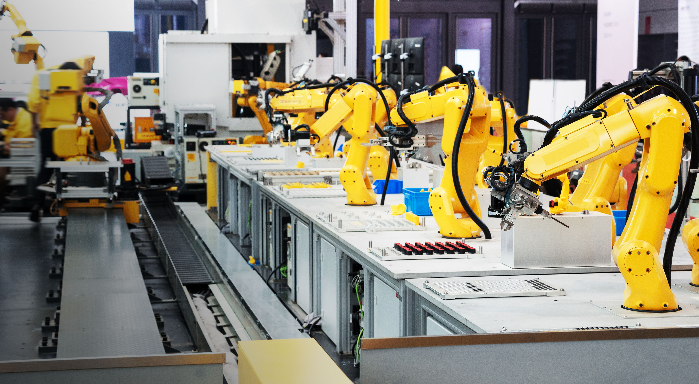
The Factors of Production
In economic terms, land includes all the natural resources found on or under ground that are used to produce goods and services.
  Examples: Water, timber, livestock, minerals, gas, oil, etc.
Labor is all the human time, effort, and talent that go into the making of products
  Examples: factory worker, architect, teacher, doctors, clerks, etc.
In economics, capital is all the resources made and used by people to produce and distribute goods and services
  Physical Capital: tools, machinery, offices, warehouses, offices, etc.
  Human Capital: college degree, job training, etc.

Slide 7



The Factors of Production
The fourth factor of production, enterprise, brings the other three together by combining vision, skills, ingenuity to create and run a business
  Entrepreneur: someone who organizes, manages, and assumes the risks of a business or enterprise; the agent in charge
In economic terms, land includes all the natural resources found on or under ground that are used to produce goods and services.
  Examples: Water, timber, livestock, minerals, gas, oil, etc.
Labor is all the human time, effort, and talent that go into the making of products
  Examples: factory worker, architect, teacher, doctors, clerks, etc.
In economics, capital is all the resources made and used by people to produce and distribute goods and services
  Physical Capital: tools, machinery, offices, warehouses, offices, etc.
  Human Capital: college degree, job training, etc.

Slide 8
















The Factors of Production
The fourth factor of production, entrepreneurship, brings the other three together by combining vision, skills, ingenuity to create and run a business
  Entrepreneur: someone who organizes, manages, and assumes the risks of a business or enterprise; the agent in charge

Slide 9

Think, Pair, Share
How Tortilla?

Slide 10


Slide 11




Check for Understanding:
With a group of 2-3 create a master list of what it takes to create tortilla chips. Then categorize what you saw in the video into Land, Labor, Capital, or Enterprise
Land
Labor
Capital
Enterprise

Slide 12

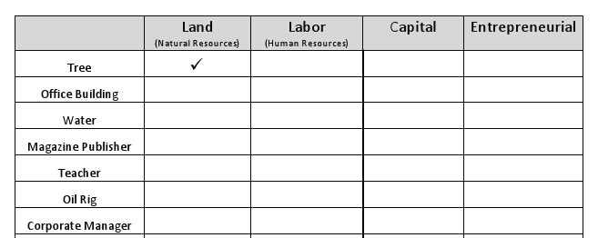
Check for Understanding:
Complete the Factors of Production Worksheet by placing a checkmark ( ) in the appropriate box to indicate whether the item would be classified as land, labor, capital, or entrepreneurial.

