Slide 1
Bell Work
If you could visit a place for a week, where would you go? What would you do?
Write 3 sentences

Slide 2
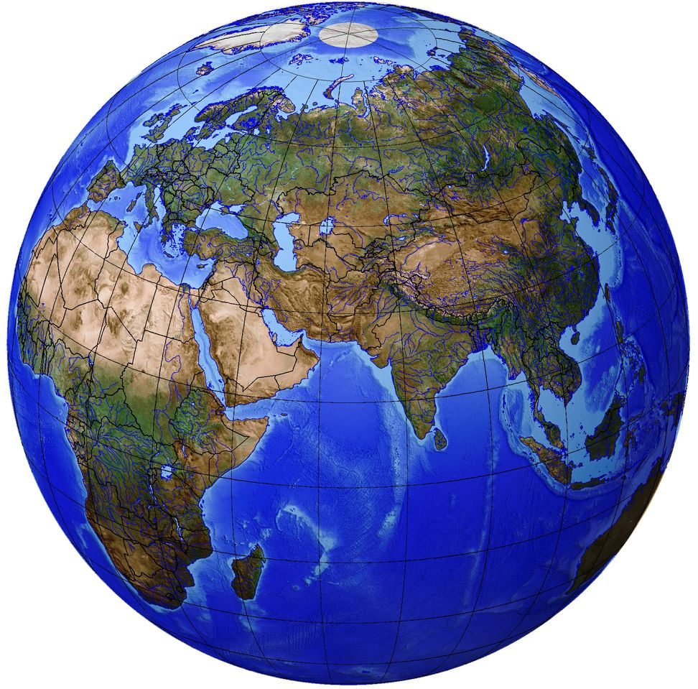
Chapter 1:
The World of Geography

Slide 3
Chapter 1:
What is Geography?
*It is the study of our earth; our home.
OR
*Anything that can be mapped!
Notes:
The last definition is really at the heart of geography. Maps are the tools of geographers: If something can be mapped, it’s geography.

Slide 4
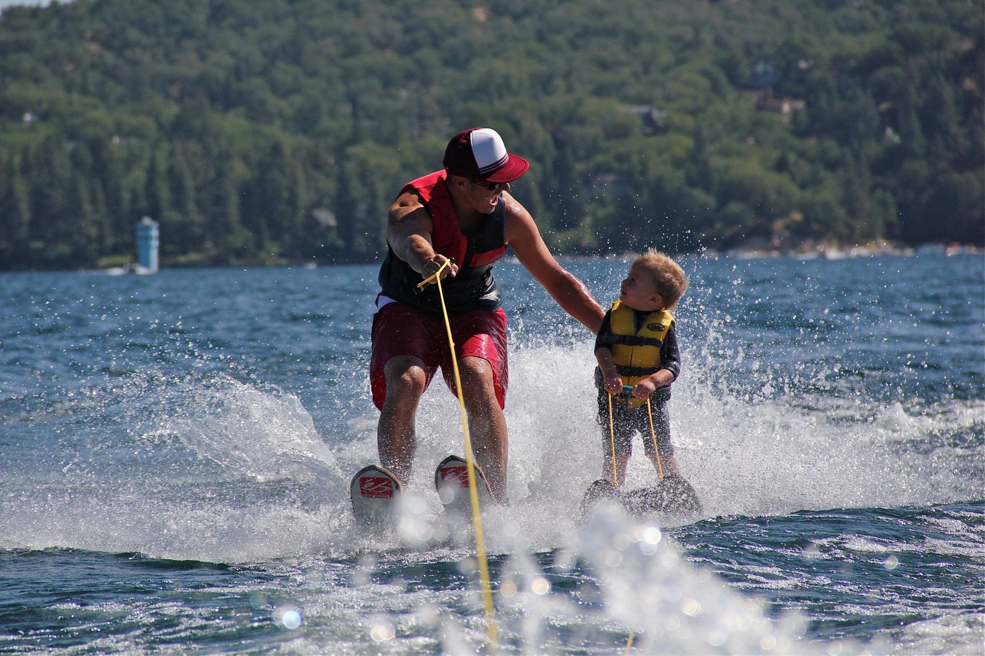
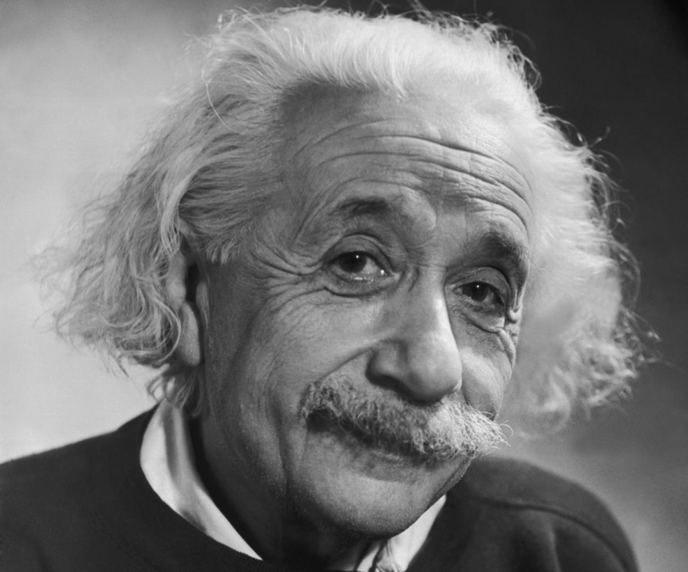
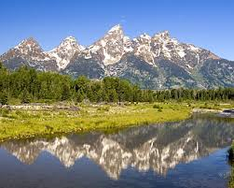
*Geography mixes up the physical and human aspects of our world into one field of study.
*Geography shows the relationship between people and the environment.

Slide 5

What is a geographer?
Someone who analyzes the Earth from many points of view.

Slide 6
The Five Themes of Geography
There are five ways to look at the earth
When geographers work, they are guided by two basic questions:
  Where are things located?
  Why are they there?
  To find these answers, geographers use five themes to organize information

Slide 7
Things that geographers study:
oceans
plant life
landforms
people
how the Earth and its people affect each other

Slide 8
The Five Themes:
Movement – Helps explain how people, goods, and ideas get from one place to another.
Regions – Geographers compare the climate, land, population, or history of one place to another.
Human-Environment Interaction – Geographers study how people affect or shape physical characteristics of their natural surroundings and how does their surroundings (environment) affect them?

Slide 9
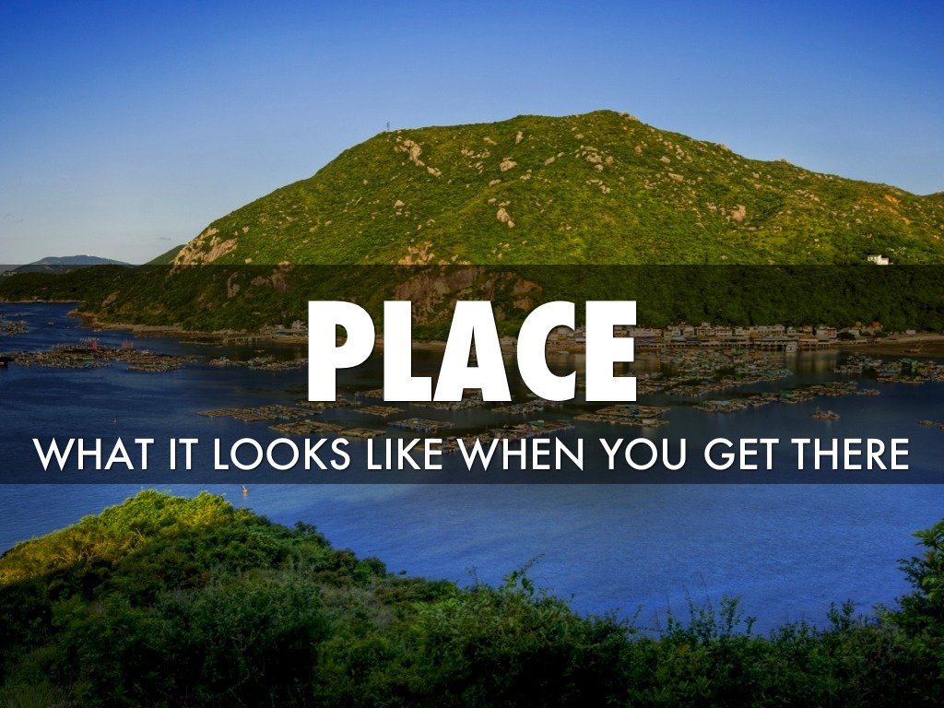
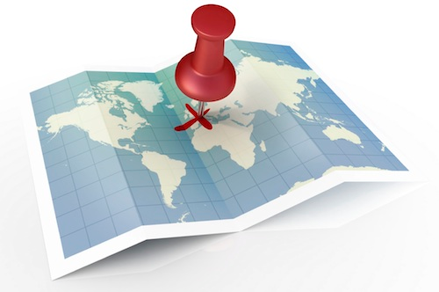
4) Location – Geographers begin to study a place by finding where it is, or its location.
5)Place – Geographers study the physical and human features of a location.

Slide 10
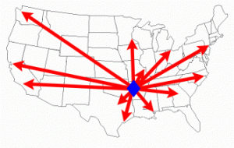
Movement
Explains how people, goods, and ideas move from one place to another.
Helps geographers understand cultural changes.

Slide 11
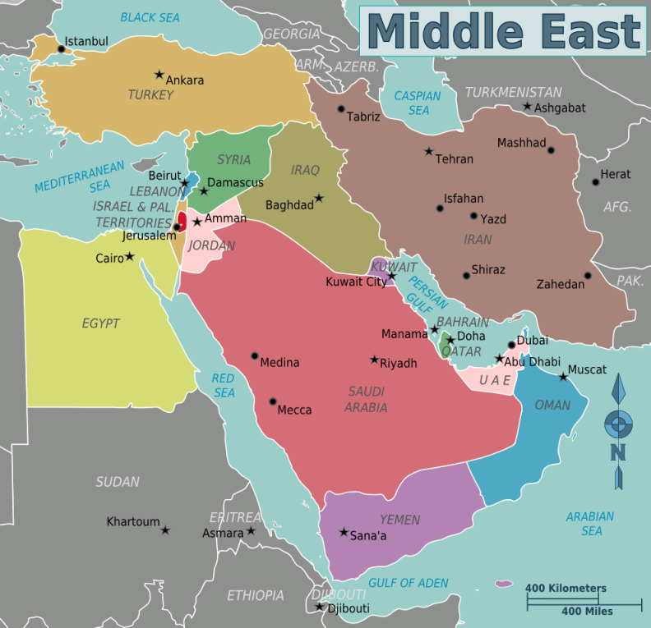
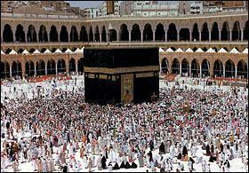
Regions
A region has a unifying characteristic, like climate, land, population, or history.
On maps, geographers use color and shape or special symbols to show regions.
Example: The Middle East, many of these countries are related to each other because of religion beliefs. Islam.

Slide 12
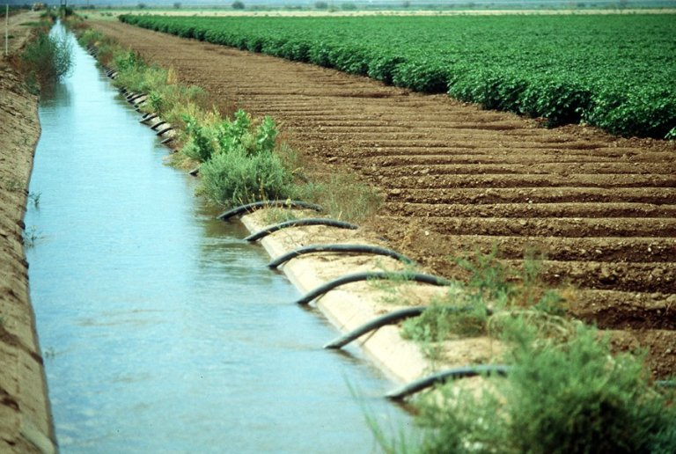
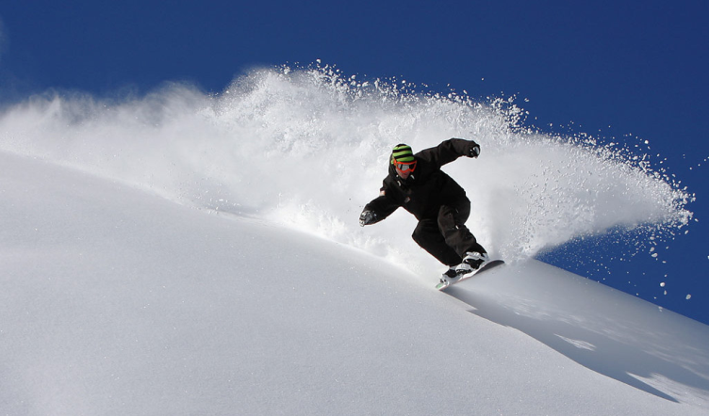
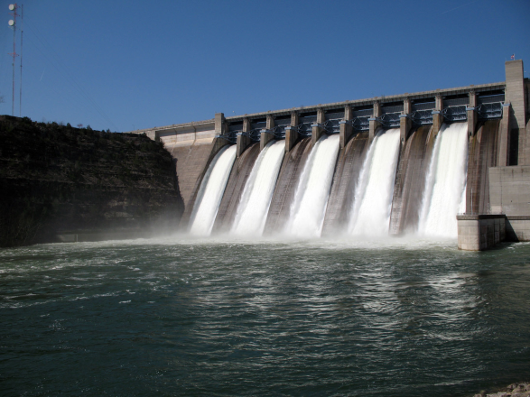
Human-Environment Interaction
How do people adjust to and change their environment? How does the environment adjust to and change the people?
Geographers also use interaction to study the consequences of people’s actions.
Divert water for crops
Play with snow on a mountain
Create power with a dam

Slide 13
Location
There are two ways to think about location:
  absolute location – describes the place’s exact position on the Earth.
  relative location – explains where a place is by describing places near it.

Slide 14
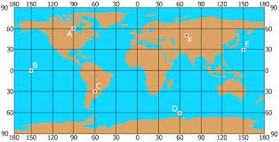
Absolute Location
describes the place’s exact position on the Earth
A= 60°N, 90°W
B= 0°, 150°W
C= 30°S, 60° W
D=60°S, 60°E
E= 30°N, 150 E
F= 50°N, 70°E

Slide 15
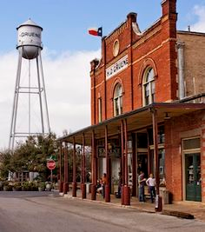
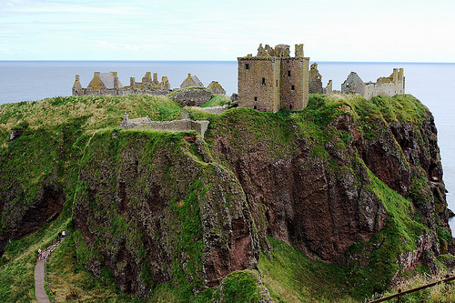
Relative Location
explains where a place is by describing places near it
The Storefront is across the street from the water tower.
The castle by the Cliffside.

Slide 16
Place
This includes a location’s physical and human features.
  To describe physical features, you might say that the climate is hot or cold or that the land is hilly.
  To describe human features, you might discuss how many people live there, what types of work they do, or what they do for fun.

Slide 17

MR HELP
Movement
Region
Human-Environment Interaction
Location
Place

Slide 18
The Geographer’s Tools
Globes and Maps:
  As people explored the Earth, they collected information about it.
  Mapmakers wanted to present this information correctly.
  The best way was to put it on a globe, a round ball that represented the Earth.

Slide 19
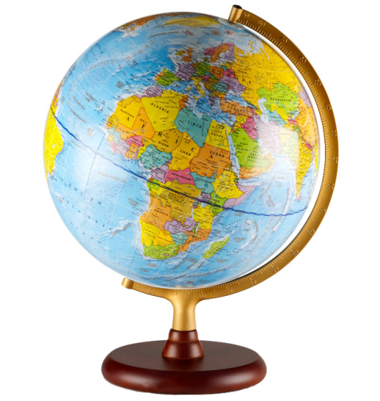
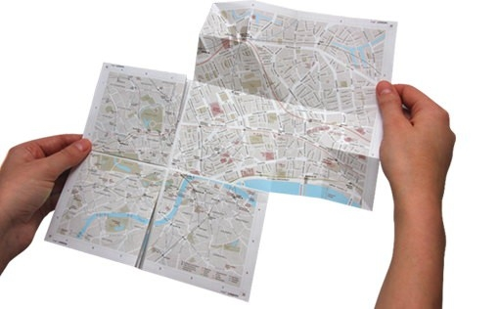
  Because globes are not practical or easy to use to carry, flat maps were invented.
  However, the earth is round and a map is flat.
  Mapmakers had to find ways to make maps accurate.

Slide 20
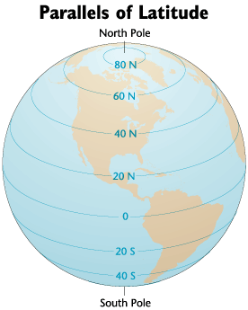
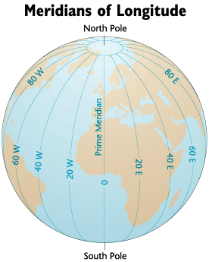
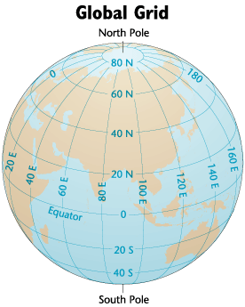
How Latitude and Longitude Form the Global Grid

Slide 21
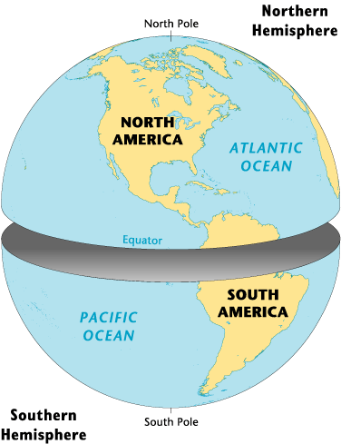
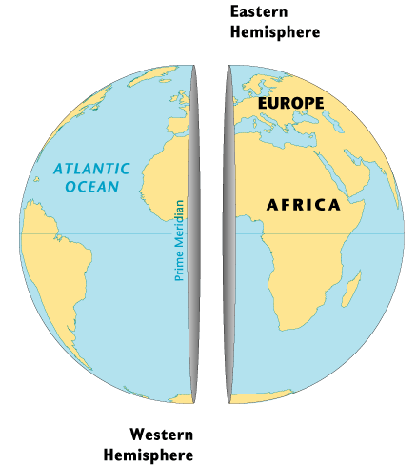
The Hemispheres

Slide 22
Globes and Maps
The most accurate way to present information on the islands, continents, and bodies of water of the world is to put it all on a globe, a round ball like the Earth itself.
The only difference between a globe and the Earth itself is the scale, or size, represented on the globe.

Slide 23
Globes have a disadvantage: They cannot be complete enough to be useful and at the same time be small enough to be convenient.
Therefore, people invented flat maps.

Slide 24
Maps try to show the Earth, which is round, on a flat surface.
This causes distortion, or a change in accuracy of the shapes and distances of places.
It is impossible to show the Earth on a flat surface without some distortion.

Slide 25
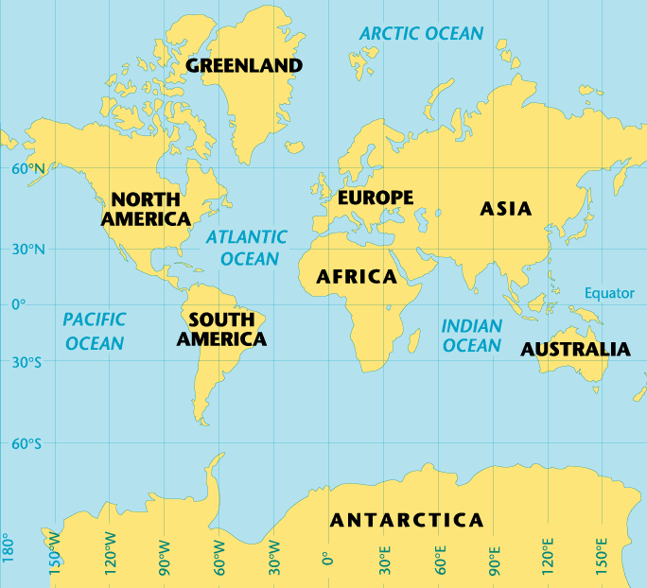
Getting It All On the Map
The World: Mercator Projection
In 1569, a geographer named Gerardus Mercator created a flat map to help sailors navigate long journeys across the globe.
The Mercator projection, or method of putting a map of the Earth onto a flat piece of paper, is used by nearly all deep-sea navigators.
The Mercator projection is a conformal map, meaning that it shows correct shapes, but not true distances or sizes.
There are many types of other projections of the globe.

Slide 26
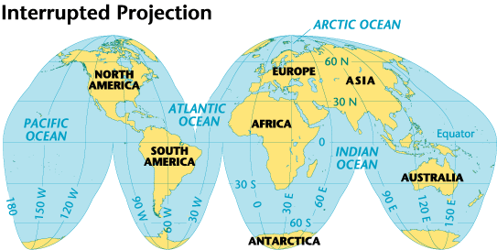
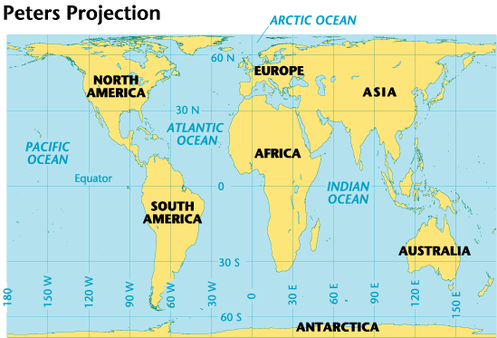
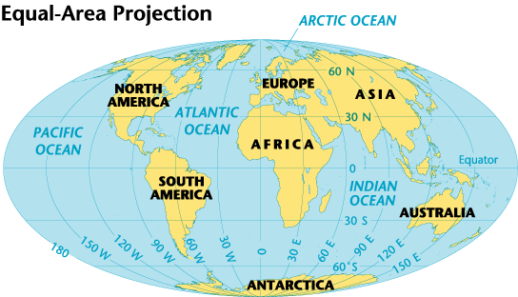
The World: Three Projections
Interrupted Projection
There are many ways to show a globe on a flat map. The interrupted projection map, on the left, shows real sizes and shapes of continents. The equal area map , below left, shows size accurately. The Peters projection, below, shows land and oceans areas and correct directions accurately
Peters Projection
Equal-Area Projection

Slide 27
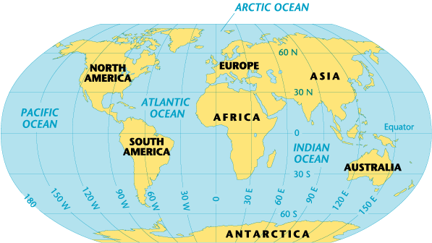
The World: A Robinson Projection
ARCTIC OCEAN

Slide 28


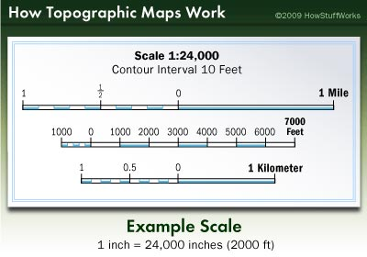
The Parts of a Map
Compass Rose
A compass rose is a model of a compass. It tells the cardinal directions, which are north, south, east, and west.
Scale
The scale on a map tells you the relative distance on the map to the real world. For example, a map’s scale may tell you that one inch on the map equals one mile in the real world.
Compass Rose

Slide 29
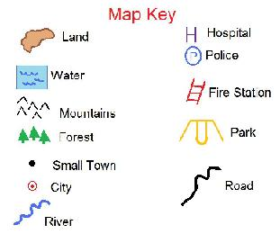
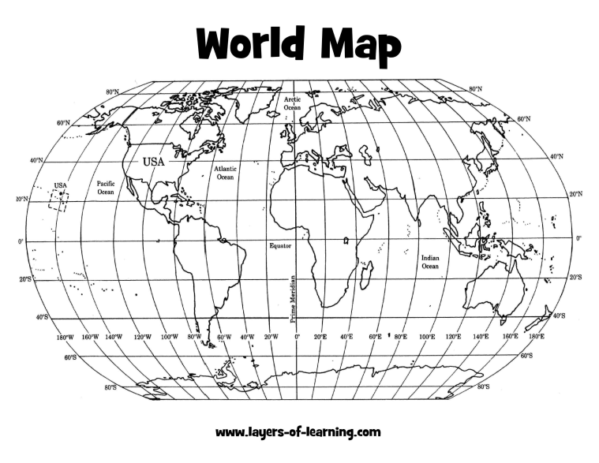
Key
The key, or legend, on a map explains what the symbols on a map represent, such as triangles representing trees.
Grids
Some maps use a grid of parallels and meridians. On a map of a small area, letters and numbers are often used to help you find your location.

Slide 30
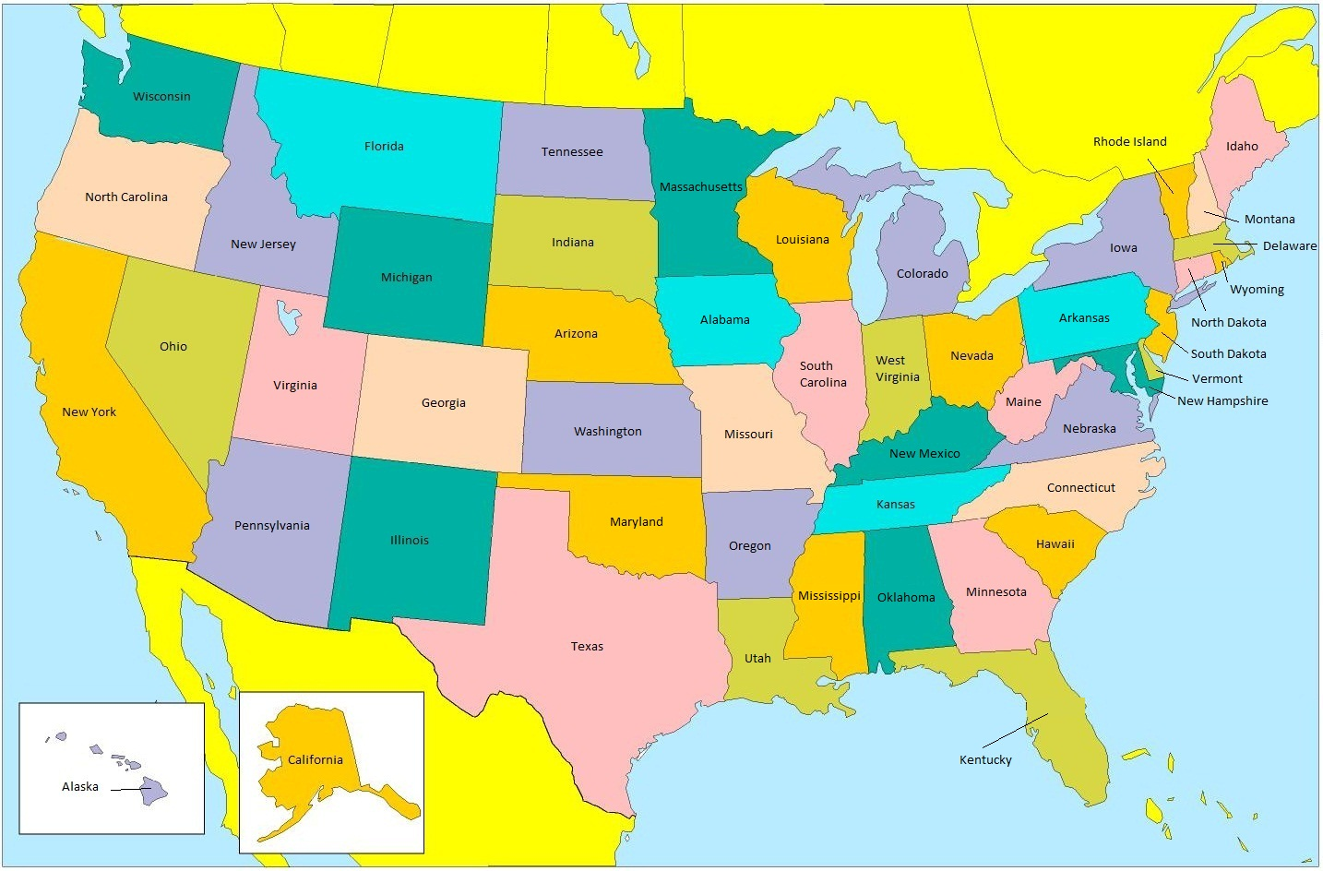
Is this a proper map?

Slide 31
