Slide 1

BSPA

Slide 2

Bloodstain Pattern Analysis:
  (aka Bloodspatter Analysis)
  Using the “dispersion, shape characteristics, volume, pattern, the number of bloodstains, and their relationship to the surrounding scene” to assist in RECONSTRUCTING an incident.
  Video – Smithsonian Channel

Slide 3

Did a crime occur?
  Homicide or suicide?
  Homicide or accident?
What kind of weapon was used?
How many blows to the victim?
What was the series of events?
How did the victim react?
What did the victim do after the suspect left the scene?

Slide 4

Force applied to the blood
Surface characteristics
Distance from surface
Angle of impact
Volume of blood
Movement

Slide 5

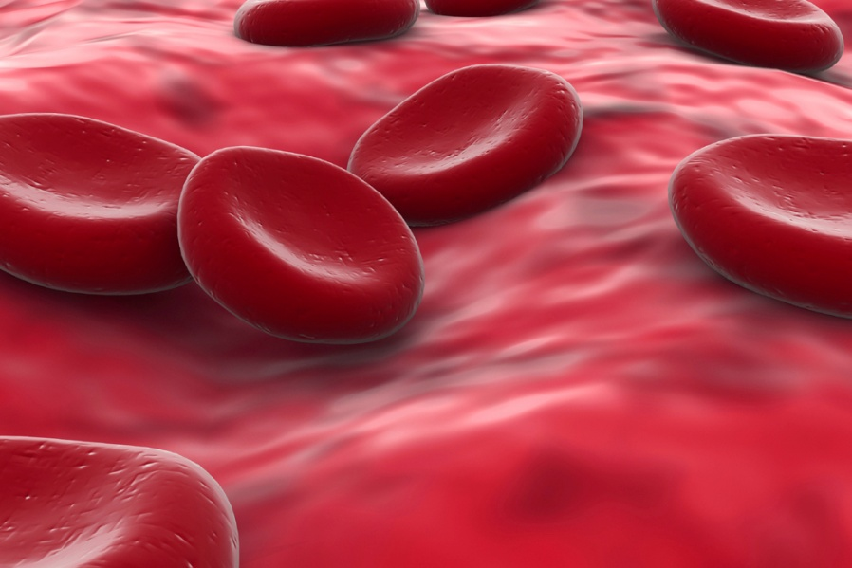
Transfer/Contact
Cast-off
Impact
Passive dripping
Blood dripping into blood
Projected blood
Arterial spurt
Flow
Voids
Pools
Wipes
Swipes
Impressions
Trails

Slide 6

Passive Stains
  Clots, drops, flows, pools
Transfer Stains
  Wipes, swipes, pattern transfers, contact stains
Impact Stains
  Spatter, splashes, cast-off, arterial spurts

Slide 7

Drip Stain: “A bloodstain pattern resulting from the formation and falling of a drop of blood”

Slide 8
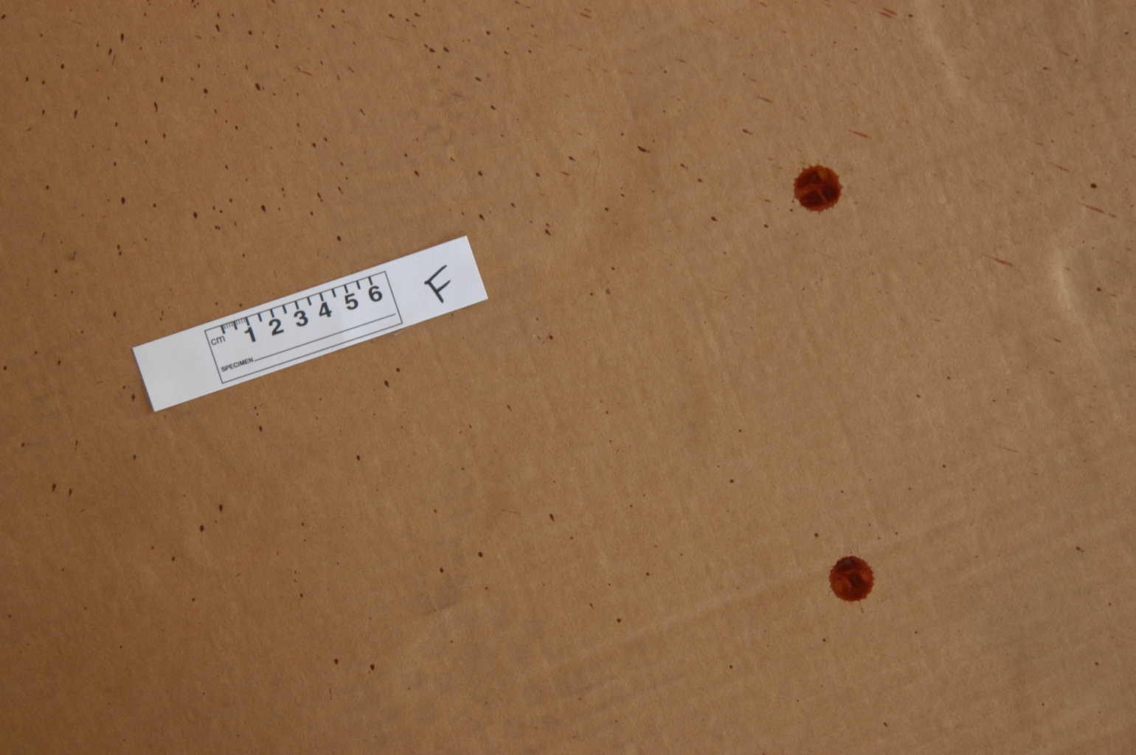

Slide 9
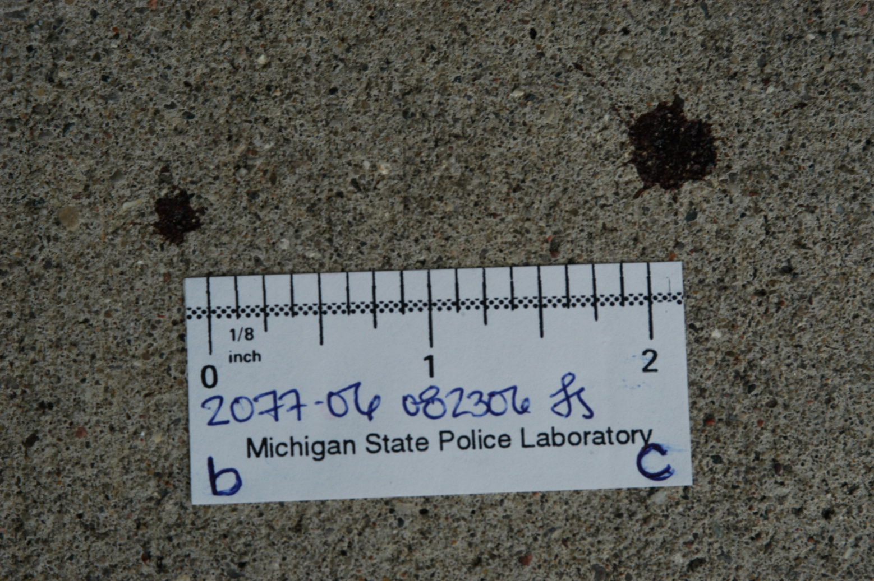

Slide 10

A blood flow created by gravity alone, with no circulatory action involved
        or
A bloodstain pattern resulting from the movement of a volume of blood on a surface due to gravity and/or movement of the target

Slide 11
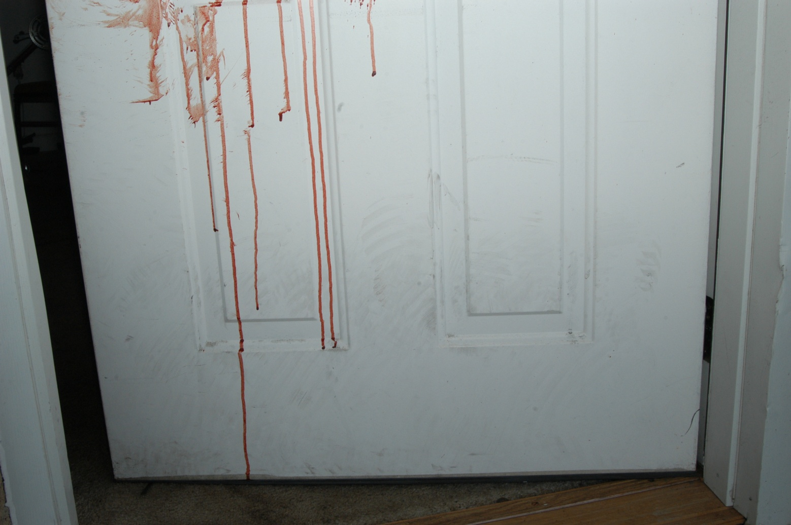

Slide 12

Pool: An accumulation of liquid blood on a surface

Slide 13

Any stain created when a wet bloody object comes in contact with another surface
Commonly observed

Slide 14
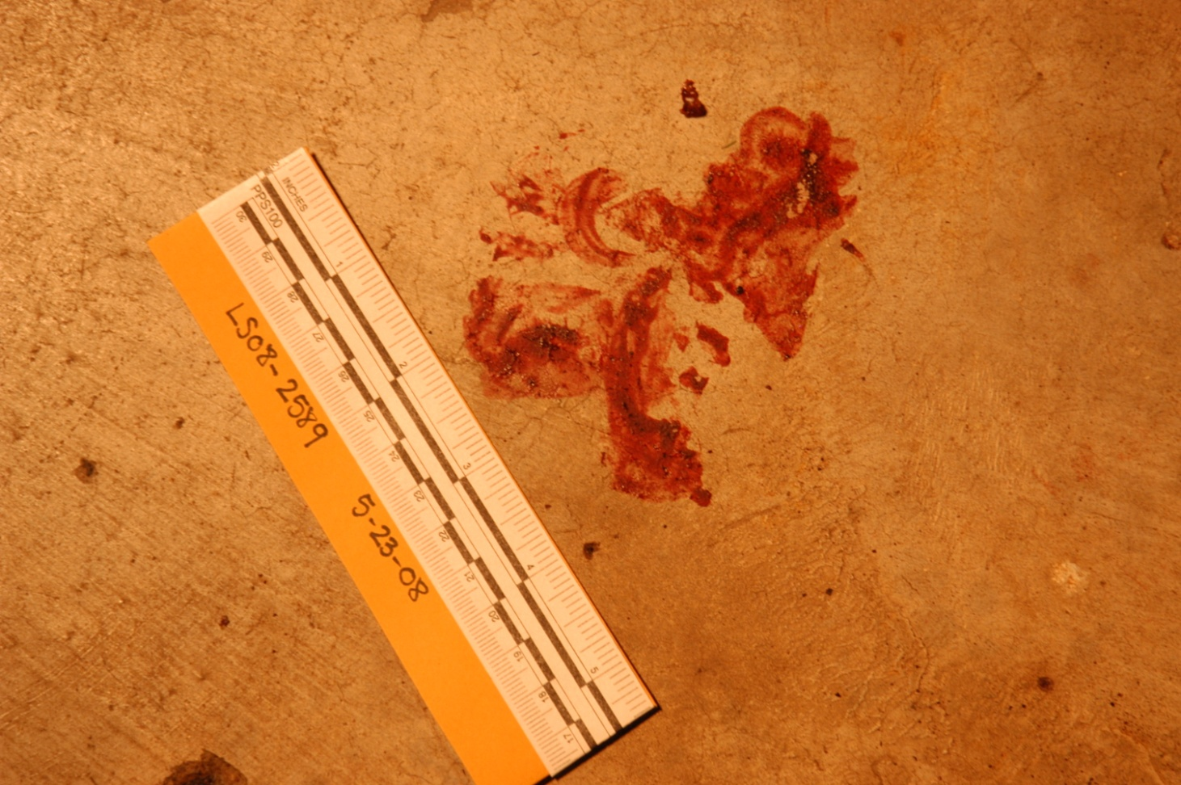

Slide 15
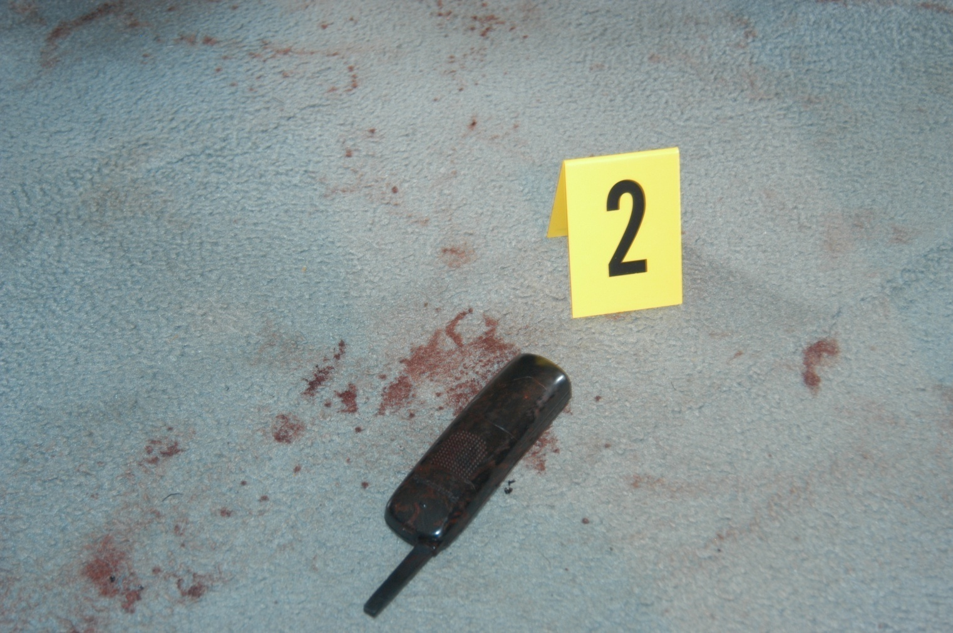

Slide 16
Stain created when an object moves through a preexisting bloodstain on another surface; the motion is assumed to be a lateral movement

Slide 17

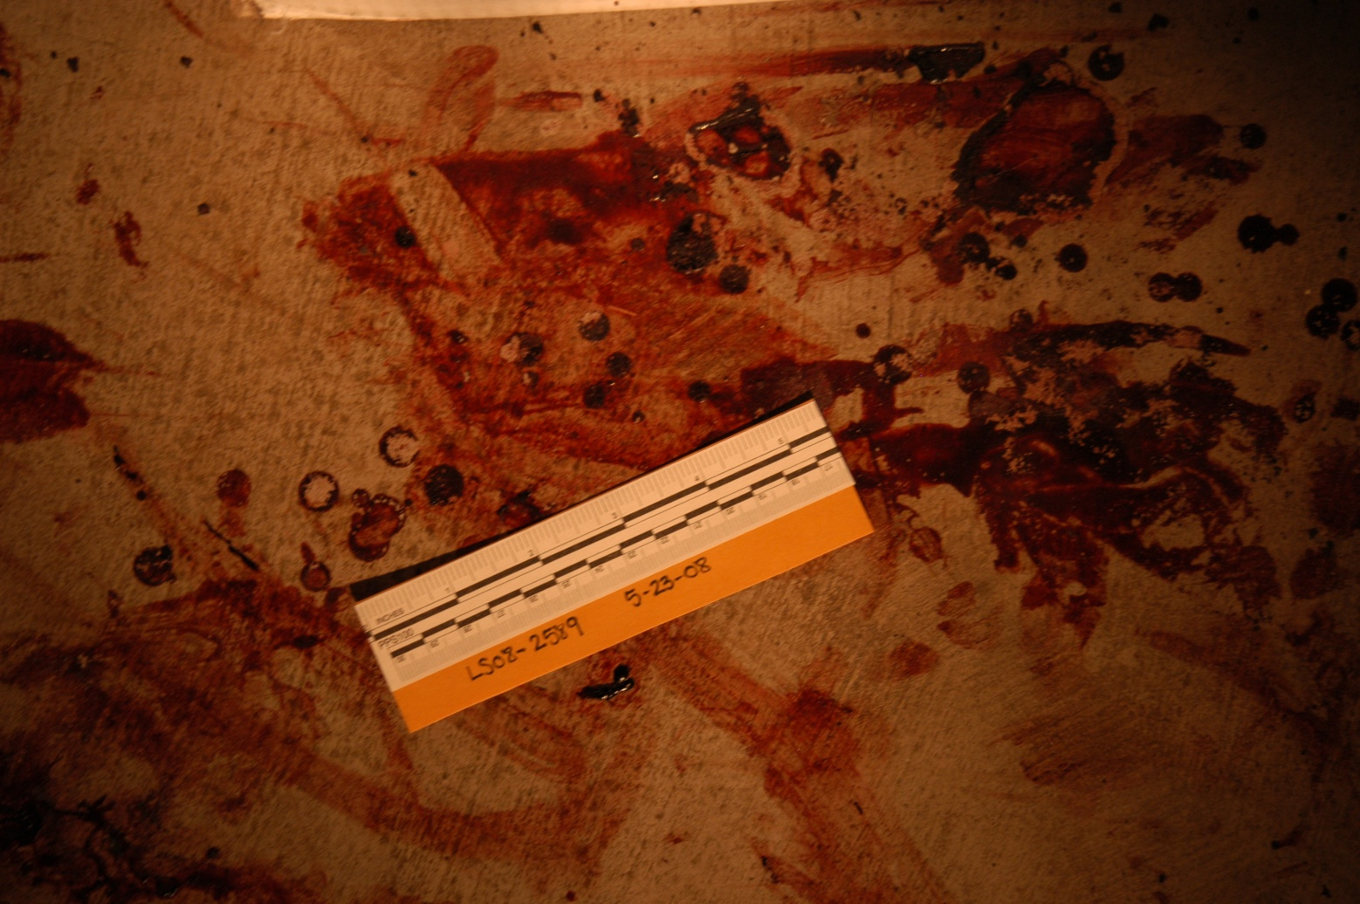

Slide 18
The transfer of blood onto a target by a moving object that is bloodstained; the motion is generally considered as some type of lateral movement

Slide 19

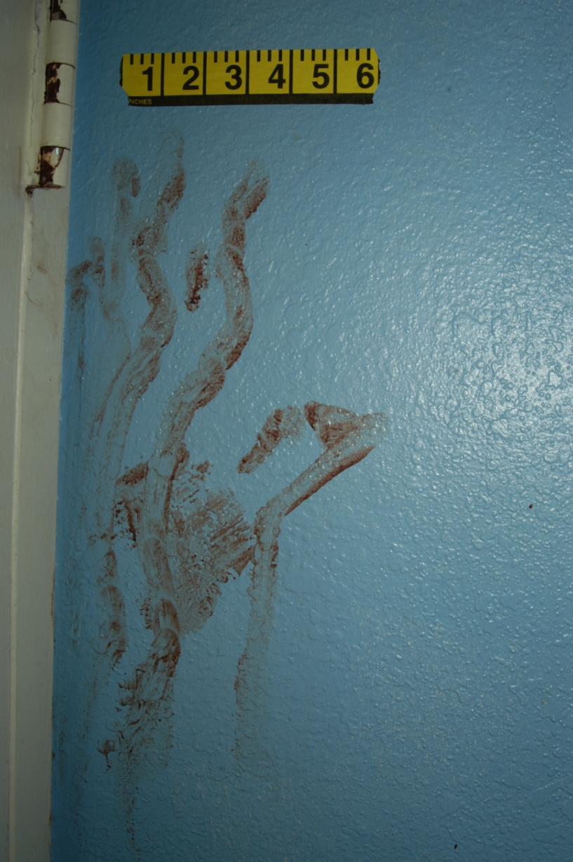

Slide 20

A type of TRANSFER
When a recognizable image of all or a portion of the original surface may be observed in the pattern

Slide 21
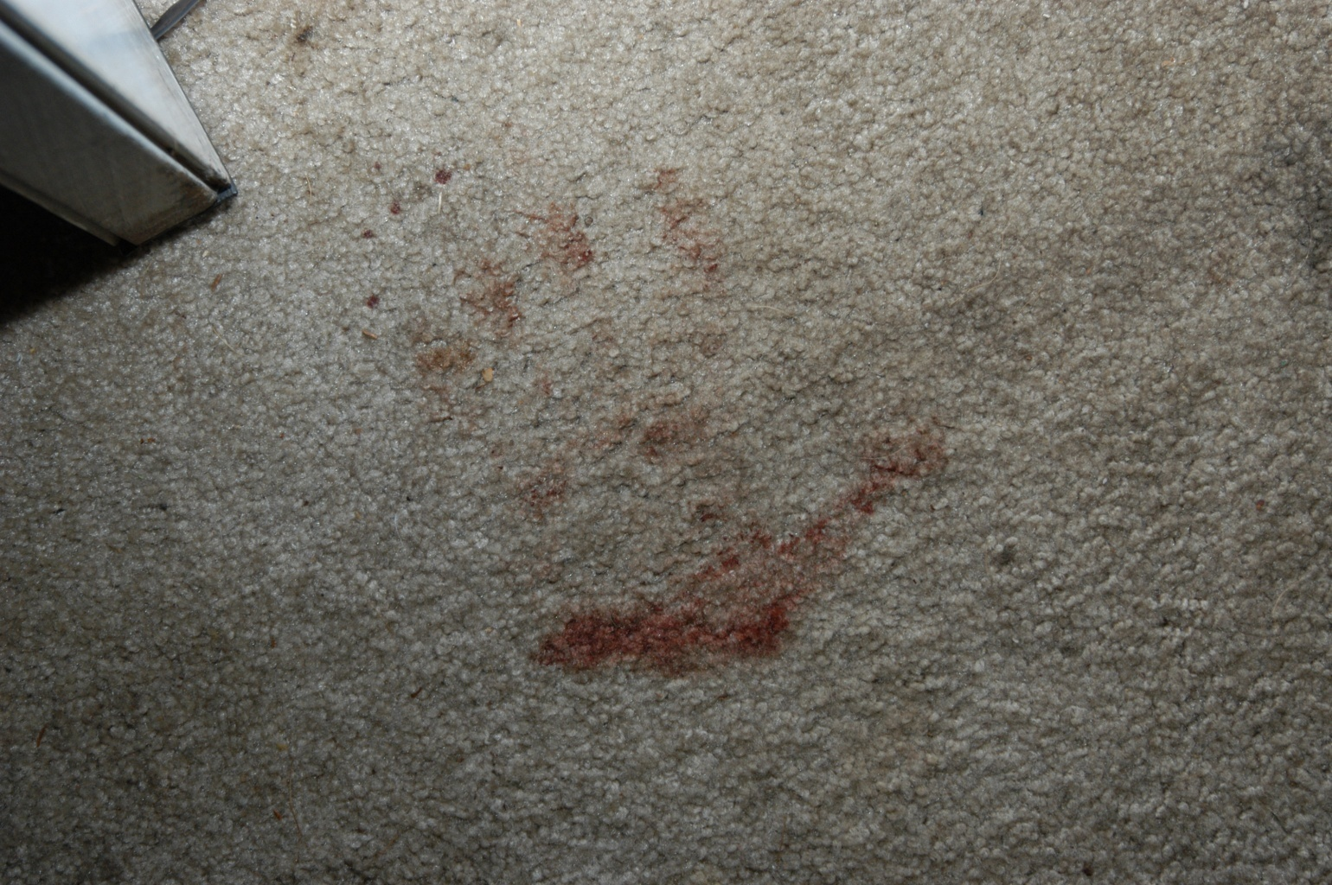

Slide 22

Stains created when blood is flung or projected from an object in motion or one that suddenly stops some motion

Slide 23
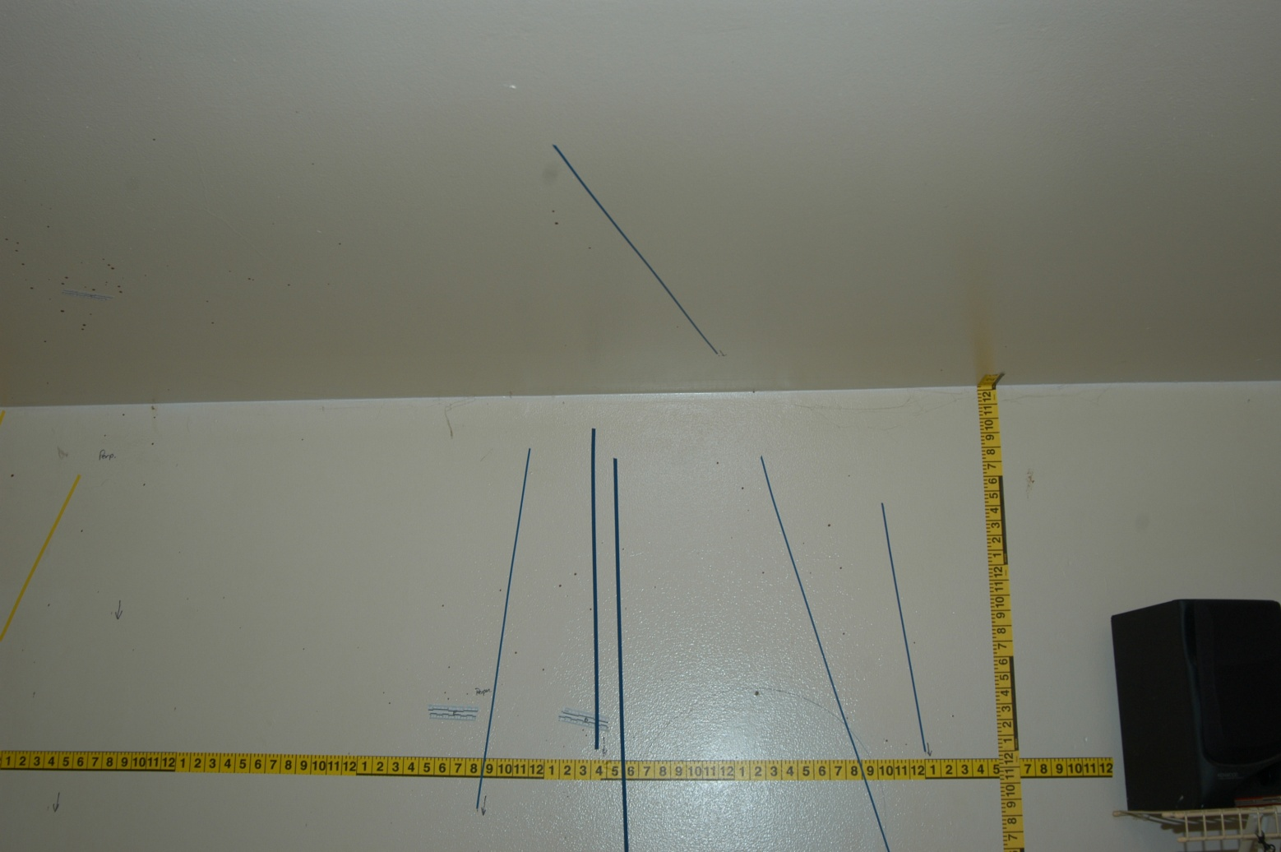

Slide 24
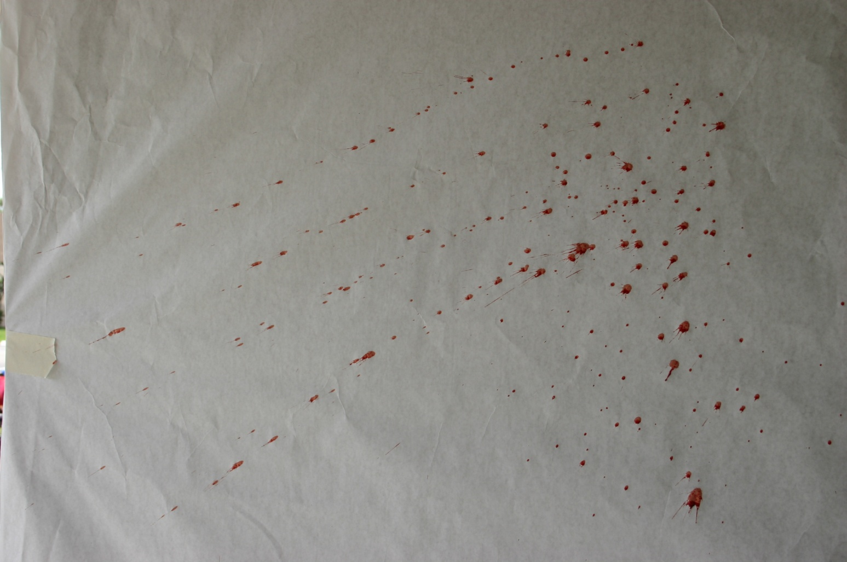

Slide 25

A bloodstain pattern resulting from an object striking liquid blood

Slide 26

Force applied to a blood source– blows to a body/wound by an object
Gunshot spatter
Expirated blood
Projected blood
Arterial spurts
A word of caution… fly spots/insect stains

Slide 27

Low Velocity/Force
  Normal force of gravity – 5 ft/sec
  Stains ≥ 4mm in diameter
Medium Velocity/Force
  5 – 25 ft/sec
  Stains 1 – 4 mm in diameter
High Velocity/Force
  100 ft/sec +
  Stains ≤ 1mm in diameter

Slide 28
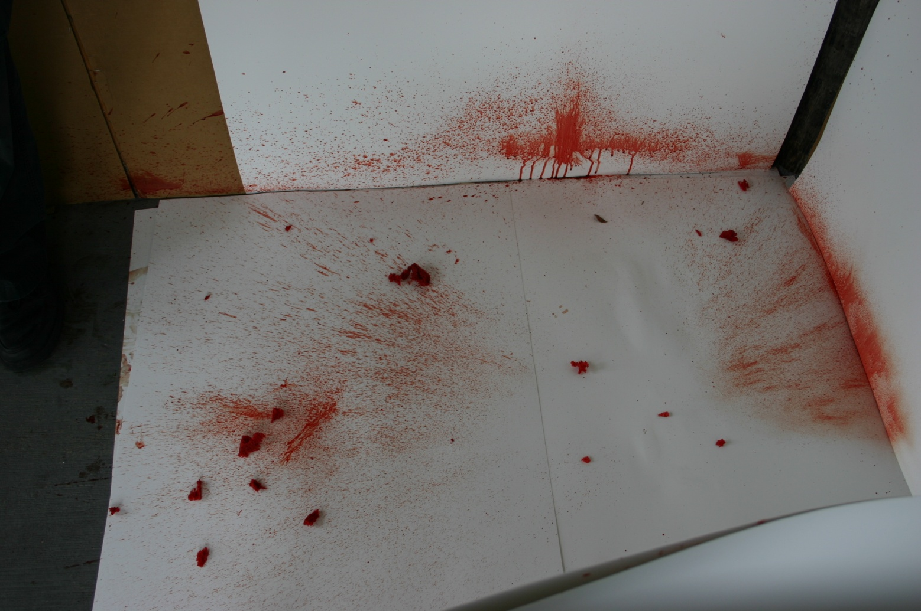

Slide 29
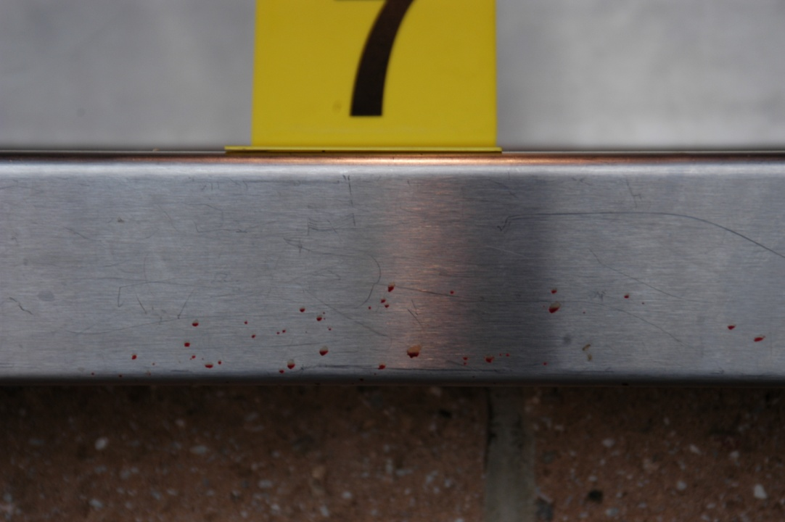
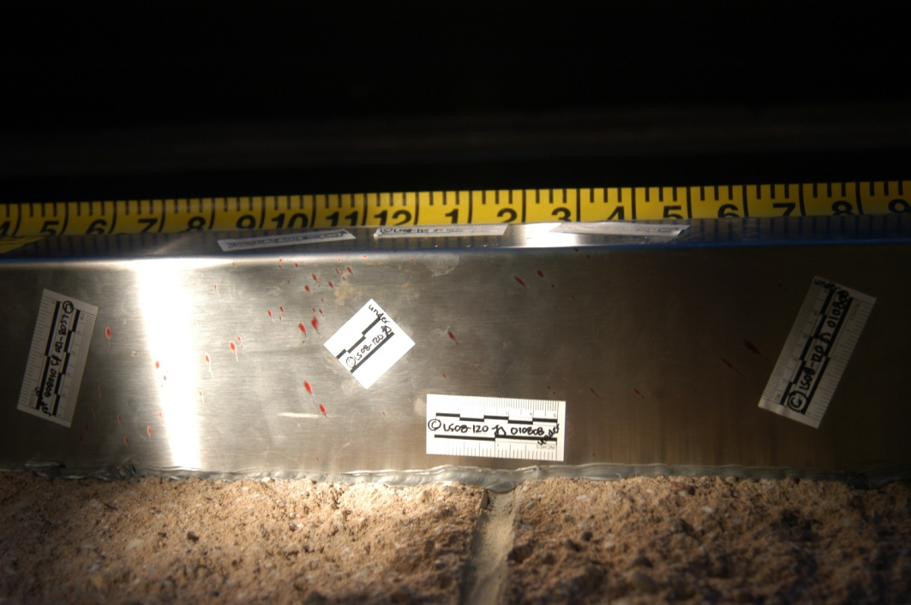
Front of counter
Underneath counter

Slide 30

Bloodstain patterns characterized by a mist-like appearance, which are generally associated with explosive force such as a gunshot

Slide 31
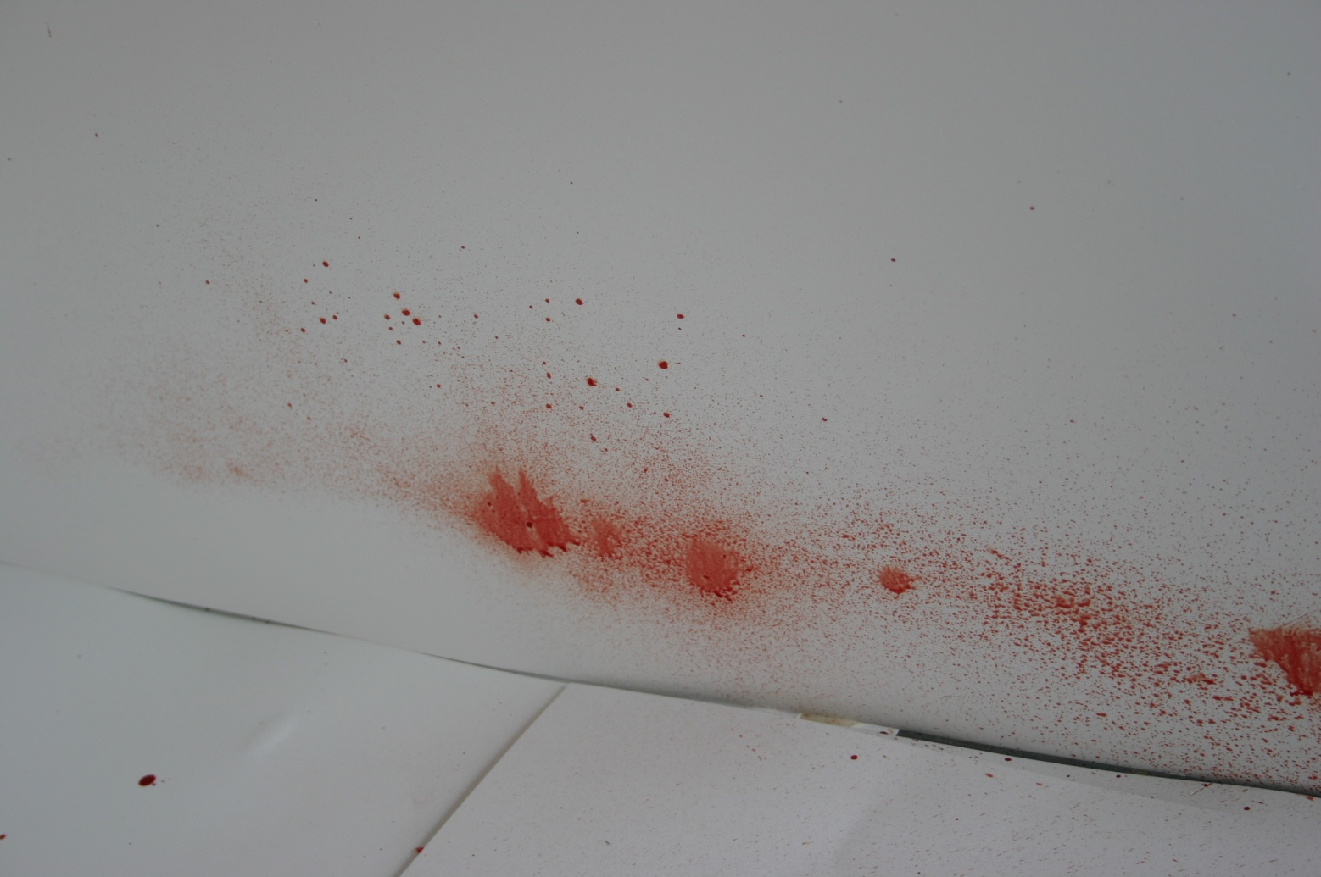
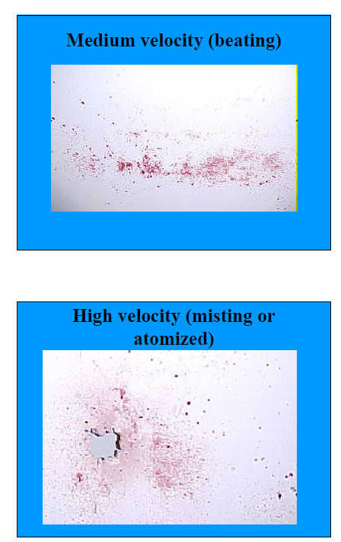

Slide 32

Blood that impacts a target or surface under pressure and in volume

Slide 33
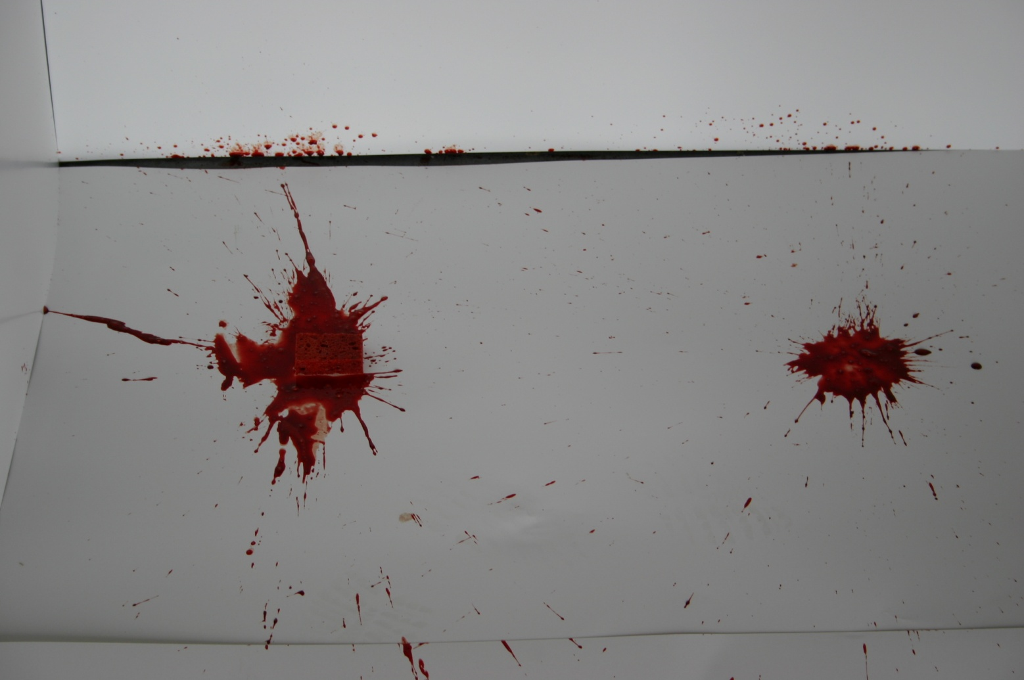

Slide 34

The escape of blood under pressure from any breach in an artery or heart, showing pressure, pressure fluctuations, or both

Slide 35

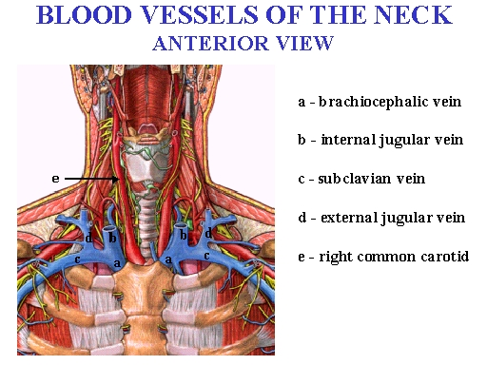

Slide 36
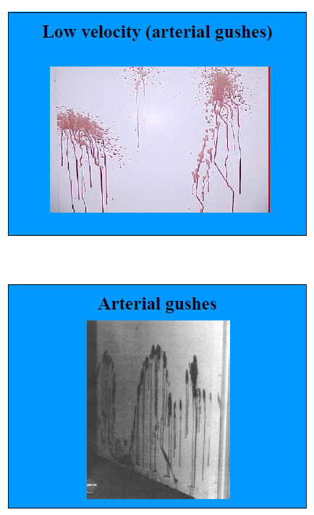
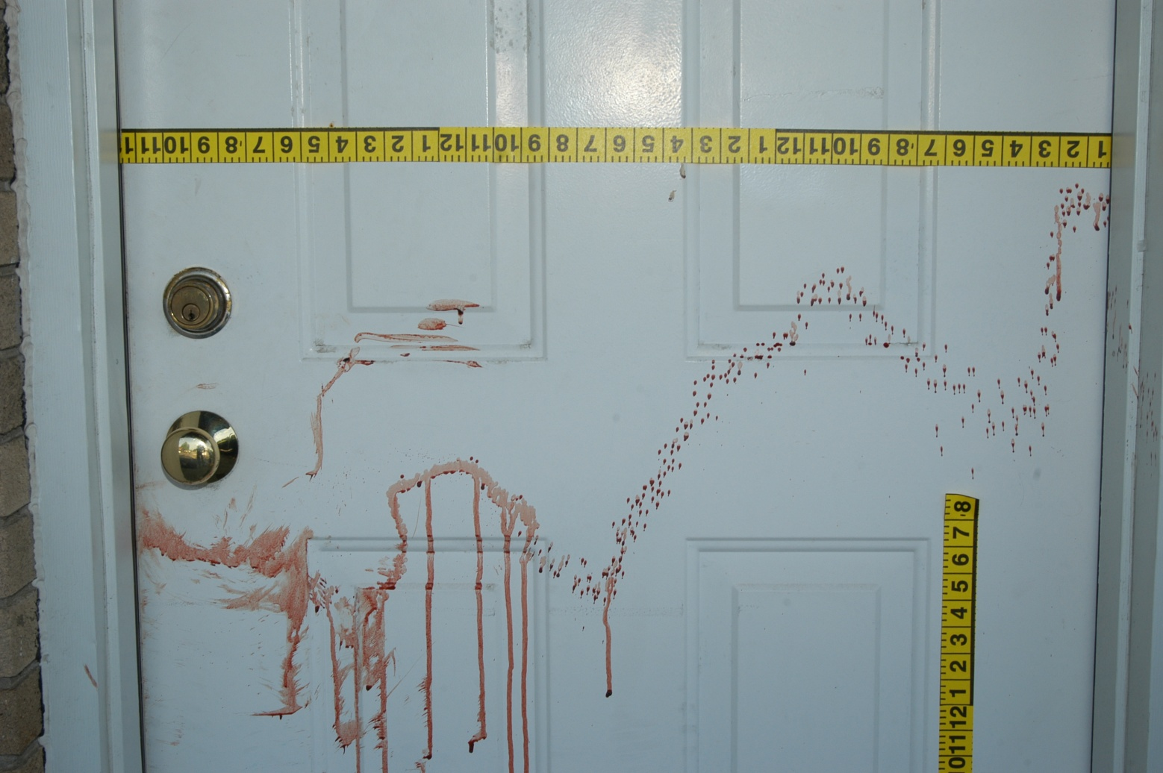

Slide 37

An area within a generally continuous bloodstain pattern that lacks bloodstains
Video – Jodi Arias trial BSPA expert

Slide 38
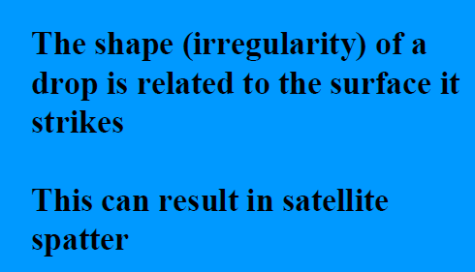
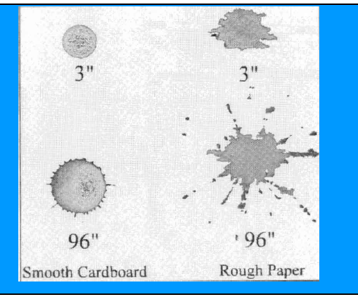
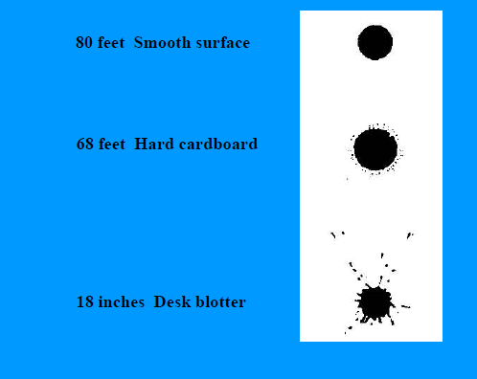

Slide 39

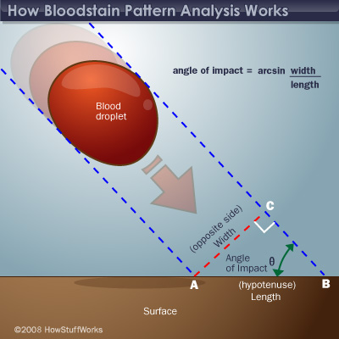
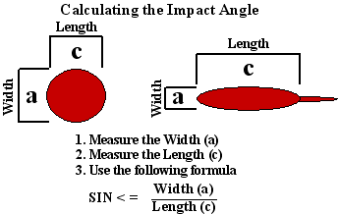

Slide 40
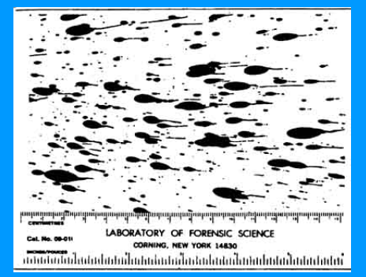

Slide 41

Luminol
  Causes blood to luminesce when applied
  Good when covering a large area and blood is not readily visible
Fluorescein
  When applied, blood will fluoresce under an Alternate Light Source
  Good if the location of the blood is reasonably expected, but the blood is not readily visible
LCV (Leucocrystal Violet)
  Darkens blood to deep purple-black color
  Good if the blood is readily visible but the surface makes it difficult to see a pattern (or if the blood is dilute)

Slide 42

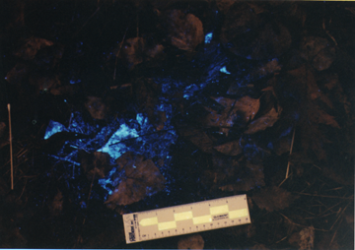
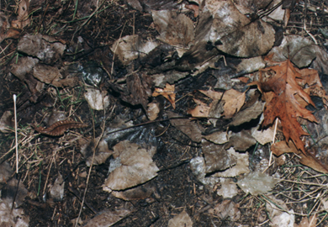
Before Luminol
After Luminol

Slide 43

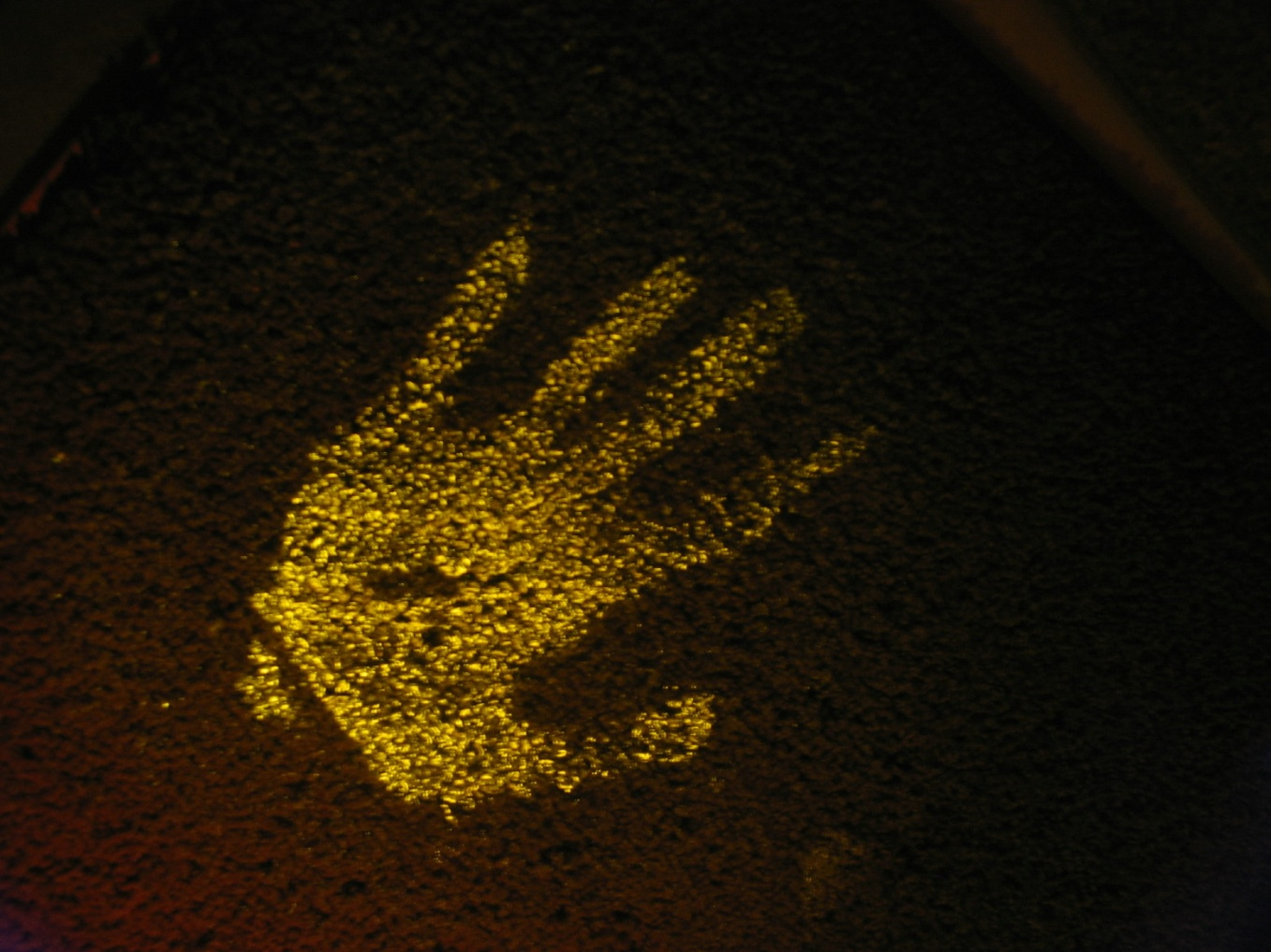

Slide 44

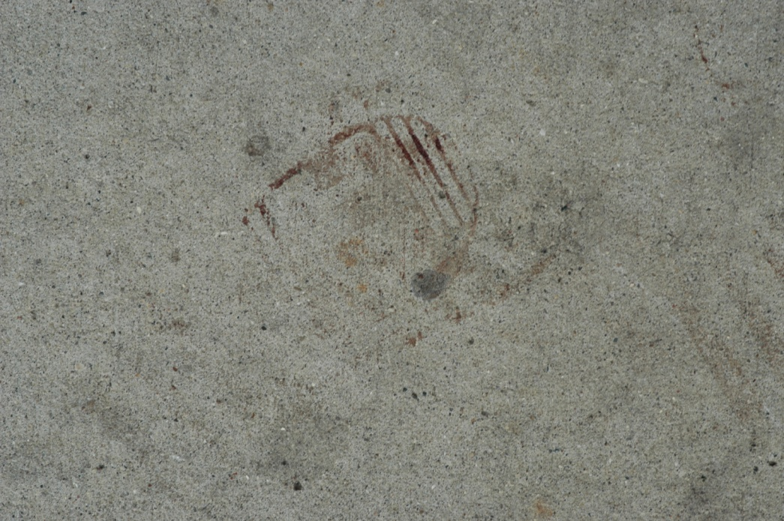
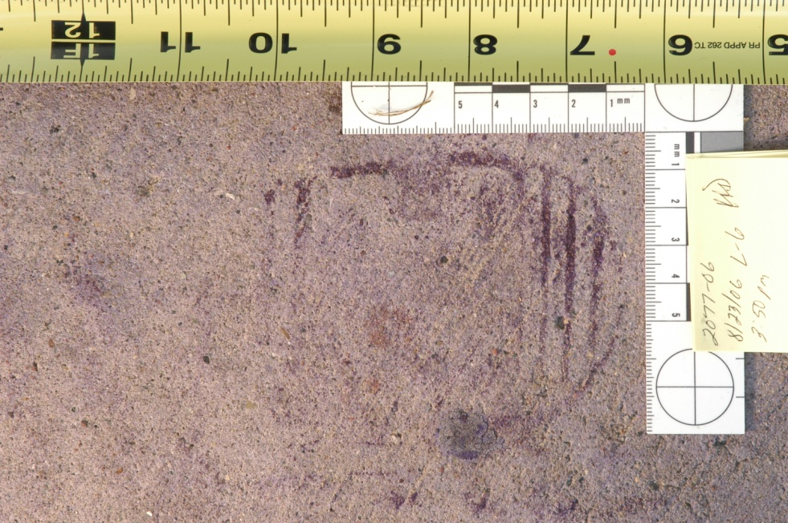

Slide 45

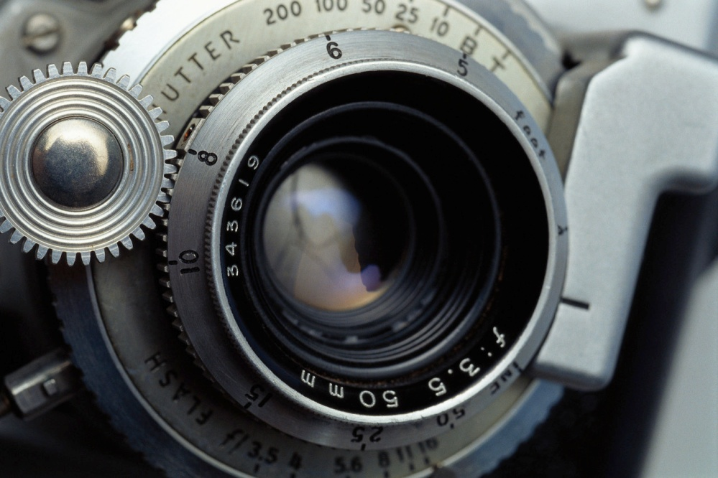
Word descriptions
Sketches/diagrams
  Colored pens/pencils
PHOTOGRAPHS!!!
  Use of scales– METRIC
  Identifying information
  Proper lighting
Reconstruction
  “Stringing”– Impact

Slide 46

BSPA is SUBJECTIVE!
Consider investigative details
  More than one person injured?
Physical aspects to consider:
  The surface
  Volume of blood
  Height from which the blood fell
  Velocity/ Pressure
  Dexter video

