Slide 1
Fibers
Forensic Science
http://media.popularmechanics.com/images/PMX0706FORENSICSHairSmall.jpg
Presentation developed by T. Trimpe 2006 http://sciencespot.net/

Slide 2

Chapter 4
A Study of Fibers and Textiles
By the end of this chapter you will be able to:
Identify and describe common weave patterns of textile samples
Compare and contrast various types of fibers through physical and chemical analysis
Describe principle characteristics used to identify common fibers (microscopic)
Apply forensic science techniques to analyze fibers (burn analysis)
Properly operate Bunsen burner
All Rights Reserved South-Western / Cengage Learning © 2012, 2009
Forensic Science: Fundamentals & Investigations, Chapter 4

Slide 3
Introduction
Fibers are used in forensic science to create a link between crime and suspect
Trace evidence
Collecting fibers within 24 hours is critical (95% lost)
Forensic Science: Fundamentals & Investigations, Chapter 4

Slide 4
Sampling and Testing
Shedding—common form of fiber transfer
Microscopic Analysis
IR, florescent, refraction spectroscopy
Destructive Testing Methods
  Burn Analysis
  Chemical Analysis
Forensic Science: Fundamentals & Investigations, Chapter 4

Slide 5
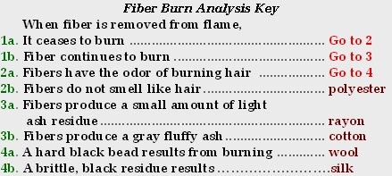
Burn Analysis
Compare fibers found on different suspects with those found at the crime scene
Forensic Science: Fundamentals & Investigations, Chapter 4

Slide 6
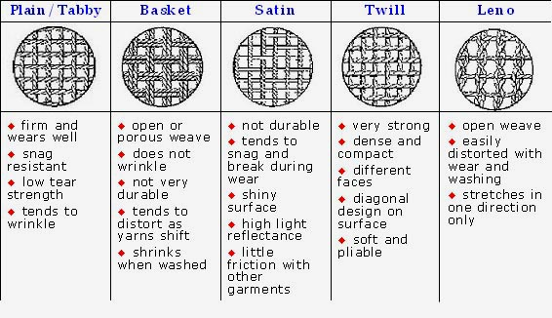
Weave Patterns
Forensic Science: Fundamentals & Investigations, Chapter 4

Slide 7
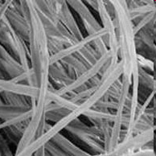
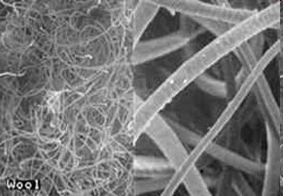
Natural Fibers
Many different natural fibers that come from plants and animals are used in the production of fabric.
Cotton fibers are the plant fibers most commonly used in textile materials
The animal fiber most frequently used in the production of textile materials is wool, and the most common wool fibers originate from sheep.
http://www.fireflydiapers.com/articles/diaperarticle_naturalfibersabsorb.htm

Slide 8

Fiber Classification
—Natural Fibers
Animal fibers (made of proteins):
Wool and cashmere from sheep
Mohair from goats
Angora from rabbits
Hair from alpacas, llamas, and camels
Silk from caterpillar cocoons Bombyx mori
(longer fiber does not shed easily)
woven wool textile
Forensic Science: Fundamentals & Investigations, Chapter 4

Slide 9

Fiber Classification
—Natural Fibers
Plant fibers (seed, stem/leaves, fruit):
Cotton—most common textile
plant fiber (picture)
Coir – coconut covering; is durable
Linen – flax stem
Hemp & jute from stems grow in bundles.
Manila fiber from abaca plant leaves (banana family)
Forensic Science: Fundamentals & Investigations, Chapter 4

Slide 10
Fiber Classification
—Natural Fibers
Mineral Fibers:
Fiberglass—a fibrous form of glass
Used to insulate buildings
Asbestos—a crystalline structure
Used for building material
Forensic Science: Fundamentals & Investigations, Chapter 4

Slide 11
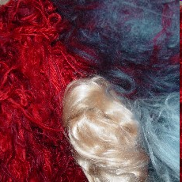
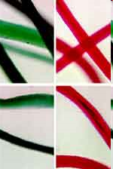

Synthetic Fibers
More than half of all fibers used in the production of textile materials are synthetic or man-made.
Nylon, rayon, and polyester are all examples of synthetic fibers.
Cross-section of a man-made fiber
Synthetic Fibers under a microscope
Images: http://www.trashforteaching.org/phpstore/product_images/YarnWS.JPG
http://www.fbi.gov/hq/lab/fsc/backissu/july2000/deedric3.htm#Fiber%20Evidence
http://www.jivepuppi.com/images/fiber_evidence.jpg

Slide 12
Fiber Classification
—Synthetic Fibers
50% of fabrics are artificially produced
Examples:
  Rayon
  Acetate
  Nylon
  Acrylic
  Polyester
Forensic Science: Fundamentals & Investigations, Chapter 4

Slide 13
Fiber Classification
—Synthetic Cellulose Fibers
Regenerated Fibers (derived from cellulose):
Rayon
  Most common in this group
  Imitates natural fibers, but stronger
Celenese®
  Cellulose chemically combined with acetate
  Found in many carpets
Polyamide nylon
  Cellulose combined with three acetate units
  Breathable and lightweight
  Used in performance clothing
Forensic Science: Fundamentals & Investigations, Chapter 4

Slide 14
Fiber Classification
—Synthetic Polymer Fibers
Synthetic Polymer Fibers
Petroleum base
Monomers join to form polymers
Uniform diameters
Forensic Science: Fundamentals & Investigations, Chapter 4

Slide 15

Fiber Classification
—Synthetic Polymer Fibers
Polyester
  “Polar fleece” (Polyethylene terephthalate (PET))
    - First made to mimic wool
  Wrinkle-resistant
  Not easily broken down by light or concentrated acid
  Added to natural fibers for strength
Nylon
  Easily broken down by light and concentrated acid
  Otherwise similar to polyester
spandex nylon
Forensic Science: Fundamentals & Investigations, Chapter 4

Slide 16

Fiber Classification
—Synthetic Polymer Fibers
Acrylic
  Inexpensive
  Tends to “ball” easily
  Substitute for artificial wool or fur
  made from a polymer (polyacrylonitrile)
Olefins
  High performance- wallpaper, rope, vehicle interiors
  Quick drying/ Resistant to wear
  Made from polyolefin (polypropyleneor polyethylene)
Forensic Science: Fundamentals & Investigations, Chapter 4

Slide 17
Yarns, fabrics, and textiles
Yarns—fibers (of any length, thick or thin, loose or tight) twisted or spun together
Blending fibers meets different needs
(e.g., resistance to wrinkling)
Fibers are woven into fabrics or textiles
  Threads are arranged side by side (the warp)
  More threads (the weft) are woven back and forth crosswise through the warp
Forensic Science: Fundamentals & Investigations, Chapter 4

Slide 18
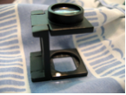
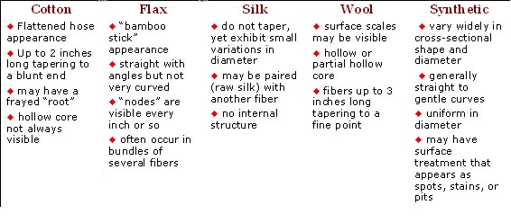
Comparison of Natural and
Synthetic Fibers
Visual Diagnostics of Some Common Textile Fibers
under Magnification
Forensic Science: Fundamentals & Investigations, Chapter 4

Slide 19



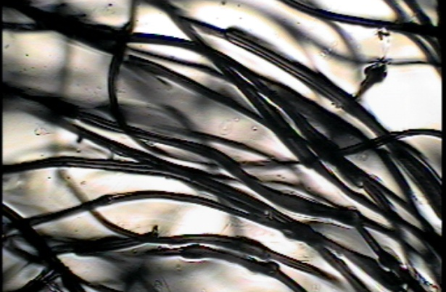
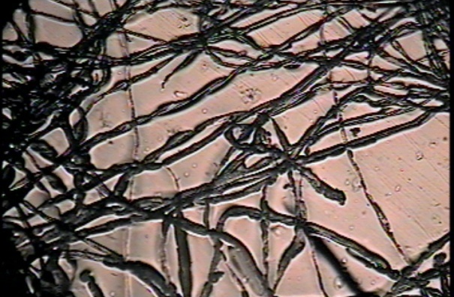
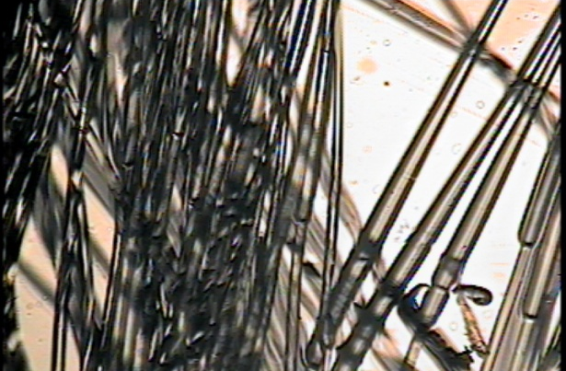
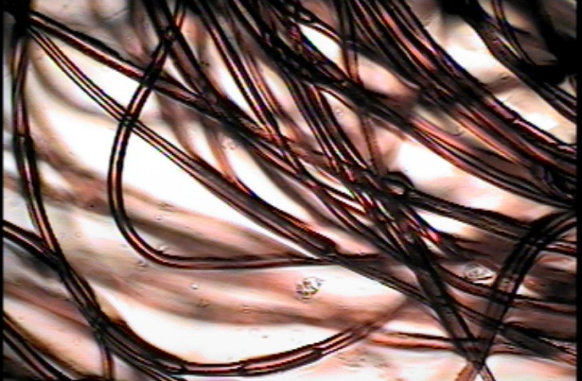
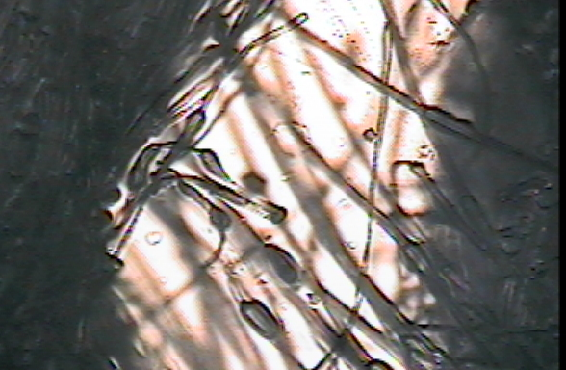
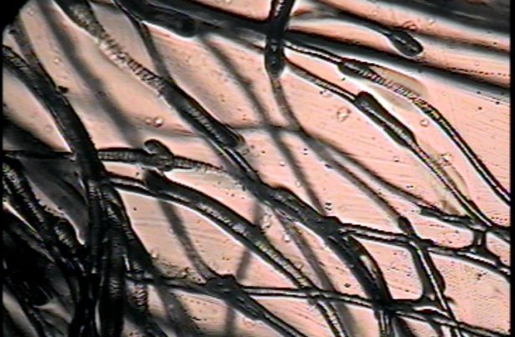




Can you identify the types of fibers shown?
Think About It …
Which samples are natural fibers?
(2) Which samples are synthetic fibers?
(3) What characteristics can be used to identify fiber samples?
Notes:
Teacher Note: I challenge students to identify each fiber sample pictured on this slide as they examine the sets of fibers I have prepared for them. An observation worksheet is available on my website which requires students to draw an image of what they see and add a description that highlights unique characteristics. A key for the fibers is available on the last slide of this presentation!

Slide 20
Types of Fibers - Key
Acrylic Yarn
Cotton Yarn
Nylon Rope
Polyester Yarn
Rayon Rope
Wool Yarn

