Slide 1
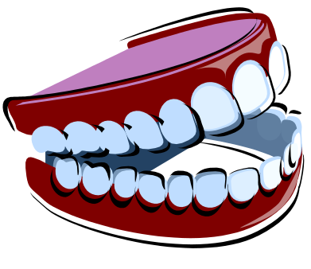
Bite Mark
Identification
Presentation developed by T. Trimpe 2010 http://sciencespot.net

Slide 2
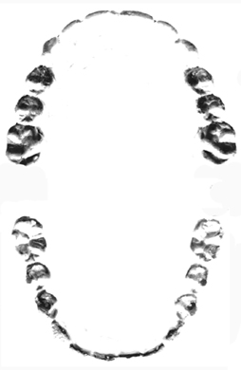
Part 1: Make an Impression
1 – Fold the Styrofoam plate in half.
2 – Label one side MAXILLA and the other MANDIBLE.
3 – Gently bite down on the plate to leave your bite mark impression.
4 – Place a sheet of the plastic film over the impression and use a permanent marker to recreate the pattern to match that of your bite mark.
5 – Use a ruler to make the measurements shown and record in the table below along with any notes regarding unique characteristics you observe in the teeth.
Maxilla
Mandible
Maxilla
Mandible
Width
Depth
http://forensicfact.files.wordpress.com/2008/05/cast_negative_resized_copy.jpg

Slide 3
Part 2: Tasty Testing
1 – Use the various pieces of candy to make bite mark impressions.
2 – Record your observations for each one as well as provide a rating of the impression quality using poor, fair, or good.
Type of Candy | Quality | Observations

