Slide 1

Latent Prints
Forensic Science
T. Trimpe 2007 http://sciencespot.net/

Slide 2
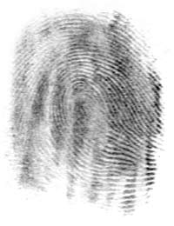
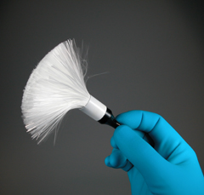
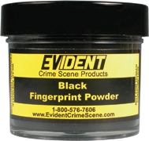
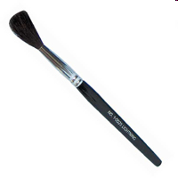
Latent prints are impressions left by friction ridge skin on a surface, such as a tool handle, glass, door, etc.
Prints may be collected by revealing them with a dusting of black powder and then lifted with a piece of clear tape.
Did you know? Camel hair is the most common animal hair used to make fingerprint brushes. Now many brushes (like the one above) are made out of fiberglass.

Slide 3

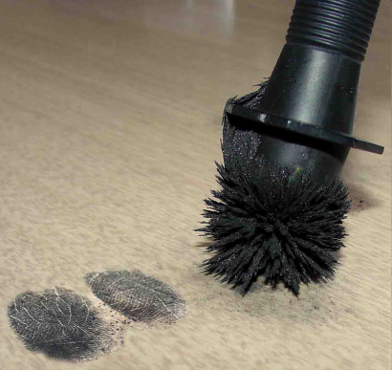
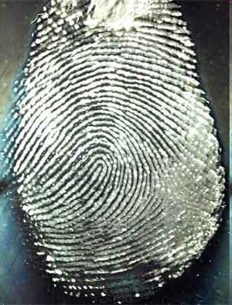
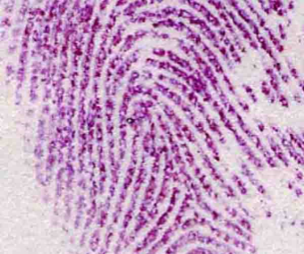

Some investigators use fluorescent powder and UV lights to help them find latent prints on multi-colored or dark surfaces.
Magnetic powder can also be used to reveal latent prints. This type of powder works better on shiny surfaces or plastic baggies or containers.
The cyanoacrylate fuming method (often called the super glue method) is a procedure that is used to develop latent fingerprints on a variety of objects.
Ninhydrin is a chemical that bonds with the amino acids in fingerprints and will produce a blue or purple color. It is used to lift prints from surfaces such as paper and cardboard.
Click the icon to view the Crime 360
Super Glue Video
Top Left: http://www.stapletonandassociates.com/images/MagPowder.jpg
Bottom Left: http://www.ok.gov/osbi/images/ninhydrin%20print.jpg
Bottom Right: http://www.forensicsrus.com/images/SupergluePrint.jpg

Slide 4
Directions:
1 - Cover your table with white butcher paper or newspaper. You must dust everything on the paper!
2 - Get a lifting kit from your teacher that contains black powder, brushes, and clear tape.
3 - Press the pad of your right thumb on a CD or glass slide to make a print. Place on the paper covering your table.
4 – Dip a brush lightly into the container of black powder and then tap off the extra on the lid. You only need a very small amount of powder to dust the print.
5 – Hold the brush over the print and rotate it between your thumb and fingers. Use the brush to remove any extra powder.
6 - Use a small piece of clear tape to lift the print and place it in the box on your worksheet.
CAUTION: The black powder will be messy and isn’t easy to clean up. Don’t dust anything without permission!

Slide 5
Clean Up
1 – Clean off the CDs or glass slides and put them back in the kit with the brushes and tape.
2 – Have someone help you fold the paper in half and tap it to return the extra black powder to the container.
3 – Put the black powder in the box and have it checked in by your teacher.
4 – Get a towel and “dry” wash the table – especially the edges that weren’t covered with paper.
5 – Get a wet towel to wash off the table and then wipe it with some dry towels. Keep cleaning until all the black powder is off the table!

