Slide 1
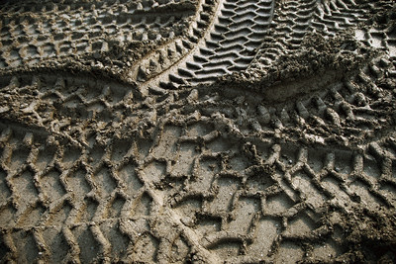
Tire Track Challenge
Forensic Science Activity
http://pro.corbis.com/images/CB001940.jpg?size=572&uid={D27A89DF-00BB-4028-AA57-7A908AF0511D}
T. Trimpe 2007 http://sciencespot.net

Slide 2
Tire Track Lab
Your group will need to document the tread patterns for each vehicle.
Step 1: Get a large piece of white paper from your teacher, an ink pad, paper towels, and a ruler. You will also need a pen or pencil.
Step 2: Gently roll a car over the ink pad several times to cover all the sides of the tires.
Step 3: Gently roll the car on the white paper for a length of 5-6” and label the tracks with the car’s letter.
Caution: You will want to apply enough pressure to get a good impression, but not too hard that you cause damage to the vehicle, its tires, or the ink pad.
Step 4: Roll the car on a piece of paper towel to remove excess ink and then pass it along to another group.
Step 5: Analyze the tire tracks to identify unique characteristics, such as blank spots, evidence of tire wear, width of the track, etc. Use a highlighter to mark each characteristic you find.

Slide 3

Tire Track Challenge
Work with your investigative team to identify each set of tracks shown on your worksheet.
Compare the tracks you made earlier and match them to the suspect tracks on the worksheet. Once you have identified all the cars, have your answers checked by your teacher.
Ready?
Set?
GO!

