Slide 1

Chapter 17 Ballistics
By the end of this chapter you will be able to:
describe rifling on a gun barrel and explain how it marks a bullet
explain barrel size and caliber
describe how bullets are test fired and matched
discuss the role of ballistics recovery and examination at a crime scene
determine the position of the shooter based on bullet trajectory
All Rights Reserved South-Western / Cengage Learning © 2009
Forensic Science: Fundamentals & Investigations, Chapter 17

Slide 2
Introduction
Ballistic evidence helps explain:
What type of firearm was used.
The caliber of the bullet.
The number of bullets fired.
Where the shooter was.
Whether a weapon was fired recently.
If a firearm was used in previous crimes.
Forensic Science: Fundamentals & Investigations, Chapter 17

Slide 3
History of
Gunpowder and Firearms
The Chinese invented gunpowder over a thousand years ago.
Muzzle-loading matchlocks used wicks to ignite the gunpowder.
The cartridge and breech loading followed.
Rifling provided greater accuracy.
Revolver, semi-automatic, and automatic handguns were developed.
Forensic Science: Fundamentals & Investigations, Chapter 17

Slide 4
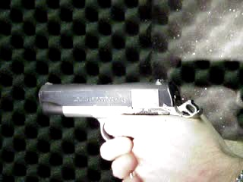
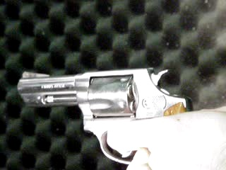
Different Types of Firearms
Semiautomatic Pistol
  A repeating firearm requiring a separate pull of the trigger for each shot fired, and which uses the energy of discharge to perform a portion of the operating or firing cycle*
Revolver
  A firearm with a cylinder having several chambers so arranged as to rotate around an axis and be discharged successively by the same firing mechanism.*
  Double Action - A mechanism in which a single pull of the trigger cocks and release the hammer.*
* Association of Firearm and Tool Mark Examiners Glossary 4th Edition
© Precision Forensic Testing
Notes:
Both a semiautomatic pistol and revolver are different types of handguns. Both are designed to be fired with one hand. The main difference between the two is that semiautomatic pistols eject the fired cartridge cases after each shot. The cartridge cases in revolvers remain in the gun until they are manually removed.
Double action revolvers are called “double action” because the trigger performs two actions. 1) the trigger cocks the hammer and 2) it releases the hammer.

Slide 5
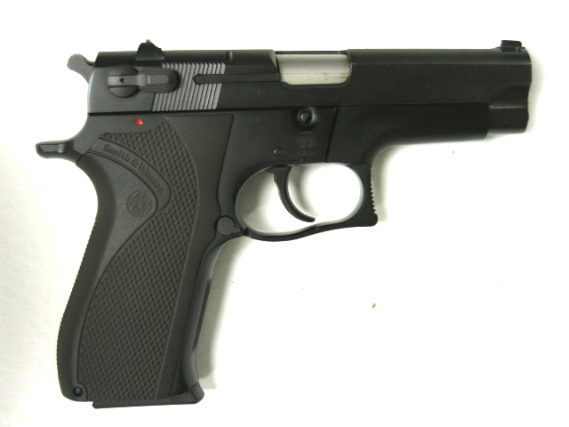
Firearm Nomenclature
Slide
Barrel
FIREARM NOMENCLATURE
Extractor
Trigger
Hammer
Safety
© Precision Forensic Testing
Notes:
We first need to discuss the various parts of a firearm to understand the functioning of a firearm. The slide of a semiautomatic firearm is used to load the firearm. In order to fire a semiautomatic pistol, the ammunition is loaded in a magazine and placed in the grip. The slide is then pulled to the rear under spring tension. On its’ forward return the slide strips a cartridge from the magazine into the barrel of the firearm. The firearm is now ready to fire.

Slide 6
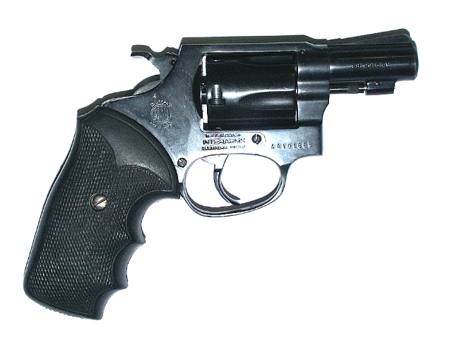
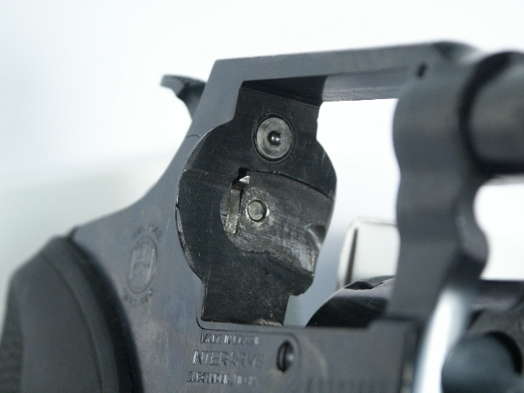
Firearm Nomenclature
Cylinder
Trigger
Hammer
FIREARM NOMENCLATURE
Barrel
Breechface
Firing Pin
© Precision Forensic Testing
Notes:
Revolvers have essentially the same parts with the exception of the cylinder. The cylinder has “chambers” which are designed to hold the cartridges. The cylinder of a revolver performs the function of a magazine on a semiautomatic pistol.
All the other parts have the same function on the revolver as they do on a semiautomatic pistol.

Slide 7
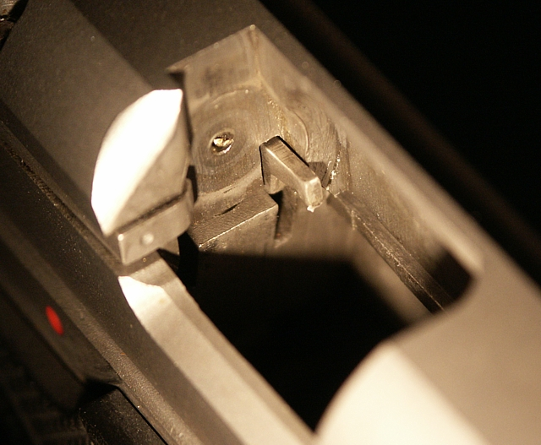
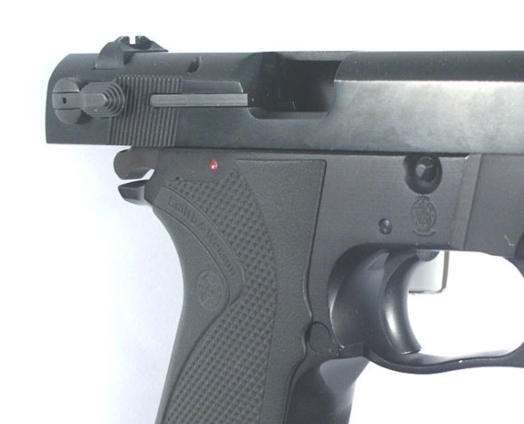
Firearm Nomenclature
Breechface
Ejector
Firing Pin Aperture
Extractor
FIREARM NOMENCLATURE
© Precision Forensic Testing
Notes:
The breechface is an area of the slide where the cartridge is seated prior to firing.
The ejector is designed to kick the fired cartridge case from the firearm when the slide is traveling rearward. Notice the ejector is exposed. The ejector is fixed, therefore when the slide is forward, it does not interact with the cartridge.
The firing pin aperture is the hole which the firing pin passes though. The firing pin is hit by the hammer to fire the cartridge.
The extractor is a “hook” designed to grab the cartridge case and pull it from the barrel after firing.

Slide 8
Basic Operation
When the trigger is pulled to fire the weapon, the hammer is driven down onto the firing pin, which in turn strikes the primer of the cartridge.
The primer mixture explodes, and this event in turn causes ignition of the powder.
The powder burns rapidly, generating an enormous amount of gas pressure within the confined space of the cartridge.
The pressure forces the slug out of the cartridge, through the barrel, and out of the muzzle of the weapon.
Each of these steps leaves class and individualistic characteristics on the bullets and casings.
BASIC OPERATION

Slide 9

Functioning of a Firearm
Video compliments of www.firearmsid.com and Hi-Point firearms
Notes:
In this video, we a semiautomatic firearm chamber a cartridge from a magazine. The firing pin is released and it travels through the firing pin aperture. The firing pin hits the primer which is composed of a shock sensitive explosive. The primer ignites the powder which produces a large amount of gas which pushed the bullet out the barrel.
The energy from the ignition of the powder pushes the cartridge case against the breechface of the firearm. The large amount of pressure produced causes the impression of machining marks from the breechface to be transferred onto the cartridge case.
As the slide moves rearward after firing, the cartridge case is pulled out by the extractor (red in this video)
This particular firearm design uses the firing pin as an ejector. At the end of the video you can see the firing pin pushing the cartridge case from the slide.

Slide 10
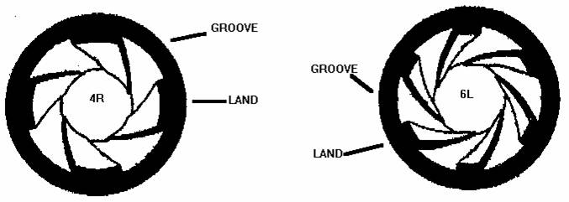
Slug Analysis-Class Characteristics
Each barrel has four class characteristics
  Caliber (bore diameter: .357, .22, .45)
  Number of lands and grooves
  Direction of twist
  Width of the lands and grooves
SLUG ANALYSIS
Notes:
The caliber is the bore (barrel) diameter. It can be measure in either metric or English units. Common calibers measured in metric units include 9mm and 7.62 x 39mm. Common English calibers include .357 Magnum, .22, and .45 and refer to the width in inches.
Some calibers have both metric and english equivalents. A .25 Auto caliber firearm also can use 6.35mm ammunition. Another example is a .32 Auto caliber firearm which can shoot 7.65mm ammunition.
Some calibers class characteristics overlap due to their relative size. For example, .380 and 9mm are .355 inches in diameter. .38 Spl. and .357 Magnum are actually .357 inches in diameter. Because only two thousandths of an inch separate all four calibers, they are considered the same class.

Slide 11
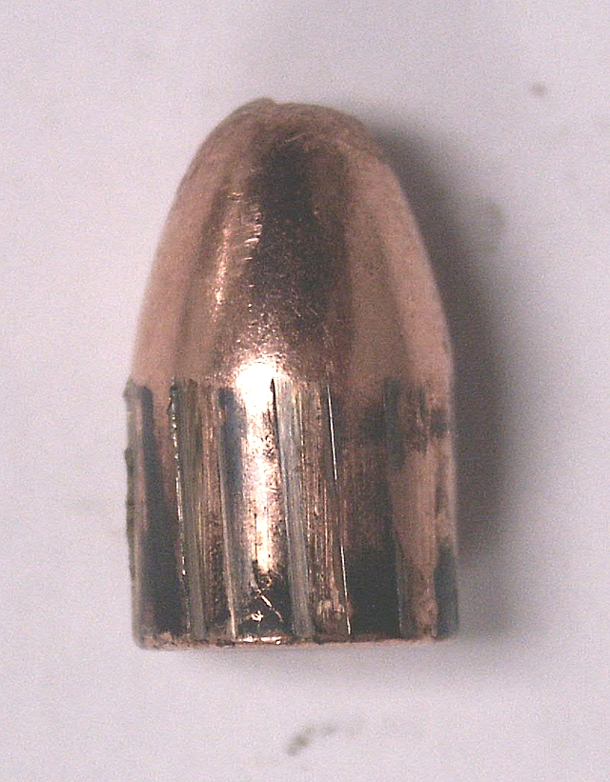
Class Characteristics-Measured
All class characteristics are measurable
  Caliber
SLUG ANALYSIS
  Number of lands and grooves
  Width of the lands and grooves
1
2
3
  Direction of twist
Notes:
It is important that students understand how to measure the class characteristics. Laboratory Exercises #1 and #2 rely on the measuring and understanding class characteristics.

Slide 12
Beyond Class Characteristics
If we look beyond the lands and grooves under a microscope, we can also see microscopic scratches called striations.
These microscopic scratches are a by-product of the manufacturing process and are totally unique to a particular firearm making them individualistic.
Thus, the scratch marks on the bullet match the scratch marks in the barrel of the gun that fired it, to the exclusion of all other weapons.
Bullets can be test fired by a suspect weapon and then compared under a comparison microscope, side by side, to a bullet recovered from the crime scene.
Seeing these striations side by side is difficult to do in the high school lab.
Striations may be visible under a stereomicroscope, but a real side by side comparison is difficult to do without a comparison microscope.
FIREARMS and BALLISTICS

Slide 13
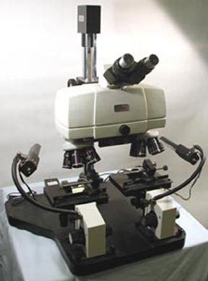
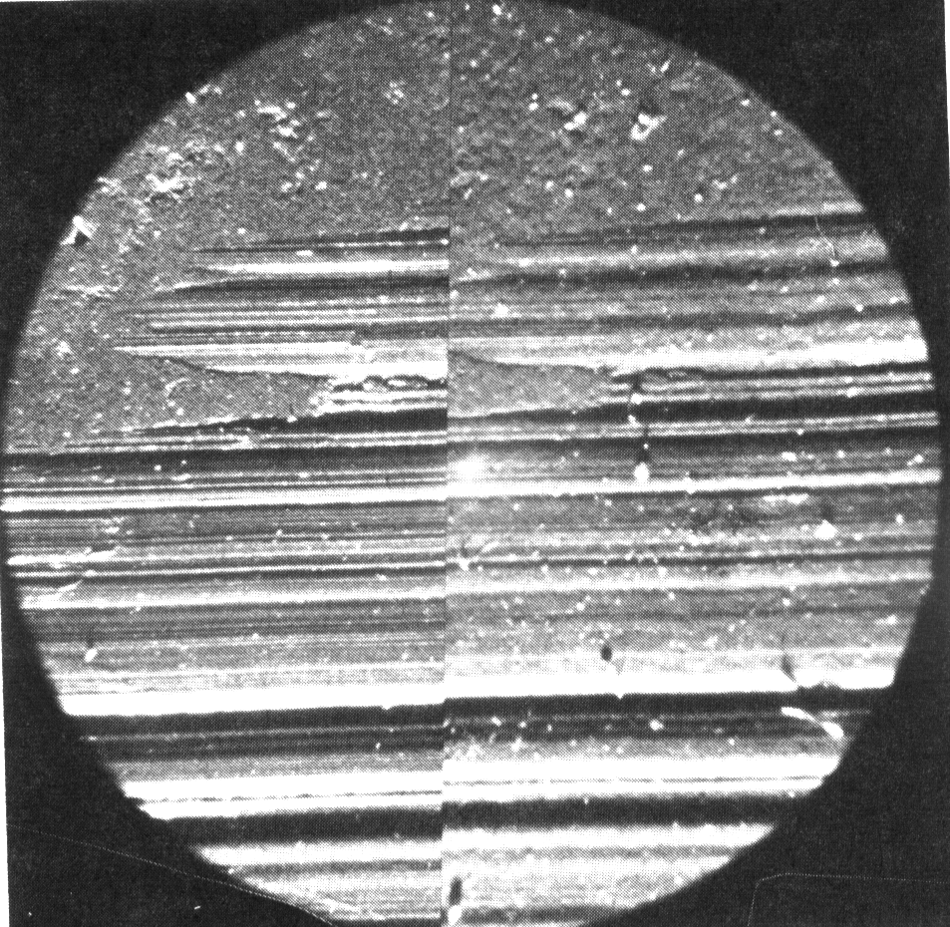
FIREARMS and BALLISTICS
Real Striation Comparison
under a microscope

Slide 14
Gunshot Residues
Particles of unburned powder and traces of smoke are the residues of gunshots.
They can leave a trace on the hand, arm, face, hair, or clothing of the shooter.
They can also leave a trace on the victim.
Chemical testing often can detect residue even if removal is attempted.
The distance from the victim to the shooter can be determined by examination of the residue pattern on the victim.
Forensic Science: Fundamentals & Investigations, Chapter 17

Slide 15

Trajectory
Wind shield
Distance along path of
bullet to window, 23.9”
Path of bullet
x
y
60 feet
Horizon
Distance along
horizon to
window, 23.5”
Two reference points are needed to define the trajectory.
Investigators can figure the shooter discharged the firearm somewhere along that line.
Forensic Science: Fundamentals & Investigations, Chapter 17

Slide 16
Trajectory
Reference points can be bullet holes in objects or victims.
An entry point and exit point on a victim can be used.
Gunshot residue or spent cartridge casings can be less specific reference points.
Investigators can use lasers to trace a straight-line path to help determine the position of the shooter.
Forensic Science: Fundamentals & Investigations, Chapter 17

Slide 17
Trajectory
Determining the Location of the Shooter
Using the illustration on Slide 11 and adding that the shot came from a nearby building, these conclusions can be made:
Since the building is about 60 feet away, the shooter was about 11 feet above the bullet hole in the seat, which was 4 feet above the ground.
This height of about 15 feet off the ground puts the shooter on the second floor in that building.
Forensic Science: Fundamentals & Investigations, Chapter 17

