Slide 1

Bloodstain Science
Forensic Science Lab Activity
Warning: Some material in this presentation and related videos may be too graphic for some people.
T. Trimpe 2006 http://sciencespot.net/

Slide 2
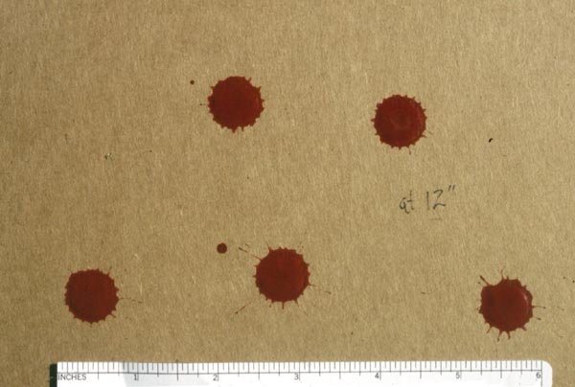
What does the abbreviation BPA represent? Bloodstain Pattern Analysis
What can an investigator learn from the analysis of a blood spatter?
 Type and velocity of weapon
 Number of blows
 Handedness of assailant (right or left-handed)
 Position and movements of the victim and assailant during and after the attack
 Which wounds were inflicted first
 Type of injuries
 How long ago the crime was committed
 Whether death was immediate or delayed
Source: http://science.howstuffworks.com/bloodstain-pattern-analysis1.htm
How does a blood droplet form? Click the image
for an animation.
http://www.crimescenetwo.com/img/popup/book2p2.jpg

Slide 3
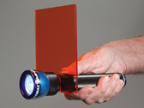

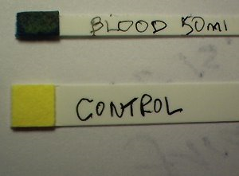
How is blood evidence detected at a crime scene?
Light Source
Investigators will first examine the crime scene to look for areas that may contain blood. They may use a high-intensity light or UV lights to help them find traces of blood as well as other bodily fluids that are not visible under normal lighting conditions.
Blood Reagent Tests
These tests, referred to as presumptive tests, are used to detect blood at crime scenes based upon the properties of hemoglobin in the blood. Further tests at the crime lab can determine if it is human blood or not.
Examples:
Phenolphthalein is a chemical that is still utilized today and is usually referred to as the Kastle-Meyer test and produces a pink color when it reacts with hemoglobin.
HemaStix is a strip that has been coated with tetramethylbenzidine (TMB) and will produce a green or blue-green color with the presence of hemoglobin.
Kastle-Meyer Test
Video
HemaStix

Slide 4
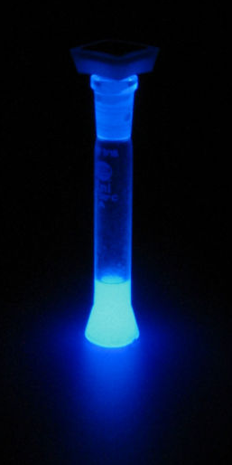
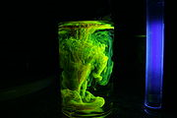
Luminol
This chemical is used by crime scene investigators to locate traces of blood, even if it has been cleaned or removed.
Investigators spray a luminol solution is throughout the area under investigation and look for reactions with the iron present in blood, which causes a blue luminescence.
One problem is that other substances also react, such as some metals, paints, cleaning products, and plant materials. Another problem is that the chemical reaction can destroy other evidence in the crime scene.
Luminol Reaction
Fluorescein
This chemical is also capable of detecting latent or old blood, similar to luminol. It is ideal for fine stains or smears found throughout a crime scene. After the solution has been sprayed onto the substance or area suspected to contain blood, a UV light and goggles are used to detect any illuminated areas, which appear greenish-white if blood is present. It may also react to many of the same things as luminol (copper and bleach).
Fluorescein Reaction in UV Light
LCV or Leuco Crystal Violet, is one type of chemical process that is used for blood enhancement. Using this test helps to make the blood evidence more visible so it can be photographed and analyzed.

Slide 5
Bloodstain Pattern Analysis Terms
Spatter – Bloodstains created from the application of force to the area where the blood originated.
Origin/Source – The place from where the blood spatter came from or originated.
Angle of Impact – The angle at which a blood droplet strikes a surface.
Parent Drop – The droplet from which a satellite spatter originates.
Satellite Spatters – Small drops of blood that break of from the parent spatter when the blood droplet hits a surface.
Spines – The pointed edges of a stain that radiate out from the spatter; can help determine the direction from which the blood traveled.
Satellite Spatters
Spines
Parent Drop

Slide 6
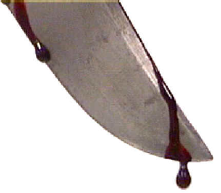
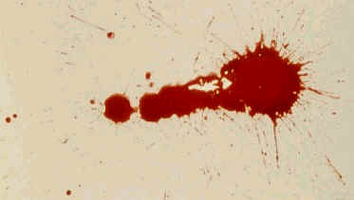
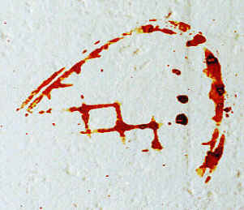
Types of Bloodstain Patterns
Blood Spatter Movie
Passive Bloodstains
  Patterns created from the force of gravity
  Drop, series of drops, flow patterns, blood pools, etc.
Projected Bloodstains
  Patterns that occur when a force is applied to the source of the blood
  Includes low, medium, or high impact spatters, cast-off, arterial spurting, expiratory blood blown out of the nose, mouth, or wound.
Transfer or Contact Bloodstains
  These patterns are created when a wet, bloody object comes in contact with a target surface; may be used to identify an object or body part.
  A wipe pattern is created from an object moving through a bloodstain, while a swipe pattern is created from an object leaving a bloodstain.
Images from http://www.bloodspatter.com/BPATutorial.htm

Slide 7
Blood Spatter Labs
You will be creating sample drop patterns using single drops and multiple drops. We will also investigate the effect of motion and the angle of impact on blood spatter.
This can be messy! Be very careful to keep the blood on the paper and not on yourself, the table, or floor.
Hold you hand as steady as possible when making the drops. Brace your wrist against the meter stick to help you.
Get your materials from your teacher – paper, black marker, meter stick, goggles, and a bottle of blood.
If you make a mess, clean it up immediately!
Notes:
Teacher Note: If you have test tube clamps available, have the students attach it to the meterstick in the desired location and hold the bottle of blood (upside-down) in the other end where the test tube would normally go. This helps keep the bottle in the right spot and the chances of hitting the same spot twice are much higher!

Slide 8
Lab 1: Single Droplets
Label two large pieces of construction paper as shown below.
Single Drops Group Members
Single Drops Group Members
Keep your drops in the correct area of the paper.
25
50
75
100
To do the lab, put on your goggles and hold the dropper bottle upside down so that the end of it is 25 cm from the paper. GENTLY squeeze the bottle so that ONE drop of blood is released and lands in the correct location on your paper. It should NOT hit the meterstick.
Repeat TWO more times at this height for a total of three drops.
Continue making drops of blood on your paper, but put the drop in a different area of the paper and change the height each time.
When you are done, analyze your results and answer the questions on your worksheet.
Make a mistake? Use a paper towel to wipe it off your paper!

Slide 9
Lab 1 Questions
Use your results to answer these questions.
What did you notice about the diameter of the parent droplets as you increased the height of the drop?
How do the spines compare from the different heights?

Slide 10
Lab 2: Multiple Droplets
Label a long piece of butcher paper (2 -3 meters in length) as shown below.
Multiple Drops Group Members
Keep your drops in the correct area of the paper.
25
50
75
100
To do the lab, put on your goggles and hold the dropper bottle upside down so that the end of it is 25 cm from the paper. GENTLY squeeze the bottle so that ONE drop of blood is released and lands in the correct location on your paper. The drop should NOT hit the meterstick.
Without moving your hand, release ONE more drop onto the first drop at that height. If you make a mistake, wipe it off with a paper towel and try it again.
Continue making drops of blood on your paper so you have three sets for each height.
When you are done, analyze your results and answer the questions on your worksheet. Clean up your area and put away your materials before you leave class.

Slide 11
Lab 2 Questions
Use your results to answer these questions.
What happened when one drop landed on top of another one?
What did you notice about the diameter of the parent droplets as you increased the height of the drop?
What do you notice about the diameter of the satellite spatter as you increased the height of the drop?

Slide 12
Lab 3: Motion Droplets
During this lab, you will see how motion affects the size and shape of the droplets and spines. You will need a long piece of butcher paper (4-5 meters in length) and tape to secure it to the floor. You will also need safety goggles.
To do the lab, you will need to hold the dropper bottle upside down so that your hand is out and away from your body (waist level), but is still over the paper.
Start off walking at a SLOW WALKING RATE along the paper strip from one end to the other and GENTLY squeeze the bottle as you walk so that blood is released ONE DROP at a time. Be sure that all the drops land on your paper strip.
Repeat this procedure using a NORMAL WALKING RATE and a FAST WALKING RATE.
Miss the paper? Use a paper towel to wipe it off the floor!
Walking Direction
When you are done, analyze your results and answer the questions on your worksheet. Clean up your area and put away your materials before you leave class.

Slide 13
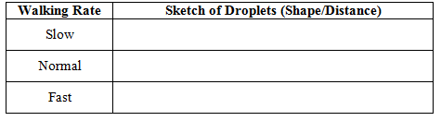
Lab 3 Questions
Use your results to answer these questions.
Draw a sketch of the droplets showing the size, shape, and/or distance between them at each speed in the chart below.
What did you notice about the shape of the droplets as you increased your walking speed?
What did you notice about the spines as you increased your walking speed?
What did you notice about the distance between the droplets as you increased your walking speed?

Slide 14
Lab 4: Angle of Impact
You will be creating sample drop patterns created by droplets landing at different angles from the same height.
Label five pieces of copy paper with your names and then indicate the angle for each droplet - 15º, 30º, 45º, 60º, or 75º.
Place the first piece of paper on the clip board and align the clipboard with the 15º line. Hold the bottle of blood at a height of 50 centimeters from the top of the table.
GENTLY squeeze the bottle so that ONE drop of blood is released and lands on the paper. Repeat two more times at this angle.
Continue testing by dropping blood from a height of 50 centimeters at each of the other angles.
Height of
50 cm
When you are done, answer the questions on your worksheet. Clean up your area and put away your materials before you leave class.
Clipboard & Paper
Angle
Guide

Slide 15
Lab 4 Questions
Use your results to answer the question.
What did you notice about the shape of the droplets as you increased the angle of the paper?

Slide 16
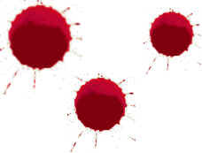
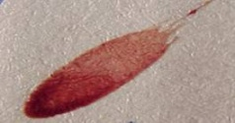
Quick Review
Which of the three blood droplets shown would have been created by a wound in the lower part of the leg? Explain.
If you have a blood droplet as shown at left, what does it tell you? Explain.
If you find a trail of blood with droplets that are round and close together, what could this mean?

